Slide 1

PMG 202
Project Planning
Prepared by Dr. Maryam ZORGUI
Lecture 1
Projects, Project Plans, and Project Management Defined

Slide 2
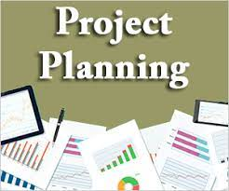

Slide 3
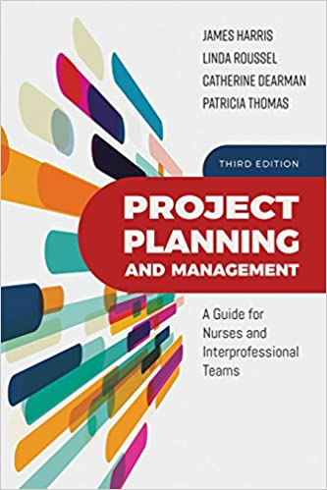

Project Planning
Resource:
Project Planning and Management: A Guide for Nurses
and Interprofessional Teams
3rd Edition
by James L. Harris, Linda A. Roussel,
Catherine Dearman, Tricia Thomas

Slide 4

Chapter objectives
1. Differentiate between a project, a plan, and their management.
2. Prioritize needs to support a project plan and program plan, program sustainability, and an operating budget.
3. Combine the components of project planning to design a value-based program.
4. Identify requisite skills and tools for the development, initiation, evaluation, and dissemination of quality improvement projects and their continuous management.
5. Generate processes necessary to manage individuals and system-wide projects and teams in virtual environments.

Slide 5
Syllabus
.
I- The Project
III-The Project Management
II-The Project Planning

Slide 6
Preamble
The genesis of any project is planning, but ongoing management of the project is essential as well.
All projects have a beginning, duration, and an end, which collectively constitute the project’s life cycle.
Project outcomes may be, for example, adopted in the form of evidence-based guidelines or seen as opportunities to conduct additional inquiry and validation studies prior to including them in practice.

Slide 7

Preamble
The Project Management Institute (PMI):
The Project Management Institute (PMI) is a leader in credentialing project management professionals and advancing the field of project management.
PMI was founded in 1969.
The PMI has a global footprint in nearly 200 countries around the world. From its global headquarters in Newton Square outside of Philadelphia, the Project Management Institute provides certifications for project management professionals, as well as career training and educational resources. The group also maintains research programs to advance scientific and practical abilities within the industry.

Slide 8
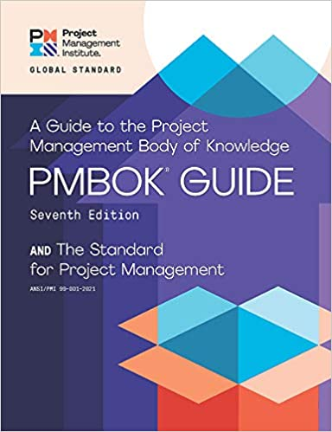
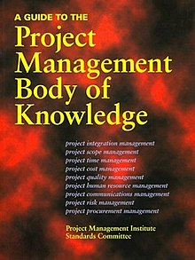
Preamble
The Project Magement Body Of Knowledges (PMBOK):
PMBOK is an internationally recognized standard edited by the PMI, that provides fundamental concepts of project management regardless of the type of the project, be it a construction project, a software development project, heavy-engineering project or automotive project.

Slide 9
I- The Project
I-1- Project Definition
I-2- Project characteristics
I- 3. Project Objectives
I- 4. Project classification
I-5- The Project Life Cycle

Slide 10
I- The Project
I-1- Project Definition
A Project has been defined by the Project Management Institute (USA) as “any project with a specific objective by which it is defined. In practice, most projects depend on limited resources or limited by objectives to be accomplished.” (PMBOK).
According to the Project Management Institute (2013):
“a project is a temporary endeavor focused on producing a unique operational entity (e.g., a product, a service, or a result differing from
that obtained in prior projects)”.
Notes:
1-The Project Management Body of Knowledge (PMBOK) :a set of standard terminology and guidelines (a body of knowledge) for project management.
2- The Project Management Institute (PMI) : a leader in credentialing project management professionals and advancing the field of project management

Slide 11
I- The Project
A Project is defined as “a non-routine, non-repetitive, usually one-time process with separate times for financial and technical objectives”. The definition is descriptive, and because of the endless variety of projects, most definitions are of this type.
A project can be considered as series of activities and tasks that:
(a) To have a specific objective to be completed within certain specifications;
(b) setting start and end dates;
(c) Financing limits (if any) and
(d) It consumes resources (eg money, time and equipment).

Slide 12
I- The Project
I-2- Project characteristics:
Project features include:
(a) The enterprise has an owner, who can, in the private sector, be an individual or a company, etc., in the public sector, a government institution or a joint sector organization, representing a public-private partnership.
(b) The project has a specific objective to be achieved within a specified time period, cost and technical performance.
(c) The project is planned, managed and controlled by an ad hoc team carried out by the project team implanted within the owner’s organization to achieve the objectives as per the specification.

Slide 13
I- The Project
(d) A project is, in general, the result of a response to the economics of environments and opportunities.
(e) A project is a project that includes activities in the future to complete the project within the estimates,” this requires a complex budget procedure with a mission.
(f) Project implementation involves coordination of work/supervision by the project team/manager.

Slide 14
I- The Project
g) The project includes activities to be implemented in the future. As such, it has some inherent risks, and in fact, the implementation process may require some changes in the plan subject to the restrictions and approval of the entrepreneur.
(i) Projects feature beginning and end of life cycle.
Organizing changes in the project as it goes through this cycle of activities starting from conception, escalation to peak during implementation, and then back to zero when the project is completed and submitted.

Slide 15
I- The Project
I- 3. Project Objectives:
A “project” is a means to achieve a “goal”.
So, in the first place, there is a goal that the entrepreneur aims for, and in order to achieve that goal, the “project” begins.
Accordingly, before we deal with the objectives of the project, we would like to dwell on the potential objectives of the project owner.
Goals without money are also important:
There are cases where projects need to be implemented with social objectives. The government primarily implements non-industrial projects aimed at realizing social benefits such as public health, irrigation, education, etc.

Slide 16
I- The Project
4. Project classification:
These projects are categorized according to the specific character of the project.
1-Projects of the different sectors: Projects can be classified according to the sector to which the project owner belongs: | 2. Industrial and non-industrial projects : | 3. Projects belonging to the primary sector : | 4. Need-Based Projects
Public Sector Projects are undertaken by public sector enterprises/enterprises (PSE or PSU) owned by the government – ​​central or state – or both Private Sector Projects:The owners of such projects are individuals or companies (private or public but not PSU), partnership firm, in which profit motive against investment plays an important role. Projects in the joint sector: Where ownership belongs to a partnership between the government and the private sector. | Projects which are undertaken without financial mission, and are primarily with social objectives such as projects of health care, public education, irrigation etc. These projects are classified as non-industrial projects undertaken mainly by the government. | There are complex mega projects undertaken by the government, which in turn helps to generate commercial activities, as well as many other industrial projects. These are power projects, port facilities, highways, mining, steel, etc. | The project grows out of needs or opportunities. Accordingly, there are different types of needs that give rise to different types of projects. We are now dealing with different considerations for projects in different sectors.
Notes:
*PSU is an abbreviation for Public sector undertaking
* PSE is an abbreviation for Public sector enterprise

Slide 17
I- The Project
I-5- The Project Life Cycle
According to the PMBOK Guide (Project Management Body of Knowledge) a project life cycle consists of 5 distinct phases including initiation, planning, execution, monitoring, and closure that combine to turn a project idea into a working product.
The Project Life Cycle is a step-by-step framework of best practices used to shepherd a project from its beginning to its end.
It provides project managers a structured way to create, execute, and finish a project.

Slide 18
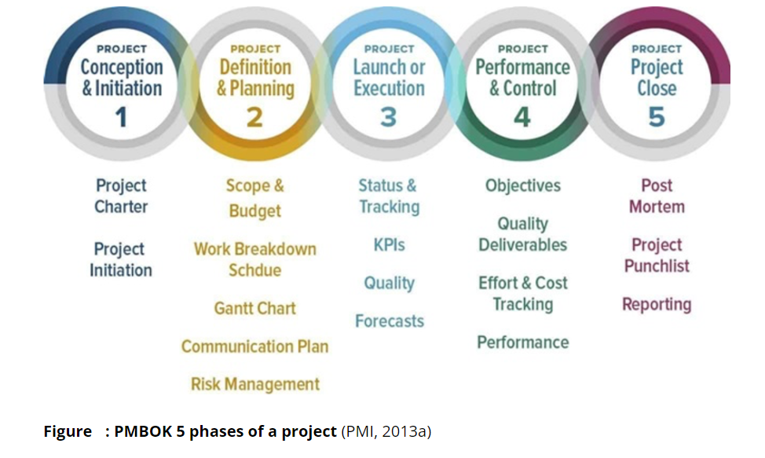
I- The Project

Slide 19
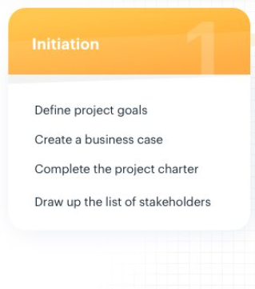
I- The Project
Phase 1: Project initiation The project initiation phase is the first stage of turning an abstract idea into a meaningful goal. In this stage, you need to develop a business case and define the project on a broad level. In order to do that, you have to determine the need for the project and create a project charter.

Slide 20
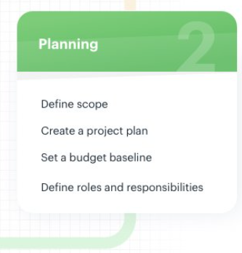
I- The Project
Phase 2: Project planning The project planning stage requires complete diligence as it lays out the project’s roadmap. Unless you are using a modern project management methodology like agile project management, the second phase of project management is expected to take almost half of the entire project’s timespan. There are several methods of setting up the project’s goals but S.M.A.R.T. and C.L.E.A.R. are the most popular.

Slide 21
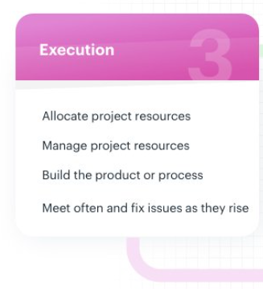
I- The Project
Phase 3: Project execution The project execution stage is where your team does the actual work. As a project manager, your job is to establish efficient workflows and carefully monitor the progress of your team.

Slide 22
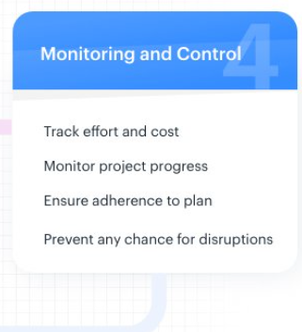
I- The Project
Phase 4: Project monitoring and controlling In the project management process, the third and fourth phases are not sequential in nature. The project monitoring and controlling phase run simultaneously with project execution, thereby ensuring that objectives and project deliverables are met.

Slide 23
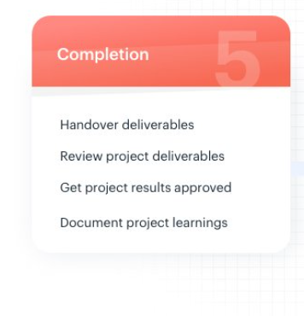
I- The Project
Phase 5: Project closing This is the final phase of the project management process. The project closure stage indicates the end of the project after the final delivery. There are times when external talent is hired specifically for the project on contract. Terminating these contracts and completing the necessary paperwork is also the responsibility of the project manager.

Slide 24
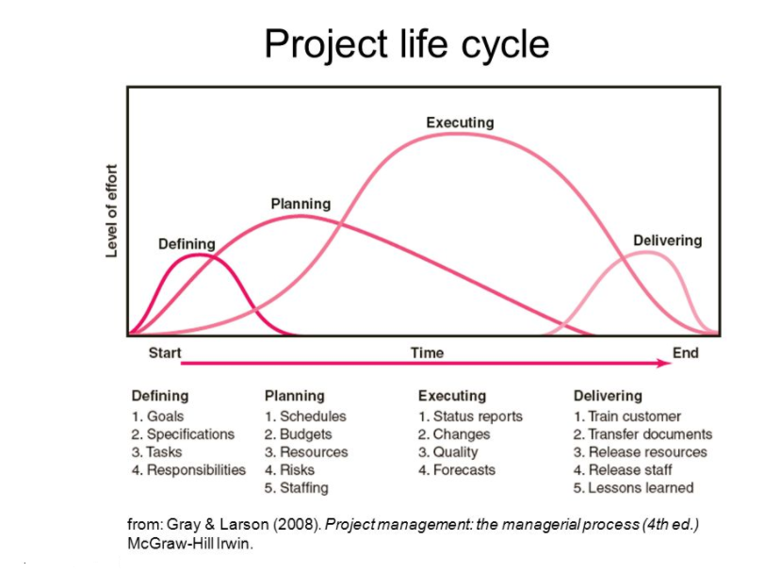
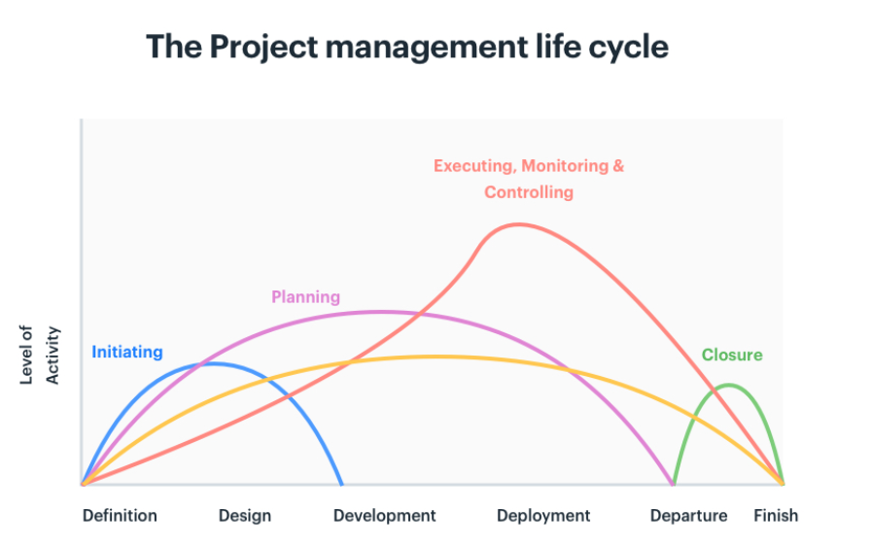

Slide 25
II-Project Planning
II-1- Basics of Project Planning
II-2- Components of project planning process
II-3- Advantages of Project Planning

Slide 26
II-Project Planning
II-1- Basics of Project Planning
In the most basic terms, project planning is defined as the process of defining the schedule, resources, and processes for successful execution of a particular project. In other words, project planning tells the stakeholders what needs to be done, when it is to be done, and how it is to be done.
As a crucial part of project management lifecycle, planning comes right after the project ideation phase. It steers as well as helps the stakeholders navigate the path to a successful project delivery.
Project planning is the product of your company’s think-tank and strategy suite in line with your mission. The process is also supported by a rigorous status reporting mechanism that enables high-quality performance. It is the most critical step of project management as it needs you to finalize resource, time, and staff estimates before embarking on the project.

Slide 27
II-Project Planning
II-2- Components of project planning process
Before you put pen to paper, it is essential to understand that project planning is a step-by-step procedure to get things ready for the implementation mode.
Interestingly, though every project has different requirements, the basic framework of planning remains just the same. It boils down to the following seven key components:

Slide 28
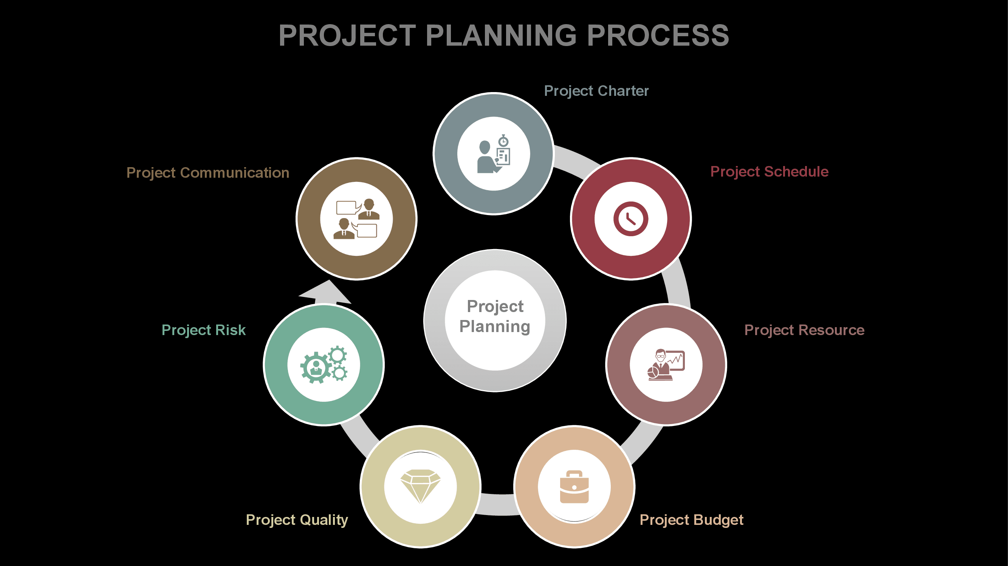
II-Project Planning

Slide 29
II-Project Planning
1. Project charter: This is a formal document that describes the objectives and the stakeholders of a project.
2. Project schedule: This component defines the time frame for the project using various scheduling tools.
3. Project resource: This component defines the equipment and human capital required for a project.
4. Project budget: What will the project cost your company? Is it even financially viable to take up the project?

Slide 30
II-Project Planning
5. Project quality: What are the parameters to judge the success of your project? What are the key performance indicators?
6. Project risk: This is the element that project planning is basically done for.
7. Project communication: This component is the consistent reporting mechanism that keeps the stakeholders and the management on the same page.

Slide 31
II-Project Planning
II-3- Advantages of Project Planning
We need project planning in the first place because its benefits outweigh those of almost any other technique of efficient project management.
Provides direction
A well-planned project gives the right direction to you and your team.
Assigns responsibilities
Project planning makes it easier to fix the accountability of the stakeholders.
Optimizes resource usage
Mitigates risks
Planning imparts a certain degree of foresightedness to the stakeholders regarding the possible risks. Therefore, it helps project managers keep themselves ready for the worst.
Cultivates knowledge
Each project is a unique challenge. Planning your projects helps your employees showcase their talent and also adds to the knowledge pool of the company.

Slide 32
III-Project Management
III-1- Definition
III-2- The Project Management framework
III-3- The Project Management Scope
III-4- The 10 Project Management Areas of Knowledge
III-5- Prioritizing Needs that support Project Plans and Programs

Slide 33
III-Project Management
III-1- Definition
The term Project Management consists en 2 terms: Project and Management
Project: a process that is temporary in nature and has certain start and end times.
Management: the act of achieving predefined goals through people and other resources.

Slide 34
III-Project Management
The Project Management Body of Knowledge (PMBOK) Guide defines project management as “application of knowledge, skills, tools, and techniques to project activities to meet project requirements.”
Project Management is accomplished through “the application and integration of the project management processes of initiating, planning, executing, monitoring and controlling, and closing”
(Project Management Institute, 2013, p. 6).
Of interest, the PMBOK Guide has, as its primary objective, the explanation of how each of the processes may be accomplished in practice.

Slide 35
III-Project Management
Project management extends beyond managing and scheduling activities.
Project management entails a combination of tools, people, and systems (Lewis, 2011):
Tools may include computers, software packages, and daily planners. * People include organizations and project teams who engage in processes geared toward goal accomplishment within systems.
Management of people may present as a challenge in this endeavor, and leaders and communicators must use multiple skills to coach and mentor individuals toward achieving the common goal.

Slide 36
III-Project Management
III-2- The Project Management Framework
It’s the processes, tasks, and tools used to take a project from start to finish.
It encompasses all the key components required for planning, managing, and governing projects.
The project management framework can
be broken into three parts:

Slide 37
III-Project Management
* A Project life cycle
Every project goes through the project life cycle, which is made up of five project management stages (PMBOK guide): initiation, planning, execution, monitoring and control and closure.
* A project control cycle
* Tool and templates to facilitate the execution of the project

Slide 38
III-Project Management
III-3- The Project Management Scope
Project scope is a part of the project planning process that documents specific goals, deliverables, features, and budgets. The scope document details the list of activities for the successful completion of the project.
In Project Management, scope refers to all of the products, services, and results provided by your project.

Slide 39
III-Project Management
The Scope is defined by understanding the project requirements and the client’s expectations.
The Scope Statement usually contains:
* Project Objectives
* Project Deliverables
* Project Constaraints
* Project Assumptions

Slide 40
III-Project Management
III-4- The 10 Project Management Areas of Knowledge
An Area of Knowledge, according the PMBOK, is:
«an identified area of project management defined by it’s knowledge requirements and described in terms of it’s processes, practises, initial data, results, tools and techniques that compose them ».

Slide 41
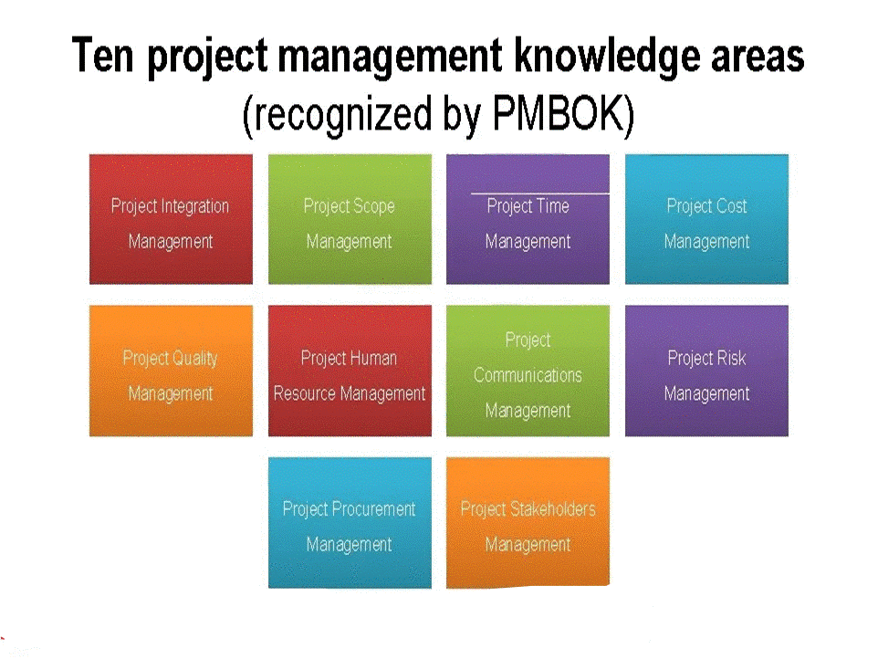
III-Project Management

Slide 42
III-Project Management
III-5- Prioritizing Needs that support Project Plans and Programs
In the complex and rapidly changing landscape where we leave, identifying what needs to be done and determining how to quickly accomplish a task is essential if projects are supported, sustained, and manageable and if they are to truly impact organizations and programs.
To ensure effectiveness of a project, one must start by prioritizing the primary need and any evidentiary basis that underpins a need for change and rapid response. Otherwise, the feasibility of any project will be jeopardized from its inception.

Slide 43
III-Project Management
Which steps should a project team take to prioritize needs? An assessment of the environment is an initial step, which is then followed by development of a strategy.
Strategy planning must include consideration of any unintended consequences of the project.
This requires the identification of “what if ” scenarios and solutions with projected and/or desired measurable outcomes

Slide 44


Slide 45
Summary
Planning provides a nexus between the managerial functions required to activate a project and the elements needed for successful project completion.
It is concerned with deciding in advance what, when, how and who will take the necessary actions to accomplish established objectives.
This lesson has examined the project environment for planning, considered the purposes of planning, focused on the stages of project planning, evaluated the elements and stages of planning and discussed the role of decision making in project planning.
Project managers seeking success should master these concepts.

Slide 46


