Slide 1



Project Cost
Management
Lecture 8
PMG 213
Prepared by
Dr. Hoda Metwally
www.midocean.ae

Slide 2
Project Cost Management
Lecture 8
Cost Classifications
PMG 213
Prepared by
Dr. Hoda Metwally
www.midocean.ae

Slide 3
Managerial accounting is concerned with providing information to managers within an organization so that they can formulate plans, control operations, and make decisions.
Purposes of cost classification
Assigning costs to cost objects
Accounting for costs in manufacturing companies
Preparing financial statements
Predicting cost behavior in response to changes in activity
Making decisions
www.midocean.ae

Slide 4
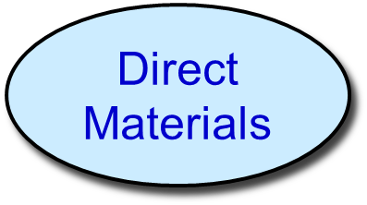
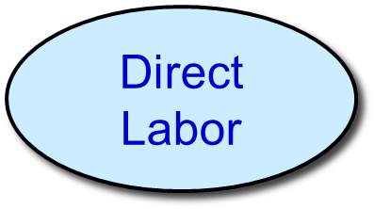

Classifications of Manufacturing Costs
www.midocean.ae

Slide 5
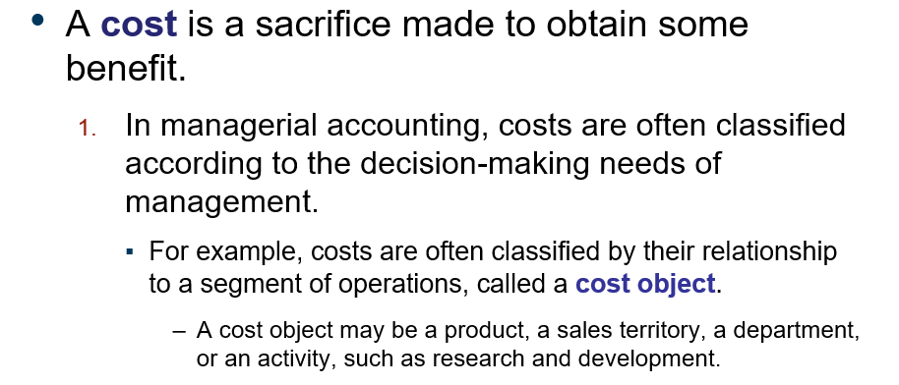
www.midocean.ae

Slide 6
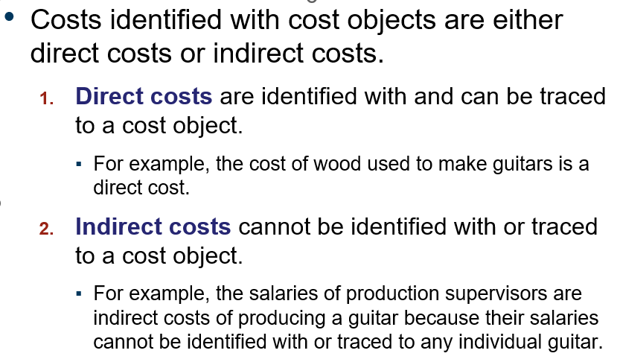
www.midocean.ae

Slide 7
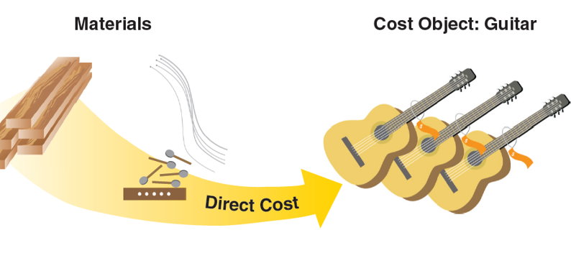

www.midocean.ae

Slide 8
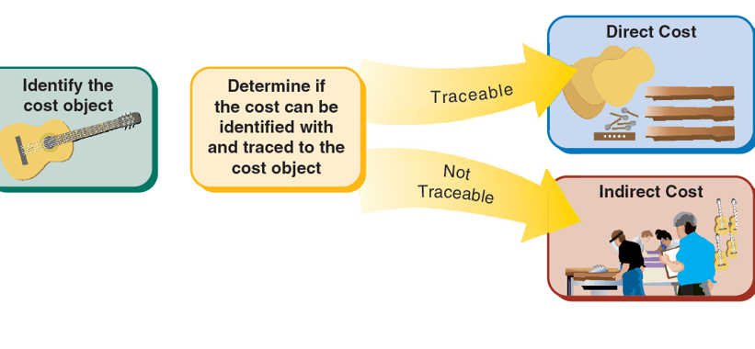
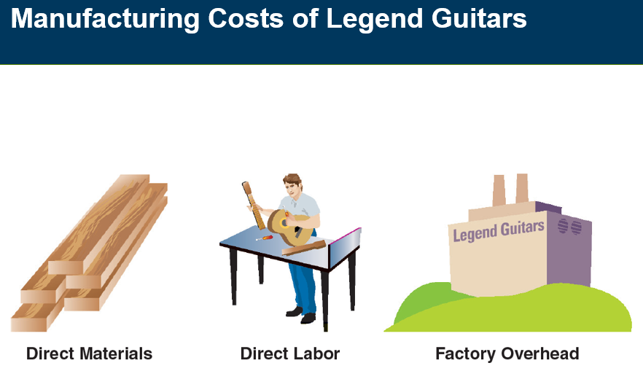
www.midocean.ae

Slide 9
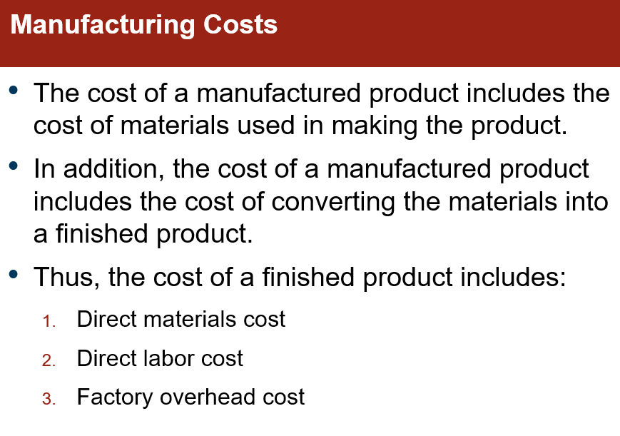
www.midocean.ae

Slide 10
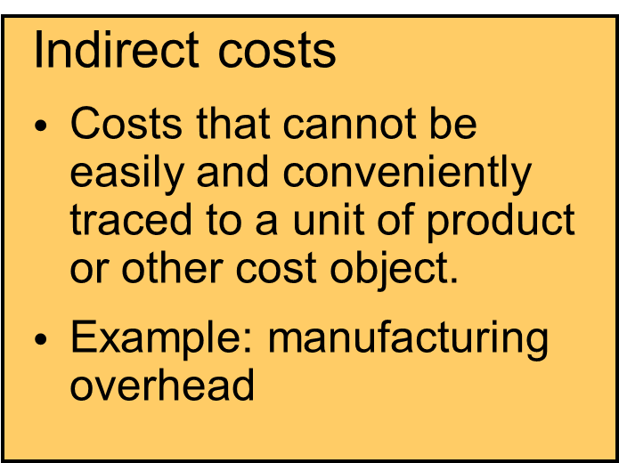
Assigning Costs to Cost Objects
Direct costs
Costs that can be
easily and conveniently traced to a unit of product or other cost object.
Examples: direct material and direct labor
Common costs
Indirect costs incurred to support a number of cost objects. These costs cannot be traced to any individual cost object.
www.midocean.ae

Slide 11
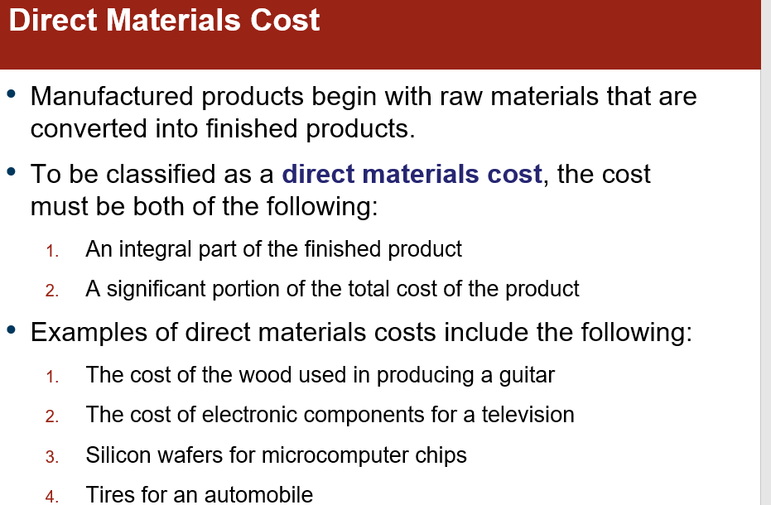
www.midocean.ae

Slide 12
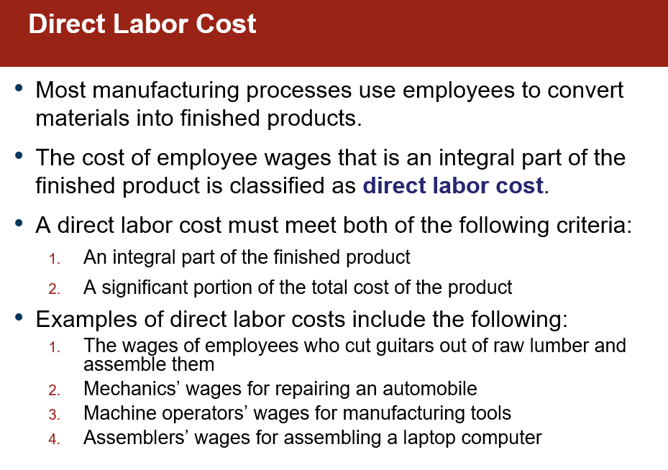
www.midocean.ae

Slide 13
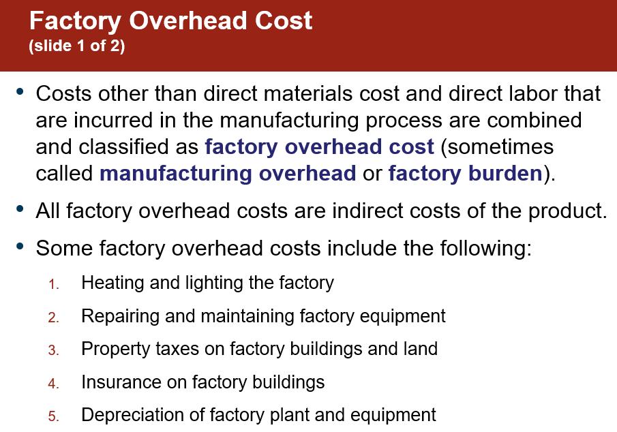
www.midocean.ae

Slide 14
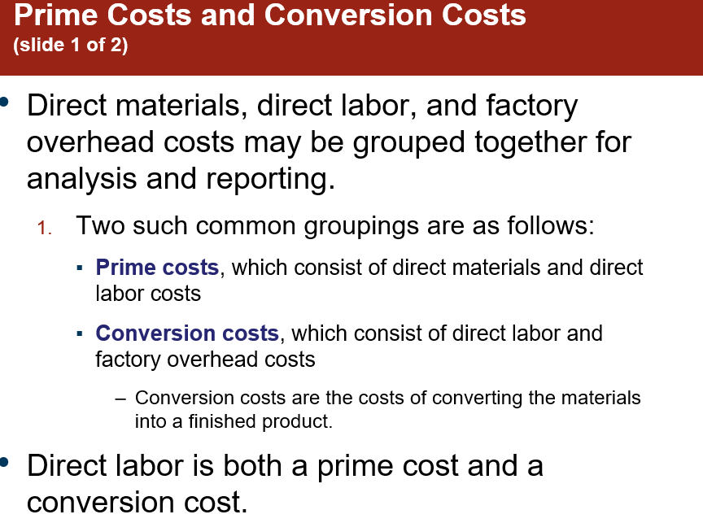
www.midocean.ae

Slide 15

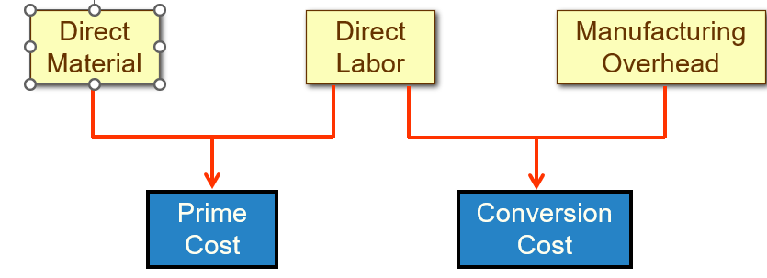
Manufacturing costs are often
classified as follows:
www.midocean.ae

Slide 16
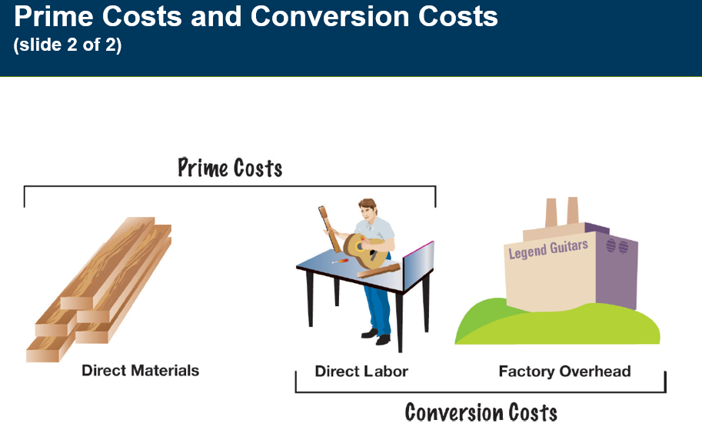
www.midocean.ae

Slide 17
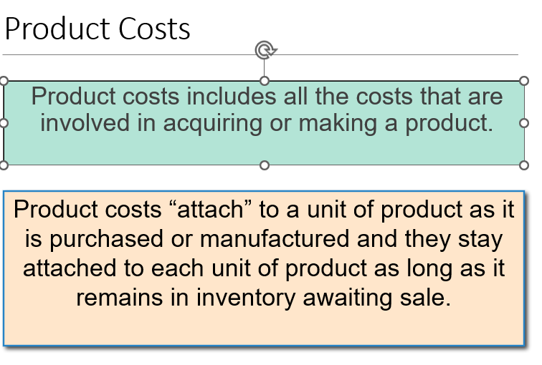
Cost classifications used to prepare financial statements: product costs and period costs.
www.midocean.ae

Slide 18
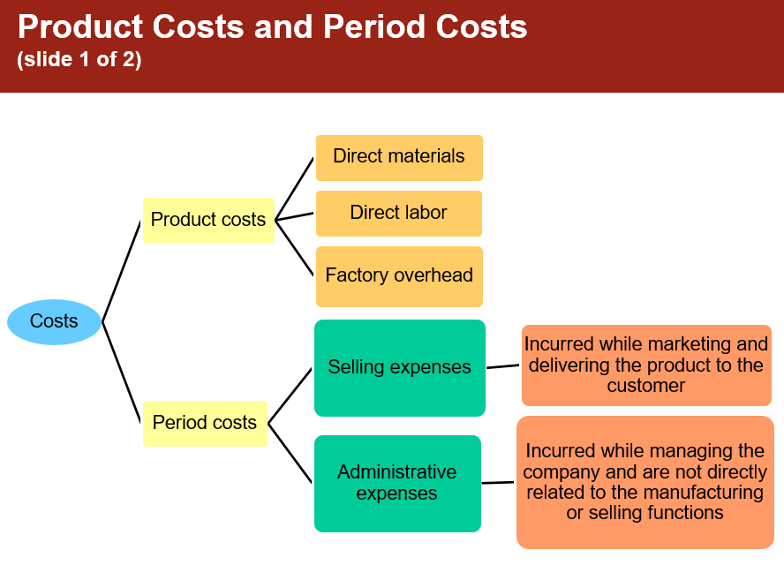
www.midocean.ae

Slide 19
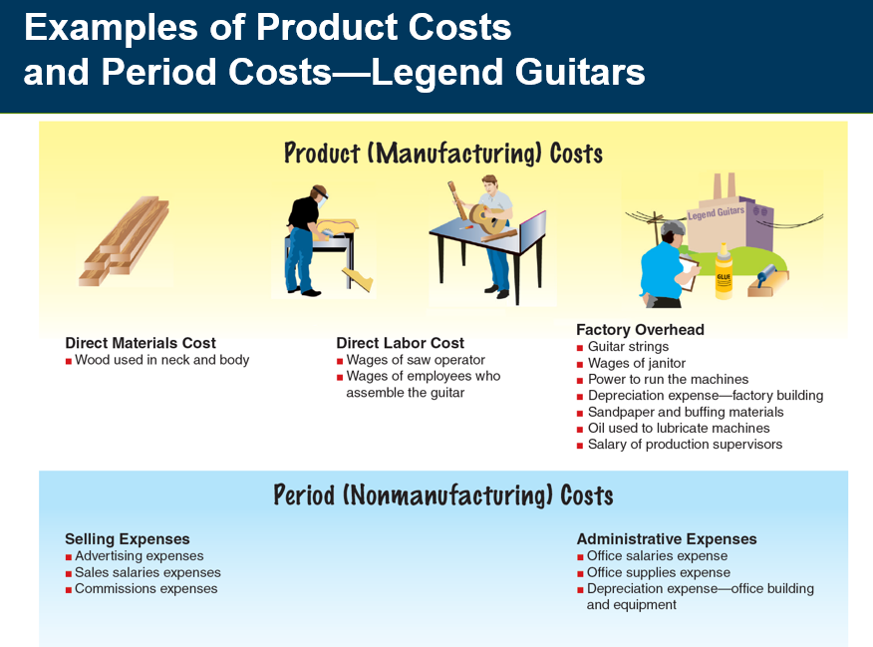
www.midocean.ae

Slide 20
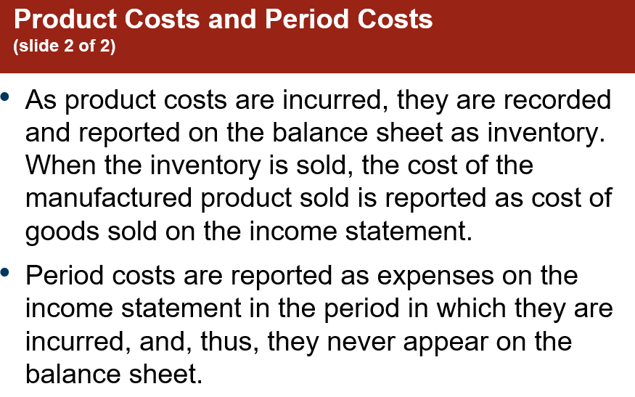
www.midocean.ae

Slide 21
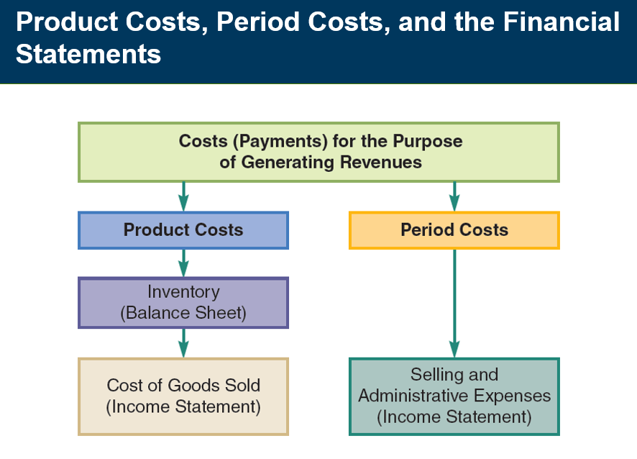
www.midocean.ae

Slide 22
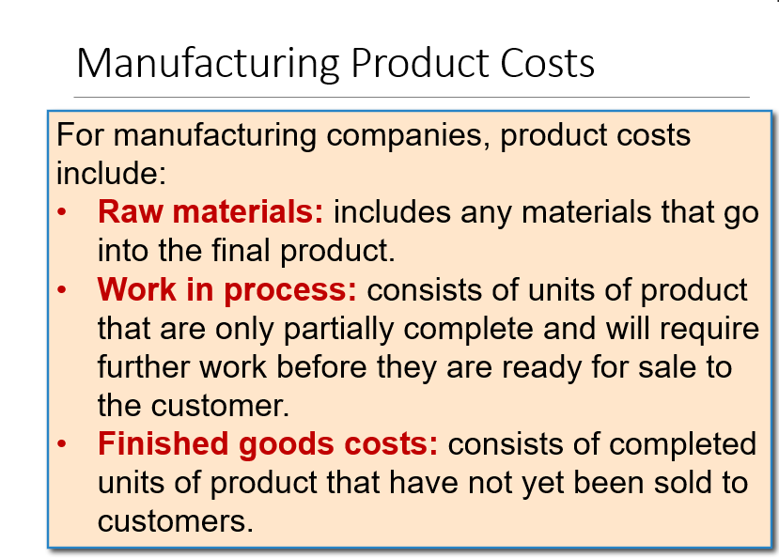
www.midocean.ae

Slide 23
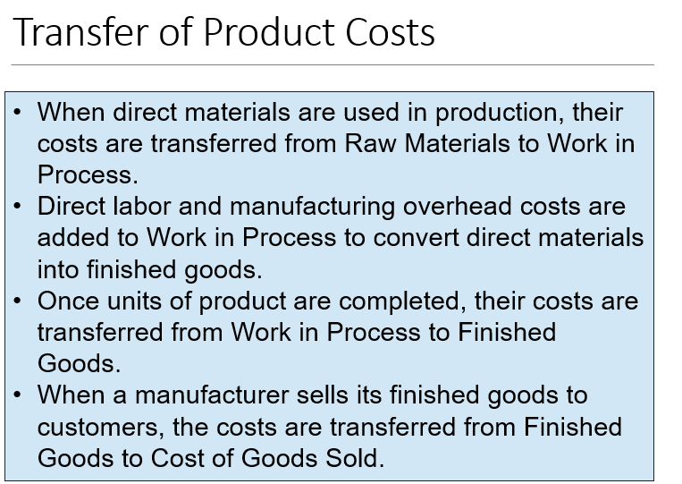
www.midocean.ae

Slide 24
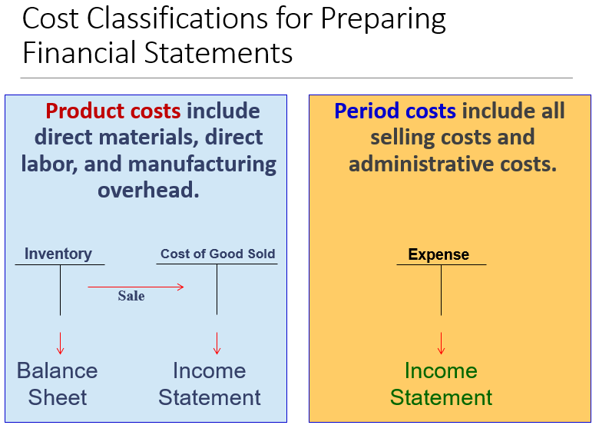
www.midocean.ae

Slide 25
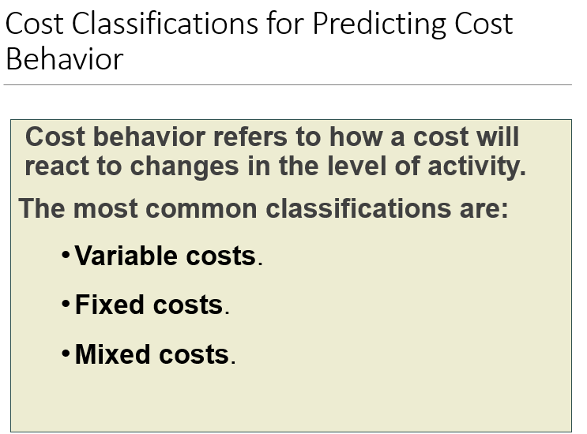
www.midocean.ae

Slide 26
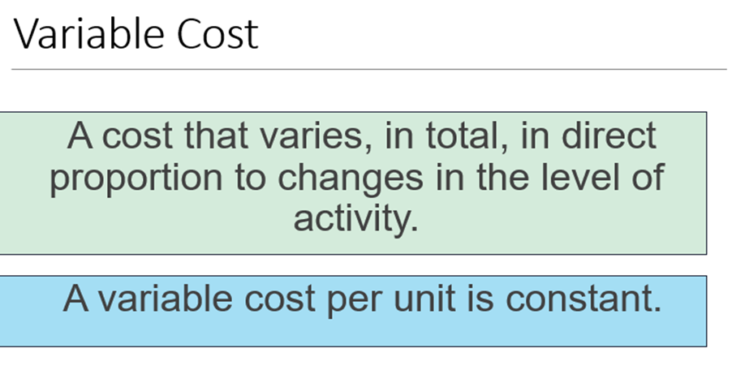
www.midocean.ae

Slide 27
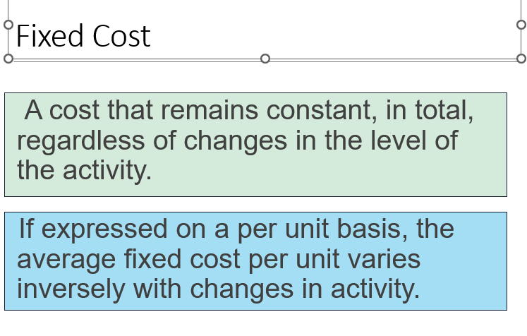
www.midocean.ae

Slide 28
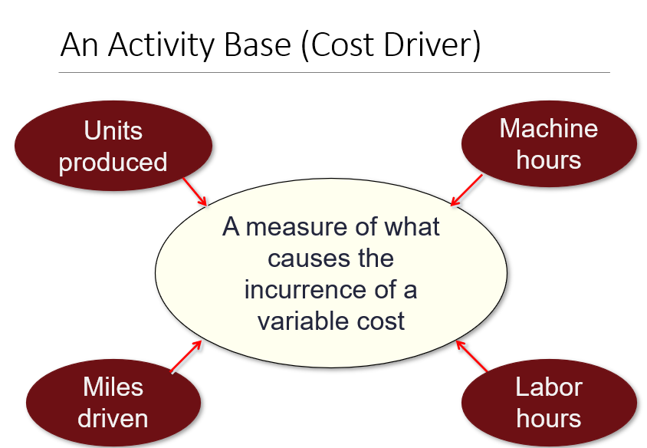
www.midocean.ae

Slide 29
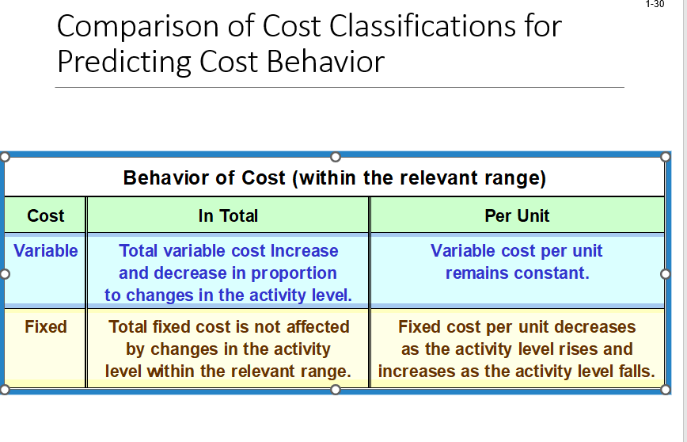
www.midocean.ae

Slide 30
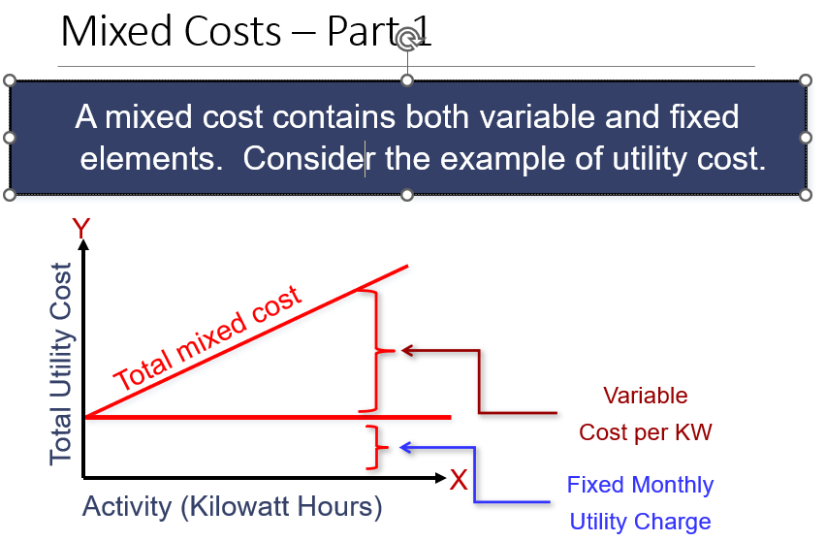
www.midocean.ae

Slide 31
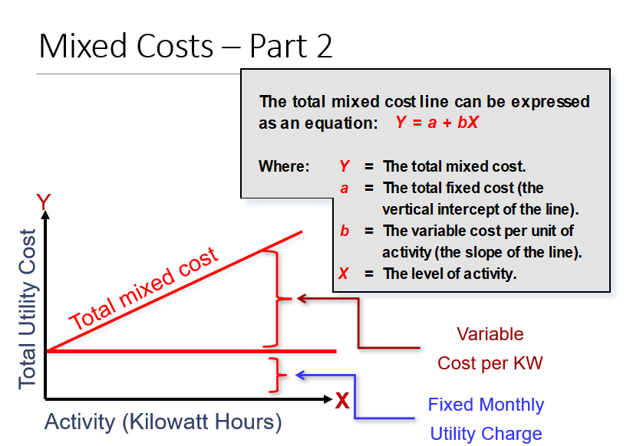
www.midocean.ae

Slide 32
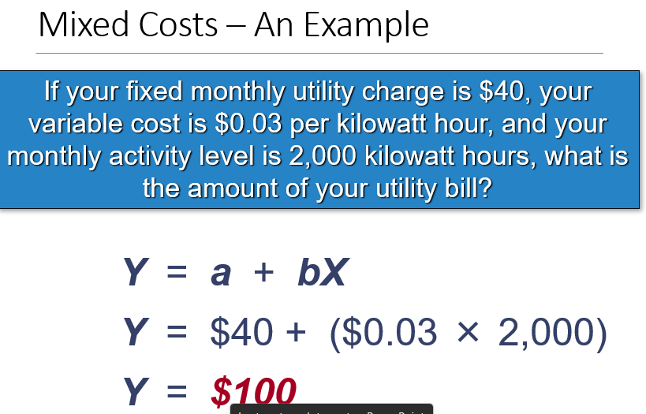
www.midocean.ae

Slide 33
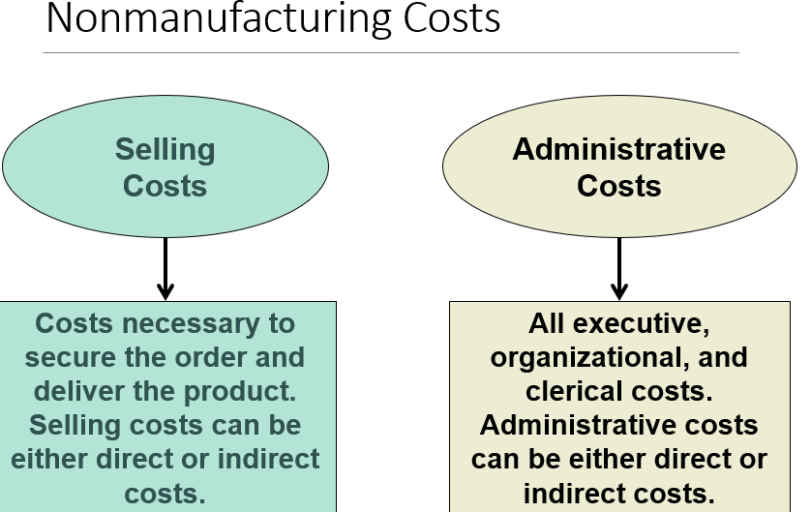
www.midocean.ae

Slide 34
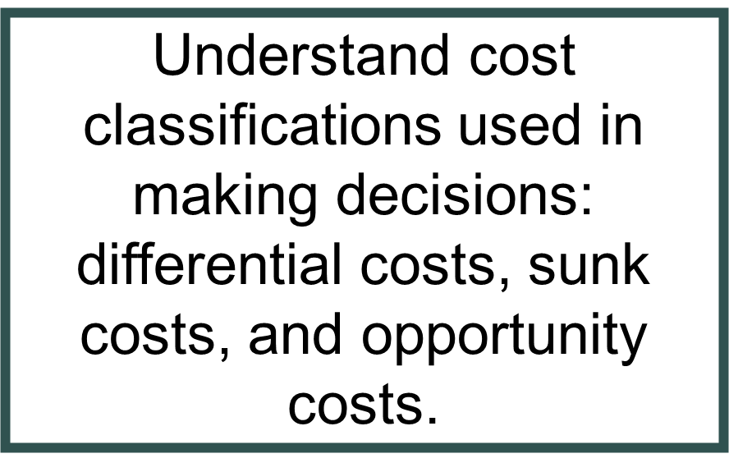
www.midocean.ae

Slide 35
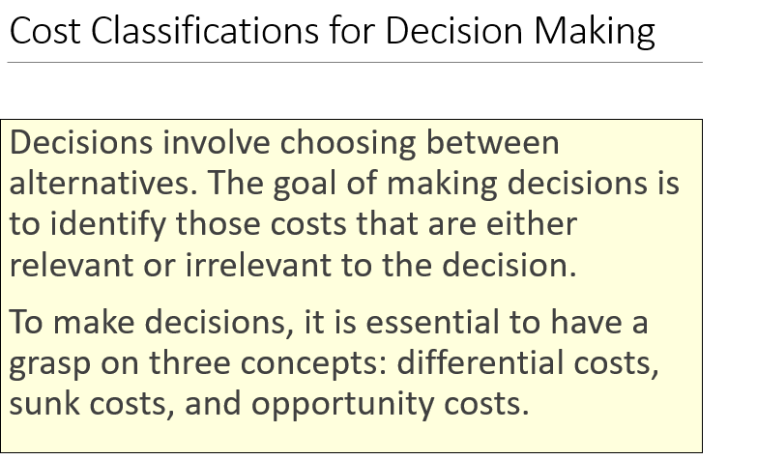
www.midocean.ae

Slide 36
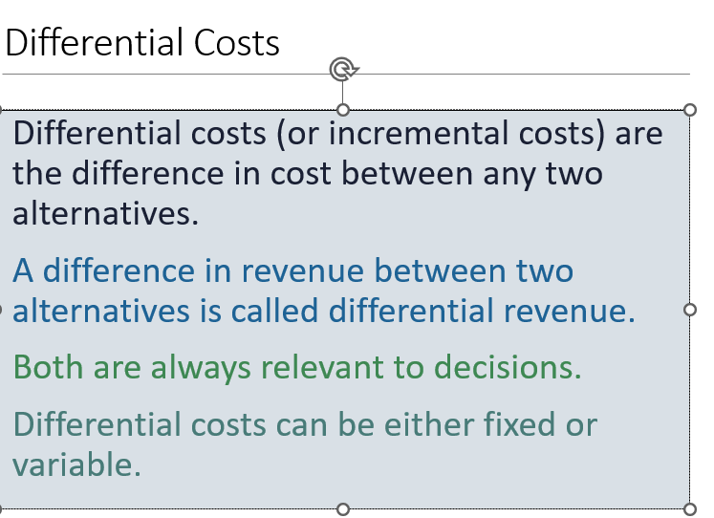
www.midocean.ae

Slide 37
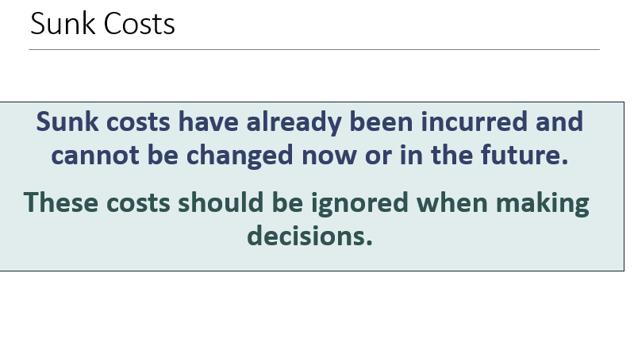
www.midocean.ae

Slide 38
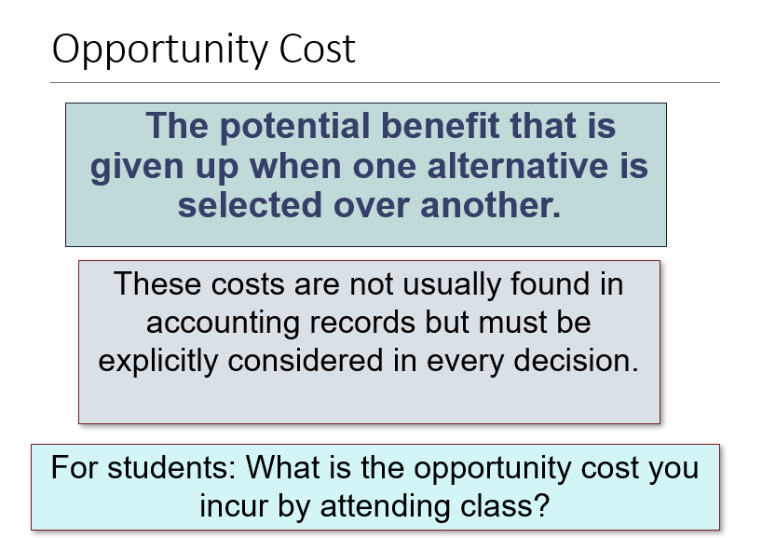
www.midocean.ae

Slide 39
Prepare income statements for a merchandising company using the traditional and contribution formats.
www.midocean.ae

Slide 40
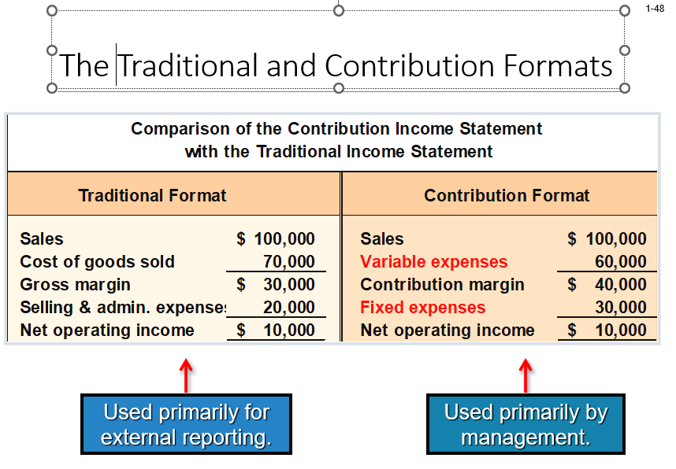
www.midocean.ae

Slide 41
The contribution income statement format is used as an internal planning and decision-making tool. We will use this approach for:
Cost-volume-profit analysis .
Segmented reporting of profit data .
Budgeting .
Special decisions such as pricing and make-or-buy analysis .
www.midocean.ae

Slide 42



Thank You

