Slide 1



Past Tenses in Use
Lecture 7
Prepared by
Ahmed Soliman
www.midocean.ae

Slide 2

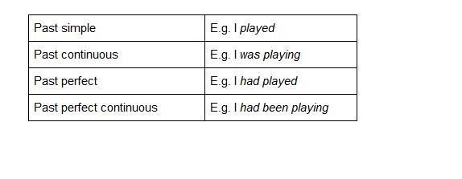
Past Tenses in Use
www.midocean.ae

Slide 3
1. Past Simple
Use
Finished actions in the past.
I was born in San Francisco.
Yesterday I went to the supermarket.
Last night we watched the football.
The phone rang five minutes ago.
www.midocean.ae

Slide 4
To tell a story
E.g. I woke up on my wedding day, I jumped out of bed and immediately called my brother. He didn’t pick up and so I began to worry.
www.midocean.ae

Slide 5
Key words
last month, last week, last summer, in 1997, when I was a child, a long time ago,
www.midocean.ae

Slide 6
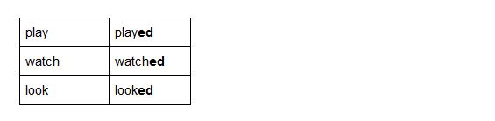
Form
For regular verbs we add -ed to the infinitive form of the verb. E.g.
www.midocean.ae

Slide 7
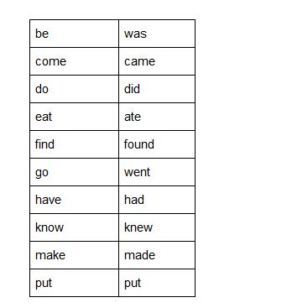
Irregular verbs however, take a different form
www.midocean.ae

Slide 8
________ (brush) his teeth
________ (try) to cook spaghetti in the pot
________ (put) the spaghetti in the bath
________ (kill) the bird
________ (take) the spaghetti out of the cupboard.
www.midocean.ae

Slide 9
2. Past Continuous
Use
A common use of the past continuous is to show that a longer action was interrupted (usually by a shorter action in the past simple). We often use the time expression when
I was swimming in the sea when I saw a shark.
Henry was sitting at home when the phone rang.
She was playing golf when it began to rain.
www.midocean.ae

Slide 10
When two continuous actions are happening at the same time we use the time expression while.
I was talking to Sarah while she was driving.
We were playing while dad was cooking dinner.
www.midocean.ae

Slide 11
We can also use it to show a continuous action happening at a specific time in the past.
Yesterday morning I was practising the piano.
At 6 o’clock I was eating dinner.
What were you doing at 8pm last night?
www.midocean.ae

Slide 12
It can be used to add some description to a story.
E.g. It was a beautiful day. The sun was shining and the birds were singing. We were walking around our favourite park.
www.midocean.ae

Slide 13
Form
was/were + verb + ing.
www.midocean.ae

Slide 14
Exercise: Choose the correct answer
1. My brother and sister _____ playing tennis at 11am yesterday.
are
was
were
2. _____ you still working at 7pm last night?
Were
Are
Was
3. At 8.30am today I _____ driving to work.
was
am
were
www.midocean.ae

Slide 15
4. We _____ sleeping when the police came.
was
weren't
won't
5. Why _____ he having lunch at 4pm?
was
does
were
6. Was he not _____ his homework?
doing
do
done
www.midocean.ae

Slide 16
3. Past Perfect
Use
We use it when one action happens before another past action.
A. The film had started when we arrived. (the film started before we arrived)
B. The film started when we arrived (we arrived at the same time the film started)
We use time expressions such as before, by the time and when.
www.midocean.ae

Slide 17
Form
had + past participle.
www.midocean.ae

Slide 18

www.midocean.ae

Slide 19
4. Past Perfect Continuous
Use
We use it to show that an action which started in the past continued up to another point in the past. For example:
She had been living in Italy for three years when she lost her job.
I had been waiting for ten minutes before the bus came.
By the time Steve arrived I had been working for nearly eight hours!
With the past perfect we use time expressions such as for five hours, for 2 weeks, for a long time, by the time.
www.midocean.ae

Slide 20
Form
had + been + verb + ing.
I had been waiting for ten minutes before the bus came.
www.midocean.ae

Slide 21


Thank You

