Slide 1


Storage Technologies
IT403
Prepared by
Dr. Ahmed El-Douh
Lecture 9

Slide 2



Storage Technologies
Lecture 9
IT403
Disaster Recovery Technology and Its Applications
Prepared by
Dr. Ahmed El-Douh

Slide 3
Objectives
Upon completion of this module, you will be able to:
  Describe the concepts and importance of Disaster Recovery.
  Differentiate the Advantages and Disadvantages of common Disaster Recovery solutions.
  Understand the technical principles of Disaster Recovery solutions.
  Learn how to deploy a Disaster Recovery solution through case study of typical application of Disaster Recovery Solution.
www.midocean.ae

Slide 4
Chapter
Outlines
09
Overview of Disaster Recovery Solution.
Architecture of Disaster Recovery Solution.
Common Disaster Recovery Technologies.
www.midocean.ae

Slide 5


Chapter
09
Overview of Disaster Recovery Solution
www.midocean.ae

Slide 6
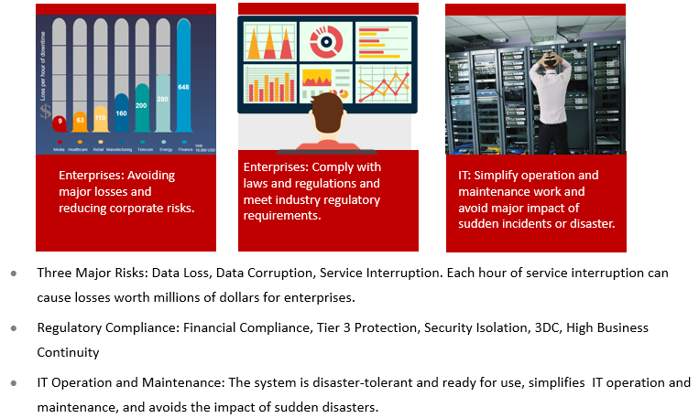
Demand For Disaster Recovery
www.midocean.ae

Slide 7
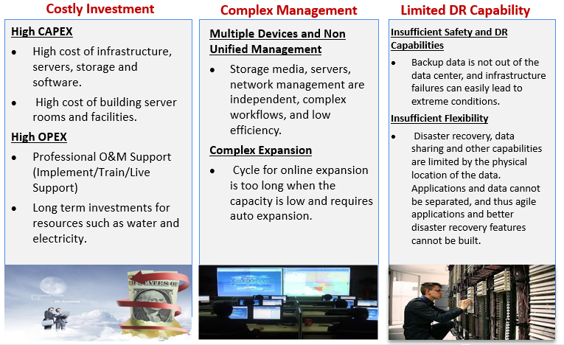
Challenges Of Disaster Recovery
www.midocean.ae

Slide 8
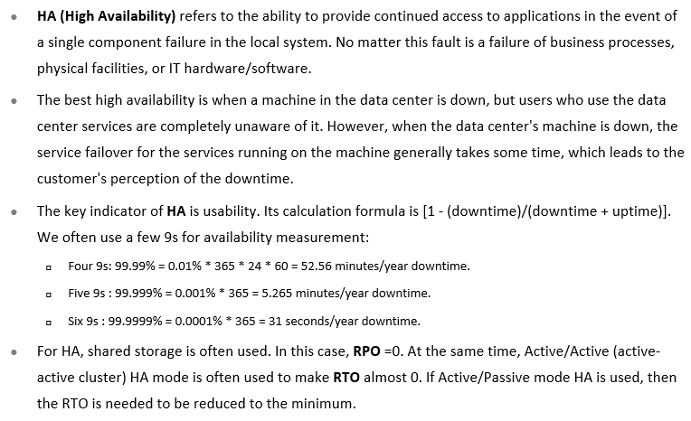
What is HA ?
www.midocean.ae

Slide 9
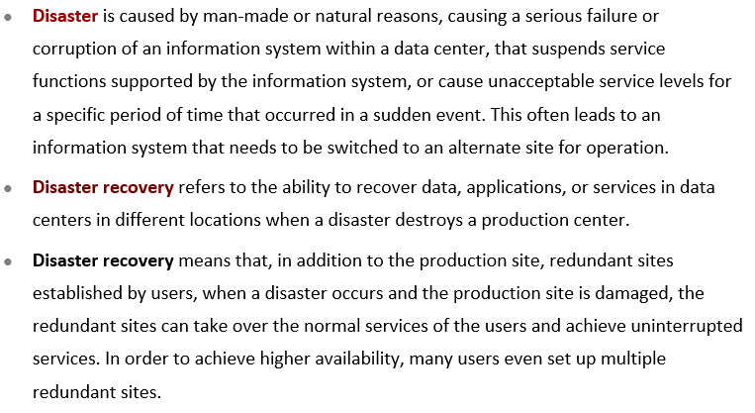
What is Disaster Recovery (DR)?
www.midocean.ae

Slide 10
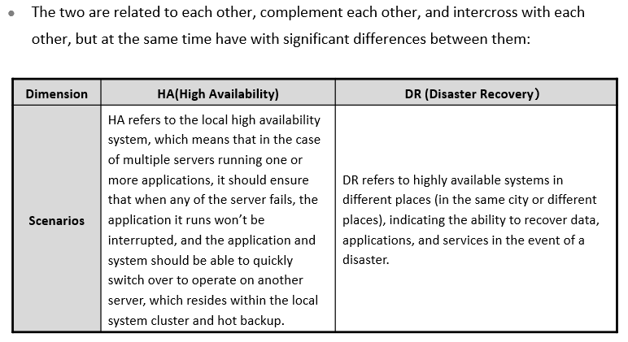
The Relationship between HA and DR (1)
www.midocean.ae

Slide 11
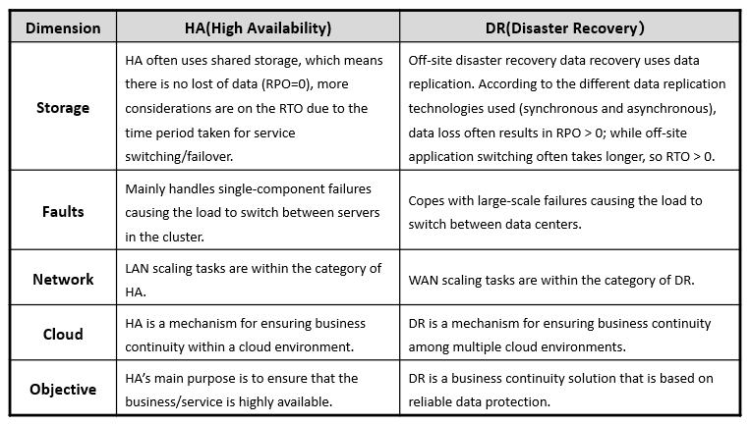
The Relationship between HA and DR (2)
www.midocean.ae

Slide 12
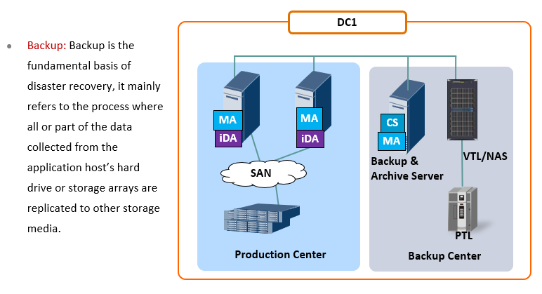
Differences Between DR & Backups (1)
www.midocean.ae

Slide 13
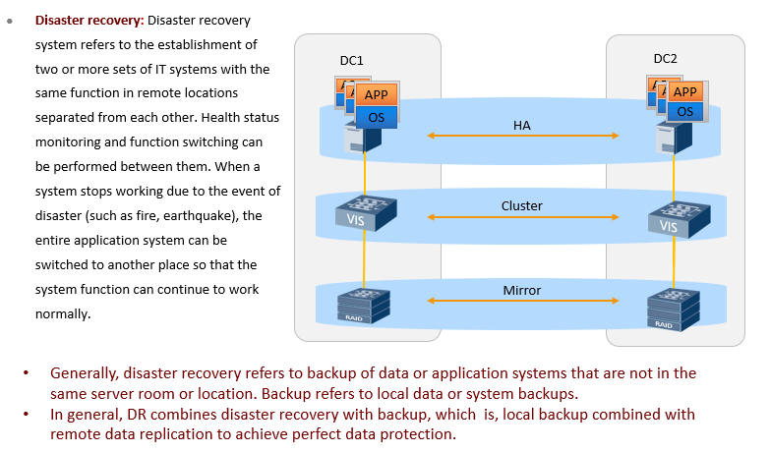
Differences Between DR & Backups (2)
www.midocean.ae

Slide 14
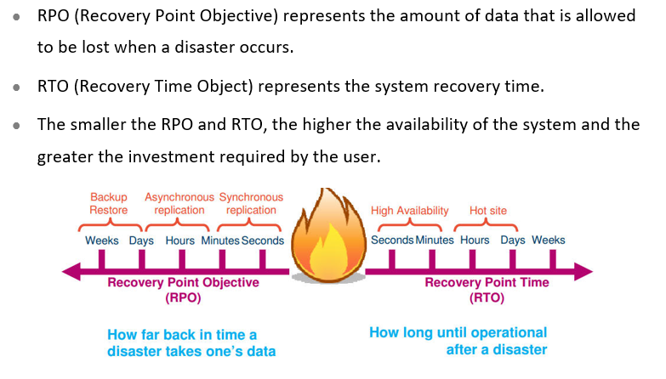
Key Indicators For Measuring DR System Performance
www.midocean.ae

Slide 15
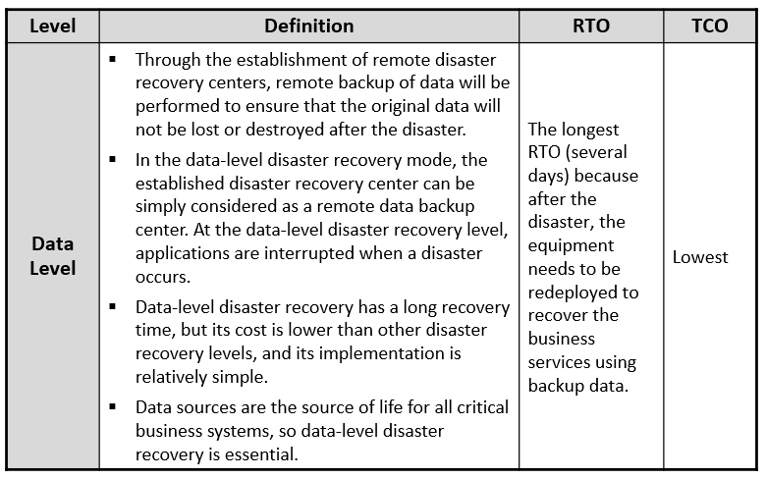
Levels Of DR Systems
www.midocean.ae

Slide 16
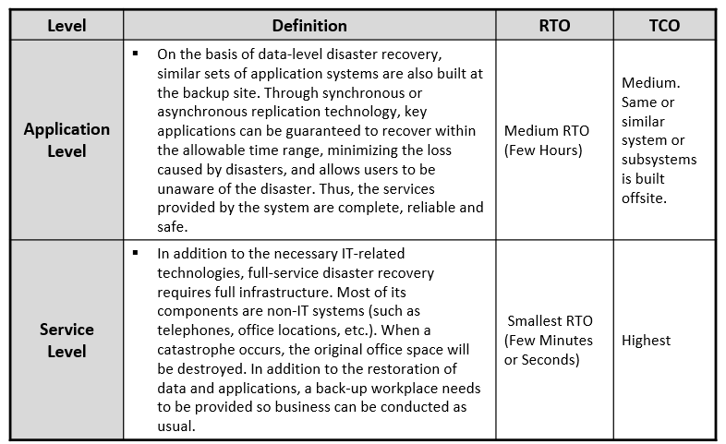
Levels Of DR Systems
www.midocean.ae

Slide 17
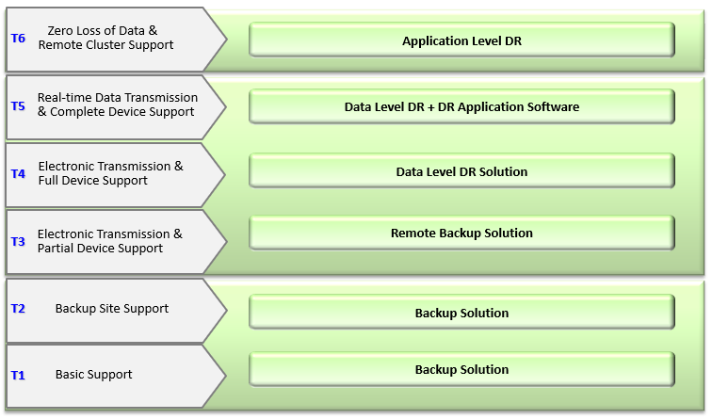
Benchmark Analysis Of DR Construction Levels
www.midocean.ae

Slide 18
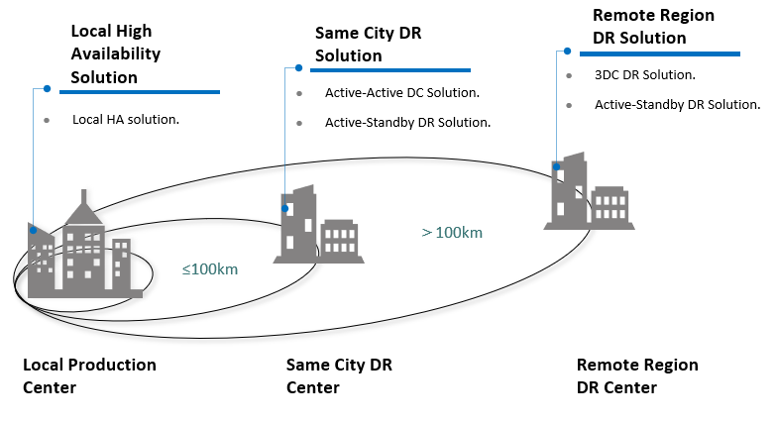
Panorama Of DR Solution
www.midocean.ae

Slide 19
Chapter
09
Architecture of Disaster Recovery Solution
www.midocean.ae

Slide 20
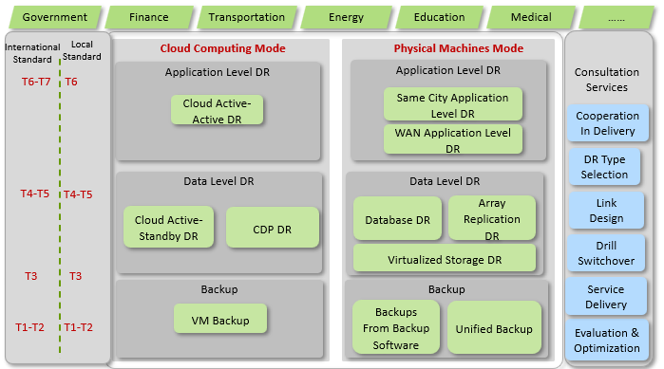
DR Backup Solution Framework
www.midocean.ae

Slide 21
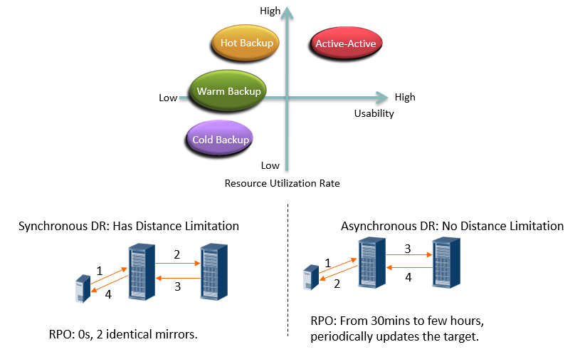
DR Design Model: Combination of Synchronous & Asynchronous
www.midocean.ae

Slide 22
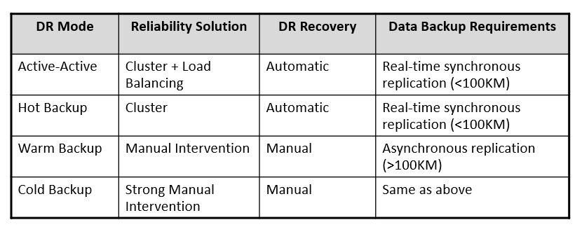
DR Design Model: Combination of Synchronous & Asynchronous
www.midocean.ae

Slide 23
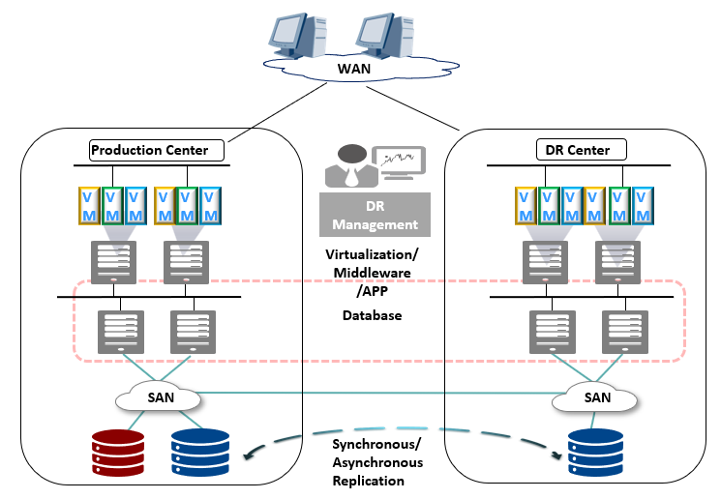
Active - Standby DR Solution
www.midocean.ae

Slide 24
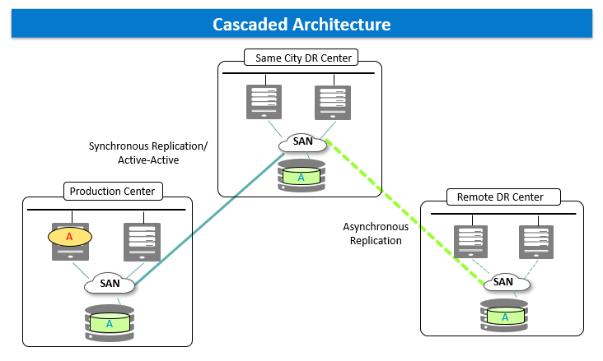
Three Datacenter (3DC) DR Solution (1)
www.midocean.ae

Slide 25
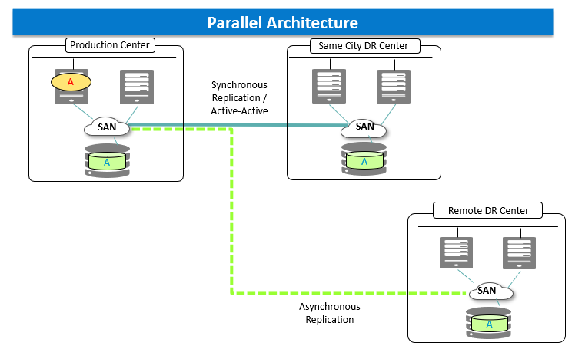
Three Datacenter (3DC) DR Solution (2)
www.midocean.ae

Slide 26
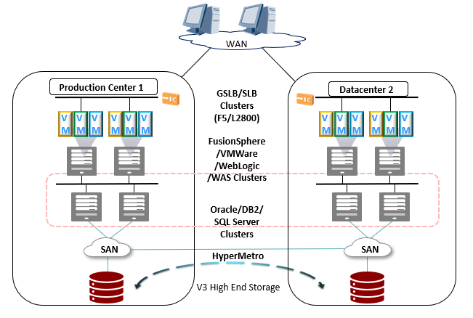
Active - Active DR Solution
www.midocean.ae

Slide 27
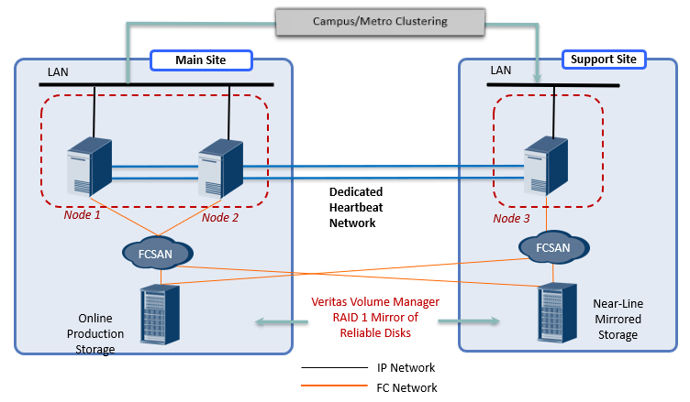
Campus/Same City Application Level DR (Physical Machines Mode)
www.midocean.ae

Slide 28
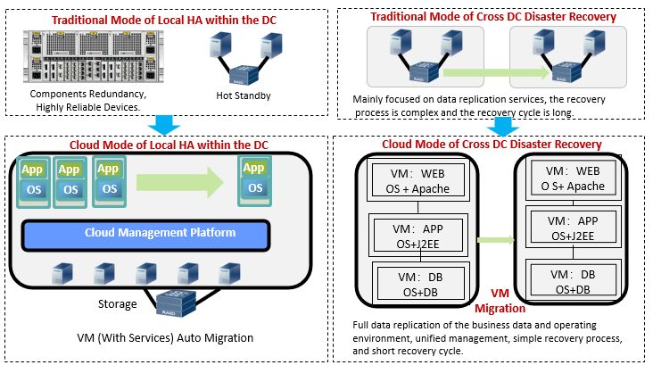
Evolution of New DR Model Under Cloud Computing
www.midocean.ae

Slide 29
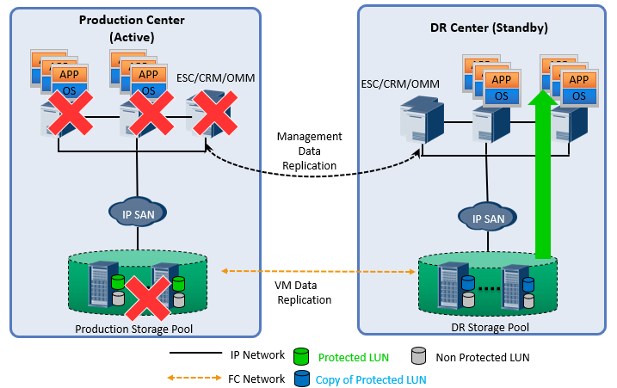
Cloud Active - Standby Data Level DR Implementation Method
www.midocean.ae

Slide 30
Chapter
09
Common Disaster Recovery Technologies
www.midocean.ae

Slide 31
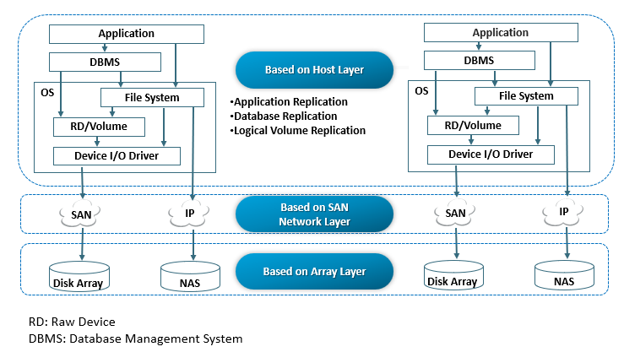
Main Technologies For DR
www.midocean.ae

Slide 32
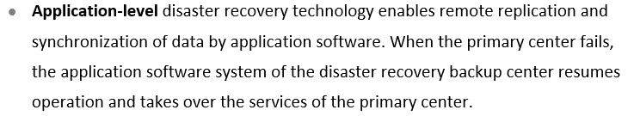
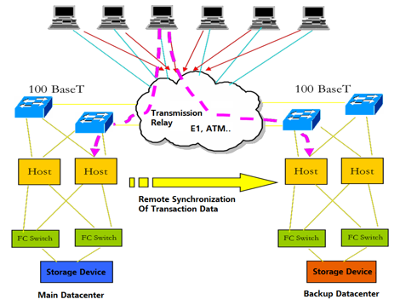
Host Layer DR Technology - Application Level
www.midocean.ae

Slide 33
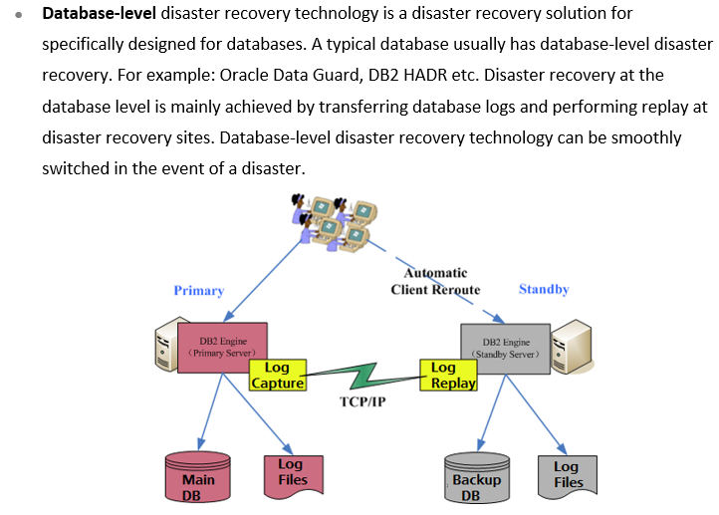
Host Layer DR Technology - Data Level
www.midocean.ae

Slide 34
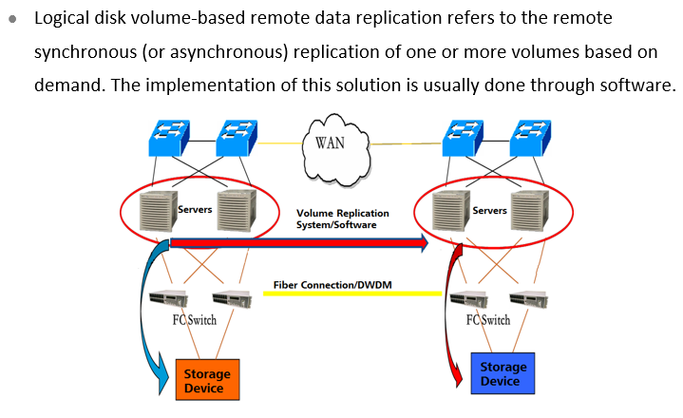
Host Layer DR Technology - Logical Volume Level
www.midocean.ae

Slide 35
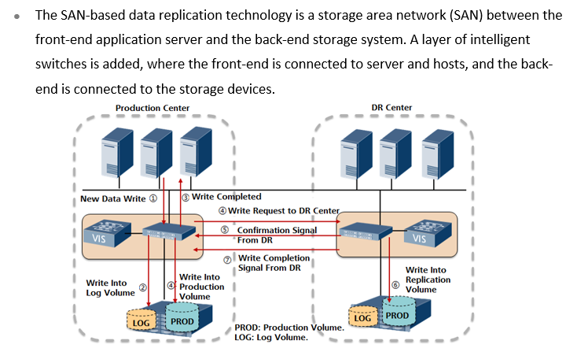
Network Layer DR Technology
www.midocean.ae

Slide 36
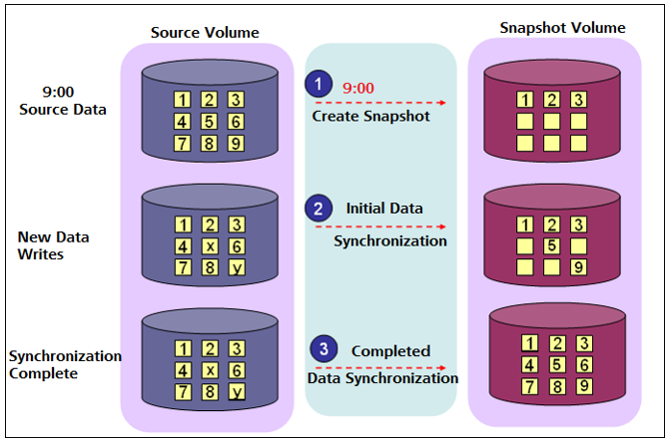
Network Layer Full Space Snapshot Working Principle
www.midocean.ae

Slide 37
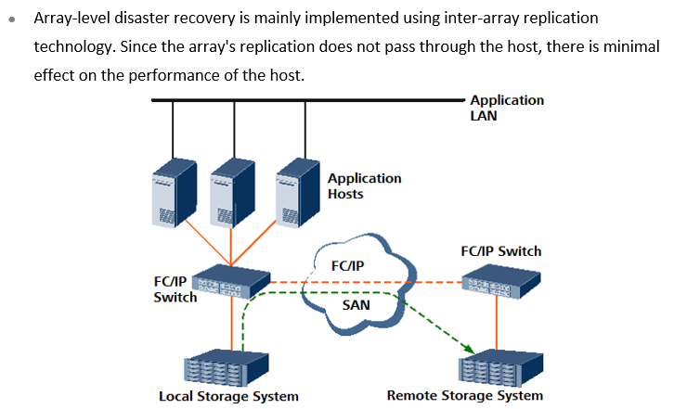
Array Level DR Technology
www.midocean.ae

Slide 38
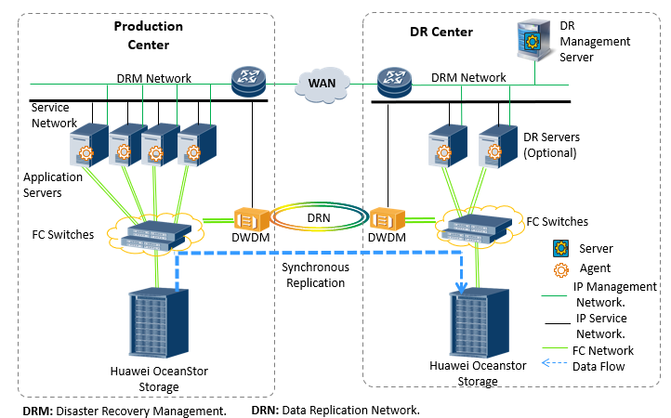
SAN Synchronous Replication DR
www.midocean.ae

Slide 39
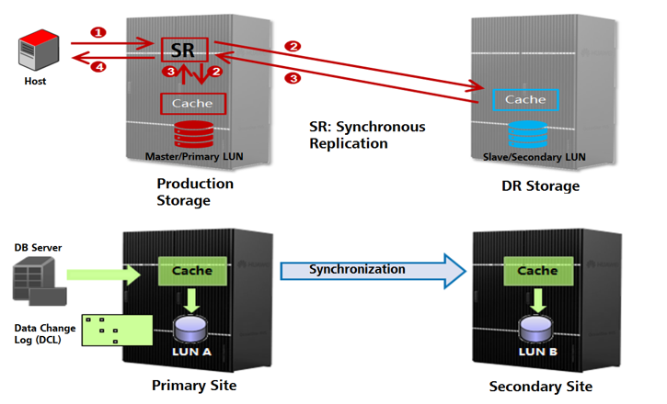
Working Principles of SAN Synchronous Replication
www.midocean.ae

Slide 40
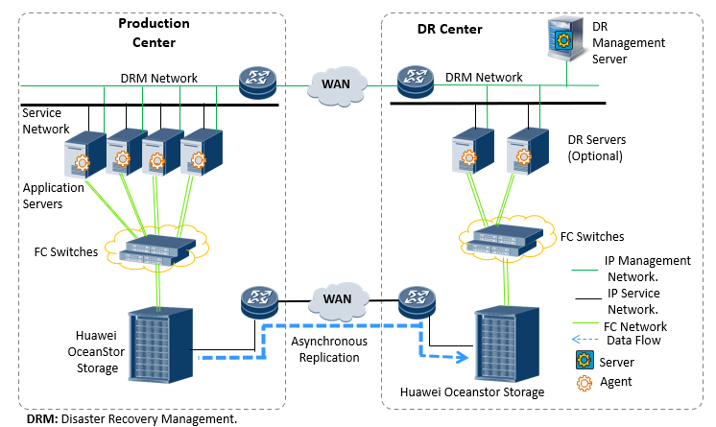
SAN Asynchronous Replication DR
www.midocean.ae

Slide 41
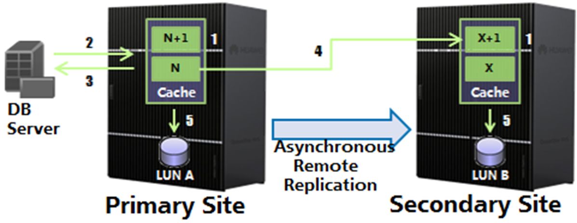
Working Principle Of SAN Asynchronous Replication
www.midocean.ae

Slide 42
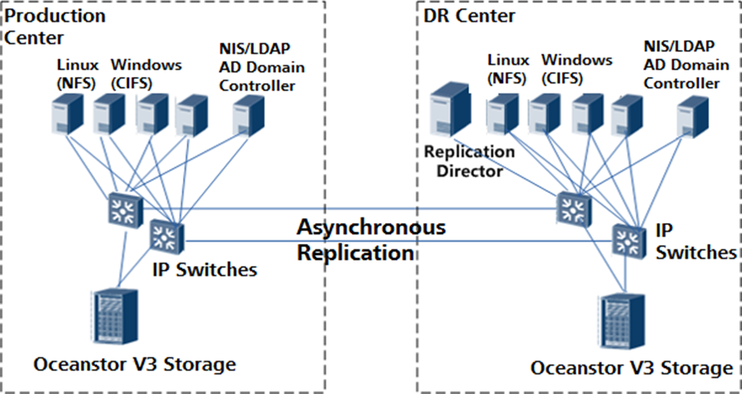
NAS Asynchronous Replication DR
www.midocean.ae

Slide 43
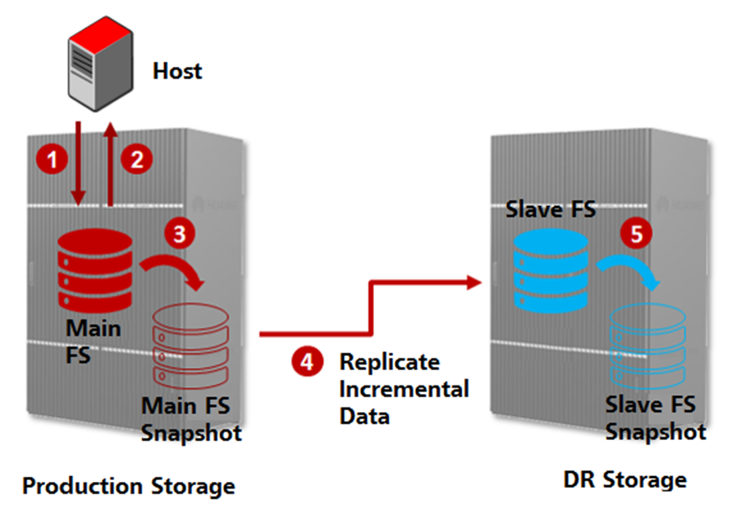
Working Principles Of NAS Asynchronous Replication
www.midocean.ae

Slide 44
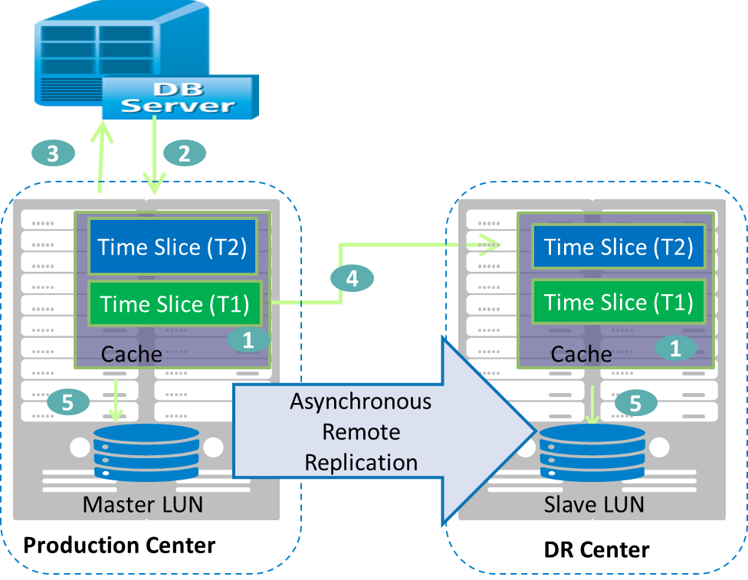
Multi Time Point Asynchronous Remote Replication –
Seconds Level RPO
www.midocean.ae

Slide 45
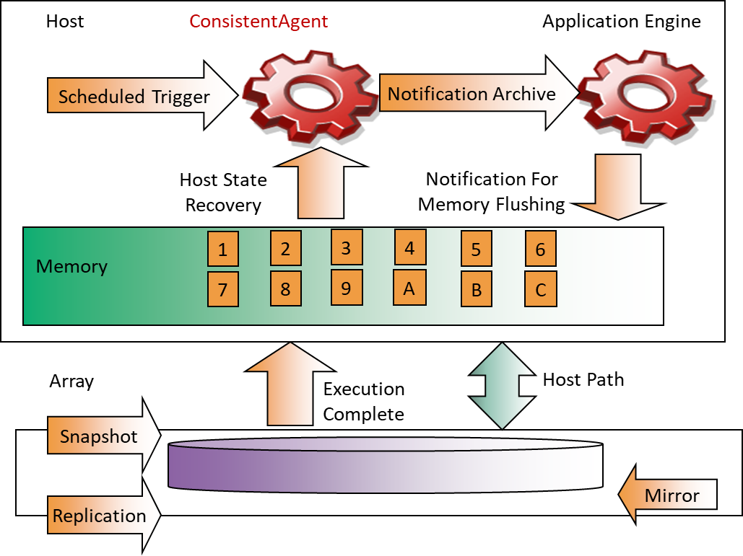
Remote Replication - Application Consistency
www.midocean.ae

Slide 46
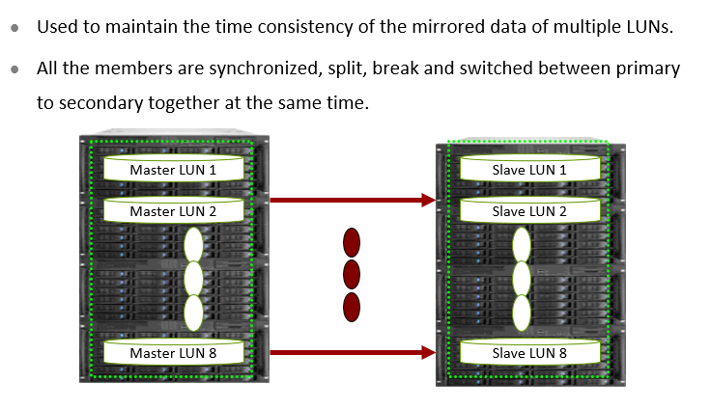
Remote Replication - Consistency Group
www.midocean.ae

Slide 47
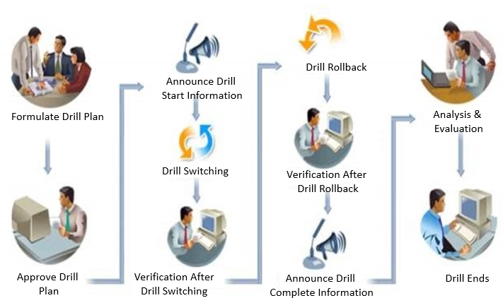
Typical DR Drill Solution
www.midocean.ae

Slide 48



Thank You

