Slide 1


Slide 2
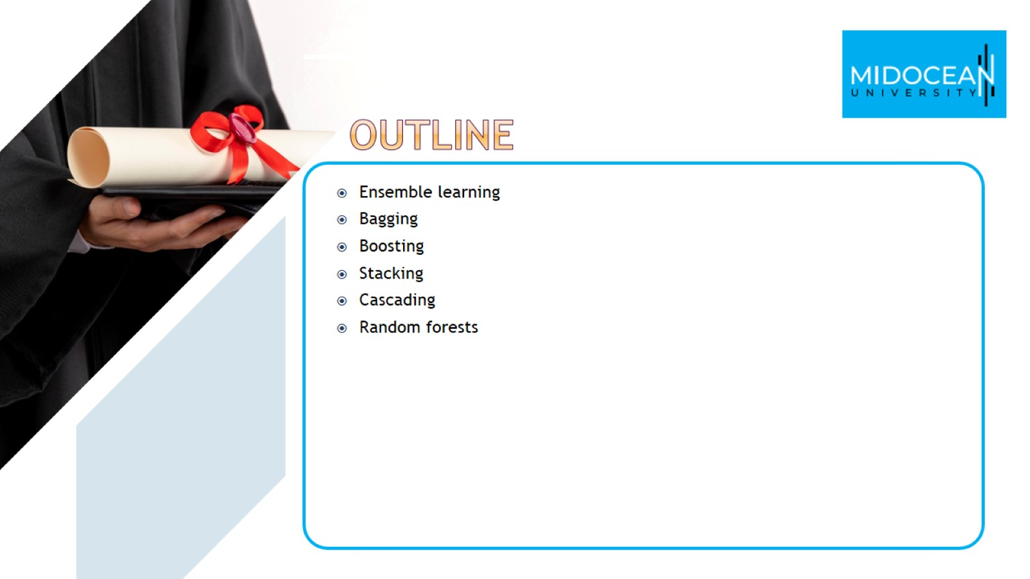

Slide 3
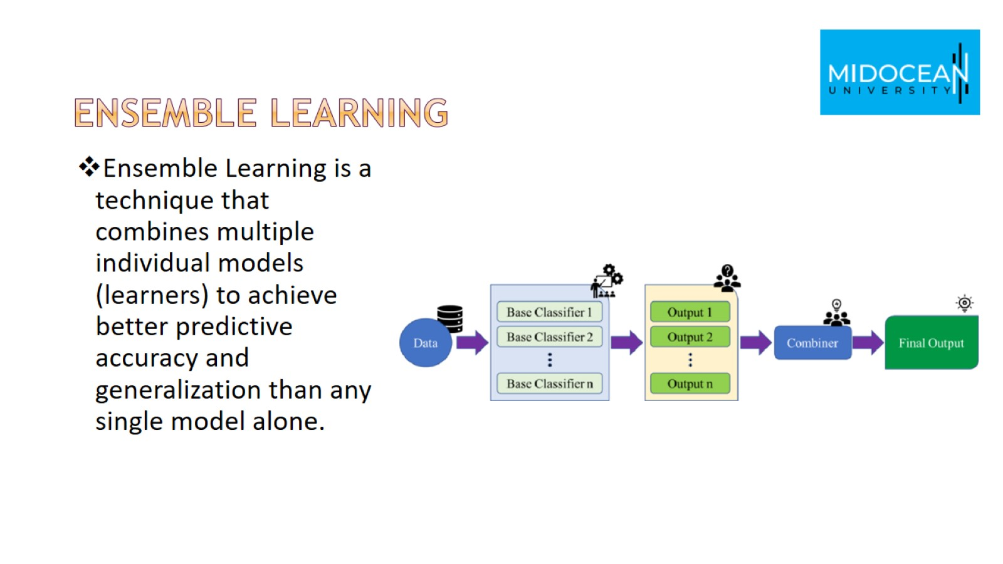
Ensemble learning

Slide 4
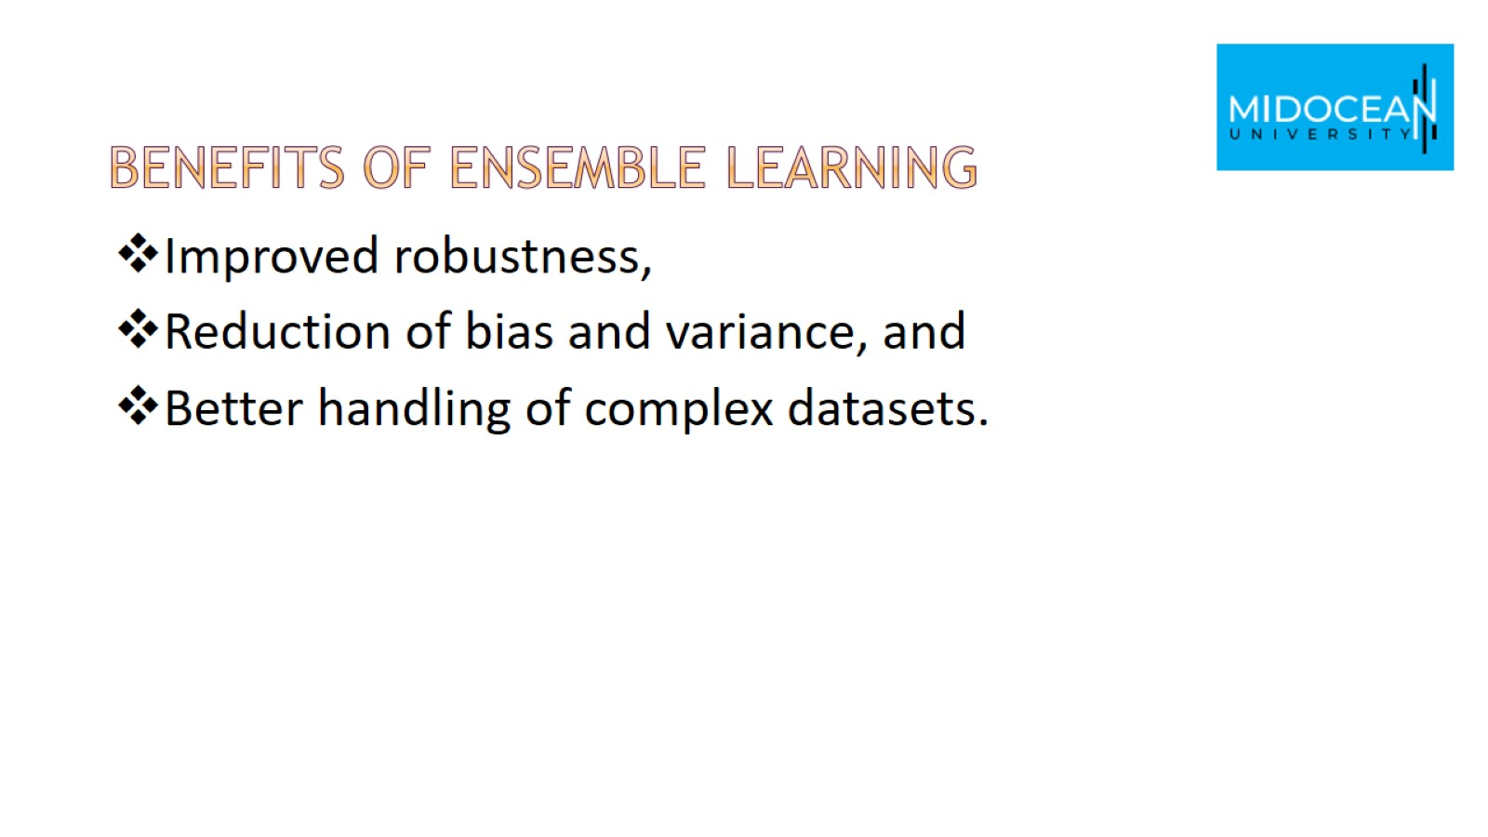
benefits of Ensemble Learning

Slide 5
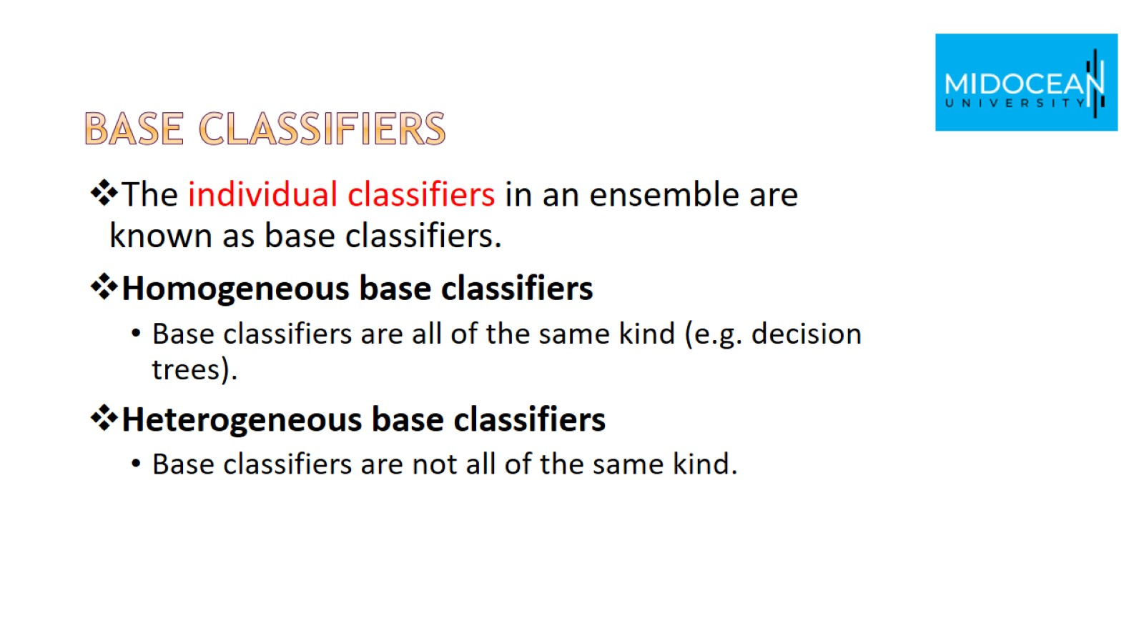
base classifiers

Slide 6
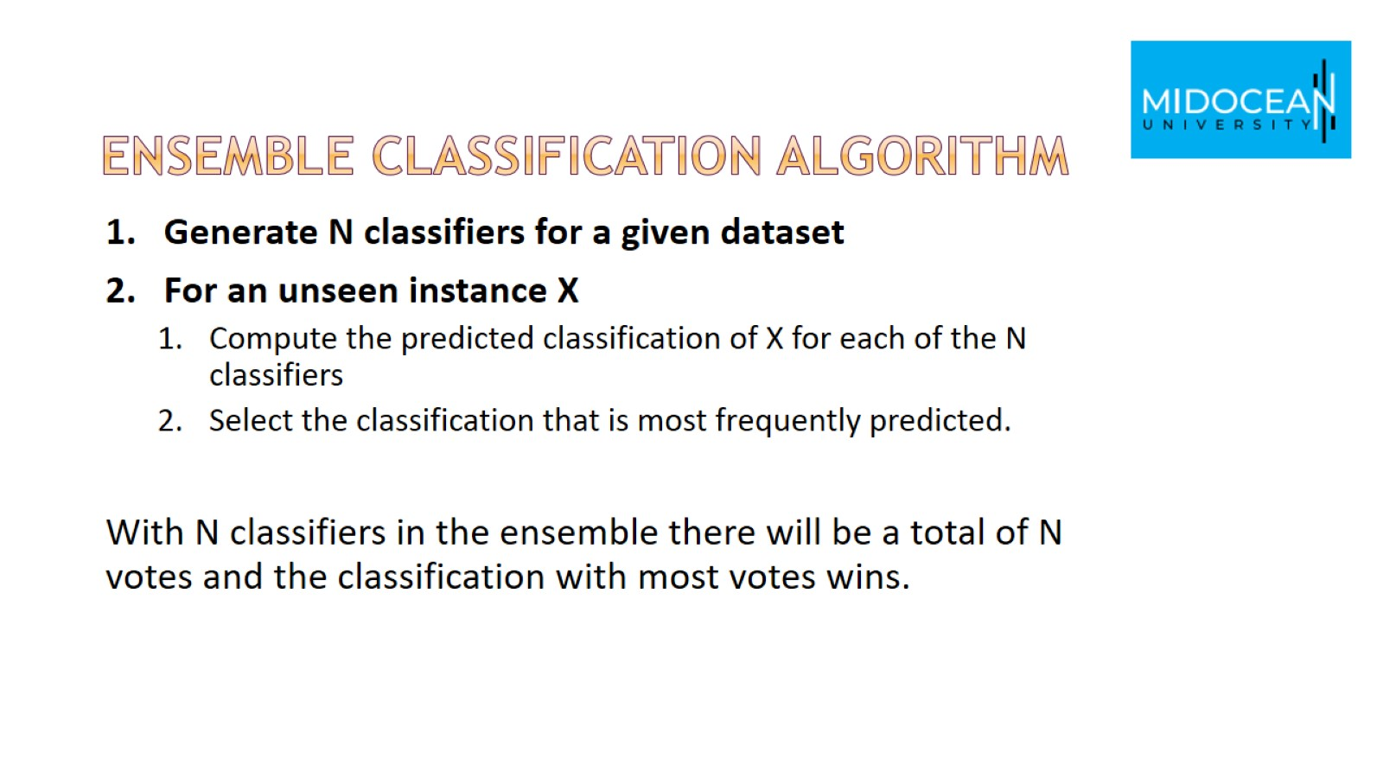
ensemble classification algorithm

Slide 7
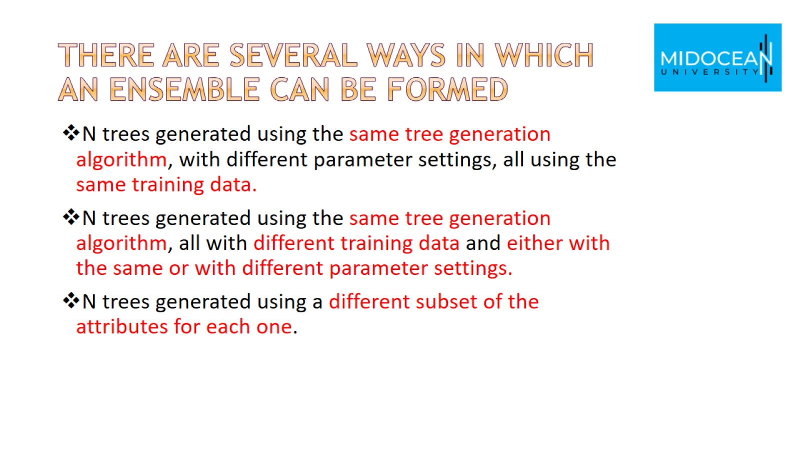
There are several ways in which an ensemble can be formed

Slide 8
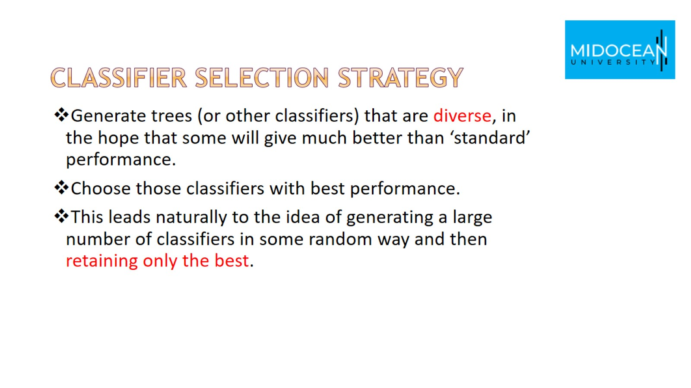
Classifier selection strategy

Slide 9
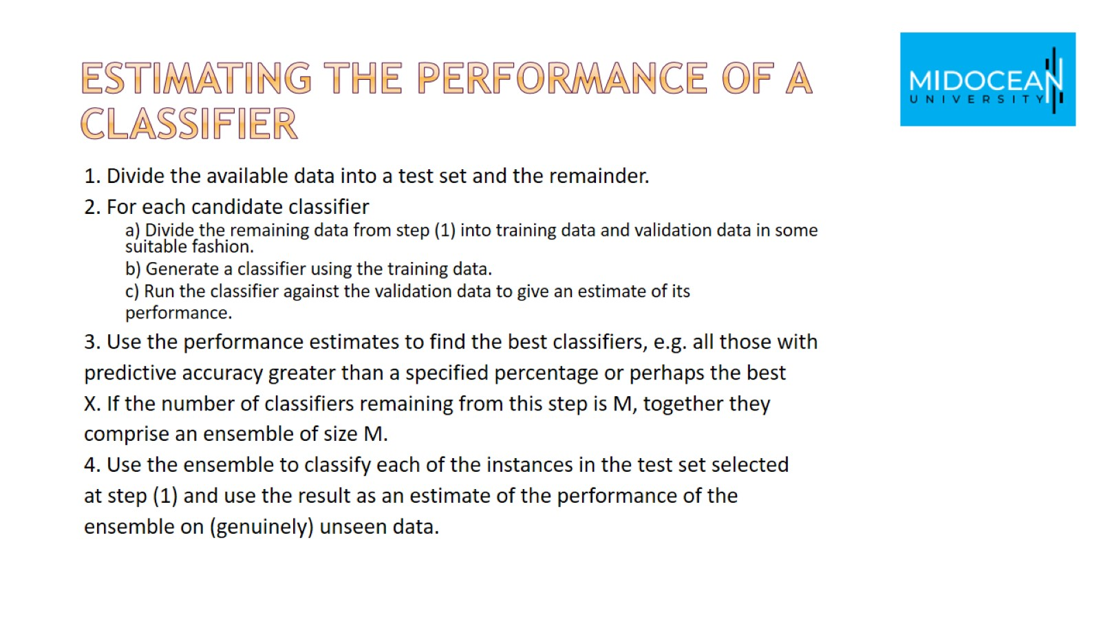
Estimating the Performance of a Classifier

Slide 10
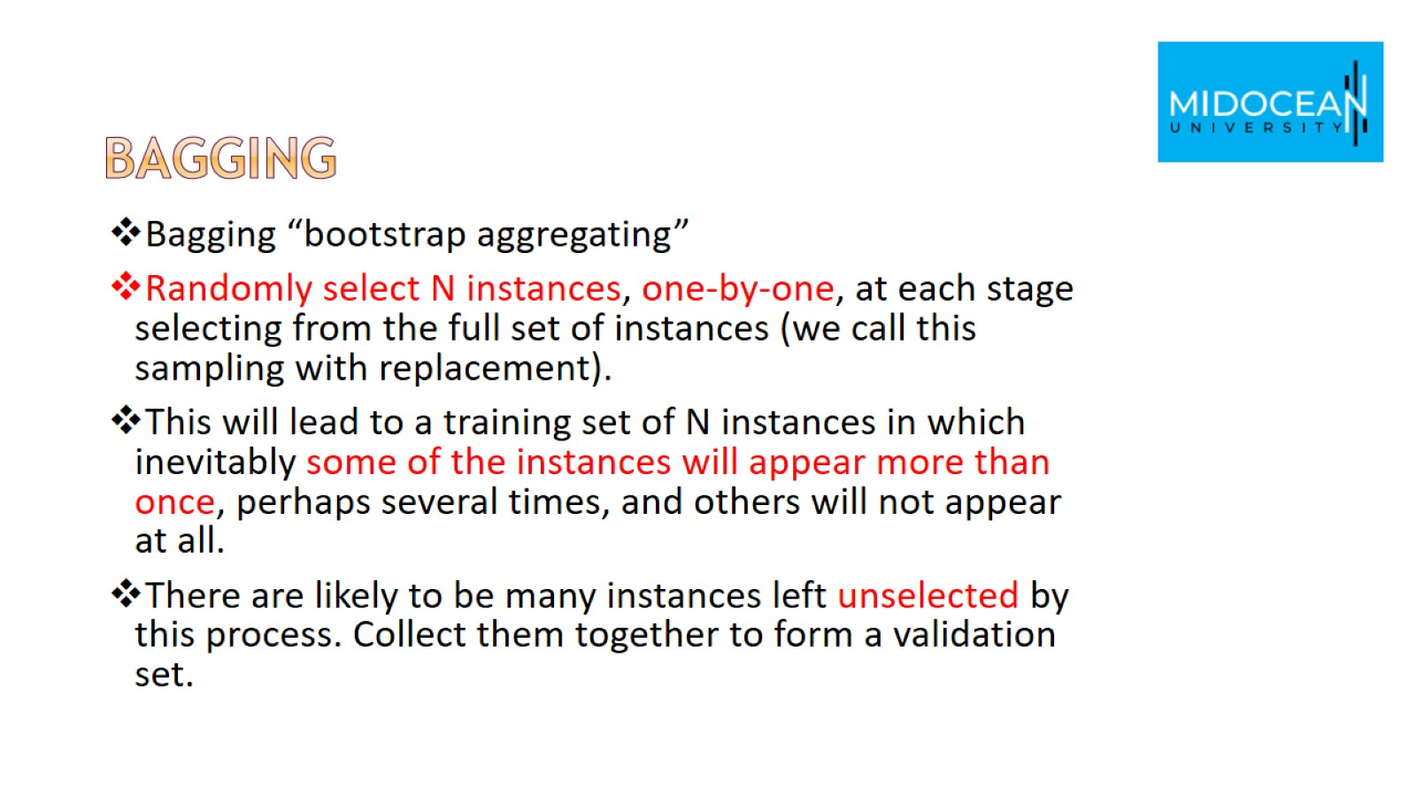
Bagging

Slide 11
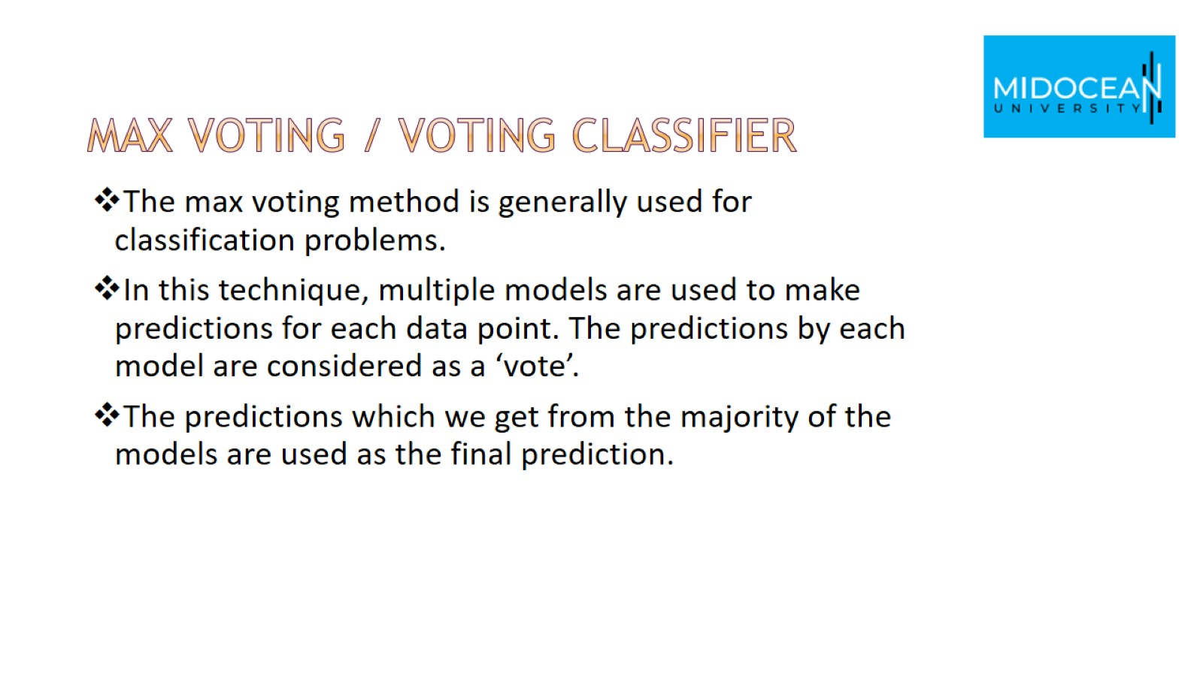
Max Voting / Voting Classifier

Slide 12
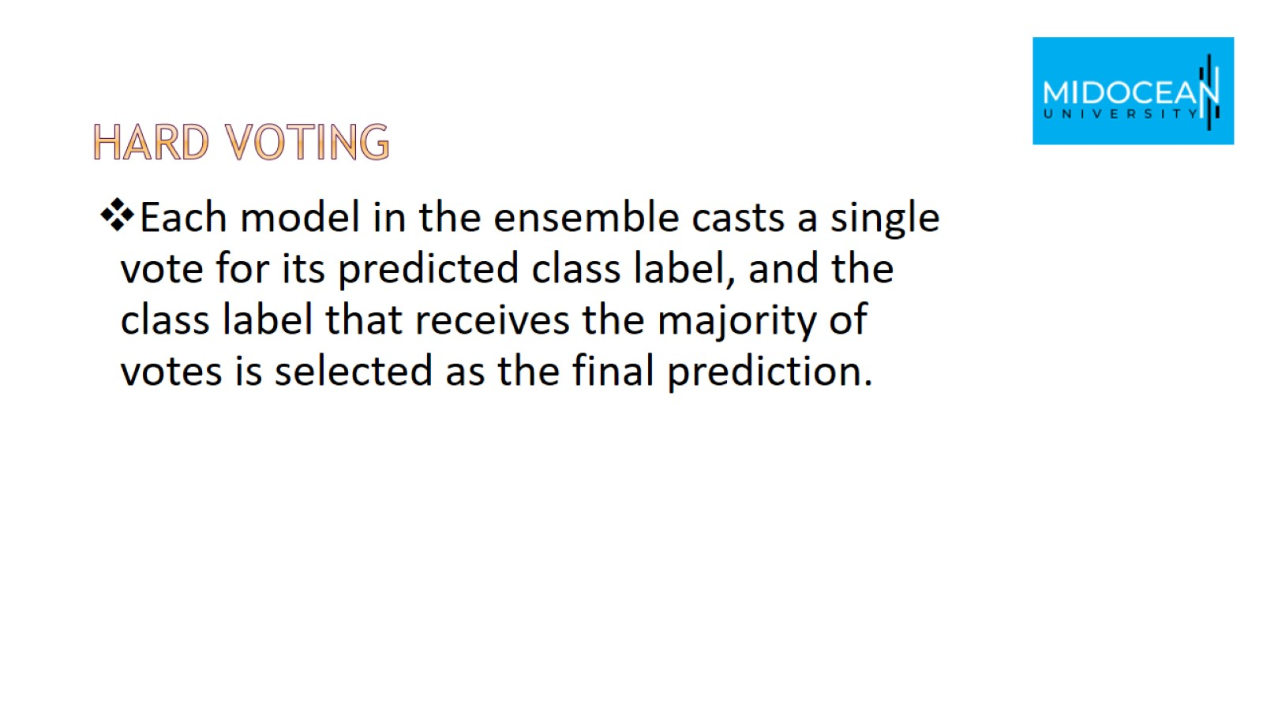
Hard Voting

Slide 13
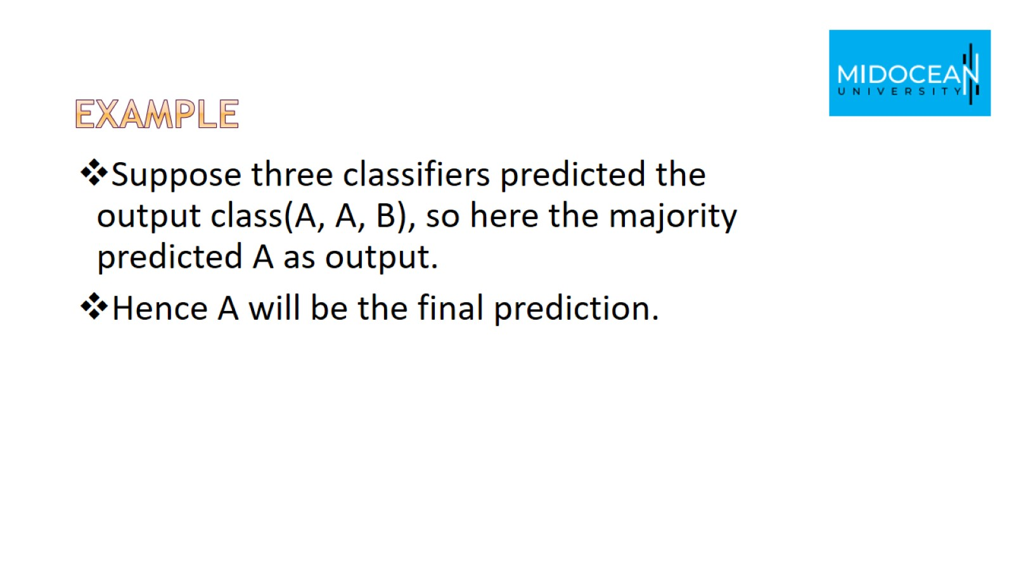
Example

Slide 14
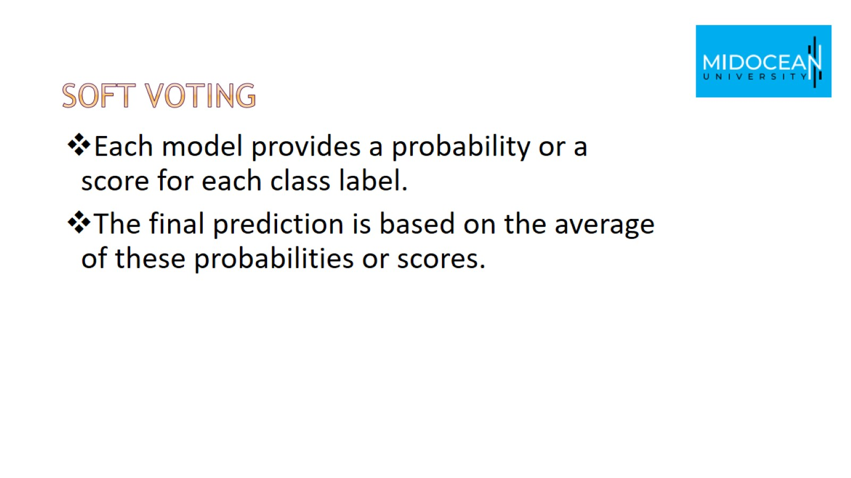
Soft Voting

Slide 15
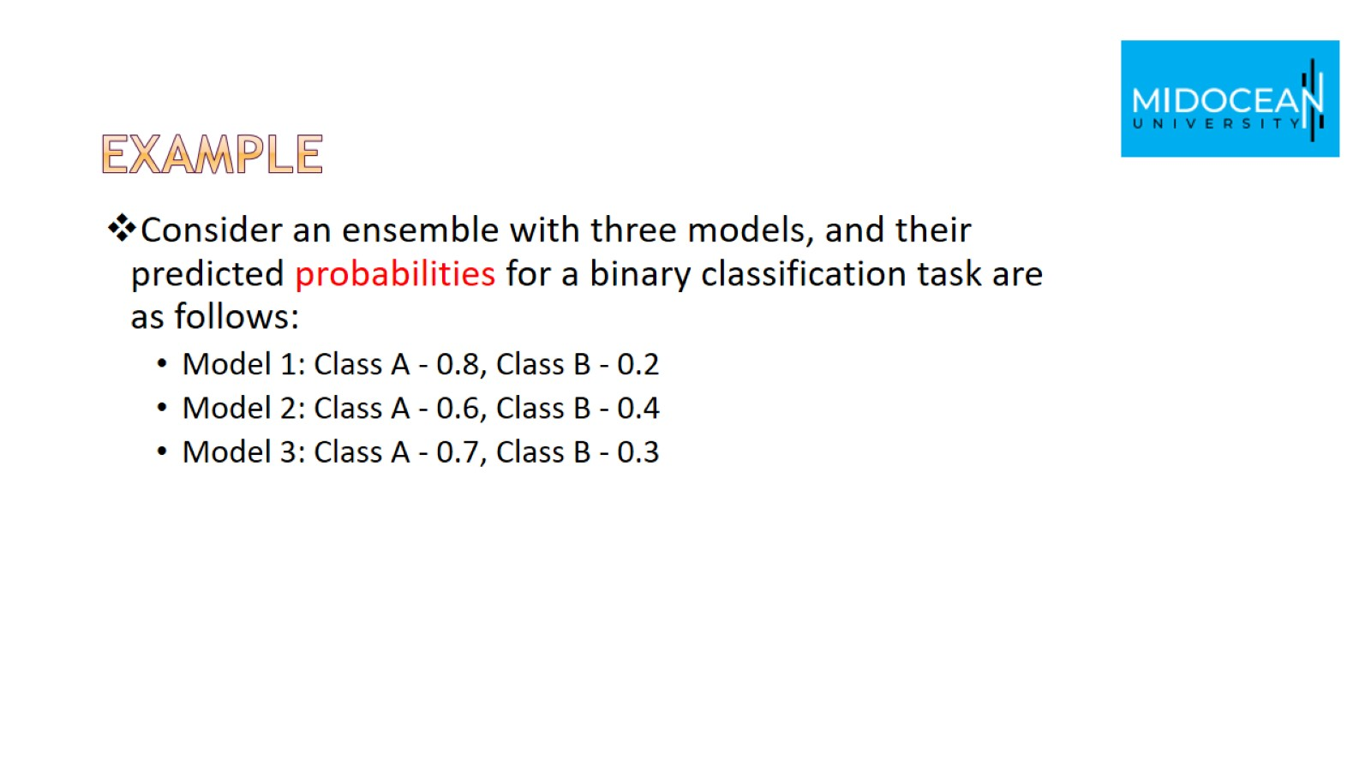
Example

Slide 16
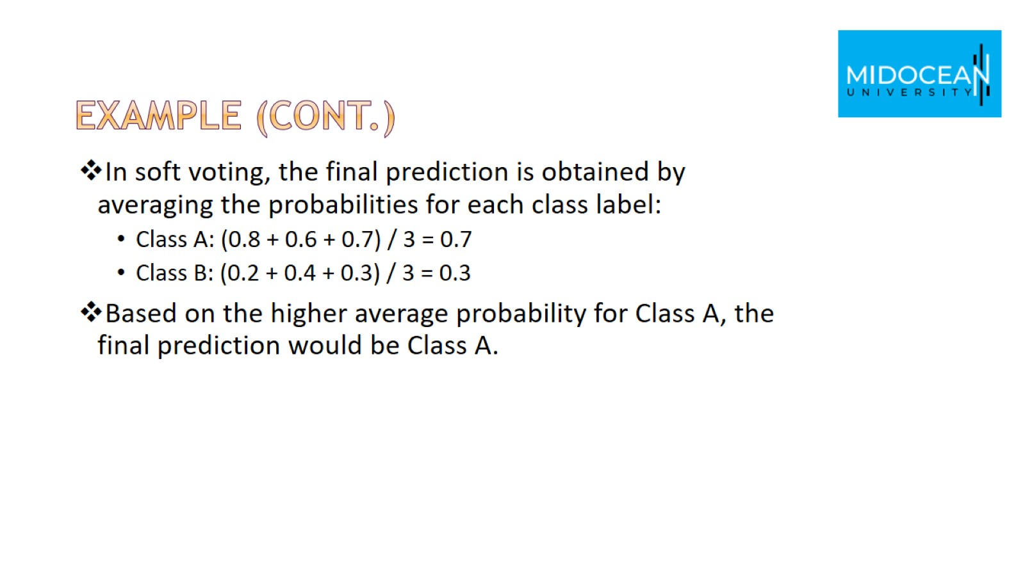
Example (cont.)

Slide 17
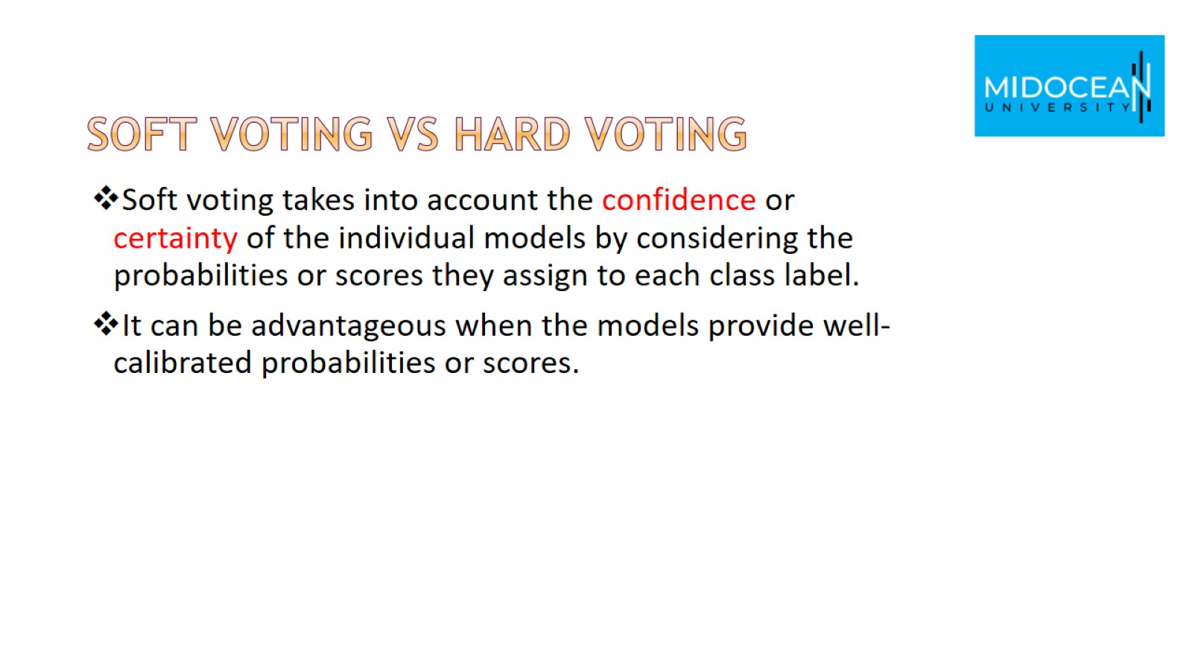
Soft voting vs hard voting

Slide 18
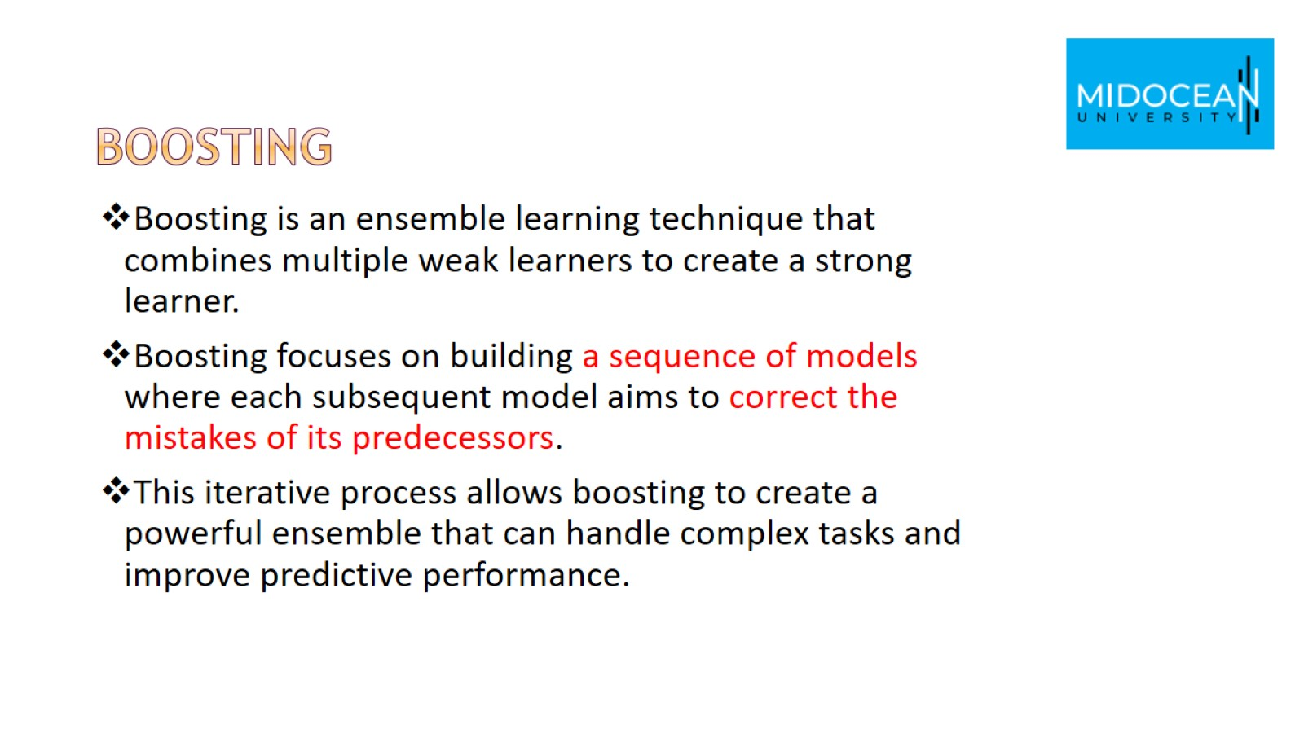
Boosting

Slide 19
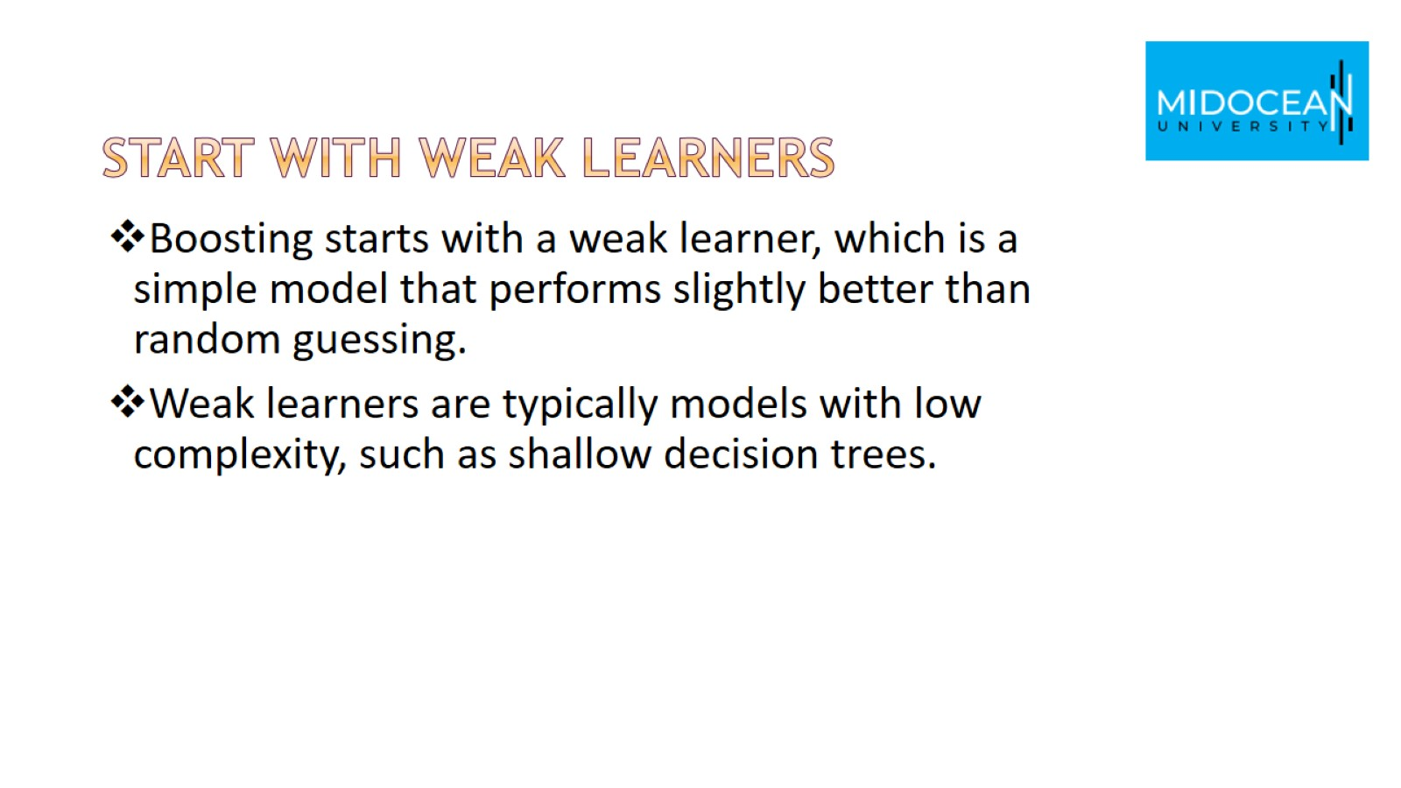
Start with weak learners

Slide 20
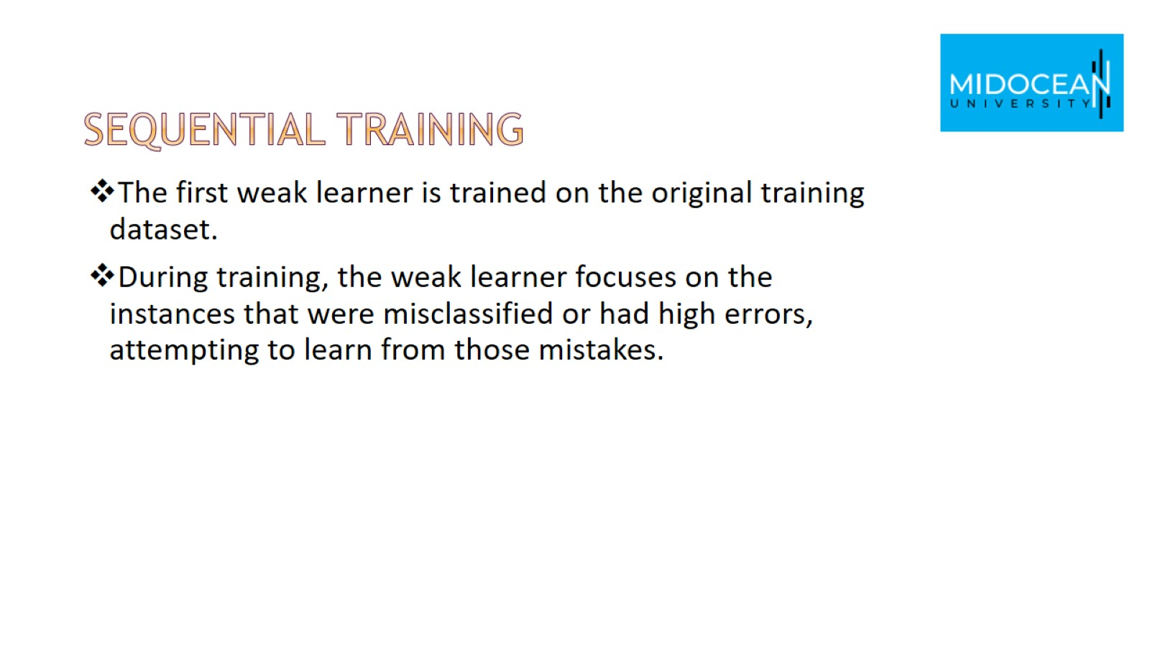
Sequential Training

Slide 21
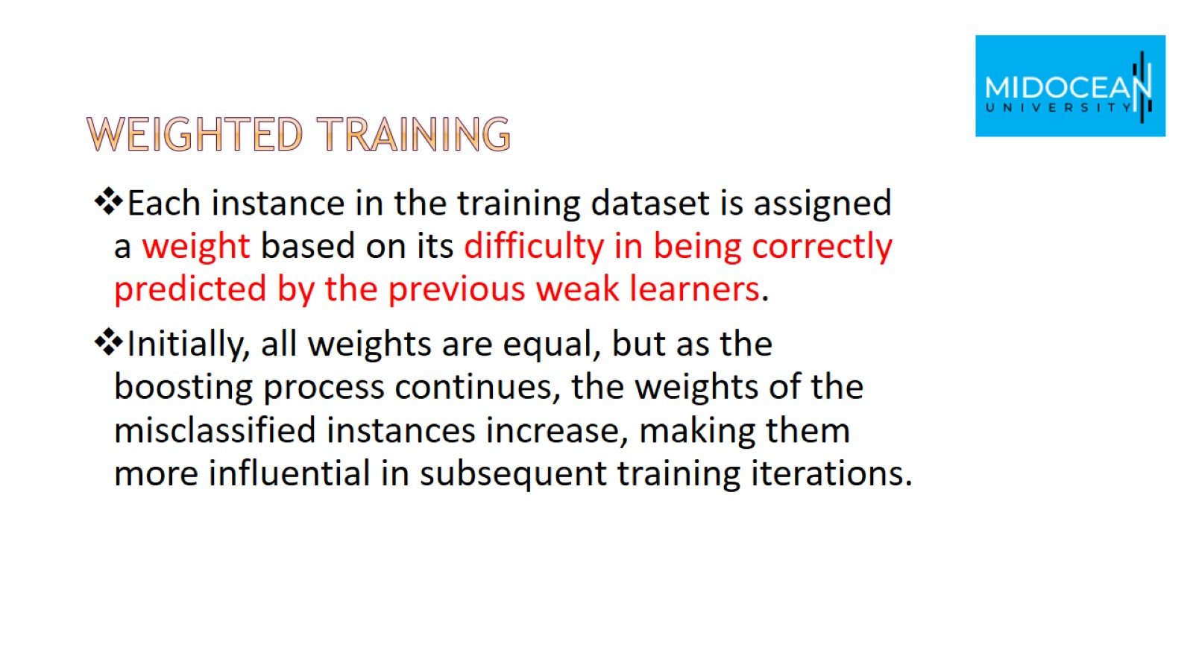
Weighted Training

Slide 22
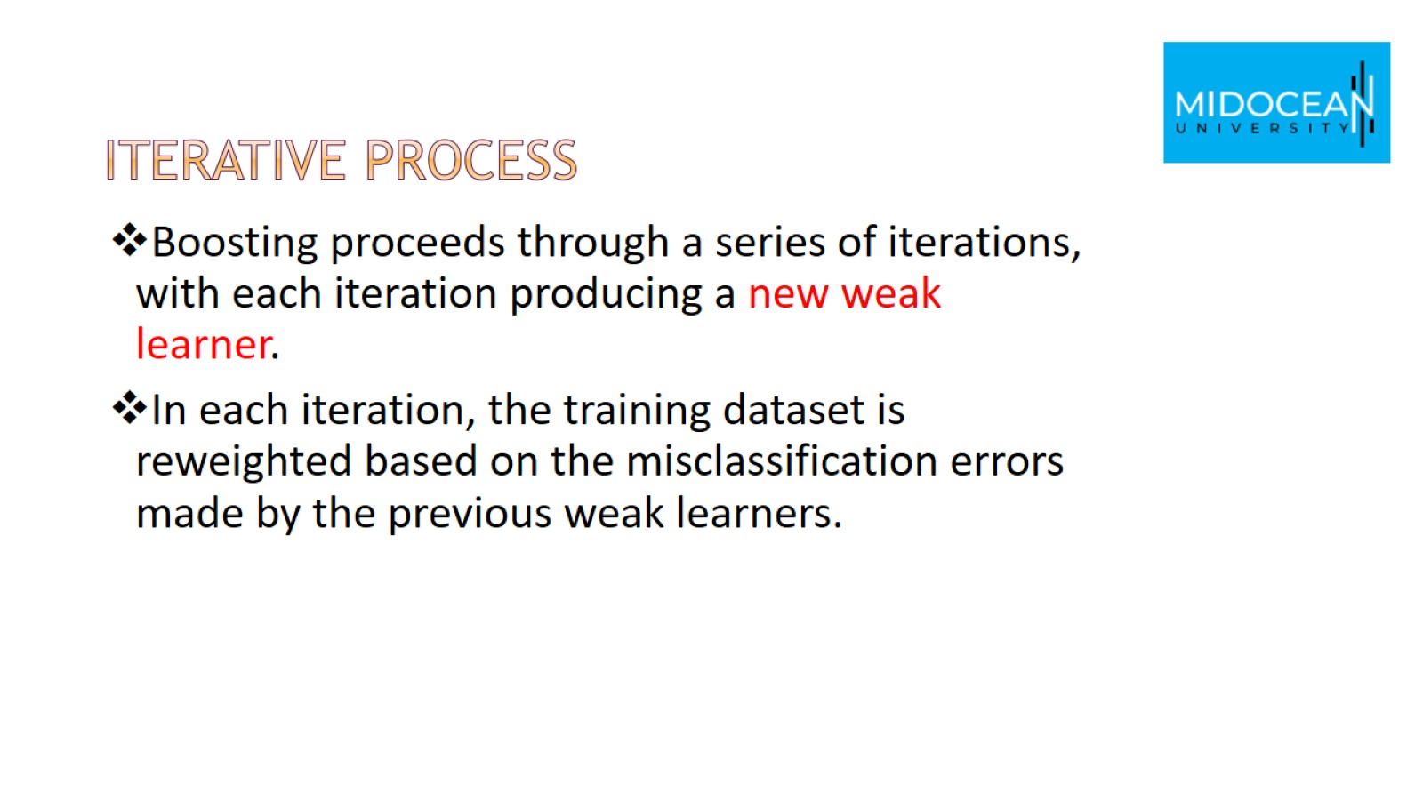
Iterative Process

Slide 23
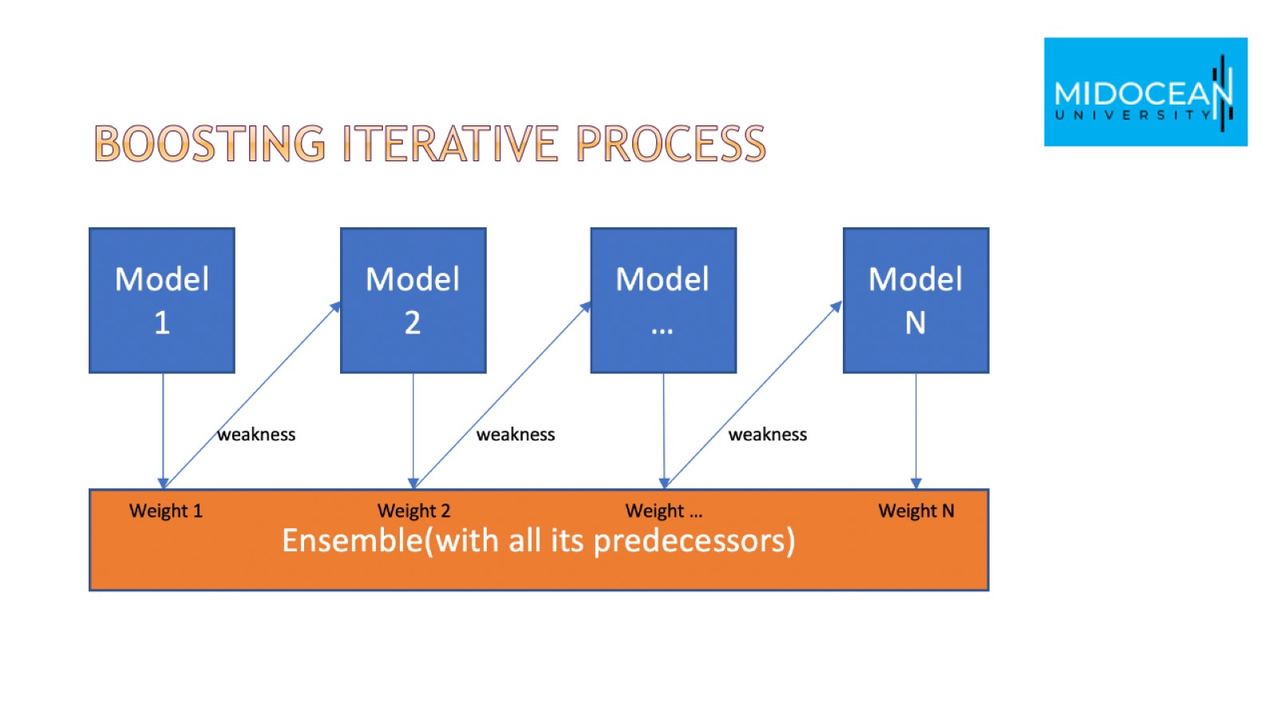
Boosting Iterative Process

Slide 24
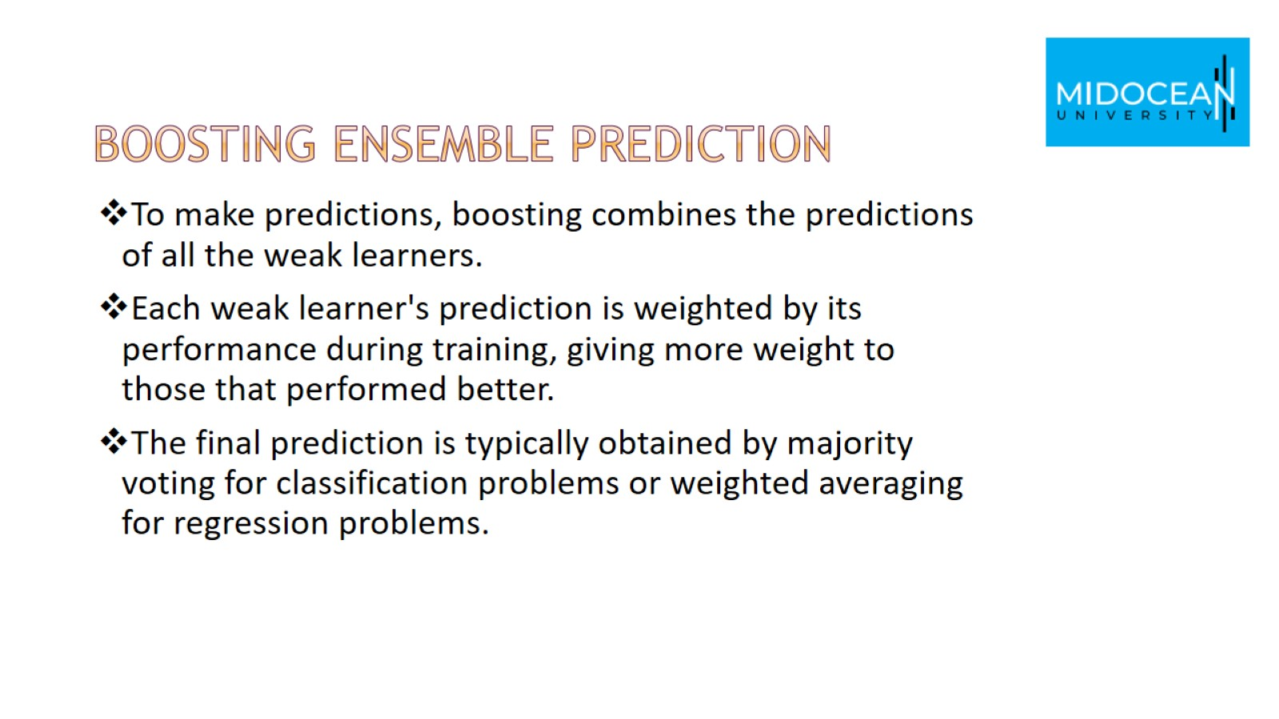
Boosting Ensemble Prediction

Slide 25
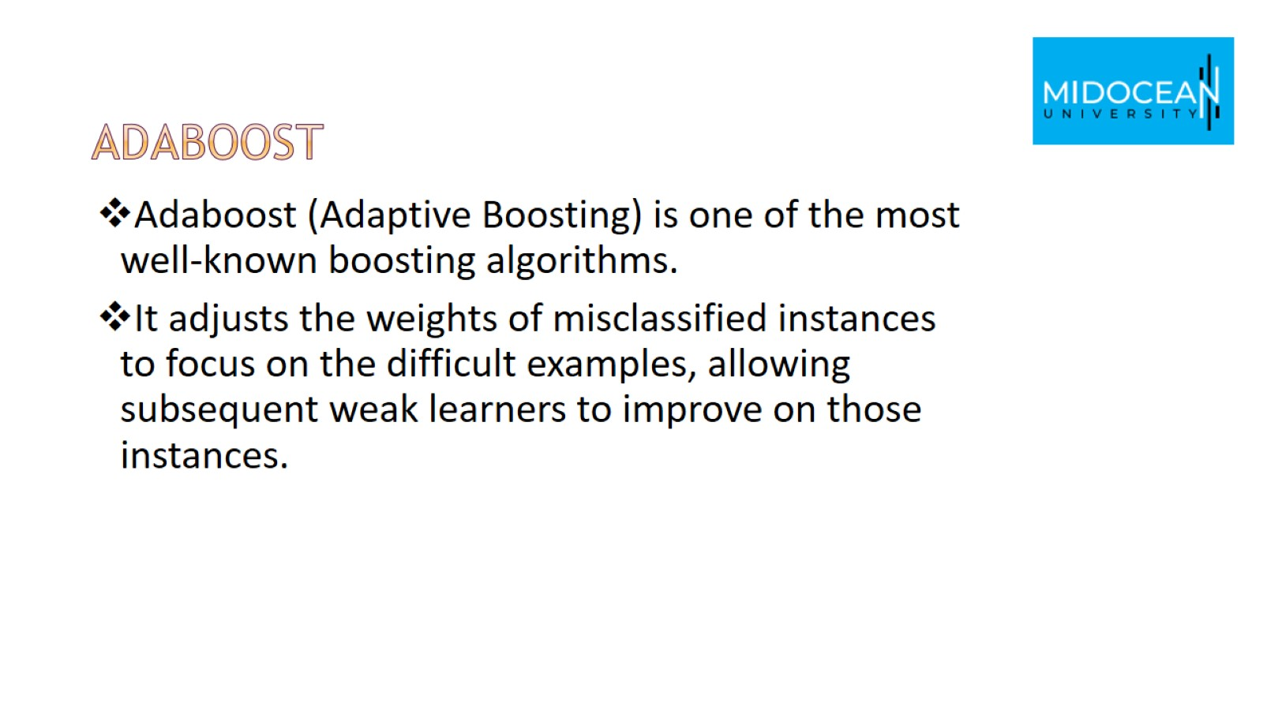
Adaboost

Slide 26
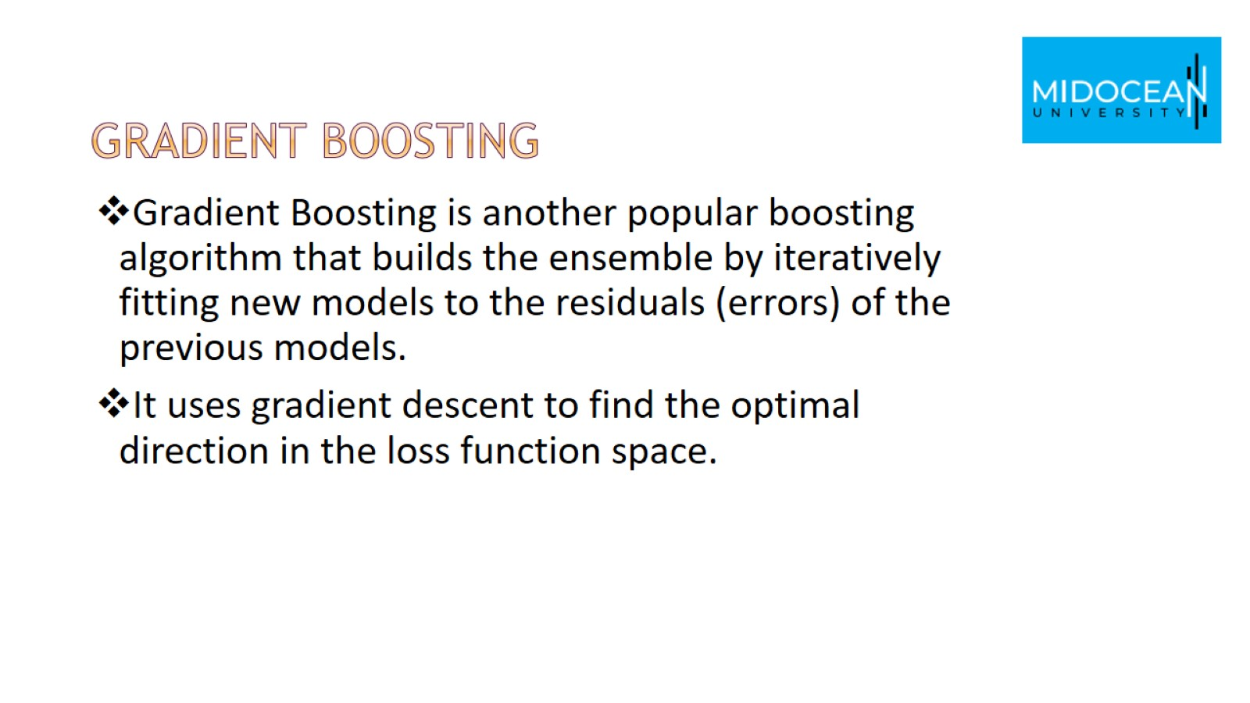
Gradient Boosting

Slide 27
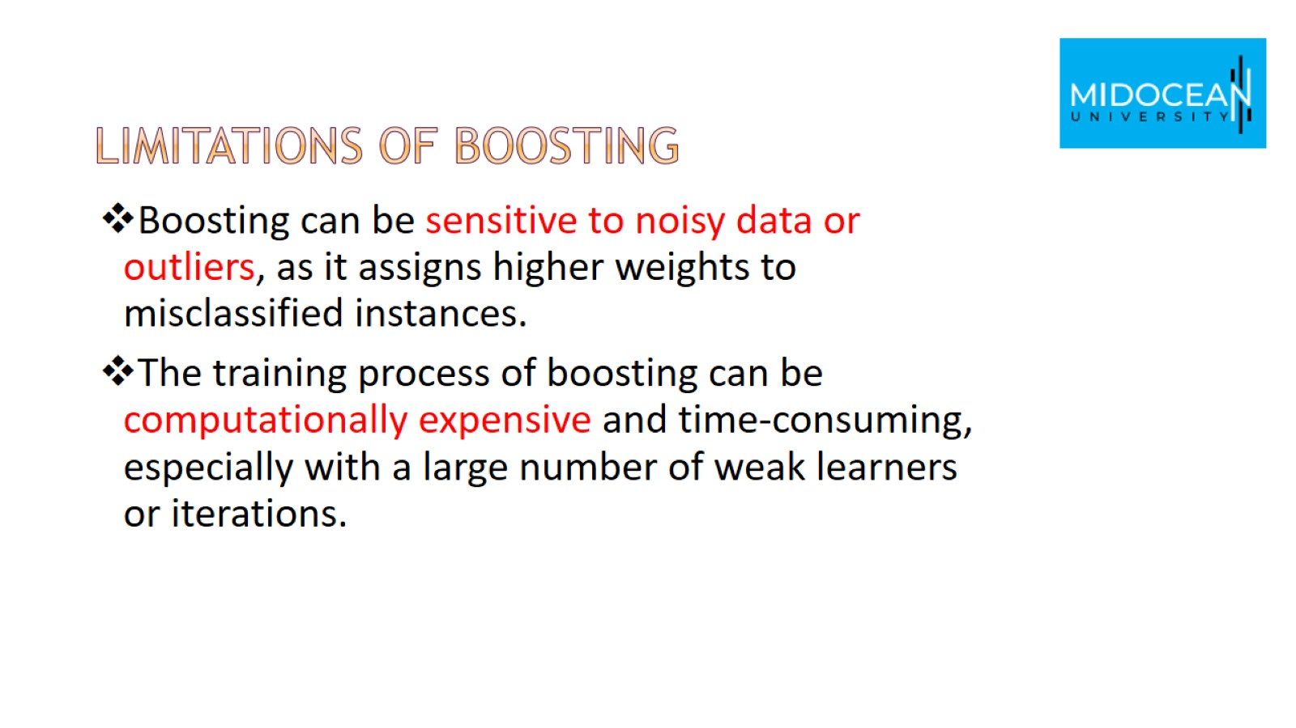
Limitations of Boosting

Slide 28
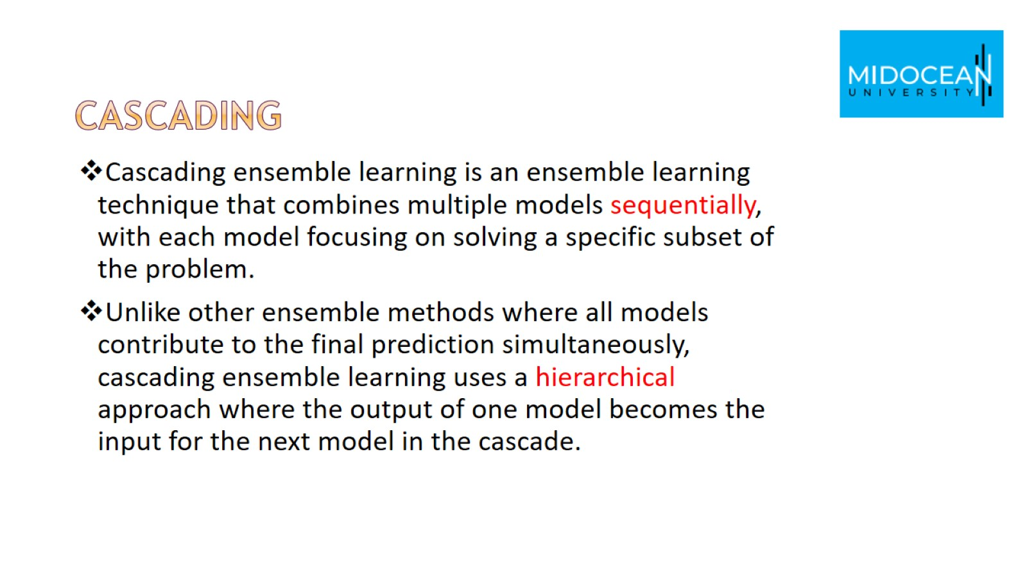
Cascading

Slide 29
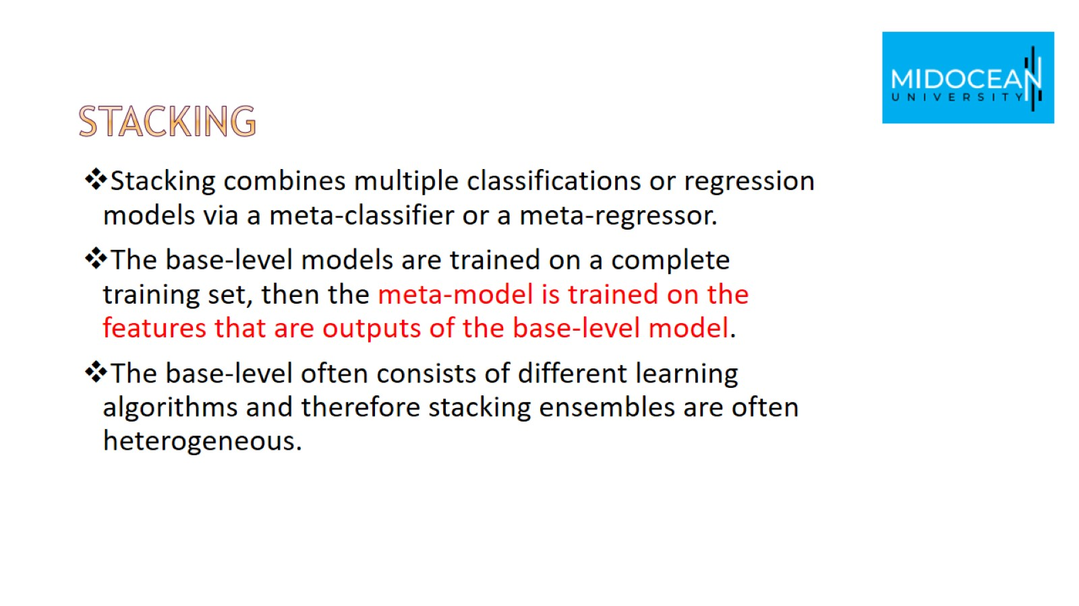
Stacking

Slide 30
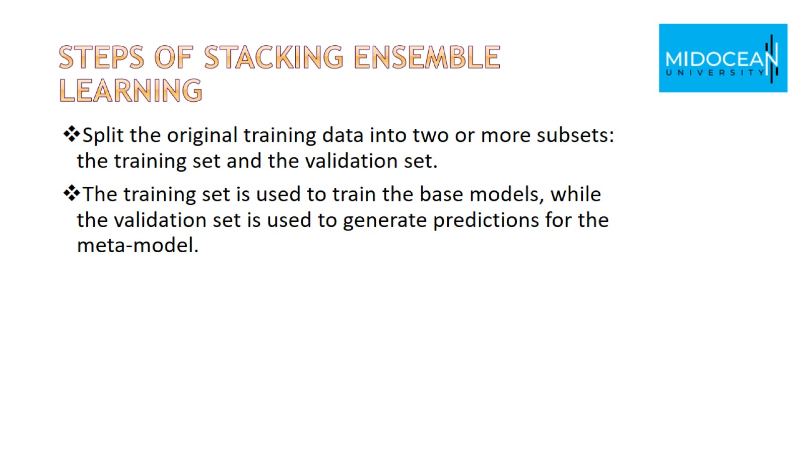
Steps of stacking ensemble learning

Slide 31
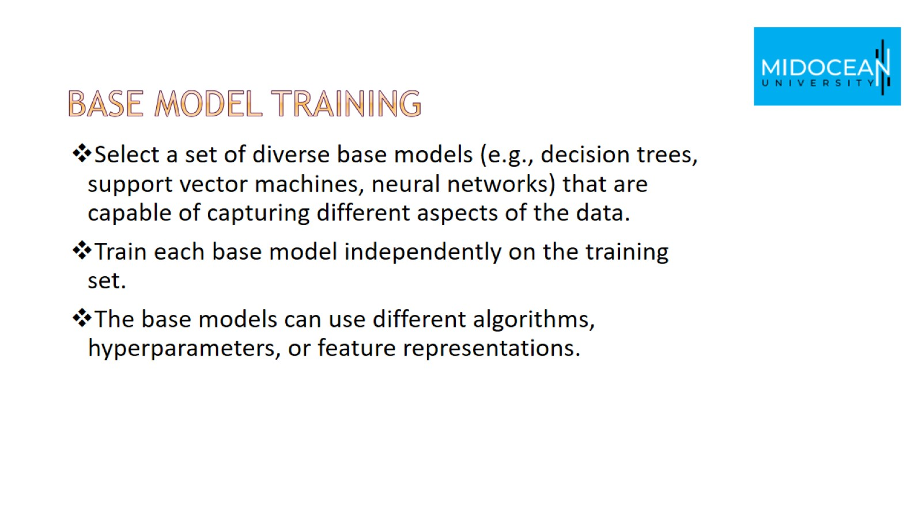
Base Model Training

Slide 32
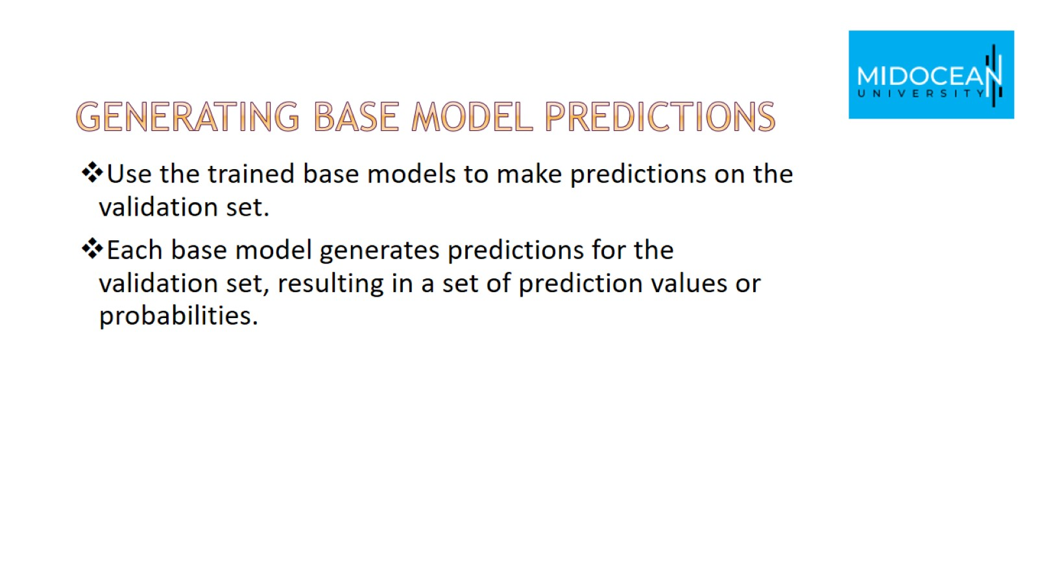
Generating Base Model Predictions

Slide 33
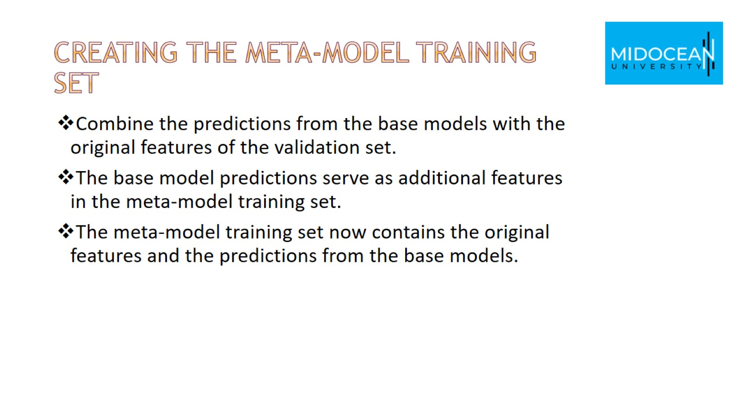
Creating the Meta-Model Training Set

Slide 34
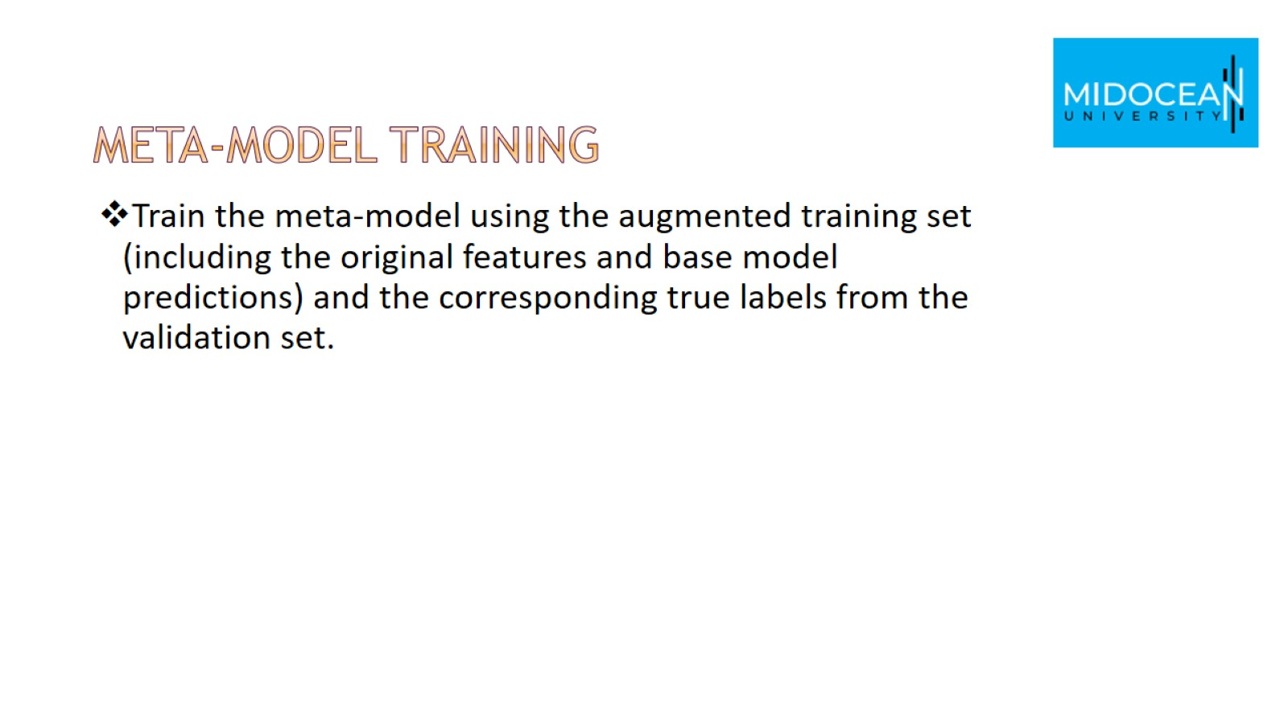
Meta-Model Training

Slide 35
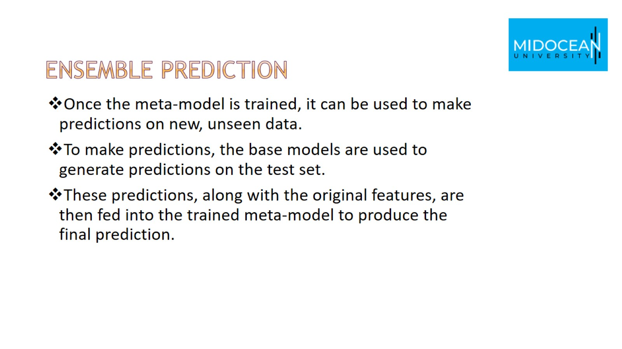
Ensemble Prediction

Slide 36
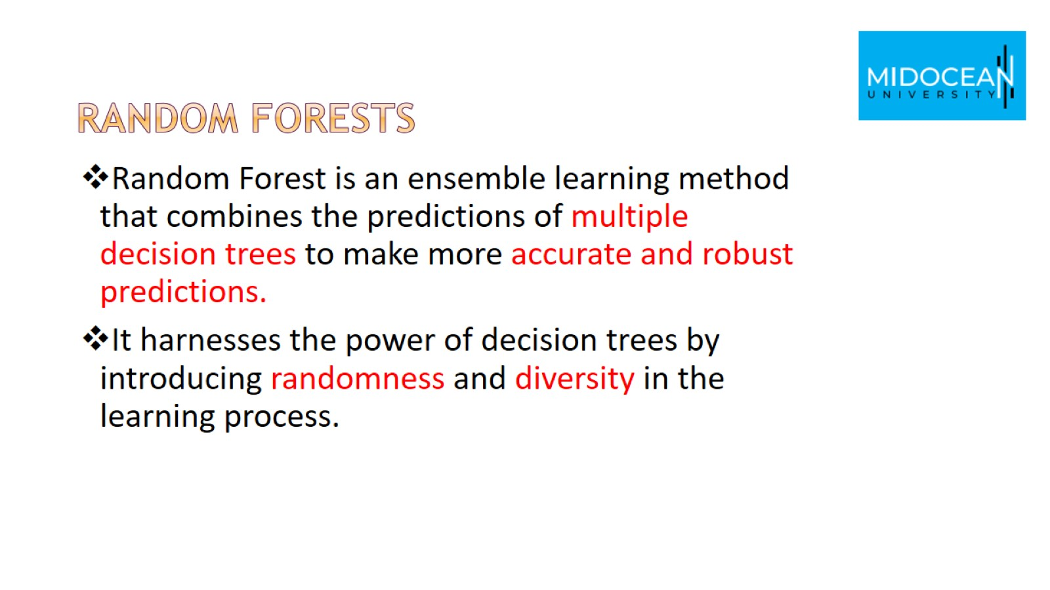
Random Forests

Slide 37
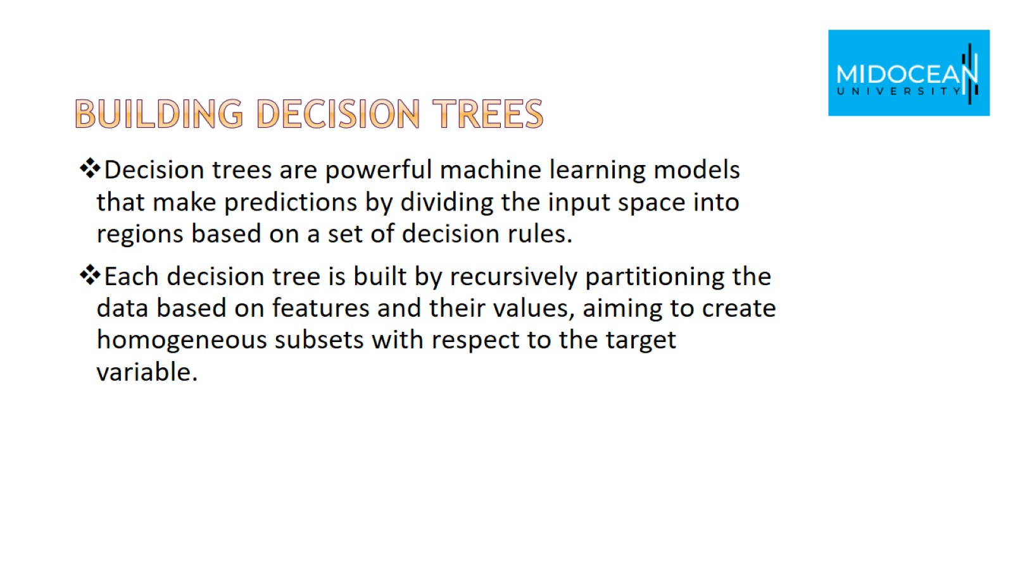
Building Decision Trees

Slide 38
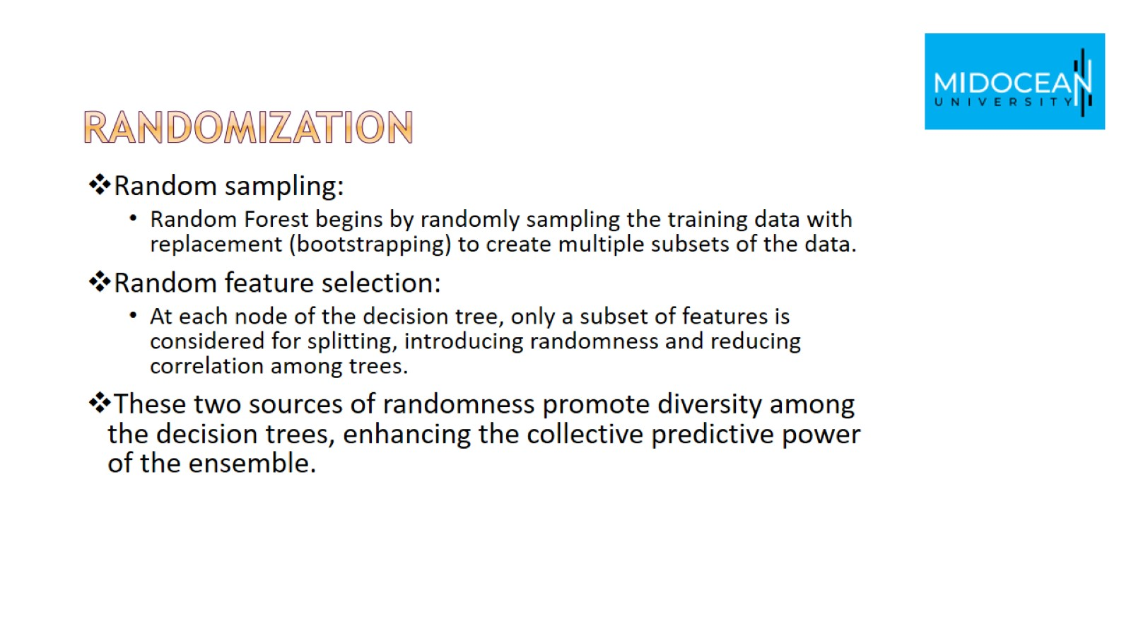
randomization

Slide 39
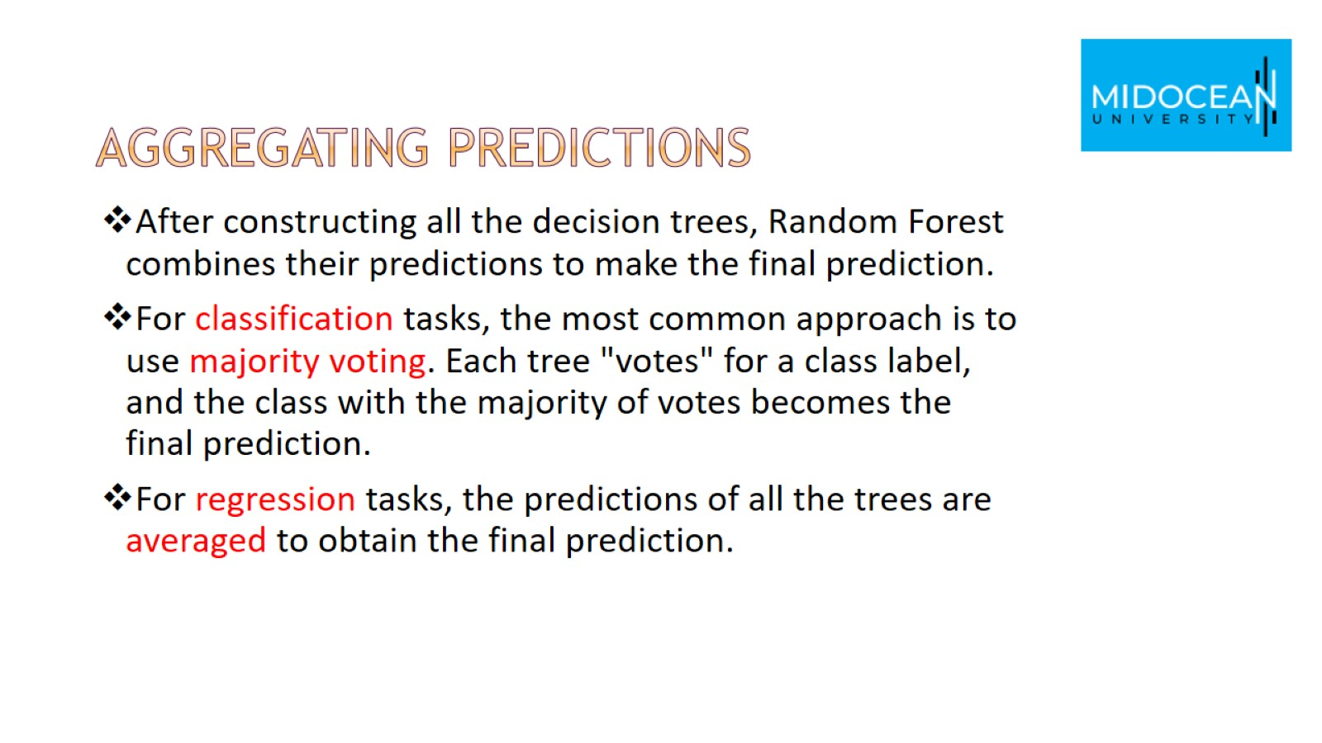
Aggregating Predictions

Slide 40
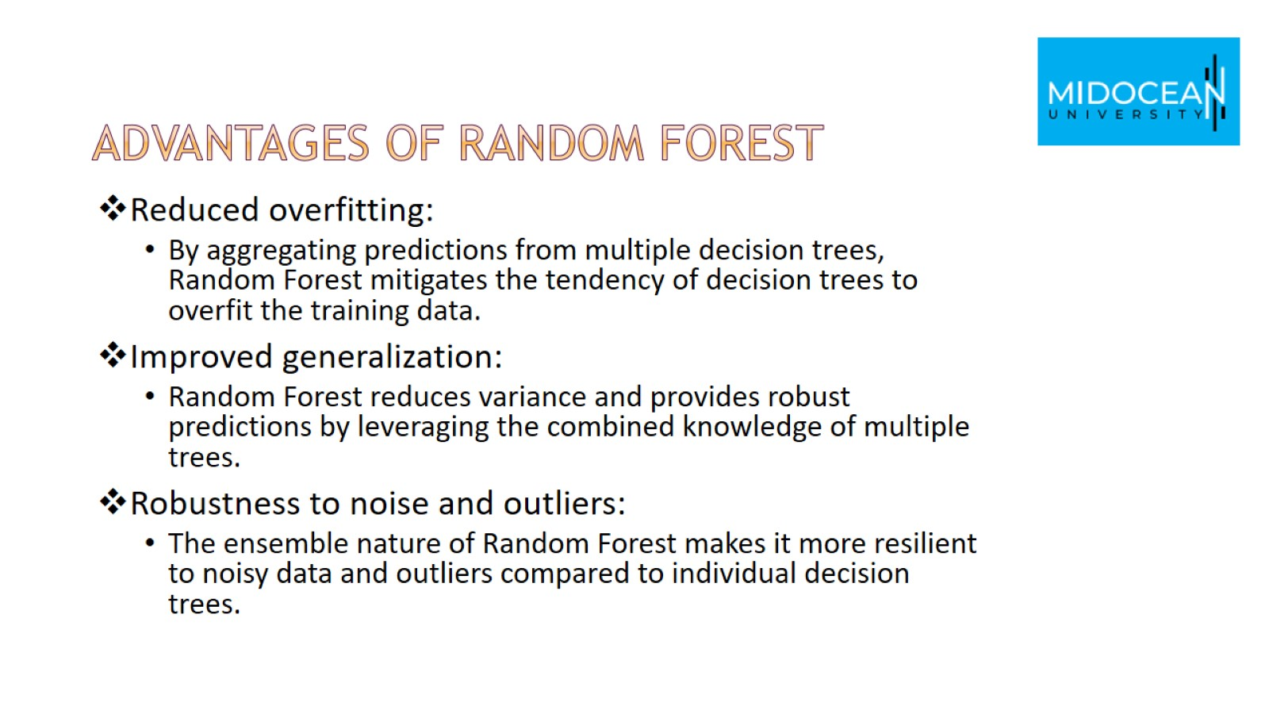
Advantages of Random Forest

Slide 41
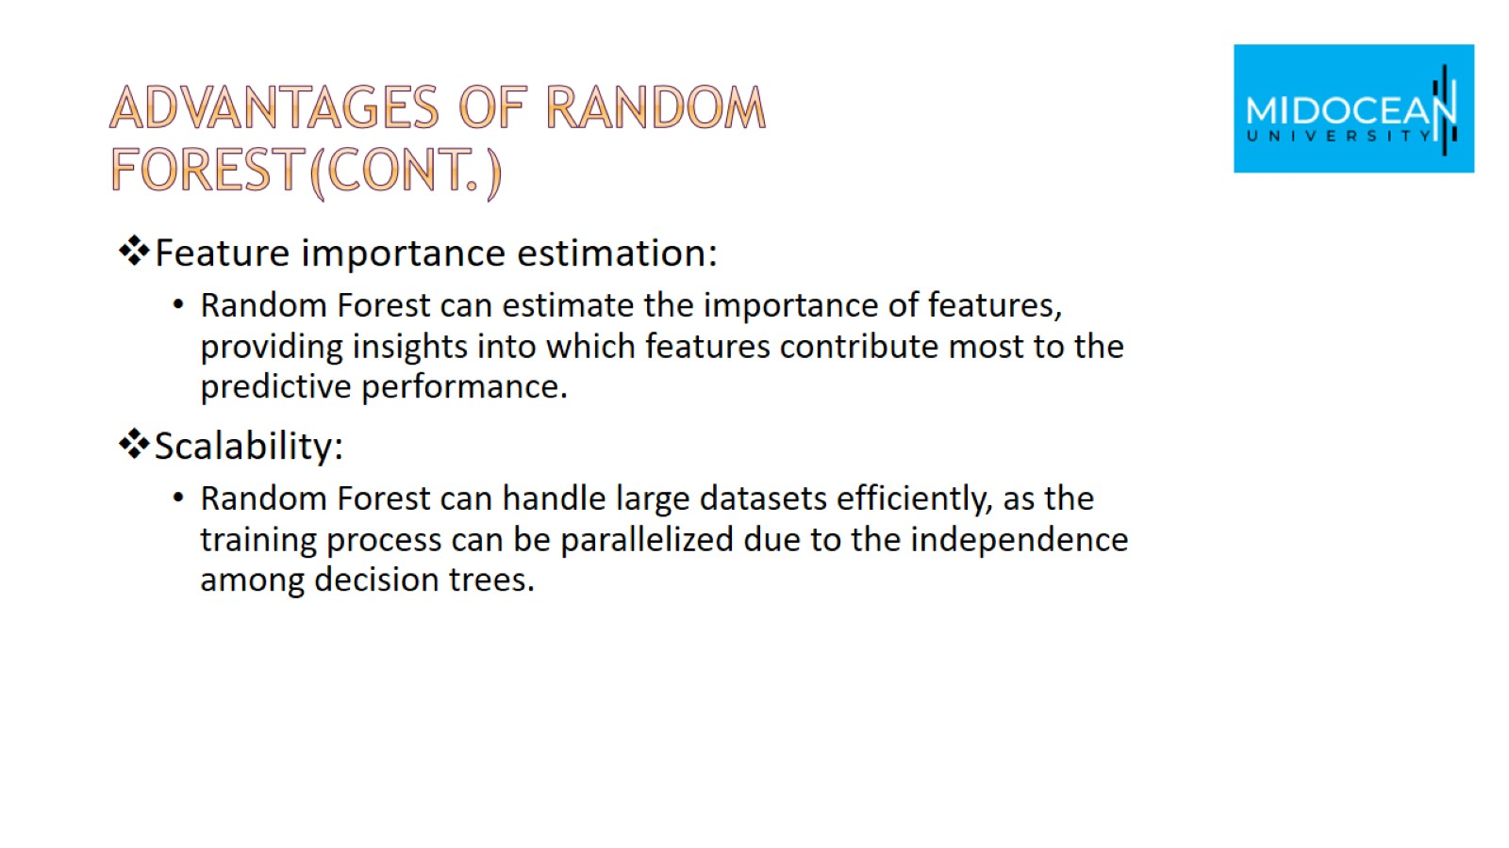
Advantages of Random Forest(cont.)

Slide 42
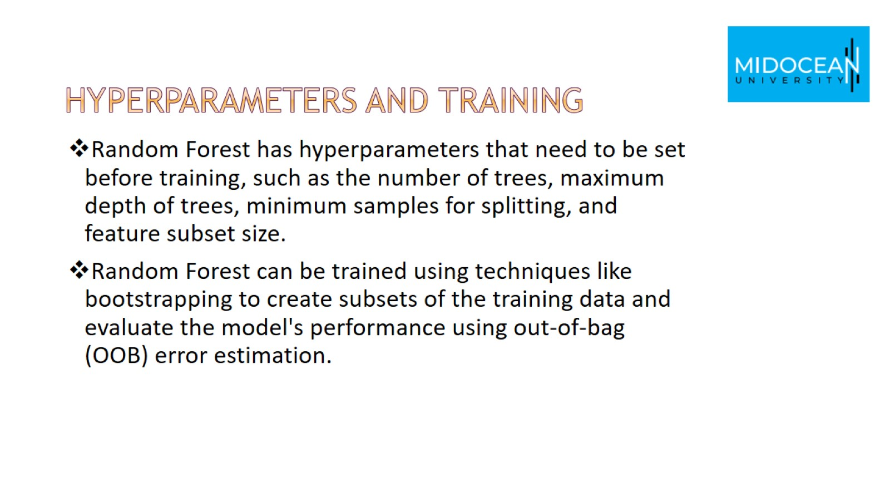
Hyperparameters and Training

Slide 43
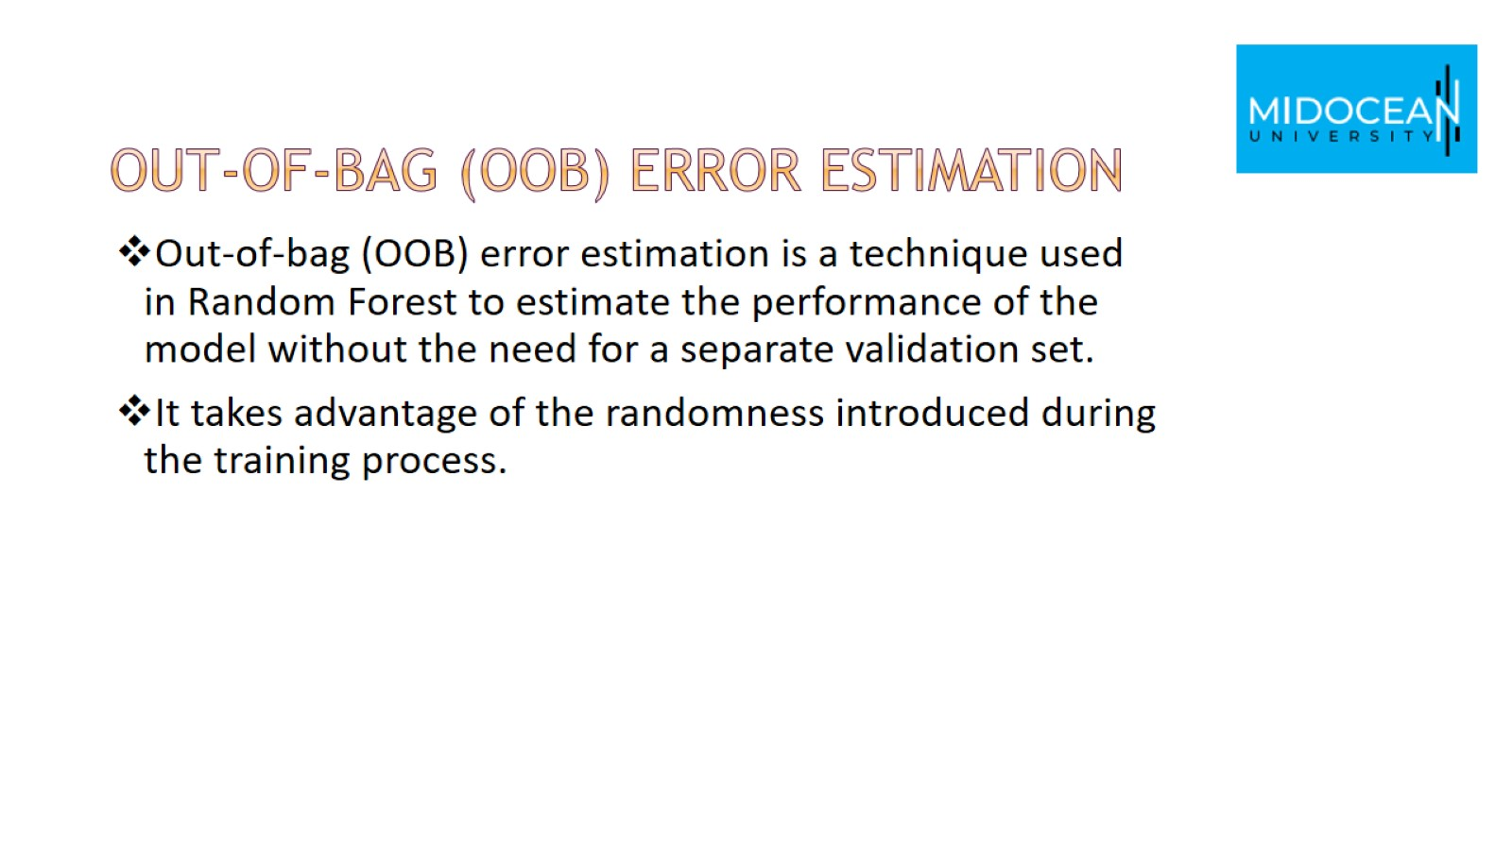
Out-of-bag (OOB) error estimation

Slide 44
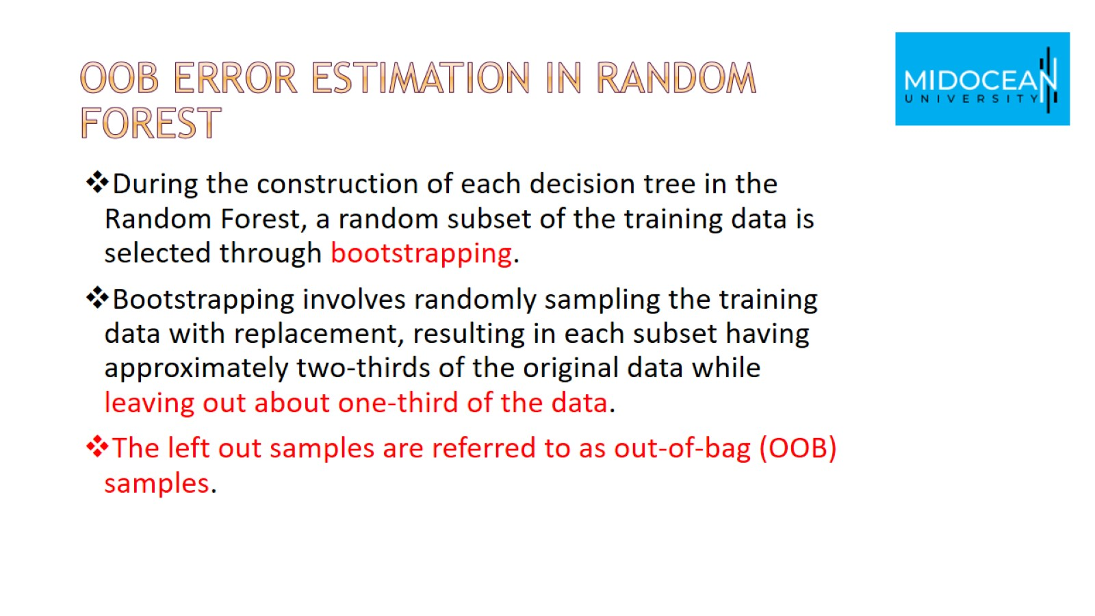
OOB error estimation in Random Forest

Slide 45
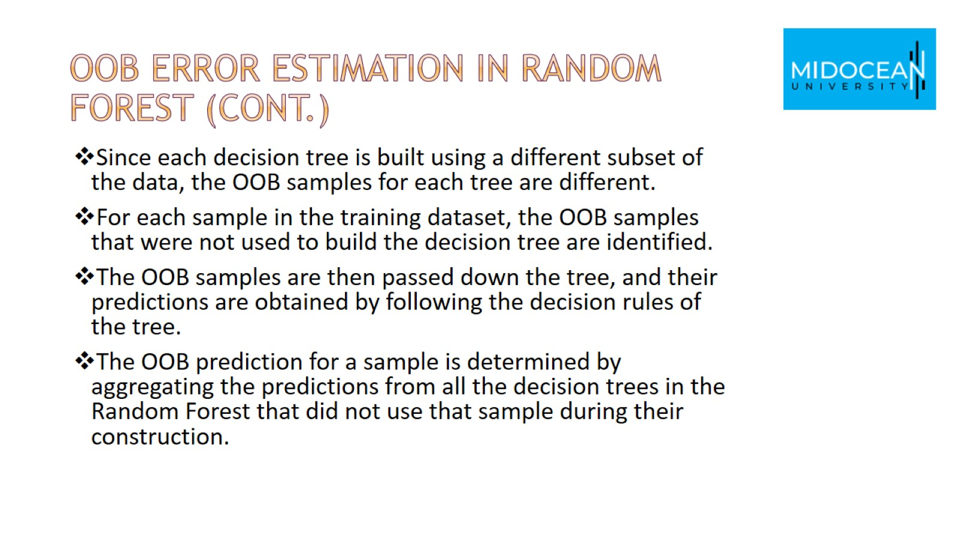
OOB error estimation in Random Forest (Cont.)

Slide 46
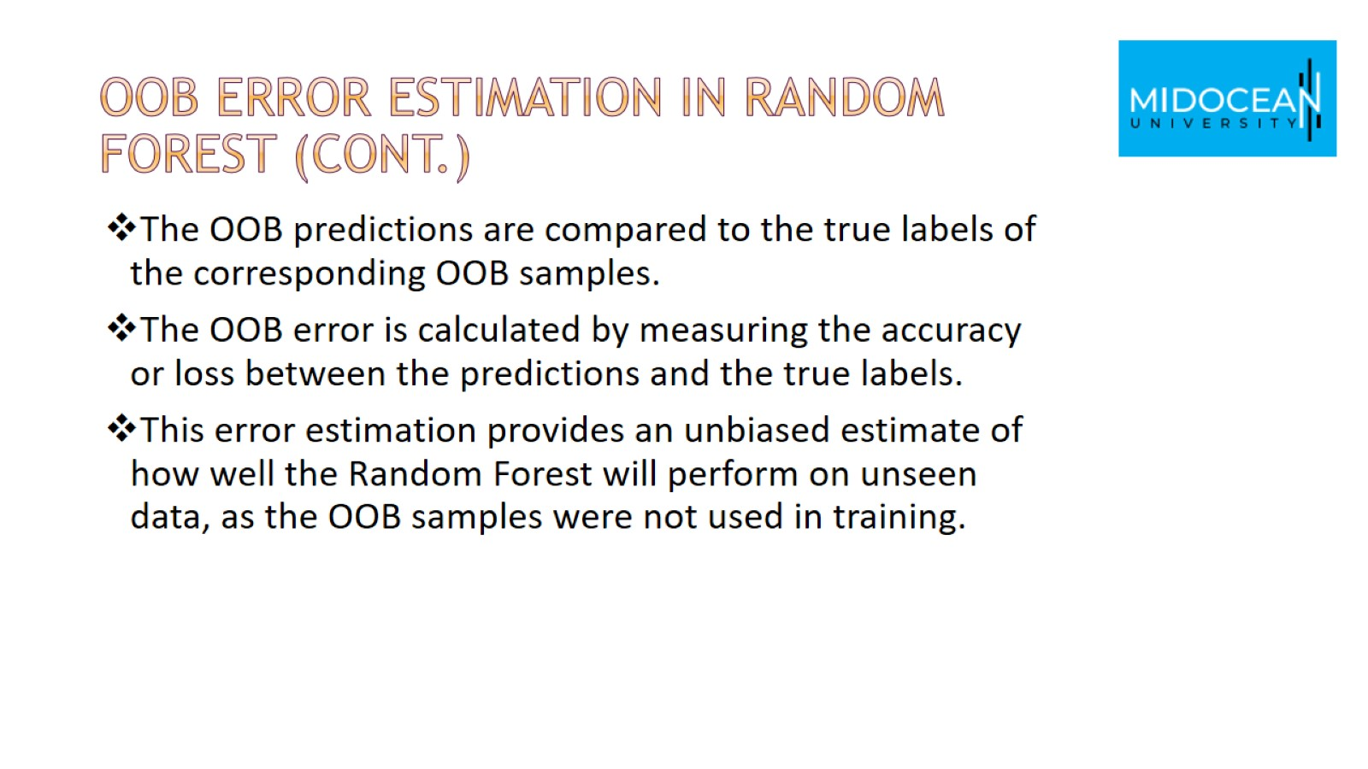
OOB error estimation in Random Forest (Cont.)

Slide 47
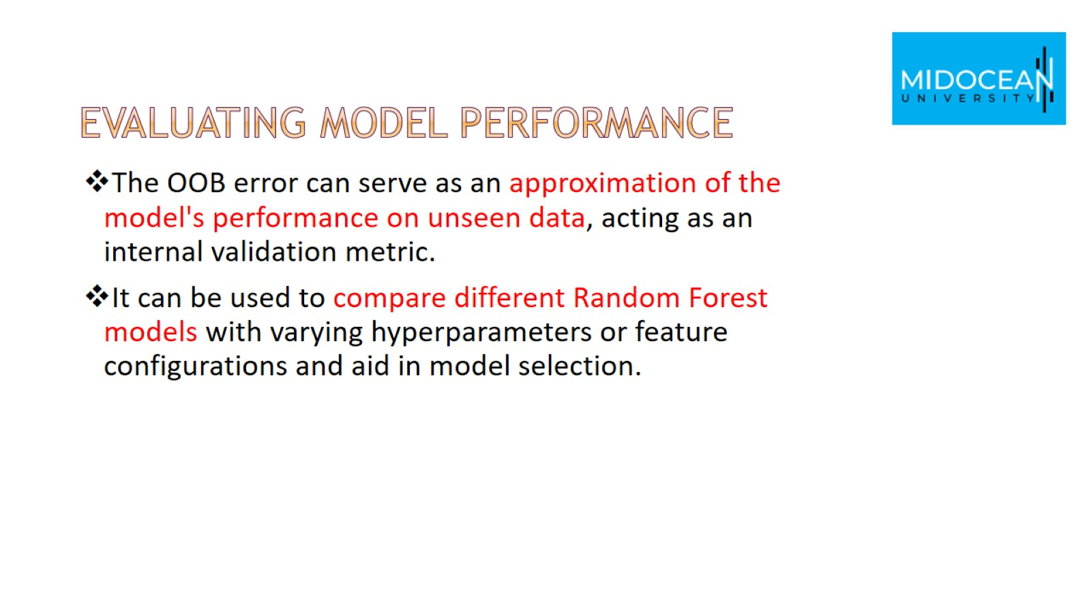
Evaluating Model Performance

Slide 48


Slide 49


