Slide 1


Introduction to Machine Learning and Finance
Prepared by Dr. Sumaya Alkubaisi
FNT633
Machine Learning in Finance
Lecture 1

Slide 2

Chapter
Learning Goals
1
By the end of this lecture, you will be able to:
Understand what Machine Learning (ML) is and why it matters in finance.
Describe the Data Science Life Cycle and its steps.
Explain the importance of Data Understanding before modeling.
Identify financial data types (numerical, categorical, time series).
Recognize common financial data sources (market, credit, transaction).
Write simple Python code for data loading, cleaning.

Slide 3
Chapter
What is Machine Learning?
1
Machine Learning (ML) is a branch of Artificial Intelligence (AI) where computers learn from data instead of being programmed with fixed rules.
ML algorithms identify patterns in data and make predictions or decisions.
In finance, ML helps automate tasks, forecast markets, and manage risks.

Slide 4

AI (Artificial Intelligence): The big umbrella — making machines act smart — able to mimic human thinking, reasoning, and decision-making.
ML (Machine Learning): A subset of AI — machines learn from data to improve without being told every rule.
Deep Learning (DL): A subset of ML — uses artificial neural networks (like the human brain’s structure) to handle very complex tasks such as image recognition, speech, and natural language.

Slide 5
Chapter
Why ML in Finance?
1
Speed – Automates decisions in milliseconds
ML algorithms can process millions of transactions instantly.
Example: High-frequency trading (HFT) systems use ML to buy and sell stocks in fractions of a second, exploiting tiny price differences before humans can react.
Accuracy – Detects fraud better than manual checks
ML models learn patterns of legitimate vs. fraudulent transactions.
Example: Credit card companies use ML to flag unusual spending behavior, preventing fraudulent purchases automatically.

Slide 6
Chapter
Why ML in Finance?
1
Insights – Finds hidden market patterns
ML uncovers trends and correlations that traditional analysis might miss.
Example: Portfolio managers use ML to detect correlations between asset classes, helping to predict market movements and optimize investment strategies.
Efficiency – Reduces cost and human error
Automating repetitive tasks saves time and reduces mistakes.
Example: Loan approval processes use ML to assess risk profiles faster than manual review, reducing operational costs and errors in decision-making.

Slide 7
Chapter
ML Example in Finance
1
Predicting Loan Default
ML models analyze historical loan data (income, credit score, debt, etc.) to predict if a borrower might default.
Example: A bank uses a Random Forest model to assign a “default risk score” to each applicant, helping decide loan approval automatically.
Forecasting Stock Prices
ML algorithms detect patterns in historical stock prices, trading volumes, and market indicators to predict future prices.
Example: LSTM (Long Short-Term Memory) networks are used to forecast daily stock prices, helping traders make informed investment decisions.

Slide 8
Chapter
ML Example in Finance
1
Detecting Fraudulent Transactions
ML identifies unusual patterns in credit card or transaction data that indicate fraud.
Example: An online payment platform uses anomaly detection to flag transactions that deviate from normal spending behavior, alerting customers in real-time.

Slide 9
Chapter
Data Science Life Cycle
1
What is the Data Science Life Cycle?
The Data Science Life Cycle is a structured, systematic process used to extract knowledge, insights, and actionable solutions from data.
It ensures that data-driven projects are organized, repeatable, and reliable, reducing errors and improving decision-making.
This lifecycle guides practitioners from understanding the problem and collecting raw data, through preparing and analyzing it, to deploying models and monitoring their performance in real-world scenarios.

Slide 10
Chapter
Life Cycle Stages
1
Main phases: Collect → Prepare → Analyze → Evaluate → Deploy.
Where Analyze means modeling (training and testing models).
Data Collection – Gather raw relevant data from multiple sources
Example: A bank collects historical loan data, customer demographics, and transaction records.
Data Preparation –Clean, integrate, and transform data for analysis
-Handling missing values, removing outliers, normalizing data, and encoding categorical variables.
Example: Filling missing income values with median values and encoding “Yes/No” columns as 1/0.

Slide 11
Chapter
Life Cycle Stages
1
Modeling –Train and test machine learning models
Use statistical methods and ML algorithms to extract insights or make predictions.
Example: Training a logistic regression model to predict loan default, and testing its accuracy on unseen data.
Evaluation – Measure performance and validate results
Check model accuracy, precision, recall, or other relevant metrics.
Example: Evaluating fraud detection model using a confusion matrix to see how many fraudulent transactions were correctly identified.
Deployment – Implement the model in real-world applications
Integrate the solution into production systems for continuous use.
Example: Deploying a credit scoring model to automatically approve or flag loan applications in the bank’s system.

Slide 12
Chapter
Example in Finance
1
Problem: Predict if a loan applicant will default.
Steps:
Steps:
Collect – Gather relevant data
Example: Applicant’s income, credit history, existing debts, age, employment status.
Prepare – Clean and organize data
- Handle missing values, remove errors, standardize formats, and encode categorical data.
Example: Fill missing income values with median income, convert “Yes/No” fields to 1/0.

Slide 13
Chapter
Example in Finance
1
Model – Train a machine learning algorithm
- Use historical loan data to teach the model patterns of default vs. successful repayment.
Example: Train a Random Forest or Logistic Regression model to predict default risk.
Evaluate – Test how well the model works
- Measure accuracy, precision, recall, and other metrics to ensure predictions are reliable.
Example: Check how many defaulters the model correctly predicts versus false positives.
Deploy – Apply the model in real life
- Integrate the model into the bank’s system to automatically assess new loan applications.
Example: Assign a “default risk score” to applicants to support faster, data-driven approval decisions.

Slide 14
Chapter
Data Collection in Finance
1
Sources of Financial Data:
Stock market prices: Historical and real-time data from exchanges.
Customer bank records: Transactions, balances, and account activity.
Credit bureau data: Credit scores, repayment history, loan applications.
Online transactions: E-commerce and digital payments data.

Slide 15
Chapter
Data Collection in Finance
1
Practical Note:
Access to real financial data is often restricted due to privacy and regulations.
For learning and experimentation, we use public datasets from platforms like Kaggle and UCI Machine Learning Repository, for example:
Credit Card Fraud Detection
Loan Default Prediction
Stock Price Data

Slide 16
Chapter
Data Science Life Cycle in Python
1
#Python Setup
import pandas as pd
pandas: manage financial data
allows us to read, clean, and manage financial data easily, whether it comes from Excel files, CSVs, or online sources.

Slide 17
Chapter
Data Science Life Cycle in Python
1
#Data collection: Load Data in Python
df = pd.read_csv("https://cf-courses-data.s3.us.cloud-object-storage.appdomain.cloud/IBM-ML0187EN-SkillsNetwork/labs/module%202/iris.csv")
df.head()
pd.read_csv() - Loads CSV into a DataFrame.
head() - shows first 5 rows.

Slide 18
Chapter
Data Science Life Cycle in Python
1
#Clean Data in Python
df.drop(['petal_width'], axis=1, inplace=True)
df.head()
df.drop() - Removes unwanted column.

Slide 19
Chapter
Data Understanding
1
What is Data Understanding?
The step of exploring and analyzing raw data before building models.
Involves looking at the data to see what it contains, how it is structured, and whether it makes sense.
Helps to detect errors, missing values, outliers, and unusual patterns that could mislead the model.
Ensures that the dataset is relevant, accurate, and meaningful for the problem being solved.
Example: In a loan dataset, checking if any applicant has a negative income value (error) or if many records are missing credit history (incomplete data).

Slide 20
Lecture
Key Terms in ML – Dataset, Features, Target
1
Dataset – A structured collection of data used for analysis or to train a machine learning model.
-Usually organized in rows and columns, like a table.
Example: A loan application dataset where each row represents one applicant, and each column represents their details (income, age, credit score, etc.).
Features (Input Variables) – The information or characteristics used by the model to make predictions.
-These are the independent variables.
Example: Applicant’s income, employment status, age, loan amount, and credit score.

Slide 21
Lecture
Key Terms in ML – Dataset, Features, Target
1
Target (Label / Output Variable) – The outcome we want the model to predict.
-This is the dependent variable.
Example: Whether the loan was approved (“Yes/No”) or whether the applicant defaulted (“Default/No Default”).
In short: Features go in → Target comes out.

Slide 22
Image source: Code signal learn
Image source: Medium

Slide 23
Chapter
Iris Flower Dataset
1
Iris Dataset Overview
What is the dataset?
A famous flower dataset used in ML, containing measurements of Iris flowers.
Variables in the dataset:
Features (Inputs):
Sepal length, Sepal width
Petal length, Petal width
Target / Label (Output):
Species → Iris setosa, Iris versicolor, or Iris virginica
Relation: Features describe flower measurements, while the target identifies the flower type.

Slide 24
Chapter
Iris Flower Dataset
1
How ML Works with Iris Data?
Training step:
The ML model learns the relationship between flower measurements and their species.
Example: Iris setosa usually has small petals, while Iris virginica has larger petals.
Prediction step:
New flower measurements are provided.
The model predicts the species.
Use case: Helps botanists or researchers automatically classify flower species based on measurements.

Slide 25
Image source: Alteryx Community

Slide 26
Chapter
Loan Default Dataset
1
What is the Dataset?
A collection of loan applications from customers, with information about their loan and whether they repaid (No Default) or failed to repay (Default).
Each row = one customer’s loan record.
Columns (variables):
Record # (ID of the record)
Default (Yes/No) → did the customer repay?
Num_Loans → number of loans taken
Amount → loan amount requested
Duration → repayment period in months
Age → age of the customer

Slide 27
Loan Default Dataset (Features, Target, Inputs, and Outputs)
Chapter
1
Features (Inputs to ML model):
Num_Loans, Amount, Duration, Age
Target / Label (Output we want to predict):
Default (Yes = defaulted, No = repaid)
Type of problem:
Classification → Predict category (Yes or No).
Relations:
Features describe the customer’s profile and loan details.
Target tells us the final outcome (Default or No Default).

Slide 28
How ML Uses This Dataset (Training Phase)
1
ML training phase
A trained model
Input
(historical data)
“understands” repayment risk.
Learning Patterns
(Small loan + older age → Lower risk)
Building Rules
(Model maps combinations of features → Default outcome)
A trained model
ML Prediction
Output
(Prediction = Default: Yes)
1. Input New Application
2.Model applies learned rules.

Slide 29
Chapter
Summarizing Data
1
Descriptive Statistics (mean, min, max, quartiles.)
Shows key numbers that summarize the dataset, such as:
Mean (Average) – the central value of the data.
Useful for: Understanding the typical or expected value in the dataset.
Example: Average applicant income = 50,000 helps the bank know the usual income range of clients.
Minimum & Maximum – the lowest and highest values in the data.
Useful for: Detecting extreme values and checking data validity.
Example: If minimum income = –5,000 → data entry error; if maximum income = 1,000,000 → possible outlier.

Slide 30
Chapter
Summarizing Data
1
Quartiles (Q1, Median, Q3) – divide data into four equal parts to show distribution.
Useful for: Understanding spread, balance, and skewness of data.
Example: If Q1 = 30,000, Median = 50,000, Q3 = 70,000 → most applicants earn between 30k–70k, with half below 50k and half above.
Example:
In a loan dataset, if the income column shows:
Mean (Average applicant income) = 50,000 (tells the bank the usual income of clients.)
Min = –5,000 (clearly an error, negative income, income can’t be negative)
Max = 1,000,000 (unusually high, possible outlier, needs checking)
Q1 = 30,000, Median = 50,000, Q3 = 70,000 → most applicants earn between 30k and 70k, with half earning less than 50k and half more.

Slide 31
Chapter
Data Visualization
1
Charts reveal patterns quickly.
Easier to understand than looking at raw numbers.
Help spot trends, clusters, outliers, and distributions at a glance.
Useful for both exploring data and explaining insights to others.
Examples:
1.Stock Price Trend Over Time (Line Chart)
Shows how stock values rise and fall across days, months, or years.
Useful for: Spotting upward/downward trends, sudden drops, or unusual spikes.
2. Distribution of Loan Amounts (Histogram / Bar Chart)
Displays how many applicants fall into different loan size ranges.
Useful for: Checking if most loans are small, medium, or large, and spotting unusual requests.

Slide 32
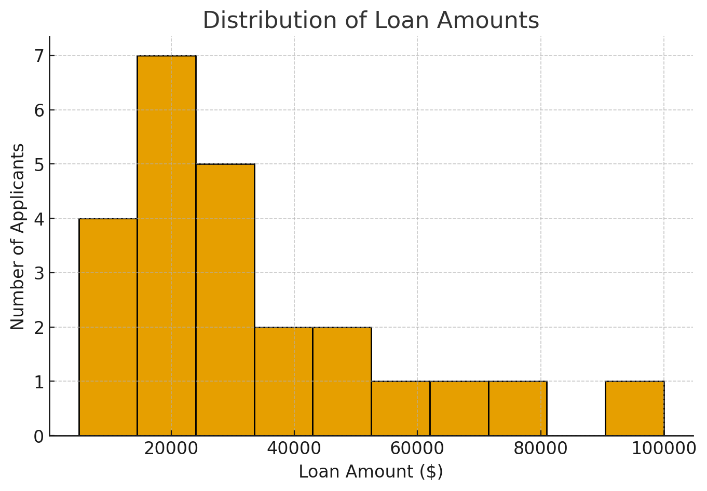
Chapter
Data Visualization
1

Slide 33
Chapter
Data Types in Finance
1
Numerical: Data expressed in numbers, such as prices, loan amounts, or interest rates.
Example: Numerical: Salary = 5000 USD.
Categorical: Data divided into groups or categories (classified data), such as loan type (personal, mortgage), credit rating (A, B, C).
Example: Categorical: Risk level = “High.”
Time Series: Data recorded in sequence over time, such as stock prices or daily exchange rates.
Example: Time Series: Apple stock closing prices over 1 year.

Slide 34
Chapter
Correlation in Data
1
Correlation = Relationship between two variables.
Range:
+1 (positive correlation): When one goes up, the other also goes up.
-1 (negative correlation): When one goes up, the other goes down.
0 (no correlation): No clear relationship.
Example in finance:
Income ↑ → Loan approval chance ↑.

Slide 35
Chapter
Data Understanding in Python
1
#Summarizing Data in Python
df.describe()
Shows statistics: mean, min, max, quartiles.
Useful for spotting outliers or strange values.

Slide 36
Chapter
Data Understanding in Python
1
#Check Data Types in Python
df.dtypes
Lists each column’s type (int, float, object, etc.).

Slide 37
Chapter
Data Understanding in Python
1
#Correlation Matrix in Python
df.corr()
Creates correlation values for all features.
Helps select the most useful features for ML.

Slide 38
Chapter
Financial Data Types and Sources
1
Types of Financial Data
Market Data – Stocks, bonds, forex, options.
Credit Data – Loans, repayment history, credit scores.
Transaction Data – Purchases, bank transfers, credit card usage.

Slide 39
Chapter
Market Data Example
1
Stock market data includes:
Open, High, Low, Close prices.
Daily trading volume.
Sources of Market Data
Bloomberg (professional financial terminals).
Yahoo Finance (public stock data).
Kaggle datasets (academic/learning datasets).

Slide 40
Chapter
Transaction Data
1
Includes credit/debit card transactions.
Online payments, e-commerce logs.
Used for fraud detection.
Example of Fraud Detection
If a card is used in two countries within one hour → suspicious.
ML models flag unusual spending behavior.

Slide 41
Lecture
Real Industry Use Case
1
Visa and Mastercard use ML fraud detection systems.
Models scan millions of transactions per second.
Alerts are raised in real time.
Summary: Financial Data Sources
Market data → stocks, forex.
Credit data → loans, scores.
Transaction data → purchases.
All are essential for ML in finance.

Slide 42
Lecture
Recap
1
In this lecture, we learned:
Machine Learning: Computers learn from data to predict/decide.
Finance Applications: Trading, fraud detection, credit scoring.
Data Science Life Cycle: Collect → Prepare → Model → Evaluate → Deploy.
Data Understanding: Explore data before modeling (types, patterns, statistics).
Financial Data: Market, credit, transaction.
Python Practice: Loaded and cleaned data.

Slide 43
Chapter
References
1
Machine Learning for Finance (Jannes Klaas).
Advances in Financial Machine Learning (López de Prado).

