Slide 1


Slide 2


Slide 3
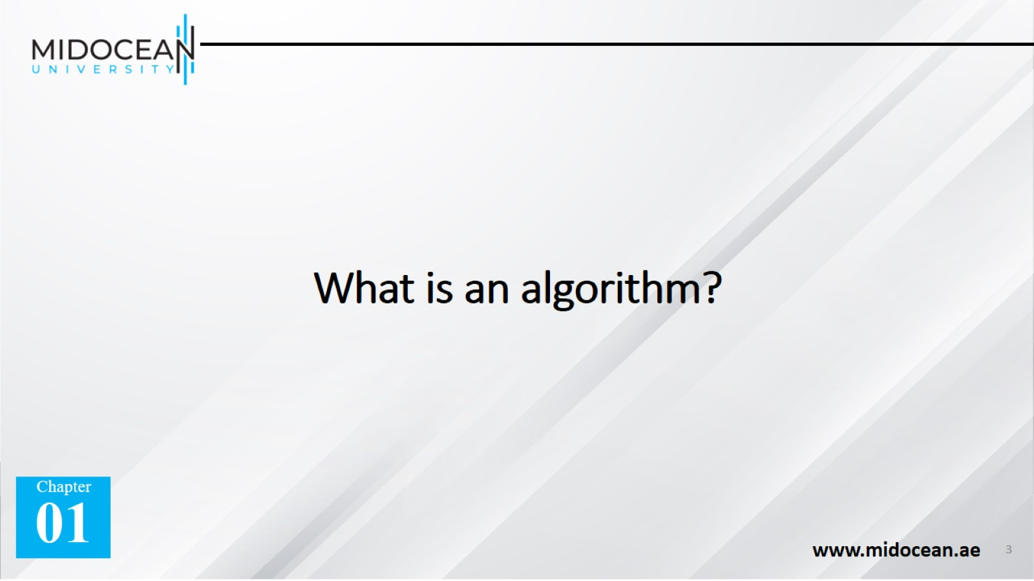
What is an algorithm?

Slide 4
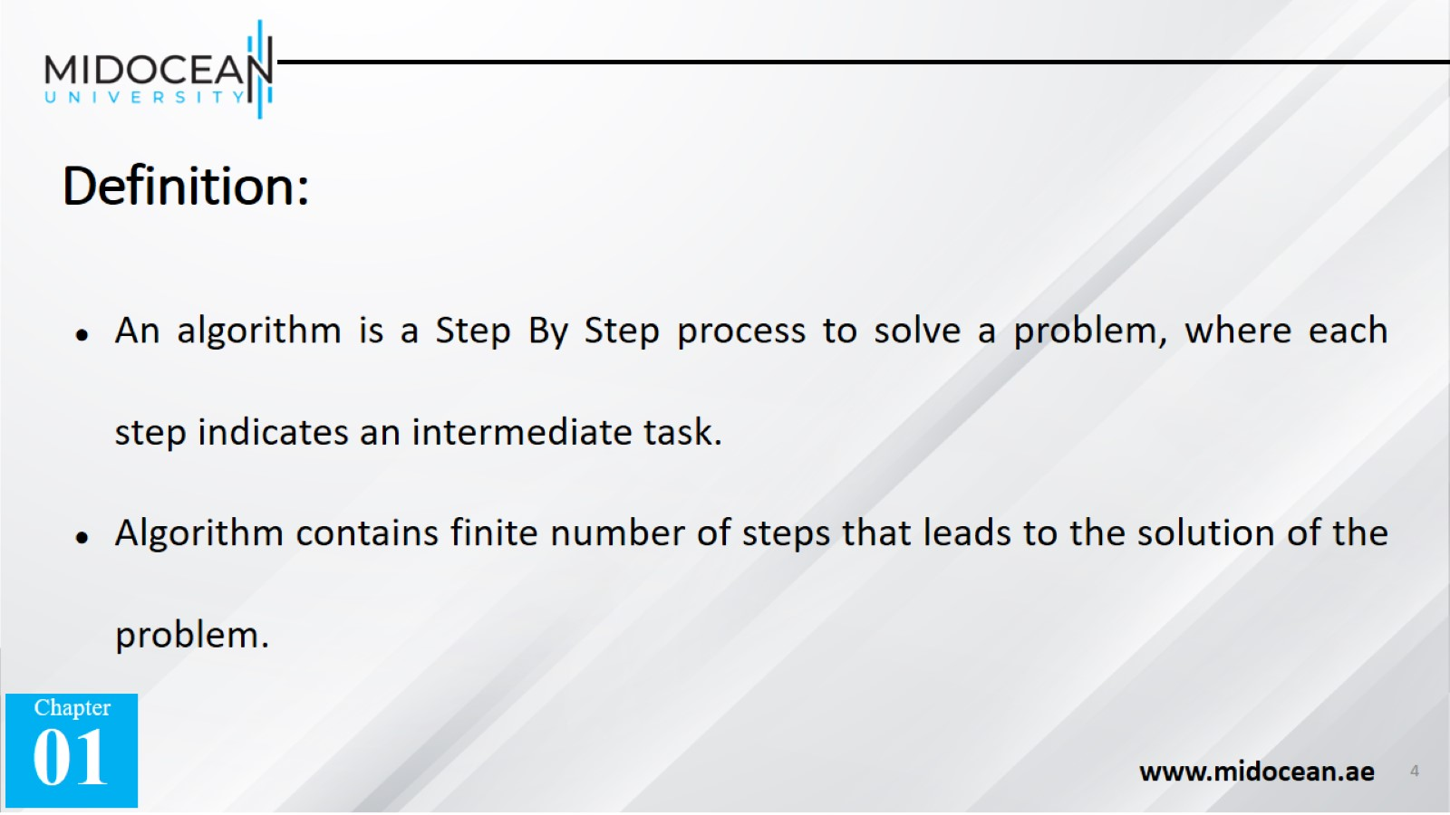
Definition:

Slide 5
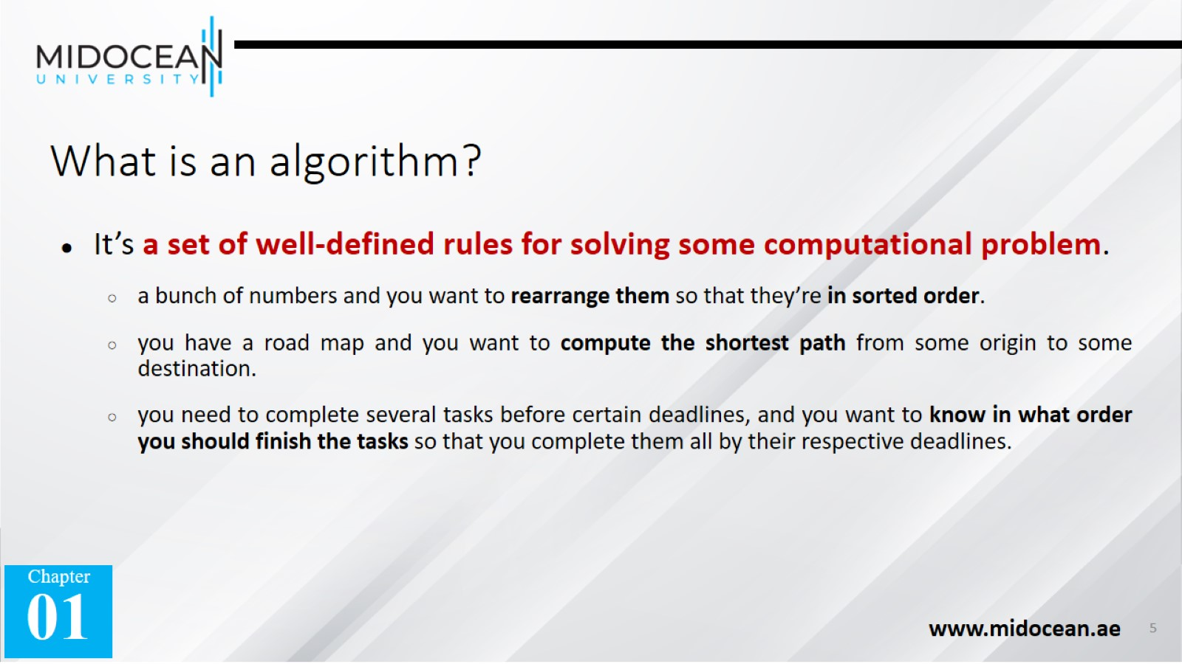
What is an algorithm?

Slide 6
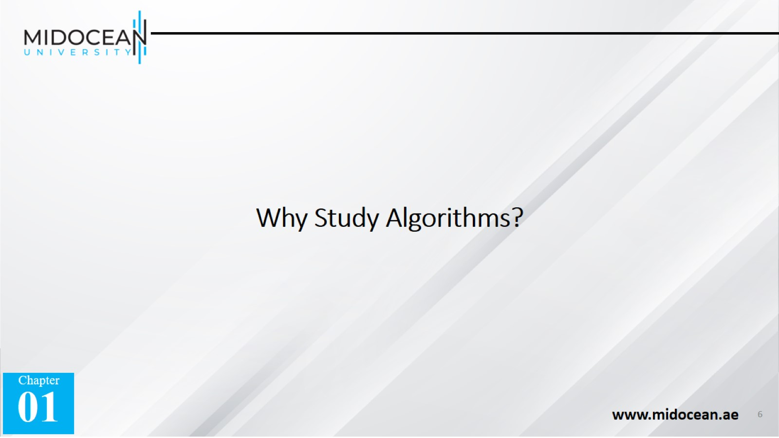
Why Study Algorithms?

Slide 7
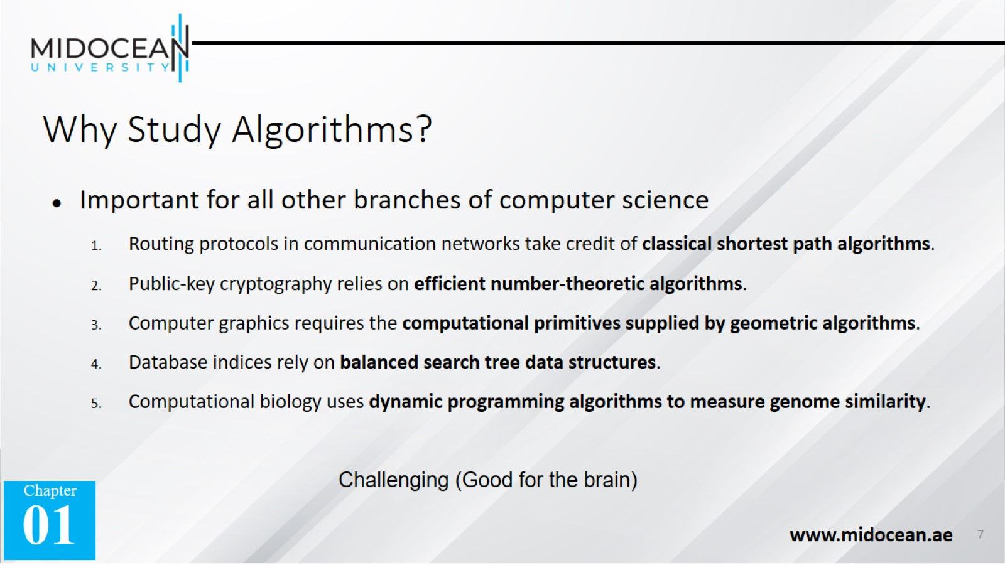
Why Study Algorithms?

Slide 8
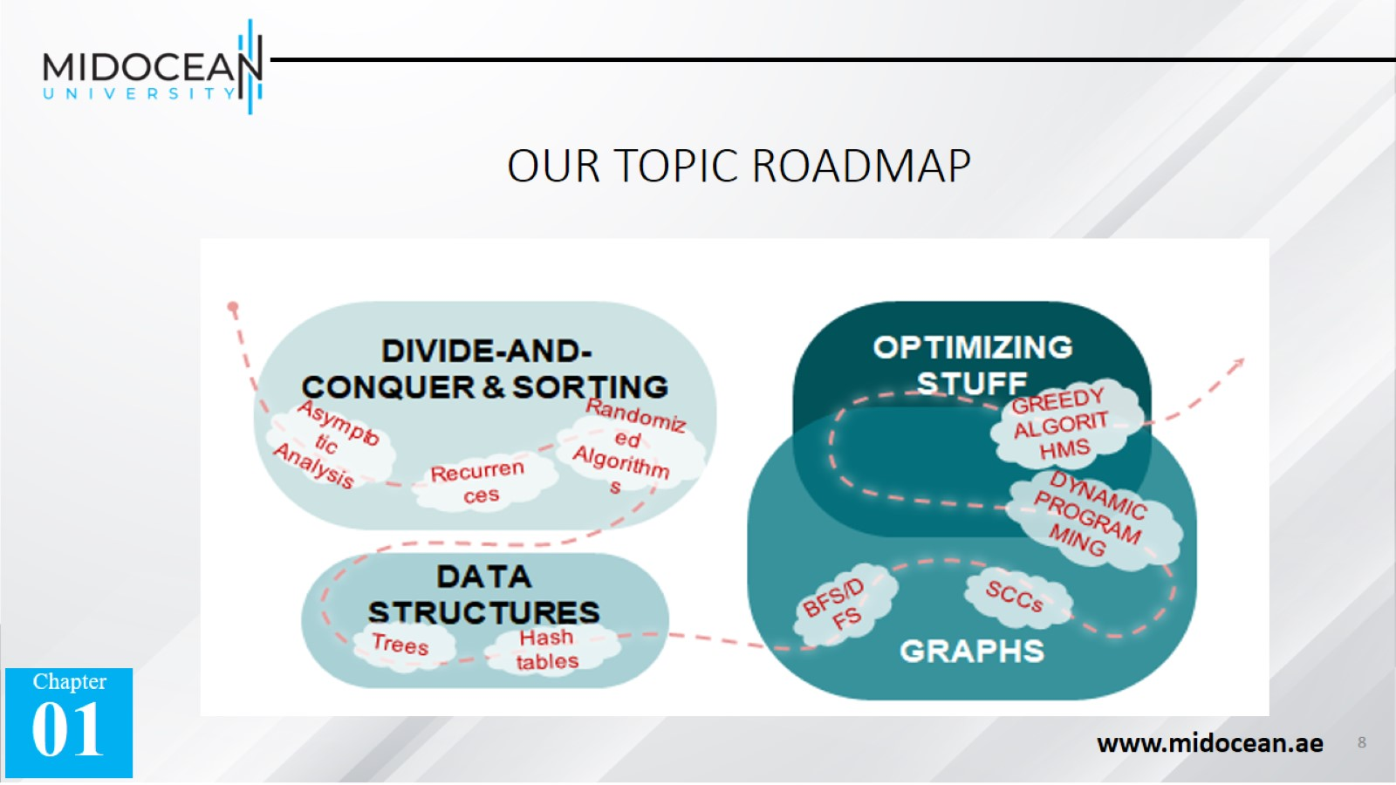
OUR TOPIC ROADMAP

Slide 9
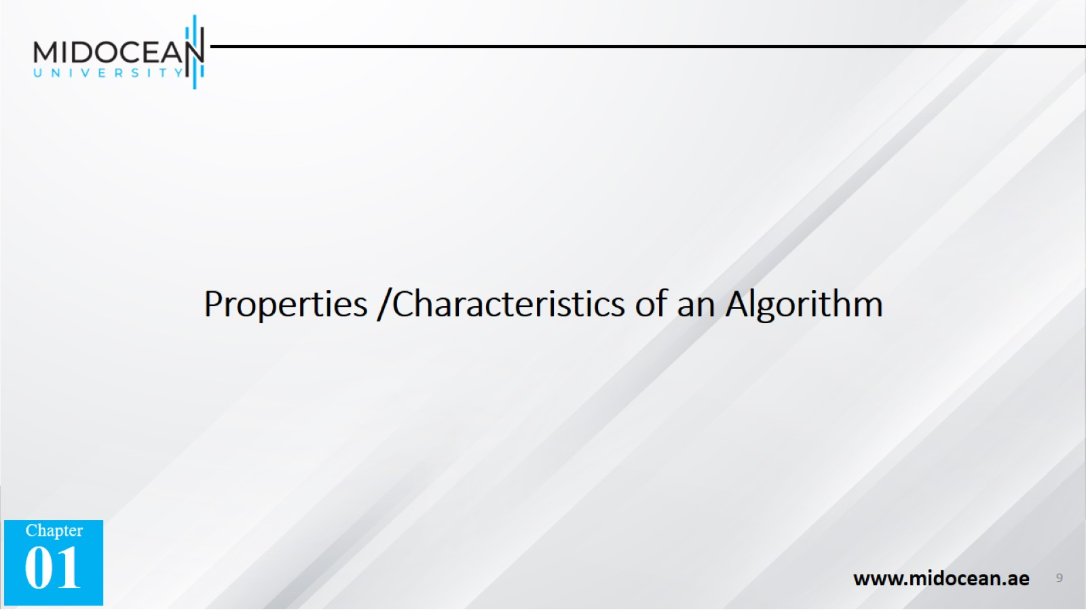
Properties /Characteristics of an Algorithm

Slide 10
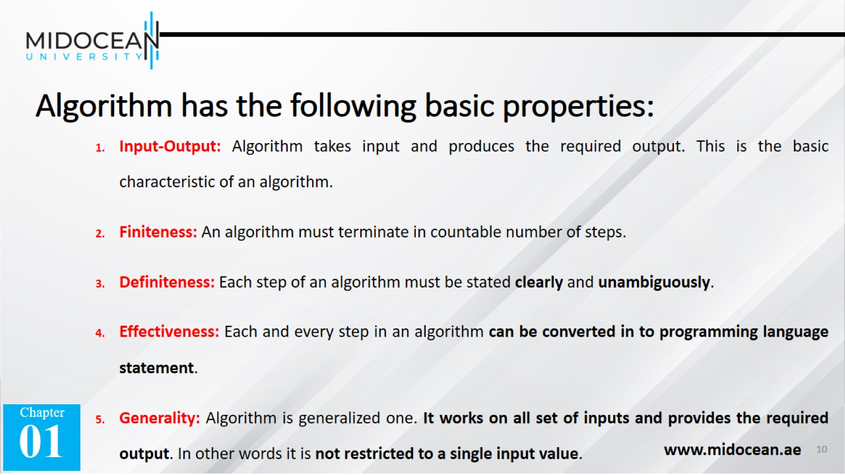
Algorithm has the following basic properties:

Slide 11
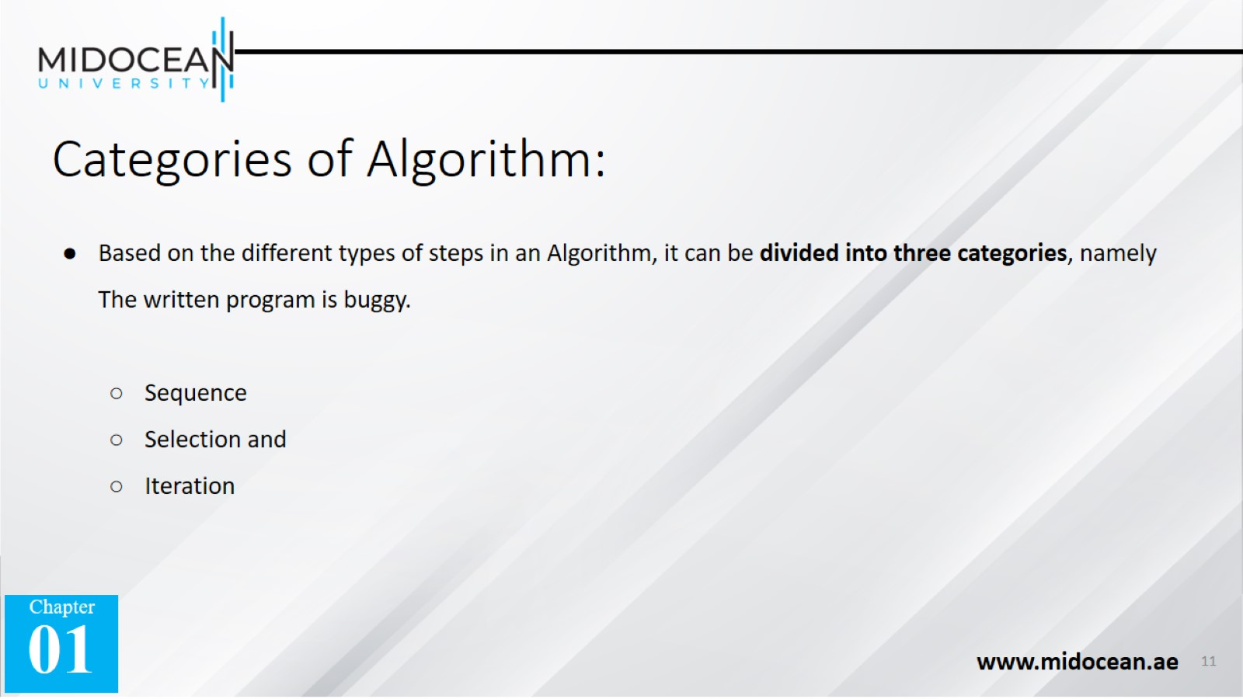
Categories of Algorithm:

Slide 12
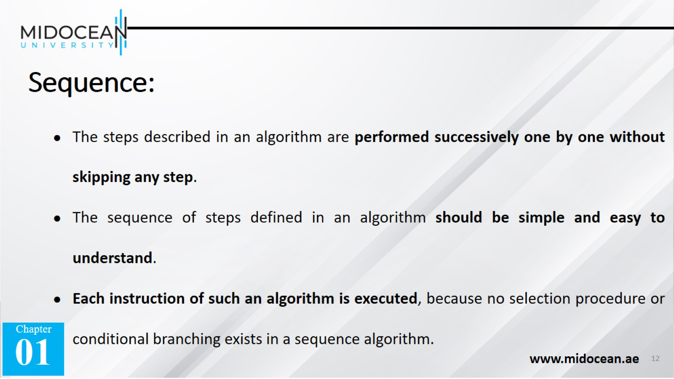
Sequence:

Slide 13
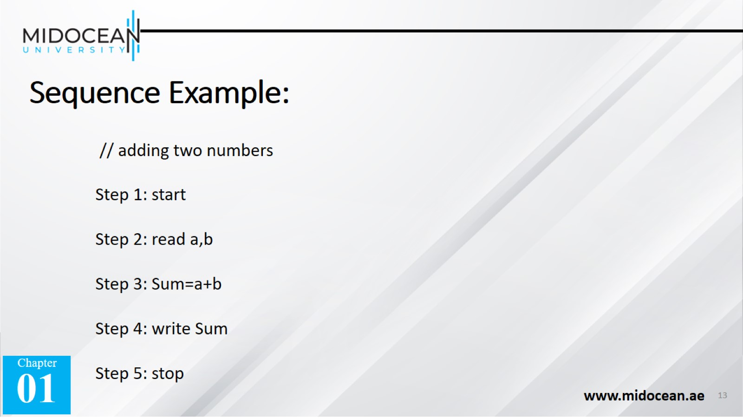
Sequence Example:

Slide 14
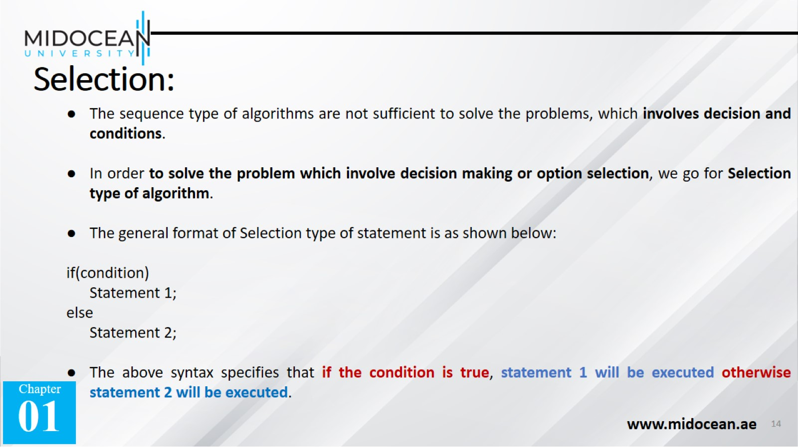
Selection:

Slide 15
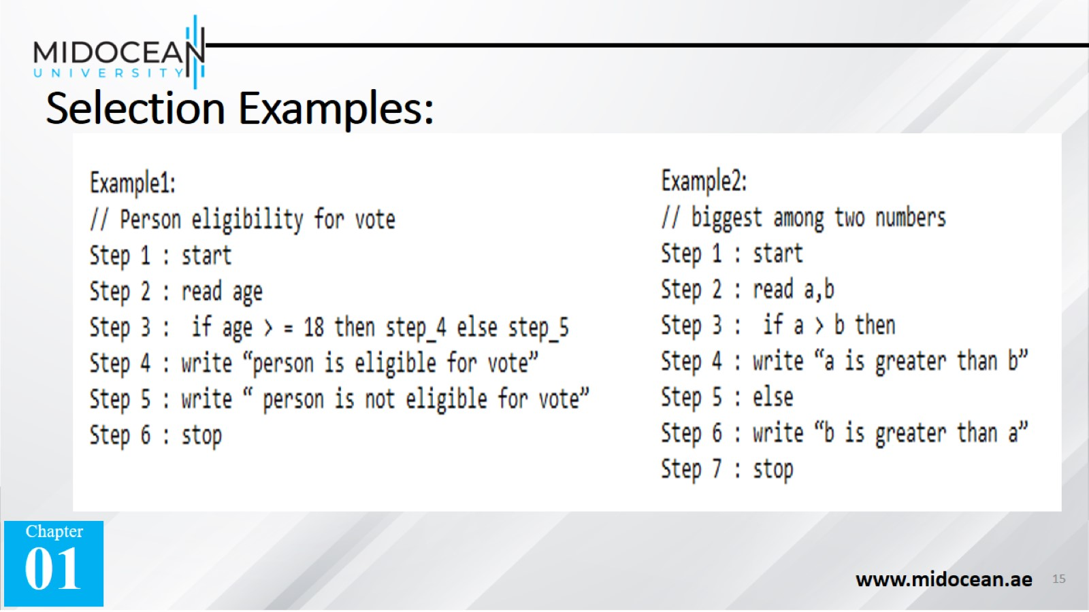
Selection Examples:

Slide 16
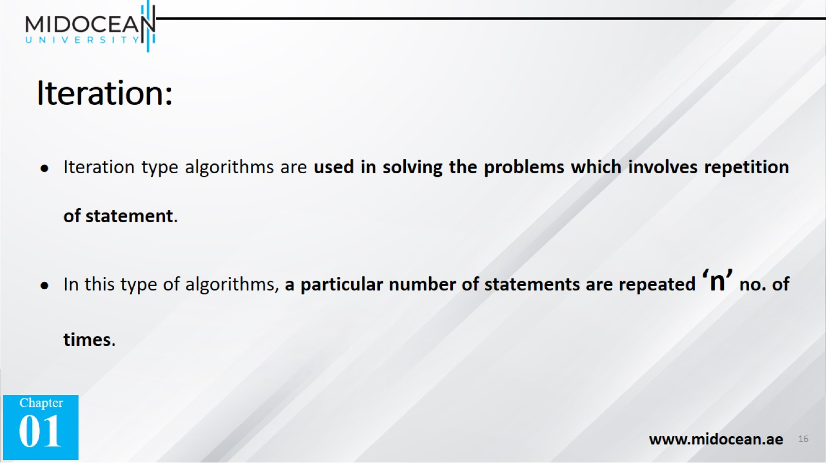
Iteration:

Slide 17
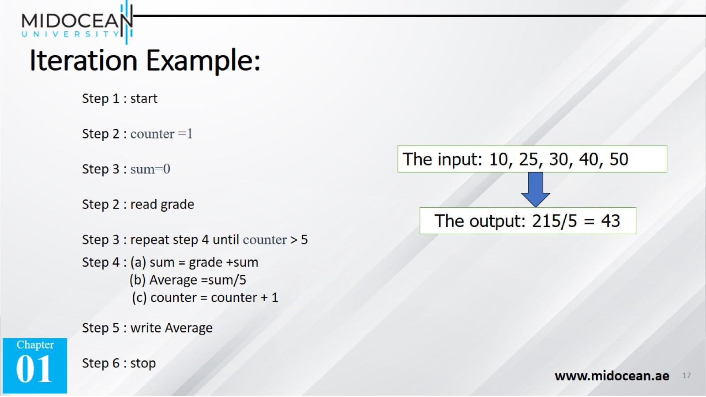
Iteration Example:

Slide 18
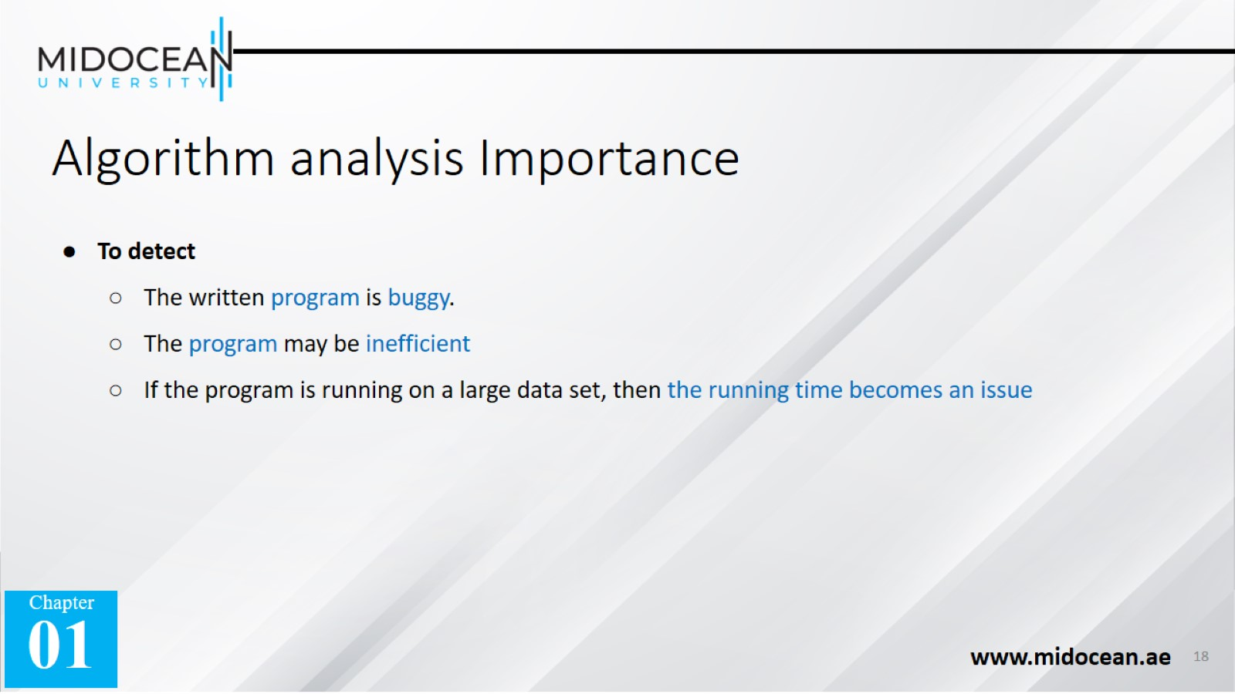
Algorithm analysis Importance

Slide 19
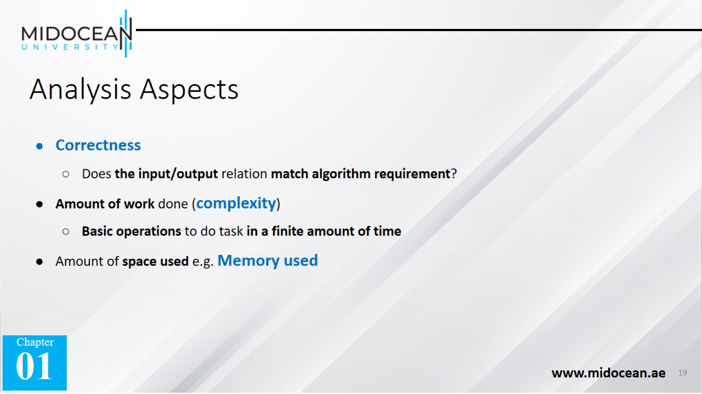
Analysis Aspects

Slide 20
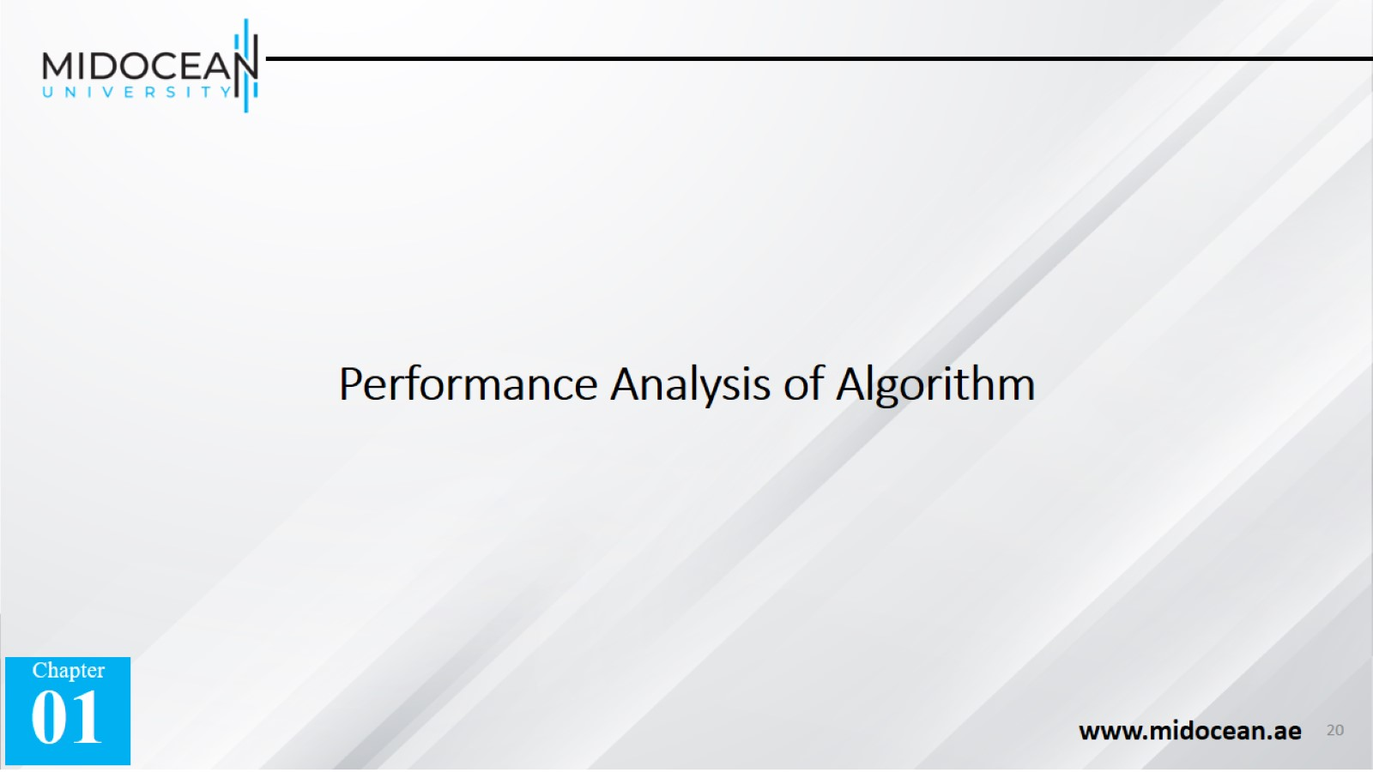
Performance Analysis of Algorithm

Slide 21
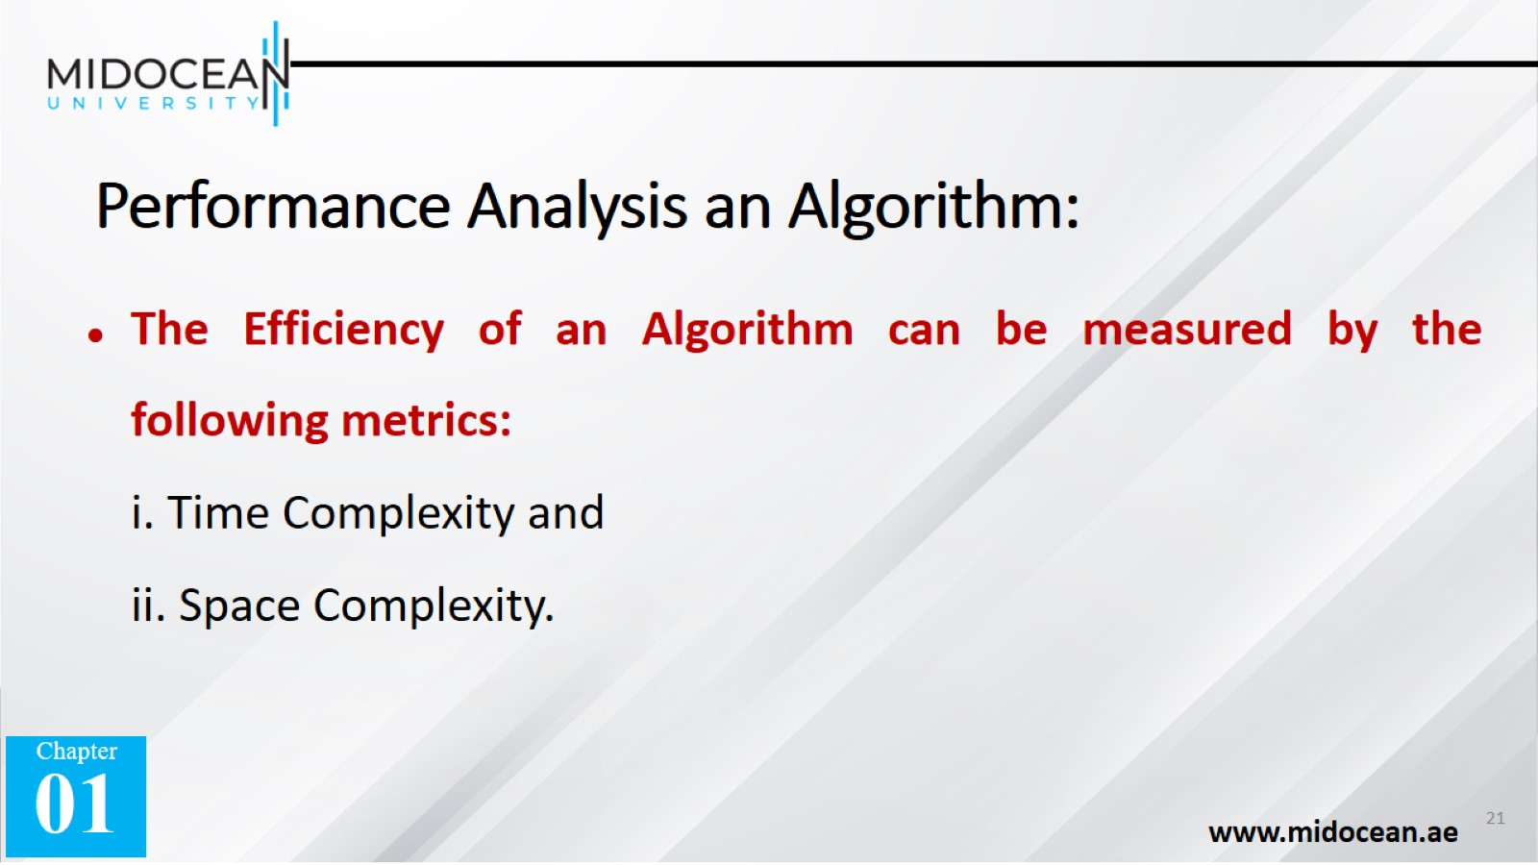
Performance Analysis an Algorithm:

Slide 22
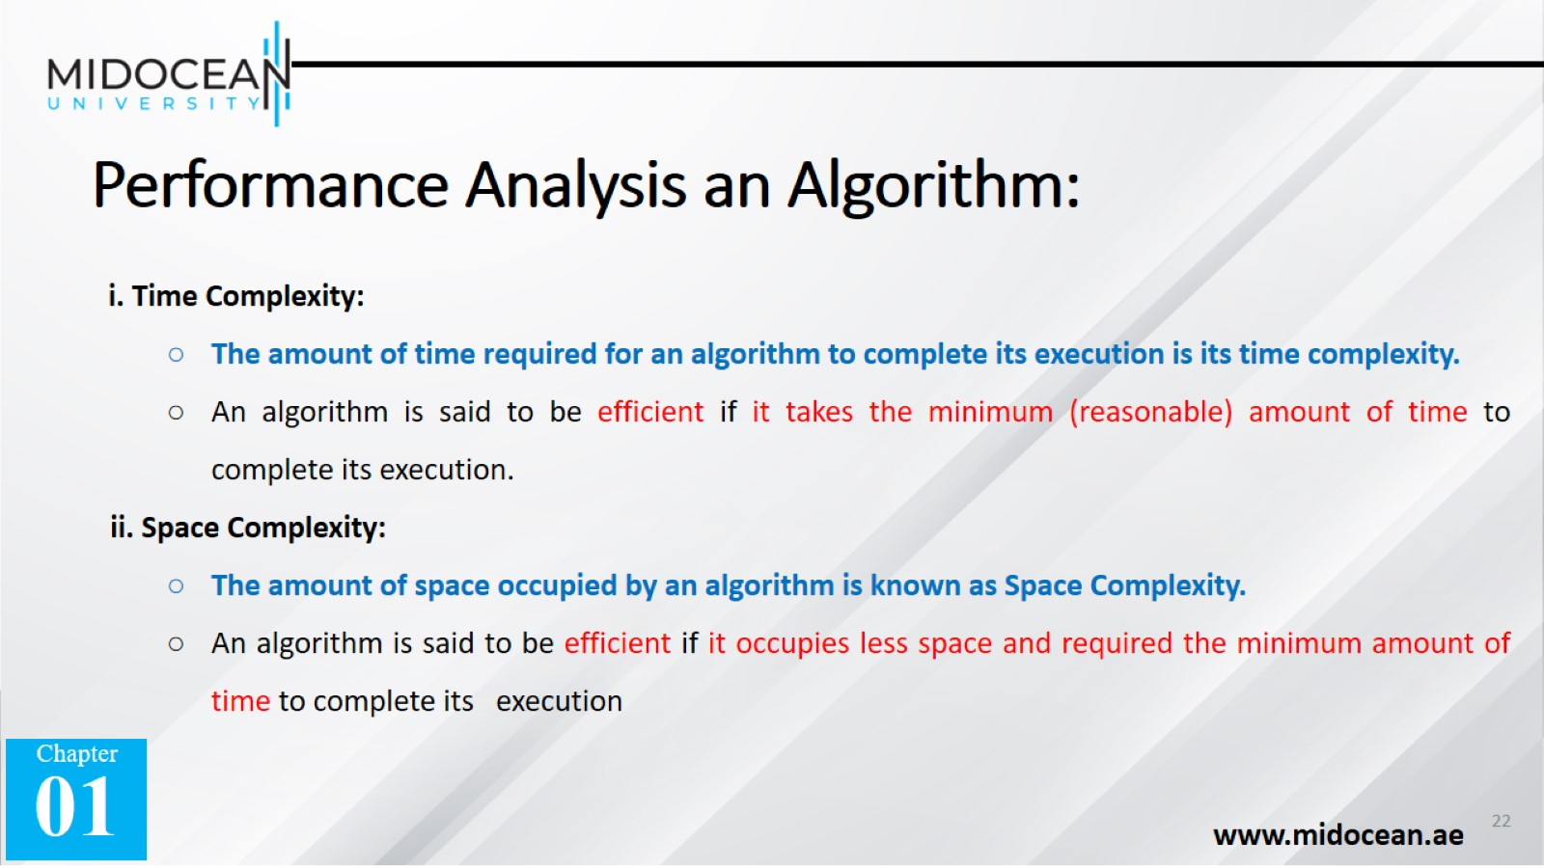
Performance Analysis an Algorithm:

Slide 23


Slide 24
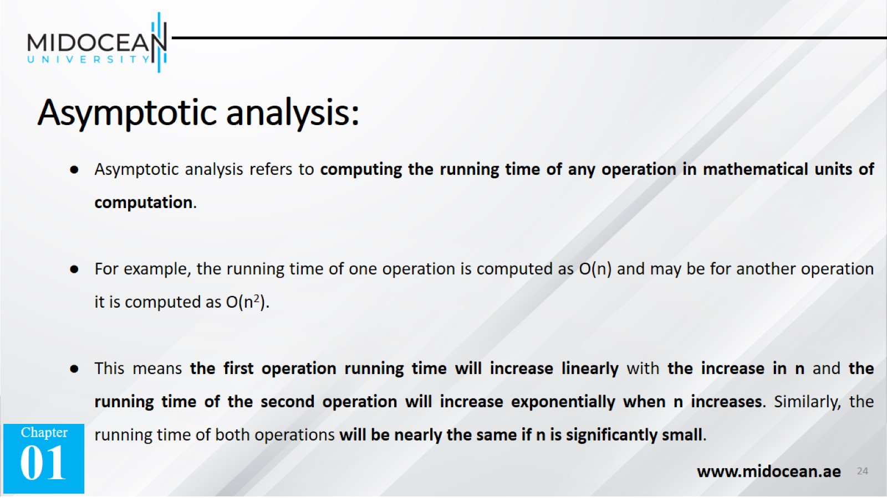
Asymptotic analysis:

Slide 25
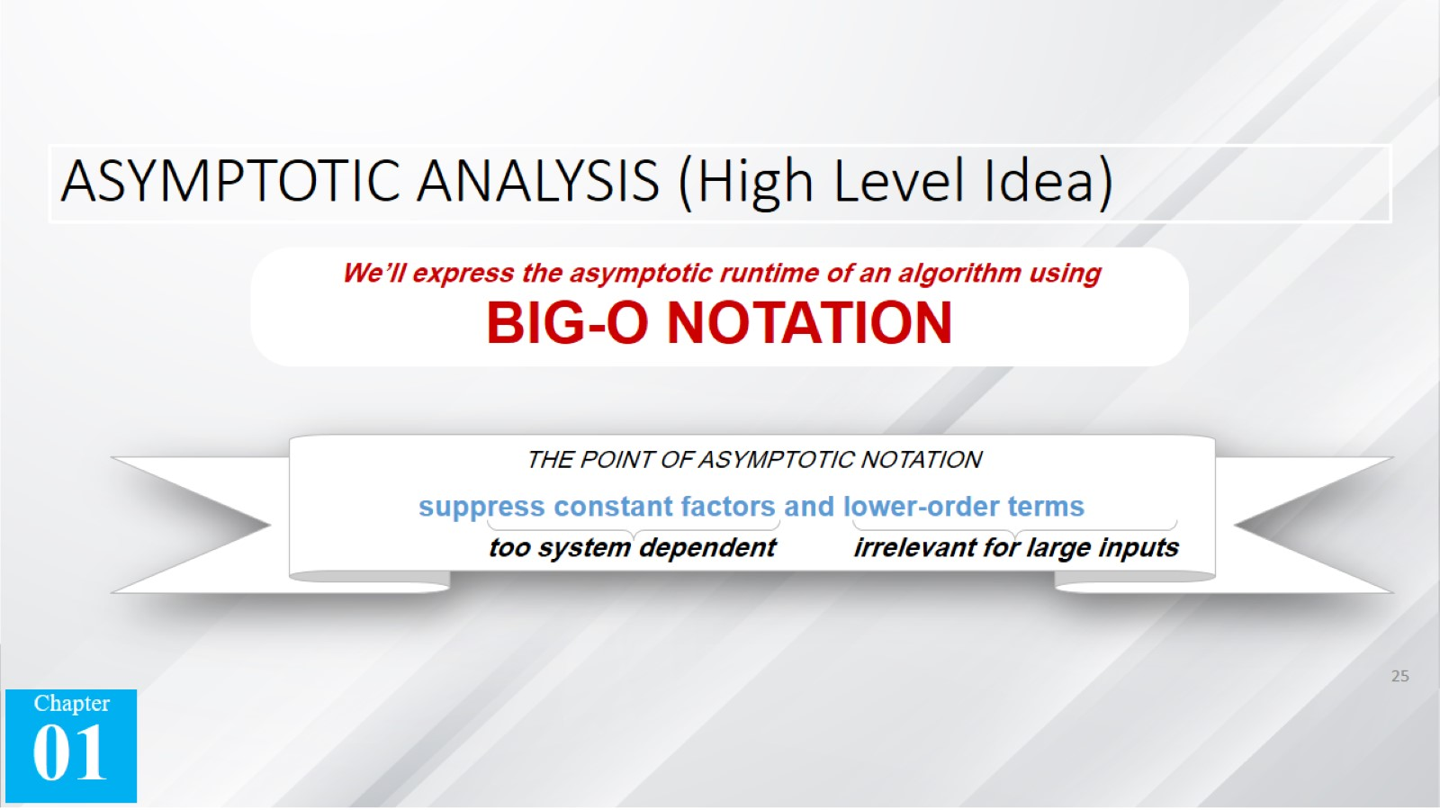
ASYMPTOTIC ANALYSIS (High Level Idea)

Slide 26
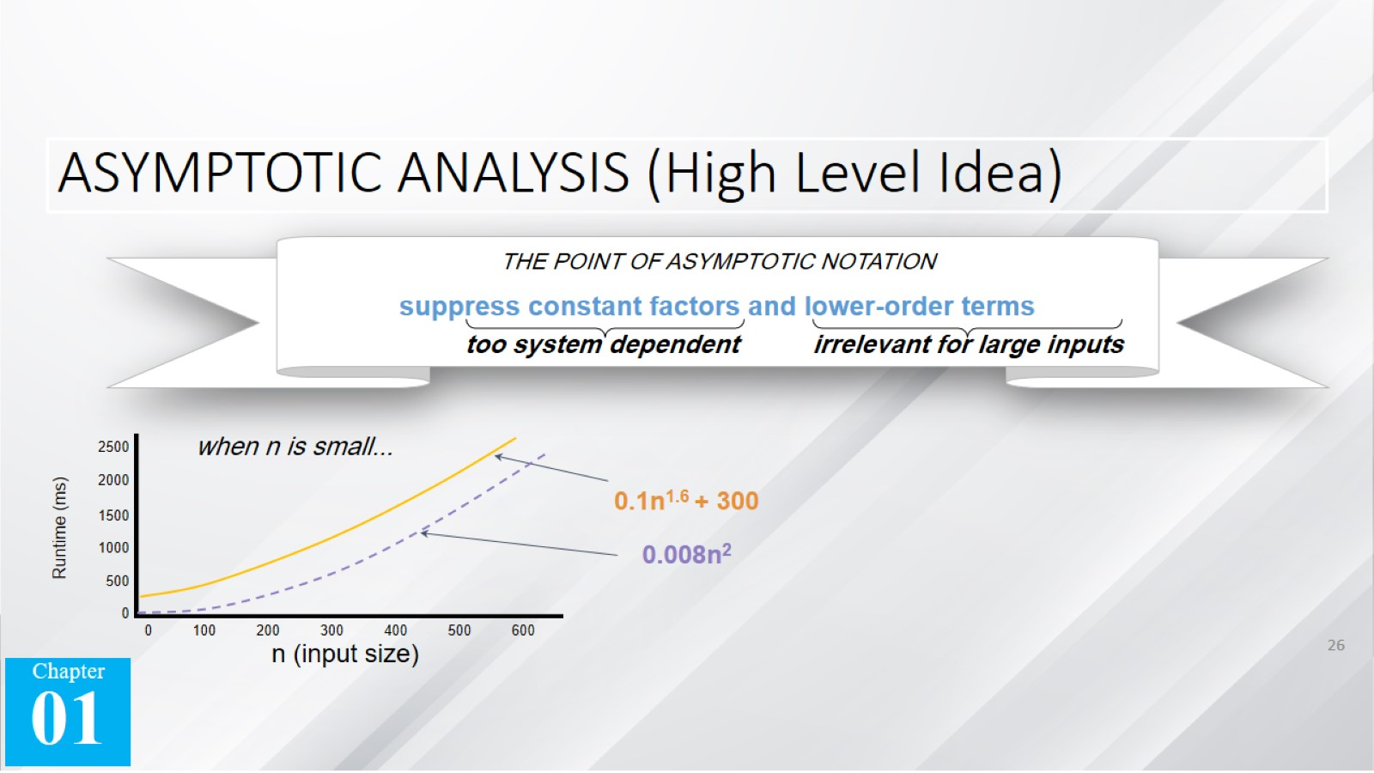
ASYMPTOTIC ANALYSIS (High Level Idea)

Slide 27
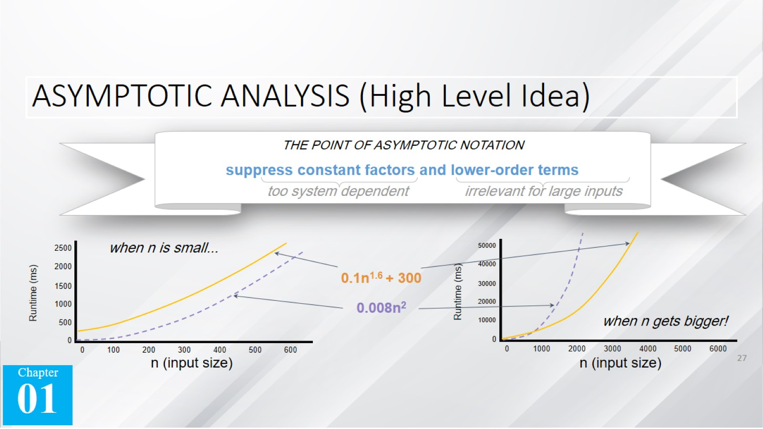
ASYMPTOTIC ANALYSIS (High Level Idea)

Slide 28
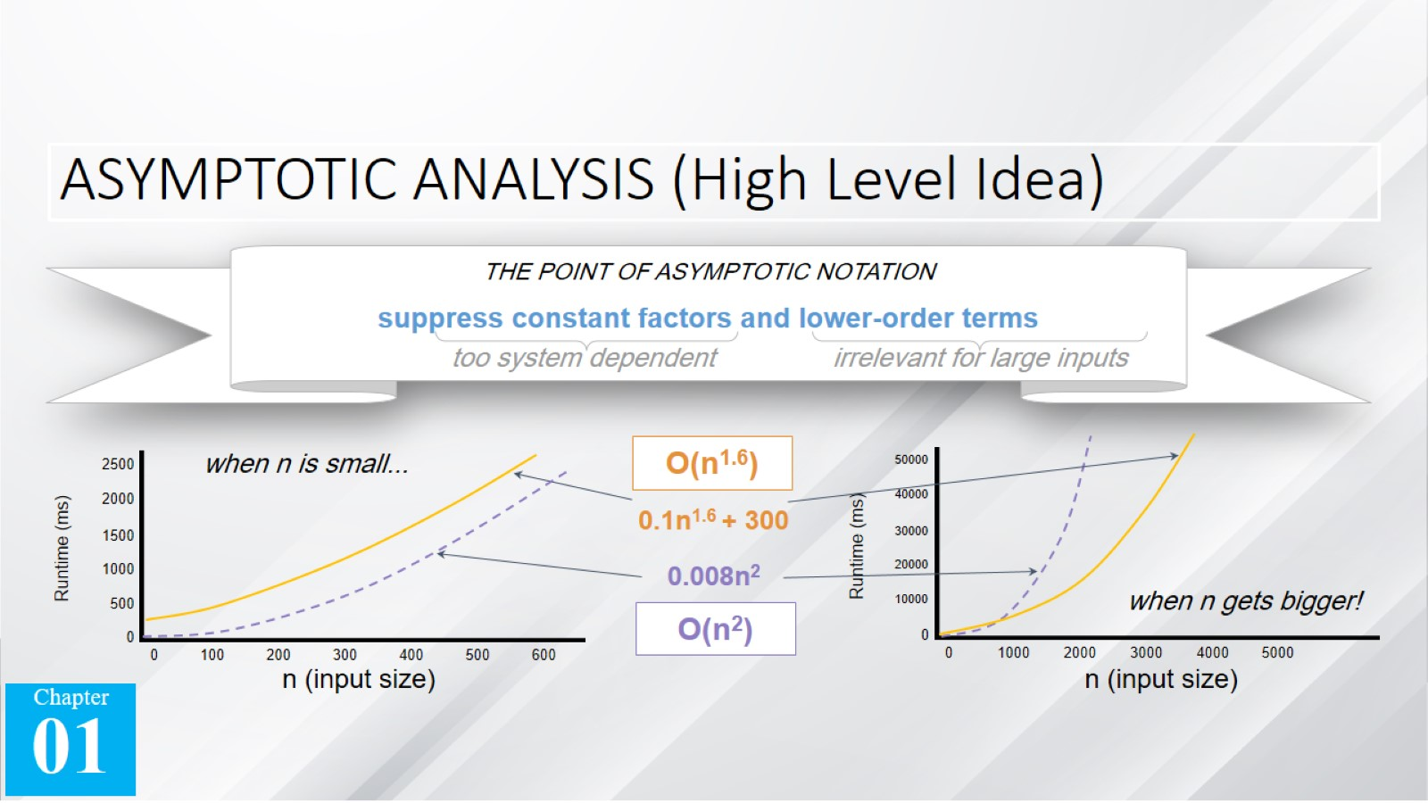
ASYMPTOTIC ANALYSIS (High Level Idea)

Slide 29
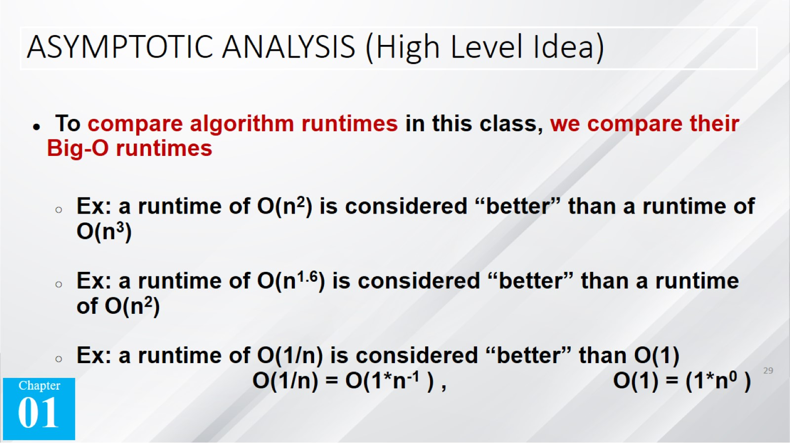
ASYMPTOTIC ANALYSIS (High Level Idea)

Slide 30
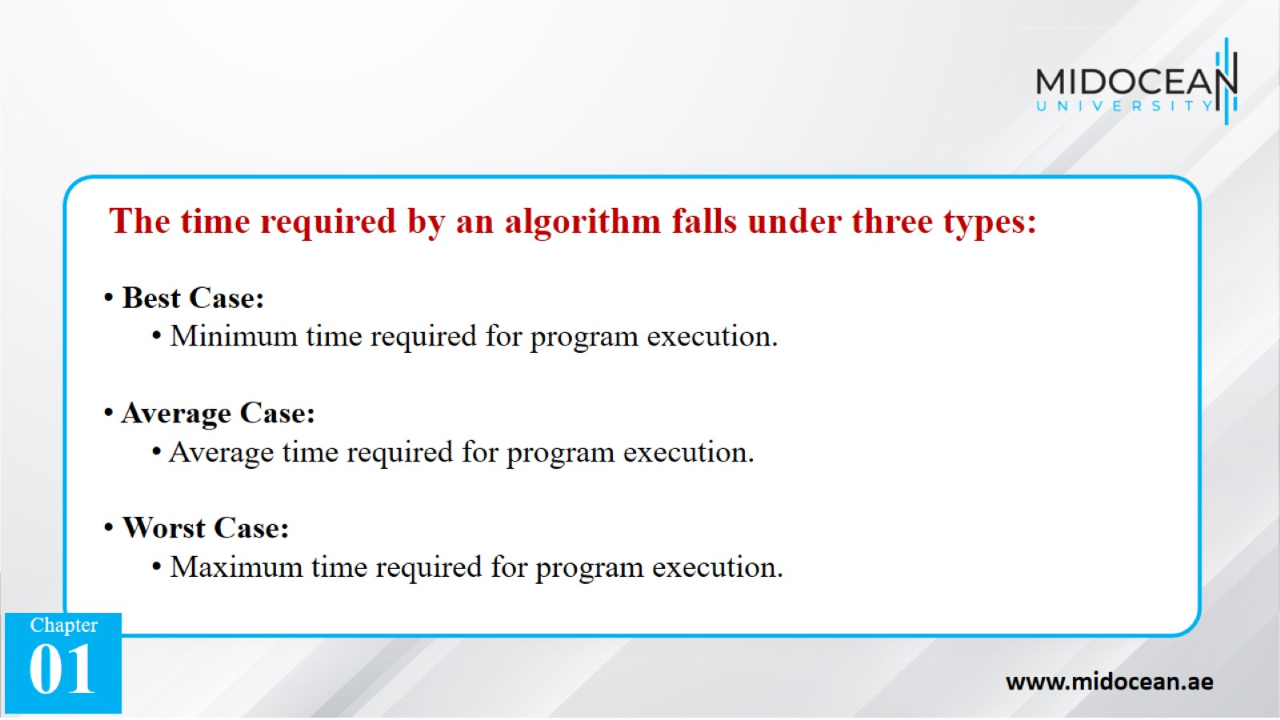

Slide 31
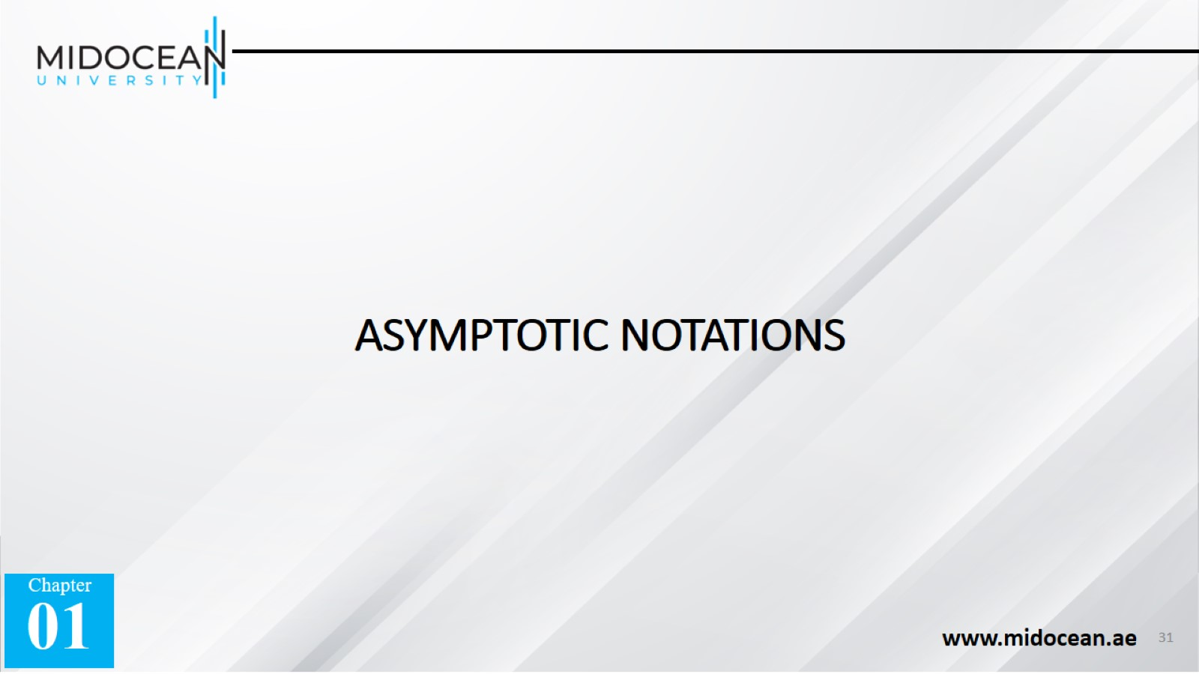
ASYMPTOTIC NOTATIONS

Slide 32
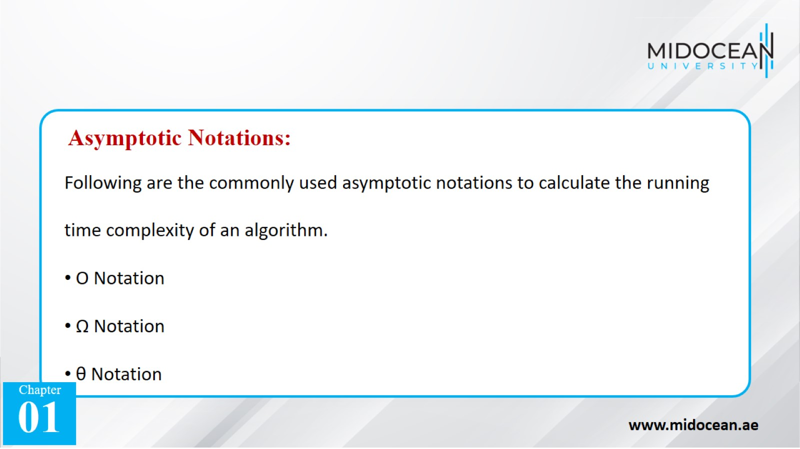

Slide 33
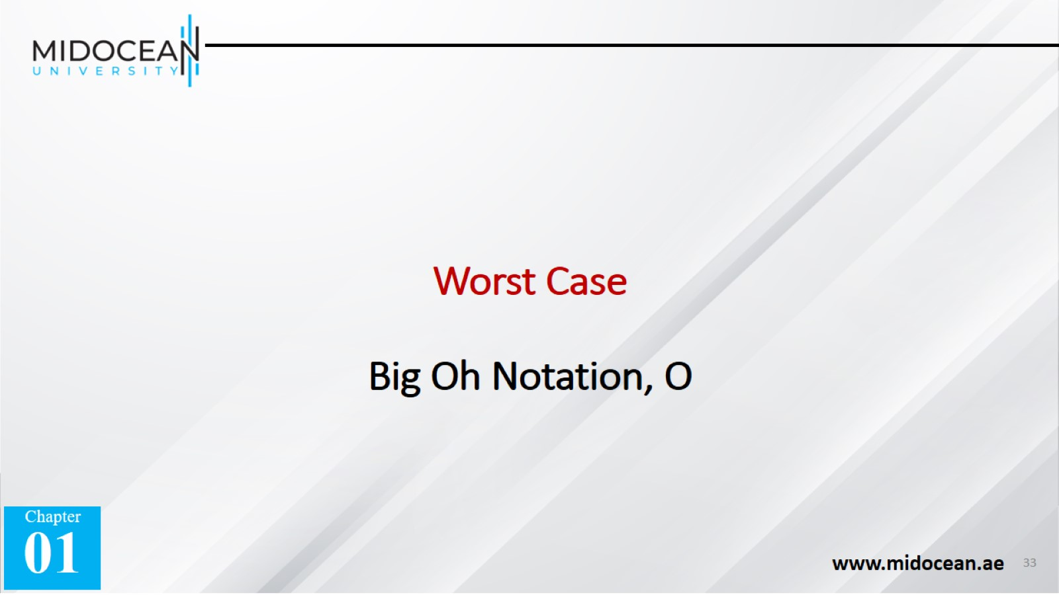
Worst Case
Big Oh Notation, Ο

Slide 34
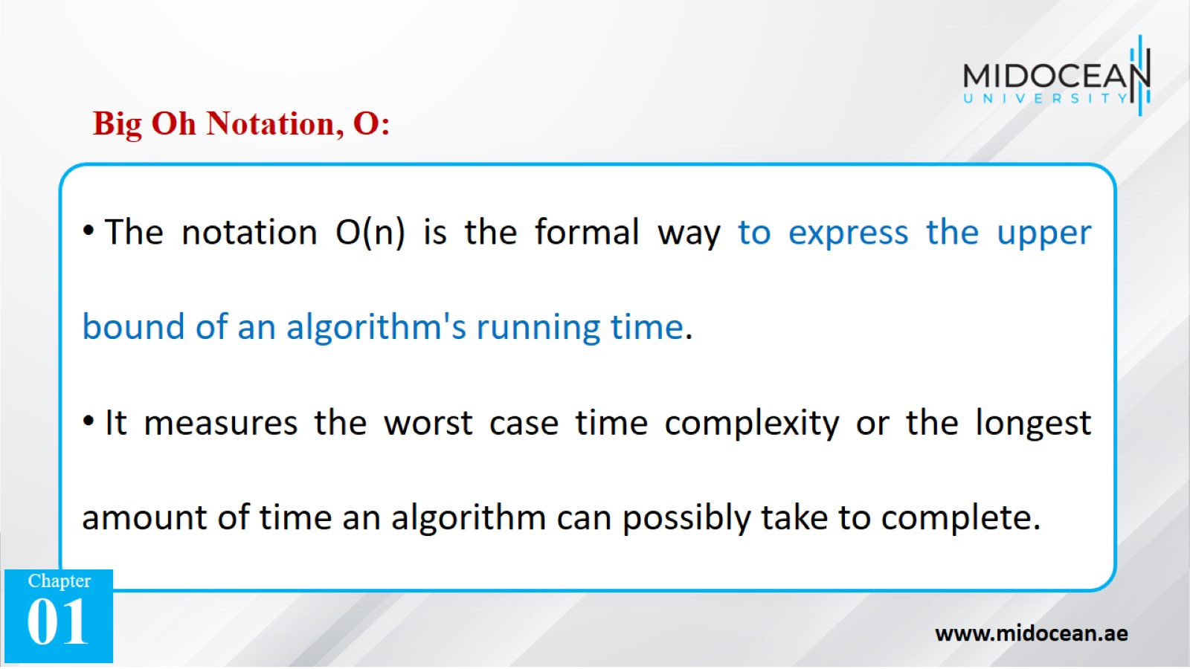

Slide 35
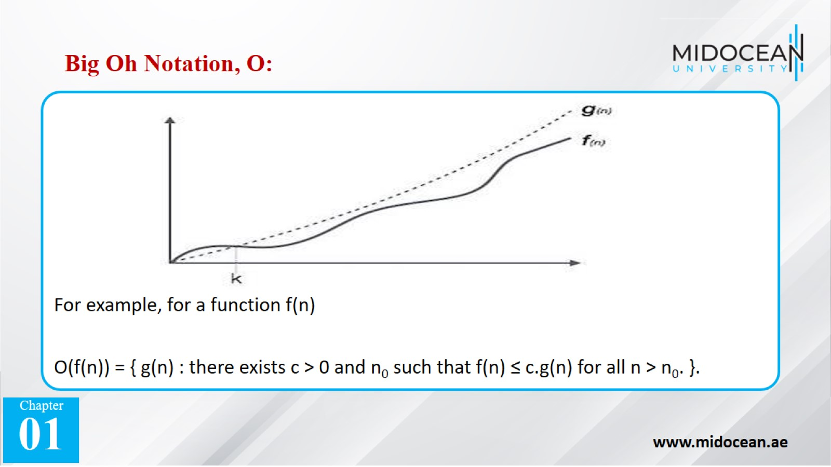

Slide 36

Best Case
Omega Notation, Ω

Slide 37
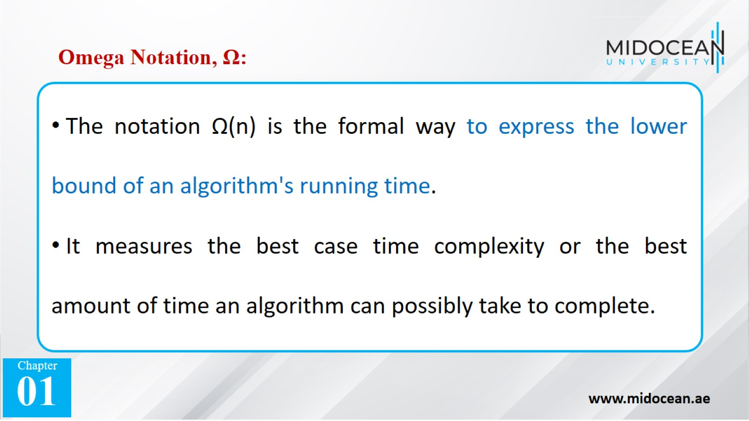

Slide 38
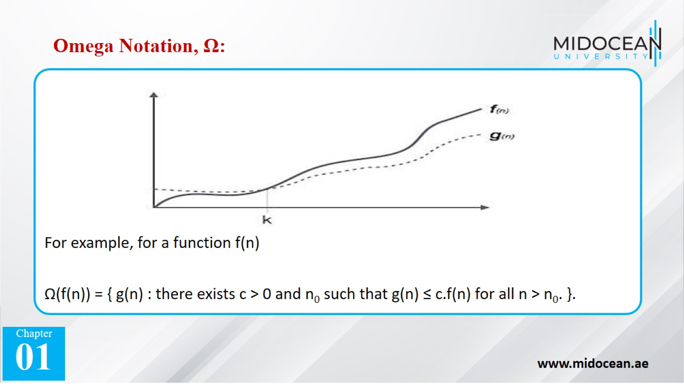

Slide 39
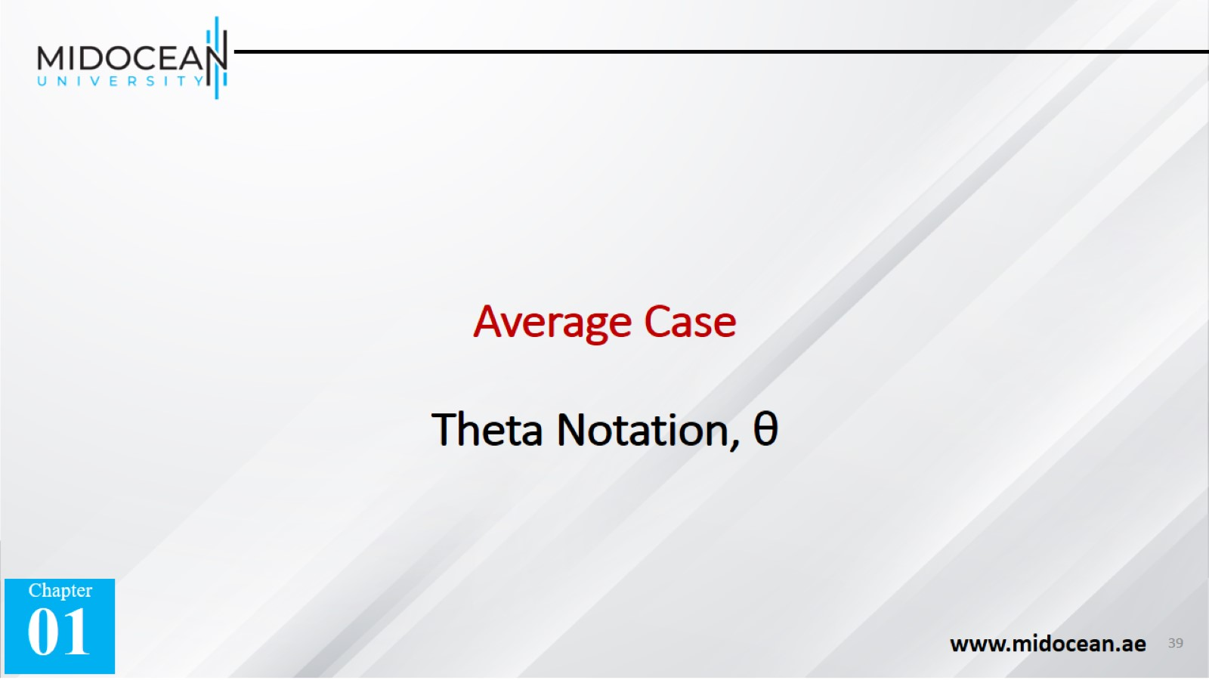
Average Case
Theta Notation, θ

Slide 40
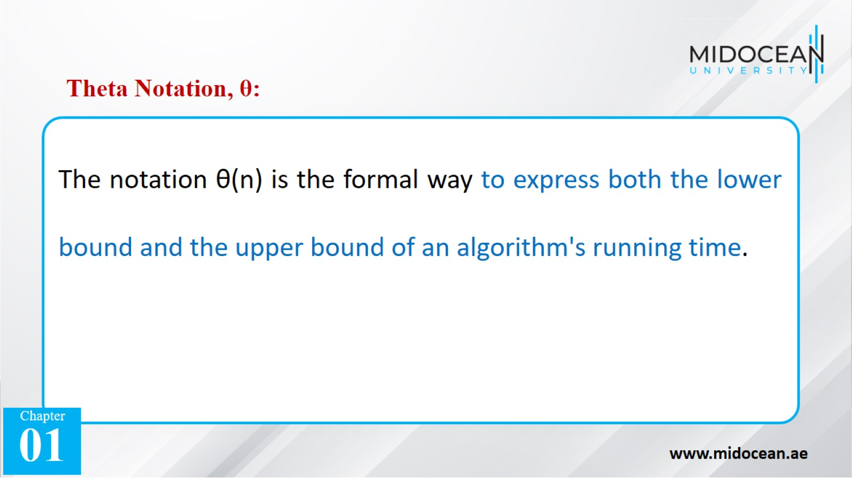

Slide 41
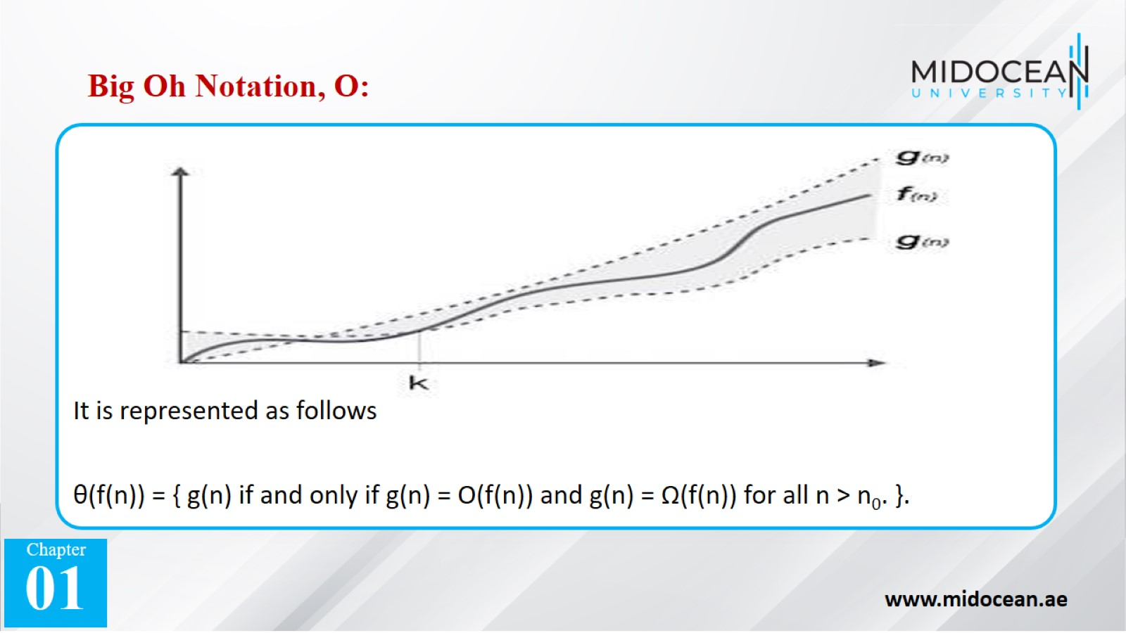

Slide 42
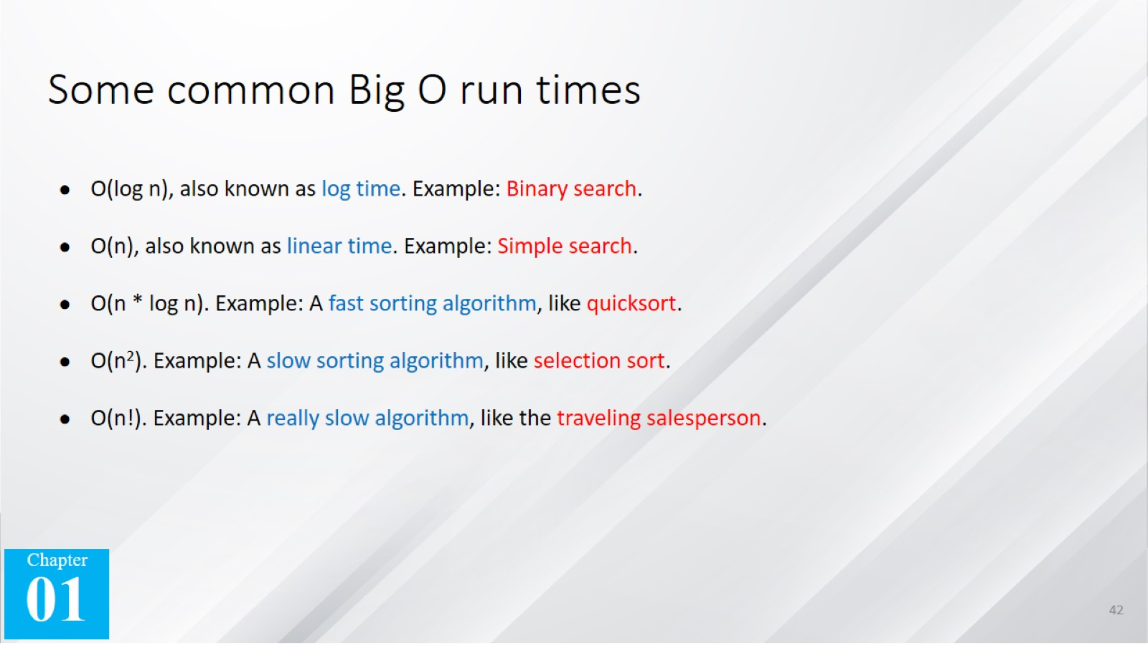
Some common Big O run times

Slide 43
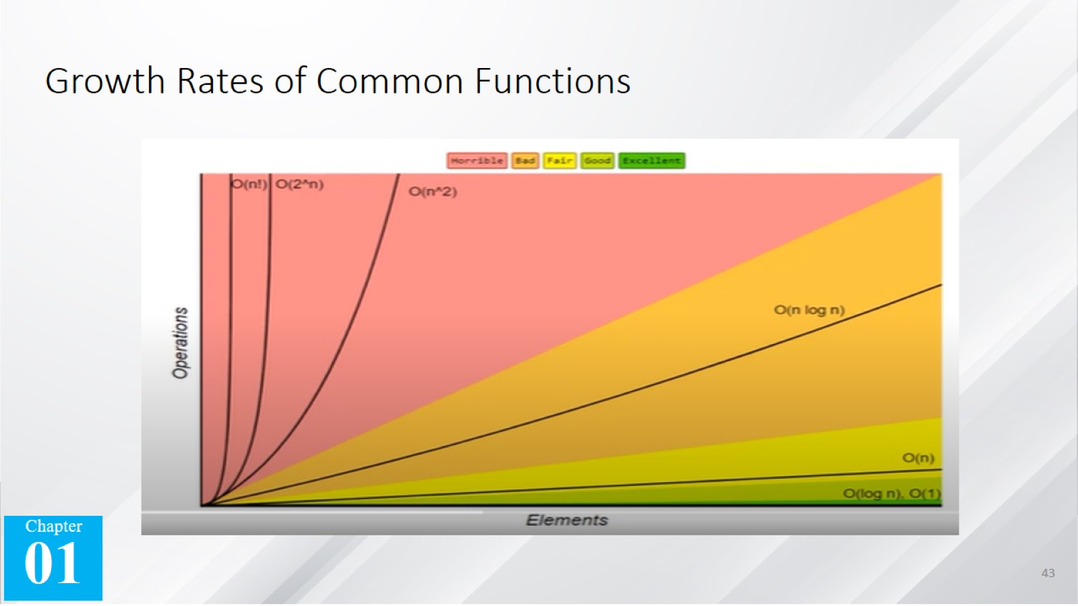
Growth Rates of Common Functions

Slide 44
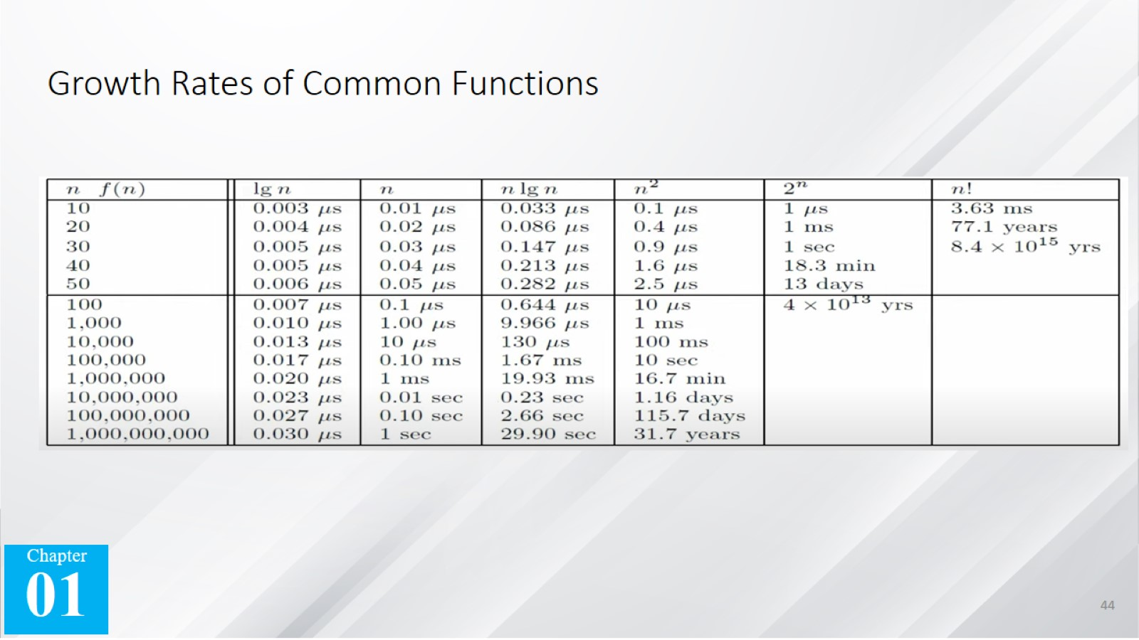
Growth Rates of Common Functions

Slide 45
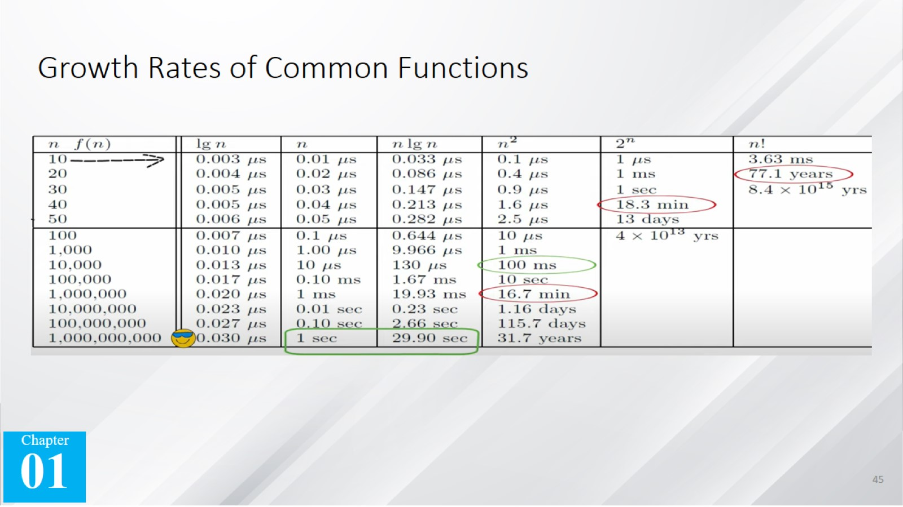
Growth Rates of Common Functions

Slide 46


