Slide 1

Risk and Decision Analytics
Prepared by Dr. Sami Alzahrani
Lecture 5
PMG 621
Utility and multi-criteria decisions

Slide 2

Lecture 4
Introduction
This chapter is for people and organizations that are not content to value decision outcomes in terms of money or money-equivalence. Even if monetary wealth is the objective, a decision maker may want a conservative risk policy.

Slide 3
Lecture 4
Introduction
Exceptions to Expected Monetary Value Decision Policy Most businesses base their decisions upon monetary value-at least that is the primary consideration. The cost/benefit/risk analysis focuses on the calculation of expected monetary value (EMV). Recall that EMVis expected value (EV) of the present value (PV) net cash flow. (The PV formula is in Chapter 3.) Maximizing EMVis a suitable decision policy for most business situations.

Slide 4
However, not all circumstances are appropriate for EMV-maximizing.
The primary exceptions are:
When there is not enough money, or other resource, to do all of the worthwhile projects or actions (then most organizations use a ranking
criterion, such as discounted return on investment described in Chapter 3, or return on investment, described in Appendix 8B). When possible outcome values are relatively large, and the decision maker is conservative.

Slide 5
When money is not an appropriate measure. Or, when it's not the sole measure of value, and no money considerations cannot be converted easily into monetary equivalents. This chapter shows how utility theory provides a logical, consistent way to deal with these last two situations.

Slide 6
Conservative Risk Attitude
Logical decision making is based upon appraisal. We appraise or value the alternatives and implement the best one. In evaluating a particular alternative, we calculate or judge the value for each possible outcome. We then weigh these possible outcomes with their probabilities of occurrence. The probability-weighted average value is the EV.
In decision analysis, we use probabilities to represent judgments about
uncertainty.

Slide 7
In a credible analysis, all of the analysis inputs should be judged as objectively as possible. Properly done, the analysis results in an unbiased distribution of project value (or cost). Assume that monetary value, PV, is the measure of value. The PV outcome distribution shows the range of possible outcomes and each outcome's likelihood of occurrence. The risk-neutral decision maker need only know the EV PV, which is the expected monetary value EMV, for each alternative, in order to choose the best one. The EMV decision rule would be the organization's decision policy.

Slide 8
Conservative Behavior
Conservative behavior is widespread-almost universal. Should this be an important part of decision policy? Yes, if it is important. For small decisions, decision makers can afford to be risk-neutral. When the outcomes become large compared to the reference net worth, often decision makers will make substantial value adjustments for risk attitude. For large, publicly held corporations and governments, risks are shared by many investors. For these entities, many of us believe that the EMV decision rule is appropriate.

Slide 9
For individuals and small, closely held companies, a conservative risk policy is more suitable. Still, small day-to-day decisions will be almost exactly the same as with the EMV decision rule. However, decisions with large potential gains or losses may require conservatism. Utility theory describes how to mow an EMV decision analysis for a conservative risk attitude.

Slide 10
Utility is a measure of value reflecting the preferences of the decision maker, based upon beliefs and values. The EV concept still applies for in utility units instead of PV. The decision rule is to choose the decision making under uncertainty; outcome value, however, is measured alternative having the highest expected (value) utility (EU).

Slide 11
Utility Function for Risk Policy:
In this section, we are using utility theory only for expressing risk attitude. Later, we will discuss how utility theory applies also to multi-criteria decisions. Assume that maximizing monetary value is the objective. The objective value measure, then, would be PV using an appropriate discount rate. In the probabilistic sense, the objective measure is EMV.

Slide 12
Risk aversion is exhibited in what economists call the law of diminishing marginal utility. As an example, for most persons, winning a $1 million prize would be a tremendously exciting event. If one already has $10 mil- lion, however, the added $1 million would be hardly noticed. Incremental positive amounts add incrementally less value as wealth is accumulated.

Slide 13
Thus, for conservative persons, value is not a linear function of PV; twice the positive PV does not represent twice as much value. We could graph a function relating to how we perceive value versus the actual monetary value. This graph is a utilityfinction. Economist and decision theorists use the word utility synonymously with value. Utility units are often called utils.

Slide 14
Figure 4.1 shows an example utility function. It translates objective value, PV (x-axis), into perceived value, utility (y-axis). The y-axis scale is arbitrary, including choice of origin. Utility curves that are concaved downward rep- resent conservative risk attitudes.
The upward-sloping straight line in Figure 4.1 represents the utility function of a risk-neutral decision maker, where value is proportional to PV. This is a risk-neutral decision policy, i.e., an EMV decision maker.

Slide 15
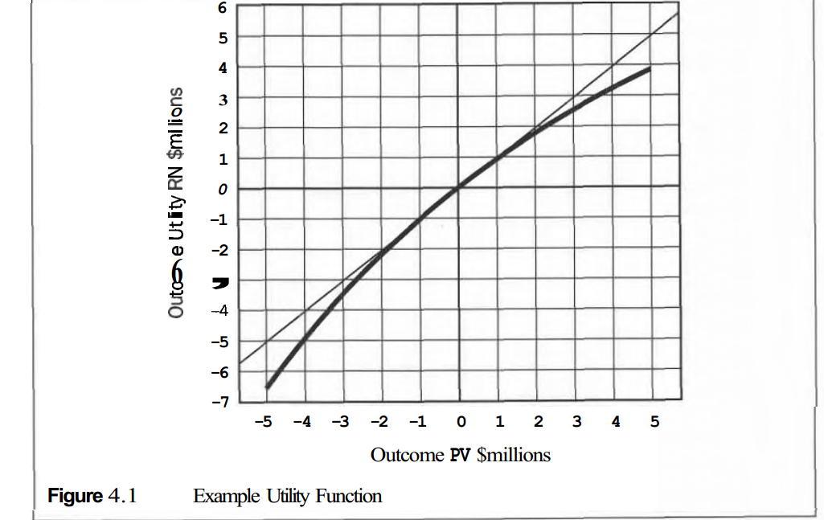

Slide 16
Many decision analysts scale the y-axis so that the worst possible out- come has utility = 0, and the best possible outcome has utility = 1. The curve, regardless of shape or scale, is usually deduced from the decision maker's answers to a series of hypothetical decision problems. I prefer the smooth exponential shape. Rather than arbitrarily defining the scale, I prefer to scale the y-axis in somewhat tangible units: risk-neutral (RN) dollars. This makes the utility measure more meaningful:

Slide 17
-RN$l million cost is one million times worse than a $1 cost.
+RN$l million benefit is one million times better than a $1 benefit.
Note that for positive PVs (benefits), incremental utility value decreases as PVs get larger. Conversely, costs or losses are amplified for negative PVs. For small decisions, near zero PV, the straight line and the curve are nearly coincident. The result is that a value determined by EMV is nearly identical with the value obtained when recognizing risk-aversion.

Slide 18
Applying the Risk Policy:
In decision analysis, we value the alternatives with either their EUs or CEs. The EMV decision policy is a special case: CE = EMV when the utility curve is a straight line, meaning that r = $w . Either the EU or CE criterion results in the same decisions. However, if any alternative is a fixed-dollar amount, then conversion to CEs is necessary. When evaluating alternatives with utility, I like to calculate every node's EMV, EU, and CE when back-solving decision trees. If there are costs placed along tree branches, these costs may then be subtracted from the CEs as the tree is back-solved.

Slide 19
Interesting situations arise, sometimes, when the highest EMV alternative is not the same as the highest EU (or CE) alternative. That is the point of having a risk policy: to show which risk versus value tradeoffs are appropriate.

Slide 20
An interesting application arises in a problem of optimizing participation fraction or "working interest" in a project. If the project has a positive EMV, the EMV decision rule says, "Take it all." (We are assuming, here, that not investing is the alternative and has a $0 value.) However, if the potential downside is serious, it may be advisable to share the risk with one or more partners. If the project has a positive EMV, then some fraction ownership is always desirable. However, you may not want it all.

Slide 21
What is the optimal interest you would want in a project?
A utility function representing risk attitude is the logical way to solve this problem. By iteration, deduce the shape of the function of EU (or CE) versus participation fraction. Choose the participation interest that maximizes EU. Keeping 100 percent of the project is often desirable. However, if the project cost is high and there is sufficient risk, a fractional share of the project will maximize utility.

Slide 22
When running a Monte Carlo simulation (simulation; we'll d&cuss how in Chapter 7), we calculate the outcome PV, then convert it to utility units in every trial. EU is the average of this utility-measured outcome. When using simulation, it is customary to provide the decision maker with risk-versus-value profile curves. These are typically reverse cumulative frequency distributions for PV, and are the natural presentation format for simulation results. Most decision tree software provides similar, although sometimes more stairstep-looking, graphs. Figure 4.4 shows example reverse cumulative distribution curves produced by simulation.

Slide 23
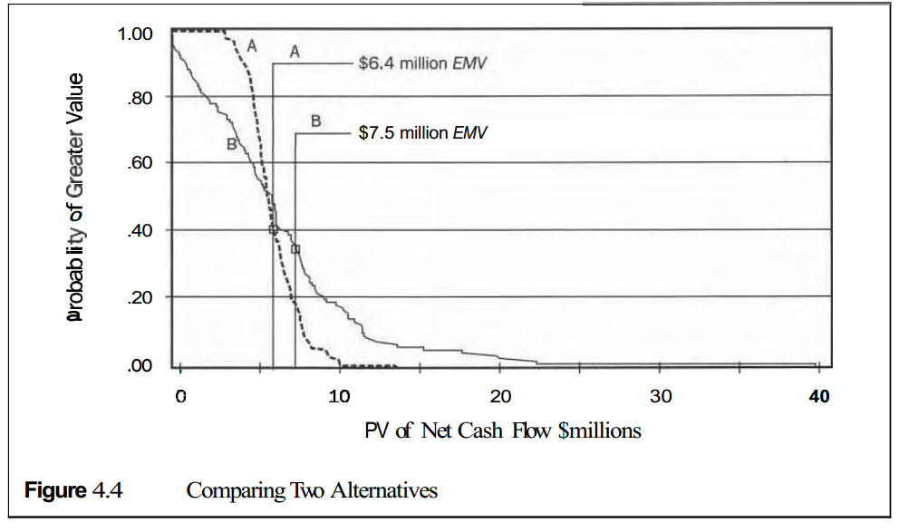

Slide 24
if the curves cross, and when the best-EMV alternative is riskier (wider), having a risk policy is useful. This is the typical and unfortunate reality: Alter- natives with better EMVs are usually associated with greater risk, as illustrated in Figure 4.4. Alternative B has a higher EMV, and has greater uncertainty. Which alternative has the best risk-versus-value profile? That depends upon the decision maker, who may visually compare the curves, allowing his intuition to make the decision. The more consistent-and recommended-way isto convert each curve into its EU (or CE); then choose the best alternative based upon the EU decision rule.

Slide 25
The utility function is a succinct, complete risk policy for an organization or individual decision maker. This is a powerful concept for a conservative company that wants to delegate decision making downward. It enables decision makers at all levels in the organization to make consistent risk-versus- value tradeoffs. Decision analysis keeps separate: objective, time value of money, risk attitude, and judgments about uncertainty. This decomposition facilitates more logical and more consistent evaluations.

Slide 26
Multi-Criteria Decisions:
Multi-criteria decision making (MCDM) is an approach for problems where value is multi-dimensioned. Usually these arise because of multiple objectives or goals. A city government, for example, faces tradeoffs across many dimensions such as schools, roads, and police protection. It can apply MCDM to solve such problems in a reasonably consistent way. There are three principal ways to deal with MCDM problems:

Slide 27
- Recast the problem solely as an economic issue, and maximize EMV, EU, or CE.
Convert no money considerations into monetary equivalents, then max- amaze EMV, EU, or CE.
- Use a multi-criteria value function (which can have risk aversion embedded), and maximize EU.

Slide 28
Monetary Value Objective Approach:
In project management, goals commonly relate to cost, time, and performance. How are we to make tradeoffs between these three dimensions? Understanding and quantdymg tradeoffs is difficult unless a value model is used. Suppose a project plan is in trouble. The main alternatives are: Spend an additional $1 million to complete on time.

Slide 29
Finish three months late but within budget.
Which alternative is better?
Figure 4.5 maps project outcome value according to two dimensions, cost and schedule, for illustration. We measure project outcome value in PV dollars. (We the uncertainties are unresolved, however, we would be measuring project value as EMV.) The project feasibility model determines the shape and position of the is value contours. In this case, the contour undulations reflect the seasonality of the business. Interpolating between the curves:

Slide 30
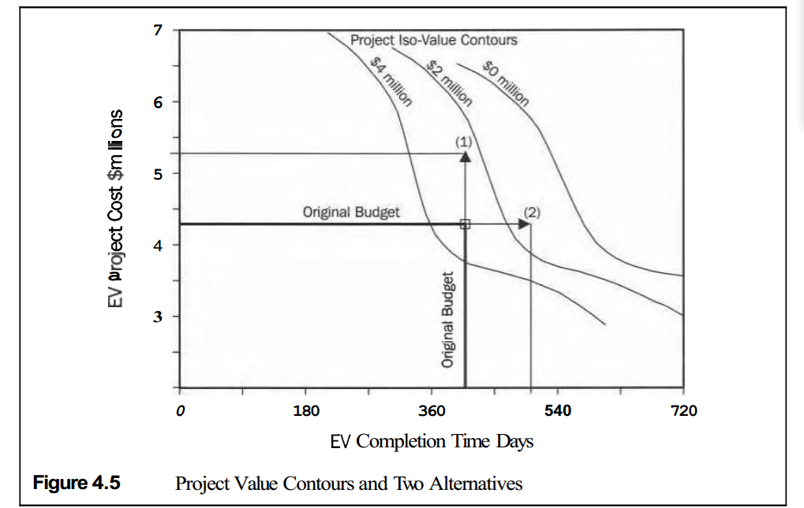

Slide 31
Alternative 1: Cost overrun EMV = $2.4 million.
Alternative 2: Late EMV = $1.5 million.
Both alternatives have unattractive outcomes compared to the original feasibility study. If maximizing EMV is the corporate decision policy, then Alternative 1 is the clear and logical choice. The contours (or the equivalent value formula) represent decision policy.

Slide 32
Monetary-Equivalents Approach
Dollars are a convenient and standard measure for comparing decision alternatives, especially in business. Increasingly, even government and not-for- profit organizations are making decisions based primarily upon monetary value.

Slide 33
Sometimes, developing a comprehensive value model is impractical or
inappropriate. However, costs or monetary value often represent 80 percent or more of the decision basis. Minor additional considerations can be included in the analysis by factoring in monetary-equivalent values for the side factors.

Slide 34
Consider the situation of a national oil company that located a new re- finery. One site was near an urban area that already had most of the needed infrastructure and good availability of labor. An alternative was to locate the refinery in an impoverished, rural area where jobs were greatly needed. Most of the decision was driven by the refinery's value in the nation's economy. However, because the company was government-owned, it was important to consider and balance other secondary objectives, such as improving employment opportunities.

Slide 35
all that we need for the substitution approach are ways to translate non- monetary criteria into money equivalents. For example, it may cost $5,000 to create a new job in the local economy. Economists can assess the value, cost, and timing of job creation, and we can then add cost equivalents into the cash flow projections. Then we can make the decision based upon EMV or CE, calculated in the usual way.

Slide 36
Multi-Criteria Value Functions:
For true MCDM problems, the principles of decision analysis still apply. A key challenge is devising a way to measure value. Often, multiple objectives are involved, usually the result of having multiple stakeholder groups. Different stakeholders, of course, have different preferences. EMV-maximizing businesses also use MCDM on occasion. It is sometimes impractical to develop a model to characterize different alternatives' impacts on corporate value, such as hiring decisions and employee evaluations.

Slide 37
Although possible, it is usually cumbersome to attribute incremental cash flow to an employee because cosmos benefits are too hard to quantify. In project management, most decisions are made considering impacts on cost, schedule, and performance. These form a hierarchy, as shown in Figure 4.6. This example structure has only two levels, but sometimes objectives hierarchies have several more levels.

Slide 38
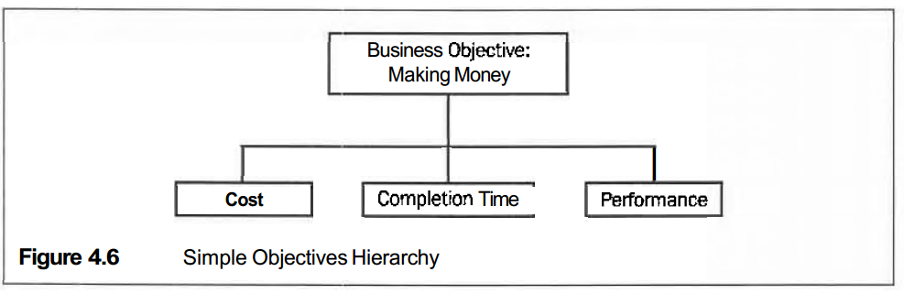

Slide 39
Three Pillars of Decision Analysis:
Let me restate and amplify something important in Chapter 1. Decision
analysis has three key characteristics:
1. Judgments as Probabilities. Usually we ask the most knowledgeable people available to express their expert judgments about risks and un-certainties as probability distributions.

Slide 40
2. Single Value Measure. The company or decision maker has a way of measuring outcome value as a single parameter. This is the "value Function" or "objective function" that we seek to optimize. For example, many for-profit companies use PV of net cash flow, PV, for this purpose. This value function may be composed of several criteria that represent measures for each of several objectives.

Slide 41
3. Expected Value. The EV calculation is the basis for calculating value under uncertainty. We condense the distribution of possible outcome values into a single measure-EV, the probability-weighted average-for valuing alternatives.

Slide 42
Recourse:
RISK and DECISION ANALYSIS in Projects
Second Edition
By: John Schuyler
Chapter 4

