Slide 1



Personal Selling
Prepared by Dr. Perihan Salah
MKT728
Lecture 9

Slide 2



Chapter
09
Learning Objectives
To understand the role of personal selling in the integrated marketing communications program
To know the advantages and disadvantages of personal selling as a promotional program element
To understand how personal selling is combined with other elements in an IMC program
To know methods used to determine the effectiveness of the personal selling effort

Slide 3
Chapter
Personal selling
09
Personal selling involves selling through a person-to-person communications process.
The emphasis placed on personal selling varies from firm to firm depending on a variety of factors, including the nature of the product or service being marketed, size of the organization, and type of industry.
Personal selling often plays the dominant role in industrial firms, while in other firms, such as makers of low-priced consumer nondurable goods, its role is minimized.

Slide 4


Chapter
09
Personal Selling
Selling through a person-to-person communications process
Affected by increased emphasis on customer relationship management

Slide 5
Chapter
09
Personal Selling
Importance varies for each firm depending on:
  Nature of the product or service being marketed
  Size of the organization
  Type of industry

Slide 6

Chapter
09
Dyadic Communication
Dyadic communication allows for specific tailoring of the message.
It is direct and interpersonal, letting the sender immediately receive and evaluate feedback from the receiver.
The message can be changed to address the receiver’s specific needs and wants.
In some situations, this ability to focus on specific problems is mandatory; a standard communication would not be enough.

Slide 7
Chapter
Factors that Determine the Role of Personal Selling
09
The factors that a manager needs to consider with regard to personal selling, when planning a promotional program.
To determine the role of personal selling, management should be guided by four questions:
What specific information must be exchanged between the firm and potential customers?
What are the alternative ways to carry out these communications objectives?
How effective is each alternative in carrying out the needed exchange?
How cost-effective is each alternative?

Slide 8
Factors that Determine the Role of Personal Selling
Chapter
09
Determining the information to be exchanged (msg must be said bet. 2 not other pillars)
Examining promotional-mix alternatives (cant use social media or adv)

Slide 9
Factors that Determine the Role of Personal Selling
Chapter
09
Evaluating the relative effectiveness of alternatives (will u buy villa from adv only? Lotsum needs personal selling & اعزمه و يشوف كل حاجة
Determining cost-effectiveness هل هاقنع الشخص اكتر لما اقابله عن التليفون

Slide 10


Characteristics of Stages of Personal Selling Evolution
Stages and description | Customer needs | Type of market | Nature and intensity of competition
Provider - Accepts orders and delivers to buyer | Assumed to exist Not a concern | Sellers’ | None
Persuader - Attempts to convince anyone to buy available offerings | Created Awakened | Buyers’ | Undifferentiated Slight intensity
Prospector - Seeks out prospects with need for available offering and resources to buy | Considered but inferred | Segmented | Differentiated Growing
Chapter
09
Increased due to competition

Slide 11
Characteristics of Stages of Personal Selling Evolution
Stages and description | Customer needs | Type of market | Nature and intensity of competition
Problem solver - Matches available offerings to solve customer-stated problems (Peugeot 205) | Diagnosed with attention to customer input | Participative | Responsive and counteractive with increasing resources
Procreator - Creates a unique offering to match the buyer’s needs as mutually specified, involving any or all aspects of the seller’s total marketing mix (tailoring & customizing for person himself) | Mutually defined Matched with tailored offering | Coactive (we both say our problems) | Focused Growing in breadth of market and service offerings
Chapter
09
Increased due to competition

Slide 12
Characteristics of Stages of Personal Selling Evolution
The different stages of personal-selling evolution:
Provider stage - Selling activities are limited to accepting orders for the supplier’s available offering and conveying it to the buyer.
Persuader stage - Selling involves an attempt to persuade market members to buy the supplier’s offerings.
Prospector stage - Activities include seeking out selected buyers who are perceived to have a need for the offering as well as the resources and authority to buy it.
Problem-solver stage - Selling involves obtaining the participation of buyers to identify their problems, which can be translated into needs, and then presenting a selection from the supplier’s offerings that corresponds with those needs and can solve those problems.
Procreator stage - Selling defines the buyer’s problems or needs and their solutions through active buyer–seller collaboration and then creates a market offering uniquely tailored to the customer.
The different stages require different promotional strategies, each integrated with personal selling to achieve the maximum communications effect.

Slide 13


Slide 14
New Role of Salespeople in IMC
Surveying
Mapmaking
Guiding
Fire starting
Chapter
09

Slide 15
New Role of Salespeople in IMC
The additional responsibilities that have been taken up by salespeople to increase their effectiveness. That is, in addition to being information providers, influencers through proximity, and demonstrators, salespeople engage in:
Surveying - Educating themselves more about their customers’ businesses and regularly assessing these businesses and their customers to achieve a position of knowledgeable authority.
Mapmaking - Outlining both an account strategy and a solutions strategy. This means laying out a plan, discussing it with a customer, and revising it as changes require.
Guiding - Bringing incremental value to the customer by identifying problems and opportunities, offering alternative options and solutions, and providing solution with tangible value.
Fire starting - Engaging customers and driving them to commit to a solution.
These additional responsibilities help create added value and develop a relationship between buyer and seller.

Slide 16
The Nature of Personal Selling
The new role of sales persons has become less focused on selling products and services and more focused on building a partnership with the customer.
Establishing a long-term, symbiotic (mutual) relationship with clients also requires working with marketing to use techniques like database marketing, message differentiation, and tracking of promotional effects in order to improve the relationship.
Chapter
09

Slide 17

Relationship Marketing
Organization’s effort to develop a long-term, cost-effective link with individual customers for mutual benefit
Customer relationship management (CRM): ) involves the business processes and supporting technologies that support the key activities of targeting, acquiring, retaining, understanding and collaborating with customers.
Ex. Real estate and cars and online
The most imp job in company 1 cust. is 7x less in cost than acquiring new 1 Vodafone target 0.5 bcoz market is saturated. Waiting for kids
Chapter
09

Slide 18
Costs of Personal Selling
The reasons for the high costs incurred in personal selling and on what basis they are evaluated.
Personal selling incurs high costs due to the following reasons:
Much attention is devoted to it due to its advantages over other communication methods.
It is an expensive form of communication.
In evaluating the costs of personal selling, one must consider the nature of the call, the objectives sought, and whether other program elements could deliver the message as effectively.
Personal selling is an expensive way to communicate, however, if the returns are greater than those from the other program elements, then the high costs are justified.
Chapter
09

Slide 19

Costs of Personal Selling
Incurs high costs (carte blanche in expenses)
  Gathers a lot of attention due to its advantages over other methods
  Expensive form of communication (Adv lacks instant feedback)
Evaluated by considering:
  Nature of the call (sales call)
  Objectives sought
  Delivery of the message by other program elements
  ايه الرسالة اللي هايقولوها للناس و ايه الاهداف اللي حققوها و لو كنت استخدمت طريقة تانية كانت هاتحققلي النتيجة ولا لأ
Chapter
09

Slide 20
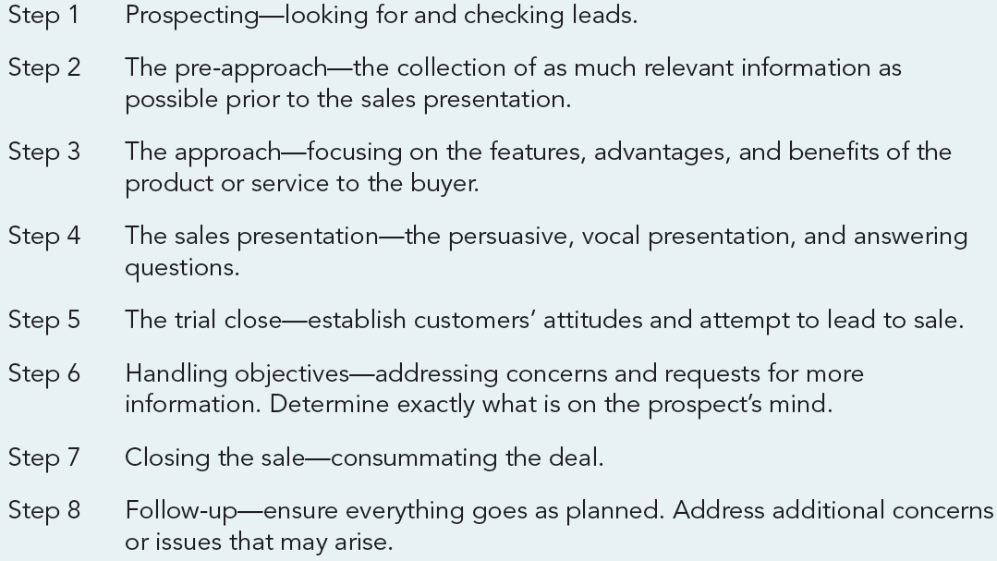
The Eight Step Personal-Selling Process

Slide 21
The Eight Step Personal-Selling Process
The steps involved in a personal-selling process.
Prospecting - Looking for and checking leads.
The pre-approach - The collection of as much relevant information as possible prior to the sales presentation.
The approach - Focusing on the features, advantages, and benefits of the product or service to the buyer.
The sales presentation - The persuasive, vocal presentation, and answering questions.
The trial close - Establish customers’ attitudes and attempt to lead to sale.
Handling objectives - Addressing concerns and requests for more information, and determining exactly what is on the prospect’s mind.
Closing the sale - Consummating the deal.
Follow-up - Ensure everything goes as planned. Address additional concerns or issues that may arise.

Slide 22


Types of Sales Positions Jobs (hierarchy of sales jobs)
1. Order taking:
Role is more casual and often involves straight rebuying by the customer, but can also involve modified rebuys.
Accomplished by:
  Inside order takers - Work inside the sales office and receive orders by phone, mail, or the Internet
  Field order takers - Travel to customers to get their orders

Slide 23
Types of Sales Jobs
2. Creative selling:
Requires skill and preparation, and the ability to assess the situation and determine the needs, present capability to satisfy those needs, and get an order.
Getting an order by:
  Assessing a situation and determining the needs
  Presenting capabilities to satisfy the needs

Slide 24


Types of Sales Jobs
The sales representative’s role
is one of supporting and
servicing the customer
rather can trying to get
new business.
3. Missionary sales: Introduce new products, promotions, and/or programs with the actual order to be taken. (offers new solutions)
  Perform a support role

Slide 25
Traits of a Salespeople
Compare the traits of effective salespeople against the traits that customers find most helpful or objectionable.
Successful salespeople
Most helpful to customers
Most objectionable to customers
  Knowledgeable
  Professional
  Thorough
  Results-oriented
  Problem solving
  Relationship-oriented
  Customer-focused
  Responsive
  Good communicators
  Reliable
  Knowledge
  Empathy
  Well organized
  Promptness
  Follow-through
  Solutions
  Punctuality
  Hard work
  Energetic
  Honesty
  Unprepared
  Uninformed
  Aggressive
  Undependability
  Poor follow-through
  Presumptuousness
  Calling without appointments
  Compulsive talkers
  Problem avoiders
  Lack of personal respect

Slide 26
Advantages and Disadvantages of Personal Selling
Advantages
Disadvantages
  Allows for two-way interaction
  Tailors the message
  Lack of distraction
  Involvement in the decision process
  Source of research information
  Inconsistent messages
  Sales force/management conflict
  High cost
  Poor reach
  Potential ethical problems

Slide 27
Ways to Use Advertising to Sell More
The various ways in which advertising can be used to sell more.
Save sales force time - Sending a reprint of an advertisement ahead of time familiarizes the potential client with the product or service. (already knows about product)
Save (avoid) lengthy explanations - Ads can explain much of what the product does and even what it doesn’t do, saving time as the salesperson only has to explain what is not already conveyed.
Visual aids - Ads can add impact to the presentation, reinforcing selling points.

Slide 28
Ways to Use Advertising to Sell More
The various ways in which advertising can be used to sell more.
Ego boosters - Telling prospects that an ad will appear in the media often makes the buyer feel she is important, and that she has inside information. Seeing the ad reinforces this.
Personal refreshers - Reviewing ad copy will often add insights to the salesperson, or remind him of key points that can be useful in a presentation.
Clues to prospects’ interests - Sometimes prospects call in reference to an ad. By reviewing the ad, the salesperson can gain insights into the benefits the potential customer may be most interested in.

Slide 29
Ways to Use Advertising to Sell More
The various ways in which advertising can be used to sell more.
Prove a point - The printed word adds credibility to salespersons’ verbal claims. One medium reinforces the other.
Nudge indecisive prospects - For indecisive prospects, a review of the ad campaign can often be the closer.
Create preference - Keeping customers and prospects aware of advertising creates favorable impressions of the company, the product or service, and the salesperson.

Slide 30
Ways to Use Advertising to Sell More
The various ways in which advertising can be used to sell more.
Provide follow-ups - Sending a reprint of an ad after the sales presentation serves as a good reminder, and can be used to focus attention on key benefits offered in the ad and in the presentation.
Fight lower-priced competitors - Ads can be used to show support and ward off low-priced competitors. The salesperson can explain how the ad will help support the customer’s own sales efforts and help them not have to get into price wars.
Getting the customer into the act - Asking the customer about the ads and getting his inputs helps cement relationships and provides valuable feedback to one’s own organization.

Slide 31
Combining Personal Selling with Other Promotional Tools
Combining personal selling and public relations:
  Personal-selling agents represent a firm and its products and can be used directly in a PR role.
  Result in goodwill toward the company and its products while at the same time benefiting society.

Slide 32
Combining Personal Selling with Other Promotional Tools
Combining personal selling and direct marketing: (best fit)
  Costs incurred can be reduced by combining telemarketing and sales efforts.
  The net result is a higher percentage of sales closings, less wasted time by the sales force, and a lower average cost per sale.

Slide 33
Combining Personal Selling with Other Promotional Tools
Combining Personal Selling and Advertising
Advantages
  Improve reach
  Reduce costs
  Increase the probability of a sale (assuming the advertising is effective)

Slide 34
Combining Personal Selling with Other Promotional Tools
Combining Personal Selling and Advertising
Disadvantages
  Many salespeople do not understand the role that advertising plays and its contribution to their sales efforts. Many view it with skepticism. (suspicion)
  Less time wasted
  Lower average cost per sale

Slide 35
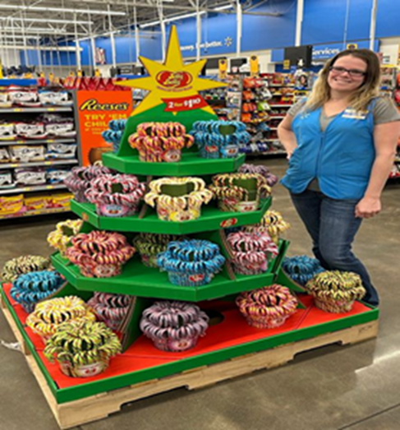
Combining Personal Selling with Other Promotional Tools
Combining personal selling and sales promotion:
  Designed to assist salespeople. Flip charts, leave-behinds, and specialty ads may be designed to assist salespeople in their presentations, serve as reminders, or just create goodwill.
  Targeted at sales force. Many sales promotions are targeted at the sales force itself. Incentives such as free trips, cash bonuses, or gifts are often used to stimulate sales efforts.

Slide 36
Combining Personal Selling with Other Promotional Tools
Combining personal selling with the Internet:
  Allows salespeople to focus on selling products and developing relationships.
  Takes care of the mundane(routine) tasks and allows the sales force to be more effective in closing orders, prospecting, problem solving, and cross selling and focusing more attention on high-value and/or new customers.
  Online meetings save time and money. Conducting online meetings in which the sales force and/or clients saves both time and money.

Slide 37
Criteria Used to Evaluate Sales Forces
Quantitative and qualitative measures are evaluated in accordance with the sales results and the sales efforts.
Measures | Sales results | Sales efforts
Quantitative measures | Orders Sales volume Margins Customer accounts | Sales calls Selling expenses Customer service
Qualitative measures | Selling skills | Sales-related activities

Slide 38
Chapter
09
To Sum Up…
Understood the role of personal selling in the integrated marketing communications program
Knew the advantages and disadvantages of personal selling as a promotional program element
Understood how personal selling is combined with other elements in an IMC program
Knew methods used to determine the effectiveness of the personal selling effort

Slide 39


Thank You
Dr. Perihan Salah

