Slide 1

Introduction to economics
Chapter 1
Everyone’s Smart
University
The challenge of economics

Slide 2

The challenge of economics
Learning Outcomes
Economics and Opportunity Cost
Factors of Production
Scarcity
Three Basic Questions
Mixed Economies
Mixed Economies
Politics versus Economics

Slide 3

Economics and Opportunity Cost
Economics:
is a social science concerned with the production, distribution, and consumption of goods and services. It studies how individuals, businesses, governments, and nations make choices about how to allocate resources
Opportunity Cost:
  The most desired goods and services that are foregone in order to obtain something else.
  The highest valued alternative that is sacrificed for the chosen alternative.

Slide 4
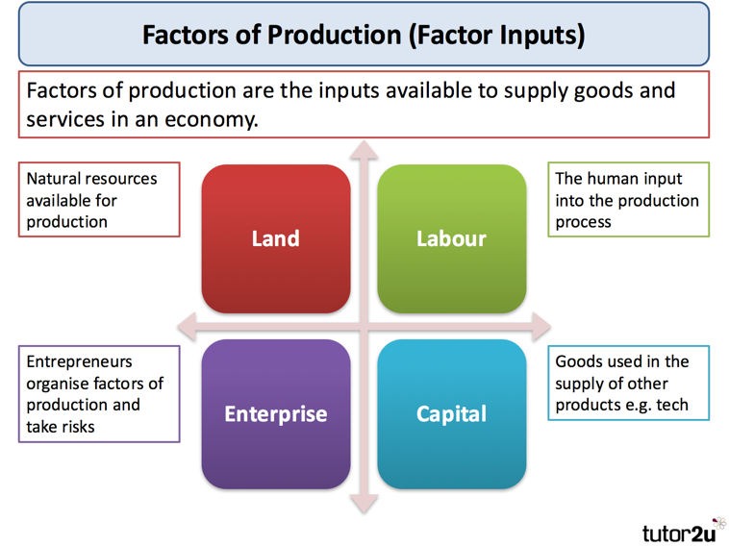
Factors of Production
Resource inputs used to produce goods and services.
The four resources:
Land, labor, capital, and entrepreneurship

Slide 5

Scarcity
Lack of available resources to satisfy all desired uses of those resources.
Central problem of economics

Slide 6
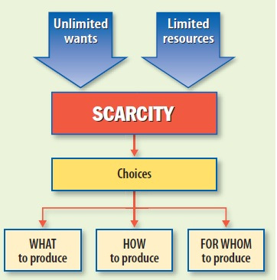
Three Basic Questions
WHAT to produce
HOW to produce
FOR WHOM to produce

Slide 7
Question 1:
WHAT to Produce?
-There aren’t enough resources in an economy to produce all the goods and services desired by society.
-We have to decide what we want most.
- We have to sacrifice less-desired activities and goods.

Slide 8
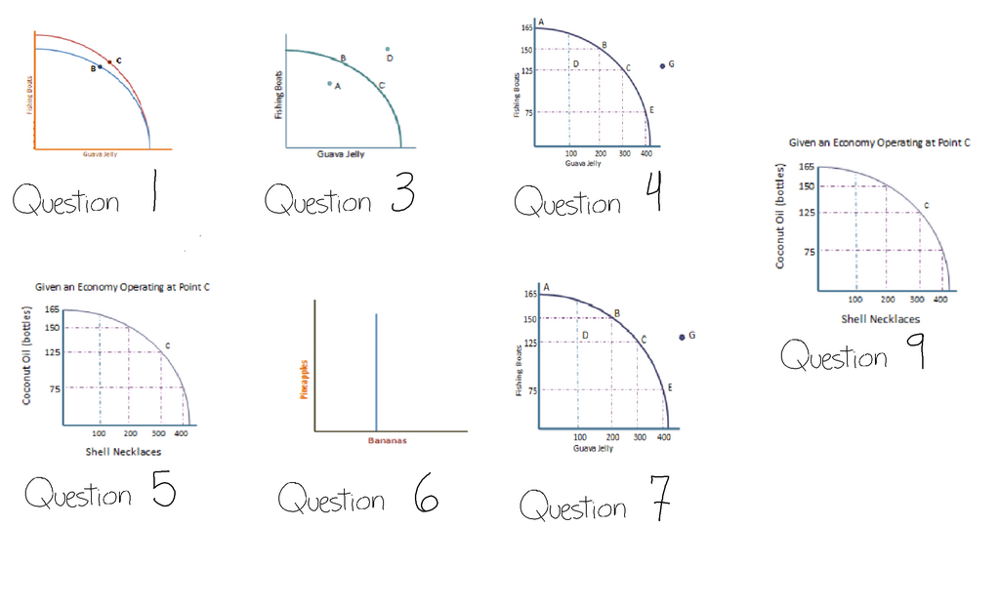
Production Possibilities Curve
Depicts the alternative combinations of good and services than can be produced given the quality and quantity of the factors of production, including:
  Land – including natural resources
  Labor – number and skills of workers
  Capital – machinery, buildings, networks
  Entrepreneurship – skill in creating products, services, and processes

Slide 9
The Choices Nations Make
A nation must choose what to do with its scarce resources during war or periods of military buildup.
Produce military goods (“guns”) or consumer goods (“butter”)?
Every time we increase missile production, house construction must be reduced.

Slide 10
The Best Possible Mix
There is only one best possible (optimal) mix of output at any given time.
The first economic goal of any society is to produce that optimal mix of output—the optimal combination of goods and services.

Slide 11

Investment and Economic Growth
Investment:
  Expenditures on (production of) new plant and equipment (capital) in a given time period, plus changes in inventories.
Economic growth:
  An increase in output (real GDP).
  An expansion of production possibilities outward.

Slide 12
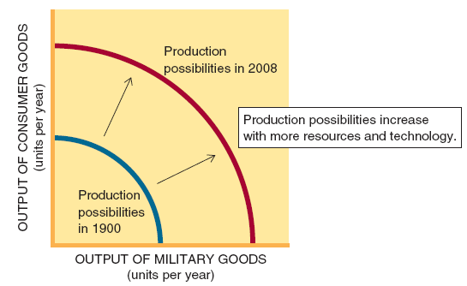

Slide 13
Question #2:
HOW to Produce?
The second economic goal for every society is to find an optimal method of producing goods and services.

Slide 14
Question #3:
FOR WHOM to Produce
The “FOR WHOM” question focuses on how an economy’s output is distributed across members of society.

Slide 15
FOR WHOM to Produce
The economic pie can be divided in several ways:
  Distribution based on productive contributions.
  Distribution based on need.
  Some combination of productive contributions and need.

Slide 16

Incentives
Distribution based on need rather than work effort may result in less work effort.
There is less output to distribute.
The size of the pie may get smaller

Slide 17

Choice & the Political Process
There are conflicts and tradeoffs with every choice.
Many basic economic decisions are made through the political process

Slide 18
The Market Mechanism
The use of market prices and sales to signal desired outputs (or resource allocations).
Market sales and prices send a signal to producers about what mix of output consumers want.

Slide 19
The Market Mechanism
Laissez faire is the doctrine of “leave it alone,” or nonintervention by government in the market mechanism.
Adam Smith’s The Wealth of Nations (1776) promoted laissez faire

Slide 20
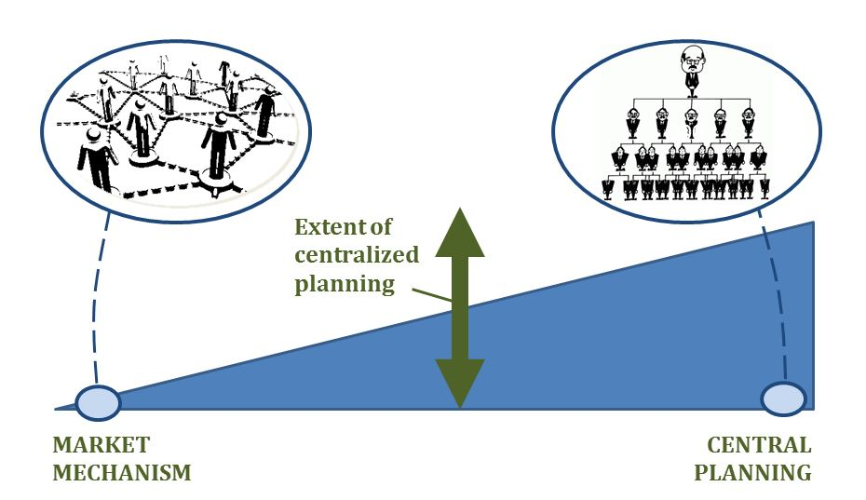
Central Planning
The government decides what goods are produced, at what prices they are sold, and who gets them.
This mechanism of choice is associated with Karl Marx.

Slide 21
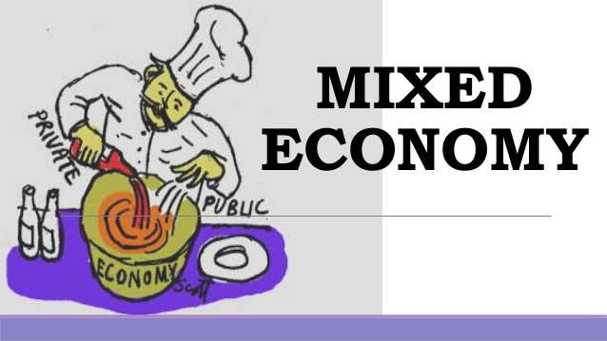
Mixed Economies
Economies that use both market and non-market signals to allocate goods and resources.
This represents a combination of the other two systems.
Most nations today are mixed economies.

Slide 22
Undesirable Choices & Failure
Markets don’t always produce the “right” mix of output.
Market Failure:
  An imperfection in the market mechanism that prevents optimal outcomes.

Slide 23
The Wrong Mix of Output
The market might produce too much of some products and too little of other products.
The market might fail to make full use of the economy’s production possibilities (the Great Depression of the 1930s and the Great Recession of 2008-09).

Slide 24
Externalities
Costs (or benefits) of a market activity borne by a third party.
The difference between the social and private costs (or benefits) of a market activity.

Slide 25
Too Much Poverty
Markets might fail to distribute goods and services in the best possible way.
Taxes and income transfers may be used to reslice the economic pie.
The Great Recession of 2008-09 saw an increase in poverty through parts of the world, including the United States.

Slide 26
Government Failure
Government intervention that fails to improve economic outcomes.
Government will not necessarily offer better answers to the WHAT, HOW, and FOR WHOM questions.

Slide 27
Government Failure
Government intervention might worsen the mix of output.
It might even reduce the total amount of output through over-regulation.
There is no guarantee that the visible hand of government will be any cleaner than the invisible hand of the marketplace.

Slide 28
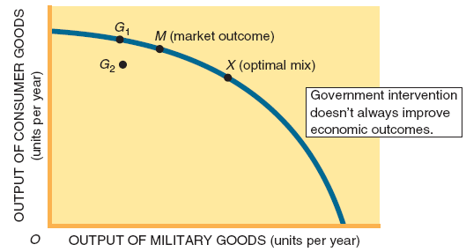
Figure 2

Slide 29
What Economics Is All About
A combination of market signals and government interventions forge better answers to the WHAT, HOW, and FOR WHOM questions.
The first goal of economic theory is to help society find better answers to the three basic questions.

Slide 30
What Economics Is All About
The second goal of economic theory is to predict how changes in government policy or market institutions will affect economic outcomes.

Slide 31
Macro versus Micro
Macroeconomics is the study of aggregate economic behavior, of the economy as a whole.
Microeconomics is the study of individual behavior in the economy, of the components or pieces of the larger economy.

Slide 32
Theory versus Reality
Reality is too complex to describe and explain in one course.
Economists focus on basic relationships and use these to predict economic events and formulate economic policies.

Slide 33
Ceteris Paribus
The assumption that nothing else is changing.
It is an important part of “thinking like an economist”.

Slide 34
Politics versus Economics
Economic theory can make significant contributions to policy formulation.
All policy decisions are ultimately a mix of politics and economic theory.
President Obama has made it clear that he believes more government intervention and less market reliance is need to attain the right what, how, and for whom answers.

Slide 35
End of chapter 1

