Slide 1


Project Business
Analysis
Prepared by Eng. Ahmed Hussein, MBA, PfMP©, PMP©, CMP APMG
PMG 461
Bachelor of Project Management
Lecture 4

Slide 2




Understanding Business Systems
Lecture 4
PMG 461
Project Business Analysis
Prepared by
Eng. Ahmed Hussein, MBA, PfMP©, PMP©, CMP APMG
www.midocean.ae

Slide 3

Lecture
What we will cover
04
Tools for documenting current business situation
Soft systems methodology (SSD) and Business Activity Modeling (BAM)
www.midocean.ae

Slide 4
Introduction
Business analysts aim to improve problematic business situations/systems.
Business Analysts elicit requirements from stakeholders using various qualitative and quantitative techniques
After eliciting requirements, Business analysts need to understand existing situations and stakeholders’ perspectives.
www.midocean.ae

Slide 5

Lecture
Tools for Documenting Current Business Situation
04
www.midocean.ae

Slide 6
Business Needs Log
Documents high-level business requirements and findings for a known problem.
Further detailed analysis of requirements will be needed.
It might include:
  Key business aims
  High-level requirements
  Issues to be addressed
Business Need | Source | Comment
The application must work on web, iPhone and android | Business development manager | Customers may need to access the application from different devices
Discounts can be given for orders above 5,000 | Sales Manager | Only valid for orders for retail customers, corporate customers are different
www.midocean.ae

Slide 7
Rich Pictures
Provides a visual overview of the entire business situation.
Rich pictures encompass all aspects of a business system while Modeling (e.g., data or process modeling) focuses on specific aspects.
No fixed notation; allows the use of relevant and useful symbols or annotations.
Key Features:
  Problems may stem from people rather than process or IT.
  Captures cultural aspects, human dynamics, process flows, and information usage.
  Traditional models may overlook human and cultural factors.
  Addresses differing viewpoints, misunderstandings, stress, interpersonal issues, dissatisfaction, and resource challenges.
www.midocean.ae

Slide 8
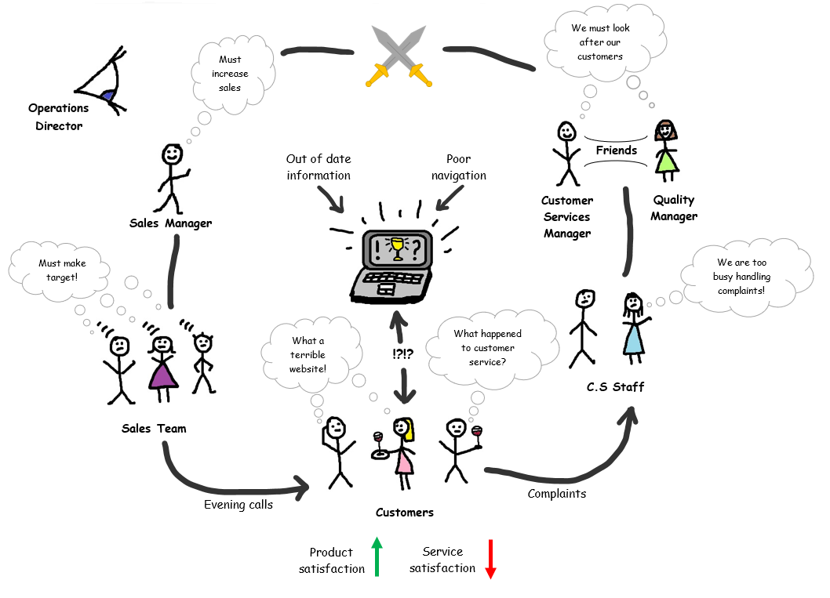
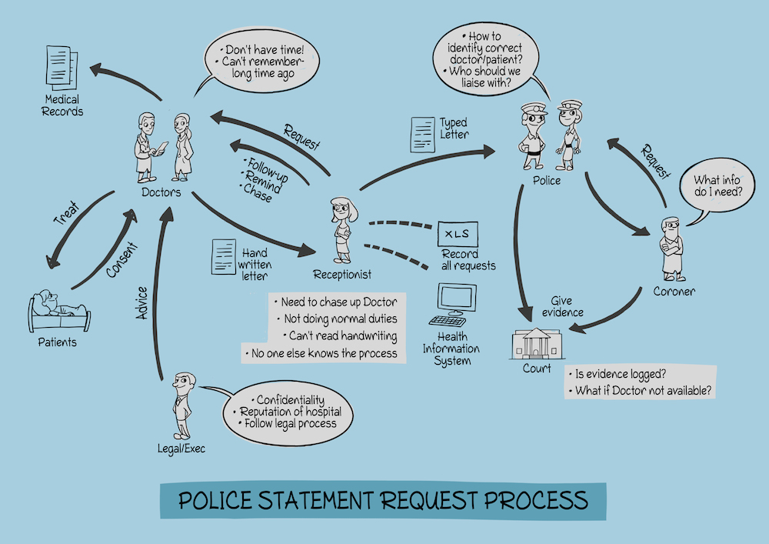
Rich Pictures
www.midocean.ae

Slide 9
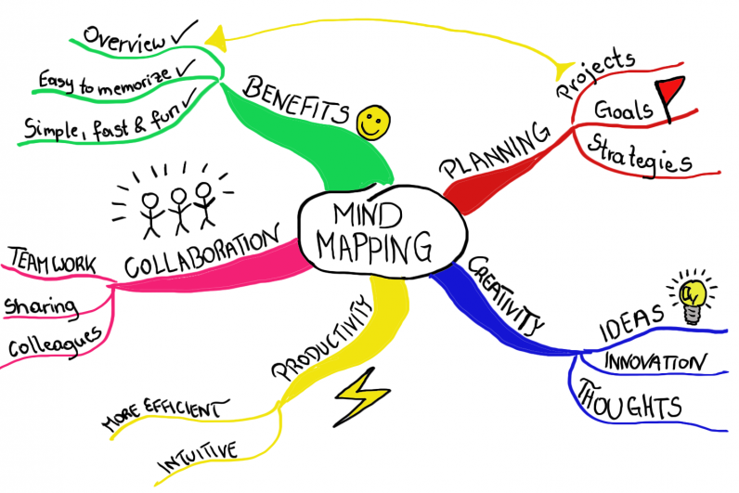
Mindmaps
Tool for summarizing extensive information visually in a structured and organized manner that highlights connections between different ideas and topics.
Works well independently and in conjunction with rich pictures.
Helps analysts organizing their thinking.
Construction Method:
  Business system or problem at the center of the diagram.
  Main elements represented as the first-level branches.
  Each branch labeled briefly to indicate specific areas or issues.
www.midocean.ae

Slide 10
Fishbone Analysis
(or cause-and-effect diagram)
A problem analysis technique used to identify the root-cause of problems.
Name of the problem is put at the head of the fish.
Spines suggest possible areas for causes of the problem as:
  The 4Ms: Manpower, Machines, materials, and methods
  Six Ps: People, place, process, product, performance measure, and physical evidence
Usually done in workshops
Some data gathering might be needed to confirm the root-cause
www.midocean.ae

Slide 11
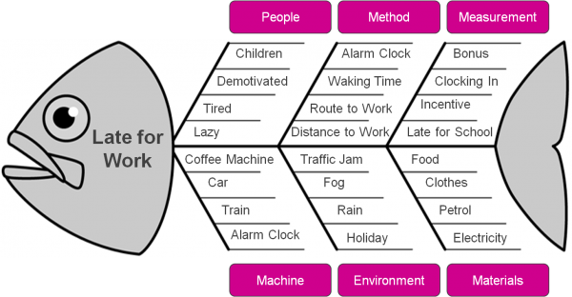
Fishbone Analysis Example
Employees Late for Work
www.midocean.ae

Slide 12
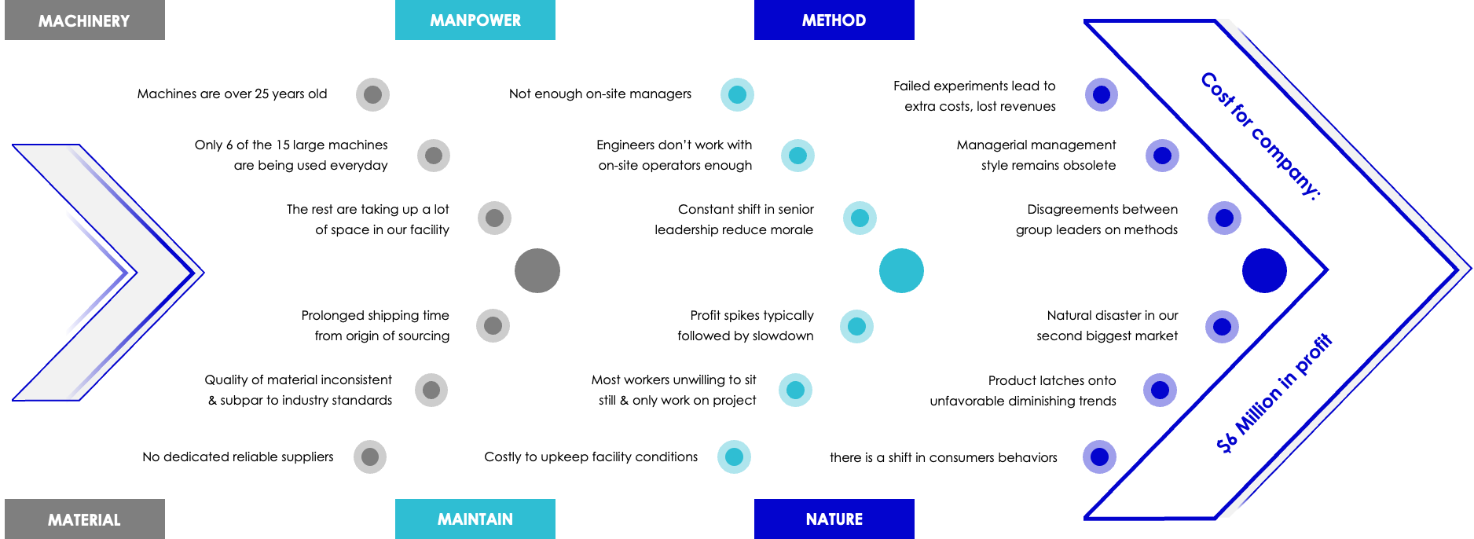
Fishbone Analysis Example:
Increasing cost of operations in a company
www.midocean.ae

Slide 13
Soft Systems Methodology (SSD) and Business Activity Models (BAM)
Lecture
04
www.midocean.ae

Slide 14
The four views of a Business System
Business System A set of business components working together in order to achieve a defined purpose. The components of a system include people, IT systems, processes and equipment.
Organization
Technology
People
Processes
www.midocean.ae

Slide 15
Business Perspectives
Importance of examining stakeholders' views in detail.
Different views, needs, and priorities must be understood before defining a new business system or improving the current one.
Business analysts consider the broader organizational context and reasons for its operations.
Business analysis aligns with organizational core values and beliefs expressed in Mission, objectives, strategy, and tactics (MOST)
www.midocean.ae

Slide 16


Example: Pen Manufacturer
Business analysts consider the broader organizational context and align solutions to organizational core values expressed through the MOST model (Mission, Objectives, Strategy, Tactics).
Manufacturer 1
Manufacturer 2
Bulk sales of low cost, moderate Quality pens to commercial customers
Luxury pens for design-conscious buyers.
Emphasis on efficient production
Emphasis on design, branding. and marketing
www.midocean.ae

Slide 17
Soft Systems Methodology (SSM)
Developed by Peter Checkland to address complex, ambiguous business situations.
Explores the 'why’ and ‘what’ of organizational situations.
SSM views business situations as systems and emphasizes a 'soft' approach in contrast with hard systems thinking.
Root Definitions (business perspectives) help identify different stakeholder views.
Speculation about different world views to create conceptual systems.
Opportunities for improvement identified by comparing possible systems with the existing situation.
Consensus models are developed through overlap analysis, leading to a desired future system.
www.midocean.ae

Slide 18
Emergent Properties
Systems with all components working together have emergent properties.
Business analysts must be aware of emergent properties in recommended business changes.
Example: A car's ability to travel is an emergent property requiring various components to work together.
www.midocean.ae

Slide 19
CATWOE Framework
Framework helps define and analyze business perspectives.
Identifying beliefs through (World view).
C = Customer:
A = Actor:
Individuals responsible for executing business activities within the defined scope.
Represents job roles within the organization or external entities like business partners.
T = Transformation:
The central activity within the system.
Involves core business processes transforming inputs into valuable outputs for the customer.
W = World View:
Represents an individual's beliefs about the organization's purpose and actions.
Defines the perspective on why the organization exists and its intended activities.
O = Owner:
The person or group with the authority to make significant decisions about the business system.
Capable of altering the system's direction or even causing its cessation.
E = Environment:
The external conditions and rules governing the system.
Factors beyond the owner's control, considered as given; includes PESTLE analysis insights and fixed internal business policies
The primary beneficiary of the transformation process.
The recipient of the system's end product or service
www.midocean.ae

Slide 20
Root Definition (CATWOE Example)
Root definition (business perspective) is developed as a sentence that ties the CATWOE elements together.
The branch is a system controlled by the bank chief executive (O), where bank tellers, back office staff and branch management (A) provide branch customers (C) who require personal service with bank counter services such as cash deposit and withdrawal, answering account enquiries and setting up standing orders, in order to satisfy their banking needs (T) within constraints imposed by government policies on banking regulation, the global banking crisis, increasing use of online services, increasing electronic funds transfer and increased regulation by financial regulators (E).
www.midocean.ae

Slide 21
Business Activity Models (BAM)
A Business Activity Model (BAM) is a conceptual model that depicts the expected business activities necessary for a successful transformation based on a specific business perspective. It is distinct from models of organizational business processes. The BAM is developed by considering the business perspective and requires analytical ability and creative thought.
Facilitate understanding of organizational goals and generate discussions about changes.
Useful in resolving differences and aligning stakeholders.
A BAM is not a model of organizational business processes but a conceptual model.
It shows expected business activities needed for successful transformation.
Developed based on a specific business perspective.
www.midocean.ae

Slide 22
Activity Types
Planning Activities:
Define resource requirements and performance metrics
Enabling Activities
Obtain and deploy resources and facilities
Doing
Activities
Directly related to achieving the transformation
Monitoring Activities
Collect metrics to check performance against targets
Control Activities
Act based on monitoring results to improve performance.
Customer
Service
Example
Define Recruitment and training needs
Recruiting and training
Serving Customers
Follow up on customer service results
Corrective actions for ex. Hire more people
www.midocean.ae

Slide 23
Dependencies and Modelling Notation
No universally agreed notation for creating BAMs.
Soft systems specialists may use 'cloud' symbols or ellipses.
Business activities labeled with an identifier and imperative verb-noun title.
Dependencies between activities represented by arrows.
P1
Do Something
www.midocean.ae

Slide 24
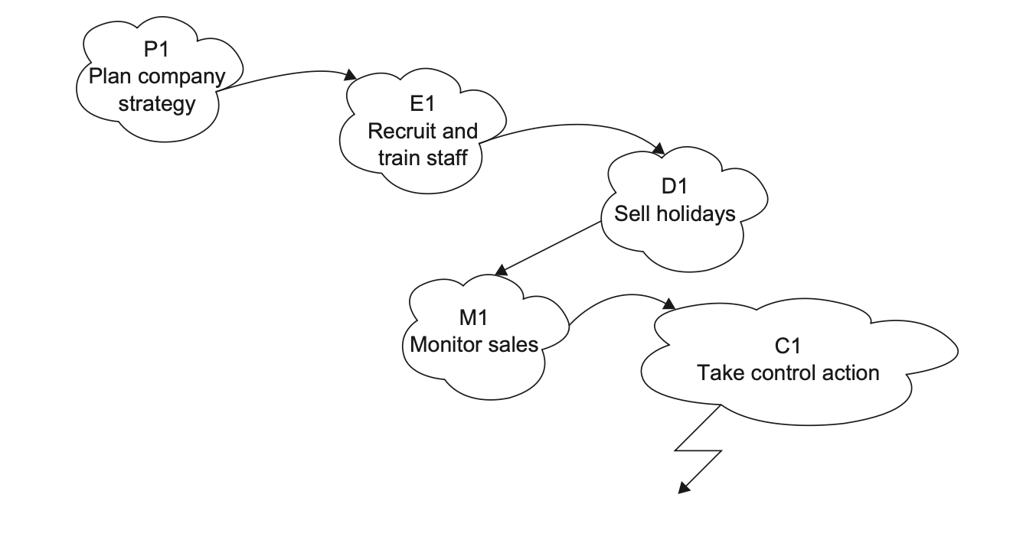
BAM Example
Source: “Business Analysis” by James Cadle, Malcolm Eva, Keith Hindle, Debra Paul, 2nd edition

Slide 25

Principles of Developing a BAM
One BAM for EACH business perspective.
Subsequent consensus model by overlaying individual BAMs.
A tool for business analysis and improvement identification.
Not concerned with who performs activities or where they occur.
BAM
Stakeholder 1 perspective
BAM
Stakeholder 2 perspective
Consensus Model
BAM
Stakeholder 3 perspective
www.midocean.ae

Slide 26
Developing a BAM
Identify main doing activities based on the business perspective.
Look for enabling and planning activities.
Add monitoring and control activities.
Consider environmental constraints.
Add dependency arrows between activities.
www.midocean.ae

Slide 27
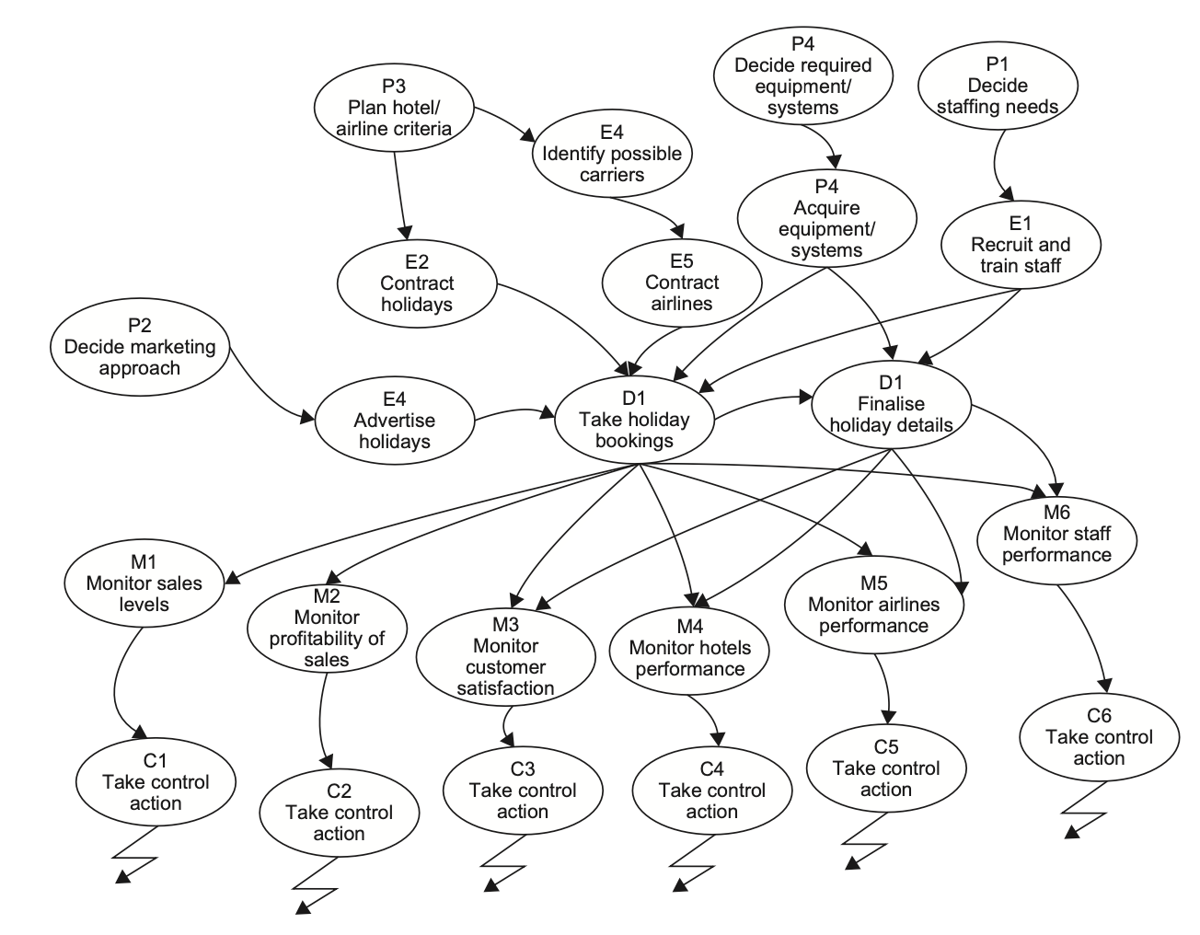
BAM Example
www.midocean.ae

Slide 28
Consensus Model Development
Derived from individual stakeholder BAMs.
Resolving conflicts between individual BAMs to create a consensus model.
Done in a Workshop environment facilitating discussion, agreement, and development of a unified BAM.
Three ways to reach consensus:
Global
Uses neutral model (for ex. Best practice, benchmark,..)
100%
All participants agree on a model
Accommodation
Compromise between participants
www.midocean.ae

Slide 29
Business Events
Business events trigger activities in response.
Three types of business events:
External
Internal decision points
Scheduled events
Example
Customer makes a request
Management take a decision based on results
End of day or end of month process
www.midocean.ae

Slide 30

Business Rules
Business rules: are the rules governing performing the activity.
Include:
  Constraints: restrict how and activity is performed (ex. Laws/regulations)
  Operational guidance: dictate how activities should be performed (ex. How to calculate discount, or how to move stock items)
Business rules should be documented to support BAM
www.midocean.ae

Slide 31

Critical Success Factors (CSFs) and
Key Performance Indicators (KPIs)
CSFs:
  Highlight essential areas for success and are the things that the organization must excel in.
  They provide insights into planning, enabling, and doing activities needed.
  For ex.: Excellent Customer Service, or maintaining low cost of production
KPIs:
  Highlight the things an organization measures to find out how well it is doing.
  Identified in planning activities and checked in monitoring activities.
www.midocean.ae

Slide 32
Validating a Business Activity Model
Checklist for completeness and internal consistency.
Ensures:
Objectives and purpose must be explicit.
Connectivity of activities.
Measures of performance and monitoring/control mechanisms.
Decision-making procedures, boundary definition, and resource management.
Systems hierarchy and scope of control activities.
www.midocean.ae

Slide 33
Use of BAM
BAM used in Gap-Analysis to identify high-level business problems and issues.
Compares theoretical model with current organizational reality.
Highlights areas of satisfaction, opportunities for improvement, and identifies missing activities.
www.midocean.ae

Slide 34
Lecture
Key Points
04
Visual Tools Enhance Understanding: Rich pictures, fishbone diagrams, and mind maps provide visual representations that aid in comprehending complex business situations, fostering holistic insights.
Structured Documentation Matters: Business needs logs systematically capture and prioritize requirements, ensuring clear communication, traceability, and effective change management.
Perspective Diversity is Key: CATWOE framework and business activity models emphasize considering diverse stakeholder perspectives, providing a comprehensive view that aids in decision-making and root cause analysis.
Flexibility in Modeling: Techniques like rich pictures and mind maps offer unstructured, flexible approaches, allowing analysts to 'brain dump' information and adapt models as more insights emerge.
Gap Analysis Guides Improvement: Business activity models serve as powerful tools for gap analysis, highlighting discrepancies between theoretical models and actual organizational situations, uncovering areas for business improvement.
www.midocean.ae

Slide 35

For Discussion Panel and Next Lecture:
Reading, Chapters 6 and 8 from textbook
“Business Analysis” by James Cadle, Malcolm Eva, Keith Hindle, Debra Paul, 2nd edition
Lecture
04
For Discussion Panel and Next Lecture
www.midocean.ae

Slide 36



Thank You

