Slide 1


Supply Chain Management
Prepared by Dr. Tarek Mohamed
MGM 660
Lecture 7

Slide 2


Coordination in a Supply Chain
Lecture 7
MGM 660
Prepared by
Dr. Tarek Mohamed

Slide 3

Course Agenda
Chapter
01
Describe supply chain coordination and the bullwhip effect, and their impact on supply chain performance.
Identify obstacles to coordination in a supply chain.
Discuss managerial levers that help achieve coordination in a supply chain.
Understand the different forms of collaborative planning, forecasting, and replenishment that are possible in a supply chain.
Benefits of AI for supply chain coordination.

Slide 4
Lack of Supply Chain Coordination and the Bullwhip Effect
Supply chain coordination – all stages of the chain take actions that are aligned and increase total supply chain surplus
Requires that each stage share information and take into account the effects of its actions on the other stages
Lack of coordination results when:
  Objectives of different stages conflict
  Information moving between stages is delayed or distorted

Slide 5
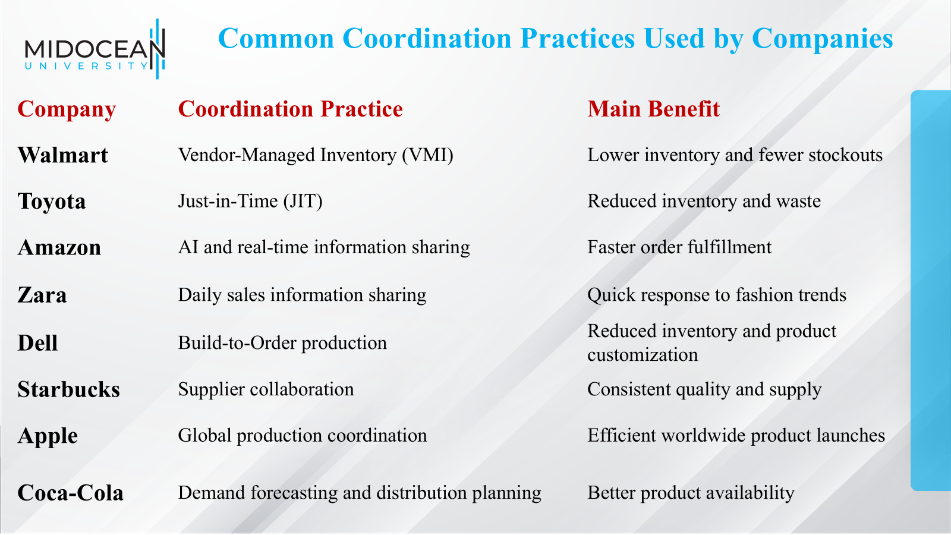

Slide 6
Real-world examples of coordination in a supply chain across different companies and industries
Walmart
Coordination Strategy: Vendor-Managed Inventory (VMI)
Walmart shares real-time sales and inventory data with suppliers.
Suppliers monitor inventory levels and replenish products automatically.
This coordination reduces stockouts, lowers inventory costs, and improves product availability.
Example: Procter & Gamble receives Walmart's sales data and schedules production and deliveries accordingly.
Toyota
Coordination Strategy: Just-in-Time (JIT) Production
Toyota coordinates closely with suppliers to deliver parts exactly when needed.
Suppliers, manufacturers, and logistics providers work together using synchronized production schedules.
This minimizes inventory while maintaining smooth production.

Slide 7
Real-world examples of coordination in a supply chain across different companies and industries
Amazon
Coordination Strategy: AI and Real-Time Data Sharing
Amazon coordinates warehouses, suppliers, transportation providers, and delivery stations using AI.
Customer orders automatically trigger inventory updates, warehouse picking, and delivery planning.
This enables fast and reliable order fulfillment.
Zara
Coordination Strategy: Fast Fashion Supply Chain
Zara shares customer sales data with designers and manufacturers every day.
Production schedules are adjusted quickly based on demand.
Stores receive new products within days instead of months.
This close coordination allows Zara to respond rapidly to changing fashion trends.

Slide 8
Real-world examples of coordination in a supply chain across different companies and industries
Dell Technologies
Coordination Strategy: Build-to-Order Manufacturing
Customers place customized orders online.
Dell immediately coordinates with component suppliers to obtain the required parts.
Manufacturing begins only after the order is confirmed.
Logistics partners coordinate deliveries directly to customers.
Starbucks
Coordination Strategy: Supplier Collaboration
Starbucks coordinates with coffee farmers, exporters, processors, and distribution centers.
Demand forecasts are shared throughout the supply chain.
This helps maintain consistent quality and product availability worldwide.

Slide 9
Bullwhip Effect
The Bullwhip Effect is a supply chain phenomenon in which small changes in customer demand at the retail level cause increasingly larger fluctuations in demand and inventory as you move upstream
(From retailer → wholesaler → distributor → manufacturer → supplier).
The Bullwhip Effect is the amplification of demand variability as orders move up the supply chain from customers to suppliers, leading to excessive inventory, stockouts, and increased costs.
The bullwhip effect moves a supply chain away from the efficient frontier by increasing cost and decreasing responsiveness.
Fluctuations in orders increase as they move up the supply chain from retailers to wholesalers to manufacturers to suppliers
Distorts demand information within the supply chain
Results from a loss of supply chain coordination

Slide 10
Bullwhip Effect
Example
Imagine customers buy 100 bottles of water this week instead of the usual 90.
Retailer orders 120 bottles to avoid running out.
Wholesaler interprets this as higher demand and orders 150 bottles.
Manufacturer expects demand to continue rising and produces 200 bottles.
Supplier purchases even more raw materials.
Although customer demand increased by only 10 bottles, the production and ordering increased much more, creating excess inventory and higher costs.
Panic buying or shortage gaming.

Slide 11
Bullwhip Effect
Causes of the Bullwhip Effect
Lack of communication and information sharing.
Demand forecasting errors.
Bulk ordering (order batching).
Price fluctuations and promotions.
Panic buying or shortage gaming.
Effects
Excess inventory.
Stock shortages.
Increased warehousing costs.
Higher transportation costs.
Poor customer service and reduced profitability.

Slide 12
Bullwhip Effect
Ways to Reduce the Bullwhip Effect
Share real-time demand information across the supply chain.
Improve demand forecasting.
Reduce order batching by ordering more frequently.
Stabilize prices and avoid excessive promotions.
Strengthen collaboration among supply chain partners.

Slide 13
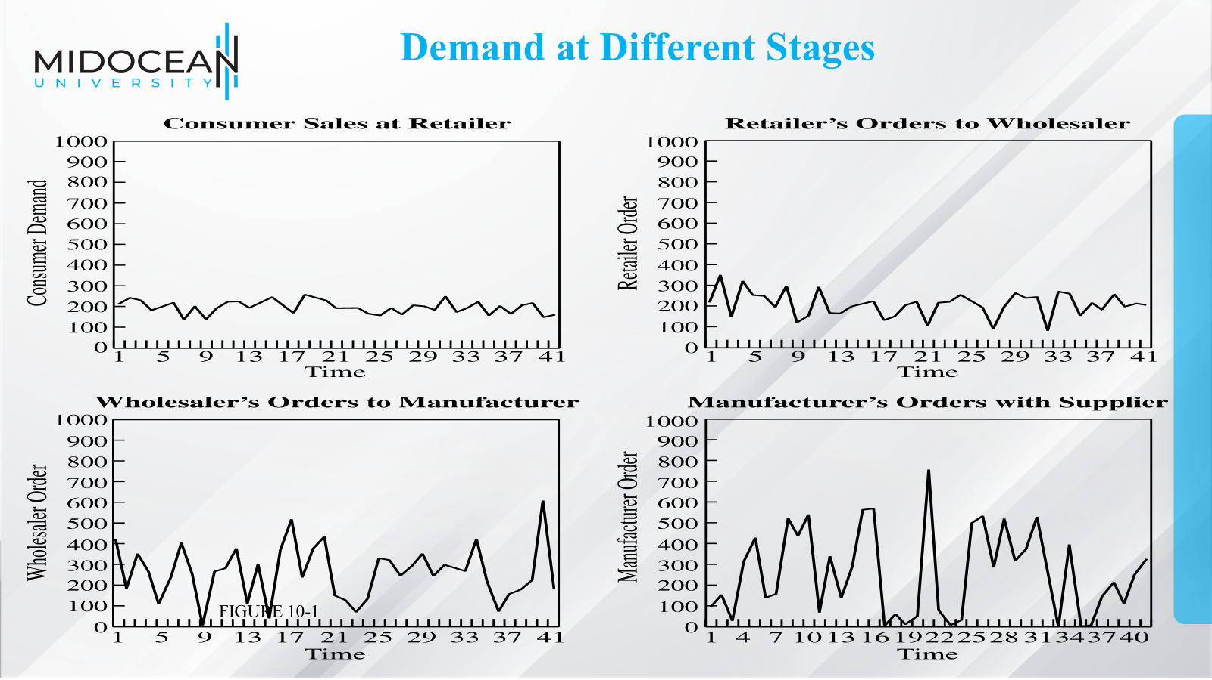

Slide 14
The Effect on Performance
Lack of coordination increases variability and hurts supply chain surplus
Impact on costs
  Manufacturing cost
  Inventory cost
  Replenishment lead time
  Transportation cost
  Labor cost for shipping and receiving
  Level of product availability
  Relationships across the supply chain

Slide 15
The Effect on Performance
Performance Measure | Impact of the Lack of Coordination
Manufacturing cost | Increases
Inventory cost | Increases
Replenishment lead time | Increases
Transportation cost | Increases
Shipping and receiving cost | Increases
Level of product availability | Decreases
Profitability | Decreases

Slide 16
Key Point
The lack of coordination hurts both responsiveness and cost in a supply chain by making it more expensive to provide a given level of product availability.

Slide 17
Obstacles to Coordination in a Supply Chain
Incentive Obstacles
Information Processing Obstacles
Operational Obstacles
Pricing Obstacles
Behavioral Obstacles

Slide 18
Incentive Obstacles
An incentive obstacle occurs when each member of the supply chain (supplier, manufacturer, distributor, retailer, or salesperson) is rewarded based on its own performance rather than the performance of the entire supply chain.
Occur when incentives offered to different stages or participants in a supply chain lead to actions that increase variability and reduce total supply chain profits
  Local optimization within functions or stages of a supply chain
  Sales force incentives
As a result, each participant makes decisions that maximize its own benefit, even if those decisions harm the overall supply chain.
  Local optimization within functions or stages of a supply chain
  Sales force incentives

Slide 19
Information Processing Obstacles
When demand information is distorted as it moves between different stages of the supply chain, leading to increased variability in orders within the supply chain
  Forecasting based on orders and not customer demand
  Lack of information sharing

Slide 20
Operational Obstacles
Occur when placing and filling orders lead to an increase in variability
  Ordering in large lots
  Large replenishment lead times
  Rationing and shortage gaming

Slide 21
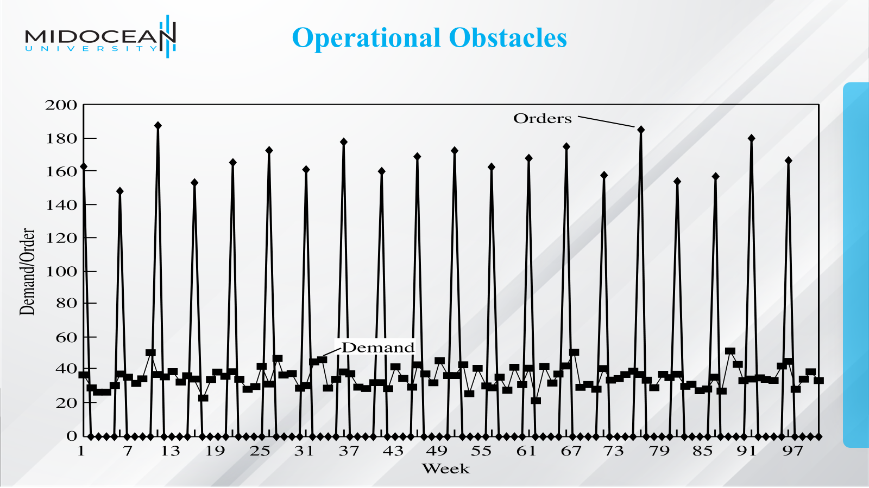

Slide 22
Pricing Obstacles
When pricing policies for a product lead to an increase in variability of orders placed
  Lot-size based quantity decisions
  Price fluctuations

Slide 23
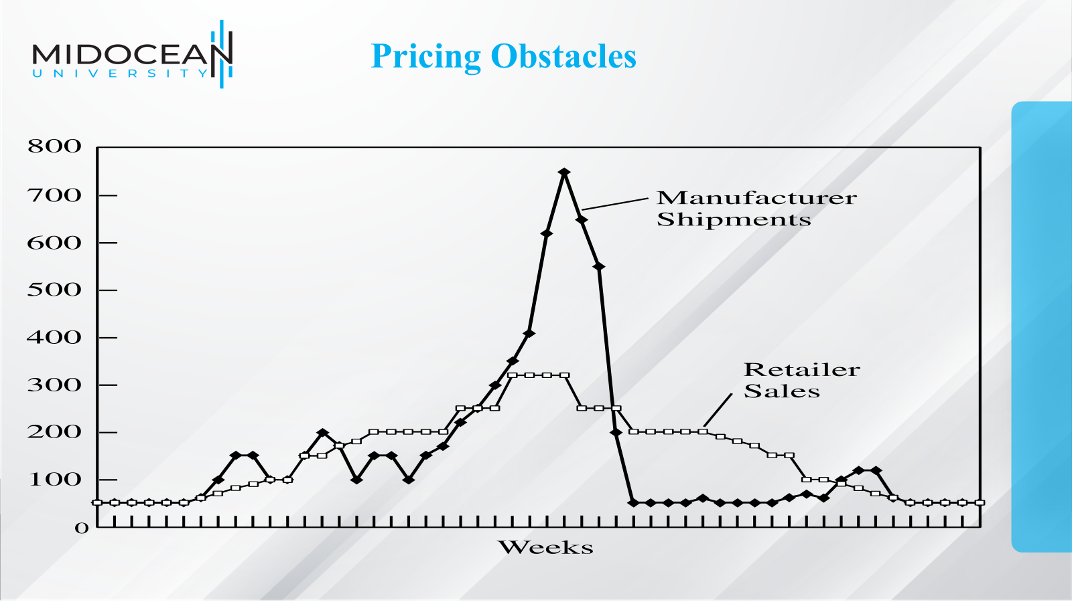

Slide 24
Behavioral Obstacles
Problems in learning within organizations that contribute to information distortion
Each stage of the supply chain views its actions locally and is unable to see the impact of its actions on other stages
Different stages of the supply chain react to the current local situation rather than trying to identify the root causes
Different stages of the supply chain blame one another for the fluctuations
No stage of the supply chain learns from its actions over time
A lack of trust among supply chain partners causes them to be opportunistic at the expense of overall supply chain performance

Slide 25
Managerial Levers to
Achieve Coordination
Aligning goals and incentives
Improving information accuracy
Improving operational performance
Designing pricing strategies to stabilize orders
Building strategic partnerships and trust
Cooperation and trust within the supply chain help improve performance for a variety of reasons
Supply chain coordination improves if all stages of the chain take actions that are aligned and together increase total supply chain surplus

Slide 26
Aligning Goals and Incentives
Align goals and incentives so that every participant in supply chain activities works to maximize total supply chain profits
Align goals across the supply chain
Align incentives across functions
Pricing for coordination
Alter sales force incentives from sell-in (to the retailer) to sell-through (by the retailer)

Slide 27
Improving Information Visibility and Accuracy
Sharing customer demand data
Implementing collaborative forecasting and planning
Designing single-stage control of replenishment
  Continuous replenishment programs (CRP)
  Vendor managed inventory (VMI)

Slide 28
Key Point
Demand planning at each stage in a supply chain based on the stream of orders received from its down- stream stage results in a magnification of fluctuation in orders as one moves up the supply chain from the retailer to the manufacturer.
It is better for the entire supply chain to forecast based on end customer demand.

Slide 29
Improving Operational Performance
Reducing replenishment lead time
Reducing lot sizes
Rationing based on past sales and sharing information to limit gaming

Slide 30
Designing Pricing Strategies to Stabilize Orders
Encouraging retailers to order in smaller lots and reduce forward buying
  Moving from lot size-based to volume-based quantity discounts
  Stabilizing pricing
  Building strategic partnerships and trust

Slide 31
Continuous Replenishment and
Vendor-Managed Inventories
A single point of replenishment
CRP – wholesaler or manufacturer replenishes based on POS data
VMI – manufacturer or supplier is responsible for all decisions regarding inventory
Substitutes

Slide 32
Collaborative Planning, Forecasting, and
Replenishment (CPFR)
Sellers and buyers in a supply chain may collaborate along any or all of the following
  Strategy and planning
  Demand and supply management
  Execution
  Analysis

Slide 33
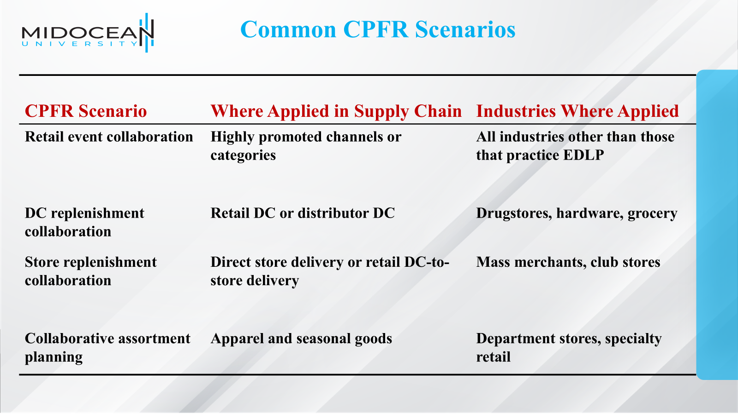

Slide 34
Collaborative Planning, Forecasting, and Replenishment (CPFR)
Retail event collaboration
DC replenishment collaboration
Store replenishment collaboration
Collaborative assortment planning
Organizational and technology requirements for successful CPFR
Risks and hurdles for a CPFR implementation

Slide 35
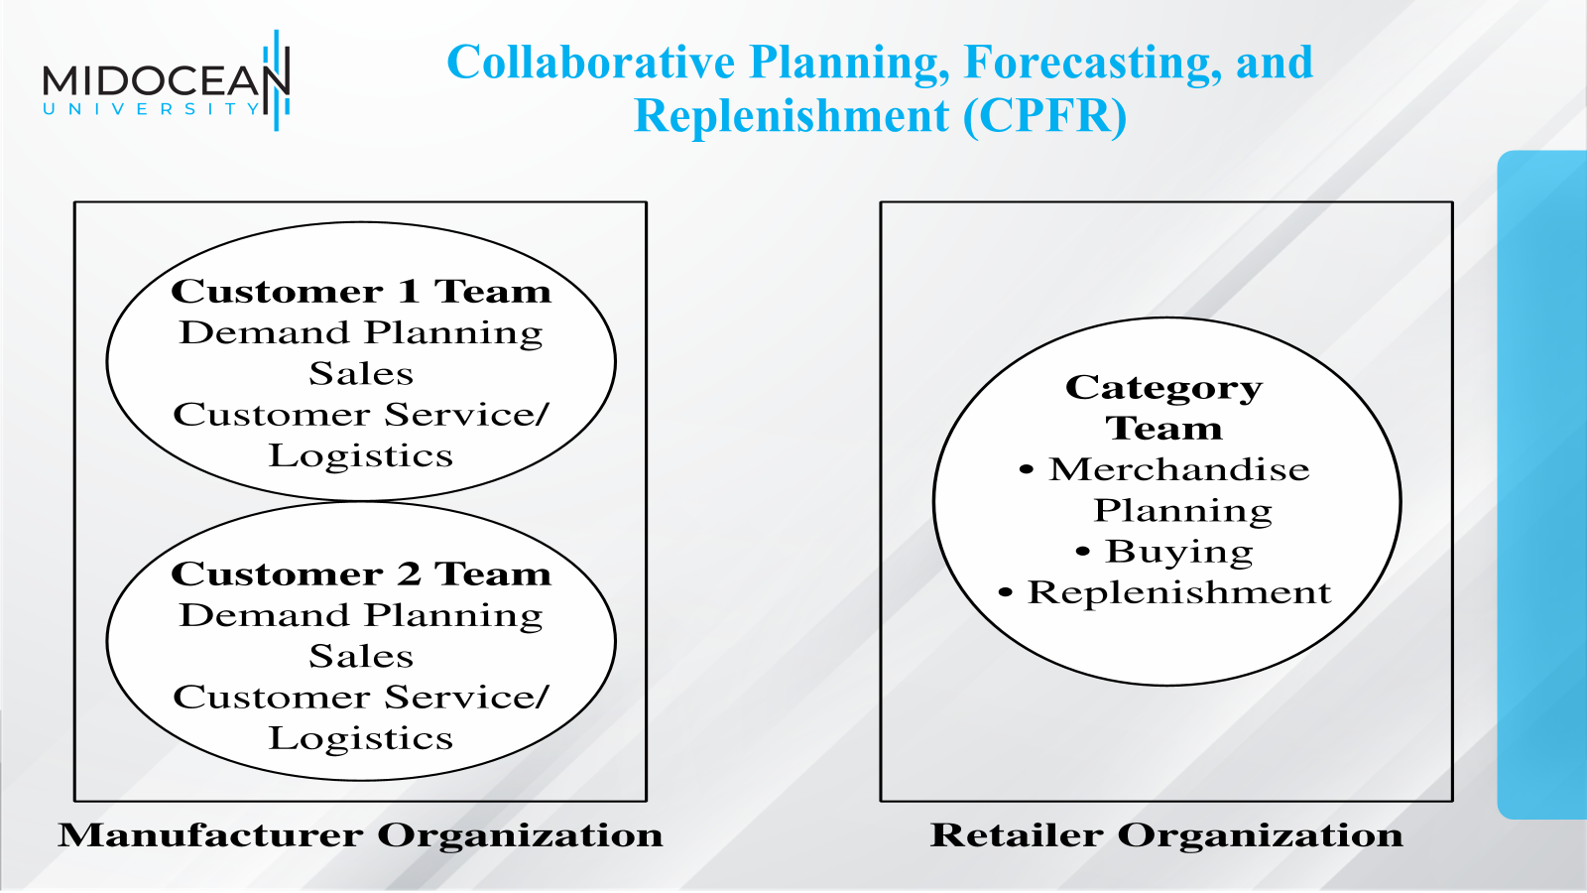

Slide 36
Achieving Coordination in Practice
Quantify the bullwhip effect
Get top management commitment for coordination
Devote resources to coordination
Focus on communication with other stages
Try to achieve coordination in the entire supply chain network
Use technology to improve connectivity in the supply chain
Share the benefits of coordination equitably

Slide 37
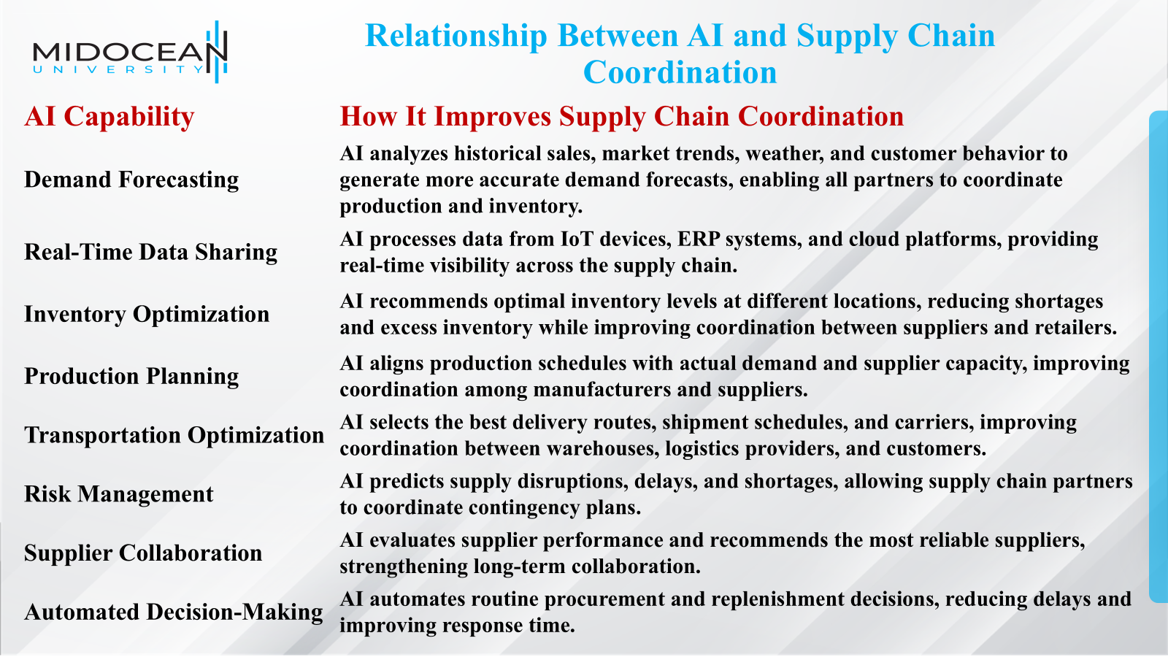

Slide 38
Benefits of AI for Supply Chain Coordination
Improves information sharing among supply chain partners.
Reduces the Bullwhip Effect through better demand visibility.
Enhances collaboration between suppliers, manufacturers, distributors, and retailers.
Increases supply chain visibility and transparency.
Improves responsiveness to changes in demand.
Reduces inventory and operating costs.
Improves customer service and product availability.
Enables faster and more accurate decision-making.

Slide 39
Benefits of AI for Supply Chain Coordination
Example
A global retailer uses AI to analyze sales data from all its stores in real time.
The AI system predicts increased demand for a product.
Suppliers receive automatic notifications to increase raw material supply.
Manufacturers adjust production schedules.
Distribution centers prepare additional inventory.
Logistics providers optimize delivery routes.
Retail stores receive products before stockouts occur.
As a result, all supply chain members coordinate their activities based on the same AI-generated information, improving efficiency and customer satisfaction.

Slide 40
Summary of Learning Objectives
Describe supply chain coordination and the bullwhip effect, and their impact on supply chain performance
Identify obstacles to coordination in a supply chain
Discuss managerial levers that help achieve coordination in a supply chain
Understand the different forms of CPFR possible in a supply chain
Benefits of AI for supply chain coordination
www.midocean.km

Slide 41
Essential Reference
Lysons, K., & Farrington, B. (2020). Procurement and supply chain management. Pearson UK.
Chopra, S., & Meindl, P. (2016). Global Edition. Pearson Education Limited. Chapter 10.
Morris, P. W., & Pinto, J. K. (Eds.). (2007). The Wiley guide to project technology, supply chain, and procurement management (Vol. 4). John Wiley & Sons.
Schwalbe, K. (2015). Information technology project management. Cengage Learning.
Supply Chain Council
www.midocean.km

Slide 42

Thank You

