Slide 1


Financial Accounting
Prepared by Dr. Emad Zaher
Assistant Professor of Accounting
MGM611
Lecture 0

Slide 2

Chapter (1) Introduction to Financial Accounting
  Learning outcomes
LO 1 Identify the origins of Accounting.
LO 2 Explain the different forms of business ownership.
LO 3 State the main reasons for studying Accounting .
LO 4 Describe Activities & different users of Accounting information.
LO 5 Explain the GAAP & the role of standards-setters bodies.
LO 6 Comparing Financial Accounting with Managerial Accounting.

Slide 3

The Origins of Accounting
The Origins of Accounting is generally attributed to the Italian mathematician “Luka Pacioli” in 1494.
Luka developed the Double entry system which includes:
Debit
Credit
Borrower
lender

Slide 4
Forms of Business Ownership
Proprietorship |  | Partnership |  | Corporation
Owned by one person Owner is often manager/operator Owner receives any profits, suffers any losses, and is personally liable for all debts |  | Owned by two or more persons Often retail and service-type businesses Generally unlimited personal liability |  | Owned by shareholders Separate legal entity organized under state corporation law Limited liability
Prepared by Dr. Emad Zaher

Slide 5

Why do we study Accounting ?
1. To Know the Business profit & loss.
2. To know the Business financial position.
3. To Know the changes in owner’s capital.
4. To Know the business cash Position.
Prepared by Dr. Emad Zaher

Slide 6
Users of Accounting Information
External Users
Internal Users
Competitors
Shareholders
Tax Authorities
External Auditors
Lenders (Banks)
Managers
Employees
Internal Auditors
Budget Officers
Notes:
Accountants prepare reports for both external and internal users. External users of accounting information are not directly involved in running the organization. Examples of external users are lenders, shareholders (investors), governments, consumer groups, customers, and the external auditors.
Internal users of accounting information are those directly involved in managing and operating an organization. They use the information to help improve the efficiency and effectiveness of an organization. Examples of internal users are managers, officers/directors, internal auditors, sales staff, budget officers and controllers.

Slide 7
QUESTIONS ASKED BY EXTERNAL USERS
How does the company compare in size and profitability with its competitors?
Is the company earning satisfactory income?
What do we do if they catch us?
Will the company be able to pay its debts as they come due?

Slide 8
QUESTIONS ASKED BY INTERNAL USERS
What is the cost of manufacturing each unit of product?
Is cash sufficient to pay bills?
Which product line is the most profitable?
Can we afford to give employees pay raises this year?

Slide 9
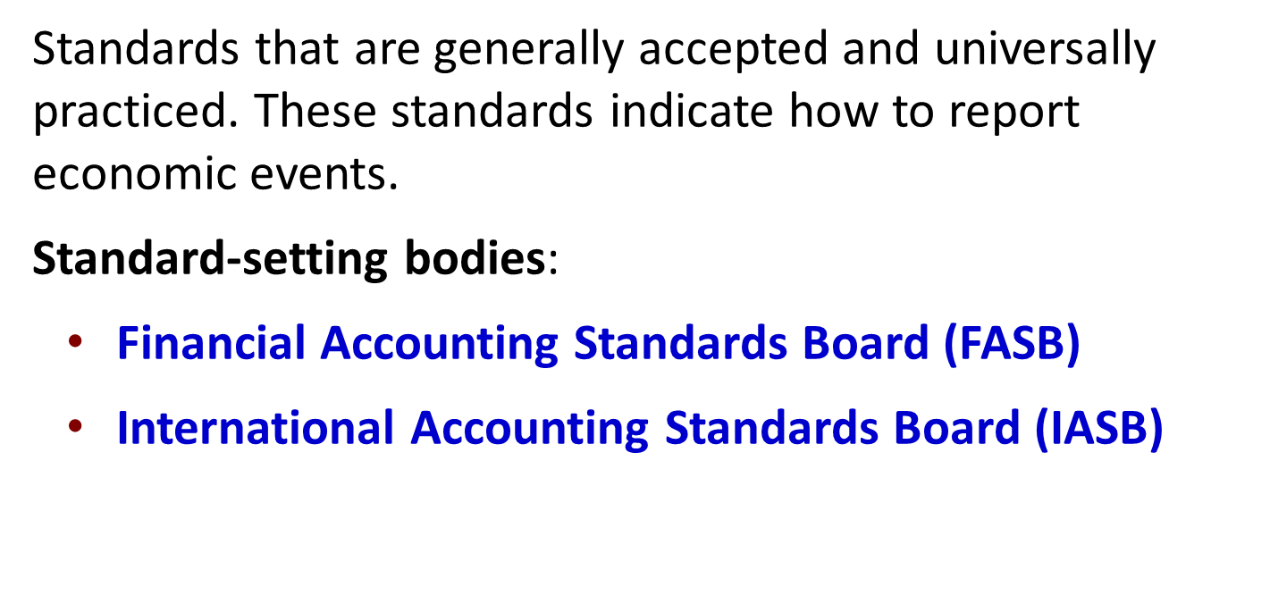


Generally Accepted Accounting Principles
Prepared by Dr. Emad Zaher

Slide 10
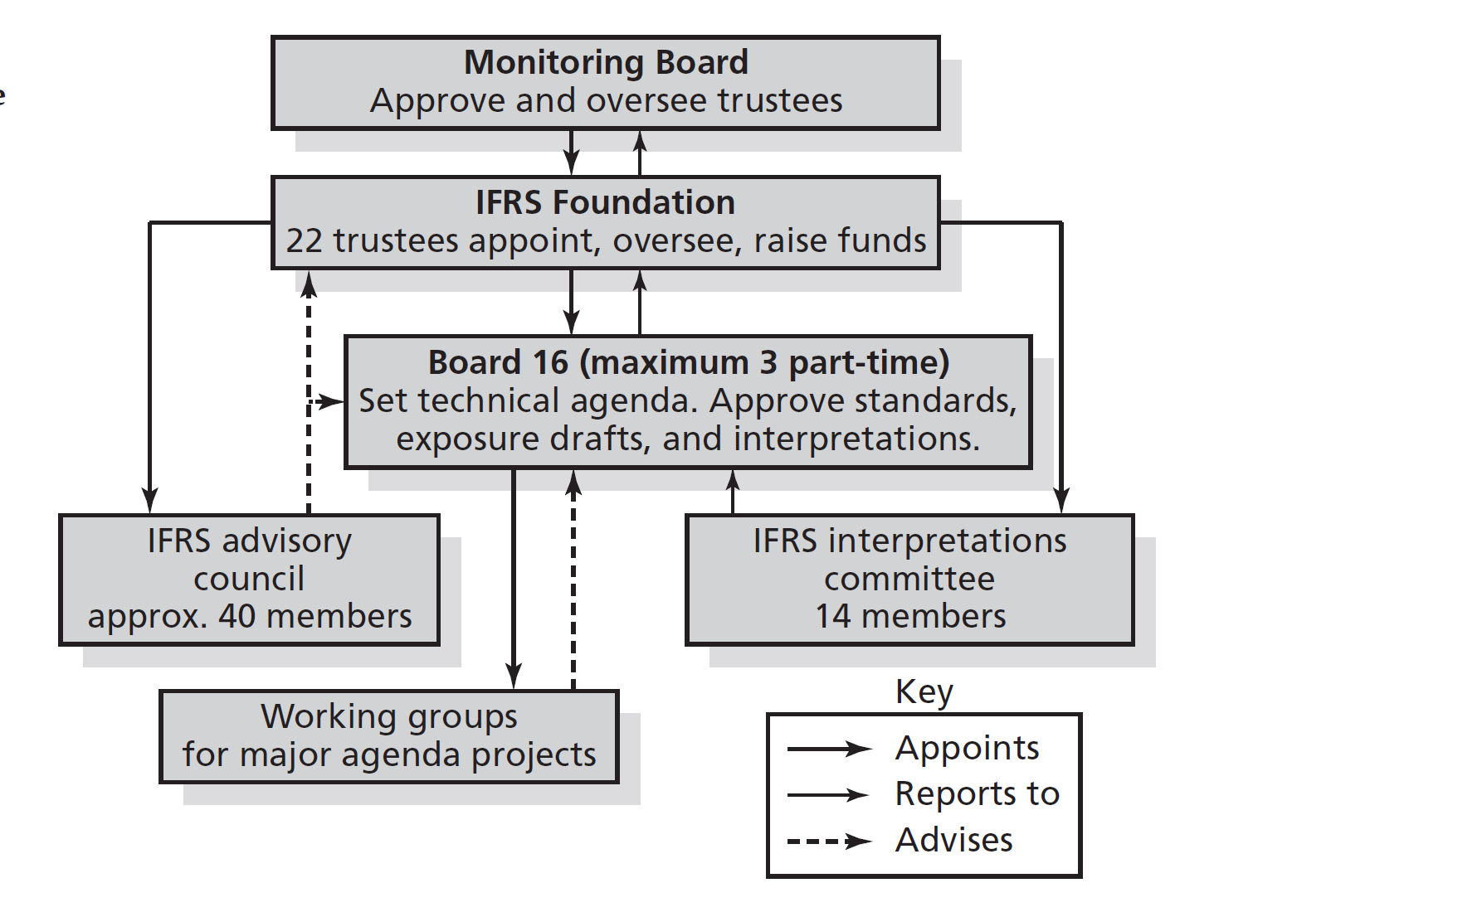
The Structure of the IASB

Slide 11
Comparing Financial and Managerial Accounting
Feature |  | Financial Accounting |  | Managerial Accounting
Primary Users |  | External users: shareholders, creditors, and regulators. |  | Internal users: officers and managers.
Frequency of Reports |  | Financial statements. Quarterly and annually. |  | Internal reports. As frequently as needed.
Purpose of Reports |  | Financial statements for General-purpose. |  | Decision Making
Focus/Emphasis |  | Past-Oriented |  | Future-Oriented
Verification Process |  | Audited by accountants According IFRS &US.GAAP. |  | No independent audits.
Prepared by Dr. Emad Zaher

Slide 12
Required Textbook:
Financial Accounting IFRS Edition, by John Wiley & Sons, Inc.
Topics:
Accounting cycle & Financial Statements.
Investing and Financing Decisions.
Operating Decisions and the Income Statement.
Communicating and Interpreting Accounting Information.
Cost of Goods Sold and Inventory.
Property, Plant, and Equipment Natural Resources.
Reporting and Interpreting Liabilities.
Financial Statements Analysis

Slide 13
Module Learning Outcomes:
This course will enable the students to combine practice and theoretical knowledge of financial Accounting.
The students of this course will be active learners and develop awareness of emerging trends in financial Accounting.
The course will provide decision making skills to the students in the financial analysis context.
The students of this course will have the ability to identify and analyze Financial Accounting problems and opportunities in real life situations.

Slide 14



Thank You

