Slide 1

  Master of Financial Technology
FNT 615 - Finance Concepts

Slide 2

Financial Statements Analysis
Chapter 4
www.midocean.ae

Slide 3

Chapter
Intended Learning Outcomes
04
Compute a company’s profits, as reflected by its income statement.
Determine a firm’s financial position at a point in time based on its balance sheet.
Measure a company’s cash flows.
Explain the purpose and importance of financial analysis.
Calculate and use a comprehensive set of measurements to evaluate a company’s performance.
Describe the limitations of financial ratio analysis.
www.midocean.ae

Slide 4
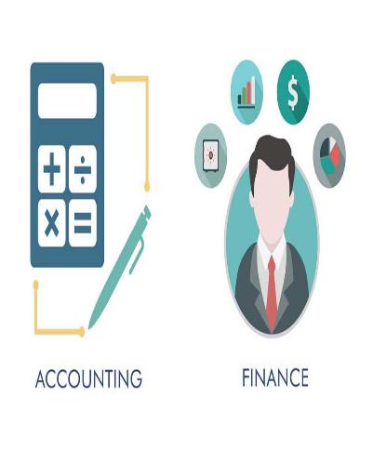
Introduction
The goal of this chapter is not to make you an accountant, but instead to provide you with the tools to understand a firm’s financial situation.
With this knowledge, you will be able to understand the financial consequences of a company’s decisions and actions—as well as your own.
The financial performance of a firm matters to a lot of groups—the company’s management, its employees, and its investors, just to name a few.
This is true whether you are in the firm’s marketing, finance, or human resources department.
So regardless of your position in the firm, it is in your own best interest to know the basics of financial statements—even if accounting is not your greatest love.

Slide 5
1. The income Statement

Slide 6

The Income Statement
An income statement, or profit and loss statement, indicates the amount of profits generated by a firm over a given time period.
In its most basic form, the income statement may be represented as follows:
Sales - expenses = profits

Slide 7
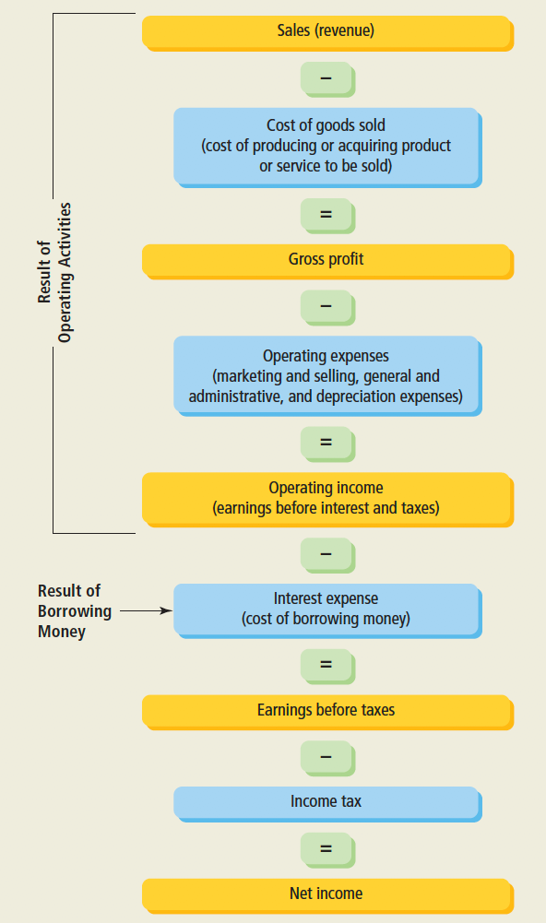
Income Statement overview

Slide 8
The Income Statement
The operating income is the result of management’s decisions relating only to the operations of the business and is not affected at all by how much debt the company owes.
In other words, the firm’s financing expenses, its interest expense resulting from borrowing money, have no effect on operating income.
Rather, the operating income of a firm reports the results of the following important activities:
  Sales (revenues), which is equal to the selling price of the products or services to be sold times the number of units sold (selling price * units sold = total sales).
  Cost of goods sold, which is the cost of producing or acquiring the goods or services that were sold.
  Operating expenses, which include:
    Marketing and selling expenses (the expenses related to marketing, selling, and distributing the products or services).
    The firm’s overhead expenses (general and administrative expenses, and depreciation expenses).

Slide 9
The Income Statement
We next determine the earnings before taxes, or taxable income, by deducting the interest expense paid on the firm’s debt. Next, the firm’s income taxes are calculated based on its earnings before taxes and the applicable tax rate for the amount of income reported.
The next and final number in the income statement is the net income, or earnings available to common stockholders, which represents income that may be reinvested in the firm or distributed to its owners—provided, of course, the cash is available to do so.

Slide 10

Important Indicators to Stockholders
After completing the income statement. The firm’s owners (common stockholders) like to know
  How much income the firm made on a per share basis, or what is called earnings per share (EPS). We calculate earnings per share as net income divided by the number of common stock shares outstanding.
  The amount of dividends a firm pays for each share outstanding, or the dividends per share (DPS).

Slide 11
Common Size Income Statement
What conclusions can we draw from income statement? To answer this question, it is helpful to look at each item in the income statement as a percentage of sales.
Such a revision is called a common-sized income statement.
The common-sized income statement allows us to express expenses and profits on a relative basis, so that we can more easily compare a firm’s income performance across time and with competitors.
The profits-to-sales relationships are defined as profit margins

Slide 12
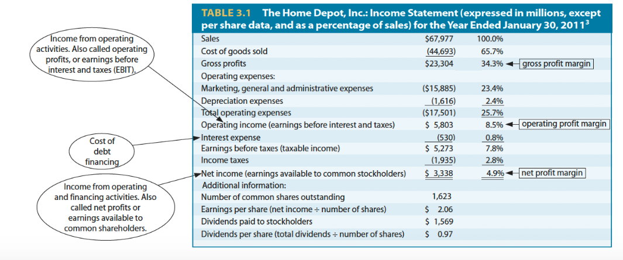
Common Size Income Statement - Example

Slide 13
Constructing and Analyzing Income Statement
Menielle, Inc. is a wholesale distributor of electronics. It sells laptops, cameras, and other electronic gadgets.
Use the scrambled information below to construct an income statement, along with a common-sized income statement. Also calculate the firm’s earnings per share and dividends per share.
  Interest expense $ 35,000
  Sales $400,000
  Cost of goods sold $150,000
  Common stock dividends $ 15,000
  Selling and marketing expenses $ 40,000
  Income taxes $ 40,000
  Administrative expenses $ 30,000
  Depreciation expense $ 20,000
  Number of shares outstanding 20,000

Slide 14
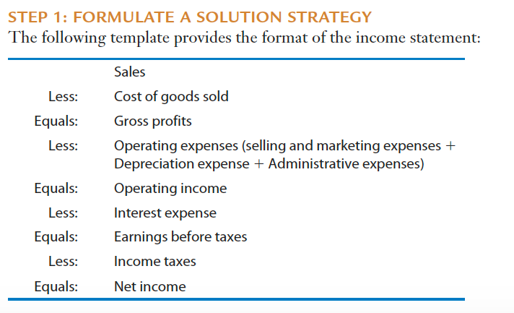

Slide 15
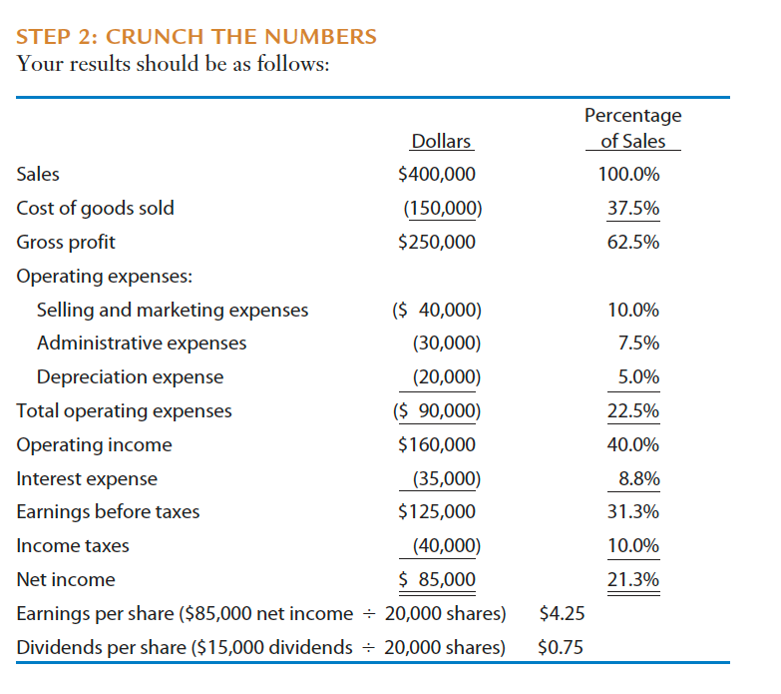

Slide 16
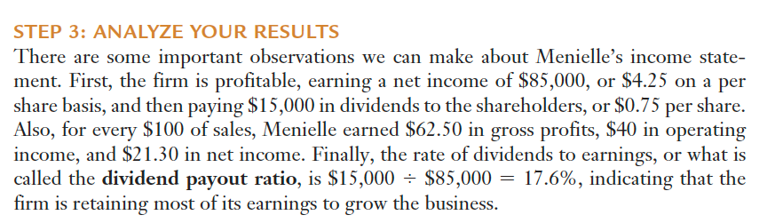

Slide 17
2. The Balance Sheet

Slide 18
The Balance Sheet
A firm’s balance sheet, on the other hand, provides a snapshot of the firm’s financial position at a specific point in time, presenting its asset holdings, liabilities, and owner-supplied capital (stockholders’ equity).
In its simplest form, a balance sheet is represented by the following balance sheet equation:
Total assets = total debt (liabilities) + total shareholders’ equity
where total assets represent the resources owned by the firm, and total liabilities (debt) and total shareholders’ equity indicate how those resources were financed.

Slide 19
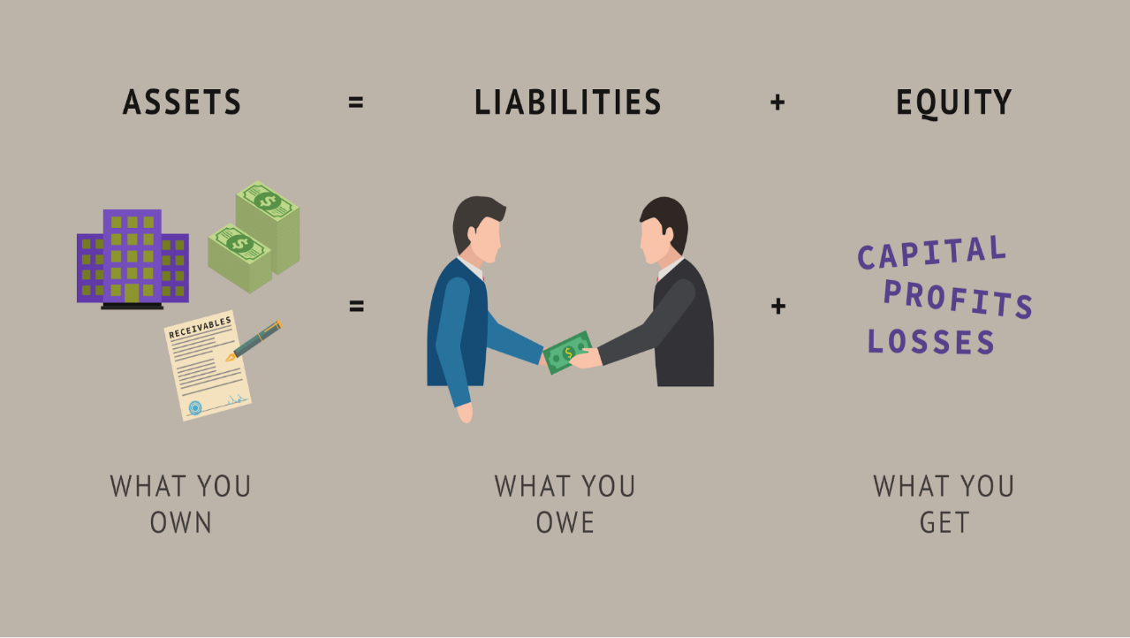

Slide 20
The Balance Sheet
The conventional practice is to report the amount of a firm’s various assets in the balance sheet by using the actual cost of acquiring them.
Thus, the balance sheet does not represent the current market value of a company’s assets and consequently does not reflect the value of the company itself. Rather, it reports historical transactions at their cost.
Therefore, the balance sheet reports a company’s accounting book value, which is simply equal to a firm’s total assets as listed in its balance sheet.

Slide 21
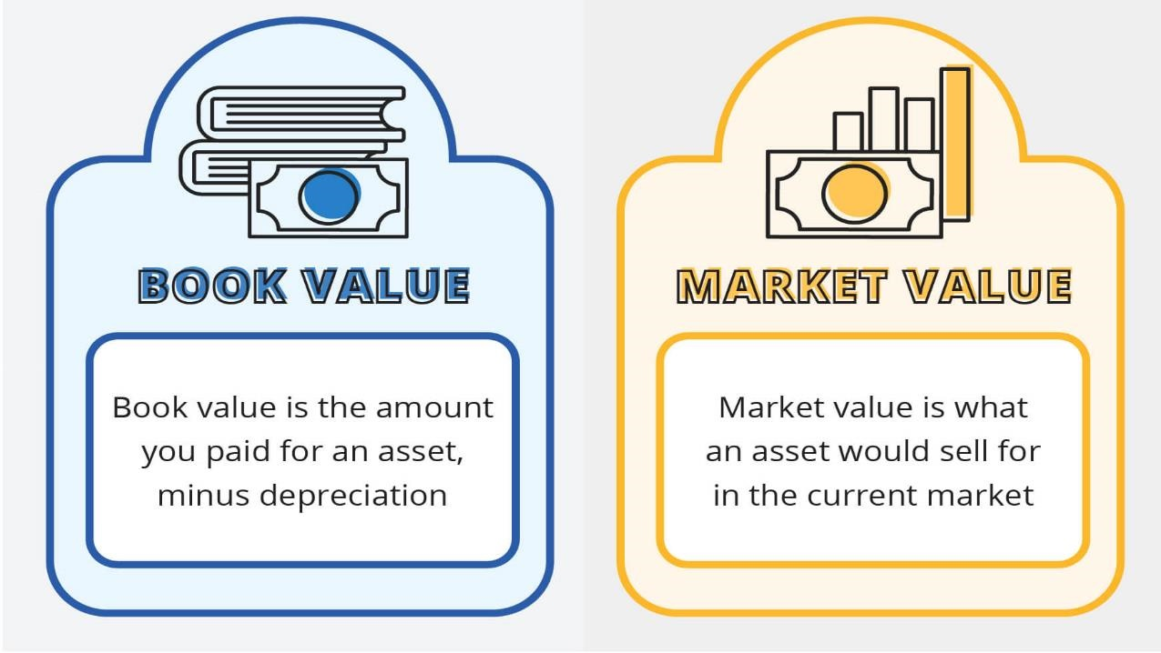

Slide 22
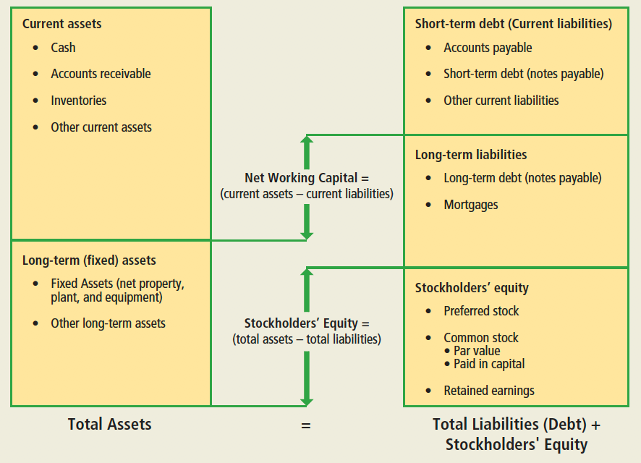
An overview of the Balance Sheet

Slide 23
Types of Assets
On the balance sheet, assets are listed from the most liquid to the least liquid, that is, in the order of decreasing liquidity.
Liquidity refers to the ability to quickly convert an asset into cash without lowering the selling price.
A highly liquid asset can be sold quickly without causing a decrease in the value of the asset, whereas an illiquid asset either cannot be easily converted to cash or can only be sold quickly at a significant discount.
For example, cash is much more liquid than a building.
Liquidity is important because holding liquid assets reduces the chance that a firm will experience financial distress. However, liquid assets usually generate less return than illiquid assets. For example, holding cash would earn no return at all.
Therefore, financial managers must choose a reasonable percentage of liquid assets so that the company can enjoy the benefits of liquidity without significantly hurting a firm’s profitability.

Slide 24
Current Assets
Company’s current assets, or gross working capital as it is sometimes called, are those assets that are expected to be converted into cash within 12 months.
Current assets includes :
  Cash. Every firm must have cash to conduct its business operations. A reserve of cash is needed because of the unequal flow of funds into (cash receipts) and out of (cash expenditures) the business.
  Accounts receivable. A firm’s accounts receivable are the amounts owed to the firm by its customers who buy on credit.
  Inventories. A company’s inventories consist of raw materials, work in progress, and finished goods held by the firm for eventual sale.
  Other current assets. Other current assets include such items as prepaid expenses. For example, a company’s insurance premium might be due before the actual insurance coverage begins; or the firm’s rent might have to be paid in advance. These expenditures are considered assets because they represent an investment that’s been made by the company. Only when, for example, the insurance premium is used up following the coverage period is the premium considered an expense.

Slide 25
Long-term Assets
A company’s long-term assets fall into two categories:
Fixed Assets (Property, Plant, and Equipment)
  A firm’s fixed assets include such assets as machinery and equipment, buildings, and land. These assets will be used over a number of years.
  When a firm purchases a fixed asset, it does not immediately report the expenditure for the asset as an expense in its income statement. Instead, it is shown as an asset in the balance sheet.
  Some of these assets, such as machinery and equipment, will depreciate over time others may not, such as land.
  With a depreciable asset, the original cost of the asset is allocated as an expense in the income statement over the asset’s expected useful life. The amount allocated as the cost each year is shown as a depreciation expense in the income statement. The sum of all depreciation taken over the life of the asset to date is shown as accumulated depreciation in the balance sheet.
Other Long-Term Assets: Other long-term assets are all of the firm’s assets that are not current assets or fixed assets. They include, for example, long-term investments and intangible assets such as the company’s patents, copyrights, and goodwill.

Slide 26
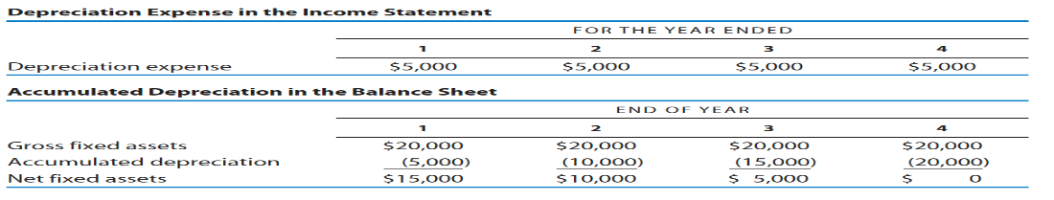
Long-term Assets
To illustrate, assume that a truck purchased for $20,000 is to be evenly depreciated over a 4-year life. The depreciation expense to be reported in the income statement for each year would be $5,000.
When a firm buys the truck, the $20,000 original cost of the asset is added to the balance sheet as a gross fixed asset. The cumulative depreciation taken over the asset’s life is reported as accumulated depreciation. We subtract the accumulated depreciation each year from the gross fixed assets to determine net fixed assets.
It is important to understand the distinction between gross fixed assets and net fixed assets and how depreciation expense in the income statement relates to accumulated depreciation in the balance sheet.
In this example, the income statements for each year and balance sheets over time would appear as follows:

Slide 27

Types of Financing
We now turn to the right side of the balance sheet labeled “Total Liabilities (Debt) + Stockholders’ Equity,” which indicates how the firm finances its assets.
Debt (liabilities) is money that has been borrowed and must be repaid at some predetermined date.
Equity, on the other hand, represents the shareholders’ (owners’) investment in the company.

Slide 28
Types of Financing
Debt capital is financing provided by a creditor, it is divided into
  Short-Term Debt (Current Liabilities) A firm’s short-term debt, or current liabilities, includes borrowed money that must be repaid within the next 12 months. The sources of a firm’s current debt include the following:
    Accounts payable. The firm’s accounts payable represent the credit that suppliers have extended to the firm when it purchased inventories. The purchasing firm may have 30, 60, or even 90 days to pay for the inventory. This form of credit extension is also called trade credit.
    Accrued expenses. Accrued expenses are short-term liabilities that have been incurred in the firm’s operations but not yet paid. For example, the company’s employees might have done work for which they will not be paid until the following week or month, and these are recorded as accrued wages.
    Short-term notes. Short-term notes represent amounts borrowed from a bank or other lending source that are due and payable within 12 months.

Slide 29
Types of Financing
  2. Long-Term Debt
    The firm’s long-term debt includes loans from banks or other sources for longer than 12 months.
    A firm might borrow money for 5 years to buy equipment, or it might borrow money for as long as 25 or 30 years to purchase real estate, such as land and buildings.
    Usually, a loan to finance real estate is called a mortgage, where the lender has first claim on the property in the event the borrower is unable to repay the loan.

Slide 30

Equity
Equity includes the shareholders’ investment—both preferred stockholders and common stockholders—in the firm.
  Preferred stockholders generally receive a dividend that is fixed in amount. In the event of the firm being liquidated, these stockholders are paid after the firm’s creditors but before the common stockholders.
  Common stockholders are the residual owners of a business. They “own” whatever income is left over after paying all expenses. In the event the firm is liquidated, the common stockholders receive only what is left over—good or bad—after the creditors and preferred stockholders are paid.
  The amount of a firm’s common equity is equal to the sum of two items:
  The amount a company receives from selling stock to investors.
  The amount of a firm’s retained earnings.

Slide 31
Common Stock
This amount may simply be shown as common stock in the balance sheet or it may be divided into par value (an arbitrary amount a firm puts on each share of stock when it is sold, frequently a penny or a dollar) and paid-in capital above par (also called capital surplus).
Paid-in capital is the amount of money above par value a firm receives when it issues new shares to investors.
For instance, if a company sells a new issue of common stock for $50 per share and sets the par value of the stock at $1 per share, then the $49 ($50-$1) would be shown as paid-in capital. So, if it sold 1 million shares, the total paid-in capital would be $49 million ($49 * 1 million shares).
Finally, the amount of common stock issued will be offset by any stock that has been repurchased by the company from its shareholders, which is shown as treasury stock.

Slide 32
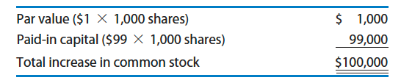
Common Stock
To illustrate how a company might record an issuance of common stock, assume that a firm issues 1,000 shares of common stock for $100 per share.
The company has a policy of assigning a $1 par value to each share of stock. (It could just as easily have chosen a par value of a penny a share.
The remaining $99 per share would be added to paid-in capital. Thus, the total increase in the common equity in the balance sheet would appear as follows:

Slide 33
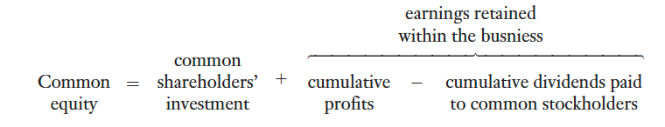
Retained Earnings
Retained earnings is the net income that has been retained in the business rather than being distributed to the shareholders over the life of the company; in other words, the cumulative total of all the net income over the firm’s life less the common stock dividends that have been paid over these years.
More simply, retained earnings at the end of a given year is determined as follows:
Beginning retained earnings + net income for the year – dividends paid during the year = ending retained earnings
To conclude, the common stockholders’ equity can be represented as follows:

Slide 34
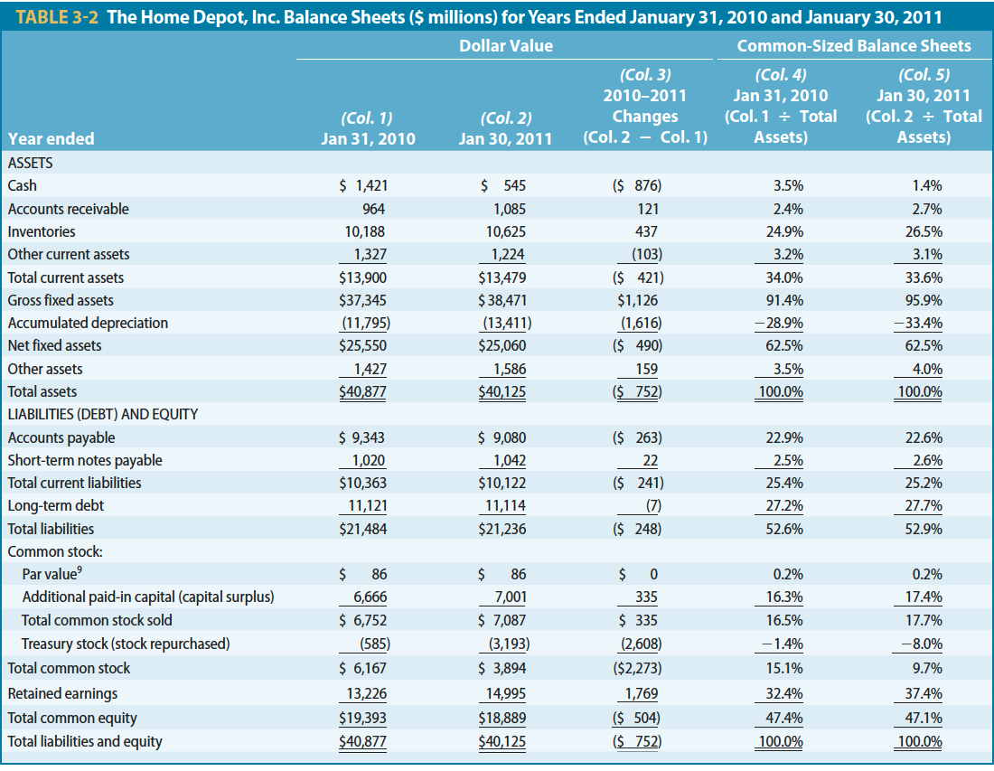

Slide 35
Changes in Home Depot’s Balance Sheet
Looking at the changes in the balance sheets for Home Depot, we observe the following:
1. The firm’s total assets decreased $752 million, going from $40.877 billion in assets to $40.125 billion. Why the decrease? Two primary reasons: the reduction in current assets and in net fixed assets.
  a. Decrease in current assets. The most significant reduction in current assets by far came from the company’s decrease in cash in the amount of $876 million. The decrease in cash was offset in part by the increases in accounts receivable, and especially inventories.
  b. Decrease in fixed assets. The reduction in the net fixed assets in the amount of $490 million came from two offsetting changes: purchasing new fixed assets (increase in gross fixed assets) in the amount of $1.126 billion, but taking $1.616 billion in depreciation of the fixed assets. So we see that the change in a firm’s net fixed assets is driven by (1) how much the firm spends on new fixed assets and (2) how much depreciation expense it takes on the fixed assets in place.

Slide 36
Changes in Home Depot’s Balance Sheet
2. We next review the changes in the firm’s debt and equity, which amounts to a $752 million decrease, exactly the amount of the decrease in total assets—as it must be. (Remember, total assets = total debt + total equity) Primarily this change is the consequence of the following actions:
  a. Paying off $263 million owed to suppliers (reduction in accounts payable).
  b. Repurchasing stock from its shareholders in the amount of $2.608 billion (increase in treasury stock) less $335 million the firm received from issuing new stock.
  c. Retaining $1.769 billion of the firm’s profits within the business (increase in retained earnings).

Slide 37
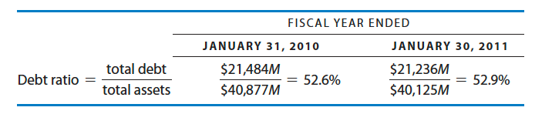
Home Depot’s Common-Sized Balance Sheet
Finally, we can gain additional perspective on a company’s financial position by looking at each item on the balance sheet as a percentage of total assets (and total debt and equity). A balance sheet expressed this way is called a common-sized balance sheet. Based on the percentages, we can observe that:
  Inventories make up most of the current assets, amounting to about one-fourth of all the assets owned by the company.
  The company’s total assets consist of about one-third current assets and two-thirds fixed assets.
  Approximately one-half of Home Depot’s financing comes from debt, with the remaining half coming from equity. To be more precise, we can calculate the debt ratio, which is the percentage of a company’s assets financed by debt. For Home Depot, the debt ratios on January 31, 2010 and January 30, 2011, respectively, were 52.6 percent and 52.9 percent:
The debt ratio is an important measure to lenders and investors because it indicates the amount of financial risk the company is bearing—the more debt a company uses to finance its assets, the greater is its financial risk.

Slide 38
Home Depot’s Common-Sized Balance Sheet
Earlier we noted that the term current assets is also referred to as gross working capital. These two terms are used interchangeably.
Net working capital = current asset - current liabilities
Thus, net working capital compares the amount of current assets (assets that should convert into cash within the next 12 months) to the current liabilities (debt that must be paid within 12 months).
The larger the net working capital a firm has, the more able the firm will be to pay its debt as it comes due.
Thus, the amount of net working capital is important to a company’s lenders, who are always concerned about a company’s ability to repay its loans.

Slide 39
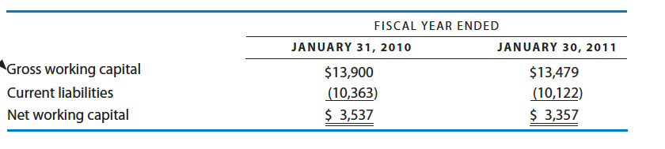
Home Depot’s Common-Sized Balance Sheet
For Home Depot, net working capital is computed as follows:

Slide 40
Example
Given the information below for Menielle, Inc., construct a balance sheet and a common-sized balance sheet. As a percent of assets, what are the firm’s largest investments and sources of financing?
Gross fixed assets $75,000 Accounts receivable $ 50,000
Cash $10,000 Long-term bank note $ 5,000
Other assets $15,000 Mortgage $ 20,000
Accounts payable $40,000 Common stock $100,000
Retained earnings $15,000 Inventories $ 70,000
Accumulated depreciation $20,000 Short-term notes $ 20,000

Slide 41
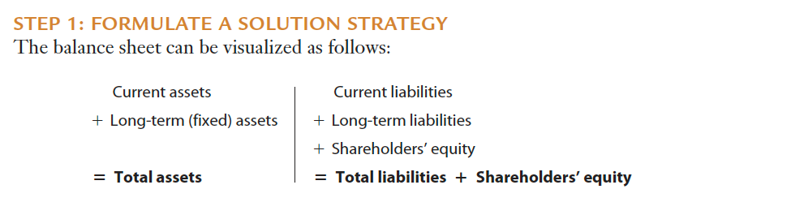

Slide 42
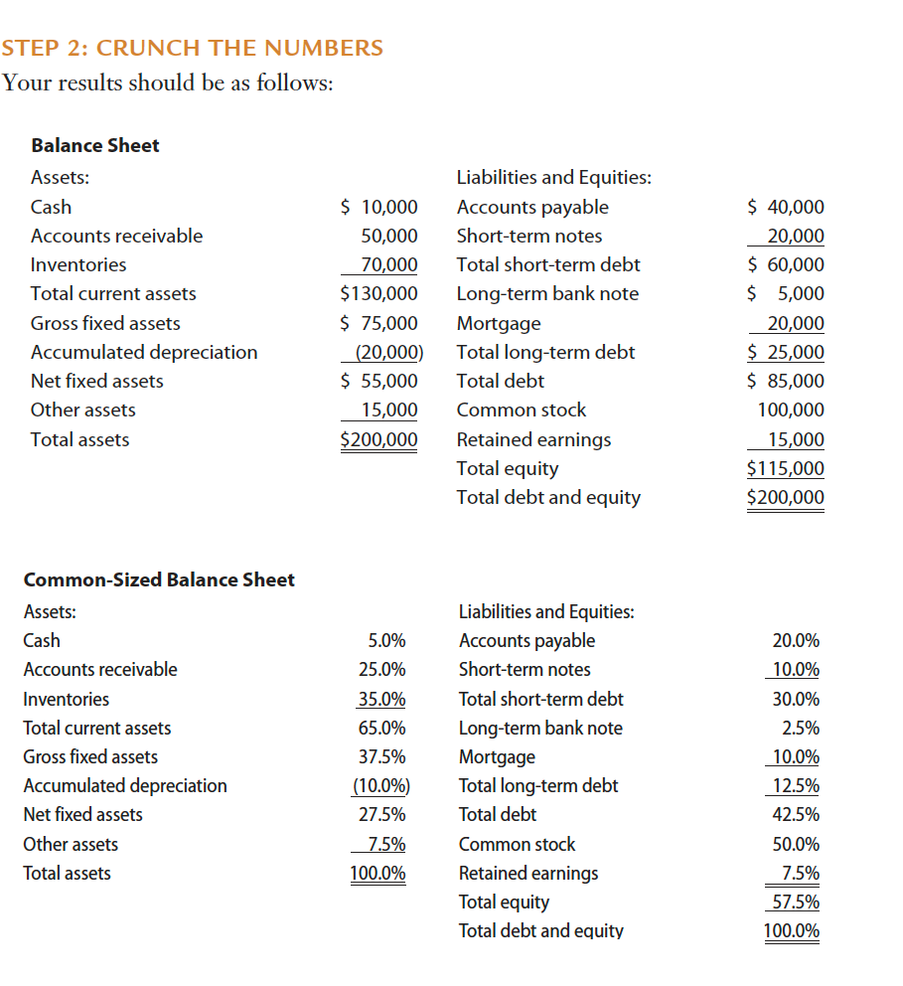

Slide 43
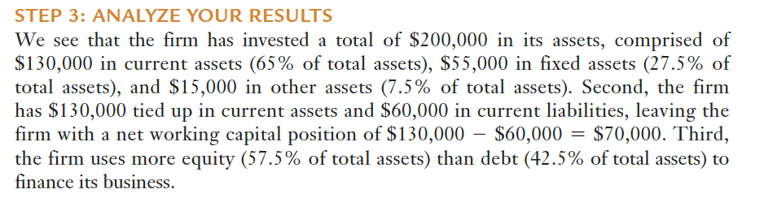

Slide 44


Thank You

