Slide 1


Master Of Real Estate
Management
Prepared by
Dr. Al Montaser Abuhussein
Artificial Intelligence in Business
Lecture 4

Slide 2



Master Of Real Estate
Management
Lecture 4
Artificial Intelligence in Business
Prepared by
Dr. Al Montaser Abuhussein

Slide 3

The Impact of AI on Business, Economics and Innovation (Part 1)
Chapter
03
1

Slide 4

Chapter
Learning Objectives
03
Explain the overall impact of AI on business, economics, and innovation.
Identify the main business benefits of AI for operations, customers, revenue, recruitment, and decision-making.
Analyze AI from a business-oriented leadership perspective, not only as a technical tool.
Explain why Machine Learning is important for business scalability, automation, real-time decisions, and predictive analytics.
Artificial Intelligence in Business | Chapter 3: AI, Business, Economics and Innovation
2

Slide 5
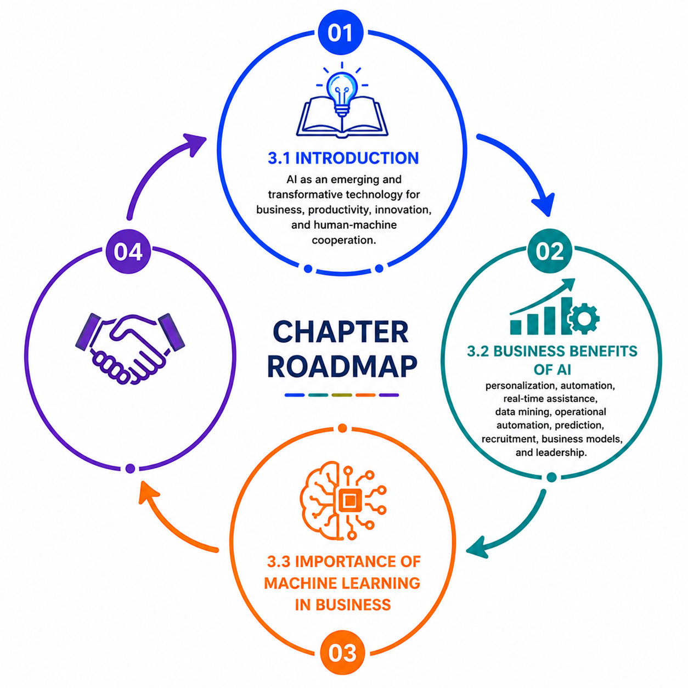
Chapter Roadmap
1. Introduction
AI as an emerging and transformative technology for business, productivity, innovation, and human-machine cooperation.
2. Business Benefits of AI
personalization, automation, real-time assistance, data mining, operational automation, prediction, recruitment, business models, and leadership.
3. Importance of Machine Learning in Business
Artificial Intelligence in Business | Chapter 3: AI, Business, Economics and Innovation
3

Slide 6
1. Introduction
AI is an emerging technology with major consequences for productivity, innovation, jobs, and organizational transformation.
Artificial Intelligence in Business | Chapter 3: AI, Business, Economics and Innovation
4

Slide 7
AI as an Emerging Business Technology
• Business Artificial Intelligence is considered an emerging technology with many future applications.
• Although AI is increasingly visible, research and implementation still focus on only some of its possible uses.
• AI powers many real-world applications and produces both societal benefits and organizational challenges.
• Businesses and economies can benefit from AI through productivity improvement and innovation.
• Because AI changes how organizations work, managers must understand both its technical possibilities and strategic consequences.
Real estate example
AI can support property valuation, tenant analytics, predictive maintenance, smart building operations, and investment forecasting.
Artificial Intelligence in Business | Chapter 3: AI, Business, Economics and Innovation
5

Slide 8
AI as a Transformational Force
• The impact of AI is compared to the historical impact of the steam engine on society and the economy.
• Like previous general transformations, AI changes production, employment, business models, and social relationships.
• AI reshapes tasks, processes, work environments, and organizational decision-making.
• Organizations that understand AI early can redesign operations and create new sources of value.
• The strategic importance of AI lies not only in automation but in how it changes the logic of business.
Artificial Intelligence in Business | Chapter 3: AI, Business, Economics and Innovation
6

Slide 9
AI and Human–Machine Cooperation
• AI should not be understood only as replacing jobs or tasks.
• AI increasingly follows a human-machine cooperation approach.
• Humans provide judgment, creativity, ethics, experience, and contextual understanding.
• AI provides speed, data analysis, prediction, automation, and scalable decision support.
• Organizations gain the most value when they redesign work so people and machines complement each other.
Real estate example
AI may estimate a property’s price, while a human real estate expert interprets legal issues, client emotions, negotiation context, and market nuances.
Artificial Intelligence in Business | Chapter 3: AI, Business, Economics and Innovation
7

Slide 10
Task-Oriented View of AI in Organizations
• A task-oriented approach requires well-documented reference processes, sub-processes, and tasks.
• Organizations must understand which tasks AI can support, automate, or improve.
• This requires process mapping before AI implementation.
• AI should be introduced where it improves efficiency, decision quality, customer experience, or innovation.
• Without task clarity, AI may be applied randomly and fail to create value.
Real estate application
Map property management tasks: tenant inquiry, lease renewal, maintenance request, valuation, marketing, viewing, contract, and after-sale service.
Artificial Intelligence in Business | Chapter 3: AI, Business, Economics and Innovation
8

Slide 11
Human and AI Intelligence Capabilities
• Because AI is developed by humans, AI is often evaluated based on human perceptions of intelligence.
• Managers need to understand both human intelligence capabilities and AI intelligence capabilities.
• AI can process, classify, predict, and automate at scale.
• Humans remain important for ethics, empathy, complex social understanding, and responsibility.
• Understanding the difference helps organizations decide which tasks should be automated, augmented, or kept human-led.
Artificial Intelligence in Business | Chapter 3: AI, Business, Economics and Innovation
9

Slide 12
2. Business Benefits of AI
AI creates business value through personalization, automation, prediction, data mining, recruitment, and strategic innovation.
Artificial Intelligence in Business | Chapter 3: AI, Business, Economics and Innovation
10

Slide 13
Overview of Business Benefits of AI
• Many businesses adopt AI to reduce operational costs, increase efficiency, grow revenue, and improve customer experience.
• AI provides benefits across customer service, marketing, operations, inventory management, recruitment, and analytics.
• The value of AI comes from its ability to process large amounts of data, identify patterns, and support action.
• AI can improve both front-office activities such as customer engagement and back-office activities such as operations and HR.
• Business benefits should always be evaluated in relation to organizational strategy and measurable outcomes.
Real estate examples
Front-office: AI property recommendations and chatbots.
Back-office: predictive maintenance, automated documentation, and portfolio dashboards.
Artificial Intelligence in Business | Chapter 3: AI, Business, Economics and Innovation
11

Slide 14
Personalized Shopping and Customer Experience
• AI enables companies to provide personalized marketing and highly accurate offers to individual customers.
• Personalization increases engagement, supports loyalty, and improves sales performance.
• AI analyzes customer behavior, previous purchases, browsing history, preferences, and context.
• In digital business, customers increasingly expect relevant and customized experiences.
• Organizations that personalize effectively can improve customer retention and lifetime value.
Real estate application
A real estate platform can recommend properties based on budget, family size, location preference, investment goal, and previous search behavior.
Artificial Intelligence in Business | Chapter 3: AI, Business, Economics and Innovation
12

Slide 15
Automating Customer Interactions
• AI allows organizations to automate customer interactions through intelligent machines and conversational systems.
• Chatbots and virtual assistants can answer common questions, guide users, and handle high-volume communication.
• Automation increases availability because AI can provide support 24/7.
• Automated interaction reduces costs and response time, but it must be designed carefully to avoid frustrating users.
• Complex or emotional customer issues should still be escalated to humans.
Real estate example
AI chatbots can answer questions about property availability, viewing times, financing options, location features, and required documents.
Artificial Intelligence in Business | Chapter 3: AI, Business, Economics and Innovation
13

Slide 16
Real-Time Assistance
• AI is useful when organizations communicate with high volumes of customers throughout each day.
• Real-time assistance improves responsiveness and customer satisfaction.
• AI can deliver personalized notifications, alerts, and updates based on user context.
• Real-time support is valuable in dynamic environments where conditions change quickly.
• Organizations can use AI to proactively inform customers rather than waiting for customer complaints.
Real estate application
Tenants can receive real-time updates on maintenance status, payment reminders, service interruptions, parking availability, or building alerts.
Artificial Intelligence in Business | Chapter 3: AI, Business, Economics and Innovation
14

Slide 17
Data Mining and Hidden Insights
• One of the major advantages of cloud-based AI is the ability to discover relevant findings in big data.
• Data mining helps organizations identify patterns that were previously hidden.
• These insights can support competitive advantage by revealing customer behavior, operational weaknesses, or market opportunities.
• AI can analyze structured and unstructured data such as transactions, reviews, sensor data, social media, and documents.
• Data mining becomes more valuable when insights are connected to managerial action.
Real estate example
AI can detect that certain neighborhood features, school ratings, transportation access, and renovation history strongly influence rental demand.
Artificial Intelligence in Business | Chapter 3: AI, Business, Economics and Innovation
15

Slide 18
Operational Automation
• AI can operate other technologies and increase automation in business processes.
• Operational automation reduces repetitive human work and improves consistency.
• Automation can increase speed, reduce errors, and improve resource allocation.
• AI can support manufacturing, service delivery, logistics, office processes, and property operations.
• Managers should redesign processes around automation rather than simply automate inefficient old routines.
Real estate application
AI can automate maintenance ticket routing, lease document classification, rent reminders, and energy management in smart buildings.
Artificial Intelligence in Business | Chapter 3: AI, Business, Economics and Innovation
16

Slide 19
Predicting Outcomes
• AI can predict outcomes based on data analysis.
• Prediction is valuable because it reduces uncertainty in decision-making.
• Businesses can predict demand, risk, customer behavior, operational failures, and financial outcomes.
• Prediction allows organizations to act proactively instead of reactively.
• In competitive markets, better prediction can lead to faster and more profitable decisions.
Real estate examples
Predict property value, rental demand, vacancy risk, maintenance failure, investment return, or neighborhood growth potential.
Artificial Intelligence in Business | Chapter 3: AI, Business, Economics and Innovation
17

Slide 20
Improving Recruitment Processes
• AI can automate parts of recruitment by quickly screening applications.
• Recruitment AI can reject applications that do not meet basic specifications and rank candidates for review.
• This improves speed and reduces administrative workload.
• However, recruitment AI must be audited for fairness and bias.
• Human oversight remains important because hiring decisions affect people’s careers and organizational culture.
Ethical note
AI recruitment systems can reproduce historical bias if past hiring data favored certain groups or profiles.
Artificial Intelligence in Business | Chapter 3: AI, Business, Economics and Innovation
18

Slide 21
Business Benefits Summary
• AI improves personalized customer experience through intelligent recommendations and tailored communication.
• AI automates interactions and operational tasks, reducing cost and increasing responsiveness.
• AI mines big data to reveal insights that support competitive advantage.
• AI predicts outcomes, helping managers make better decisions under uncertainty.
• AI improves recruitment and workforce processes but requires responsible governance.
Personalize
Automate
Mine Data
Predict
Govern
Artificial Intelligence in Business | Chapter 3: AI, Business, Economics and Innovation
19

Slide 22
2.1 The Business-Oriented Conception of AI Technologies
AI should be understood as a business model innovation and strategic transformation tool.
Artificial Intelligence in Business | Chapter 3: AI, Business, Economics and Innovation
20

Slide 23
Business-Oriented AI Technologies
• The chapter argues that business-oriented AI technologies are shaped by the evolution of emerging technologies.
• AI is both an innovation instrument and a source of disruption.
• Companies use AI to redesign business models, enhance competitive advantage, and respond to technological change.
• Business-oriented AI focuses on value creation rather than technical fascination.
• Managers should ask how AI changes customers, operations, markets, and revenue models.
Real estate application
A real estate company may use AI to shift from commission-based brokerage to data-driven property advisory services.
Artificial Intelligence in Business | Chapter 3: AI, Business, Economics and Innovation
21

Slide 24
AI and Business Model Innovation
• Technological disruptions pressure companies to innovate their business models.
• AI can create new ways of delivering value, reducing costs, reaching customers, and competing.
• Companies such as Amazon, Uber, Tesla, Google, Alibaba, and UPS have used AI to enhance business models.
• Business model innovation is often necessary when industry conditions change rapidly.
• Leaders must be open to innovations that may shift or even redefine the company’s existing model.
Real estate examples
PropTech platforms, AI valuation services, digital leasing, virtual tours, smart building subscriptions, and data-driven asset management.
Artificial Intelligence in Business | Chapter 3: AI, Business, Economics and Innovation
22

Slide 25
Entrepreneurial and Innovative Mindset
• Top executives need an entrepreneurial and innovative mindset to remain competitive in AI-driven environments.
• AI innovation should be encouraged throughout the organization, not limited to IT departments.
• Employees who see problems as opportunities become valuable contributors to digital transformation.
• Organizations increasingly seek people who can innovate around legacy systems and business processes.
• AI adoption requires cultural readiness as much as technological capability.
Artificial Intelligence in Business | Chapter 3: AI, Business, Economics and Innovation
23

Slide 26
Transform, Grow, and Scale
• The chapter presents three preconditions for success: transform the core business, grow the core business, and scale new business.
• For many companies, transforming and growing the core business comes before launching completely new businesses.
• AI may first improve existing processes, then create new digital services and revenue streams.
• Transformation should protect revenue-generating operations while preparing for future opportunities.
• This staged approach reduces risk and increases organizational acceptance.
Real estate example
First: automate property inquiries. Then: use AI valuation. Later: launch a subscription-based investor intelligence platform.
Transform
Grow
Scale
Artificial Intelligence in Business | Chapter 3: AI, Business, Economics and Innovation
24

Slide 27
AI Impact on Business and Economics
• Robotics and AI are expected to change business and economics directly and indirectly.
• Like mechanization during the Industrial Age, AI changes production factors, work organization, education, finance, and management.
• AI can reshape lifestyles, cities, buying attitudes, social behavior, and cost structures.
• Organizations must consider both economic effects and social side effects.
• AI-driven business transformation is therefore not only technological but also economic, managerial, and social.
Real estate link
Industrialization reshaped cities; AI and remote work may reshape offices, housing demand, smart buildings, and urban services.
Artificial Intelligence in Business | Chapter 3: AI, Business, Economics and Innovation
25

Slide 28
Competitor Advantage as a Driver
• The chapter notes that competitor advantage is a main driving force for using AI in business.
• Organizations may adopt AI because competitors are improving speed, personalization, costs, or customer experience.
• Other triggers include executive decisions, operational problems, experiments, customer demand, unexpected solutions, or extensions of other projects.
• Competitive pressure can accelerate AI adoption even when organizations are still learning.
• Managers should avoid reactive adoption by developing a deliberate AI strategy.
Managerial warning
Adopting AI only because competitors do may lead to poorly aligned projects with weak business value.
Artificial Intelligence in Business | Chapter 3: AI, Business, Economics and Innovation
26

Slide 29
2.2 AI for Business Leaders
Business leaders need to frame AI around business value, data, risk, responsibility, and organizational change.
Artificial Intelligence in Business | Chapter 3: AI, Business, Economics and Innovation
27

Slide 30
Business Definition of AI
• For business audiences, AI should be framed around actions, outputs, and business value.
• AI can be defined as computer-based systems that perform, enhance, or transform business activities by simulating human behavior.
• The aim is to improve business efficiency or effectiveness.
• From a business perspective, the key question is whether AI achieves better results in activities that previously required humans.
• This definition helps leaders evaluate AI based on performance and value creation.
Study focus
Managers do not need to solve philosophical debates about intelligence before using AI strategically.
Artificial Intelligence in Business | Chapter 3: AI, Business, Economics and Innovation
28

Slide 31
Human Characteristics Simulated by AI
• AI can simulate awareness and recognition of surroundings, such as cameras in self-driving systems.
• AI can interpret information and assign meaning, such as converting sketches or notes into digital outputs.
• AI can handle ambiguity, such as interpreting a search query with multiple meanings.
• AI can apply judgment, such as identifying unusual insurance claims or fraud risk.
• AI can make decisions with incomplete information, such as weighing alternative medical or financial actions.
Real estate examples
Recognize property defects in photos, interpret customer search intent, detect unusual rental applications, and recommend investment alternatives.
Artificial Intelligence in Business | Chapter 3: AI, Business, Economics and Innovation
29

Slide 32
Data, Computing Power, and Skills
• To benefit from AI, organizations must obtain and manage large amounts of data.
• AI requires substantial computing power, storage, and tools for extracting value.
• Businesses may need new skills that were not previously central to their operations.
• AI teams require expertise in data science, IT infrastructure, business process knowledge, and ethics.
• Leaders must understand enough about AI to select suitable problems and manage risks.
Real estate application
A property firm needs integrated transaction data, leasing data, tenant data, maintenance records, and market indicators before advanced AI becomes reliable.
Artificial Intelligence in Business | Chapter 3: AI, Business, Economics and Innovation
30

Slide 33
Selecting the Right Problem for AI
• One of the most important priorities for business leaders is selecting the right kind of problem to solve.
• AI should target business improvements that are meaningful, measurable, and feasible.
• The best AI problems often involve large datasets, repeated decisions, uncertainty, or high operational cost.
• Choosing the wrong problem can waste resources and create organizational frustration.
• AI success depends on matching business need, data availability, technical feasibility, and strategic relevance.
Artificial Intelligence in Business | Chapter 3: AI, Business, Economics and Innovation
31

Slide 34
Unexpected Results and Unintended Consequences
• AI implementation can produce unexpected results and unintended consequences.
• Business leaders may be held responsible for high-profile technology failures.
• AI may affect customers, employees, regulators, and public reputation.
• Leaders must anticipate ethical dilemmas, privacy concerns, workforce effects, and legal uncertainty.
• Responsible AI requires proactive governance, not only technical deployment.
Real estate risk
An AI pricing model may unintentionally overprice or underprice properties in certain neighborhoods, affecting fairness and trust.
Artificial Intelligence in Business | Chapter 3: AI, Business, Economics and Innovation
32

Slide 35
Takeaways for Business Leaders
• AI requires huge amounts and diverse forms of data.
• Organizations may need more computing power, storage, and specialist skills.
• As more data is collected, more opportunities to use AI may appear.
• More AI opportunities also increase the possibility of inappropriate data use.
• Successful AI is a collective effort, but leadership responsibility becomes highly visible when AI causes problems.
Leadership takeaway
AI leadership means managing both opportunities and risks.
Artificial Intelligence in Business | Chapter 3: AI, Business, Economics and Innovation
33

Slide 36
3. The Importance of Machine Learning in Business
Machine Learning is a catalyst for scalability, operational improvement, real-time decisions, and business analytics.
Artificial Intelligence in Business | Chapter 3: AI, Business, Economics and Innovation
34

Slide 37
Why Machine Learning Matters
• Machine Learning is described as critically important for business because of its many applications and benefits.
• ML enhances business scalability and improves business operations across the world.
• AI tools and ML algorithms have become popular in business analytics communities.
• ML transforms business by automating decision-making processes.
• Organizations use ML to personalize customer experience, improve loyalty, enhance hiring, detect fraud, and streamline IT operations.
Real estate application
ML can automate property recommendations, predict tenant churn, detect abnormal maintenance costs, and forecast market demand.
Artificial Intelligence in Business | Chapter 3: AI, Business, Economics and Innovation
35

Slide 38
AI vs Machine Learning
• AI is the broader concept of machines carrying out tasks in ways considered intelligent.
• Machine Learning is a current application of AI based on giving machines access to data so they can learn for themselves.
• ML, deep learning, and AI have benefited from Big Data and powerful computing capacity.
• ML depends on access to high-quality data and computational resources.
• Managers should understand ML as a data-driven learning approach within the broader AI field.
Study focus
AI is the umbrella; ML is one of the most important methods under that umbrella.
Artificial Intelligence in Business | Chapter 3: AI, Business, Economics and Innovation
36

Slide 39
Automated Machine Learning in Business
• Early adopters of ML embed learning processes into operational business environments.
• Automated ML allows models to update without constant human intervention.
• These models can continuously learn from the latest data.
• Automated ML enables more precise and real-time decision-making.
• Embedding ML into operations helps organizations move from experimentation to scalable business value.
Real estate example
A rent pricing model can update recommendations as new transactions, vacancy rates, and competitor listings appear.
Artificial Intelligence in Business | Chapter 3: AI, Business, Economics and Innovation
37

Slide 40
Real-Time Decision-Making
• Data volumes and sources continue to increase through sensors, speech, images, audio, video, and digital channels.
• Manual decision-making cannot keep pace with the speed and volume of modern data.
• ML can automate streams of data and support timely data-driven decisions.
• Organizations can connect ML models with core business processes to improve responsiveness.
• Real-time decision-making is especially valuable in dynamic and competitive markets.
Smart building example
Sensors generate real-time data on occupancy, energy use, air quality, and equipment status; ML turns this data into operational decisions.
Artificial Intelligence in Business | Chapter 3: AI, Business, Economics and Innovation
38

Slide 41
Analytics Workbench and Run-Time Decision Framework
• Some businesses create an analytics workbench for data science innovation.
• A governed path to production allows models developed by data scientists to be embedded into operational processes.
• A run-time decision framework automates ML models into production environments.
• This helps organizations move from model building to real business use.
• Such frameworks support high-volume decision requests and continuous model improvement.
Managerial lesson
AI value is created when models move from the laboratory to the workflow.
Artificial Intelligence in Business | Chapter 3: AI, Business, Economics and Innovation
39

Slide 42
Driving Measurable Business Value
• The chapter provides examples of organizations achieving measurable results from ML deployment.
• Benefits include reduced analytics run time, support for millions of decision requests, more leads, and increased annual revenue.
• ML is no longer only a data science concept; it provides quantifiable business outcomes.
• Organizations competing on data increasingly view ML as a critical business edge.
• Measuring impact is essential to justify AI investment.
KPI examples
Run time reduction, conversion rate, revenue growth, customer retention, error reduction, cost savings.
Artificial Intelligence in Business | Chapter 3: AI, Business, Economics and Innovation
40

Slide 43
3.1 Applications of Machine Learning
Machine Learning applications span predictive analytics, cybersecurity, IoT, transportation, healthcare, e-commerce, NLP, image recognition, agriculture, and behavior analytics.
Artificial Intelligence in Business | Chapter 3: AI, Business, Economics and Innovation
41

Slide 44
Predictive Analytics and Intelligent Decision-Making
• Predictive analytics is one of the major fields of ML application.
• It captures relationships between explanatory variables and predicted variables from previous events.
• ML uses those relationships to predict unknown outcomes.
• Accurate predictions improve decision-making in government, e-commerce, telecommunications, banking, healthcare, sales, marketing, and transportation.
• Common ML algorithms include decision trees, support vector machines, and artificial neural networks.
Real estate application
Predict property price, rent level, vacancy probability, investment risk, tenant churn, or neighborhood growth potential.
Artificial Intelligence in Business | Chapter 3: AI, Business, Economics and Innovation
42

Slide 45
Cybersecurity and Threat Intelligence
• Cybersecurity is a critical area of Industry 4.0.
• ML learns from data to detect malware, insider threats, suspicious activity, and cyber anomalies.
• Classification models can detect cyber-attacks and intrusions.
• Deep learning can analyze large-scale security datasets.
• ML enables cybersecurity professionals to act more proactively against threats.
Real estate example
Smart buildings and digital property platforms require cybersecurity because tenant data, access systems, sensors, and payment systems are connected.
Artificial Intelligence in Business | Chapter 3: AI, Business, Economics and Innovation
43

Slide 46
Internet of Things and Smart Cities
• IoT turns everyday objects into smart objects that transmit data and automate tasks.
• Smart cities use IoT and AI to improve city services and residents’ experiences.
• ML recognizes patterns and predicts behavior from IoT data.
• Applications include traffic prediction, parking availability, energy usage estimation, and context-aware decisions.
• ML becomes essential when cities and buildings generate continuous real-time data.
Real estate link
Smart buildings are part of smart city ecosystems; they use AI for energy, security, comfort, and maintenance.
Artificial Intelligence in Business | Chapter 3: AI, Business, Economics and Innovation
44

Slide 47
Traffic Prediction and Transportation
• Transportation systems are important for economic development and quality of life.
• Many cities face congestion, delays, pollution, accidents, and fuel inefficiency.
• ML and deep learning support intelligent transportation systems by predicting traffic conditions.
• These models help recommend routes, reduce disruption, and improve transportation efficiency.
• Better transportation analytics also influences real estate value and location attractiveness.
Real estate insight
Properties near efficient transport networks often gain value; AI traffic prediction can support investment location analysis.
Artificial Intelligence in Business | Chapter 3: AI, Business, Economics and Innovation
45

Slide 48
E-Commerce and Recommendation Systems
• Product recommendation is one of the most widely used ML applications.
• ML analyzes purchasing history, browsing trends, click-through rates, and customer preferences.
• Recommendation systems personalize offers and encourage purchases.
• Online retailers use predictive modeling to manage inventory, prevent stockouts, and optimize logistics.
• The future of sales and marketing depends on capturing and using consumer data responsibly.
Real estate example
A property portal can recommend apartments, offices, or investment properties based on user preferences and behavior.
Artificial Intelligence in Business | Chapter 3: AI, Business, Economics and Innovation
47

Slide 49
Chapter 3 - (Part 1) Summary
• AI is an emerging and transformative technology that affects business, economics, and innovation.
• Business benefits include personalization, automation, data mining, prediction, recruitment, and operational efficiency.
• Business leaders must select the right AI problems, manage data and skills, and anticipate ethical risks.
• Machine Learning is central to real-time decisions, predictive analytics, recommendation systems, cybersecurity, IoT, NLP, image recognition, and business scalability.
• Large-scale AI creates productivity opportunities but also social risks, including inequality, bias, trust issues, and the AI divide.
• In real estate, AI can transform valuation, smart buildings, customer experience, investment decisions, and PropTech business models.
Artificial Intelligence in Business | Chapter 3: AI, Business, Economics and Innovation

Slide 50

Discussion Questions
• How does AI create business value beyond simple automation?
• Which AI benefit is most important for real estate firms: prediction, personalization, automation, or customer experience?
• What data do real estate organizations need before adopting advanced AI systems?
• How can business leaders reduce unintended consequences of AI adoption?
• Why is Machine Learning especially important for predictive analytics and smart cities?
Artificial Intelligence in Business | Chapter 3: AI, Business, Economics and Innovation

Slide 51


Thank You
Notes:
"بهذا نكون أنهينا الجزء الثاني من الفصل الثاني.
في هذا الجزء تعرفنا على كيفية عمل الشبكات العصبية الاصطناعية، وكيف تتعلم من البيانات، وكيف يمكن استخدامها في التنبؤ واتخاذ القرار.
كما تعرفنا على الدور الاستراتيجي لأنظمة المعرفة داخل المؤسسات، وكيف يمكن للذكاء الاصطناعي أن يساهم في بناء الميزة التنافسية وتحسين الأداء.
وفي المحاضرات القادمة سننتقل إلى تطبيقات وأساليب أكثر تقدماً في الذكاء الاصطناعي داخل بيئة الأعمال والعقارات.
Thank You Everyone."

