Slide 1

Advanced Project Management APM
Prepared by Dr. Ahmad Al Ghamdi
PMG 506
Advanced Project Management (APM)

Slide 2
Advanced Project Management
Prepared by Dr. Ahmad Al Ghamdi
Lecture 1
PMG 506
Introduction

Slide 3


PMG506
Advanced Project Management (APM)

Slide 4
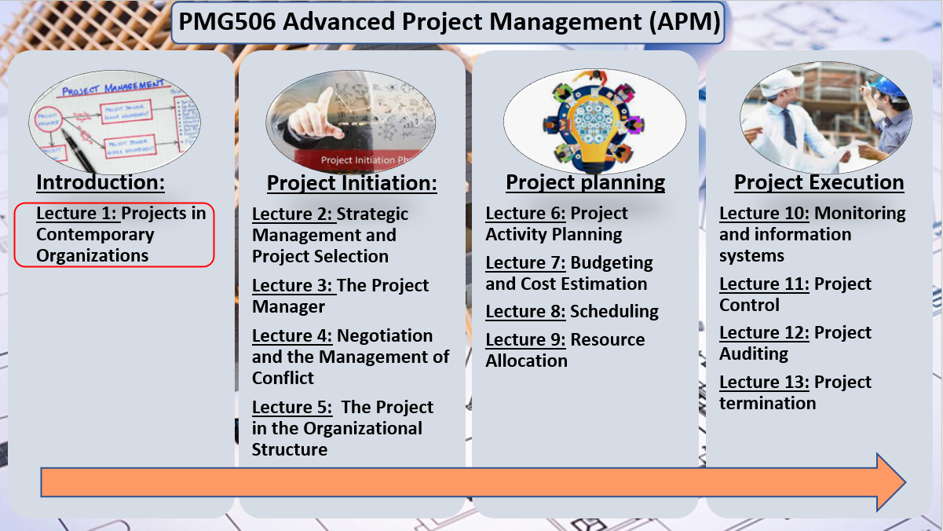
Lecture 1
Projects in Contemporary Organizations

Slide 5
Lecture 1
Projects in Contemporary Organizations
Project management provides an organization with powerful tools that improve its ability to plan, implement, and control its activities as well as the ways in which it utilizes its people and resources.
Project management has emerged because the characteristics of our contemporary society demand the development of new methods of management. Of the many forces involved, three are paramount:
the exponential expansion of human knowledge;
the growing demand for a broad range of complex, sophisticated, customized goods
and services
(3) the evolution of worldwide competitive markets for the production and consumption
of goods and services

Slide 6
Lecture 1
Projects in Contemporary Organizations
Forces Fostering Project Management:
First, the expansion of knowledge allows an increasing number of academic disciplines to be used in solving problems associated with the development, production, and distribution of goods and services.
Second, satisfying the continuing demand for more complex and customized products and services depends on our ability to make product design an integrated and inherent part of our production and distribution systems.
Third, worldwide markets force us to include cultural and environmental differences in our managerial decisions about what, where, when, and how to produce and distribute output.

Slide 7
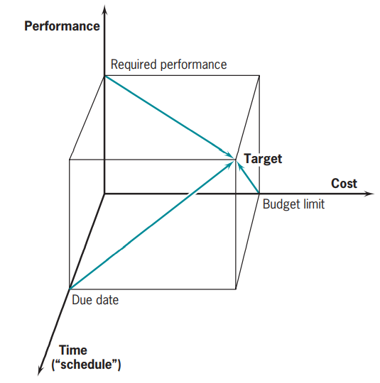
Lecture 1
Projects in Contemporary Organizations
Three Project Objectives:
All undertakings have much in common, they are complex, multidisciplinary, and have the same general objectives—performance (or scope), time, and cost.
We refer to these as “direct” project objectives or goals.
The fourth dimension is the expectations of the client.
The expectations of client and project team should be aligned and integrated throughout the entire project, but rarely are.

Slide 8
Lecture 1
Projects in Contemporary Organizations
The Project Manager:
The project manager (PM) is expected to integrate all aspects of the project, ensure that the proper knowledge and resources are available when and where needed, and above all, ensure that the expected results are produced in a timely, cost-effective manner.
The project manager’s job is not without problems.
There is the ever-present frustration of being responsible for outcomes while lacking full authority to command the requisite resources or personnel.
There are the constant problems of dealing with the parties involved in any project—senior management, client, project team, and public—all of whom seem to speak different languages and have different objectives.
There are the ceaseless organizational and technical “fires to be fought.”
There are vendors who cannot seem to keep “lightning-strike-me-dead” promises about delivery dates. This list of troubles only scratches the surface.

Slide 9
Lecture 1
Projects in Contemporary Organizations
Trends in Project Management:
Achieving Strategic Goals
Projects that do not have clear ties to the strategy and mission are terminated and their resources are redirected to those that do.
Achieving Routine Goals
This is because lower level management has become aware that projects accomplish their performance objectives within their budget and deadline, and hope to employ this new tool to improve management of their functions.
improving Project Effectiveness
The creation of a formal Project Management Office and the evaluation of an organization’s project management “maturity”

Slide 10
Lecture 1
Projects in Contemporary Organizations
Trends in Project Management:
Virtual Projects
Team members may never physically meet before the team is disbanded and another team reconstituted
Quasi-Projects
The final performance (or “scope”) requirements may not be understood, the time deadline unknown, and/or the budget undetermined.

Slide 11
Lecture 1
Projects in Contemporary Organizations
1.1THE DEFINITION OF A “PROJECT”
A project is “A temporary endeavor undertaken to create a unique product, service or result”
project, program, task, and work packages.
Program refer to an exceptionally large, long-range objective that is broken down into a set of projects. These projects are divided further into tasks, which are, in turn, split into work packages that are themselves composed of work units.

Slide 12
Lecture 1
Projects in Contemporary Organizations
Attributes that characterize projects:
Importance
It must be important enough in the eyes of senior management to justify setting up a special organizational unit outside the routine structure of the organization.
Performance
A project is usually a one-time activity with a well-defi ned set of desired end results. Often, the project itself must be coordinated with other projects being carried out by the same parent organization
Life Cycle with a Finite Due Date
From a slow beginning they progress to a build-up of size, then peak, begin a decline, and finally must be terminated by some due date.
Interdependencies
Projects often interact with other projects being carried out simultaneously by their parent organization.

Slide 13
Lecture 1
Projects in Contemporary Organizations
Attributes that characterize projects:
Uniqueness
Every project has some elements that are unique. No two construction or R & D projects are precisely alike.
Resources
The attempt to obtain additional resources (or any resources) leads to the next attribute conflict.
Conflict
The PM must be expert in conflict resolution, but we will see later that there are helpful types of conflict. The PM must recognize the difference.

Slide 14
Lecture 1
Projects in Contemporary Organizations
Attributes that characterize projects:
Nonprojects and Quasi-Projects
The use of a manufacturing line to produce a flow of standard products is a nonproject. The production of weekly employment reports, the preparation of school lunches, checking your e-mail. They are all routine
One common quasi-project in the information systems area is where the project includes discovery of the scope or requirements of the task itself (and possibly also the budget and deadline).

Slide 15
Lecture 1
Projects in Contemporary Organizations
1.2 WHY PROJECT MANAGEMENT?
The basic purpose for initiating a project is to accomplish specific goals. The reason for organizing the task as a project is to focus the responsibility and authority for the attainment of the goals on an individual or small group.
The project form of organization allows the manager to be responsive to:
  (1) the client and the environment,
(2) identify and correct problems at an early date,
(3) make timely decisions about trade-offs between conflicting project goals,
(4) ensure that managers of the separate tasks that comprise the project do not optimize the performance of their individual tasks at the expense of the total project—that is, that they do not suboptimize.

Slide 16
Lecture 1
Projects in Contemporary Organizations
1.2 WHY PROJECT MANAGEMENT?
Advantages of using Project Management
  Better control
  Better customer relations
  Increase in their return on investment
  Shorter development times
  Lower costs
  Higher quality and reliability
  Higher profit margins
  Sharper orientation toward results
  Better interdepartmental coordination
  Higher worker morale

Slide 17
Lecture 1
Projects in Contemporary Organizations
1.2 WHY PROJECT MANAGEMENT?
Disadvantages of using Project Management
  Greater organizational complexity
  Organizational policy violation
  Higher costs,
  More management difficulties
  Low personnel utilization
The disadvantages seem to be the price one pays for the advantages. On the whole, the balance weighs in favor of project organization if the work to be done is appropriate for a project.

Slide 18
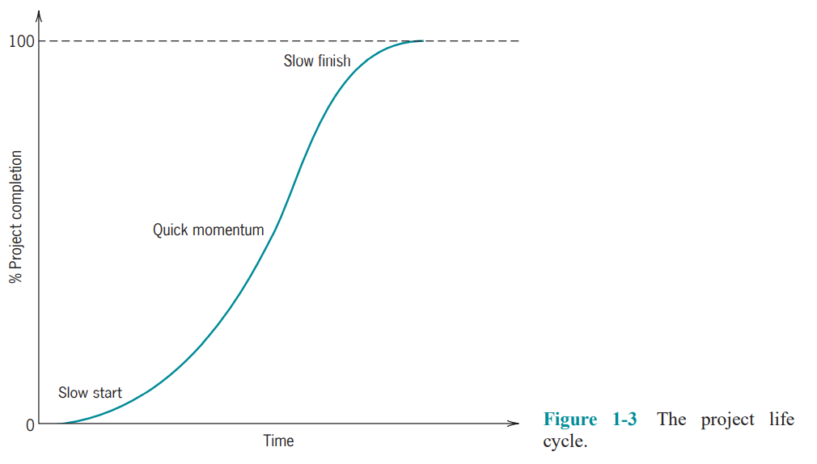
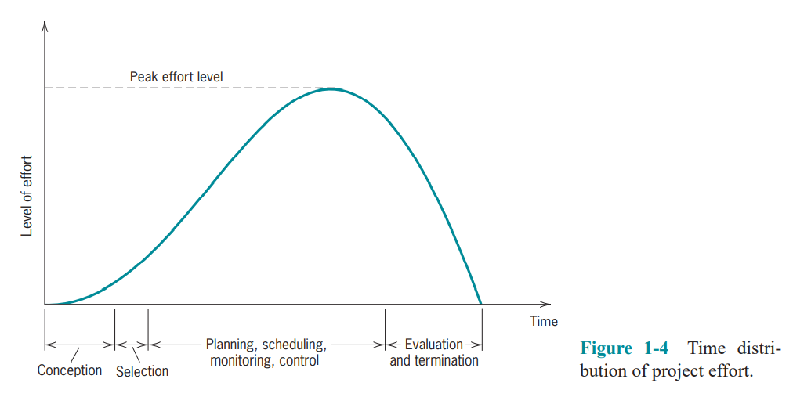
Lecture 1
Projects in Contemporary Organizations
1.3 THE PROJECT LIFE CYCLE
Most projects go through similar stages on the path from origin to completion, these stages are the project’s life cycle.

Slide 19
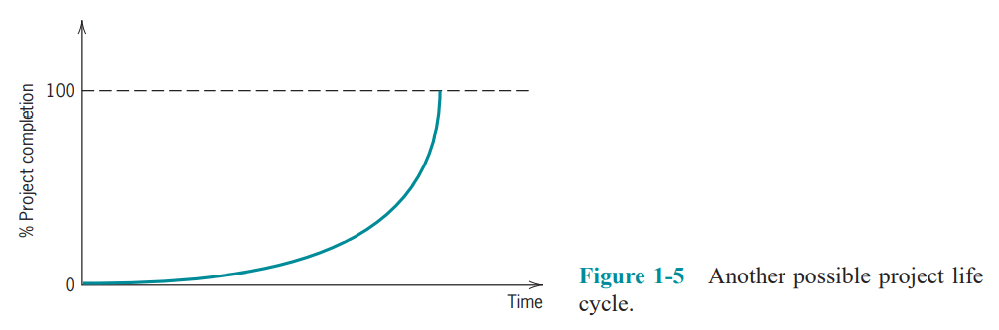
Lecture 1
Projects in Contemporary Organizations
There is a strong correlation between the life-cycle progress curve of Figure 1-3 and the effort curve of Figure 1-4 because effort usually results in corresponding progress.
For the S-shaped life cycle in Figure 1-3, percentage of project completion is closely correlated with cost, or the use of resources.
However, for the exponential progress curve in Figure 1-5, the expenditure of resources has little correlation with progress, at least in terms of final benefit.

Slide 20
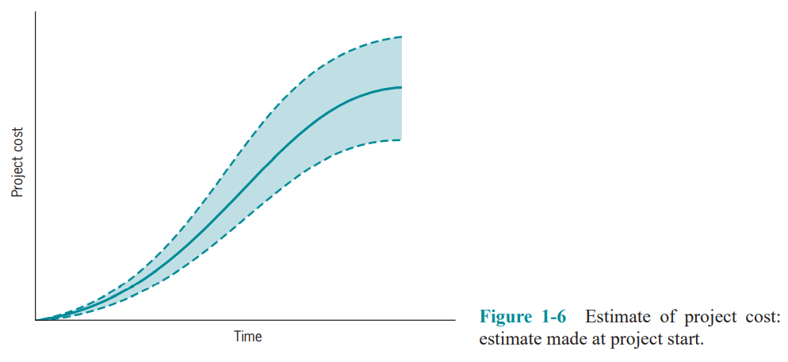
Lecture 1
Projects in Contemporary Organizations
Risk During the Life Cycle:
There may be considerable uncertainty about our ability to meet project goals (performance, time, and cost). The crosshatched portion of Figure 1-6 illustrates that uncertainty.

Slide 21
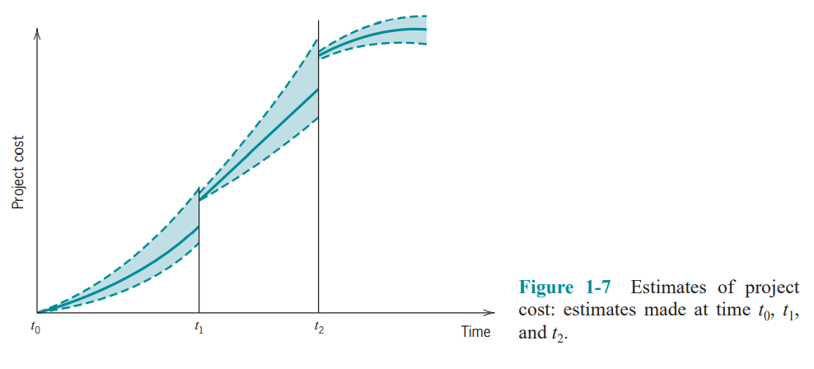
Lecture 1
Projects in Contemporary Organizations
Figure 1-7 shows how the uncertainty decreases as the project moves toward completion. From project start time, t0, the band of uncertainty grows until it is quite wide by the estimated end of the project. As the project actually develops, the degree of uncertainty about the final outcome is reduced. (See the estimate made at t1, for example.) A later forecast, made at t2, reduces the uncertainty further. It is common to make new forecasts about project performance, time, and cost either at fixed intervals in the life of the project or when specific technological milestones are reached.

Slide 22
Lecture 1
Projects in Contemporary Organizations
1.4 THE STRUCTURE OF THIS TEXT
This approach is consistent with our belief that it is helpful to understand the entire process of project management in order to understand and manage its parts.

Slide 23
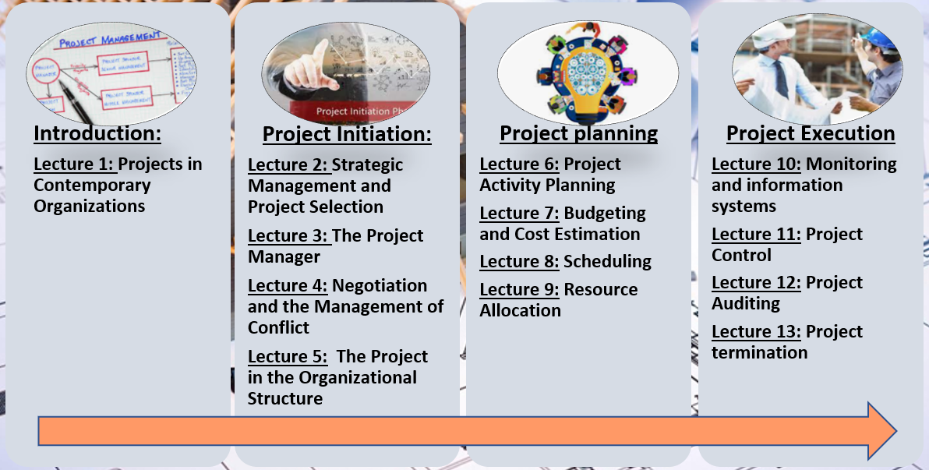
Lecture 1
Projects in Contemporary Organizations

Slide 24
Lecture 1
Projects in Contemporary Organizations
Important takeaways
This chapter introduced the subject of project management and discussed its importance in our society. It defined what we mean by a “project,” discussed the need for project management, and described the project life cycle.
The three primary forces behind project management are (1) the growing demand for complex, customized goods and services; (2) the exponential expansion of human knowledge; and (3) the global production– consumption environment.
The three prime objectives of project management are to meet specified performance within cost and on schedule.
Our terminology follows in this order: program, project, task, work package, work unit.
Projects are characterized by their importance, specific end results, a definite life cycle, complex interdependencies, some or all unique elements, limited resources, and an environment of conflict.

Slide 25
Lecture 1
Projects in Contemporary Organizations
Important takeaways
Project management, though not problem-free, is the best way to accomplish certain goals.
Projects often start slowly, build up speed while using considerable resources, and then slow down as completion nears.

Slide 26
Lecture 1
Projects in Contemporary Organizations
Glossary
Deliverables The desired elements of value, outcomes, or results that must be delivered for a project to be considered complete.
Interdependencies Relations between organizational functions where one function or task is dependent on others.
Life Cycle A standard concept of a product or project wherein it goes through a start-up phase, a building phase, a maturing phase, and a termination phase.
Parties-at-Interest Individuals or groups (the stakeholders) with a special interest in a project, usually the project team, client, senior management, and specific public interest groups.
Program Often not distinguished from a project, but frequently meant to encompass a group of similar projects oriented toward a specific goal.
Project Management The means, techniques, and concepts used to run a project and achieve its objectives.

Slide 27
Lecture 1
Projects in Contemporary Organizations
Glossary
Risk The chance that project processes or outcomes will not occur as planned.
Suboptimize Doing the best within a function or area but at a cost to the larger whole. Task A subset of a project, consisting of work packages.
Technology The means for accomplishing a task.
Trade-off Taking less on one measure, such as performance, in order to do better on another, such as schedule or cost.
Uncertainty Having only partial or no information about the situation or outcomes, often due to ambiguity or complexity.
Work Package A subelement of a task at the lowest level in the Work Breakdown Structure, used to assign costs and values.

Slide 28
Lecture 1
Projects in Contemporary Organizations
Thank you

