Slide 1





Interaction Design (DGM 729)
Prepared by
Dr. Mohamed Owies
Lecture 5
Interaction Design(DGM 729)

Slide 2



Chapter 5
Planning and Discovery Methods
Interaction Design

Slide 3




Lecture 5
Content
lecture 5 includes the following points:
method 1
UX Questionnaire
method 2
UX Project Plan
method 3
Listening Tour
method 4
Opportunity Workshop
method 5
Project Brief
method 6
Strategy Workshop

Slide 4
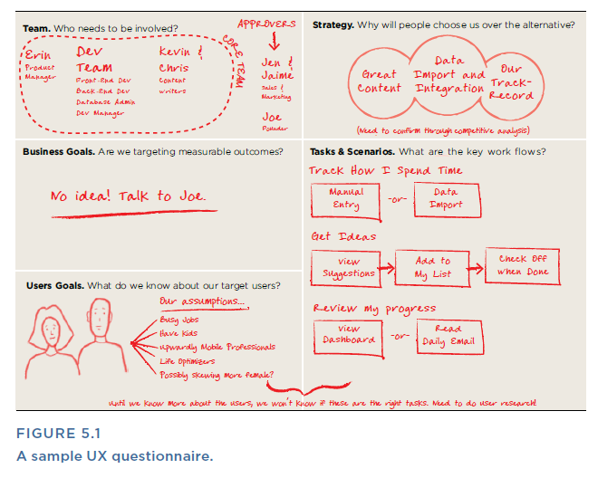
Lecture 5
UX Questionnaire
How much do you know about your product and the user experience that it’s intended to provide? What else do you need to know?
A user experience questionnaire is deceptively simple: it’s just a standard list of questions for you to ask yourself about a product or user experience at the start of any engagement. Why not just start working on the user experience and see where things go? In theory, if a product has a clear purpose and a specific audience, and you have some good ideas for how to improve the user experience, then you’re all set.

Slide 5
Lecture 5
UX Questionnaire
Of course, product design can go off track for any number of reasons. UX work, in particular, often is brought in as a silver bullet to solve what can be a dizzying set of challenges, ranging from lack of product strategy to issues with the organizational structure. The user interface is often where these problems become visible.
A good user experience questionnaire can help you spot issues early on, which puts you in a better position to point out all those red flags and prevent them from putting the design at risk. On a more practical level, a user experience questionnaire can also help you make sure that the goals are clear and that you know what you’re designing and why.

Slide 6
Lecture 5
UX Questionnaire
A good user experience questionnaire will also get you thinking about what work still needs to be done and how you might want to proceed. This then feeds into the “UX Project Plan”
You can create a template like the one shown in Figure 5.1 to make it an easily repeatable process. As you can see, the final document doesn’t have to be too polished. Mostly, it’s a scratch pad for you to help yourself think through specific questions.

Slide 7
Lecture 5
UX Questionnaire
Use When
• You’re about to start work on a new project and have questions about whether you’re set up for a successful engagement. You wonder if there is more planning, positioning, or strategic thinking that needs to be done before the user experience design can be improved.
• At any point to help you assess your own understanding of the product

Slide 8
Lecture 5
UX Questionnaire
Try It Out
1. Ask yourself some key questions.
Set aside an hour at the start of a project to answer the following questions.
• Team: Who is responsible for the product? Who is in charge?
Who sponsors changes or new work (for example, whose budget does it come out of)? Who has approval power? Who knows about the history of the product and why certain decisions are made? (These individuals would be good to talk to.) Who determines the strategic direction for the product? Who specifies what the features and functions should be? Who currently designs them? Who builds them? Who should you keep in the loop with regular project updates? Who maintains it?

Slide 9
Lecture 5
UX Questionnaire
• Goals: What are the project goals? Ideally, you can summarize this as a short list of things you aim to achieve with this project. If you have three to five items on this list, you’re probably in good shape. If the project has dozens of goals, expectations may be overly broad or ambitious. Ask around to figure out which ones are top priority, and which are less critical, if push comes to shove.
• Users: Who are the target users? Describe the main categories of users who will use the product in as much detail as possible. Why do they use the product? What are their primary motivators, passions, and goals? If the answer is “our users are everybody,” this is a red flag. Talk to colleagues to try to define your target users with more specificity.

Slide 10
Lecture 5
UX Questionnaire
• Strategy: What is the value proposition of the product?
Why do people use it? Why do they choose to use it over competitors’ products? What does the product stand for? What is the product vision?
• Tasks and scenarios: What are the primary tasks and scenarios that the design should support?
• Success measures: How does the product make money? Which levers influence whether the product is profitable or not? What user behaviors translate to profit? What key performance indicator are tracked? Are there any other numbers that people track to determine if the product is performing well or poorly?

Slide 11
Lecture 5
UX Questionnaire
• Key dates and milestones: Are there any significant deadlines
that you should be aware of, either related to one-off projects or
regular production or milestones?
• Risks: Are there any significant red flags that you see upfront?
2. If you don’t know, ask.
If you encounter a question, you don’t know the answer to, ask a co-worker—or even a few of them. Different people may give you different perspectives on the situation.

Slide 12
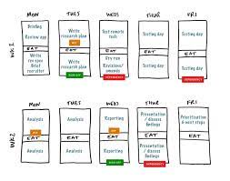
Lecture 5
UX Project Plan
Method 2
UX Project Plan
What UX practices will you employ to design a great user experience?
A UX project plan shouldn’t be confused with the overall project plan, which is usually owned by a project manager and includes such things as engineering and quality assurance. The UX project plan may help you think about how UX work will integrate with the broader project timeline, but it is primarily your plan for how you’re going to conduct UX activities.

Slide 13
Lecture 5
UX Project Plan
1. First, make sure you understand the goals of the project.
Try to summarize them in a few short statements. The goals should speak to the business or behavioral change that you hope to create through your work.
2. Brainstorm relevant methods.
Start free-listing activities that you think will help you achieve your goal. Sometimes, it helps to start by working backward. For example, if the project goal is to produce more inbound sales leads, you’ll need to make it easier for customers to understand and be excited by your services and request more information. To do that, you’ll need to redesign your landing pages. But before that, you’ll need to understand users’ perceptions of the landing pages now, why they’re going there, and in what ways the site does and doesn’t currently meet their needs.

Slide 14
Lecture 5
UX Project Plan
3. Estimate duration.
Once you’ve got a solid list of activities that you think will help achieve the project goal, estimate the time you think each activity will take.
4. Place milestones.
Talk to your colleagues—especially those who are responsible for specific milestones relating to the product—and find out if there are key milestones or firm deadlines that you need to be aware of. Often, these will influence how much time you have for each step and, in turn, what type of activity you choose. For example, do you need to have a functioning prototype ready in four weeks? If so, maybe you don’t have time for extensive in-the-field contextual research.

Slide 15
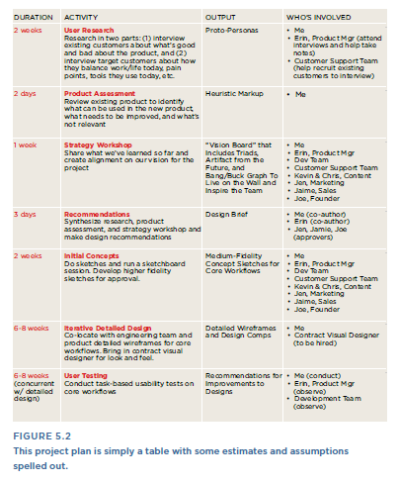
Lecture 5
UX Project Plan
5. Create a simple document.
Put your plan together in a simple document that lays out activity, duration, inputs, outputs, and who needs to be involved. You can also show points of overlap or dependencies with the broader project plan. Figure 5.3 shows how you can lay out a Project Plan to visualize dependencies.

Slide 16
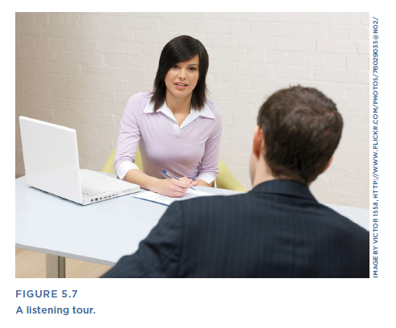
Lecture 5
Listening Tour
Method 3
Listening Tour
What are the team’s priorities, and how much awareness and support for UX currently exists?
A listening tour is time set up to gather information and learn what matters to your colleagues. Especially for teams of one, knowing the priorities of others will help you identify where there are opportunities and problems to solve, and where user-centered design practices might be a good fit. Sometimes, UX practitioners describe this as stakeholder interviews, and they usually take the format shown in Figure 5.7, just you and a colleague chatting in an office or conference room.

Slide 17
Lecture 5
Listening Tour
Whatever the label, the goal is the same: to learn about your colleagues’ priorities and goals, and to formulate a point of view on the role of UX in helping them accomplish those goals. If you’re lucky on your listening tour, you’ll be pleasantly surprised by how much people already value human-centered products (as evidenced by code words like “user-friendly,” “intuitive,” and inevitably, “Apple”). If you’re less lucky, you might find that people have a wary and seasoned caution about what can and cannot be done. But that’s valuable information, too.

Slide 18

Lecture 5
Listening Tour
Try It Out
1. Ask yourself what you want to learn.
This could be as broad as understanding the overall priorities of the company, or as specific as learning what each person on this project sees as your role. having a few clearly stated learning objectives in mind will drive who you talk to and what questions you ask. To determine your key learning objectives, ask yourself, “If I learn nothing else, what are the two or three things I must understand better after talking with people?”

Slide 19
Lecture 5
Listening Tour
2. Next, put together your list of interviewees.
Ask colleagues or a supervisor whom they would recommend that you speak to. Leverage their knowledge of the organization. Or think in terms of roles and then attach names to those roles. For example, who has the budget for this project? Who will be engineering the product? Who is marketing it? Who has ultimate veto power over the design? In any case, aim to speak to a cross-functional team so you can see the project or product from a variety of angles.
3. Write down your questions.
Basically, an interview guide is just a list of questions you want to ask. These questions should ultimately roll up to your learning objectives, but you may find that you need to ask them in different ways, depending on the role of the person you’re talking with.

Slide 20
Lecture 5
Listening Tour
Here are some good generic questions to start with:
• What’s your role in the organization, and how does it relate to the product?
• What are your goals and objectives in your role? What are your top priorities? How do you know if you’re successful? How do you measure success?
• How does your work impact customers? Who do you consider to be your primary customers? Can you describe them? What are their priorities and goals? Why do they use your products? What prevents them from using your products, if anything? What questions do you have about your users that you don’t currently have answers to?
• Who are your competitors, and how well are you doing compared
to them? What do you do well? What could be improved? What differentiates your company and your products in the market? • [If there’s a specific project underway that you’re involved in…] What
are your goals for this project? What is your vision for how this project will improve our product? Do you see any risks or red flags?

Slide 21
Lecture 5
Listening Tour
4. Start listening.
Schedule one-on-ones and ask your questions. Each conversation will probably be different, but try to refer back to your learning objectives in each one, so you can compare answers and spot interesting differences in points of view. If you’re the shy type, or you feel like it will be awkward to ask for people’s time and start interview in them in this way, here are a couple of things that may help:
• Offer to keep it short. Even 30 minutes of someone’s time is better
than nothing, and it’s a lot harder for people to turn you down.
You might even offer to take them out to coffee for this meeting,
which tends to make the conversation more natural and friendly.

Slide 22
Lecture 5
Listening Tour
5- Figure out what you heard.
After you have finished all your interviews, review your notes and tease out the big themes. Pay particular attention to:
• Expectations people have of you or of user experience.
• Assumptions and working knowledge about users. What do you absolutely know to be true, what things are merely hunches, and are there any gaping holes in your knowledge?
• Problems or concerns with the existing product.
• Things that have been tried in the past that haven’t worked well and why.
• Questions to follow up at a later date.
• Who wants to be actively involved with UX and in what ways?

Slide 23

Lecture 5
Opportunity Workshop
Method 4
Opportunity Workshop
What areas of the product are most in need of improvement from a UX perspective?
An opportunity workshop is a way to quickly assess what work needs to be done to improve the user experience, what’s the highest priority from a business perspective, and what will have the most impact from a user perspective.

Slide 24
Lecture 5
Opportunity Workshop
Try It Out
1. Host a work session.
Block off at least two hours on the calendar and invite together a cross-functional team of people who all work on the product.
2. State the goals of the work session.
• To identify issues and pain points in the current product or process
• To prioritize from a UX point of view
• To help the team decide on the next steps to address or improve any of them.

Slide 25
Lecture 5
Opportunity Workshop
3. Uncover problem areas.
Guide the team in a pain storm activity on Post-it notes or index cards, as shown in Figure 5.8. Ask everyone to write down as many things they can think of that are:
• A problem in the current product
• A missed opportunity in the current product
• Just plain important to get right in the product
• One-by-one, ask people to share their Post-it notes, and put them on the wall where others can see them.

Slide 26
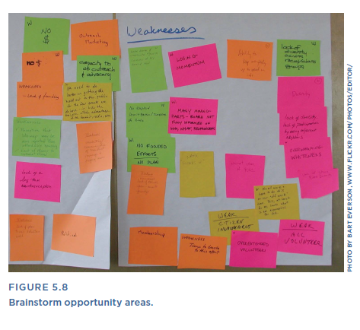
Lecture 5
Opportunity Workshop
4. Discuss strengths.
Next, ask the team to write down the product’s strengths—again, one strength per sticky note, as shown in Figure 5.9. It’s useful to follow problem areas with strengths so that the team ends on a positive note, even if the overall discussion may have been constructively critical.

Slide 27
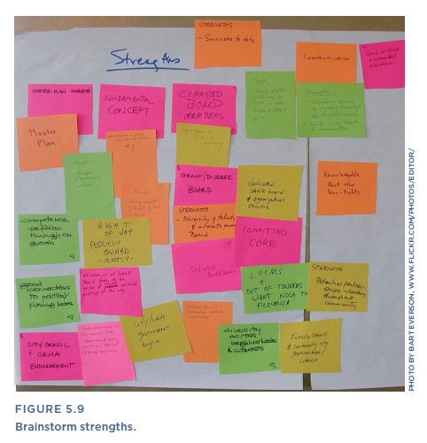
Lecture 5
Opportunity Workshop
5. Find themes.
Next, guide the team in an activity to organize the issues that were identified into related groupings. Once some clear groups begin to emerge, ask the team to label each group. Put the label on another sticky note (preferably of a different size or color, so it stands out from the other Post-its) so everyone can easily stand back and see the issues and opportunities as broad themes.

Slide 28
Lecture 5
Opportunity Workshop
6. Prioritize.
Now, lead the team in a prioritization exercise.
This could just be a discussion. Or, to make it more structured, give everyone a certain number of votes, and ask them to put their votes next to the clusters that they think are most urgent to address, improve, or enhance.
7. Discuss.
Once the priorities have been clearly identified, lead the group in a discussion about how urgently these should be addressed, and how you’d like to address them.

Slide 29
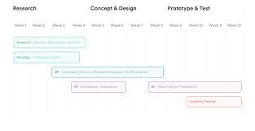
Lecture 5
Project Brief
Method 5
Project Brief
What are expected outcomes for this user-centered design project?
Often, when a project is beginning, everyone involved has distinct ideas for what the right outcome looks like. In team discussions, it’s possible for people to express their point of view and think they’re all saying the same thing, but actually have very different ideas of what they expect to see. A project brief states directly what goals or expectations should prevail as the main mandate for the work.

Slide 30
Lecture 5
Project Brief
The brief, as its name suggests, capitalizes on the cardinal virtue of brevity to distinctly and clearly summarize the overall plan for the project: what you’re doing, why you’re doing it, relevant constraints that will drive your work, and what outcomes you expect. Another bonus of the brief is that by being a short description, it’s more likely that people will actually read it. This creates an opportunity for everyone to agree or, if not agree, at least have a productive conversation about the focus and goals of the project.

Slide 31
Lecture 5
Project Brief
Use When
• You’re starting a new project.
• You’ve inherited an in-progress project or have joined a team that’s already been working together, but you need to get clarity and alignment on what you’re ultimately expected to deliver.
Try It Out
1. Determine the right building blocks for your project brief.
Based on your organization and what you’re working on, here are some key questions to ask yourself (either on paper or just in your head) when you’re teeing up a project. Note that these questions reflect many of the things you think about when doing a “UX Questionnaire” (described earlier in this chapter), so if you’ve already completed one of those, you can start by pulling your answers from there.

Slide 32

Lecture 5
Project Brief
• Business needs. What business needs are driving this project? If this is successful, what will be the impact on business? What is the revenue model for this product? What measurable impact will improving this product have?
• User needs. Who are your customers? What are their primary needs? What do you know about them? What don’t you know about them? What assumptions are you making about them that you need to validate?
• Goals. What are your team’s goals? What are your personal goals? How will you personally know if you are successful? When capturing goals, be careful not to confuse the what with the how. A how might be “redesigning your company website.” The what in this case might be “to produce more inbound sales leads through the company’s website.”

Slide 33
Lecture 5
Project Brief
• Key expectations. What are they expecting from you? Are there any discrepancies between their picture of your role and yours? What questions might they have? What things should you address prior to kicking off the work?
Consider also whether there are softer, but no less important, qualities of the work that are relevant to the overall project mandate. For example, what is the product’s value proposition, and what brand characteristics should the work reinforce or activate? If there are known design principles that should be reflected in the output, what are they? (If not, see the “Design Principles” method in Chapter
7, “Design Methods,” for guidance.)

Slide 34
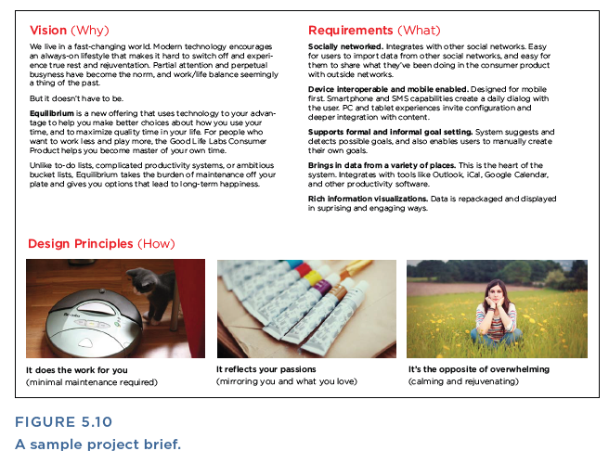
Lecture 5
Project Brief
2. Write up what you know, or your best guesses, into a short document.
Ideally, a project brief should fit on one page, so you can print it out and stick it on the wall for an ever-present reminder of the top priorities. The example shown in Figure 5.10 has just a few key sections: what we’re building; who it’s for; and what the user experience should ultimately feel like from a user’s point of view.
3. Circulate the document.
Share it with team members and key project sponsors, and get their agreement or input. If you have a hard time getting feedback by email, turn it into a meeting. Or visit people where they work.
4. Regularly revisit and make sure that you’re on track.
After the team agrees on the brief, revisit it at major milestones of the project and use it as a framework for communicating how the work is progressing toward the overall high-level goals outlined in the brief itself.

Slide 35
Lecture 5
Strategy Workshop
What is our vision for the ideal user experience, and what do we need to focus on to bring that unique experience to life?
There is a special moment that’s just right for a strategy workshop, and it’s early in the process before design has been kicked off. It’s the time when optimism and interest in “what could be” are at their highest.

Slide 36
Lecture 5
Strategy Workshop
This stage gets people when they are most likely to engage with an open mind, and times it so that strategic thinking can influence the ultimate work plan. In a strategy workshop, you’re leveraging the collective wisdom of a cross-functional team to begin to establish a vision and a strategy for your user experience. When people talk about strategy, often they’re using the same word to talk about very different concepts. To one person, strategy is about prioritization and having a timeline. To another, it might mean establishing a vision for the future. Neither is wrong, and a strategy workshop can help you get clarity on both.

Slide 37
Lecture 5
Strategy Workshop
Try It Out
1. State your goals.
Decide on your goals for the workshop. Are they to:
• Articulate what makes the product unique?
• Create an inspiring picture of the future of your product that can unify and motivate the team?
• Prioritize features and areas to focus on?
• Determine what your team should be focusing on now, next,
and later?
2. Make a plan.
Once you have identified your goals, think about how you need to structure the workshop to achieve them. A stakeholder workshop can include a hodgepodge of different activities, depending on your needs for that particular project, team, and time. A range of activities is described further in the sections that follow.

Slide 38
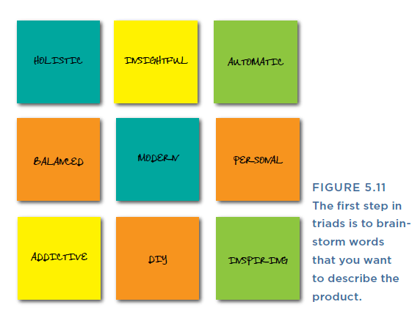
Lecture 5
Strategy Workshop
Triads
Triads help you explore the identity of your product, starting with a simple word-listing exercise. For this activity, get the team to brainstorm a list of keywords that they would like the product to embody, as shown in Figure 5.11.

Slide 39
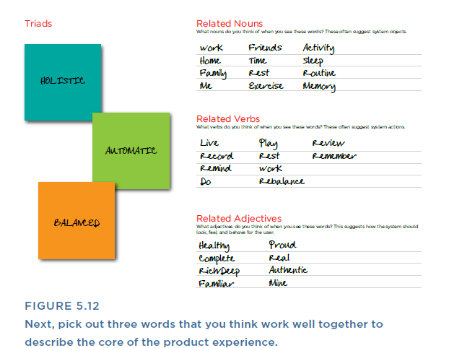
Lecture 5
Strategy Workshop
The second step is shown in Figure 5.12. Pick three words that you’d put together to describe the core of the product experience. Work with the group to identify combos that are interesting to them. Then, for that particular three-word combo, brainstorm related nouns, verbs, and adjectives that might go with a product built around this triad:
• Nouns help you think about actors or objects that you might have in the system.
• Verbs help you think about actions that the system should support.
• Adjectives help you think about the more fuzzy and abstract parts of the experience, like how it should feel, how it should look, and what design principles should be evident throughout.

Slide 40

Lecture 2
Thank You

