Slide 1



Project Planning
Lecture 8
PMG202
Project Execution
Prepared by
Lec. Dina ElWakkad
www.midocean.ae

Slide 2


www.midocean.ae

Slide 3
In this lesson, we’ll:
Learn the steps, methodology, and processes that lead to successful Project Execution.
Find Project Execution Steps and Processes, the causes and solutions to Execution Gaps , and helpful tools to support your Project’s next success, such as a Project Execution Checklist, solutions to prevent Execution Gaps.
www.midocean.ae

Slide 4
The Project Execution definition
www.midocean.ae

Slide 5
The Project Execution definition
The term Project Execution, also known as Project Implementation, refers to the actions a Team takes during the third phase of the project lifecycle, as outlined by Project Management Institute (PMI).
During the Project Execution Phase, a Project moves from planning to completion.
www.midocean.ae

Slide 6
The Project Execution definition
The term Project Execution Process (PEP) refers to the set of tasks needed to produce Deliverables.
Team members decide and assign Execution tasks during the Project Planning phase.
Execution process involves coordinating people and resources, as well as integrating and performing the activities of the project in accordance with the Project Plan.
www.midocean.ae

Slide 7
The Project Execution Steps
www.midocean.ae

Slide 8
The Project Execution Steps
The steps in Project Execution include a series of tasks to deliver a Project on Time, within Scope, and under Budget.
We can break down the major actions required during Project Execution into 4 categories:
  produce deliverables,
  manage the team and stakeholders,
  monitor and control,
  change management
www.midocean.ae

Slide 9
The Project Execution Steps
  Produce deliverables:
In order to build deliverables for clients and stakeholders, you’ll need to complete the following actions:
  Review customer requirements.
  Allocate and monitor the time required to complete each task.
  Control the quality in line with the user or client needs.
www.midocean.ae

Slide 10
The Project Execution Steps
  Manage the team and stakeholders:
It takes time to build trust and develop leadership skills within a team. Similarly, stakeholders need continuous engagement, and managing people in the project involves the following:
  Cultivate the team. Dedicate time and necessary resources to build a cohesive team.
  Communicate regularly with both the team and stakeholders on project needs and reporting status.
  Procurement of resources and supplies (as needed).
www.midocean.ae

Slide 11
The Project Execution Steps
  Monitor and Control:
Monitor and control is considered its own phase within a five-phase project lifecycle diagram, occurring directly after the execution stage (phase three).
However, it is often combined with the execution phase because they technically occur simultaneously to keep the project on track.
When you see a four-phased project lifecycle diagram, the team has combined execution (phase three) and monitoring and controlling (phase four) into one phase, typically referring to it as the “implementation” or “delivery” phase before the final closing phase.
Regardless of which lifecycle diagram you use, monitoring and controlling requires several steps to ensure the team is meeting customer requirements and operations deliver a quality product. Steps include the following: Manage your time - Manage the budget. -Verify project scope.
www.midocean.ae

Slide 12
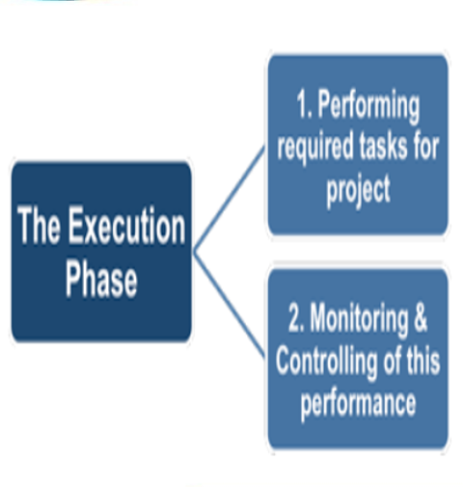
The Project Execution Steps
www.midocean.ae

Slide 13
The Project Execution Steps
Change Management:
Project managers use tools and processes to help manage change, typically by doing the following:
  Issue change requests.
  Create a CID (change, issues, decisions) log to track change requests.
  Document results and update organizational policies/processes as needed.
  Record lessons learned.
www.midocean.ae

Slide 14
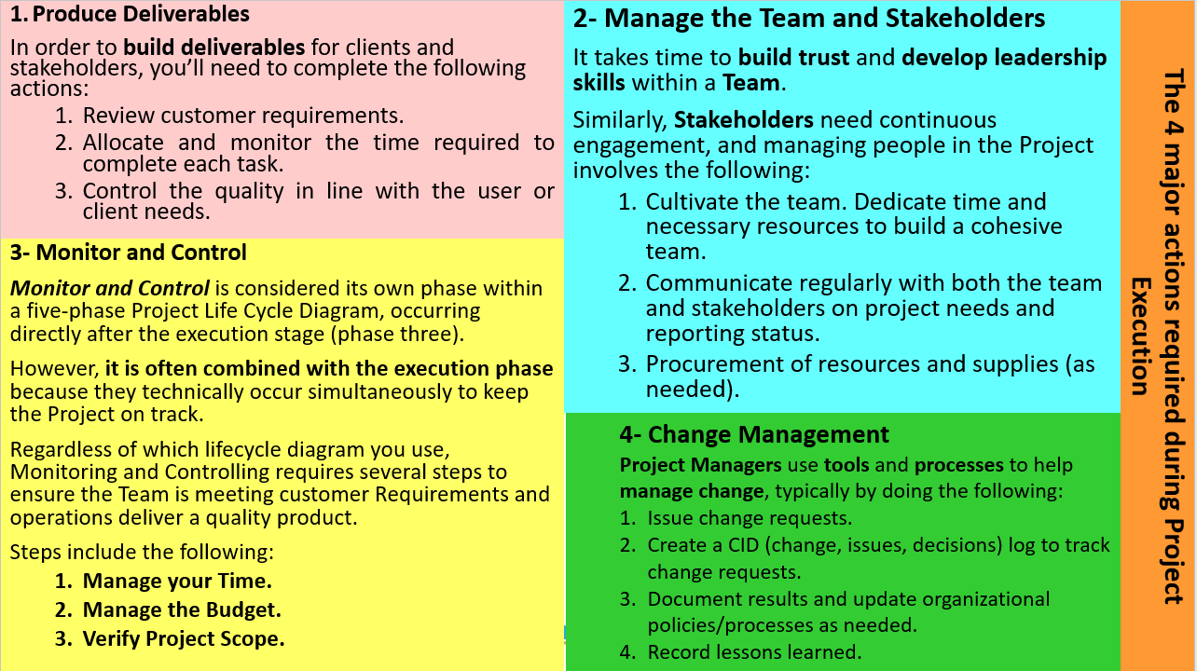

Slide 15
The Project Execution Checklist
www.midocean.ae

Slide 16
The Project Execution Checklist
A Project Execution Checklist helps organize all of the moving parts of the Execution Process.
Furthermore, a Checklist can help you keep track of what’s done and not done throughout the Project Execution.
A Project Execution Checklist will include categories identified by the Project Manager or Team.
www.midocean.ae

Slide 17
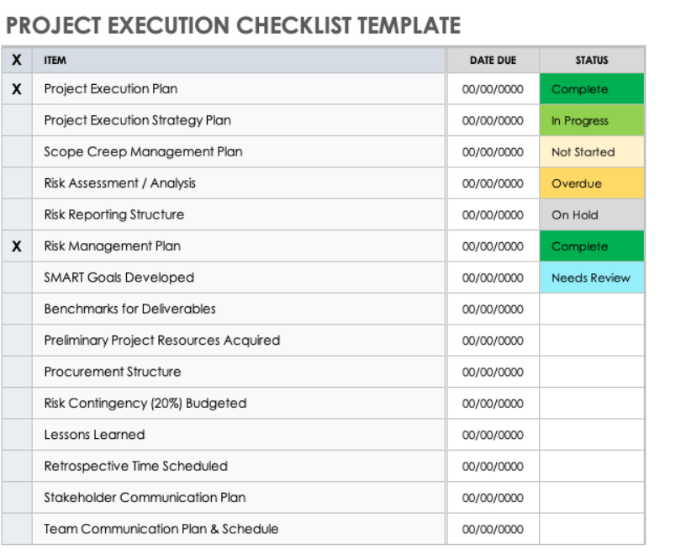
The Project Execution Checklist Template
www.midocean.ae

Slide 18
Project Execution Gaps and Causes
www.midocean.ae

Slide 19
Project Execution Gaps occur when the real-time execution of a Project fails to meet the Strategy or Goals developed during planning.
Williams’ research identifies six primary gaps that prevent successful project execution:
Absence of common understanding
Disengaged executive sponsors
Misalignment with strategic goals
Poor change management
Ineffective corporate governance
Poor leadership
www.midocean.ae

Slide 20
How to Close a Project Execution Gap
There are two pieces to closing the gap:
Aligning the strategic plan goals and objectives with an implementation plan
Executing in the program and project delivery of outcomes that meet those objectives
www.midocean.ae

Slide 21
Project Execution Gaps and Causes
During the Project, create a Gap Analysis to identify each gap’s cause and create a framework for developing a solution.
Changing organizational culture, managing up, and educating the Project reduces execution gaps beyond the immediate Project.
It is also beneficial to reflect on the Project Execution Gaps during Project Closing. This analysis and insight you gain at the conclusion of the Project will reduce Execution Gaps before they occur for any future Projects the Team takes on.
www.midocean.ae

Slide 22
Project Execution Challenges
www.midocean.ae

Slide 23
Project Execution Challenges
There are many challenges to successful project execution.
Problems may appear at any time during the project and need to be addressed right away.
www.midocean.ae

Slide 24
Project Execution Challenges
1) Communication:
Miscommunication can happen during any part of a project due to complex requirements.
Teams risk deteriorating communication if they are unaware of workflow reporting, role assignment, or generally lack a shared understanding.
www.midocean.ae

Slide 25
Project Execution Challenges
2) Personnel:
High-performing teams rely on personnel development, matching skills with the best role, and hiring the right people when possible.
Inefficient teams can form without care to develop cohesion among the team from day one or developing individuals to grow into roles.
www.midocean.ae

Slide 26
Project Execution Challenges
3) Sponsor Engagement:
A strong sponsor relationship is essential to project success.
Challenges with sponsors occur when the sponsor is not invested in the project or has underdeveloped skills for the role.
www.midocean.ae

Slide 27
Project Execution Best Practices
www.midocean.ae

Slide 28
Project Execution Best Practices
Project Execution best practices aim to create a Team with the model qualities of a high-performing Team.
www.midocean.ae

Slide 29
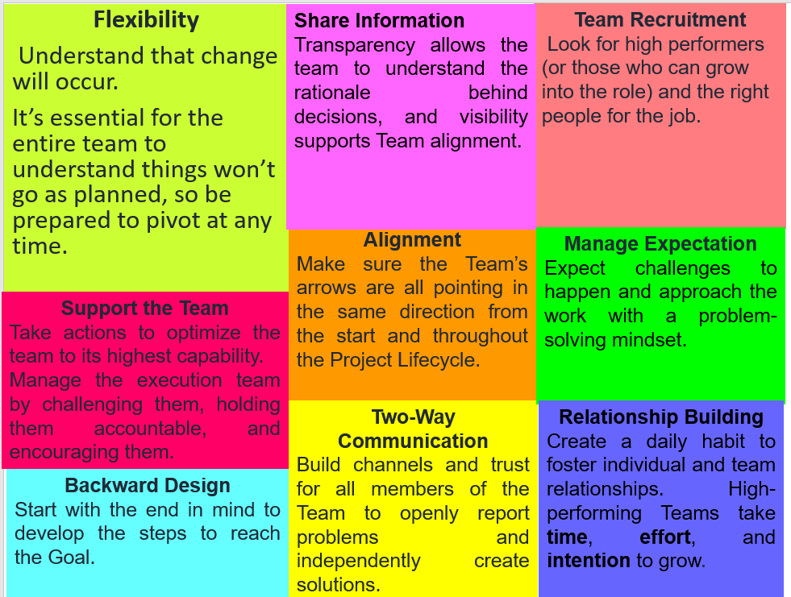
www.midocean.ae

Slide 30


Slide 31
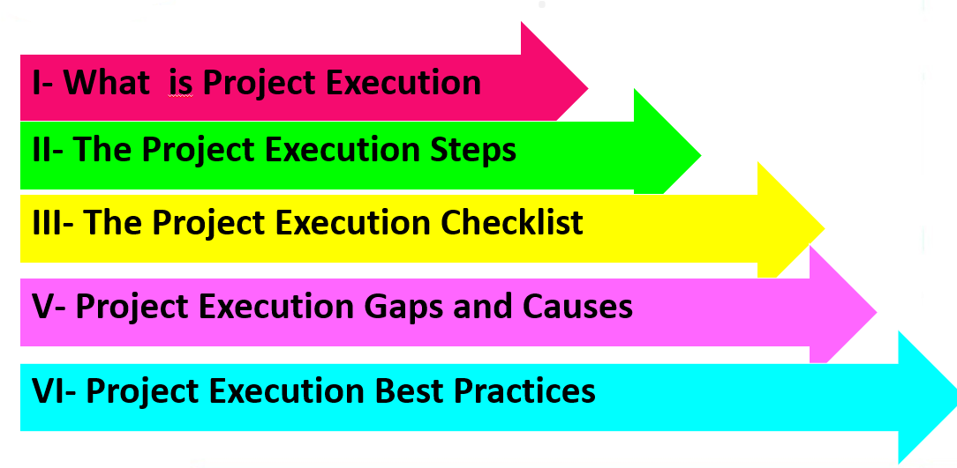
www.midocean.ae

Slide 32

www.midocean.ae

Slide 33
Questions
Project Execution during the….. The third phase of the project lifecycle The second phase of the project lifecycle The first phase of the project lifecycle The last phase of the project lifecycle
------------ refers to the set of tasks needed to produce Deliverables. Project Execution Process (PEP) Project Management Process (PMP) Project Planning Process (PPP) Project Controlling Process (PCP)
www.midocean.ae

Slide 34
Questions
To produce deliverables, you should---- All answers are correct Review customer requirements. Allocate and monitor the time required to complete each task. Control the quality in line with the user or client's needs
Monitor and Control include---------- All answers are correct Manage your time. Manage the budget. Verify project scope
www.midocean.ae

Slide 35
Questions
-----------helps organize all of the moving parts of the Execution Process. A Project Execution Checklist A Project Execution table A Project Execution graph A Project Execution line
Which of the following is one of the challenges facing the project Execution process? All answers are correct. Miscommunication Inefficient teams underdeveloped Sponsors
www.midocean.ae

Slide 36
Questions
During the Project Execution Phase, a Project moves from ------- planning to completion. initiation to completion. planning to budget. planning to risk management.
The execution process involves coordinating people and resources, as well as integrating and performing the activities of the project in accordance with --------- The Project Plan. The Project Checklist. The Project Workfile. Project book.
www.midocean.ae

Slide 37
Questions
Which of the following represents the project implementation steps: All answers are correct produce deliverables manage the team and stakeholders monitor and control
Manage the team and stakeholders include: All answers are correct Cultivate the team Communicate regularly with both the team and stakeholders Procurement of resources
www.midocean.ae

Slide 38
Questions
The team has combined execution (phase three) and monitoring and controlling (phase four) into one phase, typically referring to it as--------- The “implementation” or delivery The “implementation” phase only The “delivery” phase only All answers are incorrect
(PEP) refers to-------- Project Execution Process Performance Evaluation Process Project Energy Process All answers are incorrect
www.midocean.ae

Slide 39
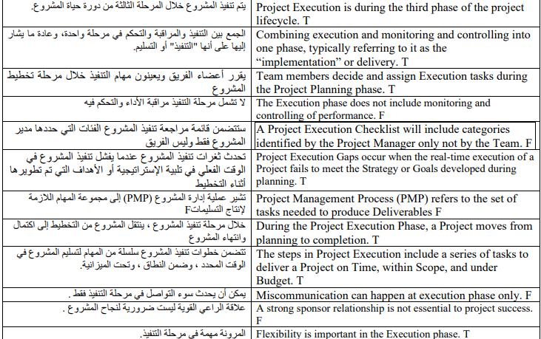
Questions
www.midocean.ae

Slide 40


Thank You

