Slide 1


Advanced Project Management
LECTURE 2
Everyone’s Smart
University
PMG 506
Project Quality Management

Slide 2

Learning Outcomes
At the end of this lecture students will be able to:
Explore the various definitions of quality and project quality management.
Understand the importance of project quality management.
Define project quality management and understand how quality relates to various aspects of projects.
Explore the Project Quality Management Processes.
Describe quality planning and its relationship to project scope management.
Discuss the importance of quality assurance.
Explore the three outputs of the quality control process.

Slide 3
Lecture Overview
definitions
Quality definition
Project quality management definition
Lecture Overview
(2) Project quality management processes
Quality planning
Quality assurance
Quality control

Slide 4
What Is Quality?
The International Organization for Standardization (ISO) defines quality as the totality of characteristics of an entity that bear on its ability to satisfy stated or implied needs.
Other experts define quality based on.
  - conformance to requirements: meeting written specifications.
  - fitness for use: ensuring a product can be used as it was intended.

Slide 5

Project Quality Management
Project Quality Management includes the processes & activities that determine quality polices, objectives & responsibilities to ensure that the project satisfies the needs for which it is undertaken.

Slide 6
Project Quality Management Definition
A subset of project management that includes the processes and activities of the performing organization that determine quality policies, objectives, and responsibilities so that the project will satisfy the needs for which it was undertaken.

Slide 7
Project Quality Management Processes
1. Quality planning: identifying which quality standards are relevant to the project and how to satisfy them
2. Quality assurance: evaluating overall project performance to ensure the project will satisfy the relevant quality standards
3. Quality control: monitoring specific project results to ensure that they comply with the relevant quality standards while identifying ways to improve overall quality

Slide 8

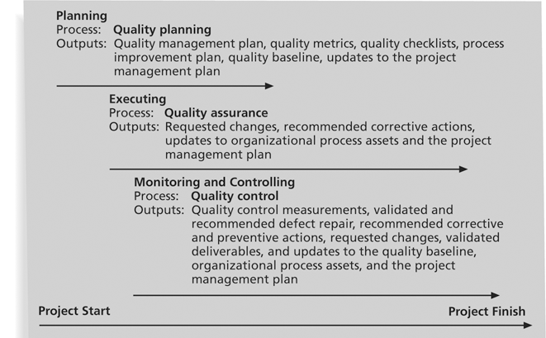
Project Quality Management Summary

Slide 9
1. Quality Planning
Implies the ability to anticipate situations and prepare actions to bring about the desired outcome.
Important to prevent defects by:
  - Selecting proper materials.
  - Training and indoctrinating people in quality.
  - Planning a process that ensures the appropriate outcome.

Slide 10
1. Quality Planning
Quality planning: identifying which quality standards are relevant to the project and how to satisfy the.

Slide 11
1. Quality Planning
It is important to design in quality and communicate important factors that directly contribute to meeting the customer’s requirements.
Design of experiments helps identify which variables have the most influence on the overall outcome of a process.

Slide 12
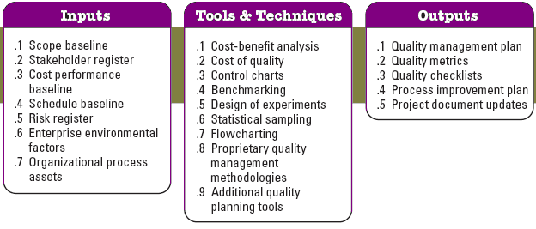
Quality Planning Flowchart

Slide 13

Quality Planning Inputs
1. Scope Baseline.
Scope statement: contain details of technical issues and other concerns.

Slide 14
Quality Planning Inputs
2. Stakeholder Register.
Identifies stakeholders with a particular interest in, or impact on, quality.
3. Cost performance Baseline.
Documents the accepted time phase used to measure cost performance.
4. Schedule Baseline.
Documents the accepted schedule performance measures including start and finish dates.

Slide 15
Quality Planning Inputs
5. Risk register.
  Threats and opportunities.
6. Enterprise Environmental Factors.
  Governmental agency regulations.
  Rules, standards & guidelines.
  working / operating conditions.

Slide 16
Quality Planning Inputs
7. Organizational process assets.
  Organizational quality polices, procedures & guidelines.
  Historical databases.
  Lessons learned from previous projects.
  Quality policy.

Slide 17
Tools and Techniques for Quality Planning
1. Cost / Benefit analysis.
The planning process must consider benefit/cost tradeoffs.
The Primary Cost: Is the expanses associated with PQM activities.
The Primary Benefit: Is less work, higher productivity, lower costs, and increased stakeholder satisfaction.

Slide 18
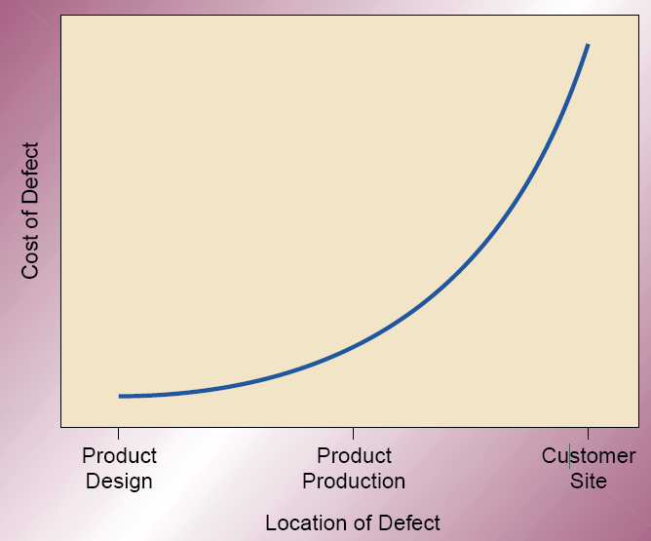
Tools and Techniques for Quality Planning
2. Cost of Quality ( COQ ).

Slide 19
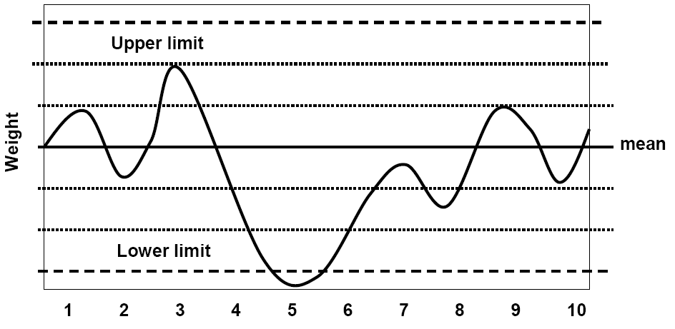
Tools and Techniques for Quality Planning
3. Control charts.
To determine whether or not a process is stable or has predictable performance.

Slide 20
Tools and Techniques for Quality Planning
4. Benchmarking.
Benchmarking involves comparing actual or planned project practices to those of other projects to generate ideas to:
1- Generate ideas for improvement.
2- provide a standard for measurement of performance.

Slide 21
Tools and Techniques for Quality Planning
5. Design of Experiments DOE.
Aims to define variables that have most influence on the overall outcome.
Commonly applicable to the product of the project issues.
Used in project management issues such as cost and schedule tradeoffs to allow for optima solutions.

Slide 22
Tools and Techniques for Quality Planning
6. Statistical Sampling.
Choosing part of a population of interest for inspection.
Sample frequency and sizes should be determined during the plan quality process.

Slide 23
Tools and Techniques for Quality Planning
7. Flowcharting.
The flowcharting techniques in quality management generally include:
cause and effect diagram.
System or process flow charts.
Flowcharting can help in anticipating probable quality problems and thus helps to develop approaches for dealing with them.

Slide 24

Tools and Techniques for Quality Planning
8. Quality Management Methodologies.
Six Sigma, Lean Six Sigma, Quality Function Deployment, etc

Slide 25
Tools and Techniques for Quality Planning
9. Additional Quality Planning Tools.
Brainstorming.
Affinity diagrams.
Nominal group techniques.
Matrix diagrams.
Prioritization matrices.
Force field analysis.

Slide 26
Outputs from Quality Planning
1. Quality Management Plan.
The Quality Plan should address:
Quality Control of the project.
Quality Assurance.
Quality Improvement of the project.

Slide 27
Outputs from Quality Planning
2. Quality Metrics.
  On-time performance, budget control, defect frequency, failure rate, availability, reliability and test coverage.
3. Quality checklists.
  A structured tool used to verify that a set of required steps or requirements have been performed.

Slide 28
Outputs from Quality Planning
4. Process Improvement Plan.
  Process boundaries.
  Process configurations.
  Process metrics.
  Targets for improved performance.

Slide 29
Outputs from Quality Planning
5 Project Document Updates.
  Stakeholder register.
  Responsibility Assignment Matrix.

Slide 30
2. Quality Assurance
Quality assurance includes all the activities related to satisfying the relevant quality standards for a project.
  Another goal of quality assurance is continuous quality improvement.

Slide 31
2. Quality Assurance
Benchmarking generates ideas for quality improvements by comparing specific project practices or product characteristics to those of other projects or products within or outside the performing organization.

Slide 32
2. Quality Assurance
A quality audit is a structured review of specific quality management activities that help identify lessons learned that could improve performance on current or future projects.
  Perfomed by in-house auditors or third parties.

Slide 33
2. Quality Assurance
Process of auditing the quality requirements and the results from quality control measurements to ensure appropriate quality standards and operational definitions are used.
Continuous process improvement reduces waste and eliminates activities that do not add value.

Slide 34
2. Quality Assurance
Quality assurance: evaluating overall project performance to ensure the project will satisfy the relevant quality standards.

Slide 35
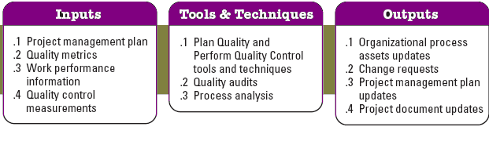
Quality Assurance Flowchart

Slide 36
Inputs To Quality Assurance
1. Project management plan.
  Quality management plan : how quality assurance will be performed.
  Process improvement plan: steps for analyzing processes to identify activities which enhance their value.
2. Quality Metrics.

Slide 37
Inputs To Quality Assurance
3. Work Performance Information.
  Technical performance measures.
  Project deliverables status.
  Schedule progress.
  Costs incurred.

Slide 38
Inputs To Quality Assurance
4. Quality Control Measurements.
  To analyze the quality standards and processes of the performing organizations.

Slide 39
Tools and Techniques For Quality Assurance
1. Plan quality and Perform Quality Control Tools & Techniques.
2. Quality Audits.
  Identify all the good/best practices being implemented.
  Identify all the gaps/shortcomings.
  Share the good practices introduced or implemented.
  Proactively offer assistance in a positive manner.
  Highlight contributions of each audit in the lessons learned.

Slide 40
Tools and Techniques For Quality Assurance
3 Process analysis.
  Examines problems experienced, constraints. experienced and non-value-added activities.
  Includes root cause analysis to develop the required preventive actions.

Slide 41
Outputs From Quality Assurance
1. Organizational Process Assets Updates.
2. Change requests.
  To increase effectiveness and/or efficiency of the policies, processes and procedures.
3. Project Management Plan Updates.
  Quality management plan.
  Schedule management plan.
  Cost management plan.

Slide 42
Outputs From Quality Assurance
4. Project Document Updates.
  Quality audits reports.
  Training plans.
  Process documentation.

Slide 43
3. Quality Control
Quality control: monitoring specific project results to ensure that they comply with the relevant quality standards while identifying ways to improve overall quality.

Slide 44
3. Quality Control
Although one of the main goals of QC is to improve quality, its main outcomes are:
  Acceptance decisions: are the products/services acceptable or should they be rejected and rework is then necessary.
  Rework : action taken to bring rejected items into compliance with products specs. Can be very expensive.
  Process adjustments : correct or prevent further quality problems based on quality control measurements (purchase faster server if response time is too slow).

Slide 45
3. Quality Control
The main outputs of quality control are:
  acceptance decisions.
  Rework.
  process adjustments.
Some tools and techniques include:
  Pareto analysis.
  statistical sampling.
  Six Sigma.
  quality control charts.

Slide 46
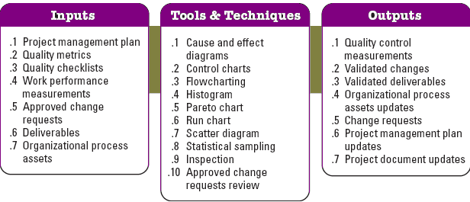
Quality Control Flowchart

Slide 47
Inputs To Quality Control
1. Project Management Plan.
2. Quality Metrics.
3. Quality Checklists.
4. Work performance measurements.
  Planned vs. actual technical performance.
  Planned vs. actual schedule performance.
  Planned vs. actual cost performance.

Slide 48
Inputs To Quality Control
5. Approved change requests.
6. Deliverables.
7. Organizational process assets.
  Quality standards & polices.
  Standards & work guidelines.
  Issue and defect reporting procedures and communication polices.

Slide 49

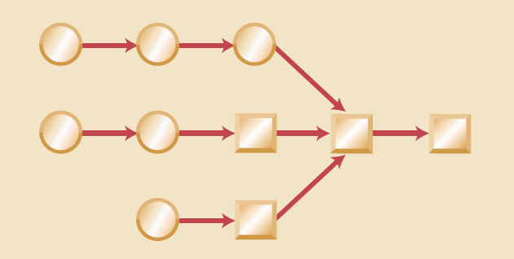
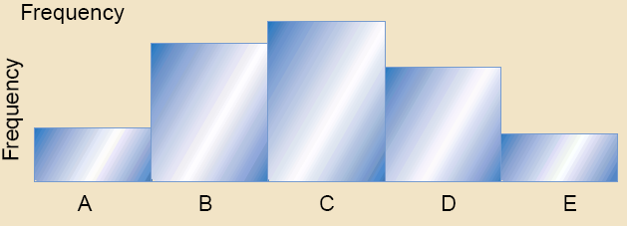
Tools and Techniques for Quality Control
1. Cause & Effect Diagram.
2. Control Charts.
3. Flowcharting.
4. Histogram.

Slide 50

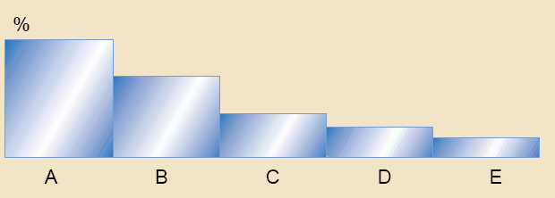
Tools and Techniques for Quality Control
5. Pareto Diagram.
A Pareto diagram is a histogram ordered by frequency of occurrence which shows how many results were generated by what category or identified cause.

Slide 51

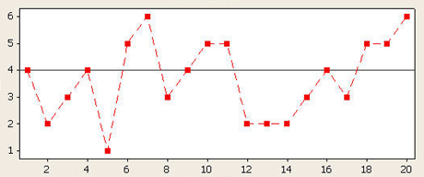
Tools and Techniques for Quality Control
6. Run Chart.
Shows trends in a process over time, variation over time, or declines or improvements in a process over time.
Trend analysis is often used to monitor:
  - Technical performance.
  - Cost & schedule performance.

Slide 52
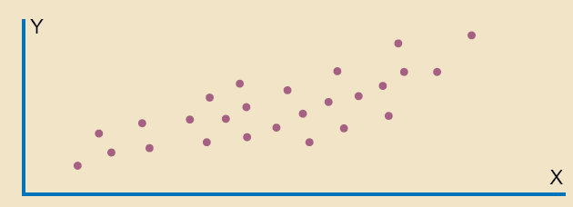
Tools and Techniques for Quality Control
7. Scatter diagram
8. Statistical Sampling

Slide 53

Tools and Techniques for Quality Control
9. Inspection.
  Examination of a work product to determine whether it confirms to documented standards.
10. Approved change requests review.

Slide 54
Outputs for Quality Control
1. Quality Control Measurements.
Documented results of quality control activities in the format specified during quality planning.
2. Validated changes. where the inspected items will either be accepted or rejected and those rejected may be reworked.
3. Validated deliverables.

Slide 55
Outputs for Quality Control
4. Organizational Process Assets Updates.
  Completed checklists.
  Lessons learned.
5. Change requests.
  A change request should initiated in accordance with the defined perform integrated change control.

Slide 56
Outputs for Quality Control
6. Project Management Plan Updates.
  Quality management plan updates.
  Process improvement plan updates.

Slide 57
Outputs for Quality Control
7. Project document updates.
Completed Checklists, which become a part of a project record when they are used.
Process Adjustments, which involves immediate corrective or preventive action as a result of quality control measurements.

Slide 58
Thank You For your Attention!
Dr. Adam Yagoub Abker Hamad
Assistant professor- of Business Administration
EVERYONE’S SAMART- Uni

