Slide 1

Operating Systems
Prepared by Dr. Alaa Mohamed
Module 8
Threads & Protection in OS

Slide 2
Chapter 4: Threads
Module
8
Threads (Objectives)
Motivation of using threads
Multithreading Models
Threading Issues

Slide 3
Motivation
Module
8
The general structure of a process assumes that the process has an address space with a single sequential execution sequence. Which leads to low resource utilization.
Thread is a mechanism to provide multiple execution control to the processes

Slide 4
Motivation
Module
8
Most modern applications are multithreaded
Threads run within application
Multiple tasks with the application can be implemented by separate threads
  Update display
  Fetch data
  Spell checking
  Answer a network request
Process creation is heavy-weight while thread creation is light-weight
Can simplify code, increase efficiency
Kernels are generally multithreaded

Slide 5
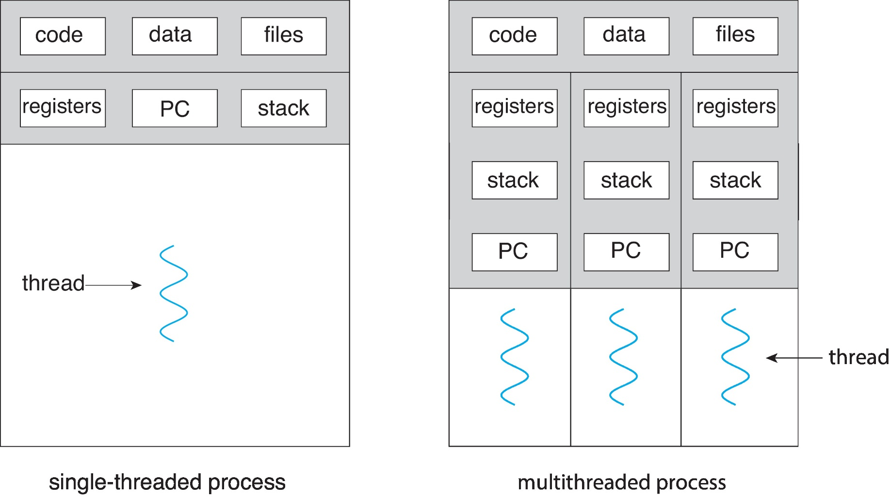
Single and Multithreaded Processes
Module
8

Slide 6
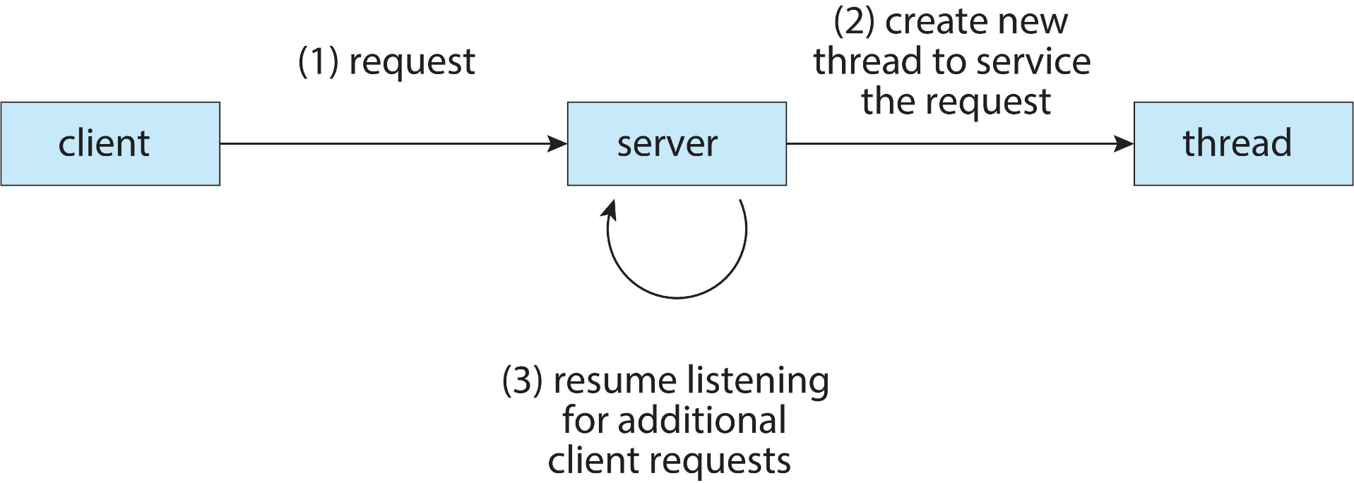
Multithreaded Server Architecture
Module
8

Slide 7
Benefits
Module
8
Responsiveness – may allow continued execution if part of process is blocked, especially important for user interfaces
Resource Sharing – threads share resources of process, easier than shared memory or message passing
Economy – cheaper than process creation, thread switching lower overhead than context switching
Scalability – process can take advantage of multicore architectures

Slide 8
Multicore Programming
Module
8
Multicore or multiprocessor systems putting pressure on programmers, challenges include:
  Dividing activities
  Balance
  Data splitting
  Data dependency
  Testing and debugging
Parallelism implies a system can perform more than one task simultaneously
Concurrency supports more than one task making progress
  Single processor / core, scheduler providing concurrency

Slide 9
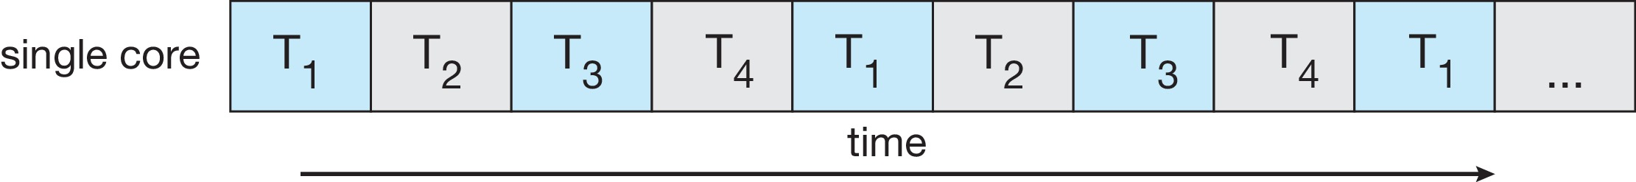
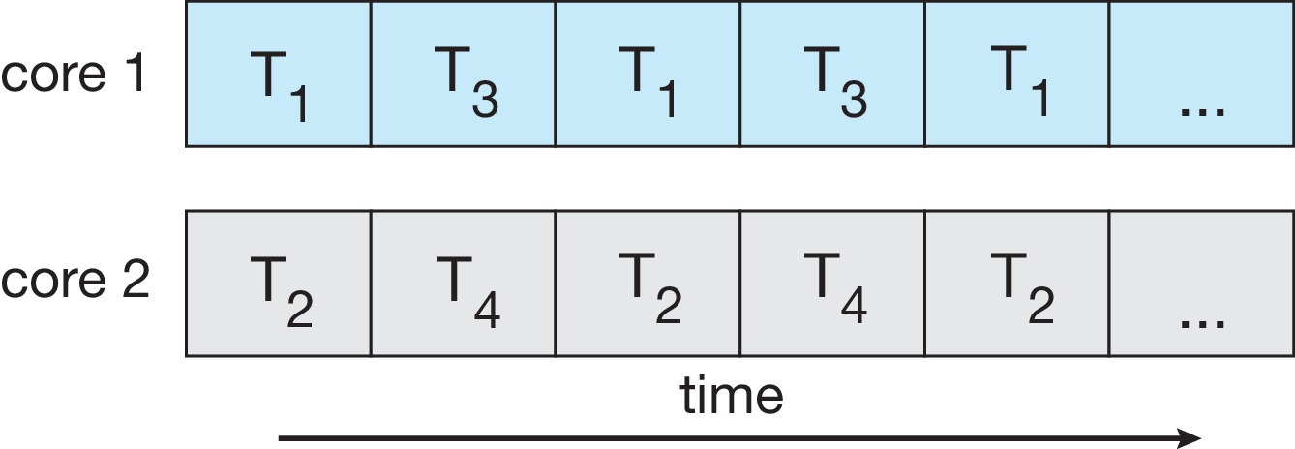
Concurrency vs. Parallelism
Module
8
Concurrent execution on single-core system:
Parallelism on a multi-core system:

Slide 10
Multicore Programming
Module
8
Types of parallelism
  Data parallelism – distributes subsets of the same data across multiple cores, same operation on each
  Task parallelism – distributing threads across cores, each thread performing unique operation

Slide 11
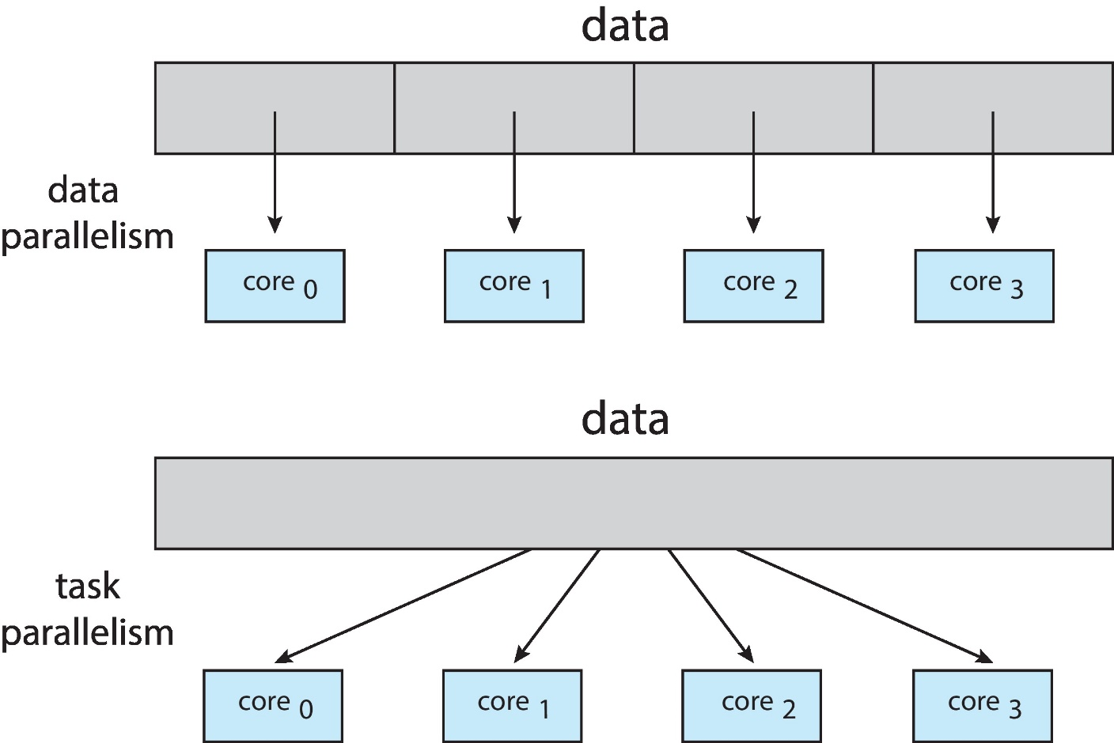
Data and Task Parallelism
Module
8

Slide 12
User Threads and Kernel Threads
Module
8
User threads - management done by user-level threads library
Three primary thread libraries:
  POSIX Pthreads
  Windows threads
  Java threads
Kernel threads - Supported by the Kernel
Examples – virtually all general purpose operating systems, including:
  Windows
  Linux
  Mac OS X
  iOS
  Android

Slide 13
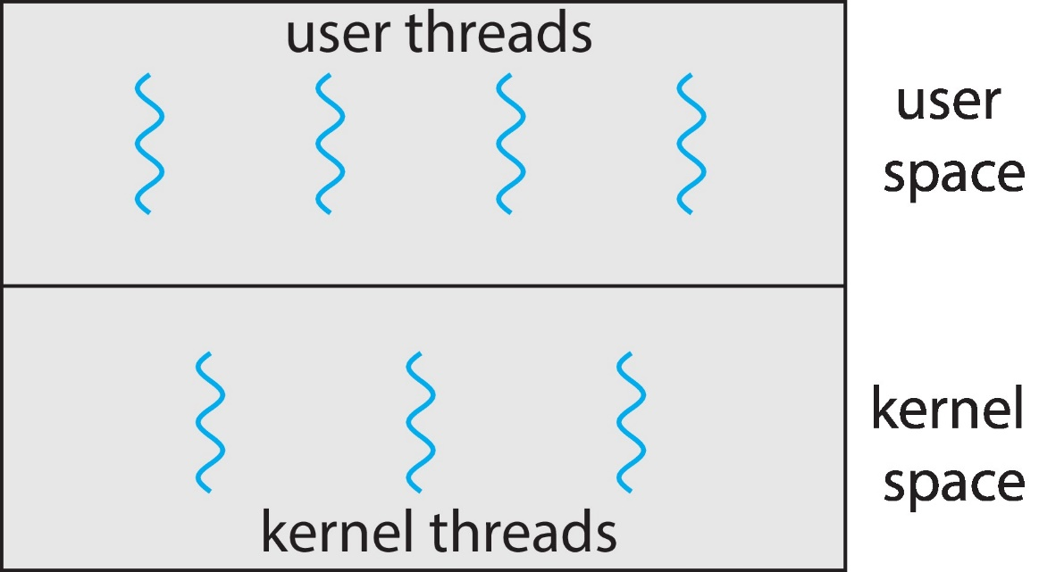
User and Kernel Threads
Module
8

Slide 14
Multithreading Models
Module
8
Many-to-One
One-to-One
Many-to-Many

Slide 15
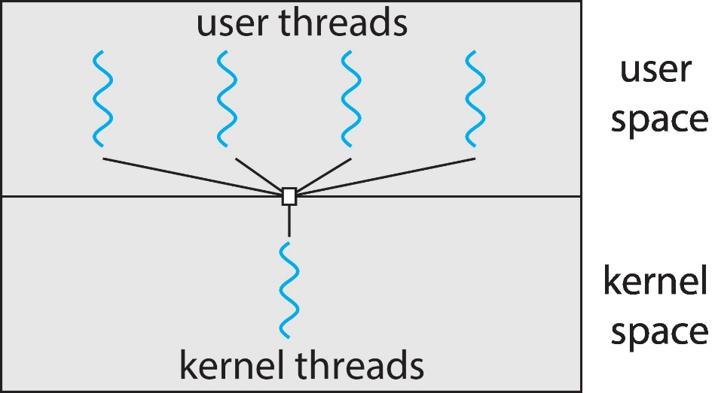
Many-to-One
Module
8
Many user-level threads mapped to single kernel thread
One thread blocking causes all to block
Multiple threads may not run in parallel on muticore system because only one may be in kernel at a time
Few systems currently use this model
Examples:
  Solaris Green Threads
  GNU Portable Threads

Slide 16
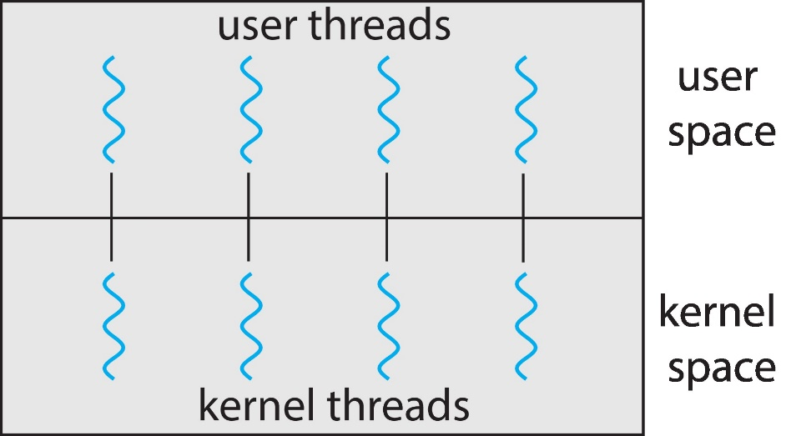
One-to-One
Module
8
Each user-level thread maps to kernel thread
Creating a user-level thread creates a kernel thread
More concurrency than many-to-one
Number of threads per process sometimes restricted due to overhead
Examples
  Windows
  Linux

Slide 17
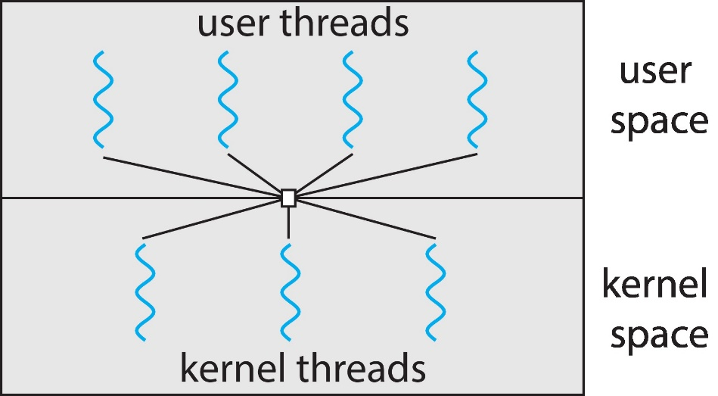
Many-to-Many Model
Module
8
Allows many user level threads to be mapped to many kernel threads
Allows the operating system to create a sufficient number of kernel threads
Windows with the ThreadFiber package

Slide 18
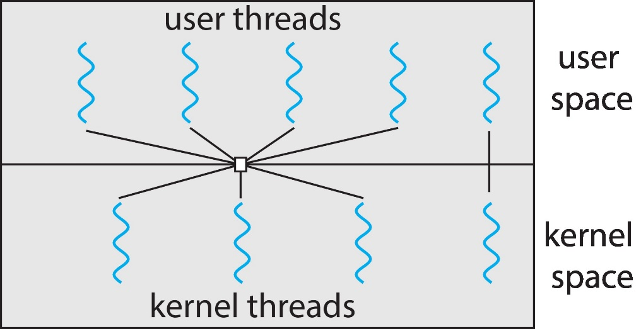
Two-level Model
Module
8
Similar to M:M, except that it allows a user thread to be bound to kernel thread

Slide 19
Threading Issues
Module
8
Thread cancellation of target thread
  Asynchronous or deferred
Thread-local storage
Scheduler Activations

Slide 20
Thread Cancellation
Module
8
Terminating a thread before it has finished
Thread to be canceled is target thread
Two general approaches:
  Asynchronous cancellation terminates the target thread immediately
  Deferred cancellation allows the target thread to periodically check if it should be cancelled

Slide 21
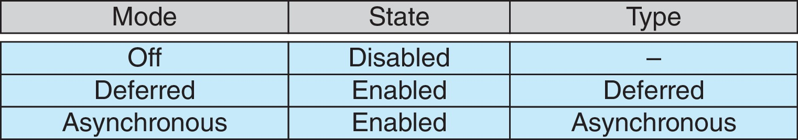
Thread Cancellation (Cont.)
Module
8
Invoking thread cancellation requests cancellation, but actual cancellation depends on thread state
If thread has cancellation disabled, cancellation remains pending until thread enables it
Default type is deferred
  Cancellation only occurs when thread reaches cancellation point

Slide 22
Thread-Local Storage
Module
8
Thread-local storage (TLS) allows each thread to have its own copy of data
Different from local variables
  Local variables visible only during single function invocation
  TLS visible across function invocations
Similar to static data
  TLS is unique to each thread

Slide 23
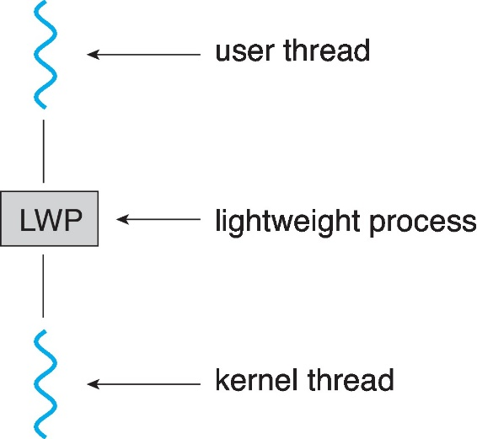
Scheduler Activations
Module
8
Both M:M and Two-level models require communication to maintain the appropriate number of kernel threads allocated to the application
Typically use an intermediate data structure between user and kernel threads – lightweight process (LWP)
  Appears to be a virtual processor on which process can schedule user thread to run
  Each LWP attached to kernel thread
  How many LWPs to create?
Scheduler activations provide upcalls - a communication mechanism from the kernel to the upcall handler in the thread library
This communication allows an application to maintain the correct number kernel threads

Slide 24
Protection (Objectives)
Module
8
Goals of Protection
Principles of Protection
Protection Rings
Domain of Protection
Access Matrix
Revocation of Access Rights
Access Control methods

Slide 25
Module
8
Overview
Protection: a mechanism for controlling the access of programs, processes, or users to the resources defined by a computer system.
This mechanism should impose controls together with a means of enforcement.

Slide 26
Module
8
Protection Goals
In any protection model, computer consists of a collection of objects, hardware or software
Each object has a unique name and can be accessed through a well-defined set of operations
Protection problem - ensure that each object is accessed correctly and only by those processes that are allowed to do so

Slide 27
Module
8
Principles of Protection
Guiding principle – An operating system following the principle of least privilege
  Programs, users and systems should be given just enough privileges to perform their tasks
  So, failure or compromise of a component does the minimum damage and allows the minimum damage to be done.

Slide 28
Module
8
Principles of Protection
  For Example:
  In UNIX OS— Normal user should not run as root.
    root user can execute privileged commands.
    Most users respect that to avoid accidental delete operation for which there is no corresponding undelete.
  Now consider that rather than human error, damage may result from malicious attack (Virus ,….etc).
    The principle of least privilege would give the system a chance to mitigate the attack
    if malicious code cannot obtain root privileges, then there is a chance that adequately defined permissions may block all, or at least some, of the damaging operations.
    Permissions can act like an immune system at the operating-system level.

Slide 29
Module
8
Principles of Protection
Another important principle,
often seen as a derivative of the principle of least privilege, is compartmentalization.
  Compartmentalization is the process of protecting each individual system component through the use of specific permissions and access restrictions.
  if a component is subverted, another line of defense will “kick in” and keep the attacker from compromising the system any further.
  Compartmentalization is implemented in many forms such as virtualization.

Slide 30
Protection Rings
Module
8
The main component of modern operating systems is the kernel, which manages access to system resources and hardware.
The kernel, is a trusted and privileged component and therefore must run with a higher level of privileges than user processes.
This privilege separation requires hardware support
A popular model of privilege separation is called protection rings.

Slide 31
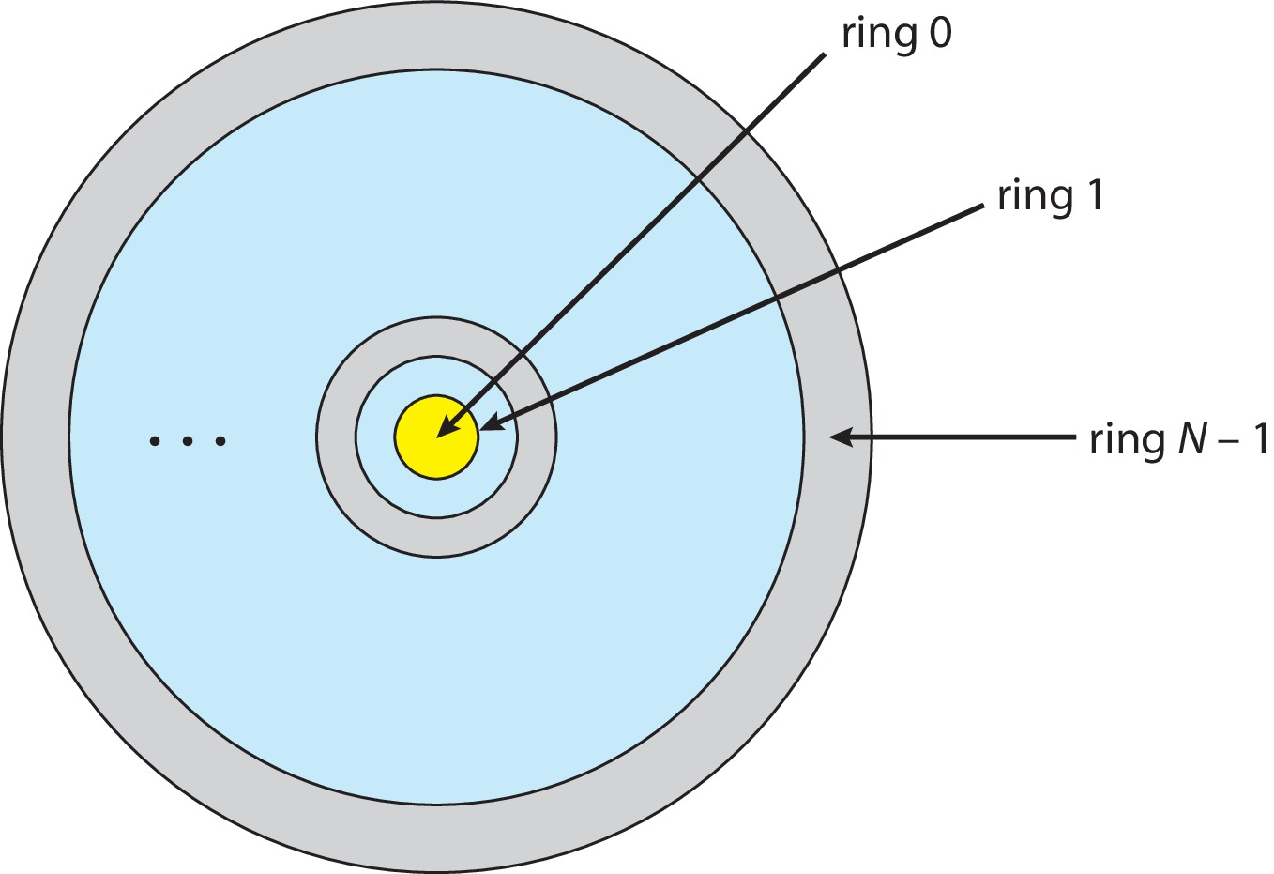
Protection Rings
Module
8
In this model, execution is defined as a set of concentric rings, with ring i providing a subset of the functionality of ring j for any j < i.
The innermost ring, ring 0, thus provides the full set of privileges.

Slide 32
Protection Rings
Module
8
When the system boots, it boots to the highest privilege level.
Code at that level performs necessary initialization before dropping to a less privileged level.
To return to a higher privilege level, code usually calls a special instruction, called gate.
The syscall instruction (in Intel) is one example (Switch from user to kernel).

Slide 33
Domain of Protection
Module
8
Rings of protection separate functions into domains and order them hierarchically
Computer can be treated as processes and objects
  Hardware objects (such as devices) and software objects (such as files, programs, semaphores
Process should only have access to objects it currently requires to complete its task.

Slide 34
Protection Rings
Module
8
Let D_{i} and D_{j} be any two domain rings
If j < I ⇒ D_{i} ⊆ D_{j}

Slide 35
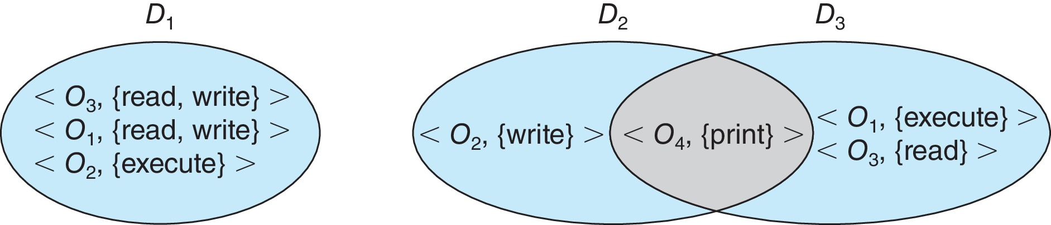
Domain Structure
Module
8
Domain = set of access-rights
Access-right = <object-name, rights-set>
where rights-set is a subset of all valid operations that can be performed on the object

Slide 36
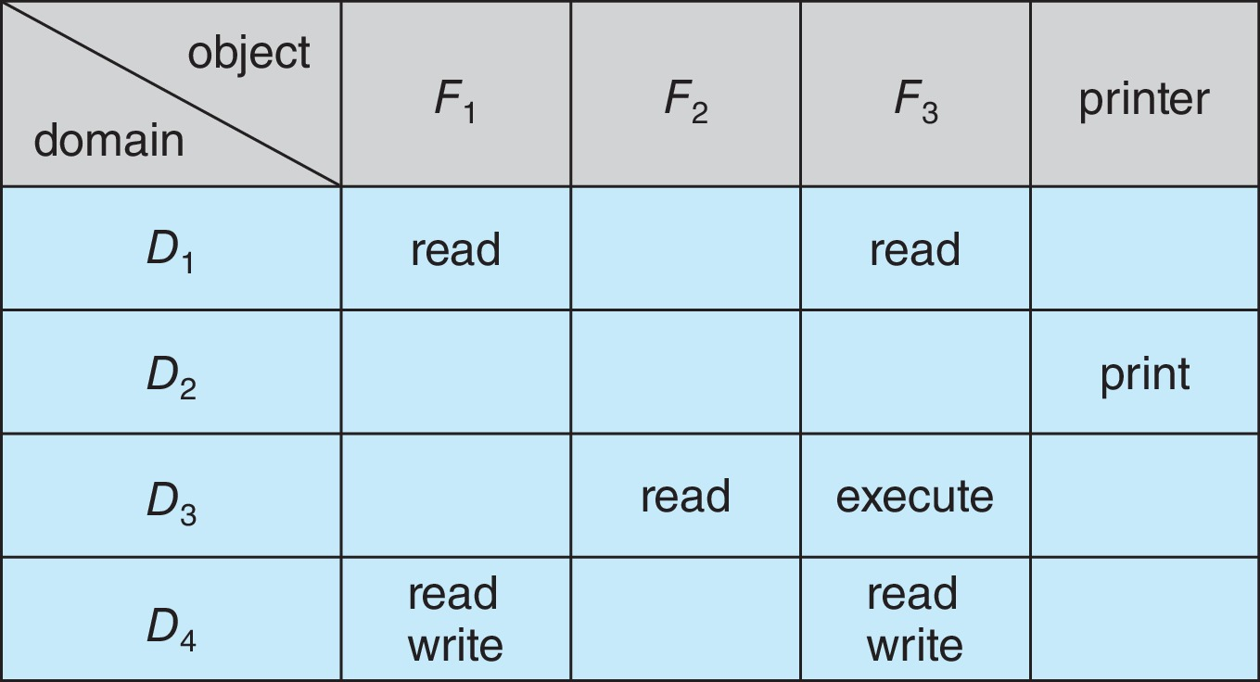
Access Matrix
Module
8
The general model of protection can be viewed abstractly as a matrix, called an access matrix.
Rows represent domains
Columns represent objects
Access(i, j) is the set of operations that a process executing in Domain_{i} can invoke on Object_{j}

Slide 37
Use of Access Matrix
Module
8
The access matrix can implement policy decisions concerning protection.
if a process in Domain Di tries to do “op” on object Oj, then “op” must be in the access matrix
User who creates object can define access column for that object
To switch a process from one domain to another, (switch operation) is executing an on an object (the domain).

Slide 38
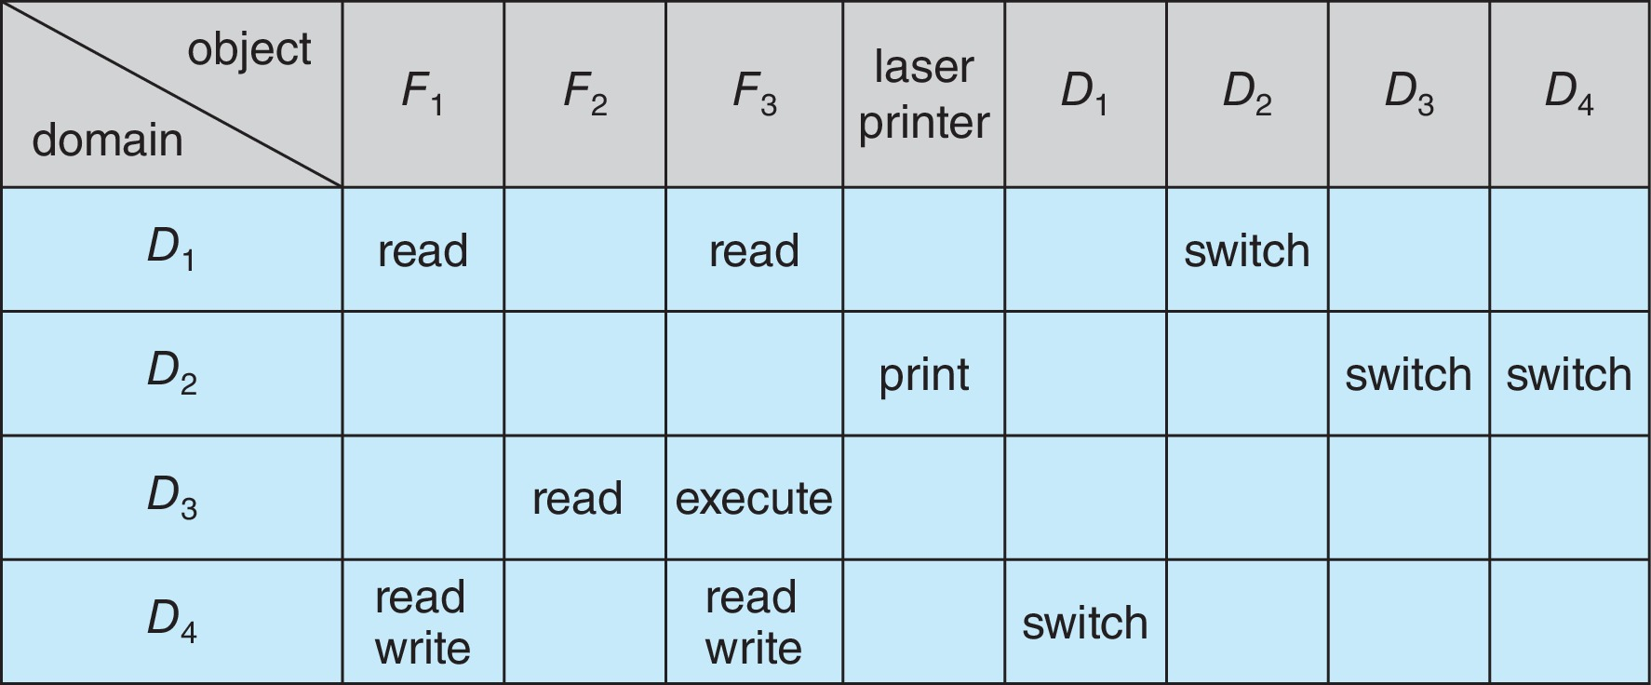
Access Matrix of
Domains as Objects
Module
8
Use of Access Matrix Cont.….

Slide 39
Use of Access Matrix Cont.….
Module
8
Allowing controlled change in the contents of the access-matrix entries requires three additional operations: copy, owner, and control.
The ability to copy an access right from one domain (or row) of the access matrix to another is denoted by an asterisk (*) appended to the access right.
The copy right allows the access right to be copied only within the column (that is, for the object) for which the right is defined.
In the following example, process executing in domain D2 can copy the read operation into any entry associated with file F2.

Slide 40
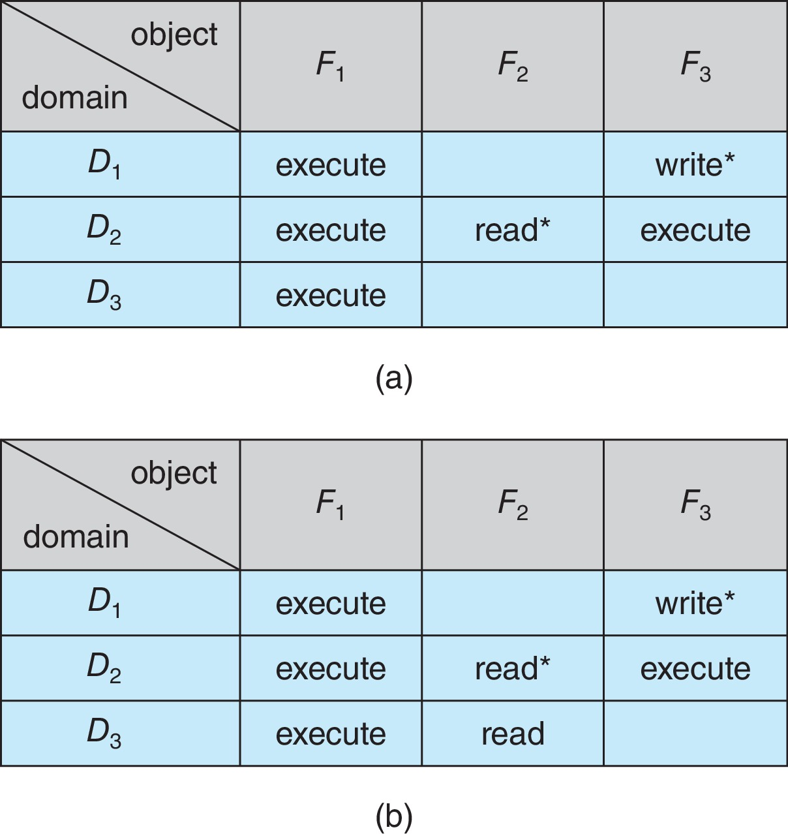
Access Matrix with Copy Rights
Module
8

Slide 41
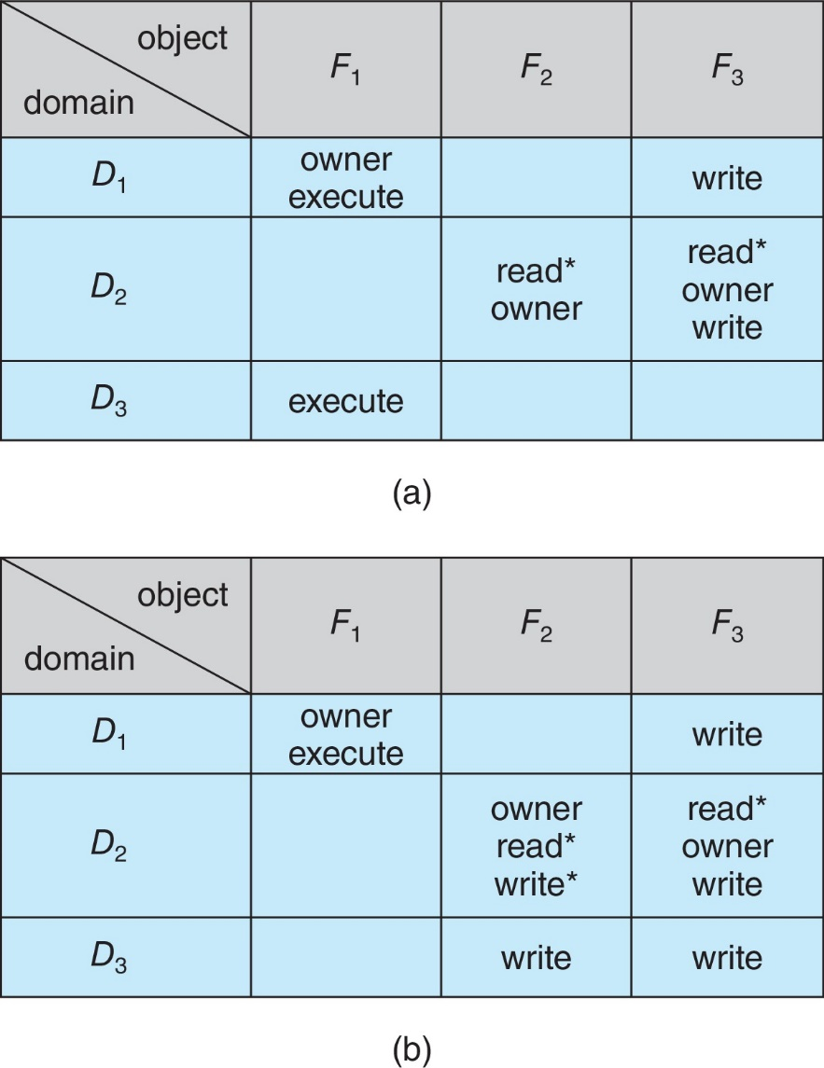
Access Matrix With Owner Rights
Module
8
Owner Rights
Allowing controlled change in the contents of the access-matrix
Copy and Owner applicable to an object

Slide 42
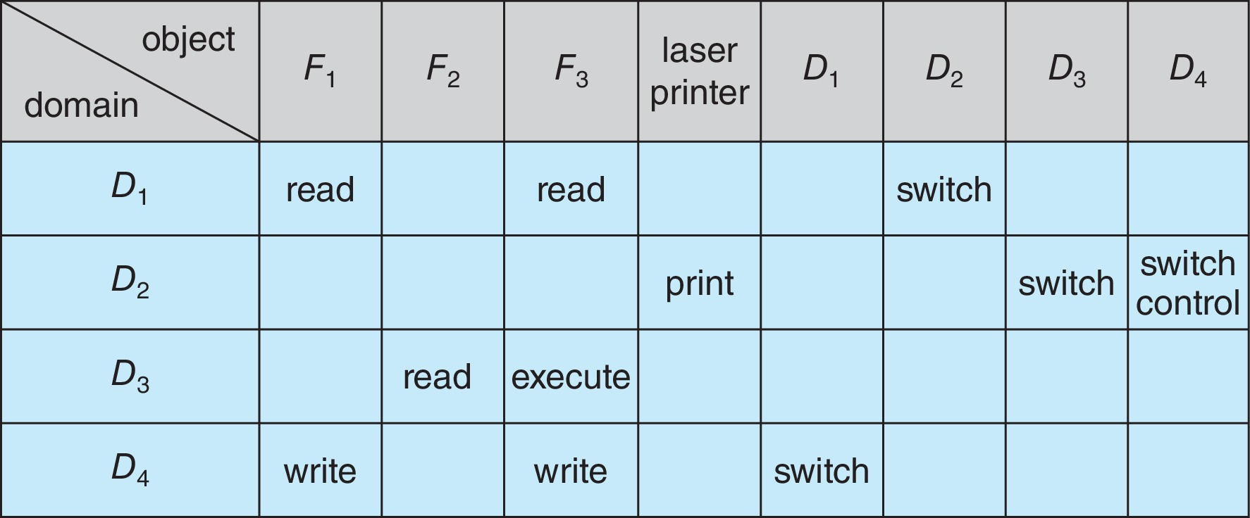
Modified Access Matrix of Figure B
Module
8
Control rights : A mechanism is also needed to change the entries in a row.
Control applicable to domain object

Slide 43
Revocation of Access Rights
Module
8
In a dynamic protection system, we may sometimes need to revoke access rights to objects shared by different users.
Various options to remove the access right of a domain to an object
  Immediate vs. delayed
    Does revocation occur immediately, or is it delayed? If revocation is delayed, can we find out when it will take place?
  Selective vs. general
    When an access right to an object is revoked, does it affect all the users who have an access right to that object, or can we specify a select group of users whose access rights should be revoked?

Slide 44
Revocation of Access Rights
Module
8
  Partial vs. total
    Can a subset of the rights associated with an object be revoked, or must we revoke all access rights for this object?
  Temporary vs. permanent
    Can access be revoked permanently (that is, the revoked access right will never again be available), or can access be revoked and later be obtained again?
Access List – Delete access rights from access list
  Simple – search access list and remove entry
  Immediate, general or selective, total or partial, permanent or temporary

Slide 45
Discretionary and Mandatory Access Access Control (DAC Vs MAC)
.)
Module
8
  Access control regulates which users, applications, and devices can add, edit, view and delete resources in an organization’s environment to protect sensitive data from misuse, theft, abuse, and other threats.
  Mandatory Access Control (MAC) and Discretionary Access Control (DAC) are two of the popular access control models in use.

Slide 46
Discretionary and Mandatory Access Access Control (DAC Vs MAC)
.)
Module
8
  The key difference among these two approaches is in how they provide access to users.
    With MAC, admins creates a set of levels where each user is linked to a specific access level where that user can access all the resources that are not greater than his access level.
    In contrast, each resource in DAC has a list of users who can access it. DAC provides access by identity of the user and not by permission level.

Slide 47
Discretionary and Mandatory Access Access Control (DAC Vs MAC)
.)
Module
8
As a brief example of MAC, consider a simple set of Levels, ordered according to level of privilege:
  “unclassified,” “secret,” and “top secret.”
A user with “secret” level, will have access to “unclassified” and “secret” files, but not to “top secret” files.
No user or processes will be aware of the existence of “top secret” files, the operating system filters them out of all file operations
Same with User processes, "unclassified" process would not be able to see or perform IPC requests to a “secret” (or “top secret”) process.

Slide 48
Module
8
End of Module 8

