Slide 1
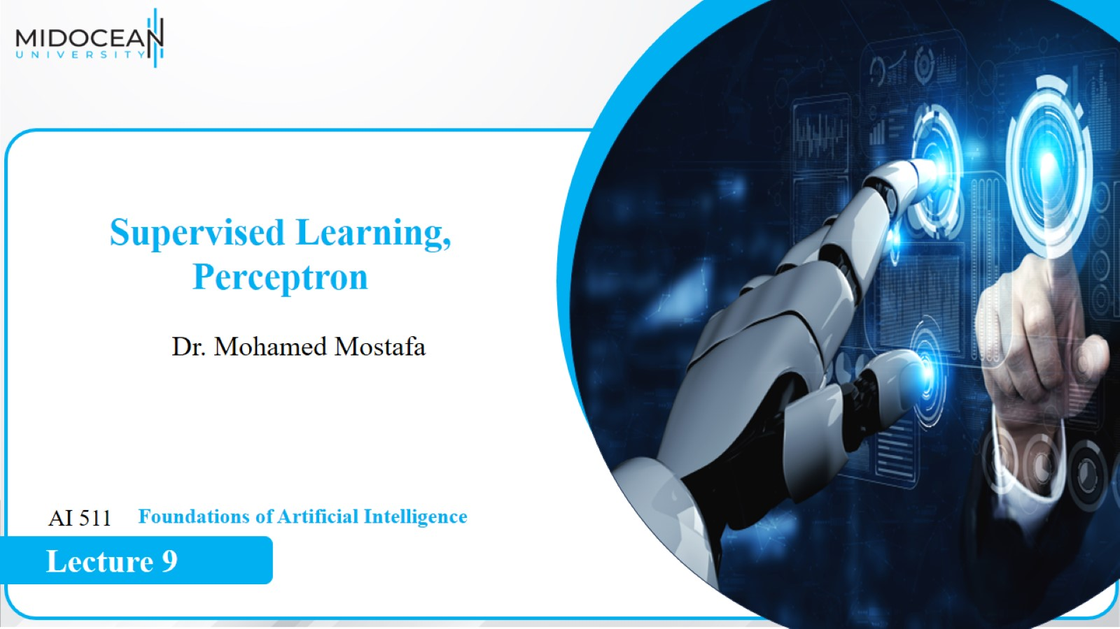

Slide 2
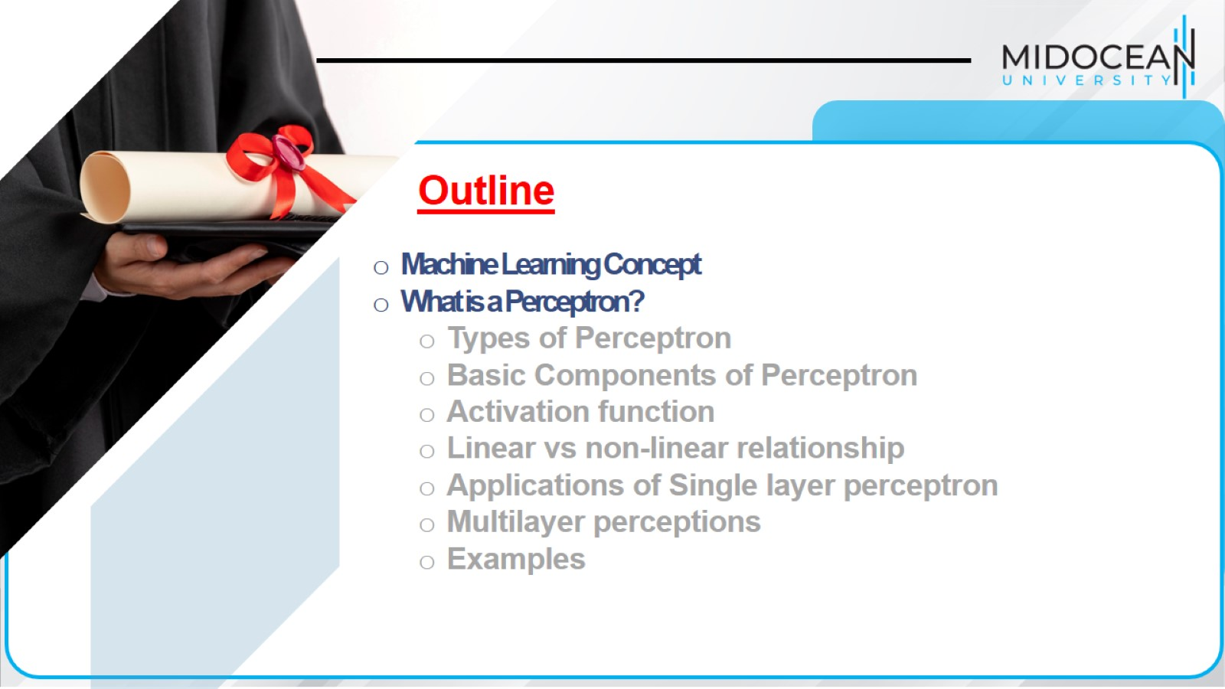

Slide 3
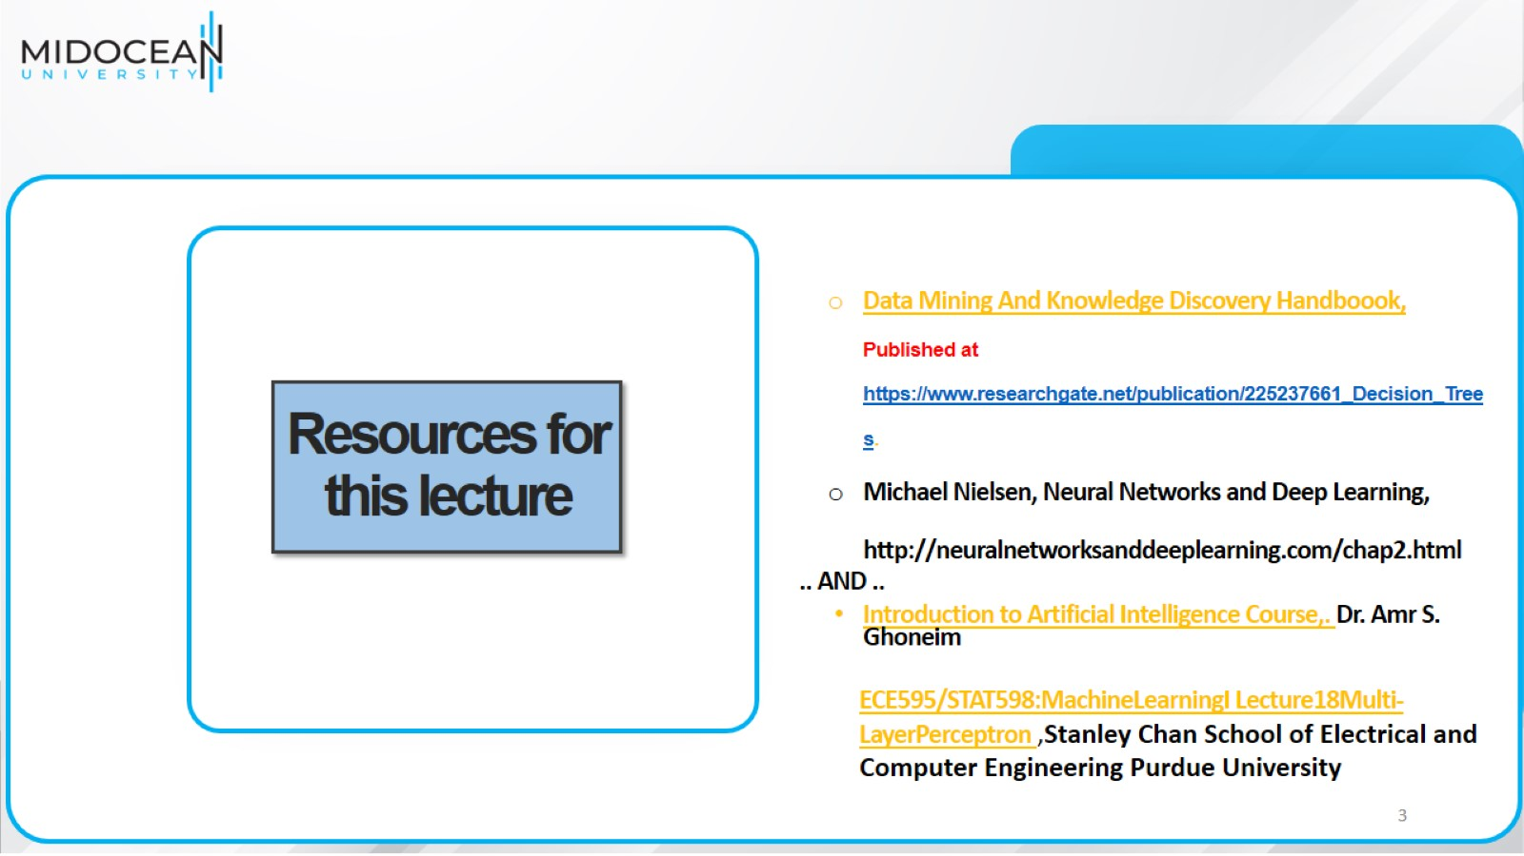
Resources for this lecture

Slide 4
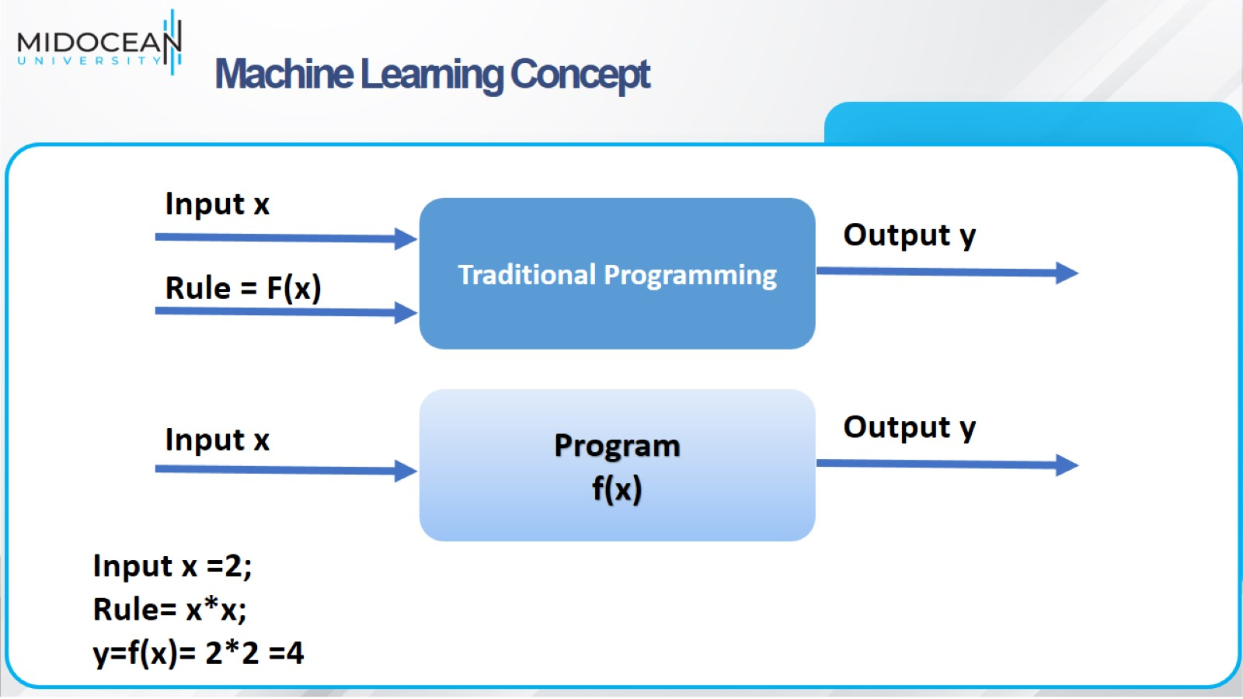
Machine Learning Concept

Slide 5
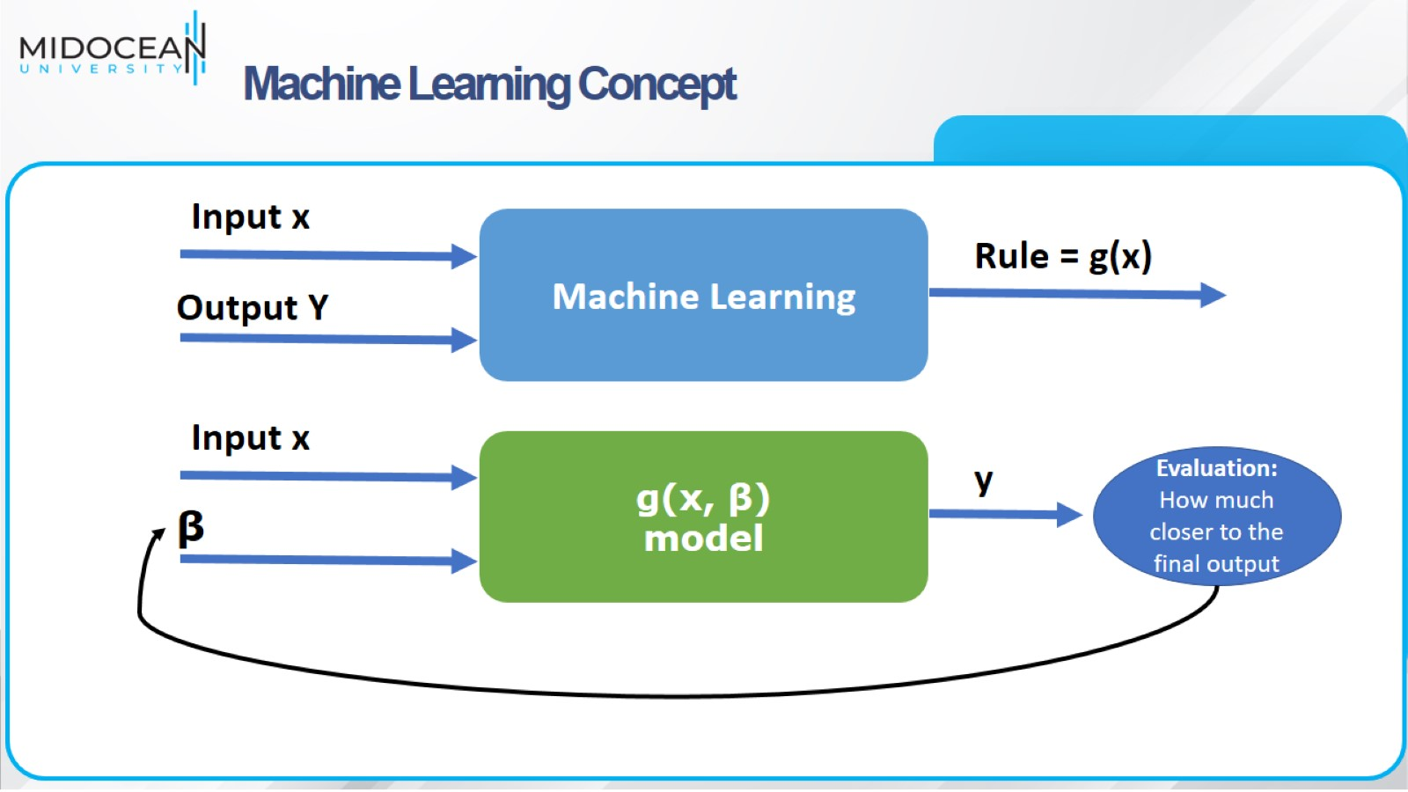
Machine Learning Concept

Slide 6
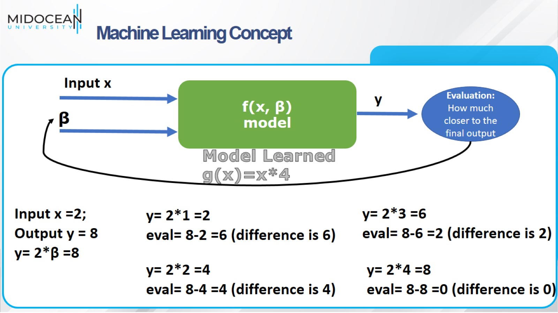
Machine Learning Concept

Slide 7
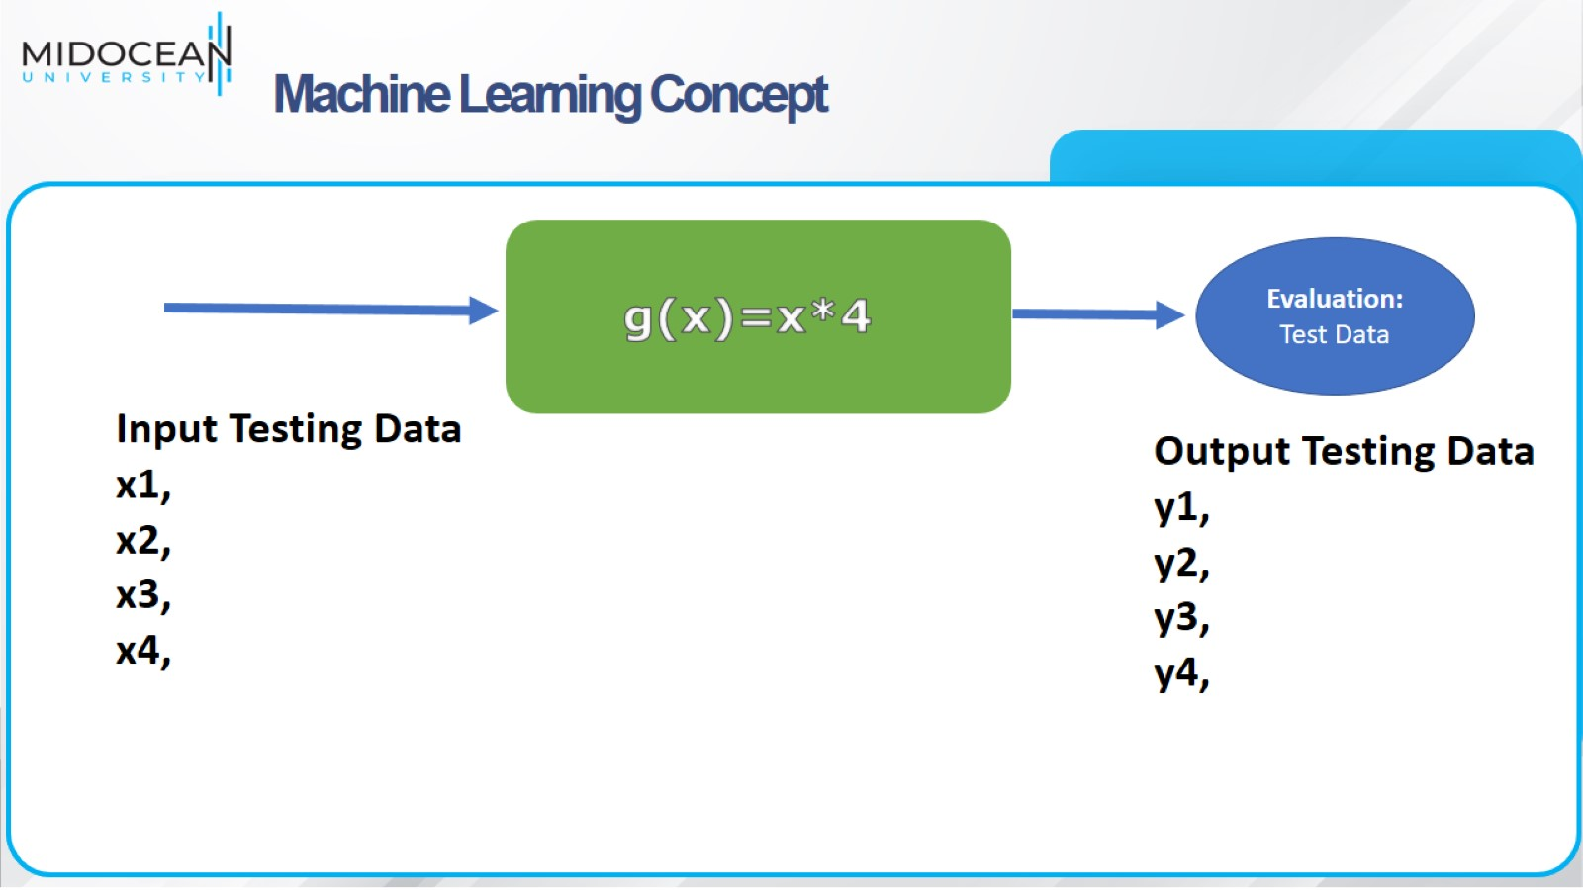
Machine Learning Concept

Slide 8
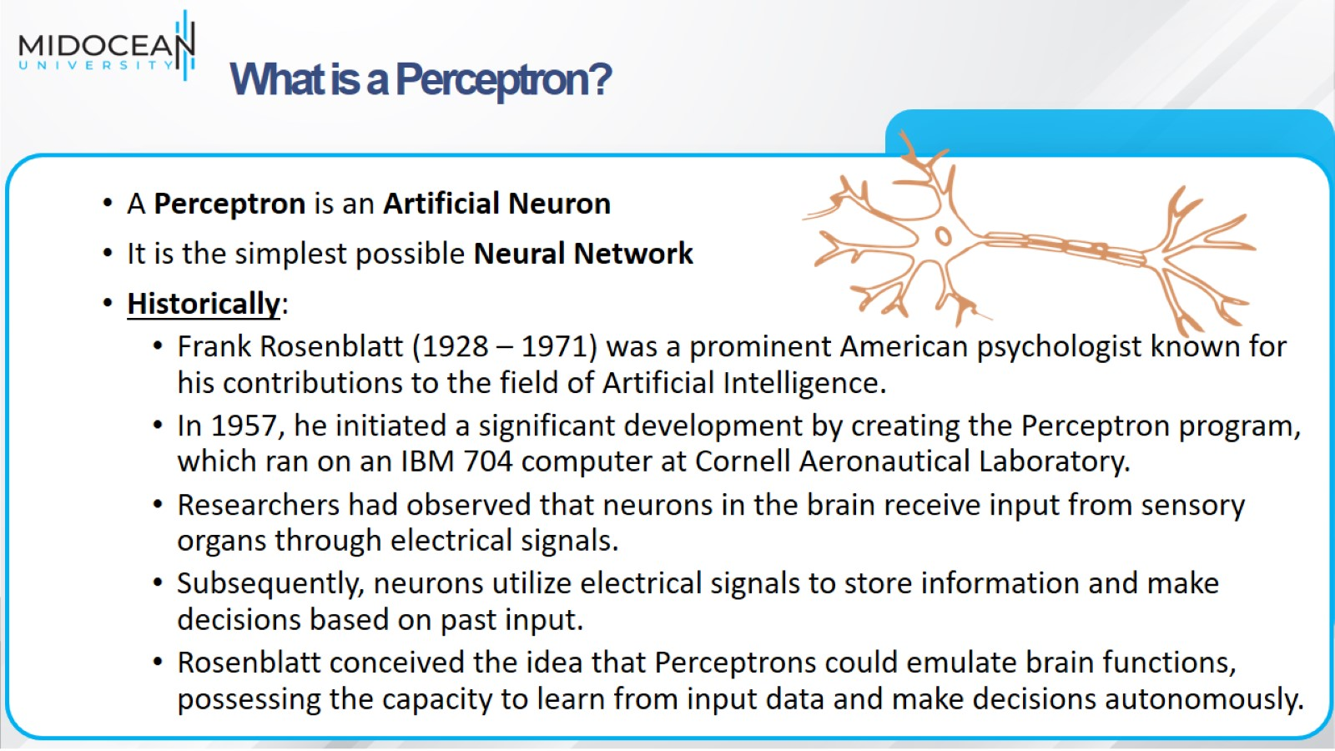
What is a Perceptron?

Slide 9
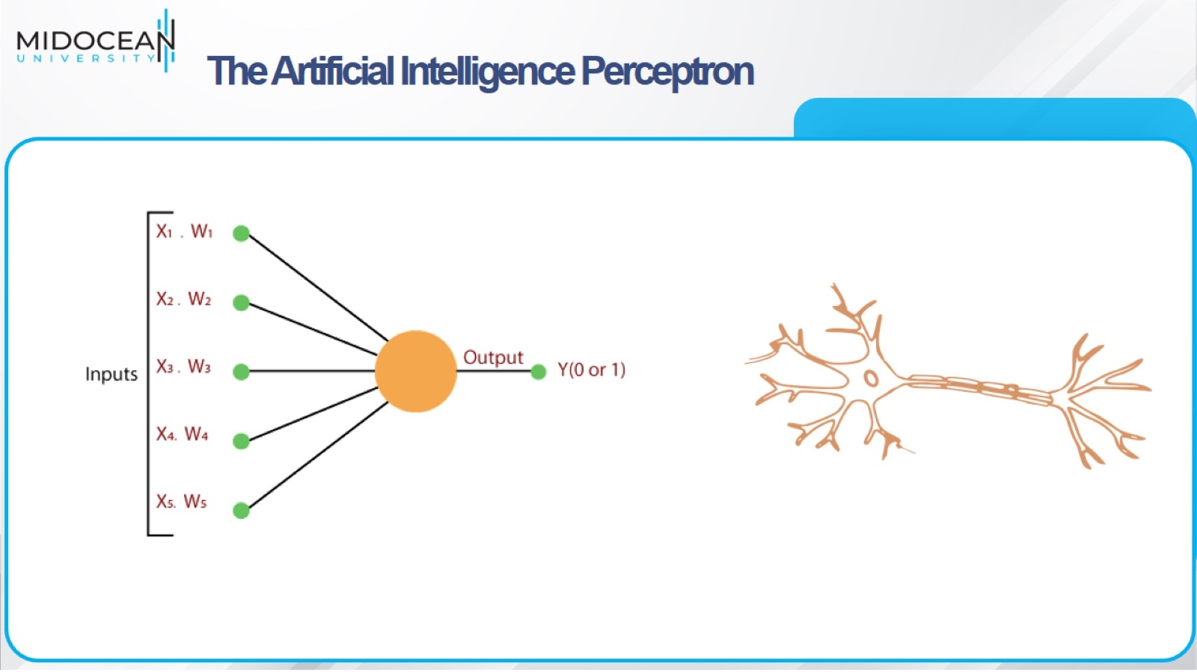
The Artificial Intelligence Perceptron

Slide 10
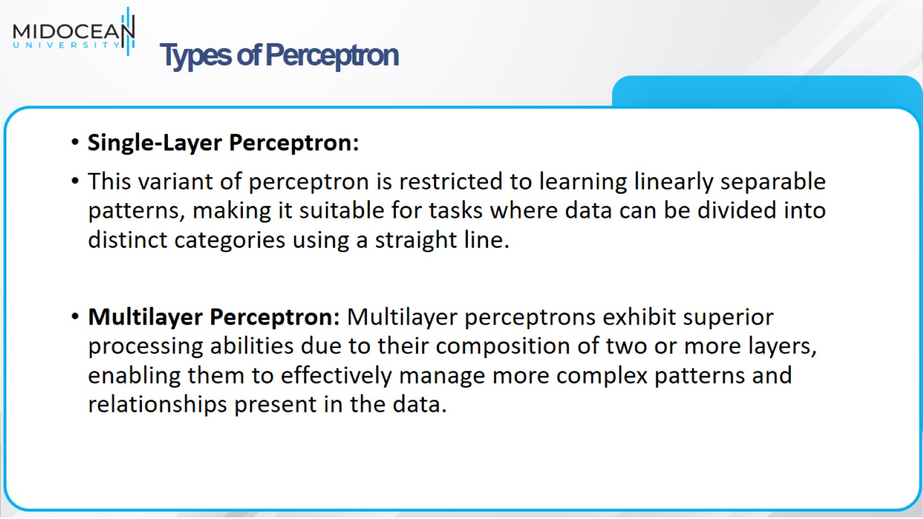
Types of Perceptron

Slide 11
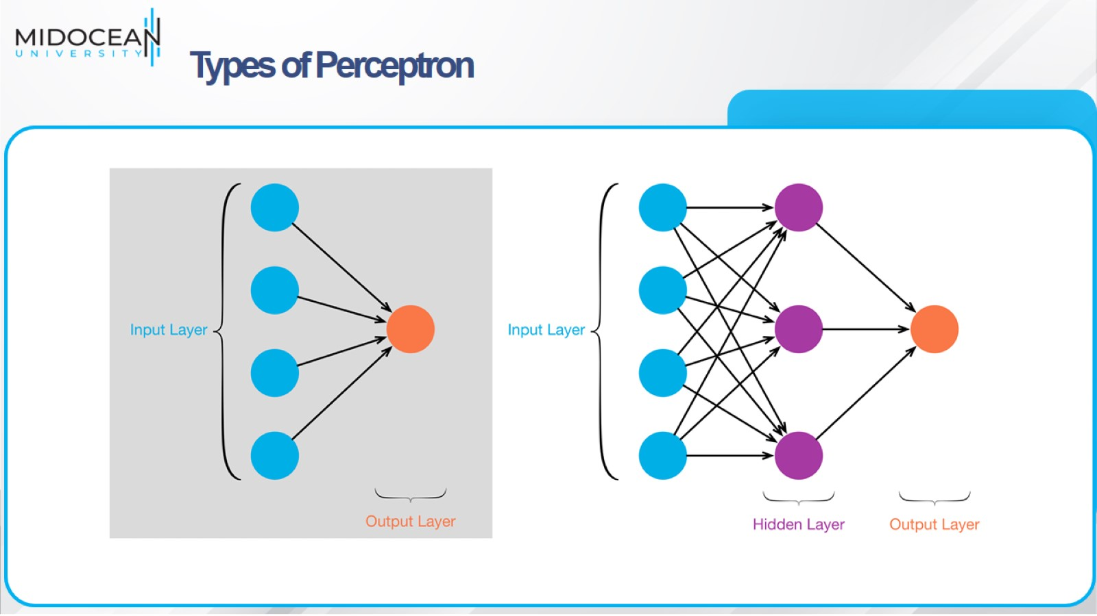
Types of Perceptron

Slide 12
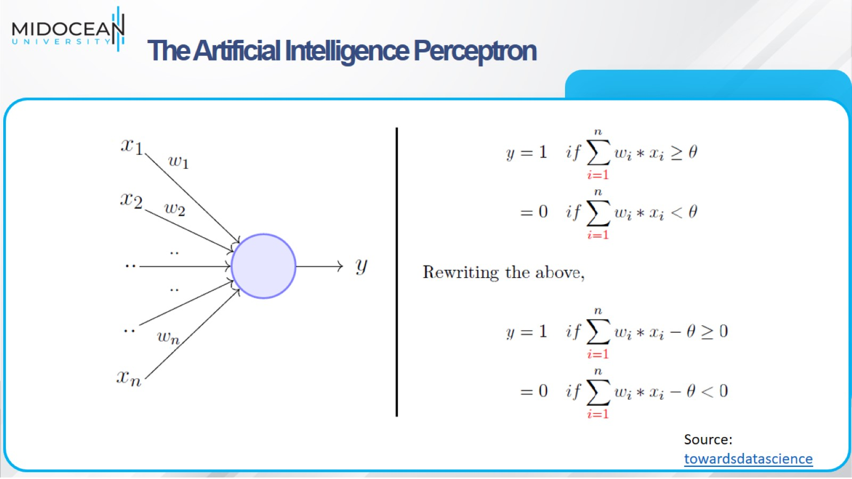
The Artificial Intelligence Perceptron

Slide 13
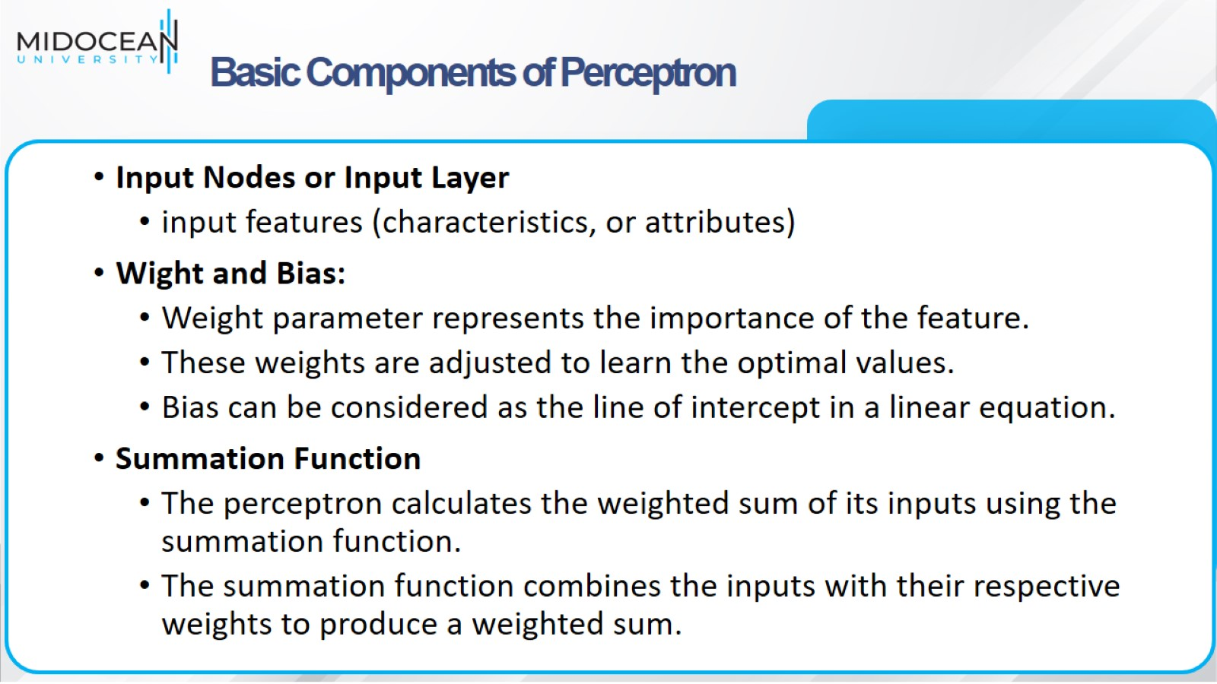
Basic Components of Perceptron

Slide 14
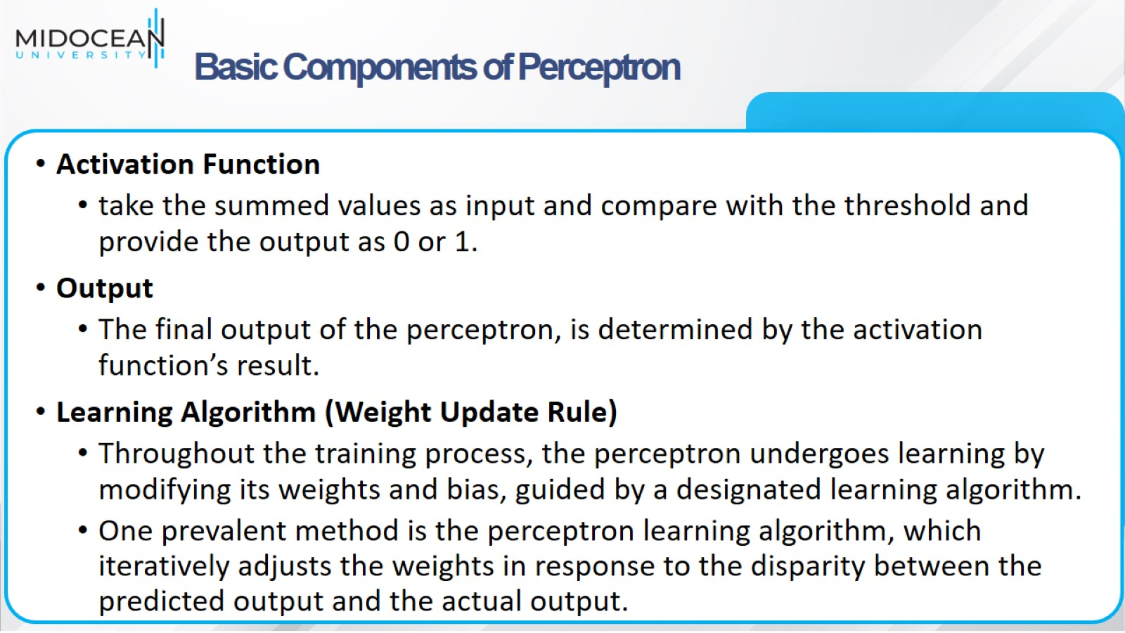
Basic Components of Perceptron

Slide 15
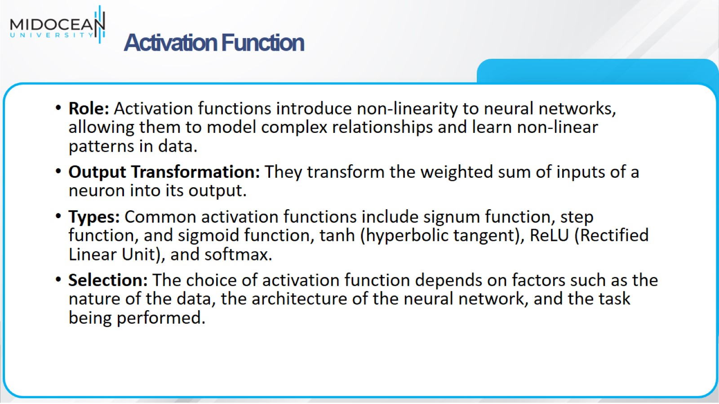
Activation Function

Slide 16
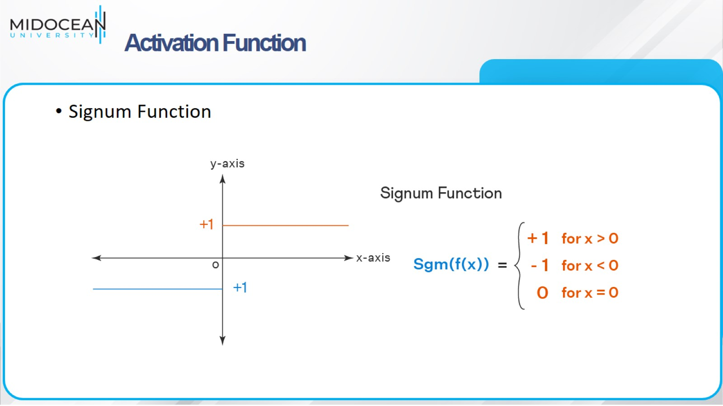
Activation Function

Slide 17
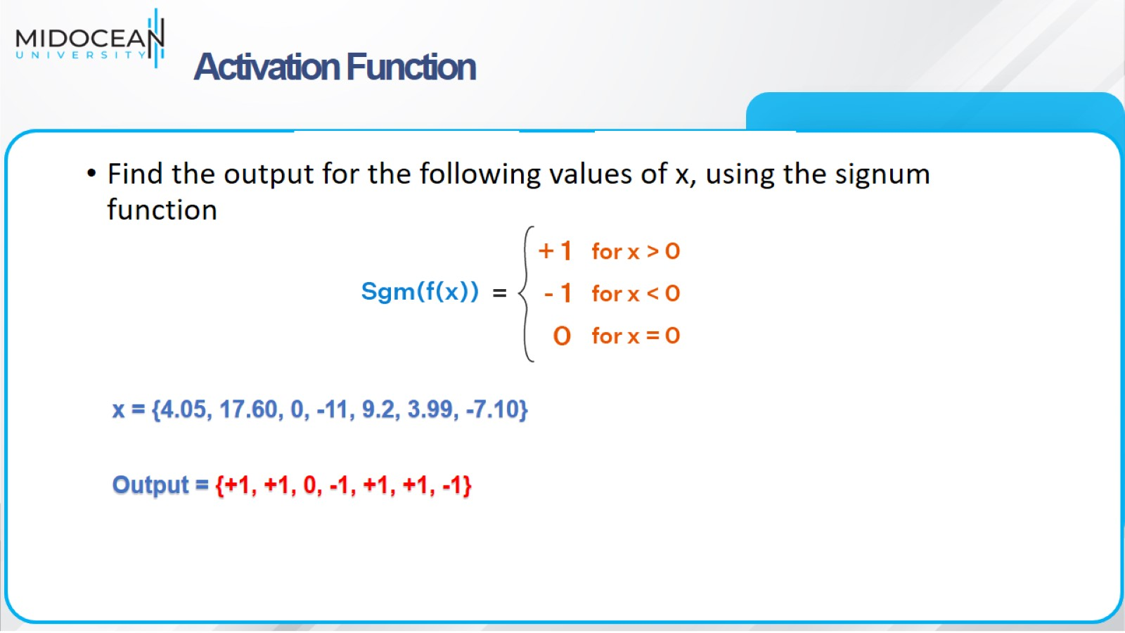
Activation Function

Slide 18
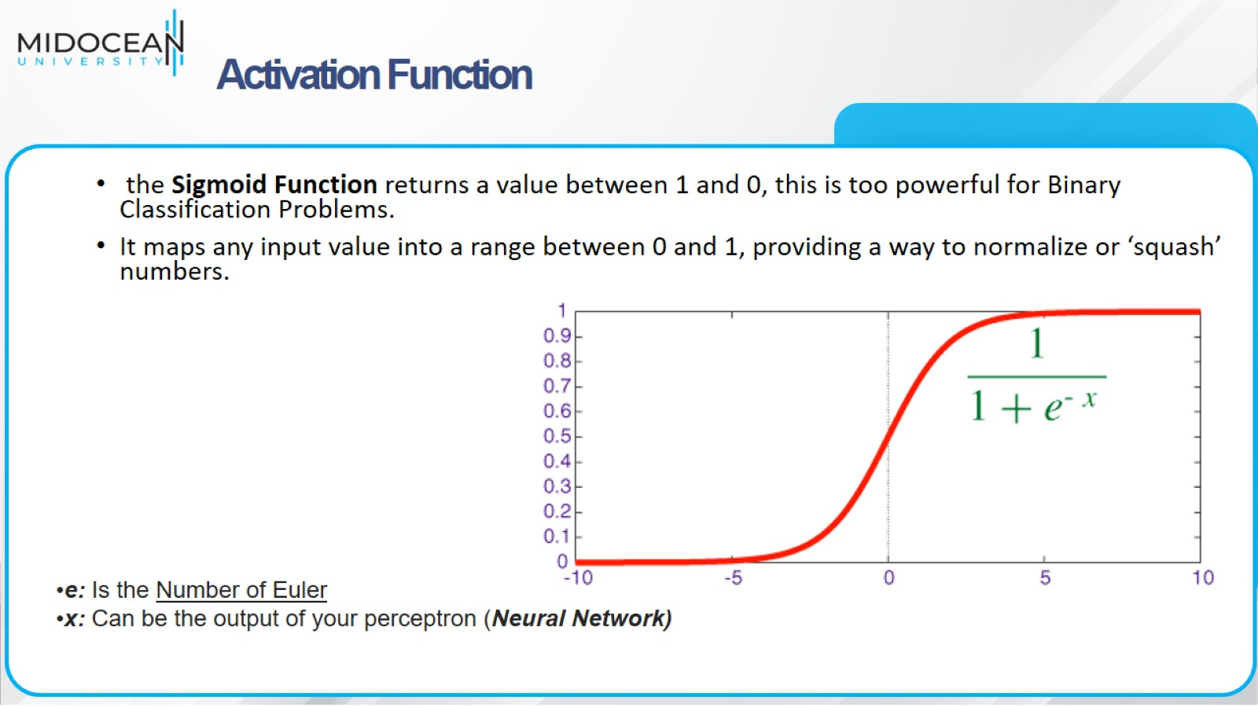
Activation Function

Slide 19
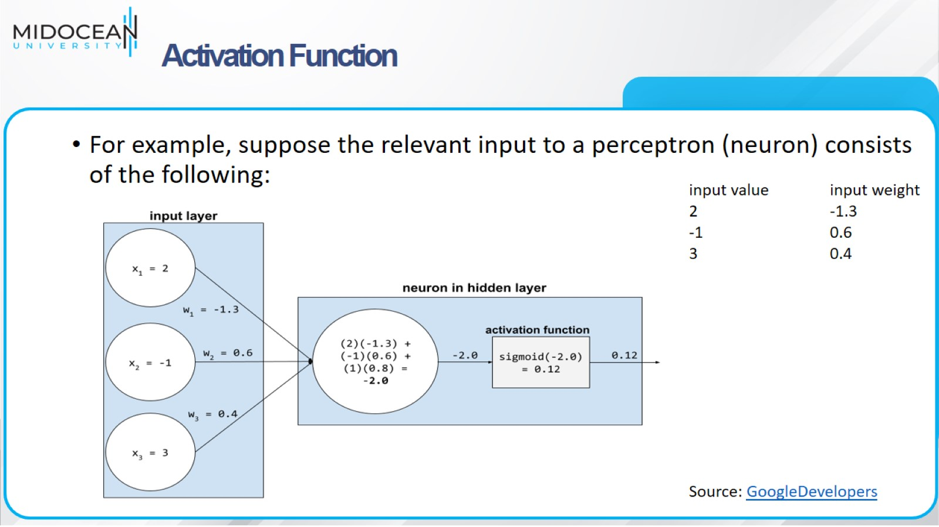
Activation Function

Slide 20
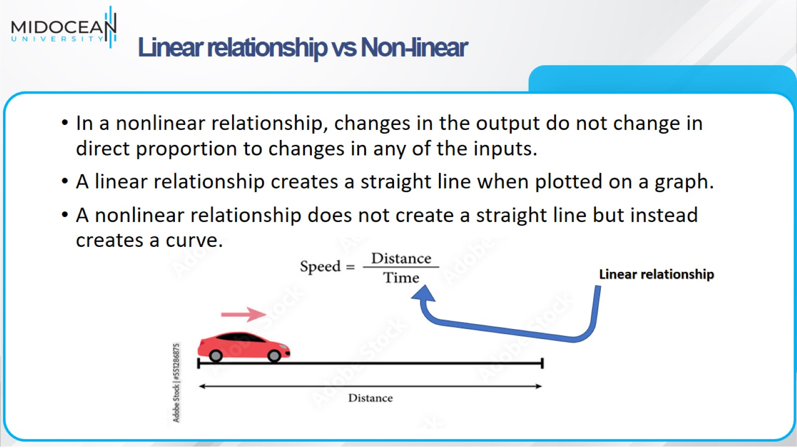
Linear relationship vs Non-linear

Slide 21
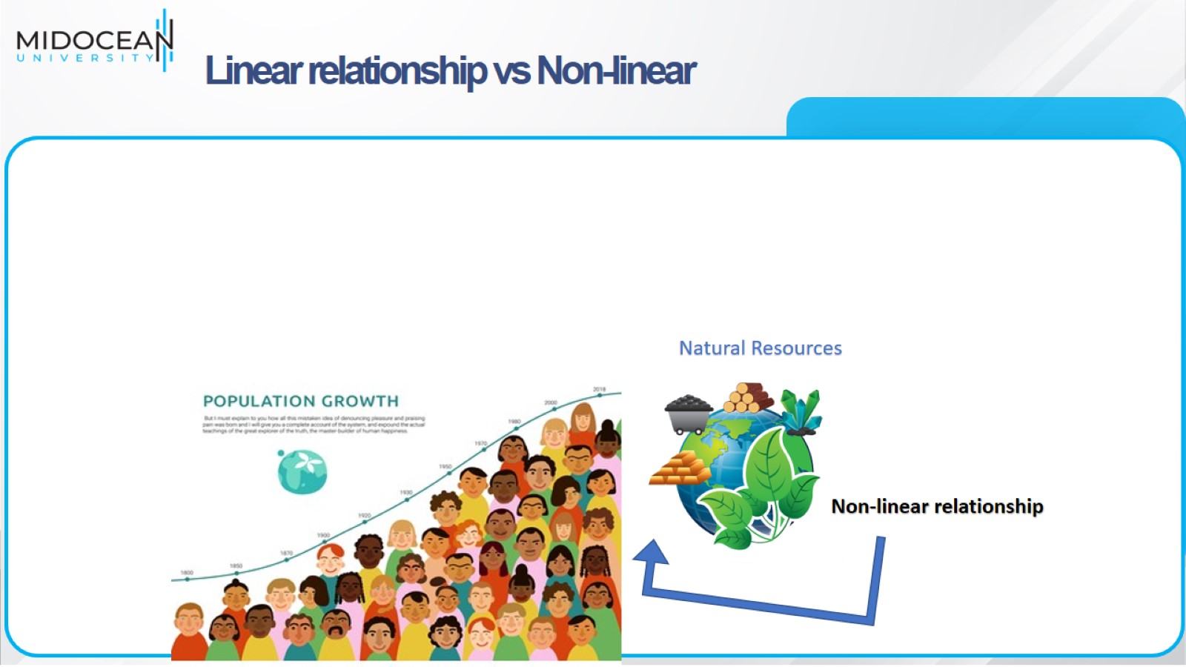
Linear relationship vs Non-linear

Slide 22
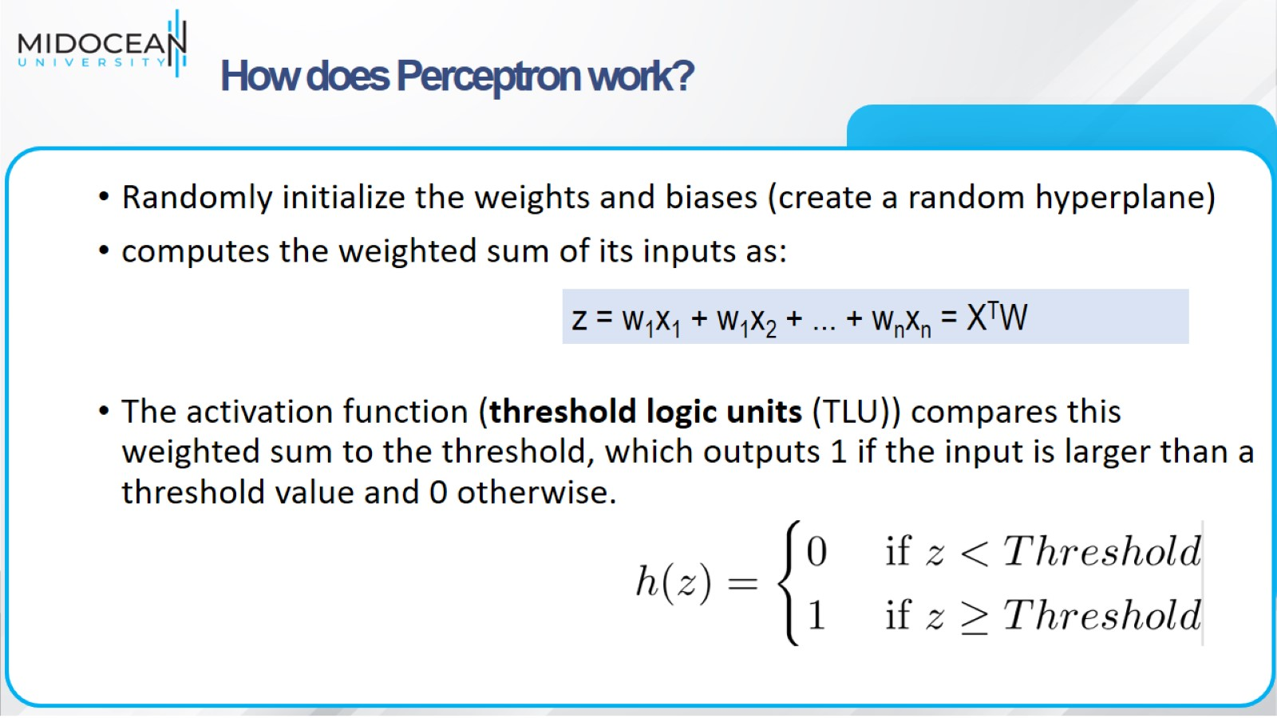
How does Perceptron work?

Slide 23
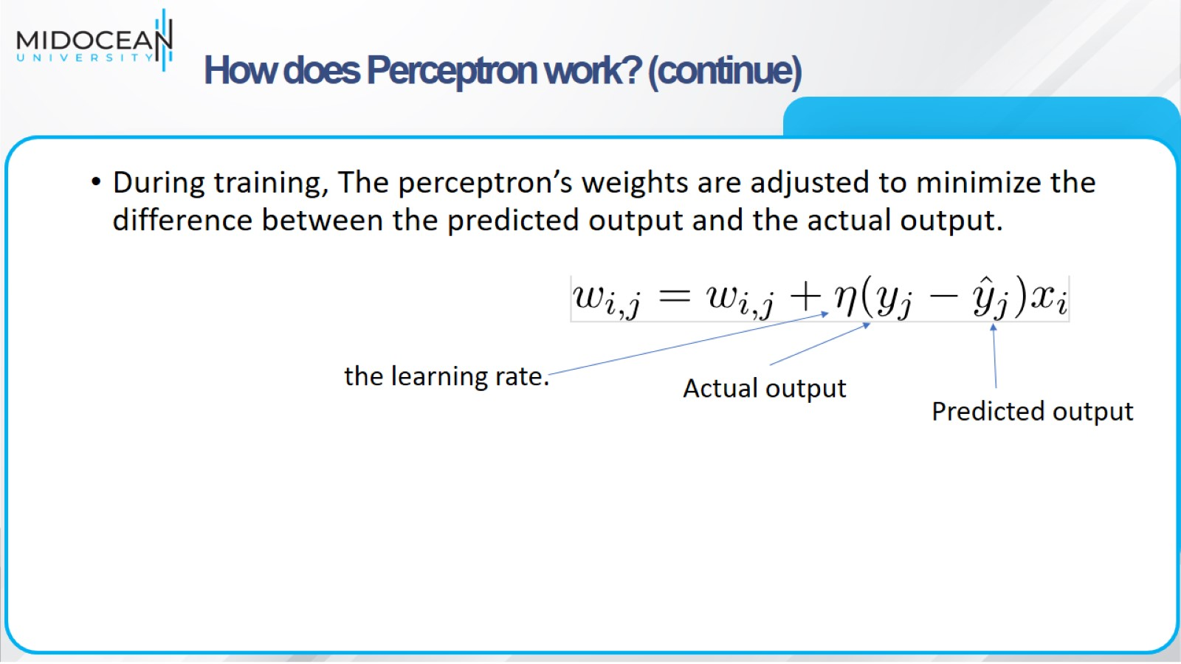
How does Perceptron work? (continue)

Slide 24
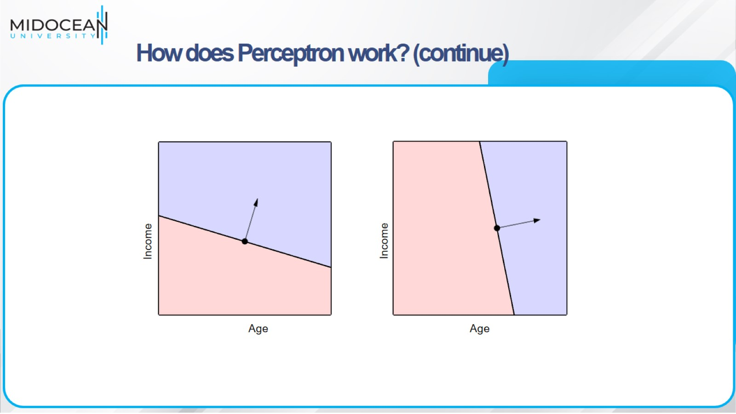

Slide 25
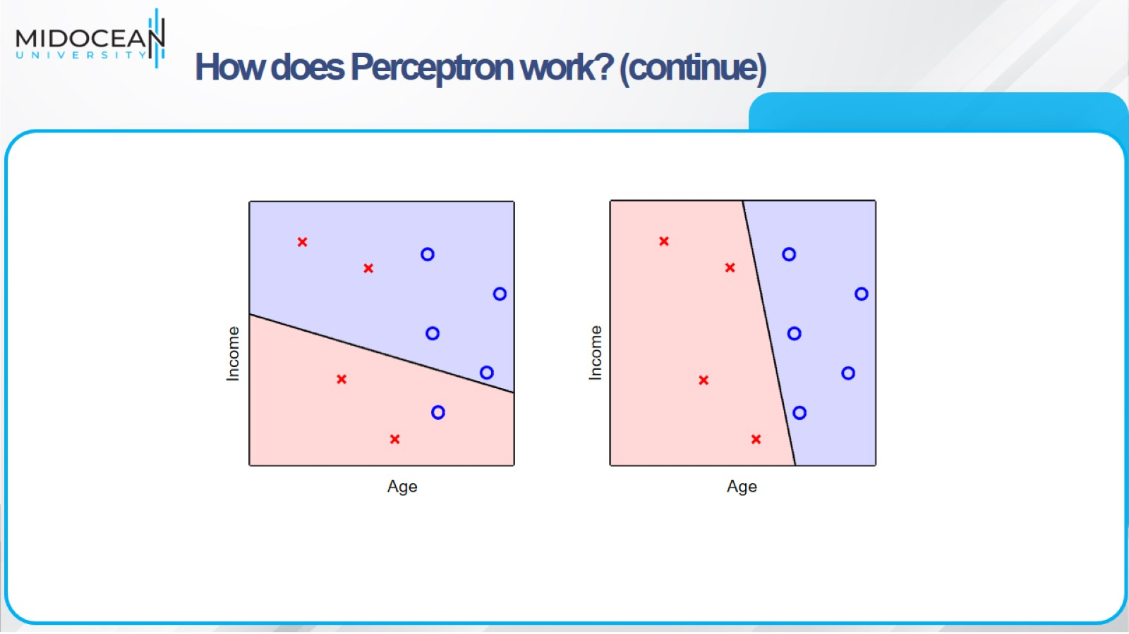
How does Perceptron work? (continue)

Slide 26
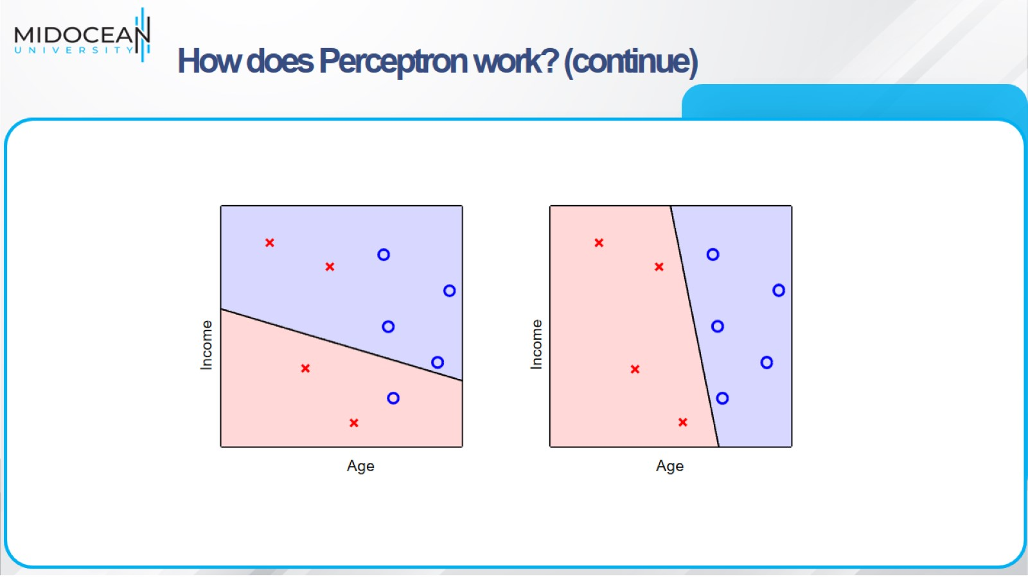
How does Perceptron work? (continue)

Slide 27
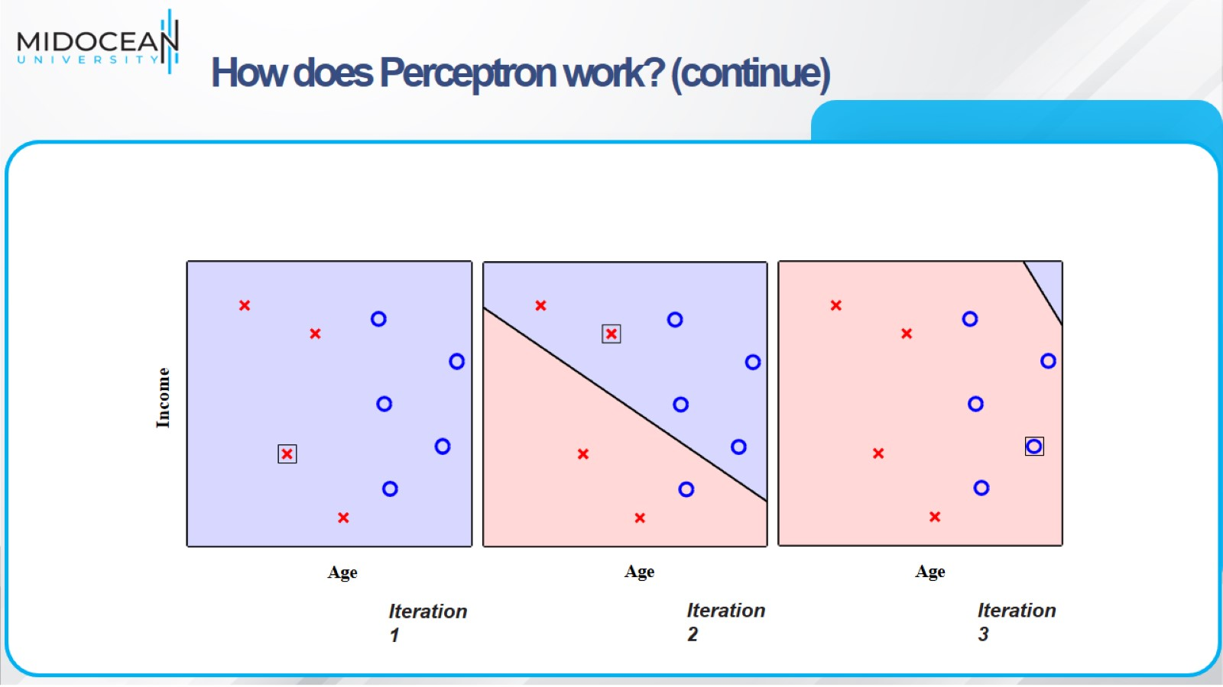
How does Perceptron work? (continue)

Slide 28
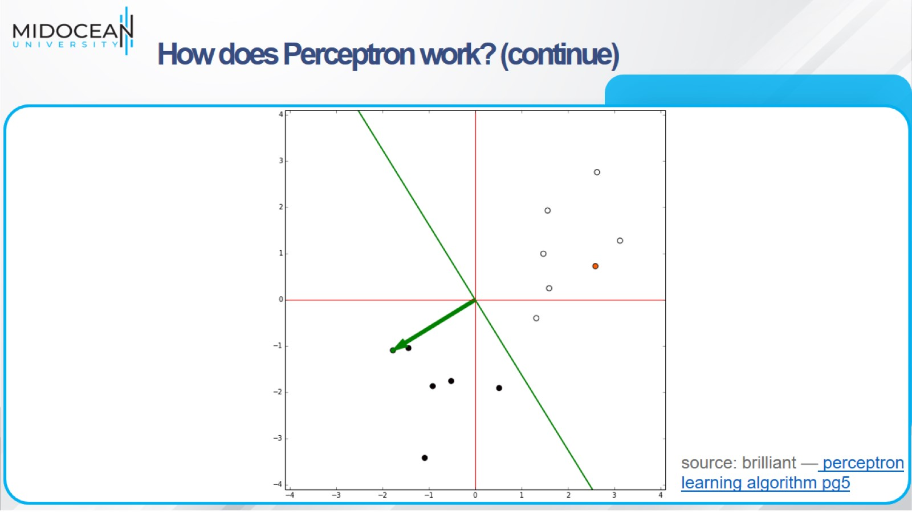
How does Perceptron work? (continue)

Slide 29
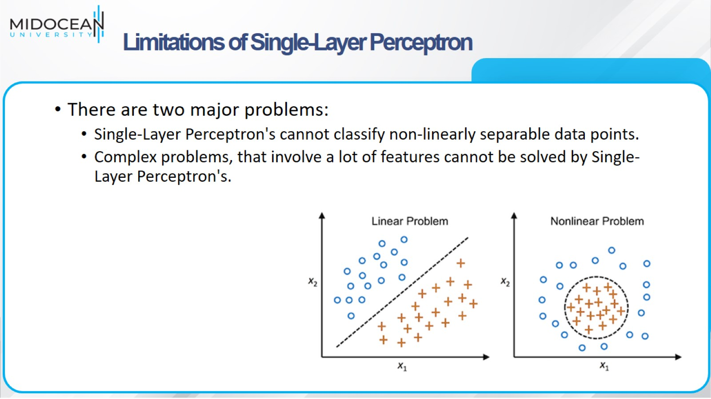
Limitations of Single-Layer Perceptron

Slide 30
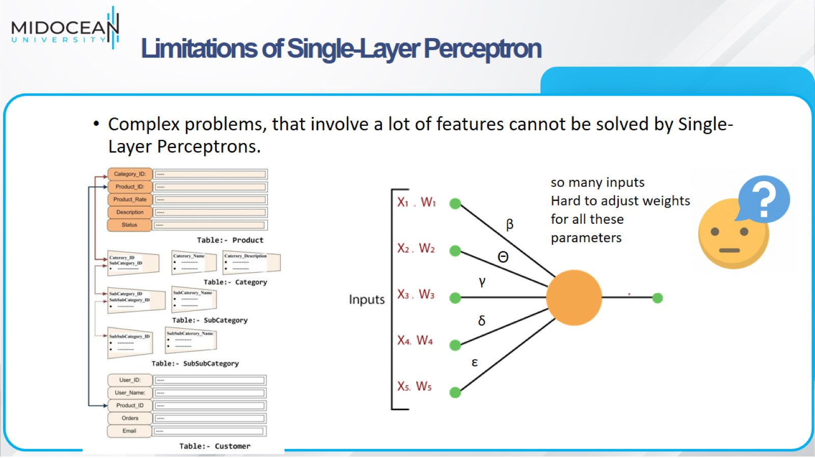
Limitations of Single-Layer Perceptron

Slide 31
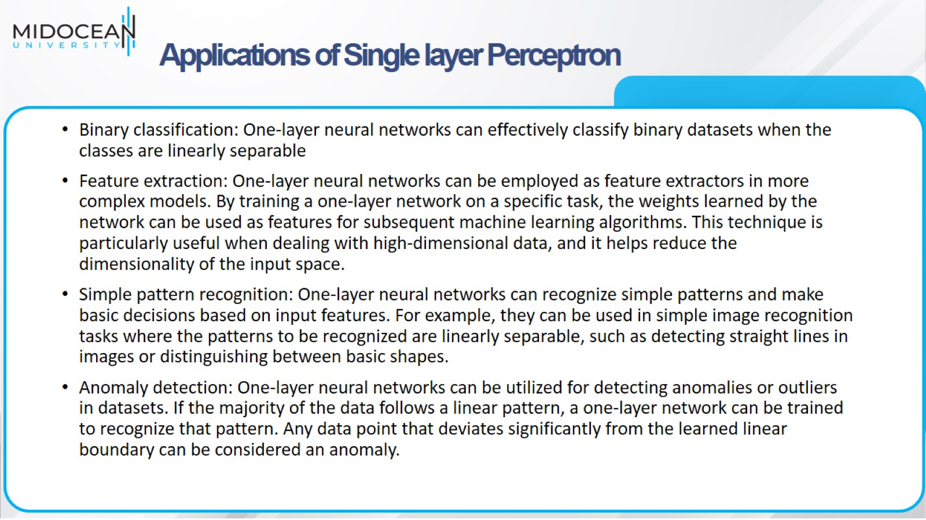
Applications of Single layer Perceptron

Slide 32
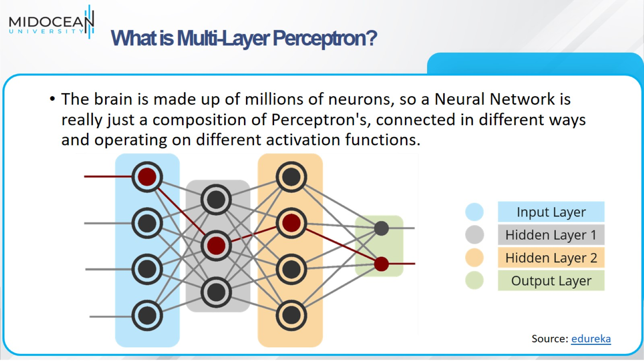
What is Multi-Layer Perceptron?

Slide 33
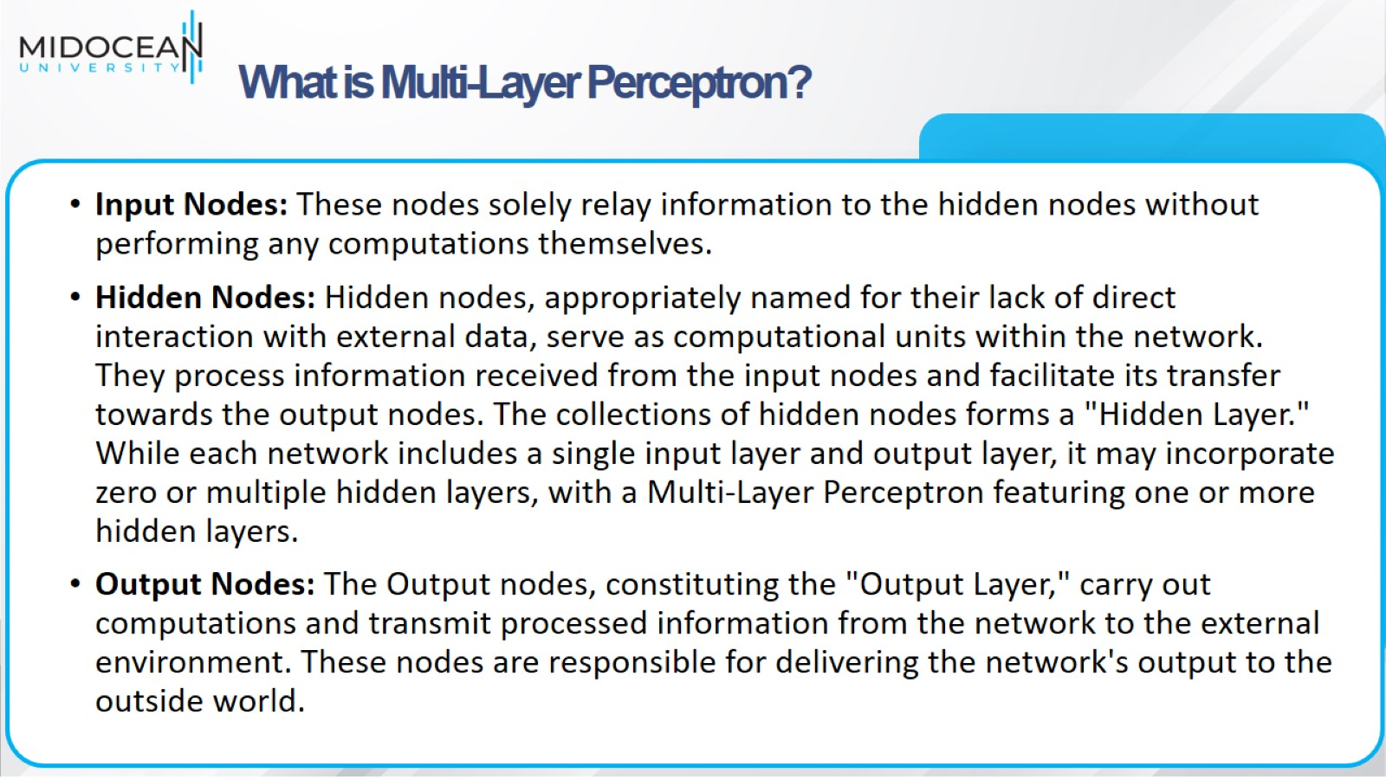
What is Multi-Layer Perceptron?

Slide 34
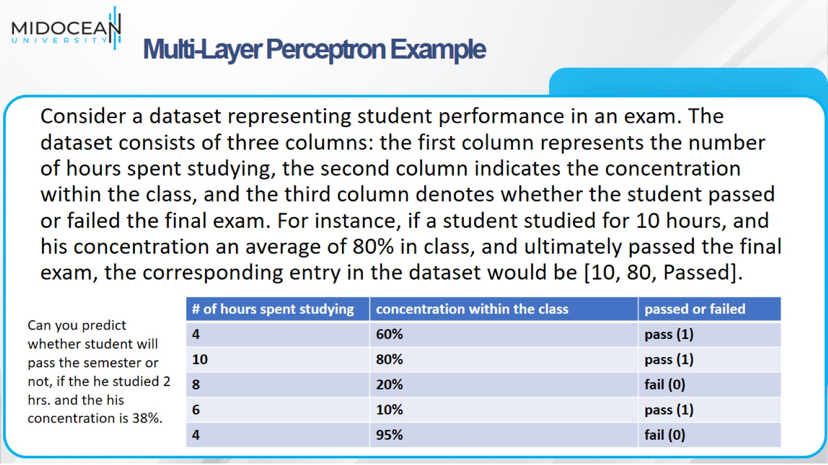
Multi-Layer Perceptron Example

Slide 35
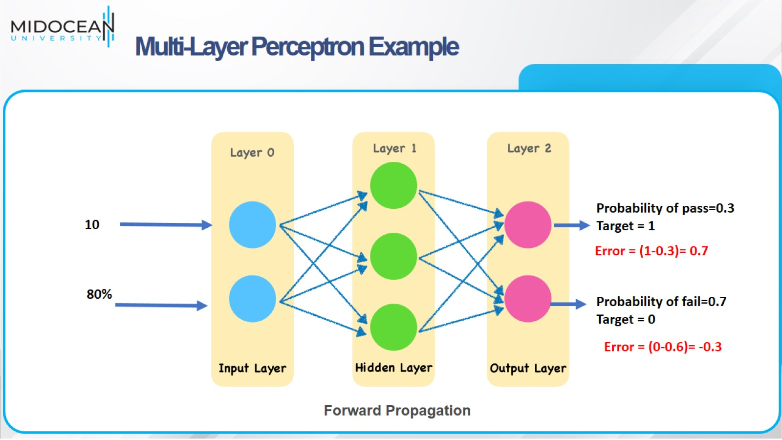
Multi-Layer Perceptron Example

Slide 36
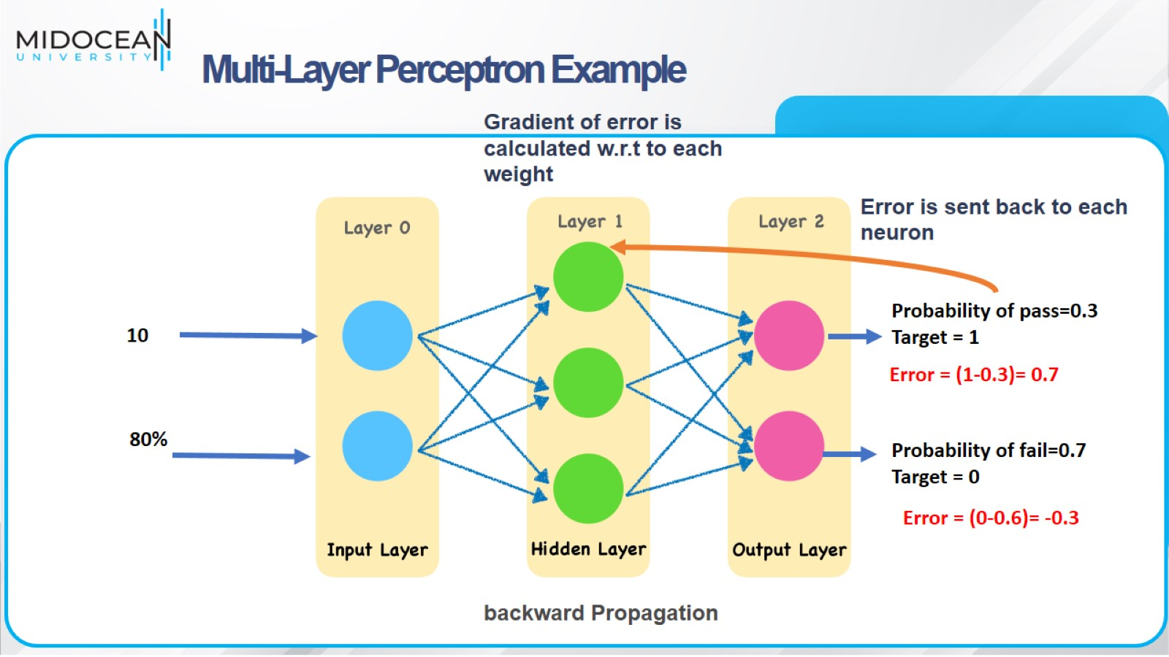
Multi-Layer Perceptron Example

Slide 37
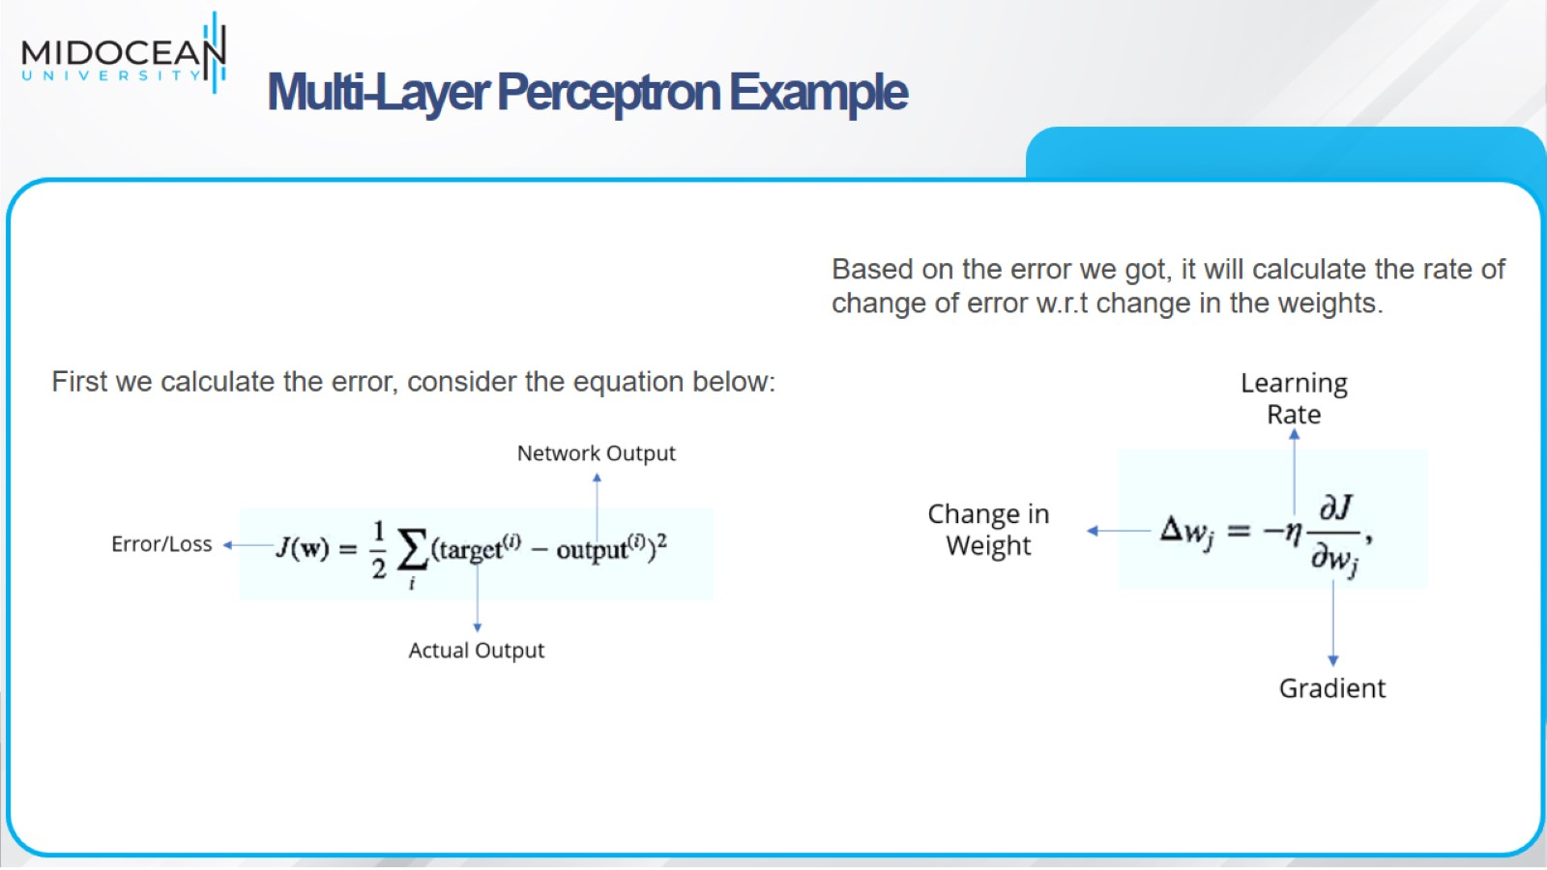
Multi-Layer Perceptron Example

Slide 38

Multi-Layer Perceptron Example

Slide 39
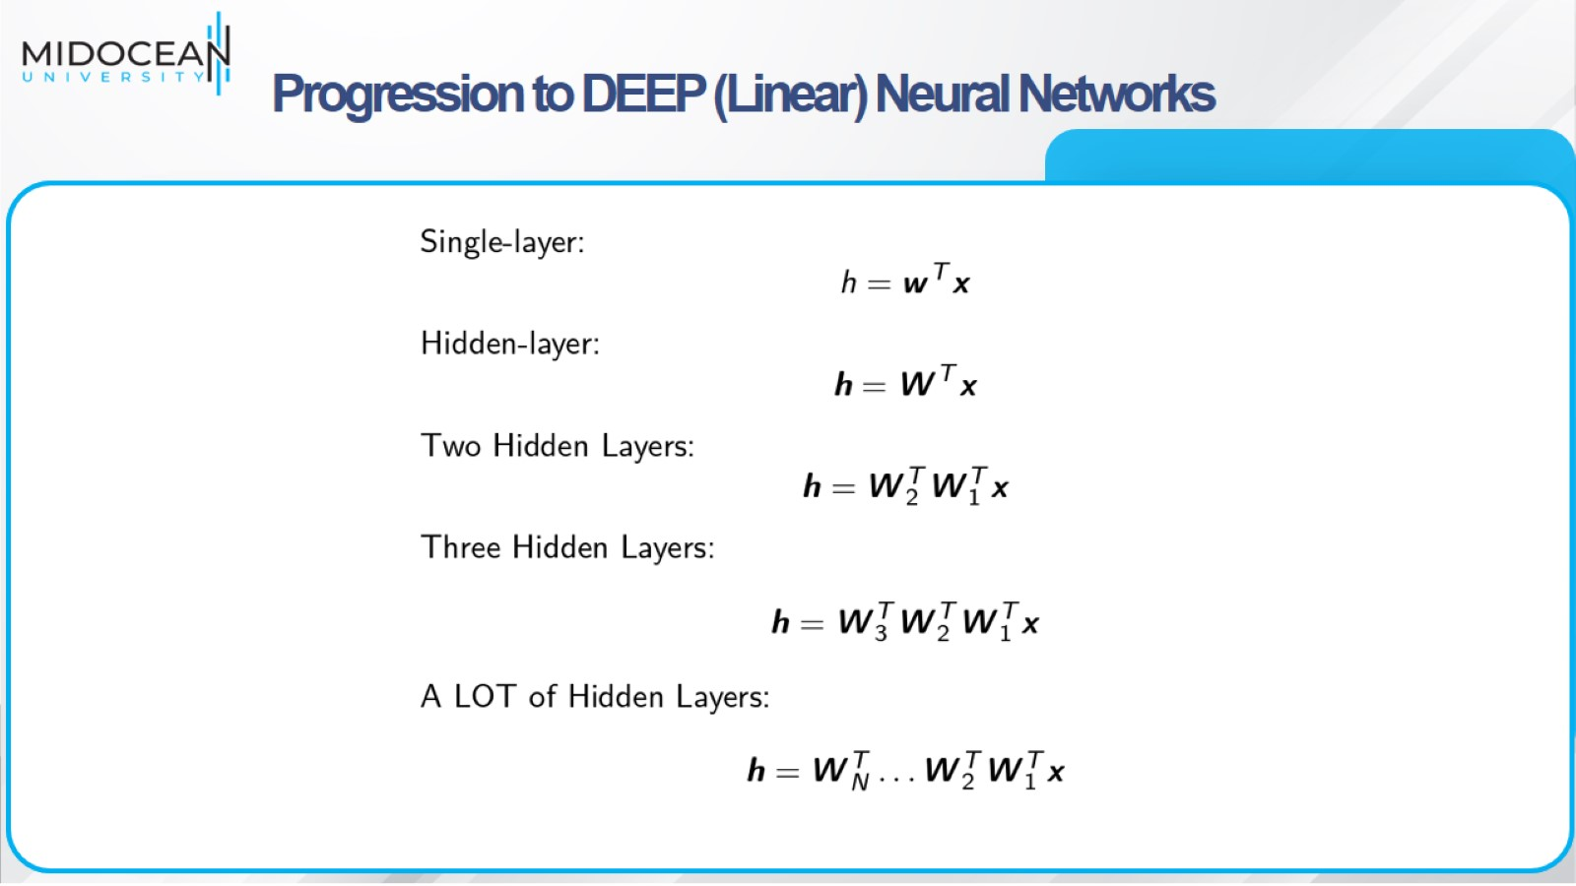
Progression to DEEP (Linear) Neural Networks

Slide 40
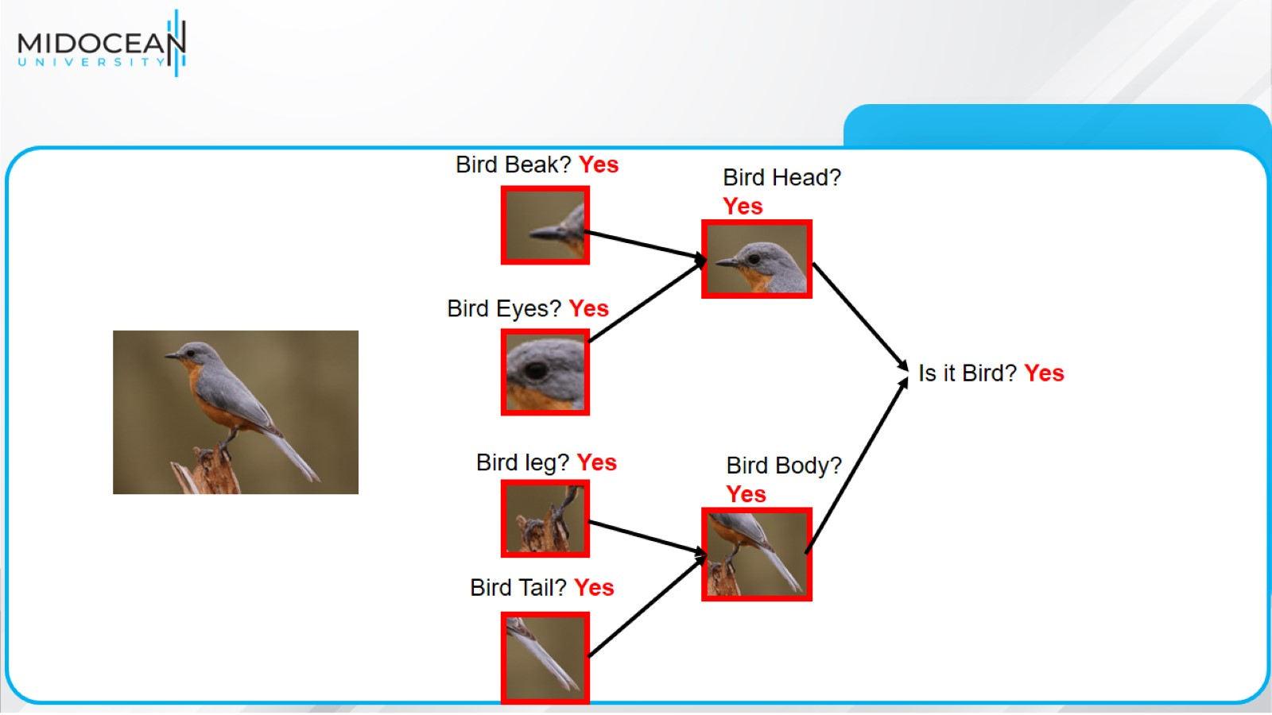

Slide 41
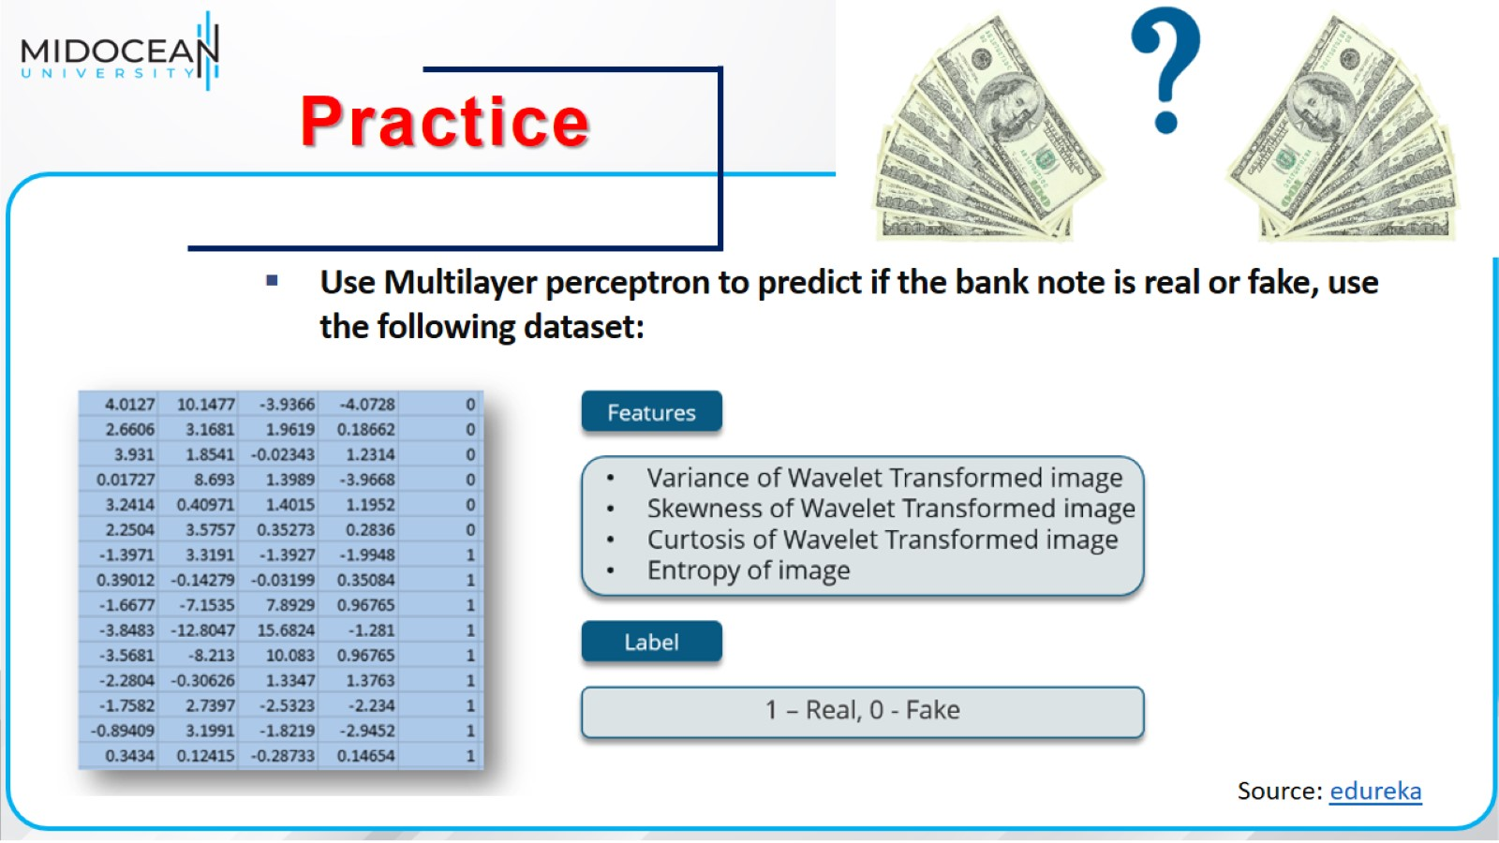

Slide 42
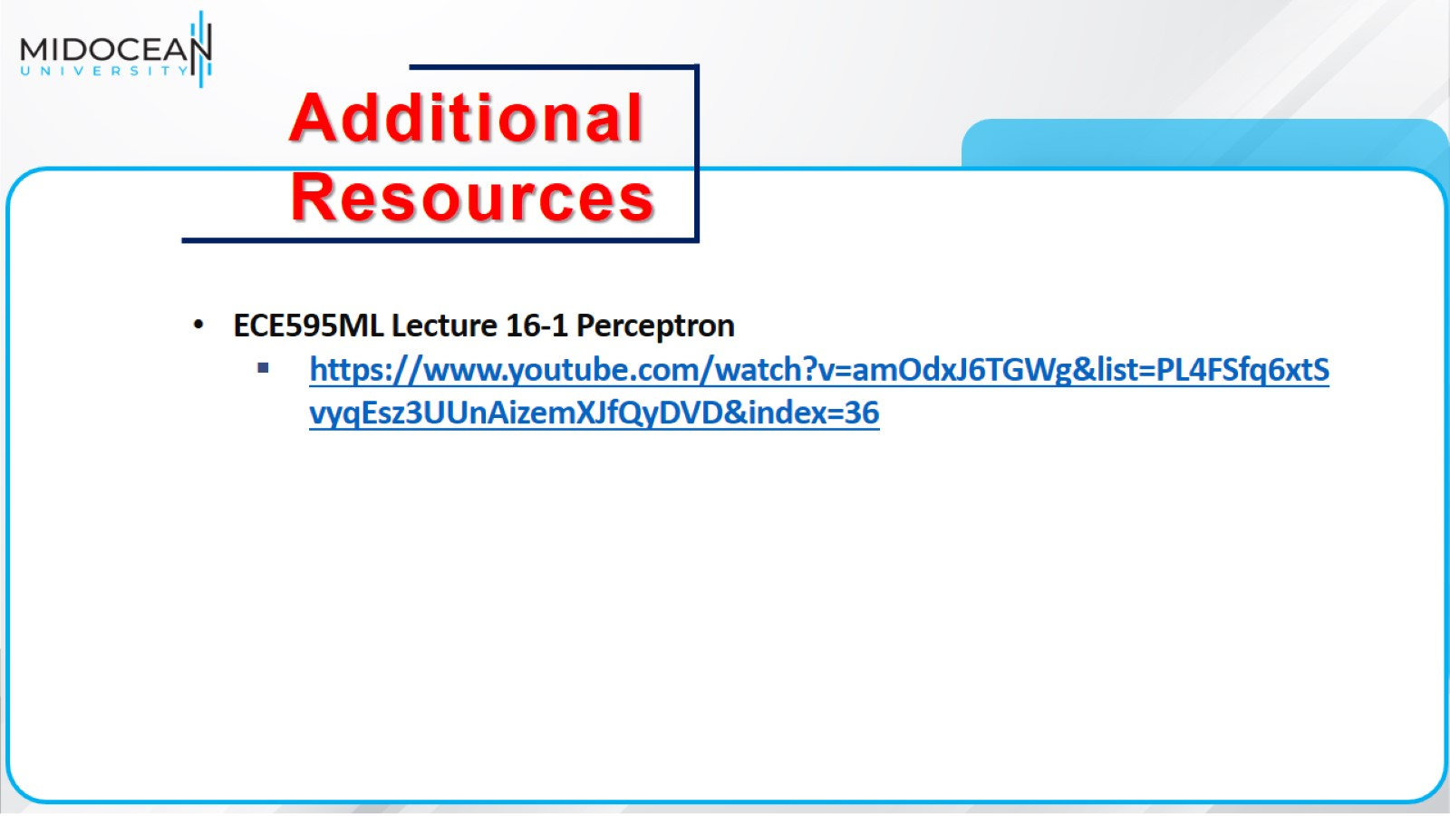

Slide 43


