Slide 1
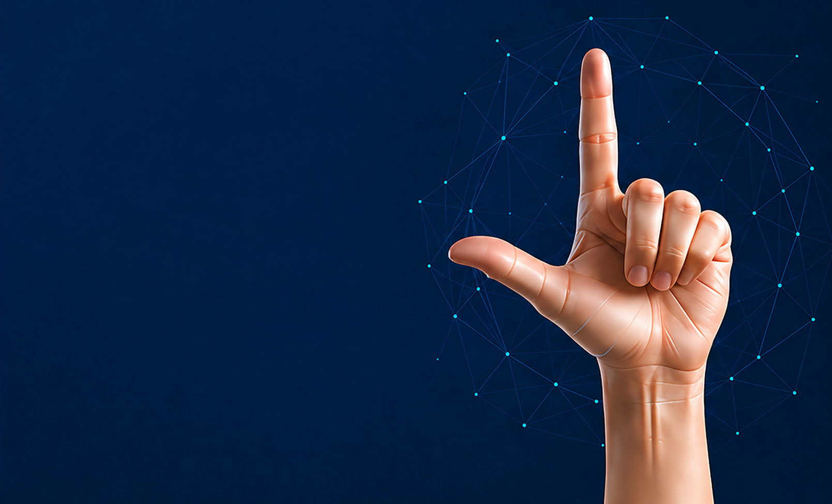

Comparative Study of Deep Learning Models for American Sign Language Fingerspelling Recognition
Master's Thesis Presentation
Prepared By
Anas Alzain ID: 453001724
Mohammed Alqathmi ID: 253001437
Supervisor
Dr. Hager Saleh
College of Informatics
Midocean University Comoros

Slide 2

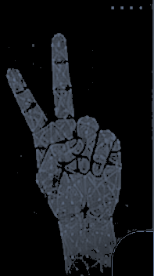
AGENDA
01
Introduction
09
Proposed Hybrid MobileNetV2-Swin Architecture
02
  Problem Statement
10
Experimental Setup and Training Configuration
03
  Literature Review
11
Performance Comparison of Six Models
04
Research Gap
12
Model Size & Efficiency
05
Objectives and Contributions
13
Pre-Class Error Analysis
06
Proposed Methodology Pipeline
14
Accuracy-Speed Trade-Off
07
  Data Description
15
Gradio Application: From Letters to Words
08
Data Augmentation
16
Conclusion & Future Work
17
Thank You

Slide 3

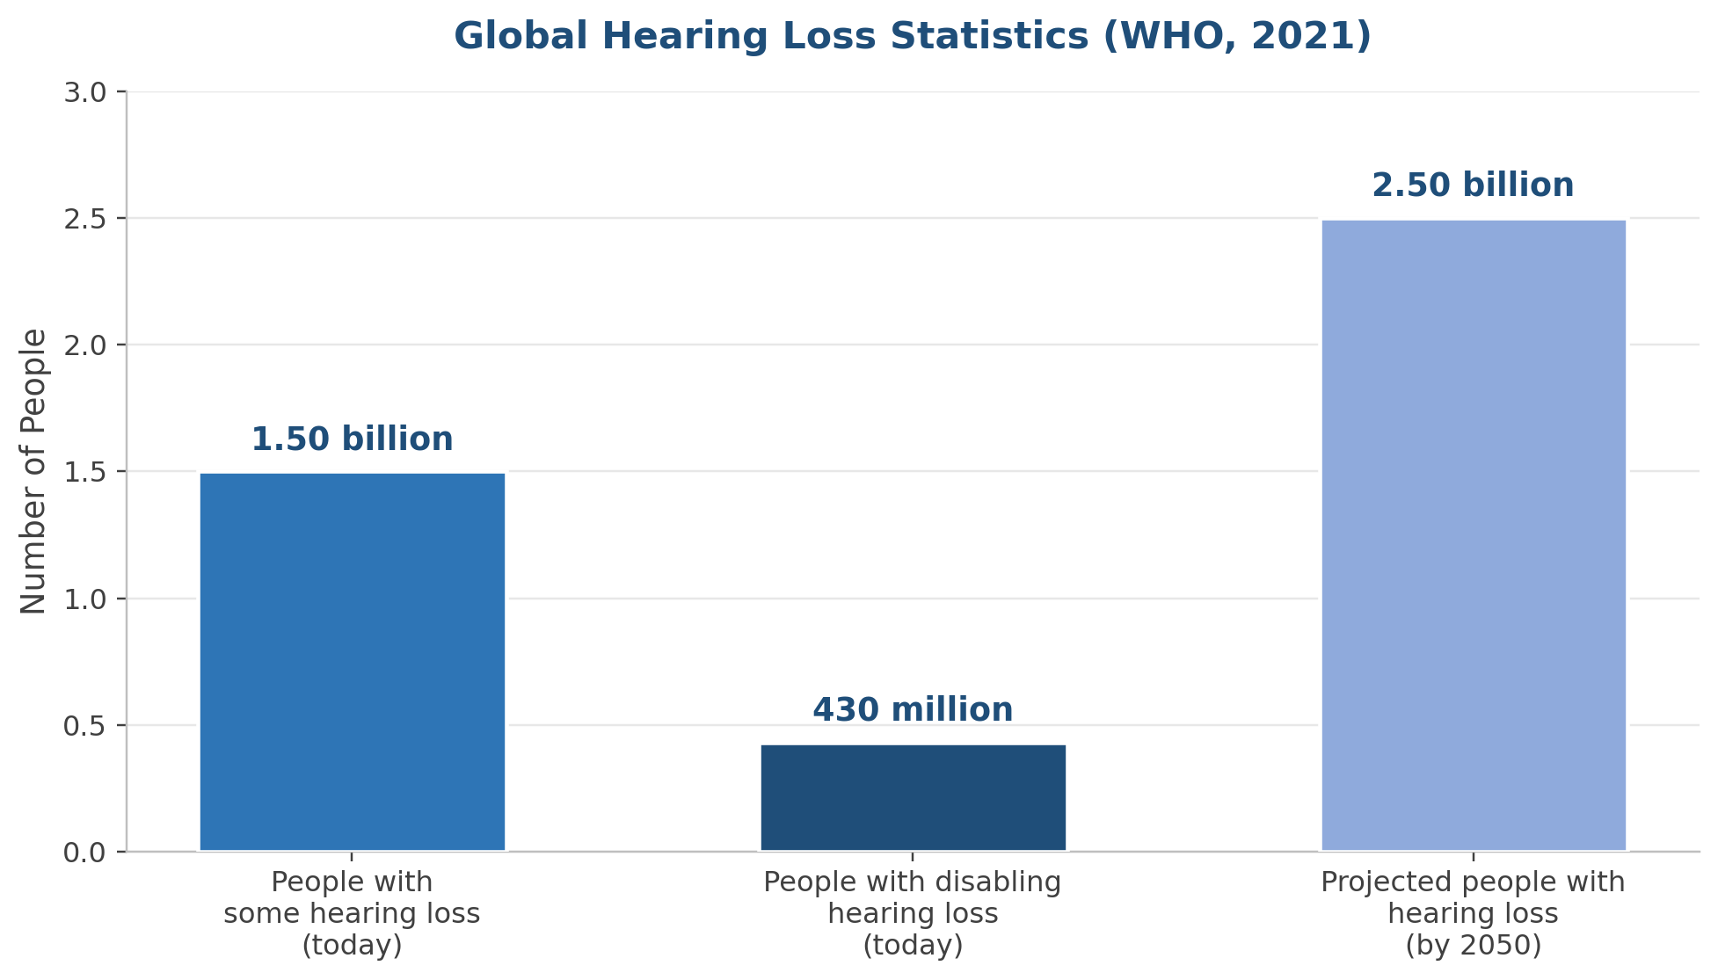
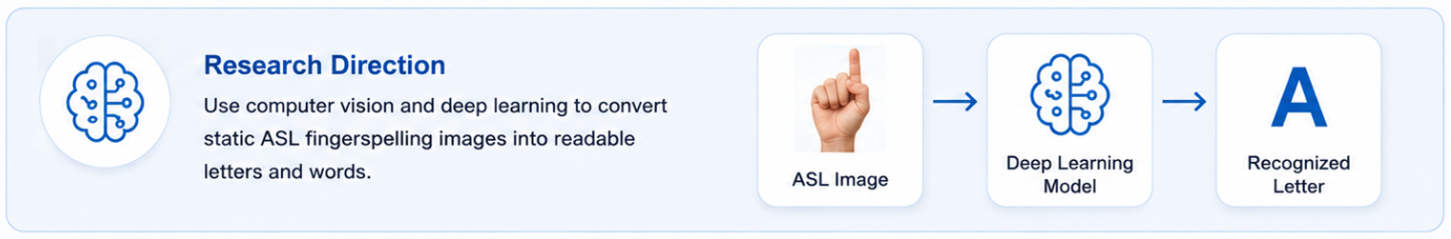
1
INTRODUCTION
Why this matters
1.5B+
430M
people worldwide live with some degree of hearing loss
people require intervention for disabling hearing loss
2050
ASL
projected to reach nearly 2.5B people
fingerspelling is a key building block of communication
A Comparative Study of Deep Learning Models for ASL Fingerspelling Recognition
Notes:
Explain the human problem first. The goal is not just classification; it is reducing communication barriers for Deaf and Mute individuals by converting visual hand gestures into text.

Slide 4




2
2
PROBLEM STATEMENT
Communication Gap
The Deaf and hard-of-hearing community relies on ASL, but most hearing people cannot understand it — creating barriers in daily life, education, and healthcare.
Reliance on Human Interpreters
Manual interpretation requires a human interpreter to be available, which is often costly and does not scale to every situation.
Limitations of Current Automated Systems
Most prior work compares CNNs only, struggles with visually similar signs (e.g., '0' vs 'O'), and lacks a unified cross-model benchmark.
Need for a Real-Time, Practical Solution
An accurate, robust, efficient system is needed — one that goes beyond single-letter classification into real, usable communication.
A Comparative Study of Deep Learning Models for ASL Fingerspelling Recognition

Slide 5
3
LITERATURE REVIEW
Our Improvement
Previous Studies
Approach
Compared three CNN models under the same experimental settings and benchmarked them against Transformer and Hybrid models.
Achieved good accuracy using transfer learning but mainly captured local features and often evaluated individual CNN models.
CNN-Based Approaches
Included ViT in a unified comparison with CNN, Swin, and Hybrid architectures.
Improved global feature representation but was usually evaluated independently.
Vision Transformer (ViT)
Evaluated Swin using the same dataset, data split, GPU, and evaluation metrics as all other models for a fair comparison.
Demonstrated strong recognition performance through hierarchical attention.
Swin Transformer
Proposed a Hybrid MobileNetV2–Swin Transformer model and compared it fairly with five other deep learning models.
Combined CNN and Transformer features but were rarely evaluated alongside multiple architectures under identical conditions.
Hybrid Approaches
Developed a word formation module with automatic spelling correction to improve usability.
Most studies focused only on letter recognition.
Word Formation &
Spelling Correction
Developed a web-based application for real-time ASL fingerspelling recognition and model comparison.
Many studies reported experimental results without a deployable system.
Practical Application
A Comparative Study of Deep Learning Models for ASL Fingerspelling Recognition

Slide 6

4
RESEARCH GAP
Drawing directly from the comparison on the previous slide, four gaps stand out across prior ASL fingerspelling recognition studies:
Limited Cross-Architecture Comparison
Underexplored Hybrid Architectures
CNNs, ViT, Swin, and Hybrid models are typically evaluated in isolation — rarely benchmarked together under one unified, fair protocol (same dataset, split, GPU, and metrics).
Hybrid CNN–Transformer approaches combine local and global features but are rarely evaluated fairly alongside multiple standalone architectures under identical conditions.
Letter-Only Recognition
No Deployable, Practical System
Most systems stop at single-letter classification, with no word-formation stage or automatic spelling correction to make the output directly usable.
Many studies report experimental results only, without a working, real-time deployable application that demonstrates real-world value.
A Comparative Study of Deep Learning Models for ASL Fingerspelling Recognition

Slide 7








5
OBJECTIVE & CONTRIBUTIONS
OBJECTIVES
CONTRIBUTIONS
Main Objective
Develop a Hybrid MobileNetV2–Swin Transformer Model to Enhance American Sign Language (ASL) Fingerspelling Recognition.
Hybrid Model
• Developed a Hybrid MobileNetV2–Swin Transformer model to improve ASL fingerspelling recognition.
Fair and Comprehensive Benchmark
Specific Objectives
• Compared six deep learning models using the same dataset, data split, and training protocol to ensure a fair comparison.
1
Compare the performance of six deep learning models for ASL fingerspelling recognition.
Comprehensive Performance Evaluation
2
Develop a Hybrid MobileNetV2–Swin Transformer architecture.
• Evaluated models using Accuracy, Precision, Recall, F1-score, Inference Time, Model Size, and Number of Parameters.
3
Evaluate the models using unified experimental settings and multiple performance metrics.
Practical Web Application
4
Develop a web-based ASL recognition application with automatic spelling correction.
• Developed an interactive web application that supports letter recognition, word formation, and automatic spelling correction.
Key Impact
Bridging the gap between research and real-world application by delivering a high-accuracy, deployable, and user-friendly ASL recognition system.
A Comparative Study of Deep Learning Models for ASL Fingerspelling Recognition

Slide 8






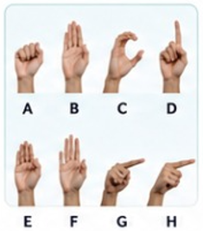
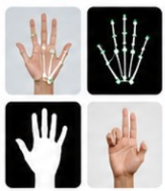
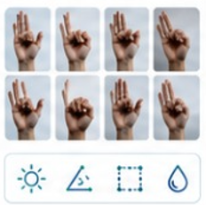
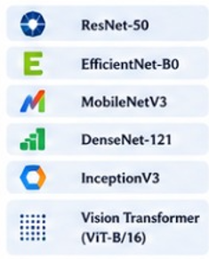
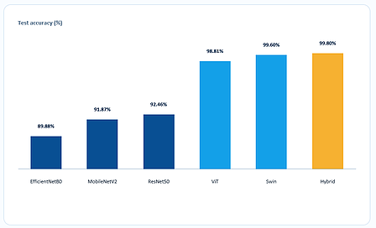


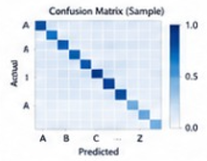

6
PROPOSED METHODOLOGY PIPELINE
1
2
3
4
5
6
7
8
Data
Collection
Data
Preparation
Data Augmentation
& Normalization
Model Training —
Six Architectures
Model
Evaluation
Comparative Analysis
& Selection
Multi-Letter
Word Formation
Automatic Spelling
Correction
Accuracy
Precision
Recognized Output
(Hell0)
Hand
92.6%
91.3%
Recall
F1-Score
HELLO
↓
Crop
91.8%
91.5%
Corrected Output
(HELLO)
•
Collect ASL alphabet hand images/videos
•
Frame extraction (for videos)
•
Sequence modeling for letter recognition
Top Suggestions
•
Hand detection & cropping
•
Rotation, scaling, flipping
1. HELLO
(0.96)
•
Diverse subjects, lighting and backgrounds
•
Compare all six architectures
•
Temporal smoothing
2. HELLO
(0.89)
•
Skin segmentation
•
Brightness & contrast adjustment
•
Transfer learning
3. HELLO
(0.78)
•
Fine-tuning on ASL dataset
Confusion Matrix (Sample)
•
Rank by multiple metrics
•
Word construction from predicted letter sequence
•
Dictionary & language model based correction
•
Balanced classes for all letters (A–Z)
•
Landmark extraction
•
Background variation
•
Accuracy, Precision, Recall, F1-Score
•
Select best-performing model
•
Resize to consistent input size
•
Normalization (pixel scaling & standardization)
•
Adam optimizer
•
Support for continuous signing
•
Edit distance & confidence scoring
•
Early stopping & LR scheduling
•
Confusion matrix
•
•
ROC-AUC (per class)
Improved final text output
A Comparative Study of Deep Learning Models for ASL Fingerspelling Recognition
Notes:
This slide defines the gap. Emphasize that the study is not merely another model test, but a controlled comparison that also considers practical deployment metrics and a working application.

Slide 9


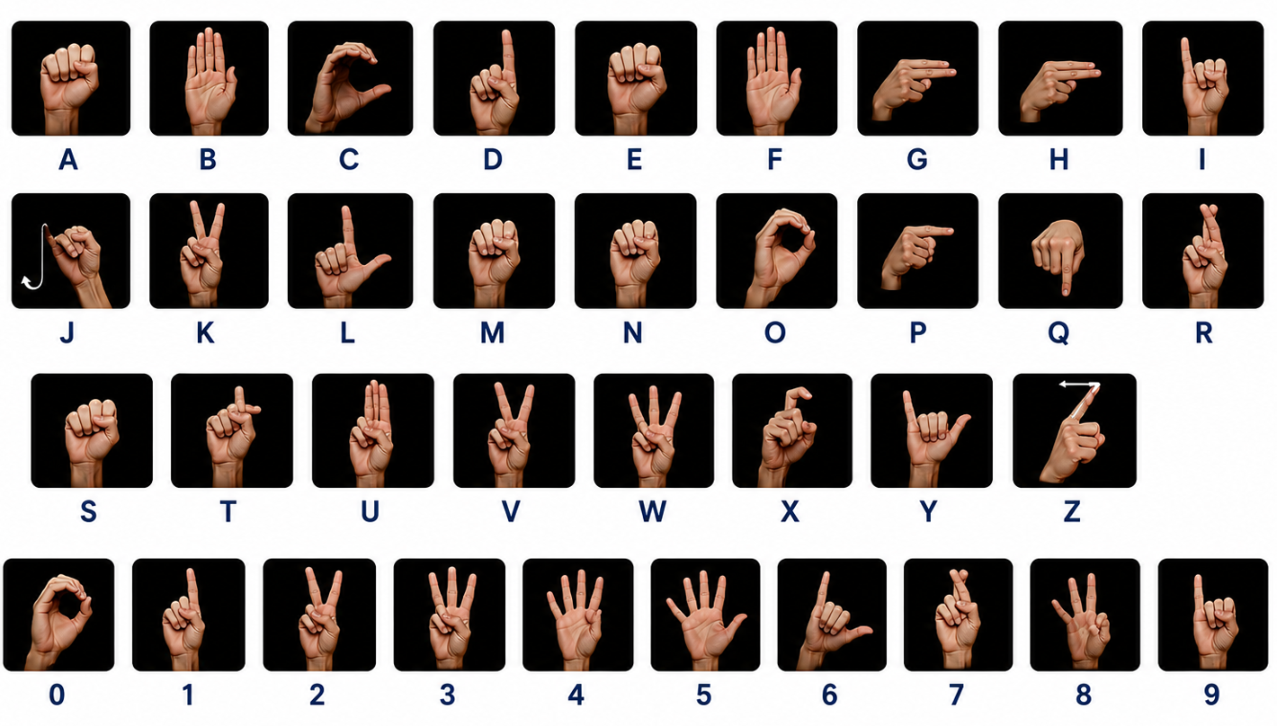


5
7
DATA DESCRIPTION
Dataset Overview
Original Dataset Samples
Dataset
American Sign Language (ASL) Fingerspelling
Classes
36 (A–Z and 0–9)
Total Images
2,515
Input Resolution
224 × 224 pixels
Train / Validation / Test Split
Training (70%)
Validation (10%)
Testing (20%)
Split
Images
Percentage
Description
Training
1,760
70%
Used to train the deep learning models.
Validation
251
10%
Used to tune hyperparameters and prevent overfitting.
Testing
504
20%
Used to evaluate the final performance of the models.
A fixed 70% / 10% / 20% split was used to ensure a fair evaluation across all six deep learning models.
A Comparative Study of Deep Learning Models for ASL Fingerspelling Recognition

Slide 10
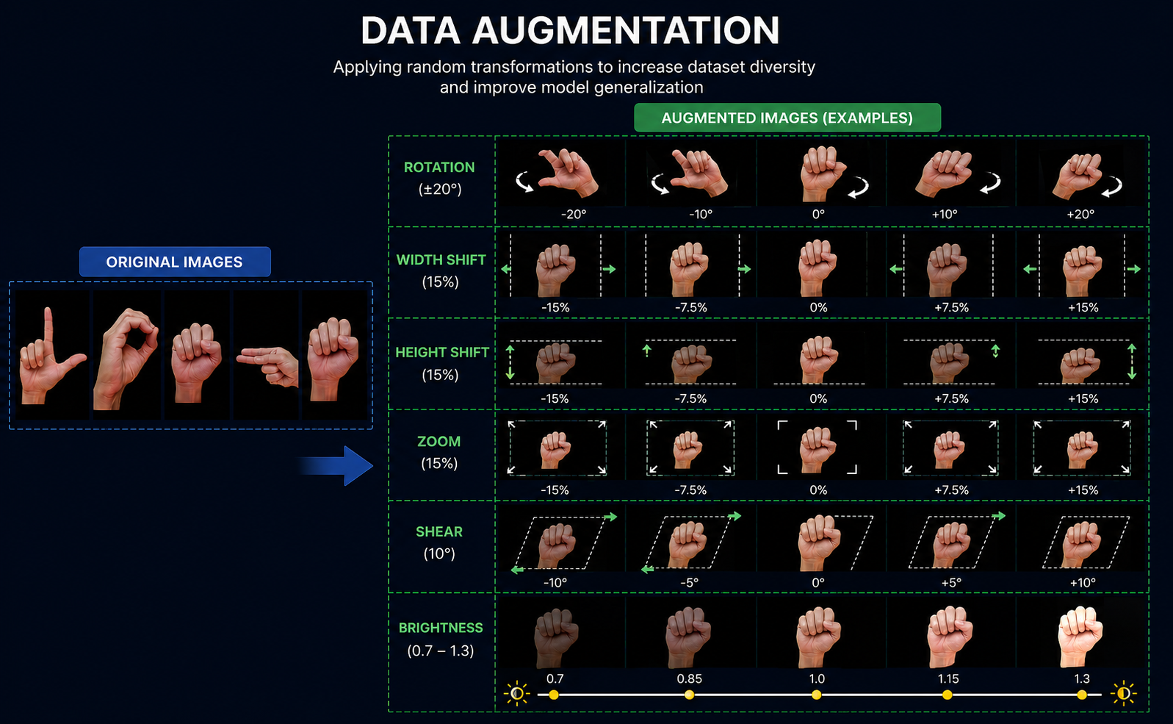




6
8
DATA AUGMENTATION
Purpose:
Increase dataset diversity, improve model generalization, and reduce overfitting.
APPLIED TRANSFORMATIONS
Rotation (±20°)
Width Shift (15%)
Height Shift (15%)
Zoom (15%)
Shear (10°)
Brightness (0.7 – 1.3)
BENEFITS
Improve generalization
Reduce overfitting
Increase data diversity
Improve model robustness
Data augmentation was applied only to the training set.
A Comparative Study of Deep Learning Models for ASL Fingerspelling Recognition

Slide 11






9
HYBRID MOBILENETV2-SWIN ARCHITECTURE
MobileNetV2 Branch
Local convolutional features
1,280-D vector
Feature Concatenation
Classification Head
FC 2048 -> 512
ReLU + Dropout 0.5
Input Image
2,048-D fused vector
36-Class Output
A-Z and 0-9
224 × 224
Swin-Tiny Branch
Shifted-window attention
768-D vector
A Comparative Study of Deep Learning Models for ASL Fingerspelling Recognition
Notes:
Explain the dataset: 36 classes, letters a-z and digits 0-9, 2,515 images. Highlight that the test set has 504 images, 14 per class, and was not augmented.

Slide 12
10
EXPERIMENTAL SETUP
Image Size
Batch Size
Epochs
224×224
16
Up to 30
Maximum Epochs 30 (Early Stopping Applied)
Learning Rate
Split
GPU
0.0001
70 / 10 / 20
NVIDIA A100
Evaluation metrics
Accuracy • Weighted Precision/Recall/F1 • Macro F1 • Inference time • Model size • Parameter count
A Comparative Study of Deep Learning Models for ASL Fingerspelling Recognition
Notes:
The most important point here is fairness: all six models were evaluated on the same 504-image test set and same GPU with comparable settings.

Slide 13
11
11
PERFORMANCE COMPARISON OF SIX MODELS
Performance Comparison of the Six Models on the Test Set
Rank | Model | Test Images | Test Loss | Accuracy | Precision | Recall | F1 | Macro F1
1 | Hybrid MobileNetV2-Swin | 504 | 0.0112 | 99.80% | 99.81% | 99.80% | 99.80% | 99.80%
2 | Swin Transformer | 504 | 0.0189 | 99.60% | 99.60% | 99.60% | 99.60% | 99.60%
3 | Vision Transformer | 504 | 0.0427 | 98.81% | 98.83% | 98.81% | 98.81% | 98.81%
4 | ResNet50 | 504 | 0.3774 | 92.46% | 93.36% | 92.46% | 92.42% | 92.42%
5 | MobileNetV2 | 504 | 0.3565 | 91.87% | 92.86% | 91.87% | 91.93% | 91.93%
6 | EfficientNetB0 | 504 | 0.5200 | 89.88% | 91.42% | 89.88% | 89.51% | 89.51%
★ Best overall: Hybrid MobileNetV2-Swin
A Comparative Study of Deep Learning Models for ASL Fingerspelling Recognition

Slide 14
13
12
MODEL SIZE & EFFICIENCY
Model Size, Parameter Count, and Inference-Time Comparison
A Comparative Study of Deep Learning Models for ASL Fingerspelling Recognition

Slide 15
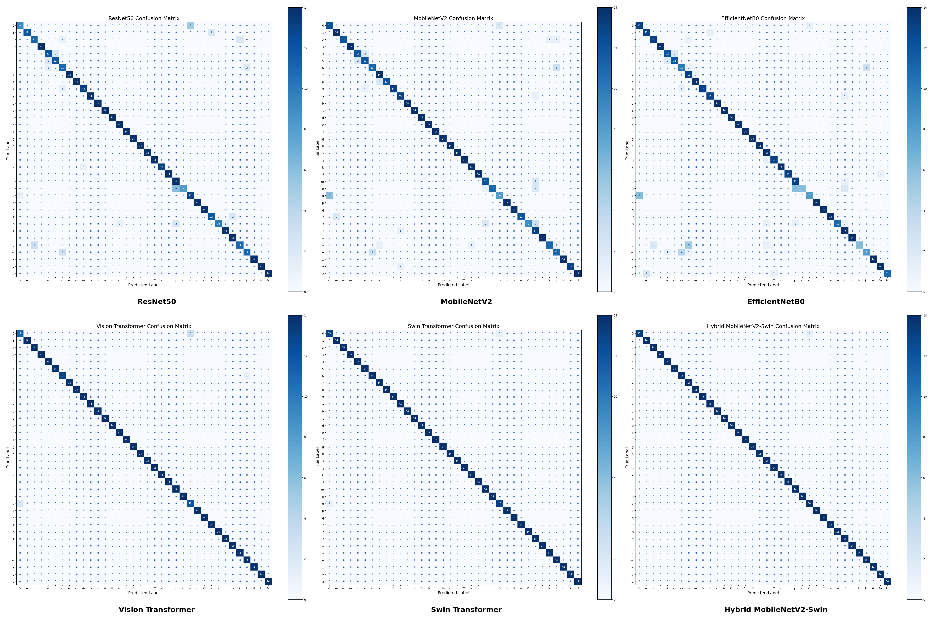
13
PER-CLASS ERROR ANALYSIS
DOMINANT CONFUSION
Hybrid
Swin
ViT
CNNs
digit '0' ↔ letter 'o'
1 error
2 errors
6 errors
broader errors
0 → o only
0 ↔ o
mostly 0 / o
m/n/o, u/v/w, 4/5
A Comparative Study of Deep Learning Models for ASL Fingerspelling Recognition
Notes:
Do not read every number. Focus on the separation between transformer-based models and CNN baselines. State that the Hybrid model reached the highest accuracy.

Slide 16
14
ACCURACY-SPEED TRADE-OFF
Swin
Hybrid
Swin
ViT
Fastest + very high accuracy
Accuracy
Hybrid
ResNet
Highest accuracy
MobileNet
EffNet
MobileNetV2
Smallest model
Faster ← Total inference time (s) → Slower
Recommendation: deploy Swin when speed and accuracy both matter; deploy Hybrid when maximum accuracy is the priority.
A Comparative Study of Deep Learning Models for ASL Fingerspelling Recognition
Notes:
This is one of the strongest findings. Explain that Swin was unexpectedly the fastest overall, so the practical recommendation is not simply “choose a CNN for speed.”

Slide 17
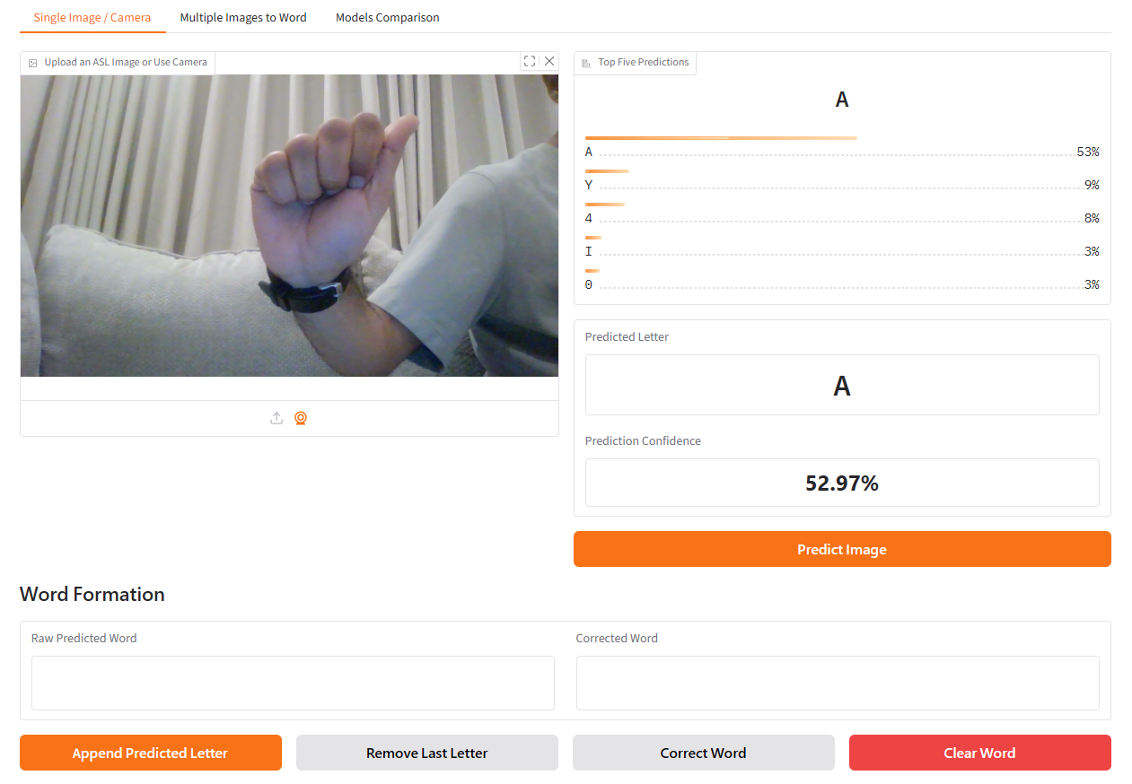
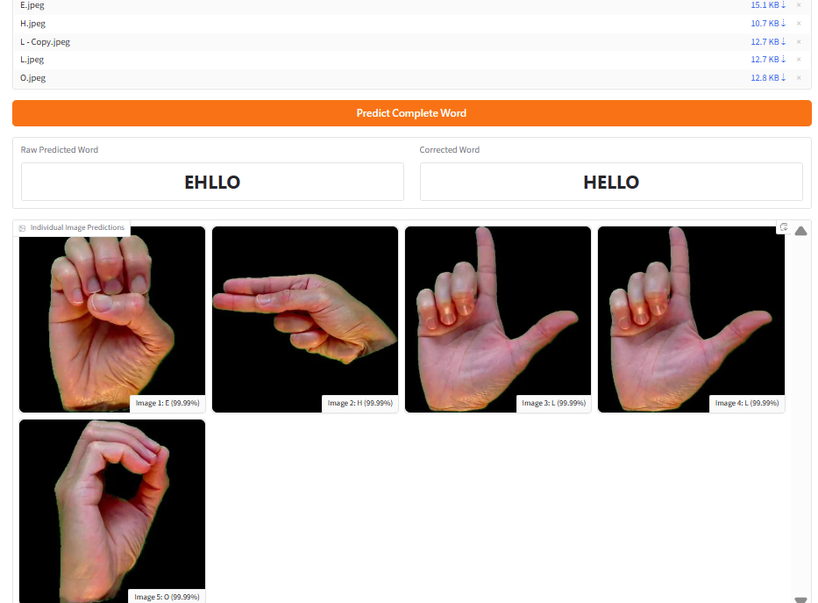
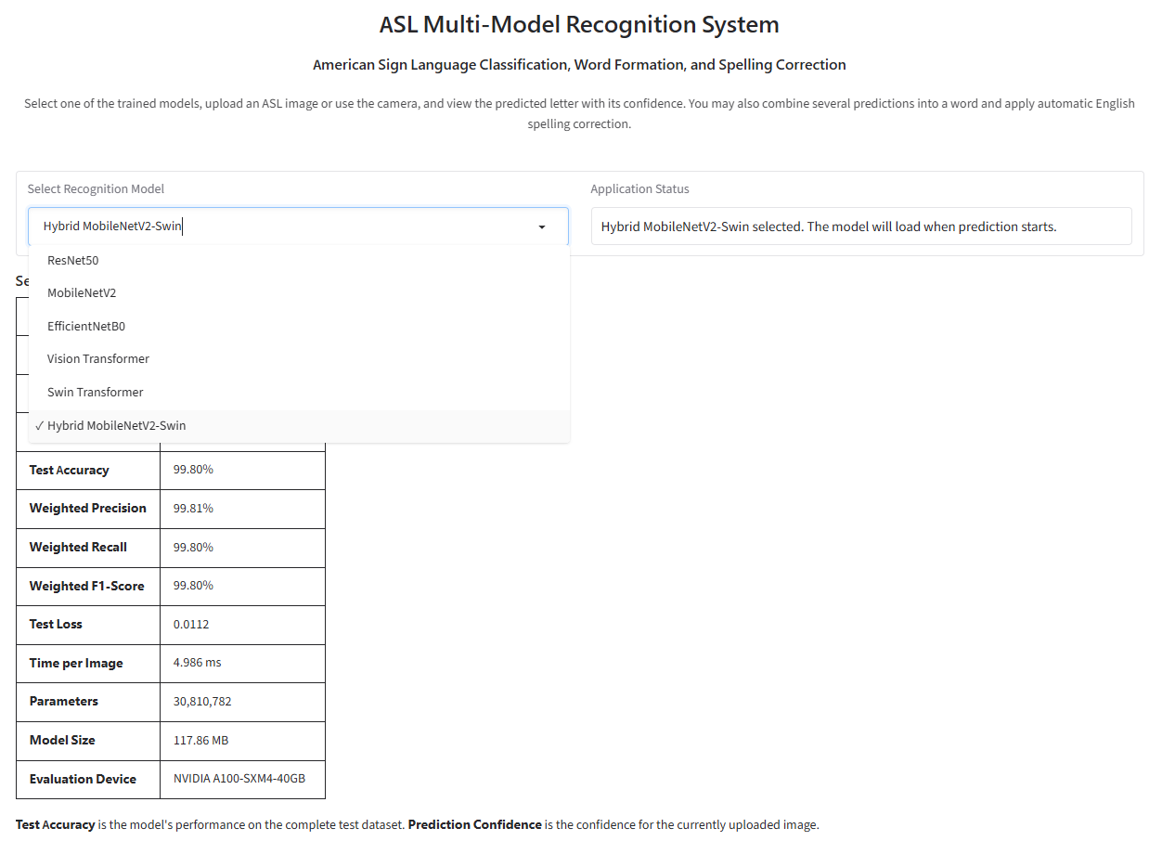
15
GRADIO APPLICATION: FROM LETTERS TO WORDS
Single Image / Camera
Multiple Images to Word
Model Comparison
Predict letter + confidence
Assemble sequence + correct spelling
Compare all six model metrics
Example: EHLLO → HELLO
A Comparative Study of Deep Learning Models for ASL Fingerspelling Recognition
Notes:
Explain that the Gradio app is a demonstration, not the main scientific contribution. It shows how single-letter recognition can support word formation and spelling correction.

Slide 18


16
CONCLUSION & FUTURE WORK
Conclusion
Future Work
Developed a Hybrid MobileNetV2–Swin Transformer model for ASL fingerspelling recognition.
Extend to dynamic, sentence-level sign language recognition using video sequences.
Achieved the highest performance (99.80% accuracy) among all six evaluated models.
Optimize for mobile and edge devices via a cross-platform app (web, desktop, mobile).
Evaluate the system on larger, more diverse datasets.
Transformer-based models consistently outperformed CNN-based models under identical experimental settings.
Integrate with video-conferencing platforms (Teams, Webex, Zoom, Meet) for real-time translation.
Developed a web-based ASL recognition application with word formation and automatic spelling correction.
Deploy across education, healthcare, government, and customer support to improve accessibility.
Established a fair, unified benchmark for comparing six deep learning models.
Expand to additional sign languages, such as Arabic Sign Language (ArSL) and British Sign Language (BSL).
A Comparative Study of Deep Learning Models for ASL Fingerspelling Recognition
Notes:
Summarize the study in less than one minute: Hybrid is most accurate, Swin is most practical, and the work can be extended to dynamic gestures and video conferencing.

Slide 19

Thank You
A Comparative Study of Deep Learning Models for American Sign Language Fingerspelling Recognition
Mohammed Alqathmi • Anas Alzain
Notes:
Thank the committee and invite questions. Keep this slide on screen during the question period.

