Slide 1



Graduation Project-1
Lecture 1
PMG496
Research Title
Prepared by
Dr. Mona Moustafa Elashry
www.midocean.ae

Slide 2

Lecture Outline
Introduction to Research Methodology
Have a finger print in your project
Characteristics of the scientific research
Research Process
Research proposal (See Research proposal template pdf.)
Research variables
Select a research title (See Research title pdf.)
Examples
Online Lecture
Exercises
Online Workshop (online lecture)
www.midocean.ae

Slide 3

Introduction to Research Methodology
مقدمة في منهجية البحث
01
www.midocean.ae

Slide 4
ما هو الفرق بين البحث ومنهجية البحث؟
What is the difference between Research and Research Methodology?
www.midocean.ae
www.midocean.ae

Slide 5
Research
ي
يشير البحث إلى التحقيق المنهجي في موضوع أو قضية معينة لاكتساب معرفة أو رؤى أو فهم جديد. يتضمن جمع البيانات وتحليلها وتفسيرها للإجابة على أسئلة البحث أو اختبار الفرضيات. يمكن إجراء الأبحاث في مجالات مختلفة، بما في ذلك التعليم والعلوم والعلوم الاجتماعية وغيرها.
Research refers to the systematic investigation of a particular topic or issue to gain new knowledge, insights, or understanding. It involves the collection, analysis, and interpretation of data to answer research questions or test hypotheses. Research can be conducted in various fields, including education, science, social sciences, and more.
www.midocean.ae
www.midocean.ae

Slide 6
Research methodology
ي
تشير منهجية البحث إلى النهج العام أو الإستراتيجية المستخدمة لإجراء البحث. ويشمل التقنيات والإجراءات والأدوات المستخدمة لجمع البيانات وتحليلها. تتضمن منهجية البحث اختيار تصميم البحث، وطرق جمع البيانات، وتقنيات أخذ العينات، وإجراءات تحليل البيانات، وتفسير النتائج.
Research methodology refers to the overall approach or strategy used to conduct research. It encompasses the techniques, procedures, and tools employed to gather and analyze data. Research methodology includes the selection of research design, data collection methods, sampling techniques, data analysis procedures, and interpretation of findings.
www.midocean.ae

Slide 7
ما هي أهمية منهجية البحث؟
What is the Importance of Research Methodology?
www.midocean.ae
www.midocean.ae

Slide 8
Research methodology
ي
Firstly, it helps researchers define the scope and objectives of their studies. By clearly stating research questions and objectives, researchers can focus their efforts and avoid unnecessary diversions.
أولاً، يساعد الباحثين على تحديد نطاق وأهداف دراساتهم. من خلال تحديد أسئلة البحث وأهدافه بوضوح، يمكن للباحثين تركيز جهودهم وتجنب الانحرافات غير الضرورية.
Research methodology plays a vital role in academia for several reasons.
تلعب منهجية البحث دورًا حيويًا في الأوساط الأكاديمية لعدة أسباب.
www.midocean.ae

Slide 9
Research methodology
ي
Secondly, research methodology ensures the validity and reliability of research findings. By following systematic procedures, researchers can minimize bias and errors, making their results more trustworthy and accurate.
ثانياً، تضمن منهجية البحث صحة وموثوقية نتائج البحث. ومن خلال اتباع إجراءات منهجية، يمكن للباحثين تقليل التحيز والأخطاء، مما يجعل نتائجهم أكثر موثوقية ودقة.
Research methodology plays a vital role in academia for several reasons.
تلعب منهجية البحث دورًا حيويًا في الأوساط الأكاديمية لعدة أسباب.
www.midocean.ae

Slide 10
Research methodology
ي
Thirdly, research methodology allows for replication and verification of findings. By providing detailed documentation of the research process, other researchers can replicate the study and validate the results. This promotes the growth of knowledge and contributes to the advancement of the field.
ثالثا، تسمح منهجية البحث بتكرار النتائج والتحقق منها. ومن خلال توفير توثيق تفصيلي لعملية البحث، يمكن للباحثين الآخرين تكرار الدراسة والتحقق من صحة النتائج. وهذا يعزز نمو المعرفة ويساهم في تقدم هذا المجال.
Research methodology plays a vital role in academia for several reasons.
تلعب منهجية البحث دورًا حيويًا في الأوساط الأكاديمية لعدة أسباب.
www.midocean.ae

Slide 11
ما هي المكونات الرئيسية لمنهجية البحث؟
What are The Key Components of Research Methodology
www.midocean.ae
www.midocean.ae

Slide 12
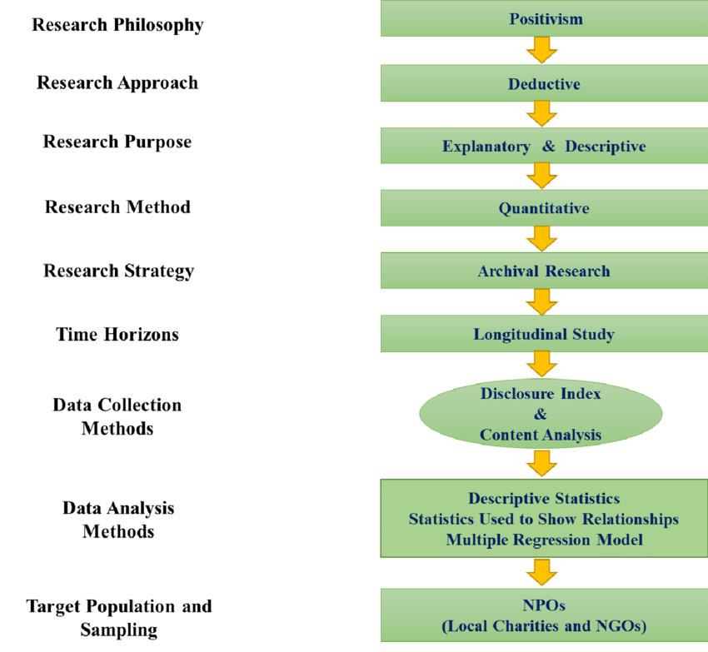

Slide 13

How do you have a finger print in your thesis?
كيف تكون لك بصمة في رسالتك؟
02
www.midocean.ae

Slide 14

www.midocean.ae

Slide 15

Tools الأدوات
www.midocean.ae

Slide 16

www.midocean.ae

Slide 17

www.midocean.ae

Slide 18

www.midocean.ae

Slide 19

www.midocean.ae

Slide 20


www.midocean.ae

Slide 21

Vision رؤية
www.midocean.ae

Slide 22

www.midocean.ae

Slide 23


www.midocean.ae

Slide 24


www.midocean.ae

Slide 25
Vision رؤية
www.midocean.ae

Slide 26



www.midocean.ae

Slide 27


www.midocean.ae

Slide 28


www.midocean.ae

Slide 29

www.midocean.ae

Slide 30
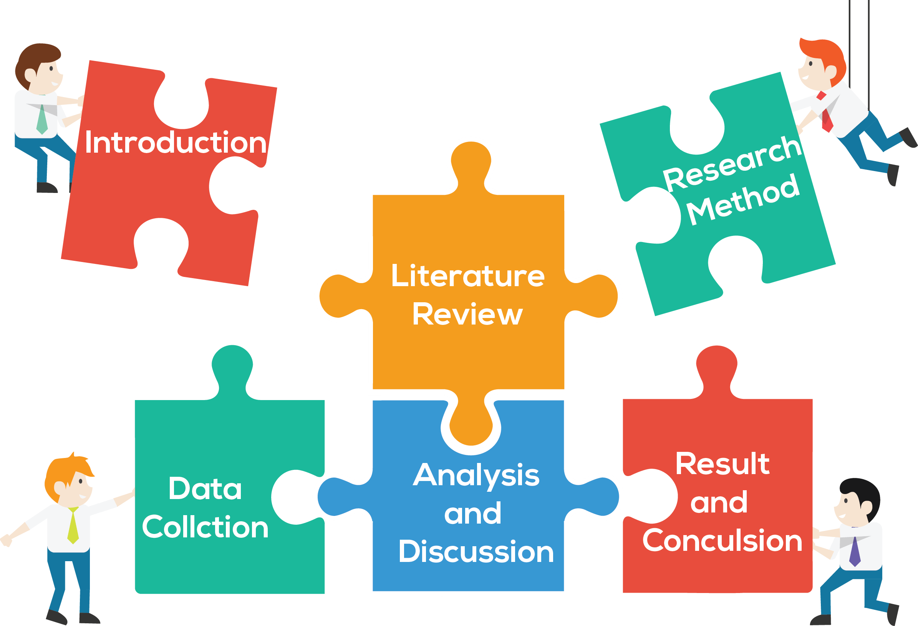
www.midocean.ae
www.midocean.ae

Slide 31

Characteristics of Scientific Research
03
www.midocean.ae

Slide 32
Characteristics of Scientific Research..
Purposiveness
Rigor
Testability
Replicability
Precision
Objectivity
Generalizability
Parsimony
www.midocean.ae

Slide 33
Characteristics of Scientific Research..
We will explain each of these characteristics in the context of the following example:
Consider the case of a manager who is interested in investigating how employees’ commitment to the organization can be increased
www.midocean.ae

Slide 34
Purposiveness.
The manager has started the research with a definite aim or purpose.
The focus is on increasing the commitment of employees to the organization, as this will be a beneficial in many ways.
www.midocean.ae

Slide 35
Purposiveness- Cont.
An increase in employee commitment will translate into less turnover, less absenteeism, and increased performance levels, all of which would definitely benefit the organization.
www.midocean.ae

Slide 36
Rigor
A good theoretical base and a sound methodological design would add rigor to a purposive study.
Rigor means carefulness, and the degree of exactitude الدقة in research investigations
www.midocean.ae

Slide 37
Rigor- Cont..
In the case of our example of increasing the commitment of employees
Let us say that the manager of an organization asks 10 of its employees to indicate what would increase their level of commitment to the organization.
If the manager depends solely on the basis of their responses reaches to several conclusions on how employee commitment can be increased, the whole approach to the investigation would be unscientific
www.midocean.ae

Slide 38
Testability.
After taking random selection of employees of the organization, and the study of previous research done of the area of organizational commitment, the researcher develops certain hypotheses on how employee commitment can be enhanced.
www.midocean.ae

Slide 39
Testability- Cont..
Then these hypotheses can be tested by applying certain statistical tests to the data collected for the purpose.
Scientific research tends itself to testing logically developed hypotheses to see whether or not the data support the hypotheses that are developed
www.midocean.ae

Slide 40
Replicability
The results of the tests of hypotheses should be supported again and again when the same type of research is repeated in other similar circumstances.
If the results are repeated, we will gain confidence in the scientific nature of our research
www.midocean.ae

Slide 41
Precision and Confidence
Precision refers to the closeness of the findings to reality based on a sample.
Confidence refers to the probability that our estimations are correct.

Slide 42
Precision and Confidence-Cont.
It is not enough to be precise, but it is also important that we can confidently claim that 95% of the time our results would be true and there is only a 5% chance of our being wrong. This is also known as confidence level.
The greater the precision and confidence we aim at in our research, the more scientific is the investigation and the more useful are the results
www.midocean.ae

Slide 43
Objectivity
The conclusions drawn through the interpretation of the results of data analysis should be objective.
The conclusions should be based on the facts of the findings derived from actual data, and not on our own subjective or emotional values.
The more objective the interpretation of the data, the more scientific the research investigation becomes.
www.midocean.ae

Slide 44
Generalizability
Generalizability refers to the scope of applicability of the research findings in one organizational setting to other settings.
The wider the range of applicability of the solutions generated by research, the more useful the research is to the users
www.midocean.ae

Slide 45
Parsimony.
Parsimony refers to simplicity in explaining the phenomena or problems that occur, and in generating solutions for the problems.
Economy in research models is achieved when we can build into our research framework a lesser number of variables that would explain the variance far more efficiently than a complex set of variables that would only marginally add to the variance explained.
www.midocean.ae

Slide 46
Research Process
عملية البحث
04
www.midocean.ae

Slide 47
مراحل عملية البحث
Stages of Research Process
www.midocean.ae
www.midocean.ae

Slide 48
Research Process
ي
تشير عملية البحث إلى المنهج المنظم المستخدم لجمع المعلومات وتحليل البيانات واستخلاص النتائج من أجل الإجابة على سؤال بحثي أو التحقيق في موضوع معين. يتضمن عادةً الخطوات التالية:
The research process refers to the systematic and organized approach used to gather information, analyze data, and draw conclusions in order to answer a research question or investigate a specific topic. It typically involves the following steps:
www.midocean.ae

Slide 49
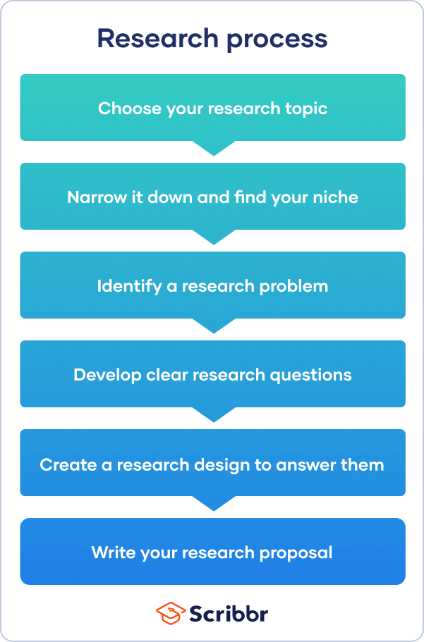

Slide 50
Research proposal( Project 1)
مكونات مقترح البحث(المشروع 1)
05
See Research proposal template pdf
www.midocean.ae

Slide 51
ما هو مقترح البحث؟
What is the research proposal?
www.midocean.ae
www.midocean.ae

Slide 52
Research Proposal
ي
يعد مقترح البحث وثيقة أساسية في المجال الأكاديمي، خاصة لطلاب الدراسات العليا. وهو بمثابة مخطط للدراسة البحثية ويحدد أهداف البحث المقترح ومنهجيته وأهميته.
A research proposal is an essential document in the field of academia, particularly for postgraduate students. It serves as a blueprint for the research study and outlines the objectives, methodology, and significance of the proposed research.
www.midocean.ae

Slide 53
ما هي مكونات مقترح البحث؟
What are the components of a research proposal?
www.midocean.ae
www.midocean.ae

Slide 54
Research Proposal Components
Introduction المقدمة
Research Problem مشكلة الدراسة
Research Questions أسئلة الدراسة
Research Objectives أهداف الدراسة
Research Model & Hypotheses نموذج وفرضيات الدراسة
Research Methodology منهجية الدراسة
Scope of Study الدراسة الميدانية
Proposed Research Structure الهيكل المقترح للدراسة
References قائمة المراجع
Appendices الملاحق
Research Title عنوان الدراسة
Research Significant أهمية البحث
Abstract المستخلص
www.midocean.ae

Slide 55
Research variables
متغيرات البحث
06
www.midocean.ae

Slide 56
ما معنى متغيرات البحث؟
What the Meaning of Research variables?
www.midocean.ae
www.midocean.ae

Slide 57
Research variables
Research variables are characteristics or attributes that can be measured and analyzed in a research study.
متغيرات البحث هي خصائص أو سمات يمكن قياسها وتحليلها في دراسة بحثية.
They are the key elements that researchers manipulate, measure, or observe to understand their relationship with other variables.
وهي العناصر الأساسية التي يتلاعب بها الباحثون أو يقيسونها أو يلاحظونها لفهم علاقتها بالمتغيرات الأخرى.
In management research, variables can be classified into four main types: independent variables, dependent variables, mediating variables and moderating variables.
في البحوث الإدارية، يمكن تصنيف المتغيرات إلى أربعة أنواع رئيسية: المتغيرات المستقلة، والمتغيرات التابعة، والمتغيرات الوسيطة، والمتغيرات المعتدلة.
www.midocean.ae

Slide 58
Independent Variables:
ي
For example, if researchers want to investigate the effect of leadership style on employee satisfaction, the independent variable would be….
Independent variables are the factors that researchers manipulate or control in a study. They are the causes or predictors of the outcome or dependent variable.
المتغيرات المستقلة هي العوامل التي يتلاعب بها الباحثون أو يتحكمون فيها في الدراسة. إنها الأسباب أو المتنبئين بالنتيجة أو المتغير التابع.
The leadership styles.
www.midocean.ae

Slide 59
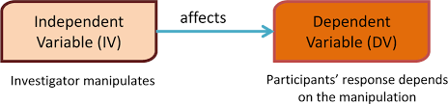
Independent Variables:
www.midocean.ae

Slide 60
Dependent Variables:
ي
For example, if researchers want to investigate the effect of leadership style on employee satisfaction, the dependent variable would be….
Dependent variables are the outcomes or results that researchers measure or observe. They are influenced by the independent variables
المتغيرات التابعة هي النتائج التي يقيسها الباحثون أو يلاحظونها. أنها تتأثر بالمتغيرات المستقلة
Employee satisfaction
www.midocean.ae

Slide 61
Mediating variables
ي
For example, if researchers want to investigate the effect of leadership style on employee satisfaction via Leader`s interpersonal skills, the mediating variable would be….
Mediating variables are variables that help explain the relationship between the independent and dependent variables. They act as intermediate factors that transmit the effect of the independent variable to the dependent variable
المتغيرات الوسيطة هي متغيرات تساعد في تفسير العلاقة بين المتغيرات المستقلة والتابعة. وهي تعمل كعوامل وسيطة تنقل تأثير المتغير المستقل إلى المتغير التابع
Leader`s interpersonal skills
www.midocean.ae

Slide 62
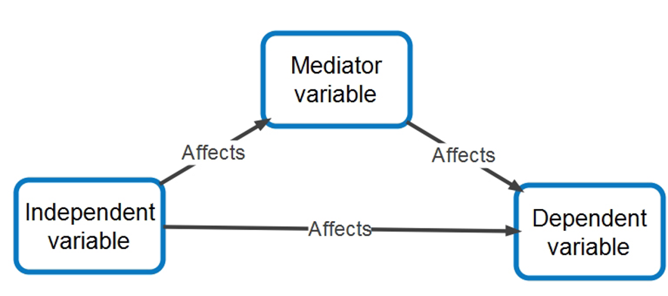
Mediating variables
www.midocean.ae

Slide 63
Moderating variables
ي
For example, if researchers want to investigate The effect of demographic variables on the relationship between leadership style and employee satisfaction, the moderating variable would be….
Moderating variables influence the strength or direction of the relationship between the independent and dependent variables. They interact with the independent variable to determine the outcome on the dependent variable
تؤثر المتغيرات المعدلة على قوة أو اتجاه العلاقة بين المتغيرات المستقلة والتابعة. يتفاعلون مع المتغير المستقل لتحديد النتيجة على المتغير التابع
Demographic Variables
www.midocean.ae

Slide 64
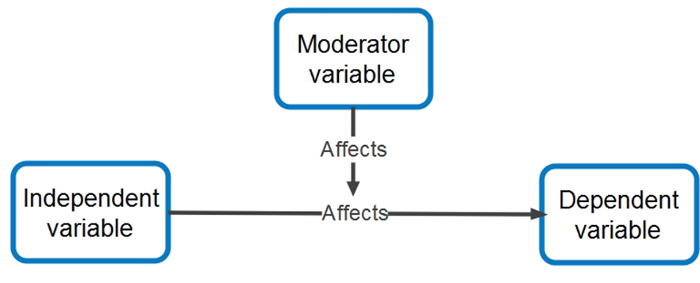
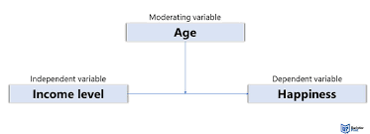
Moderating variables
www.midocean.ae

Slide 65
The impact of risk mitigation strategies on financial losses
The independent:
risk mitigation strategies
The dependent:
financial losses
www.midocean.ae

Slide 66
The relationships between project scope and project completion time
The independent:
project scope
The dependent:
project completion time
www.midocean.ae

Slide 67
Select a Research Title
اختر عنوان البحث
06
See Research title pdf
www.midocean.ae

Slide 68
ما أهمية اختيار عنوان البحث؟
What is the Importance of Selecting a Research Title?
www.midocean.ae

Slide 69
ي
The research title serves as a concise representation of the study's focus and objectives. It should be clear, concise, and reflective of the research problem or question.
A well-chosen research title not only captures the attention of readers but also provides a framework for the entire research process.
عنوان البحث بمثابة تمثيل موجز لتركيز الدراسة وأهدافها. ويجب أن تكون واضحة وموجزة وتعكس مشكلة البحث أو سؤاله. إن عنوان البحث المختار جيدًا لا يجذب انتباه القراء فحسب، بل يوفر أيضًا إطارًا لعملية البحث بأكملها.
www.midocean.ae

Slide 70
ما هي معايير العناوين البحثية الجيدة؟
What are Criteria for Good Research Titles?
www.midocean.ae
www.midocean.ae

Slide 71
Criteria for Good Research Titles
A good research topic should be feasible (can be done), interesting, novel, ethical and relevant (has an implication)
يجب أن يكون موضوع البحث الجيد ممكنًا (يمكن القيام به)، مثيرة للاهتمام، جديد، أخلاقي و ذو صلة (له أثر)
FINER :
F = feasible
I = interesting
N = novel
E = ethical
R = Relevant
www.midocean.ae

Slide 72
Criteria for Good Research Titles
Clarity and Concisenessالوضوح والإيجاز
Relevance and Significance الصلة والأهمية
Specific محدد
Originality and Uniqueness الأصالة والتفرد
www.midocean.ae

Slide 73

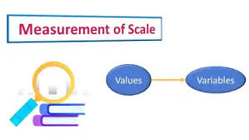
Criteria for Good Research Titles
Availability of previous studiesتوفر الدراسات السابقة
Measurable القابلية للقياس
www.midocean.ae

Slide 74
أمثلة على عناوين البحوث
Examples of Research Titles
www.midocean.ae

Slide 75
"The Impact of Leadership Styles on Employee Motivation in the Retail Industry“
"أثر أنماط القيادة على تحفيز الموظفين في صناعة البيع بالتجزئة"
"Exploring the Relationship between Organizational Culture and Employee Job Satisfaction in Multinational Corporations“
"استكشاف العلاقة بين الثقافة التنظيمية والرضا الوظيفي للموظفين في الشركات المتعددة الجنسيات"
www.midocean.ae

Slide 76
"An Analysis of Cybersecurity Risks in Financial Institutions: A Case Study of XYZ Bank"
"تحليل مخاطر الأمن السيبراني في المؤسسات المالية: دراسة حالة بنك XYZ"
"Examining the Effectiveness of Risk Assessment Models in the Oil and Gas Industry"
"دراسة فعالية نماذج تقييم المخاطر في صناعة النفط والغاز"
www.midocean.ae

Slide 77
"Investigating the Factors Influencing Project Success in Construction Industry Projects"
"دراسة العوامل المؤثرة على نجاح المشاريع في مشاريع صناعة البناء"
"The Role of Agile Methodologies in Managing Software Development Projects: A Comparative Study"
"دور المنهجيات الرشيقة في إدارة مشاريع تطوير البرمجيات: دراسة مقارنة"
www.midocean.ae

Slide 78
Online Lecture
www.midocean.ae

Slide 79
Exercises 1
07
Good and Bad Research Titles
www.midocean.ae

Slide 80
ي
Which of the following research titles is an example of a good research title?
a) "The Effects of Exercise on Physical Fitness"
b) "My Thoughts on Physical Fitness"
c) "Physical Fitness: A Study"
d) "Physical Fitness and Stuff"
a) "The Effects of Exercise on Physical Fitness"
www.midocean.ae

Slide 81
ي
Which of the following research titles is an example of a bad research title?
a) "The Impact of Climate Change on Global Agriculture"
b) "A Comprehensive Analysis of Climate Change and Its Effects on Agriculture"
c) "Climate Change and Agriculture"
d) "Climate Change: A Research Paper"
d) "Climate Change: A Research Paper"
www.midocean.ae

Slide 82
ي
Which of the following research titles is an example of a good research title?
a) "The Benefits of Technology in the Classroom"
b) "Technology in Education"
c) "Using Technology to Enhance Learning"
d) "Technology: A Study"
c) "Using Technology to Enhance Learning"
www.midocean.ae

Slide 83
ي
Which of the following research titles is an example of a bad research title?
a)"The Relationship Between Parent Involvement and Student Achievement"
b)"Parent Involvement and Student Achievement: A Quantitative Study"
c)"The Impact of Parent Involvement on Student Achievement"
d) "Parent Involvement: A Research Paper"
d) "Parent Involvement: A Research Paper"
www.midocean.ae

Slide 84

Exercises 2
07
Evaluate Research Titles
www.midocean.ae

Slide 85
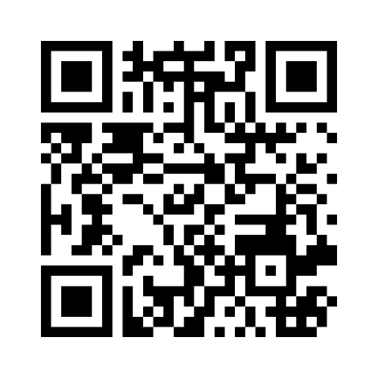
اكتب أسمك+ تعليقك
https://www.menti.com/aldxwb1axvxv
هل هذا العنوان جيد أم لا؟
حدد أنواع المتغيرات؟
مكان التطبيق؟
Clarity and Concisenessالوضوح والإيجاز
Relevance and Significance الصلة والأهمية
Specific محدد
Originality and Uniqueness الأصالة والتفرد
Availability of previous studiesتوفر الدراسات السابقة
Measurable القابلية للقياس
www.midocean.ae

Slide 86

Workshop
08
Brainstorming Activity to generate potential research titles
www.midocean.ae

Slide 87

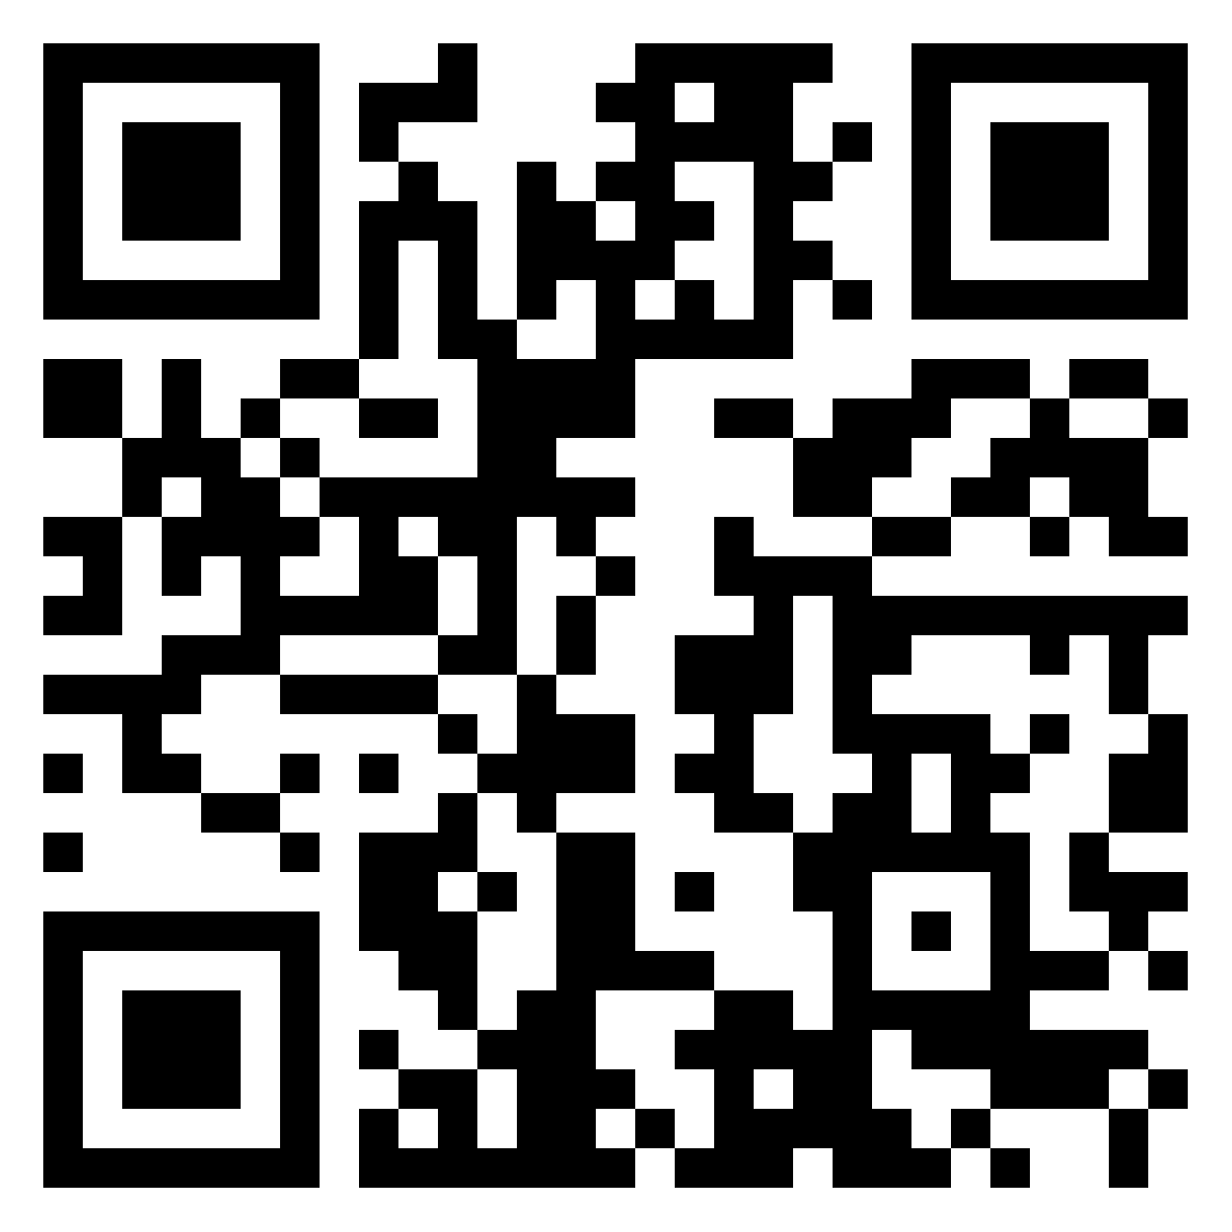
مطلوب من كل طالب تحديد عنوان بحثي يحتوي على معايير العنوان الجيد
مع تحديد:
أنواع المتغيرات بالعنوان: مستقل, تابع - وسيط, معدل(إن وجد)
مكان التطبيق- عينة الدراسة
Clarity and Concisenessالوضوح والإيجاز
Relevance and Significance الصلة والأهمية
Specific محدد
Originality and Uniqueness الأصالة والتفرد
Availability of previous studiesتوفر الدراسات السابقة
Measurable القابلية للقياس
https://padlet.com/monaalashry77/brainstorming-activity-to-generate-potential-research-titles-l514v7r0c4qvrbpn
www.midocean.ae
www.midocean.ae

Slide 88




Thank You

