Slide 1


Attitudes and Job Satisfaction
Organizational Behavior
and Projects
Lecture 5
PMG421
Communication
Prepared by
Dr. Mohammed Mustafa
www.midocean.ae

Slide 2




The Process of Managerial Communication
Types of Communications in Organizations
Factors Affecting Communications and the Roles of Managers
Managerial Communication and Corporate Reputation
The Major Channels of Management Communication Are Talking, Listening, Reading, and Writing
www.midocean.ae

Slide 3
Learning Objectives
Describe the types of interpersonal communication.
Evaluate how to choose communication methods and handle barriers to effective communication.
Discuss the various forms of virtual communication used in modern organizations.
Analyze the issues surrounding smartphones, social media, and cybersecurity confronting modern organizations.
Recognize how to engage in effective cross-cultural communication in organizations.
www.midocean.ae

Slide 4
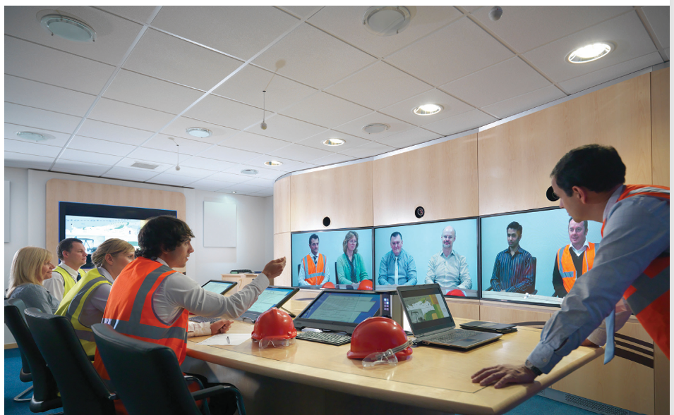
Communication
Communication is the primary means through which people connect with one another.
Communication is not only used to transmit a message or impart meaning—it is also used to bond and forge connections with others.
www.midocean.ae

Slide 5
Communication
For instance, Shelley Zalis (CEO of The Female Quotient [FQ]) has created The FQ Lounge, which has connected more than 17,500 women in the corporate world.
According to Jocelyn Greenky, CEO of Sider Road, this network has enabled women to find their voice and “build circles of trust with one another.”
www.midocean.ae

Slide 6
Communication
It may surprise you that communication includes both the transfer and the understanding of meaning.
Communicating is more than merely imparting meaning; that meaning must also be understood.
In ideal communication, a thought would be perfectly understood by the person receiving the message exactly how the sender would have intended.
www.midocean.ae

Slide 7
Communication
As a student of organizational behavior (OB), understanding communication processes and barriers can help you become more aware of how to diagnose communication breakdowns and fix them.
In this chapter, we will explore communication in the modern workplace.
We will learn more about communication processes and their implications for OB, including virtual communication, knowledge management, cross-cultural communication, and employability.
www.midocean.ae

Slide 8
Interpersonal Communication
How you approach communicating with others (e.g., using oral, written, nonverbal modes of communication) in organizations can greatly enhance or detract from the way the perceiver reacts to the message.
For example, consider a doc tor at a hospital in California who informed a 78-year-old man (surrounded by his family) that he was unlikely to survive his illness.
You may picture the doctor gently comforting the family of the dying man. However, the family was outraged that the doctor sent a rolling medical assistant robot to deliver the news instead.
www.midocean.ae

Slide 9
Oral Communication
When most of us think of communication, we most likely immediately jump to oral communication. We might first think of virtual (e.g., Zoom, Google Voice, or WhatsApp calls) or in-person conversations and discussions we have with others or their more formal counterpart, meetings.
We might also think about the speeches our fellow coworkers or leaders give to convey information or motivate us to unite toward accomplishing a common goal.
www.midocean.ae

Slide 10
Oral Communication
Synchronicity: When we think of oral communication, we often assume synchronicity, with both the sender and receiver present, aware, and focused on the communication exchange.
The advantages of this synchronous communication are speed, feedback, and exchange.
Regarding speed, we can convey a message and receive a response in minimal time.
www.midocean.ae

Slide 11
Oral Communication
If the receiver is unsure of the message, rapid feedback allows the sender to detect and correct it quickly.
The exchange given through oral communication has social, cultural, and emotional components.
Social exchange, in which we purposefully share social exchanges that transcend cultural boundaries, can build trust, cooperation, and agreement between individuals and teams.
As a part of this exchange, communication partners develop a rhythm and rapport, matching each other’s communication styles (even in writing!).
www.midocean.ae

Slide 12
Oral Communication
However, given the advent of technological advances in communication, it may surprise you to learn that oral communication can also be asynchronous communication, with verbal messages sent and received outside a physically or psychologically present communication exchange.
For instance, whenever you check your voicemail, you are engaging in asynchronous oral communication (although many now claim voicemail is “officially dead” and many people no longer rely on it).
www.midocean.ae

Slide 13
Oral Communication
As another example, many companies and leadership are now filming update messages that are viewed by employees on their own terms.
During the COVID-19 pandemic, for instance, Hans Vestberg (Verizon CEO) and Christy Pambianchi (Verizon HR leader) frequently filmed videos where they communicated to employees, company-wide and asynchronously, how the company was addressing the challenges of the pandemic.
www.midocean.ae

Slide 14
Oral Communication
Conversations, Discussions, and Listening: Regardless of whether we are psychologically and physically present when communicating with others, we should acknowledge that we are usually bad listeners.
We are often prone to “listener burnout,” in which we tune the other person out, think about what we are going to say next, or rush to offer advice.
www.midocean.ae

Slide 15
Oral Communication
Sometimes, stressors also lead us to listener burnout more quickly; when we are preoccupied with other things going on in our lives, it is difficult to be fully present in conversations.
Not all conversations and discussions are stimulating and energizing as well—people are motivated to avoid conversations that they expect to cause conflict or that infringe upon their privacy.
www.midocean.ae

Slide 16
Oral Communication
Conversations and discussions not only have an immediate effect on how people take in and respond to information—they also impact how people store and integrate knowledge and make sense of their environments.
For instance, con versations and discussions can influence (for better or worse) our shared mental models and transactive memory systems (see the chapter on teams), which are important for how we work together as dyads, groups, or teams.
www.midocean.ae

Slide 17
Oral Communication
Conversation is critical to developing these effective systems.
It has the potential to make an impact beyond the team context, influencing entire departments and organizations.
For example, research on site visits of globally distributed teams has shown that they are critical in enabling remote coworkers to familiarize themselves with others styles, personalities, interests, roles, and the cultural context in which they work.
www.midocean.ae

Slide 18
Oral Communication
However, it is also a double-edged sword—conversation and discussion can also be wildly ineffective.
For instance, they can lead people to recall less important material than if they were thinking about the subject alone (e.g., think of how often you forget to bring something up in a conversation with someone else—even when you have a meeting agenda!),
www.midocean.ae

Slide 19
Oral Communication
to ignore topics or items that are not brought up during the conversation (e.g., focus too narrowly on only what was discussed in the conversation), and to engage in audience tuning (i.e., framing and representing the information to be exchanged in the discussion to the conversation partners), which can turn the attention away from important pieces of information.
www.midocean.ae

Slide 20
Oral Communication
Active listening: Actively engaging in sensing and processing others’ communication messages (both subtle and overt) and then responding in ways that show we are actively engaged in the conversation.
Research suggests that improving active listening can result in more effective communication.
For instance, one study on customer service employees in a Fortune 500 company found that active listening training led these employees to better understand customers’ needs and perspectives, increased their sense of self-efficacy and confidence, and reduced their anxieties during difficult customer interactions.
www.midocean.ae

Slide 21
Oral Communication
Reflective listening: Acknowledging, restating, or reformulating others’ messages to provide nonjudgmental affirmation and encourage them to further elaborate or share.
Reflective listening enables you to show others they have your attention, helps build trust, encourages them to confide in you, and increases the chances you will not miss anything important in the conversation.
When conversing with others who hold different opinions than you, showing that you are receptive to their standpoints through reflective listening can dampen potential conflict, lead them to see you as a better collaborator, and increase their intentions to collaborate with you in the future.
www.midocean.ae

Slide 22
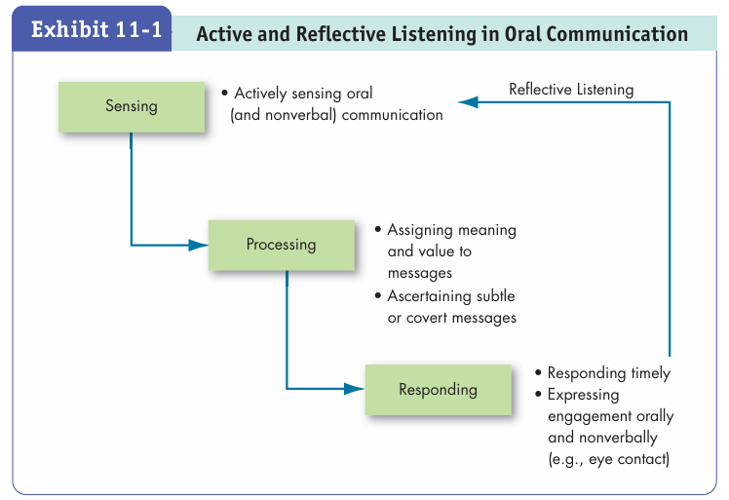

Slide 23
Oral Communication
Meetings: Meetings are often thought of as formal discussions or conversations that include two or more people and take place in almost any venue (virtual or in person).
Although millions of meetings take place in the United States daily and dozens of hours are spent in meetings on a weekly basis, most people hate them yet begrudgingly acknowledge that they are necessary.
www.midocean.ae

Slide 24
Oral Communication
An Adobe study of thousands of workers noted that “wasteful” meetings (58 percent) and unexpected phone meetings (32 percent) were two of the top three factors that “get in the way of your work” while at the same time indicating that they are the most effective forms of communication available.
The negative effect of meetings has been amplified by the COVID-19 pandemic, with many employees battling “Zoom fatigue” with seemingly endless virtual meetings throughout the week.
www.midocean.ae

Slide 25
Oral Communication
So many companies try to make them more effective: Amazon meetings begin with 30 minutes of attendees silently reading their meeting memos and agendas to themselves, Shopify and Asana have “no meeting days,” and some organizations limit the duration of meetings.
Indeed, research on effective virtual teams suggests that the best teams work in bursts—meeting to coordinate and communicate but then moving toward long periods of uninterrupted “deep work.
www.midocean.ae

Slide 26
Oral Communication
Research suggests that several aspects of meetings have implications for OB.
For instance, some researchers have framed satisfaction with meetings as a facet of job satisfaction (see the chapter on job attitudes) that contributes to how much people like their jobs overall.
The interpersonal dynamics within the meeting are especially important for meeting satisfaction.
www.midocean.ae

Slide 27
Oral Communication
People can engage in a number of rude behaviors during meetings; nonparticipation (e.g., daydreaming) and inappropriate interpersonal behavior (e.g., disrespecting or making fun of others) especially affect satisfaction with meetings and their perceived effectiveness.
Beyond incivility during meetings, they can be draining in other ways.
www.midocean.ae

Slide 28
Oral Communication
For instance, surface acting (e.g., inauthentically displaying emotions during the meeting that you do not truly feel, like feigning enthusiasm when you really cannot wait for the meeting to end) can cause you to become emotionally exhausted and to consider quitting.
www.midocean.ae

Slide 29
Oral Communication
The timeliness of meetings matters quite a bit. When meetings start late, participants’ meeting satisfaction and effectiveness perceptions suffer, their creativity during the meetings suffers, and they may even experience relational conflict.
Conversely, the meeting may start on time but individual participants themselves may be late.
These participants may often be those who are dissatisfied with their jobs and thinking about quitting, or they just might be low on conscientiousness (see the chapter on personality).
www.midocean.ae

Slide 30
Oral Communication
Regardless, other meeting participants may become angry with these late arrivals and willing to punish them.
However, meeting participants are more likely to react with sympathy and support if the latecomer’s excuse pointed to something beyond their control.
How can OB contribute to the conversation of how organizations can make meetings more effective? In professor Steven Rogelberg’s book The Surprising Science of Meetings, he outlines a number of common suggestions to this aim (there are forty-eight outlined in the book in total!), including:
www.midocean.ae

Slide 31
Oral Communication
Only meet when it is truly needed.
Gather input from attendees prior to meeting.
Provide an agenda to attendees.
Delegate roles to attendees.
Limit distractions.
Start and end meetings on time.
www.midocean.ae

Slide 32
Oral Communication
Gallo asked this CEO, “You’re very successful. You’re considered a good speaker. Why do you feel as though you need to improve?” The CEO responded: “I can always get better.
Every point up or down in our share price means billions of dollars in our company’s valuation. How well I communicate makes a big difference.
www.midocean.ae

Slide 33
Written Communication
Written communication includes letters, e-mail, instant messaging, blogs (dis cussed in the next section), newsletters, and any other method that conveys written words or symbols.
Some of these create a digital or physical long-term record, while the advantage of others is quick, fleeting information exchange.
www.midocean.ae

Slide 34
Written Communication
Although we may take written communication for granted and may assume it matters less than we think, even small, incidental forms of communication can have a huge impact on, say, employee motivation.
For instance, a supervisor’s words in a narrative comment in the quarterly performance appraisal of an employee can drastically affect that employee’s motivation and fairness perception.
www.midocean.ae

Slide 35
Written Communication
E-mail: Since the first e-mail ever was sent nearly fifty years ago, the growth of this written communication mode has been spectacular.
Its use is so pervasive that it is hard to imagine life without it.
In 2020, there were more than 3.9 billion active e-mail users worldwide (more than half of the world’s population) operating 5.6 billion separate accounts, with employees spending an average of three hours every day checking e-mail (roughly 37.5 percent of a forty-hour workweek).
www.midocean.ae

Slide 36
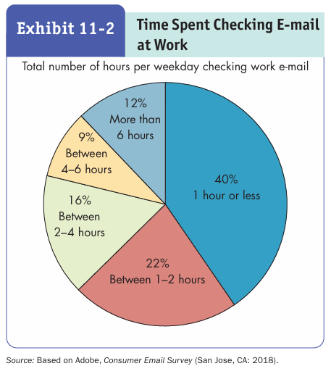

Slide 37
Nonverbal Communication
When we deliver a verbal message, we also impart an unspoken message.
Sometimes the nonverbal component may stand alone as a powerful message in and of itself.
If you read the minutes of a meeting, you would not grasp the impact of what was said the same way as if you had been there or could see the meeting on video. Why is this so?
There is no record of nonverbal communication, and the emphasis given to words or phrases would likely be missing.
www.midocean.ae

Slide 38
Nonverbal Communication
No discussion of communication would thus be complete without consideration of nonverbal communication—which includes body language and movement, information conveyed through contact and our senses, and the physical use of space and time in interactions.
www.midocean.ae

Slide 39
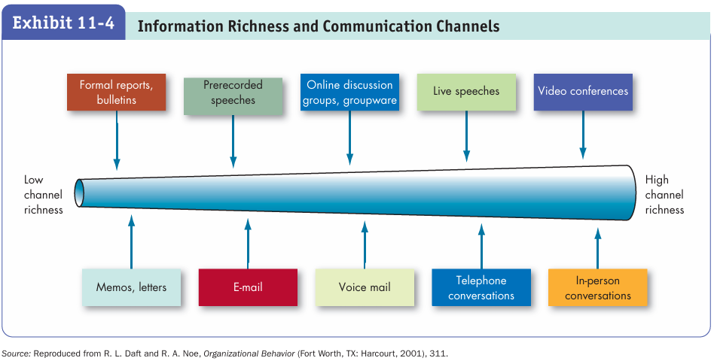

Slide 40



Thank You

