Slide 1
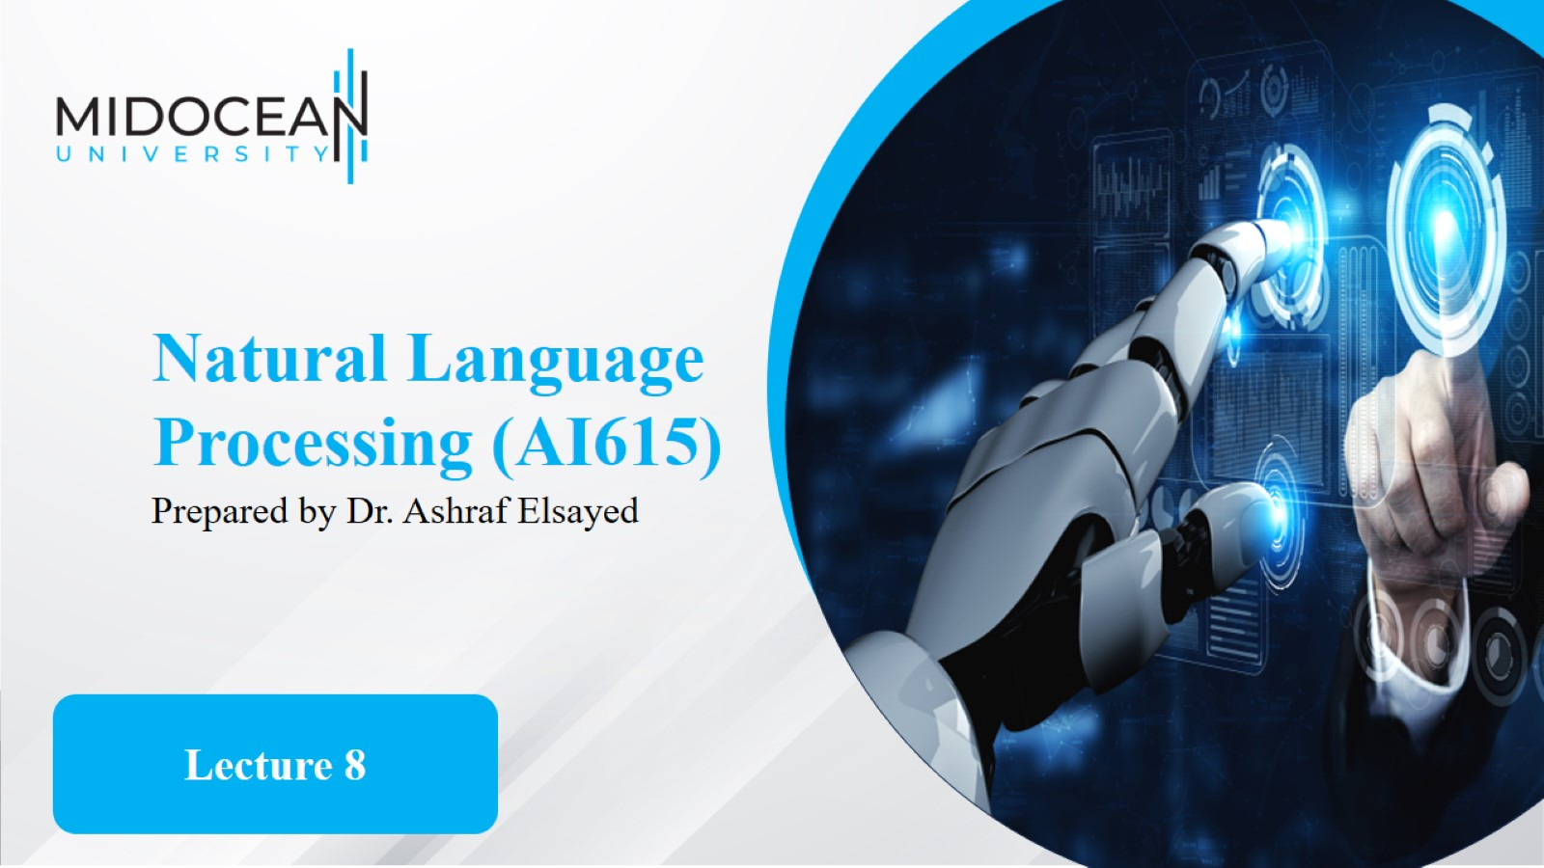

Slide 2
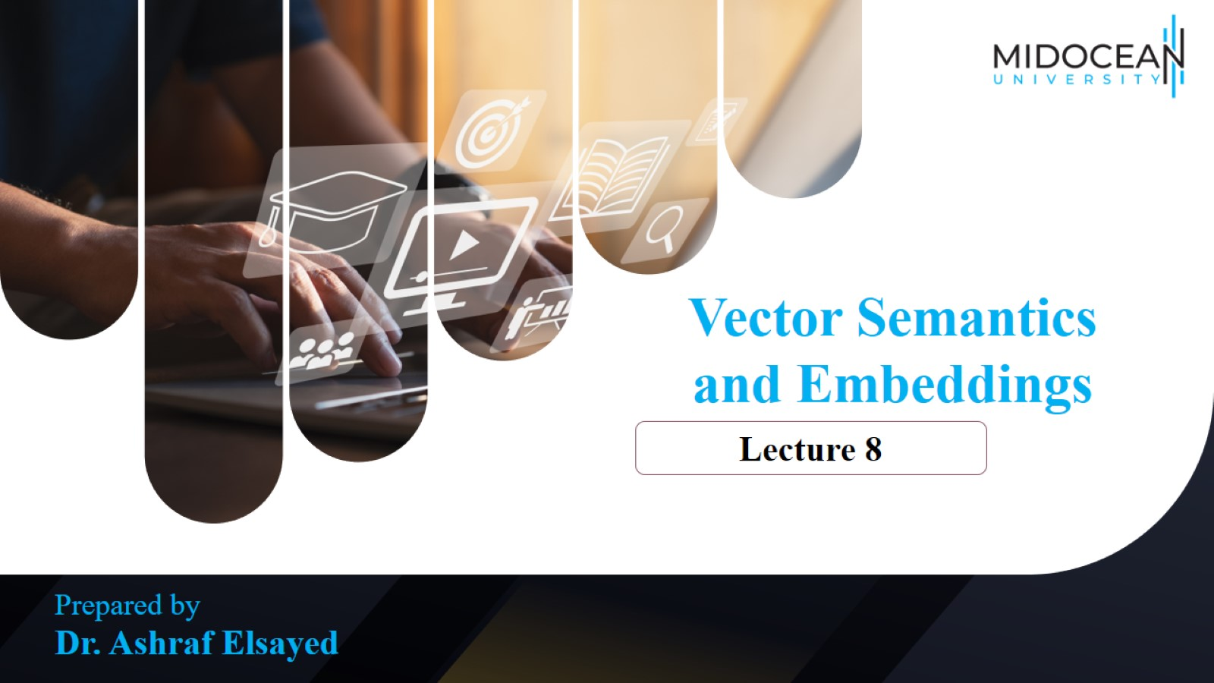

Slide 3
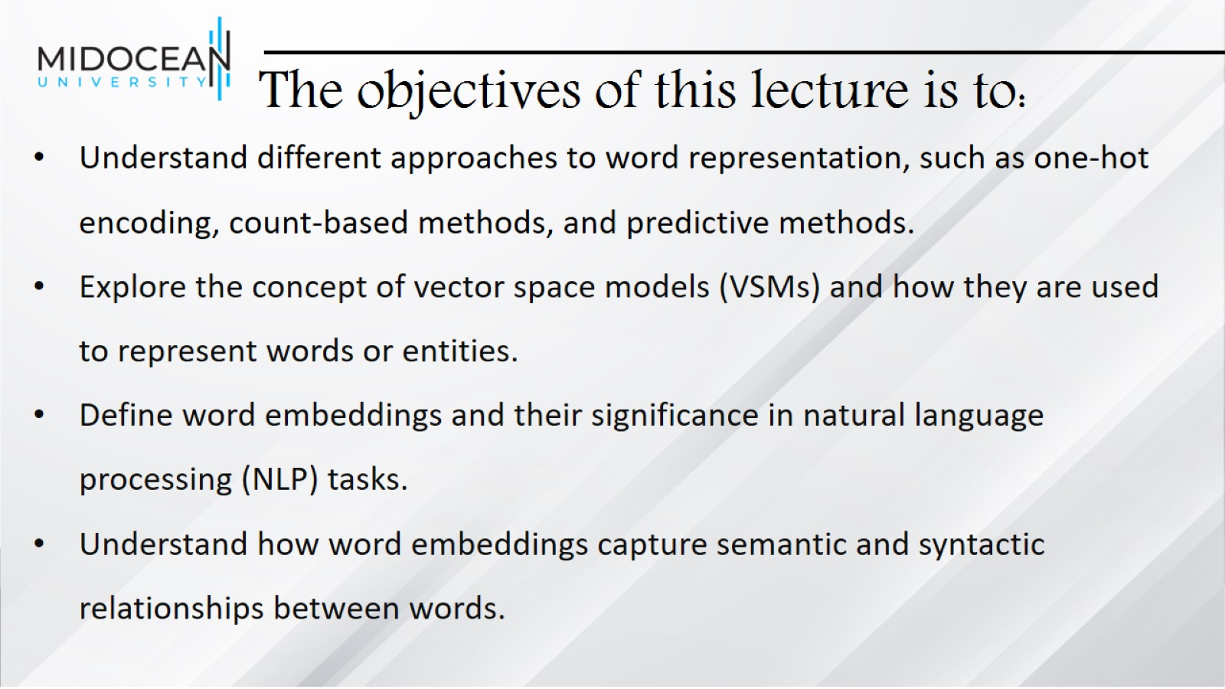
The objectives of this lecture is to:

Slide 4
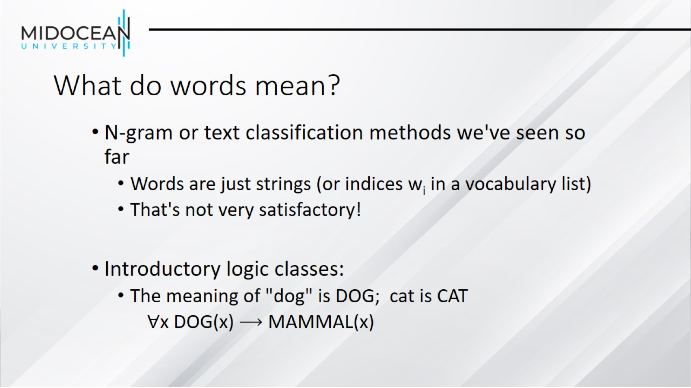
What do words mean?

Slide 5
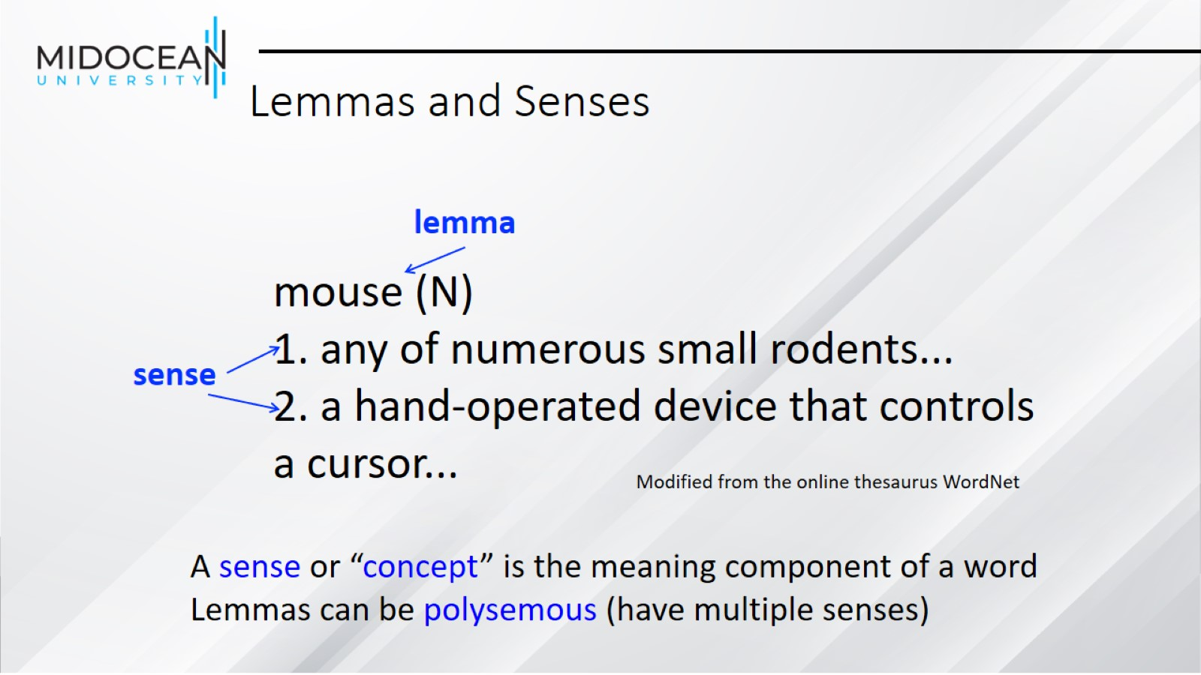
Lemmas and Senses

Slide 6
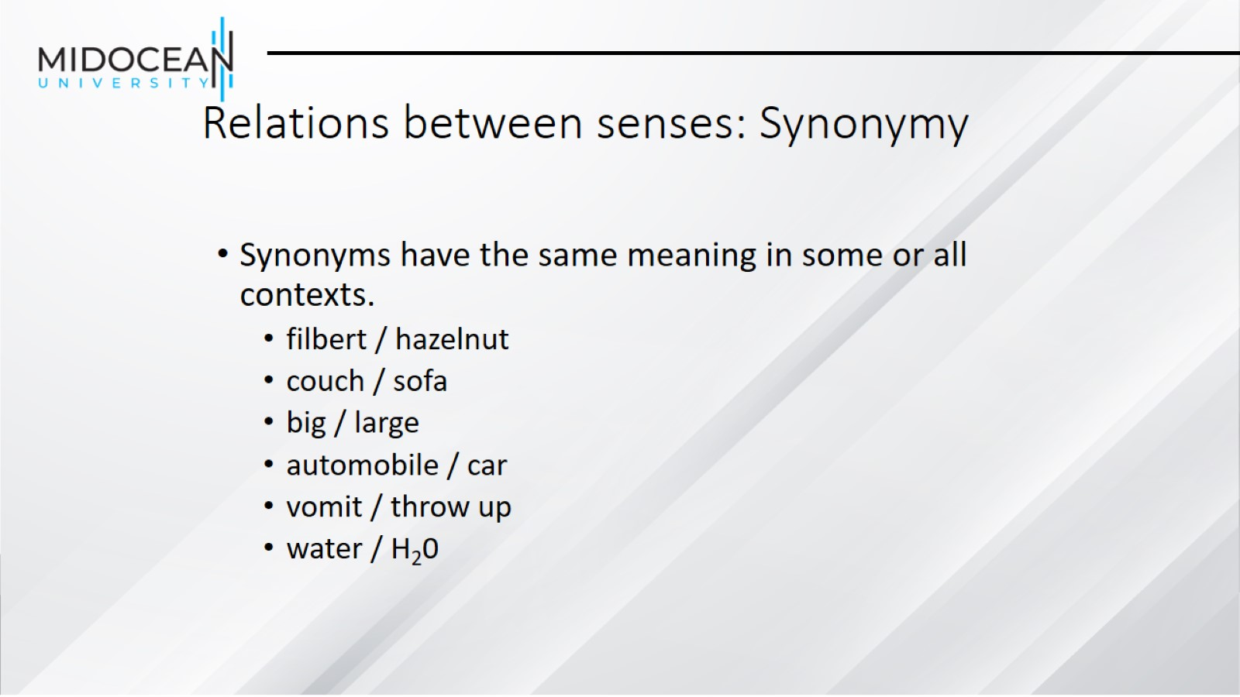
Relations between senses: Synonymy

Slide 7
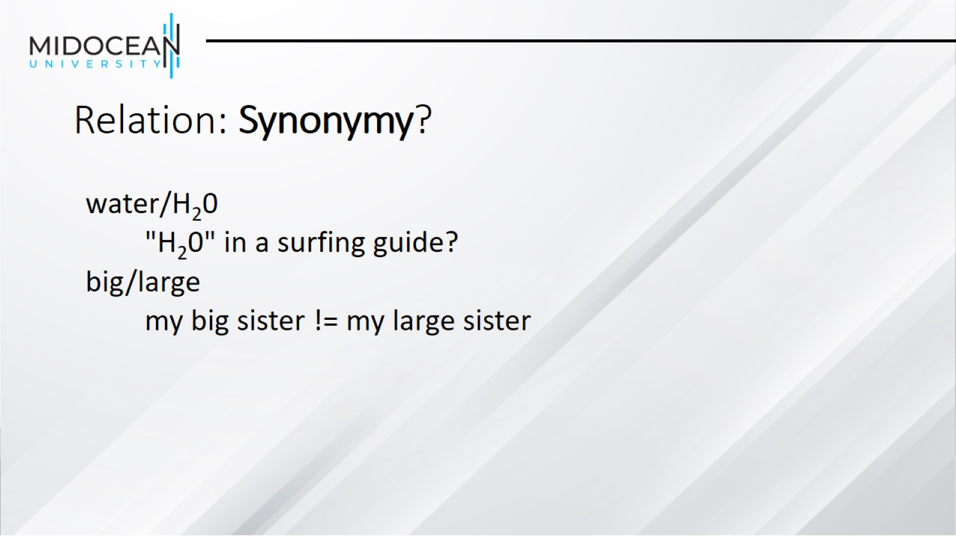
Relation: Synonymy?

Slide 8
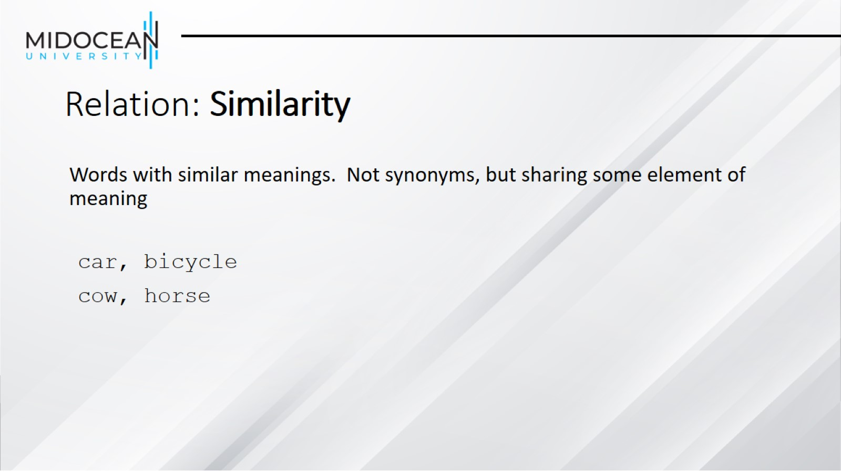
Relation: Similarity

Slide 9
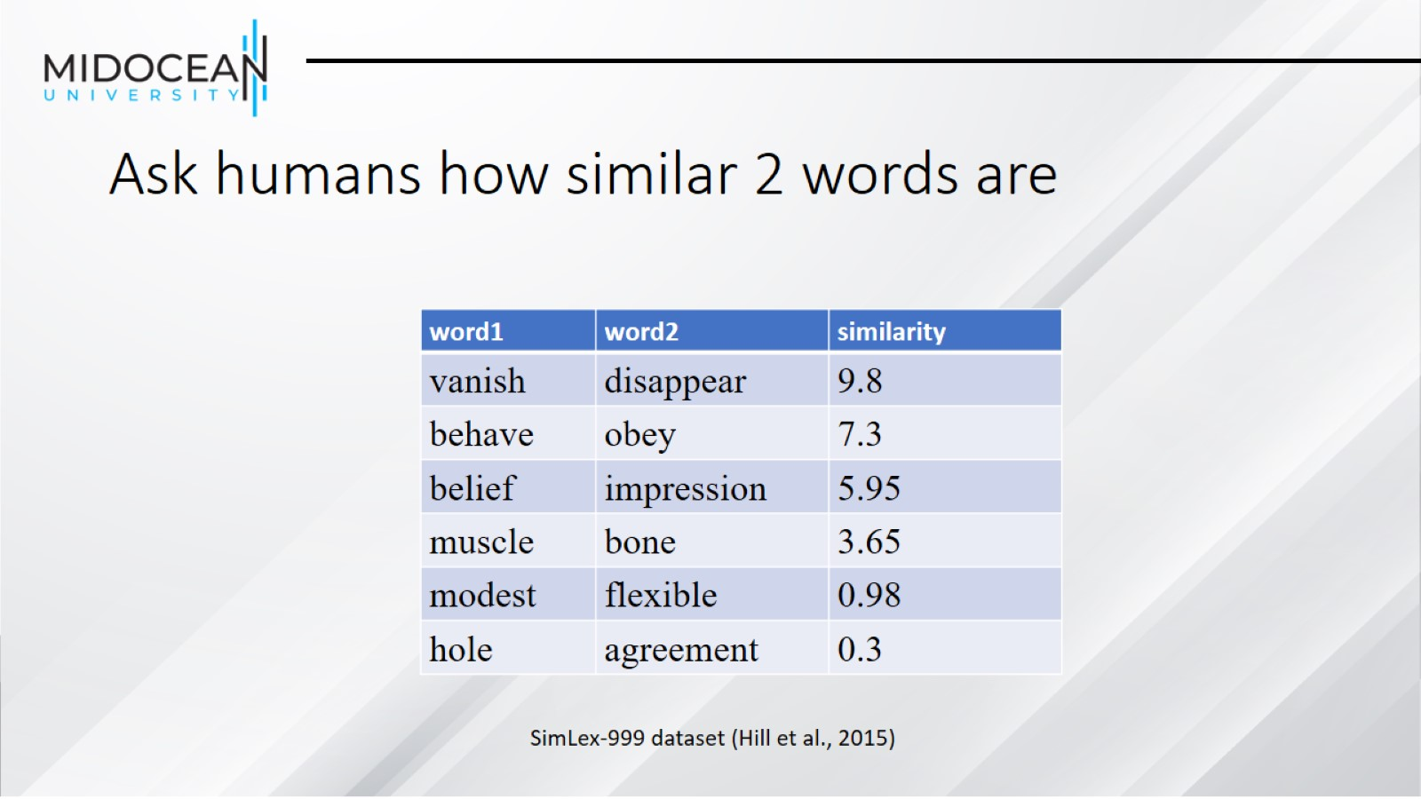
Ask humans how similar 2 words are

Slide 10
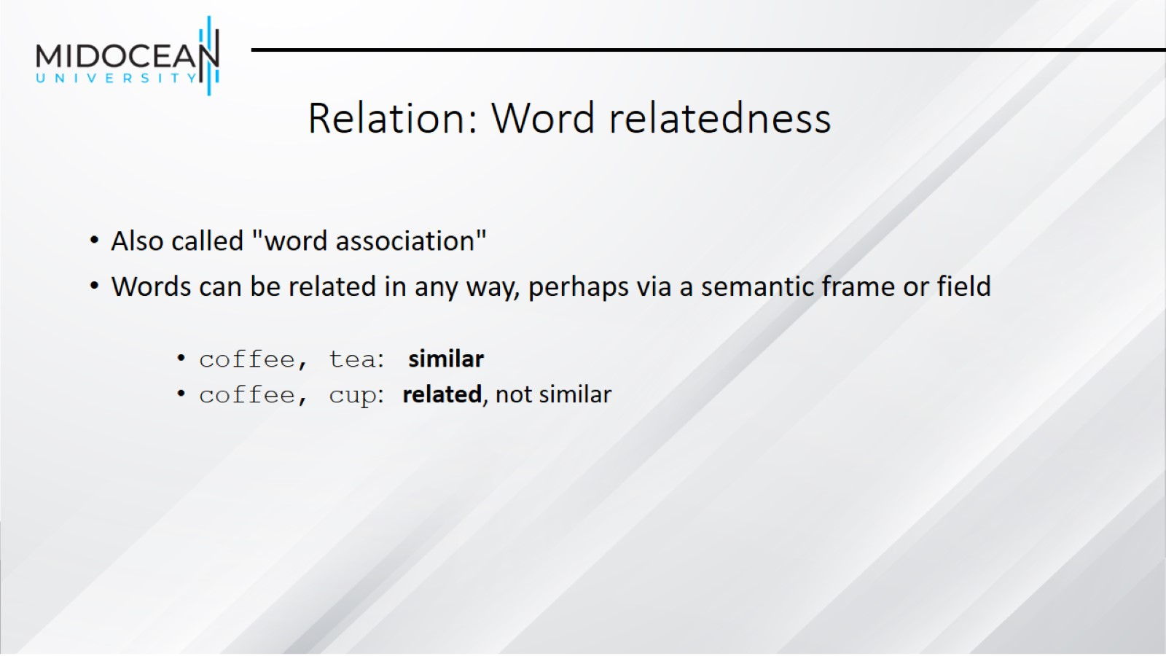
Relation: Word relatedness

Slide 11
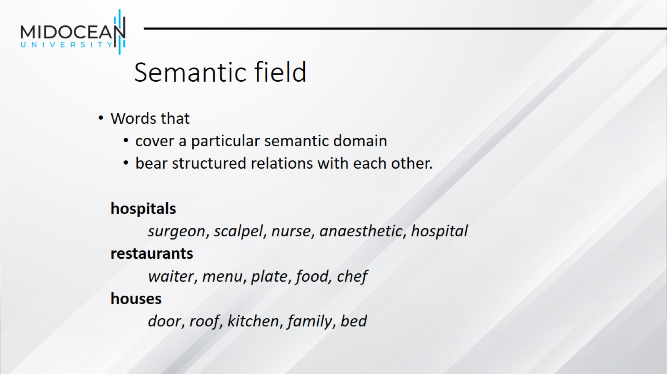
Semantic field

Slide 12
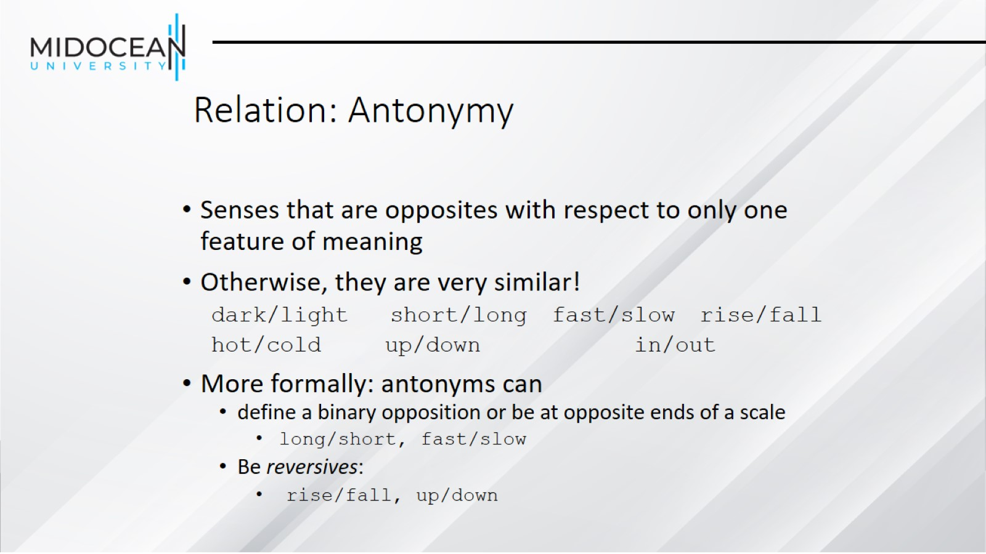
Relation: Antonymy

Slide 13
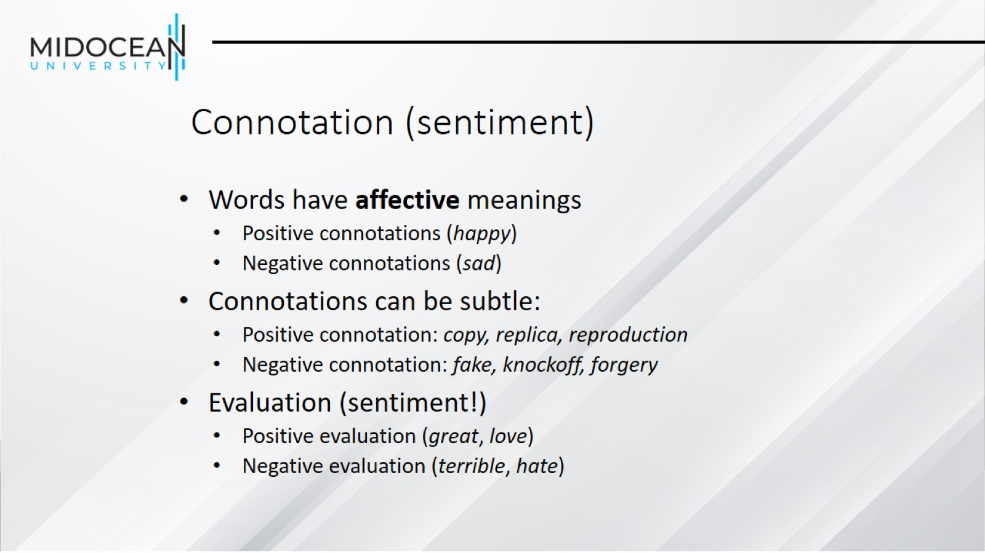
Connotation (sentiment)

Slide 14
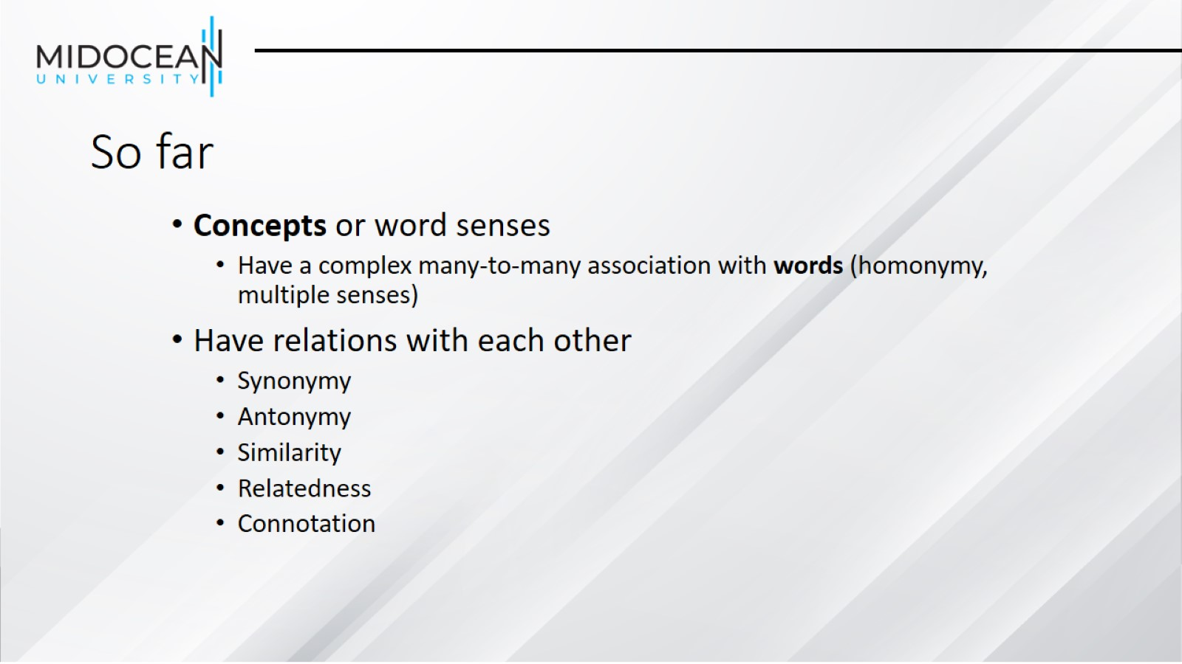
So far

Slide 15
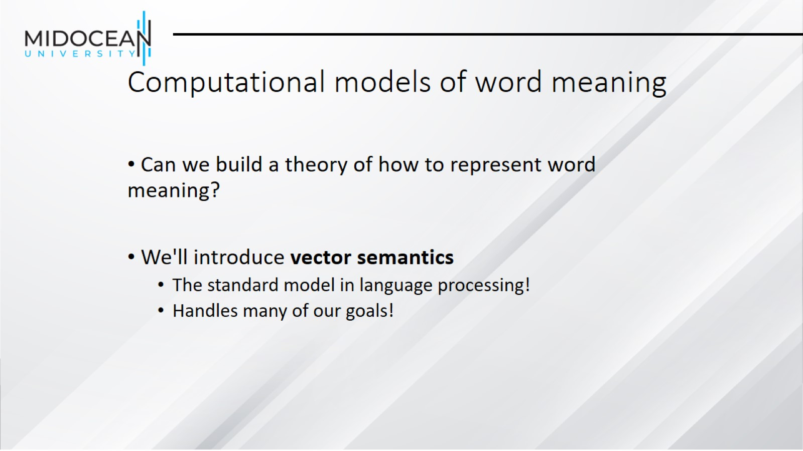
Computational models of word meaning

Slide 16
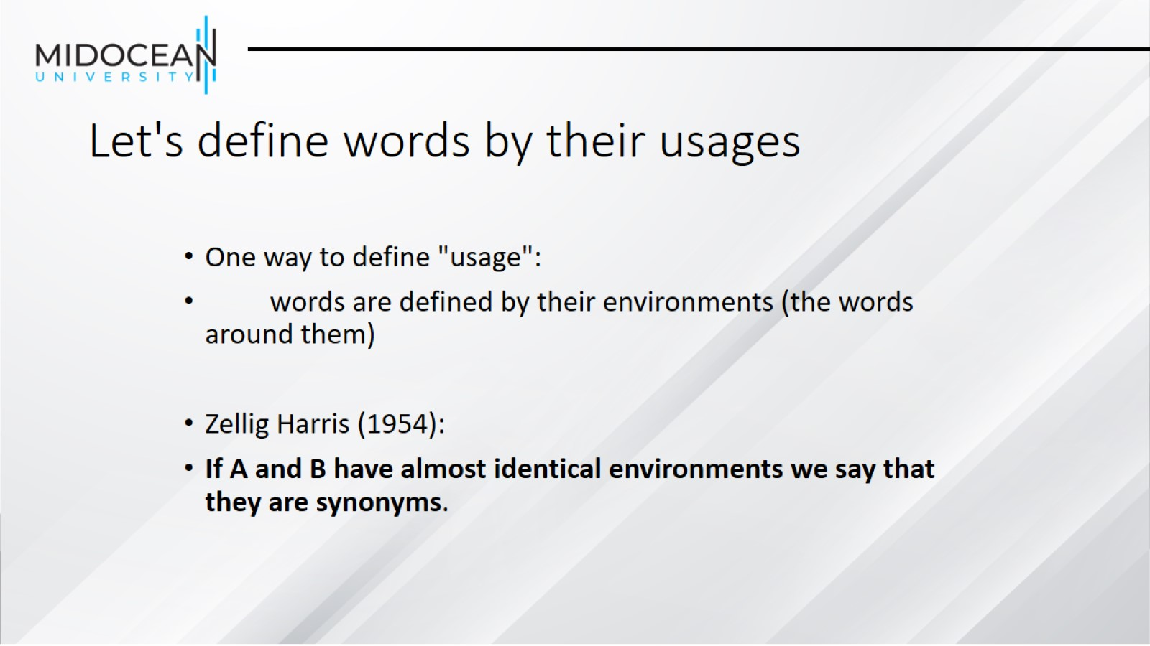
Let's define words by their usages

Slide 17
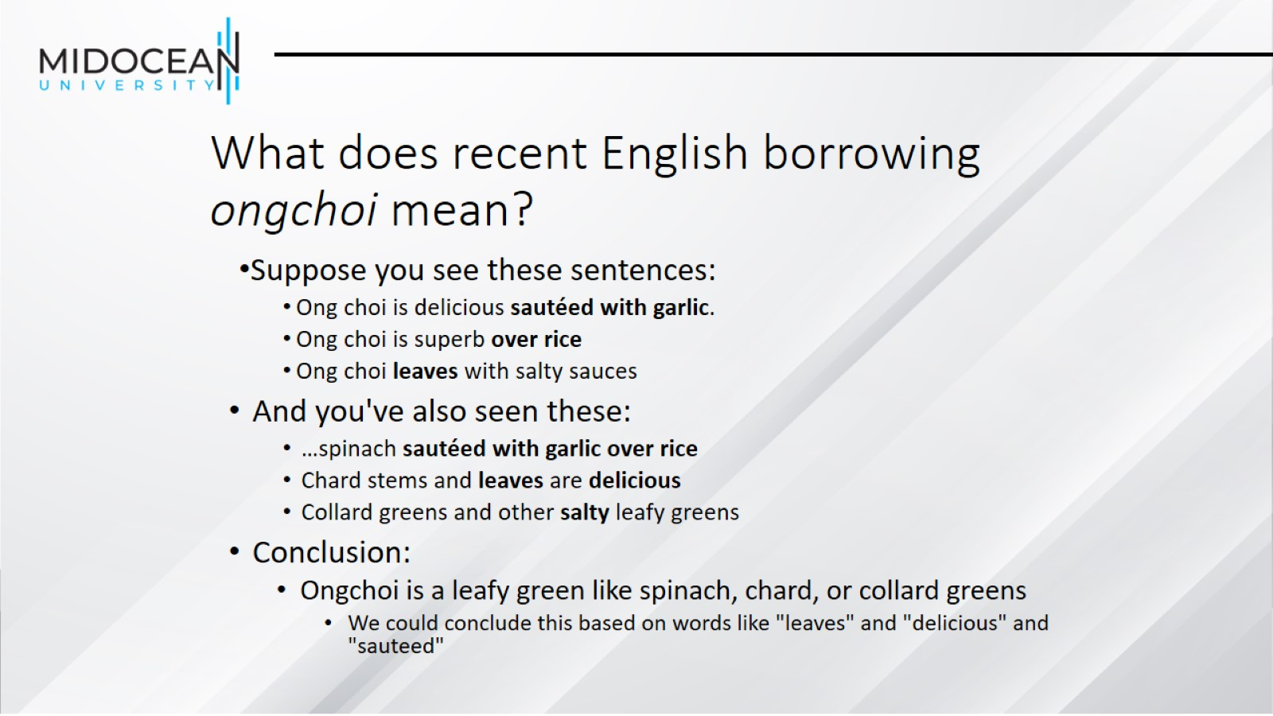
What does recent English borrowing ongchoi mean?

Slide 18
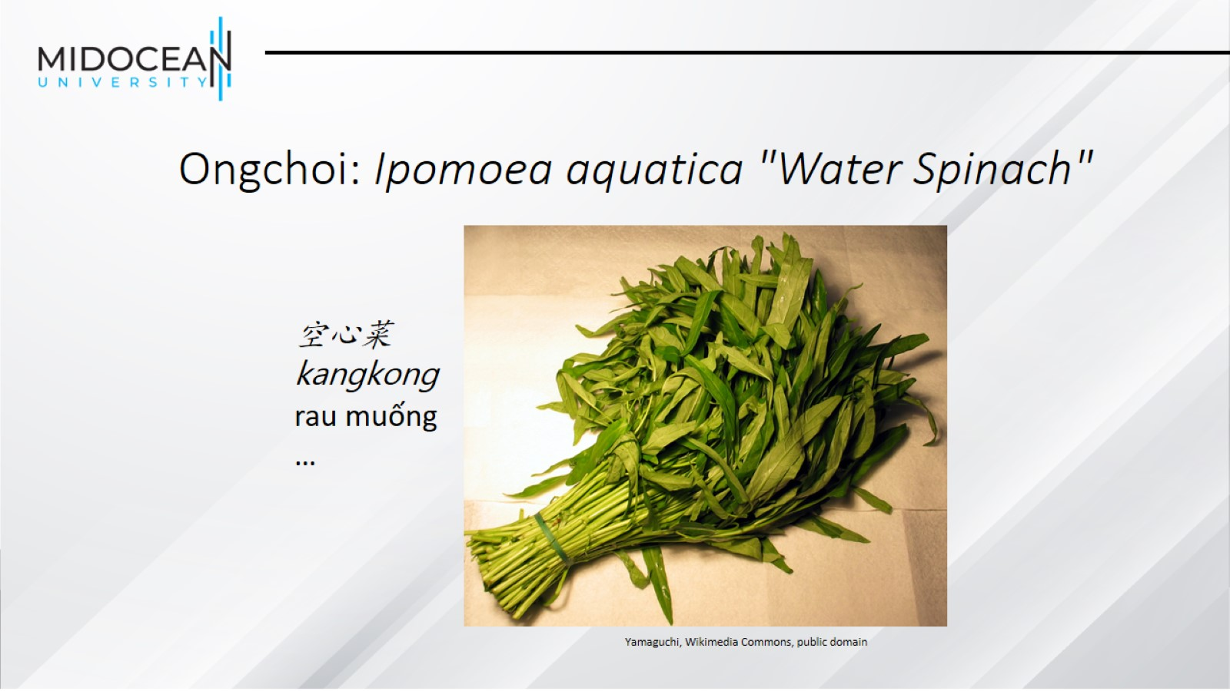
Ongchoi: Ipomoea aquatica "Water Spinach"

Slide 19
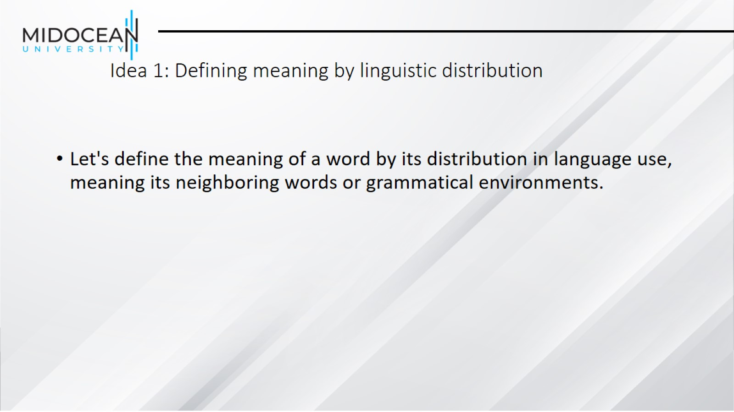
Idea 1: Defining meaning by linguistic distribution

Slide 20
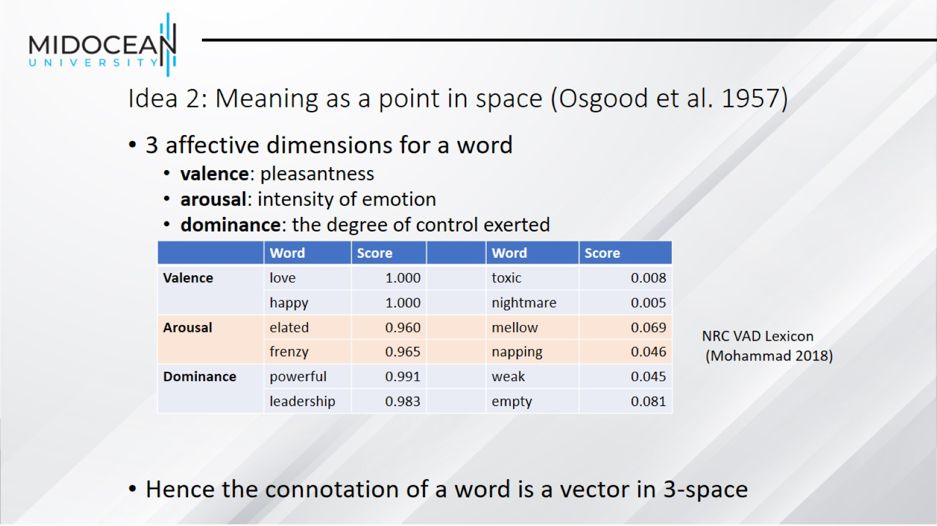
Idea 2: Meaning as a point in space (Osgood et al. 1957)

Slide 21
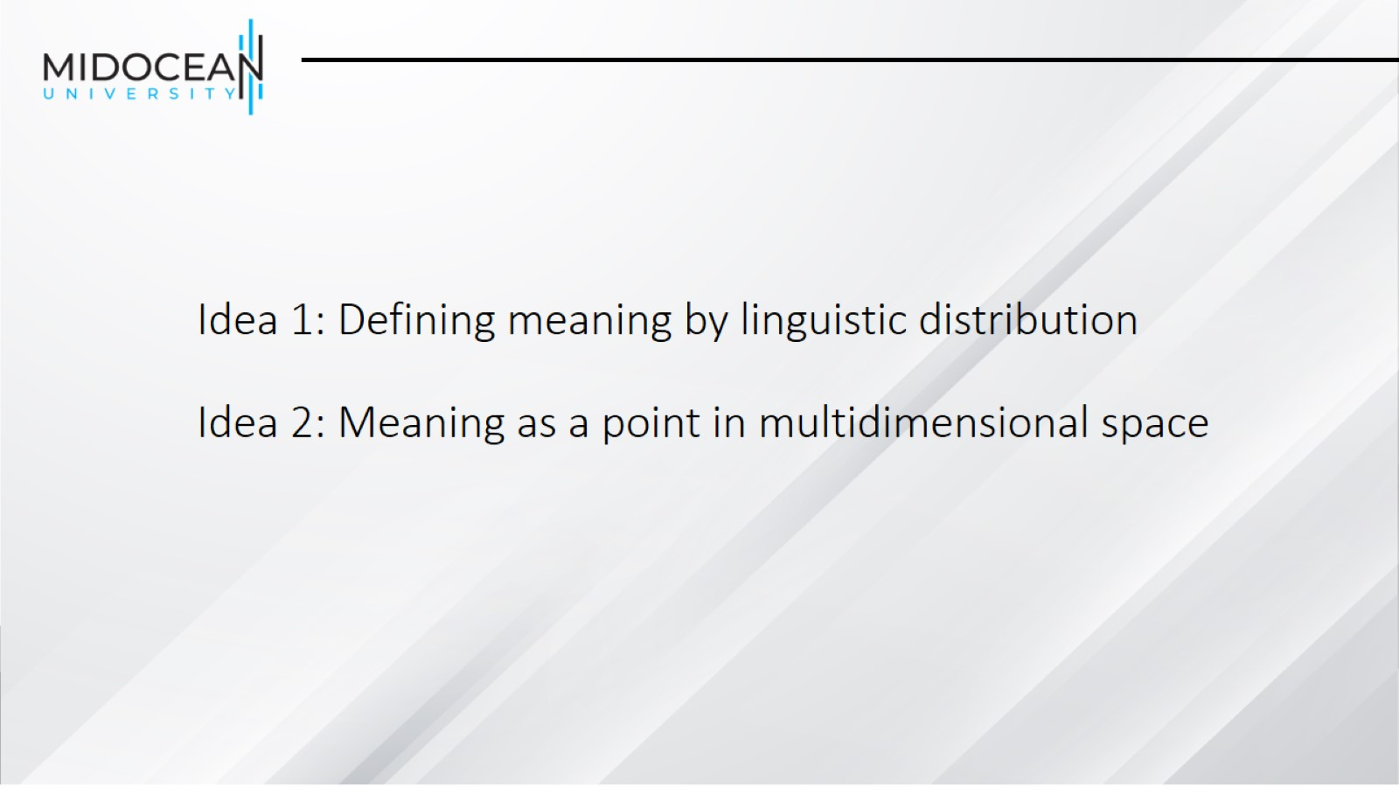
Idea 1: Defining meaning by linguistic distribution
Idea 2: Meaning as a point in multidimensional space

Slide 22
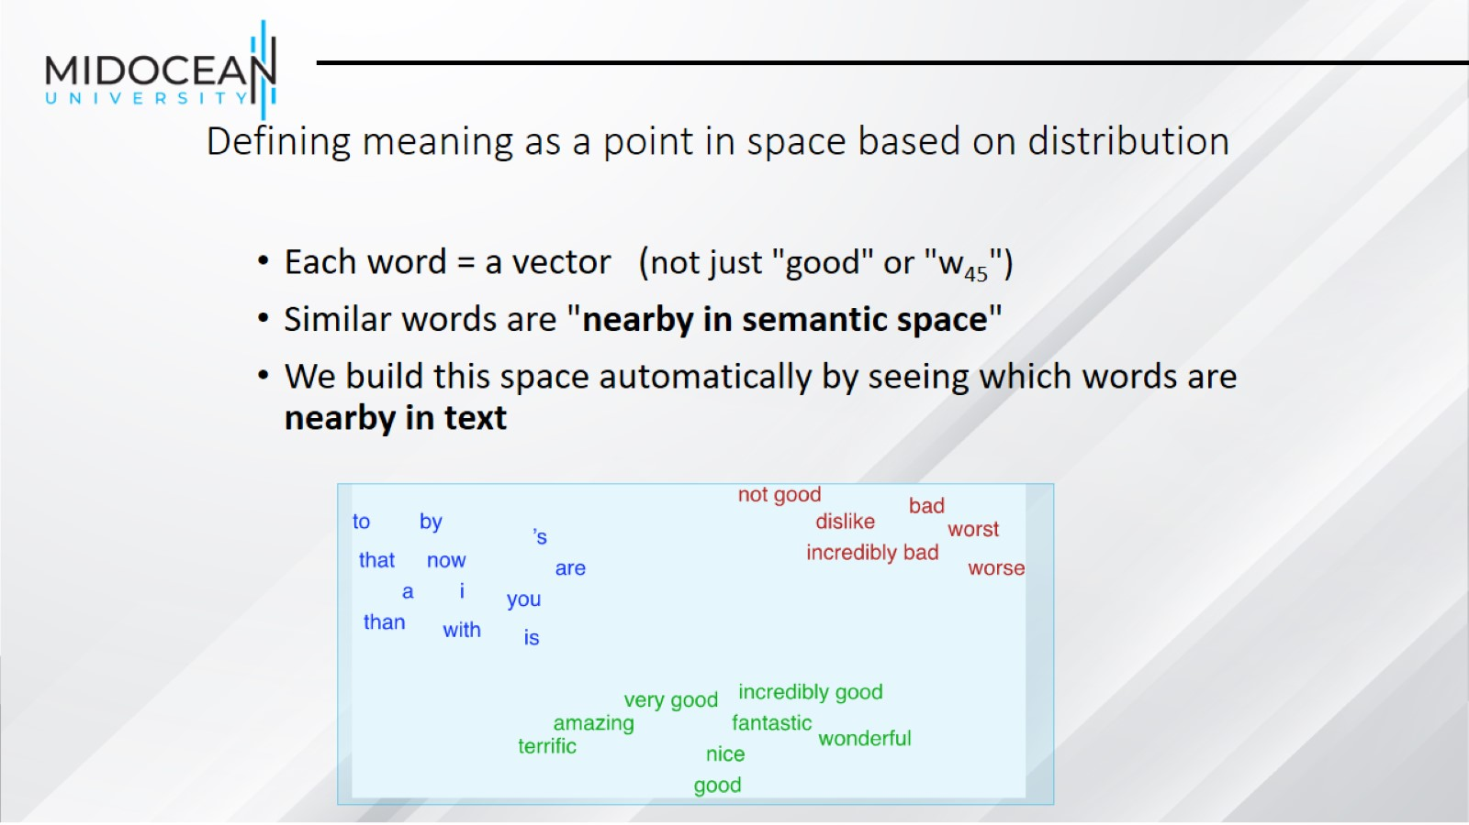
Defining meaning as a point in space based on distribution

Slide 23
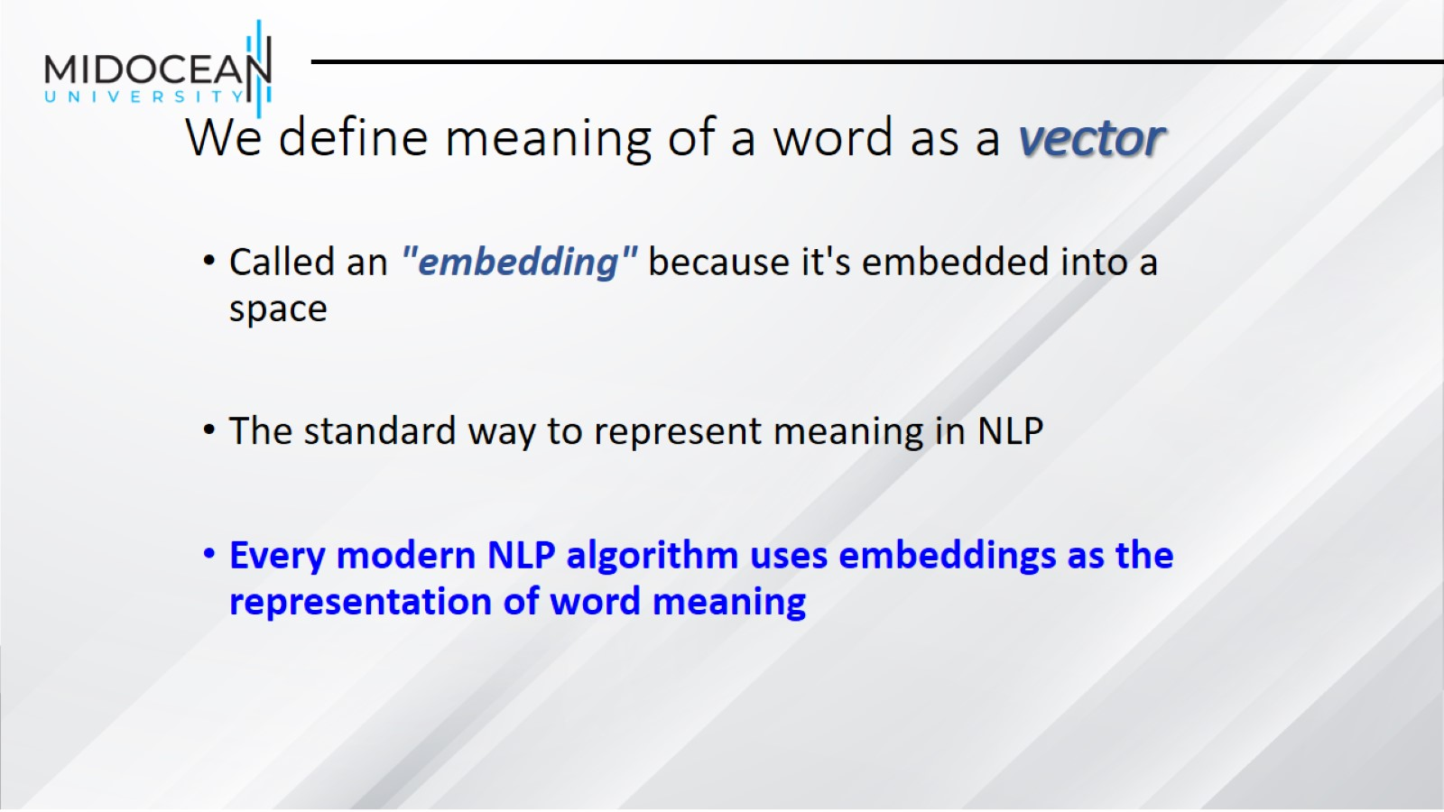
We define meaning of a word as a vector

Slide 24
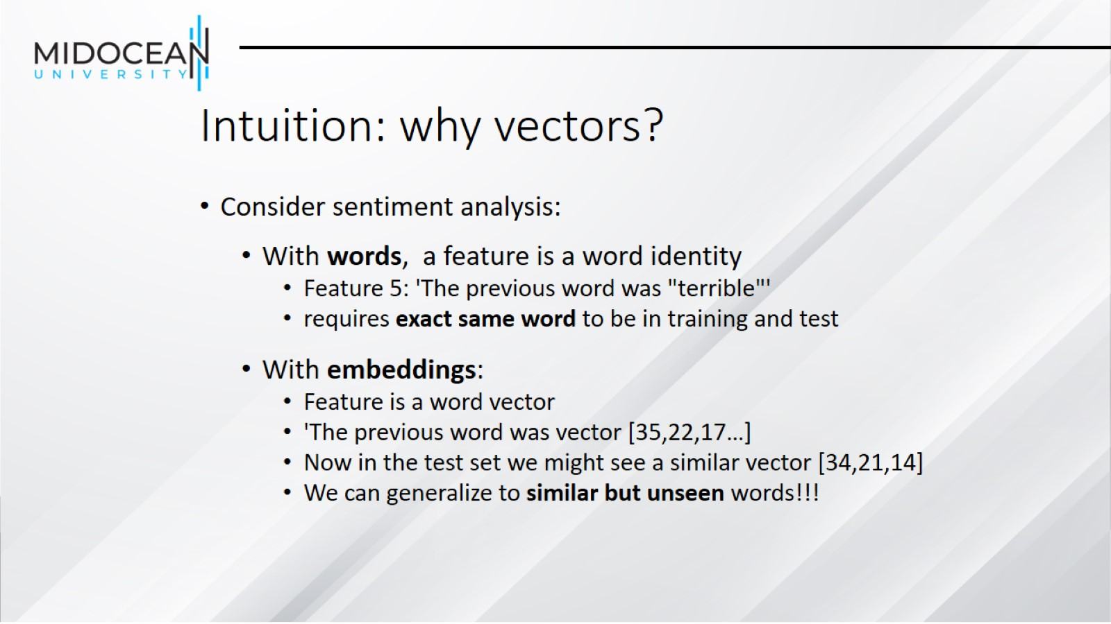
Intuition: why vectors?

Slide 25
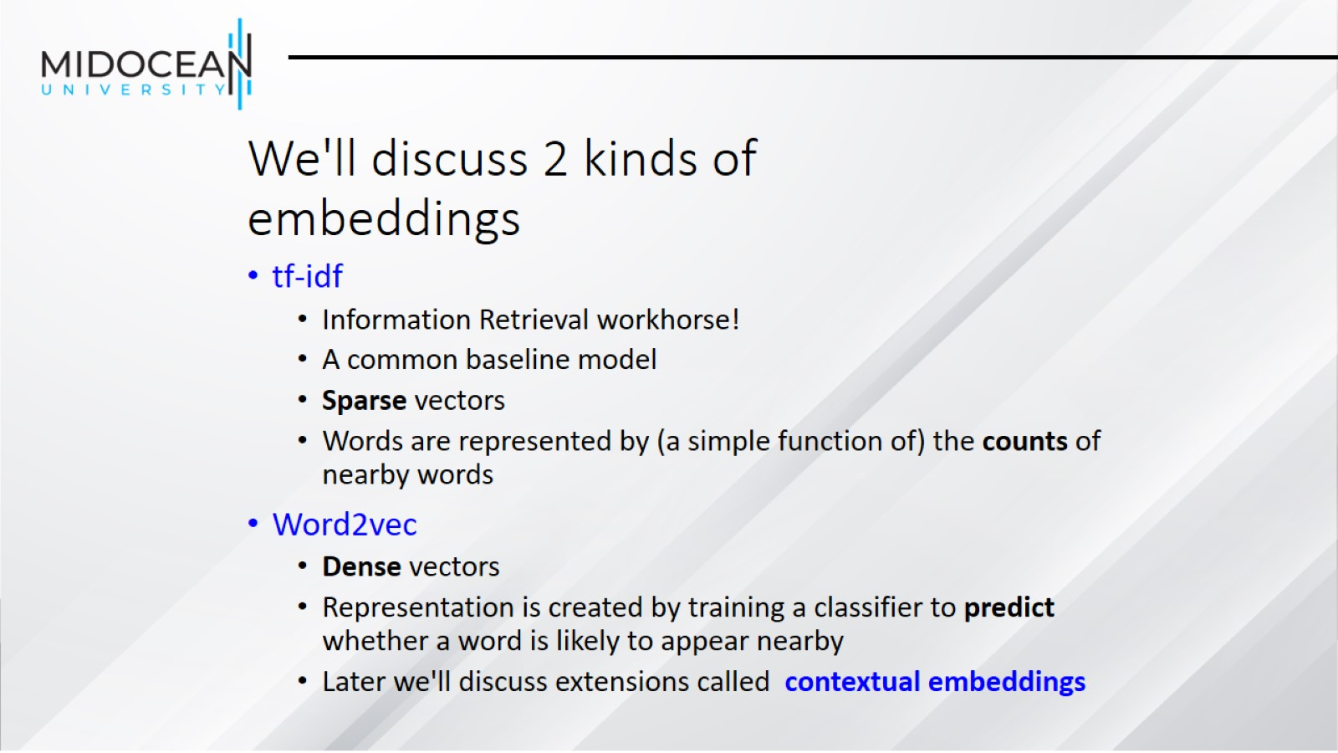
We'll discuss 2 kinds of embeddings

Slide 26
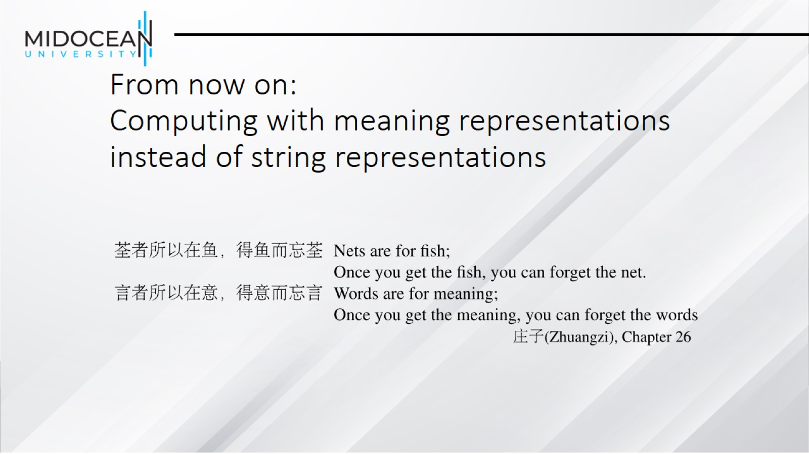
From now on:
Computing with meaning representations instead of string representations

Slide 27
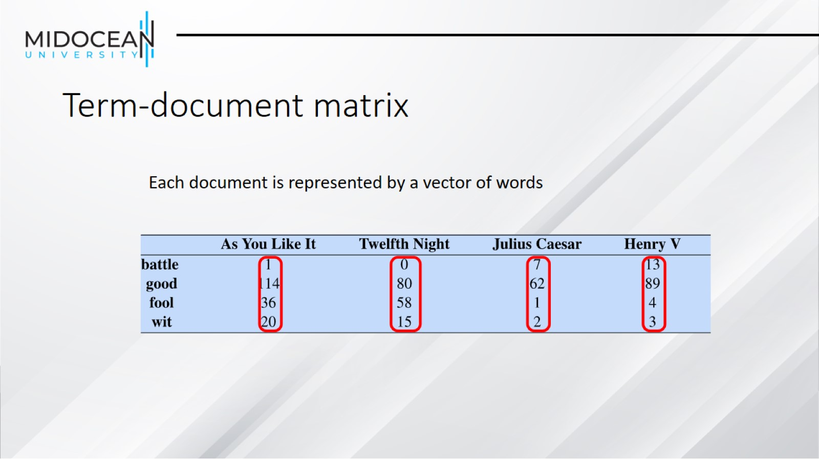
Term-document matrix

Slide 28
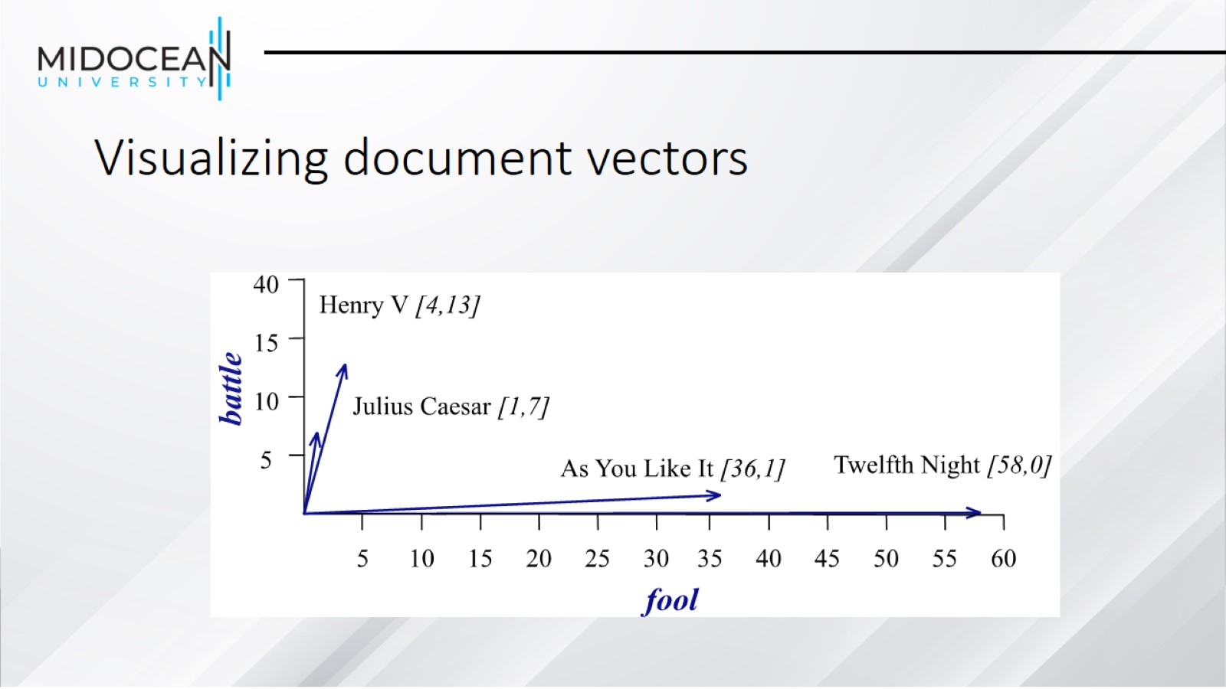
Visualizing document vectors

Slide 29
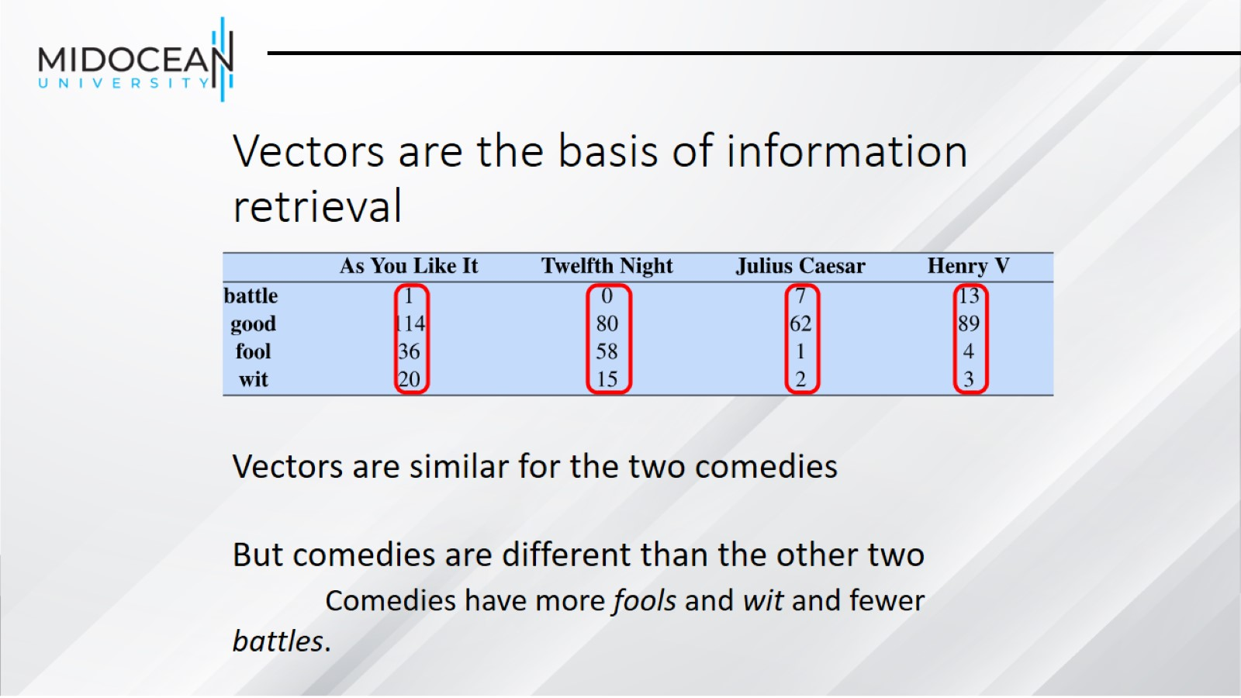
Vectors are the basis of information retrieval

Slide 30
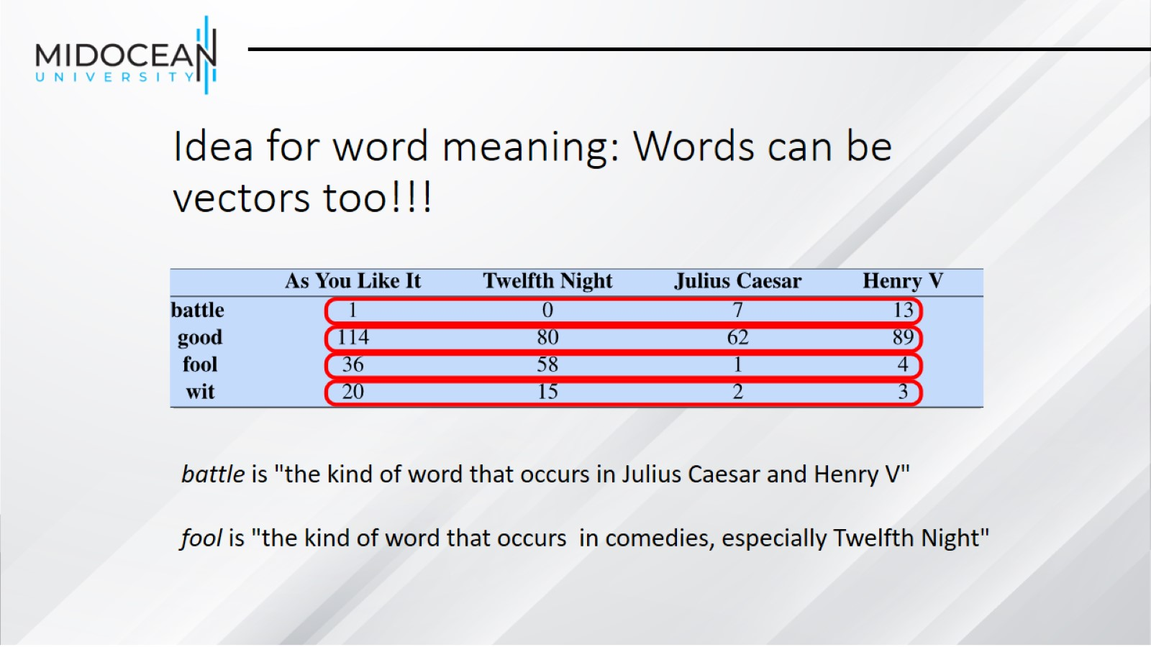
Idea for word meaning: Words can be vectors too!!!

Slide 31
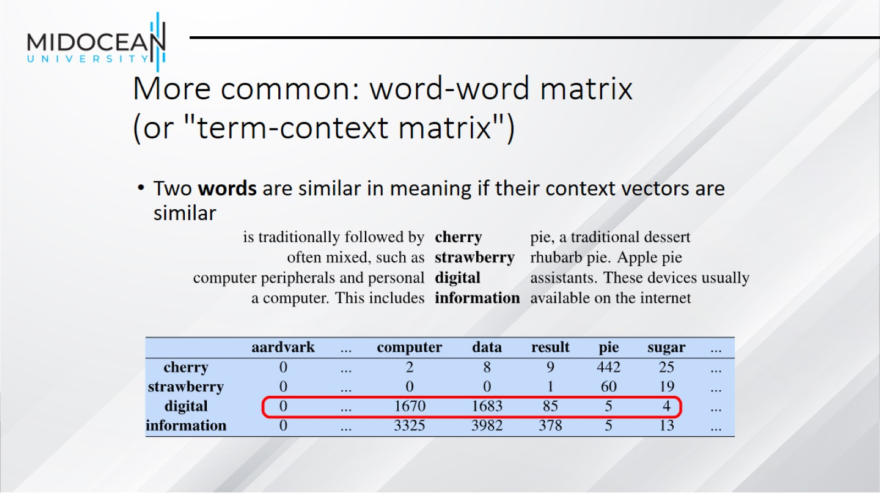
More common: word-word matrix
(or "term-context matrix")

Slide 32
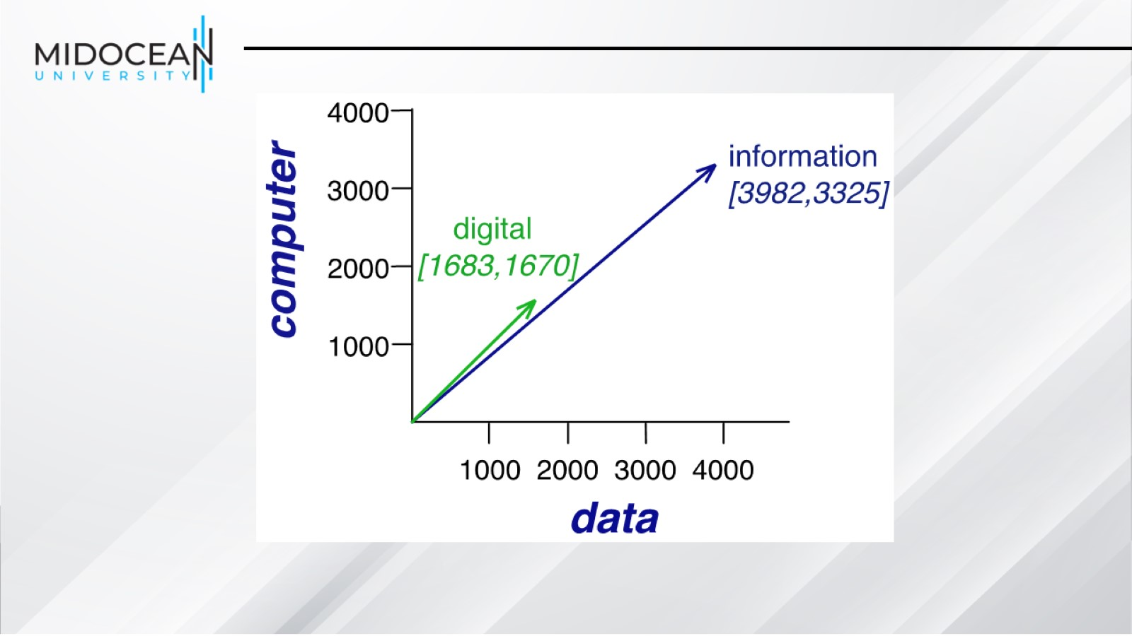

Slide 33
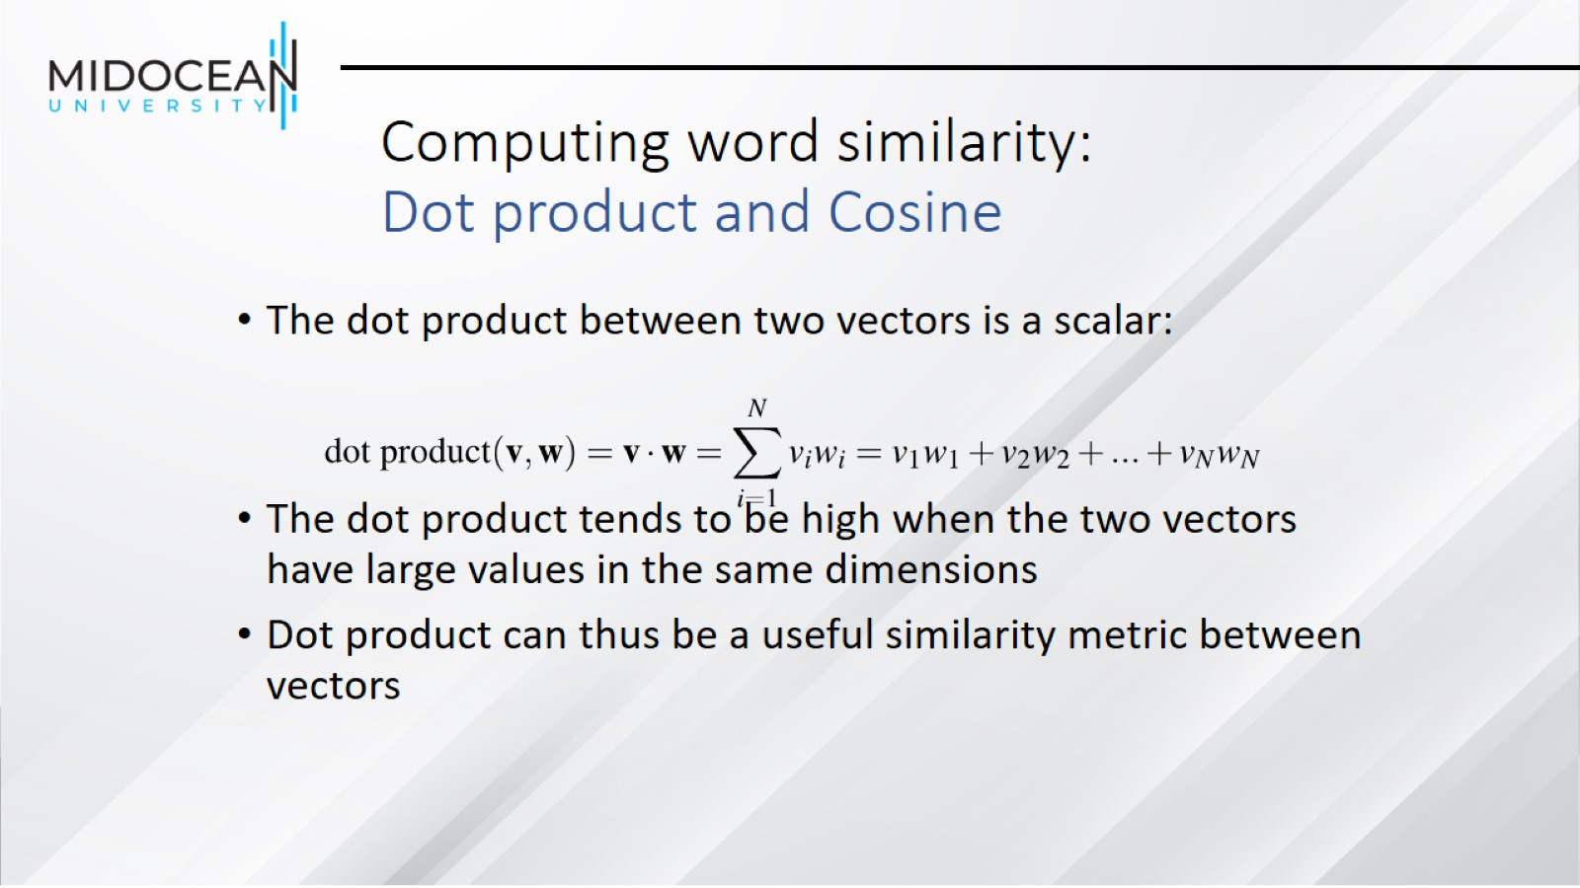
Computing word similarity: Dot product and Cosine

Slide 34
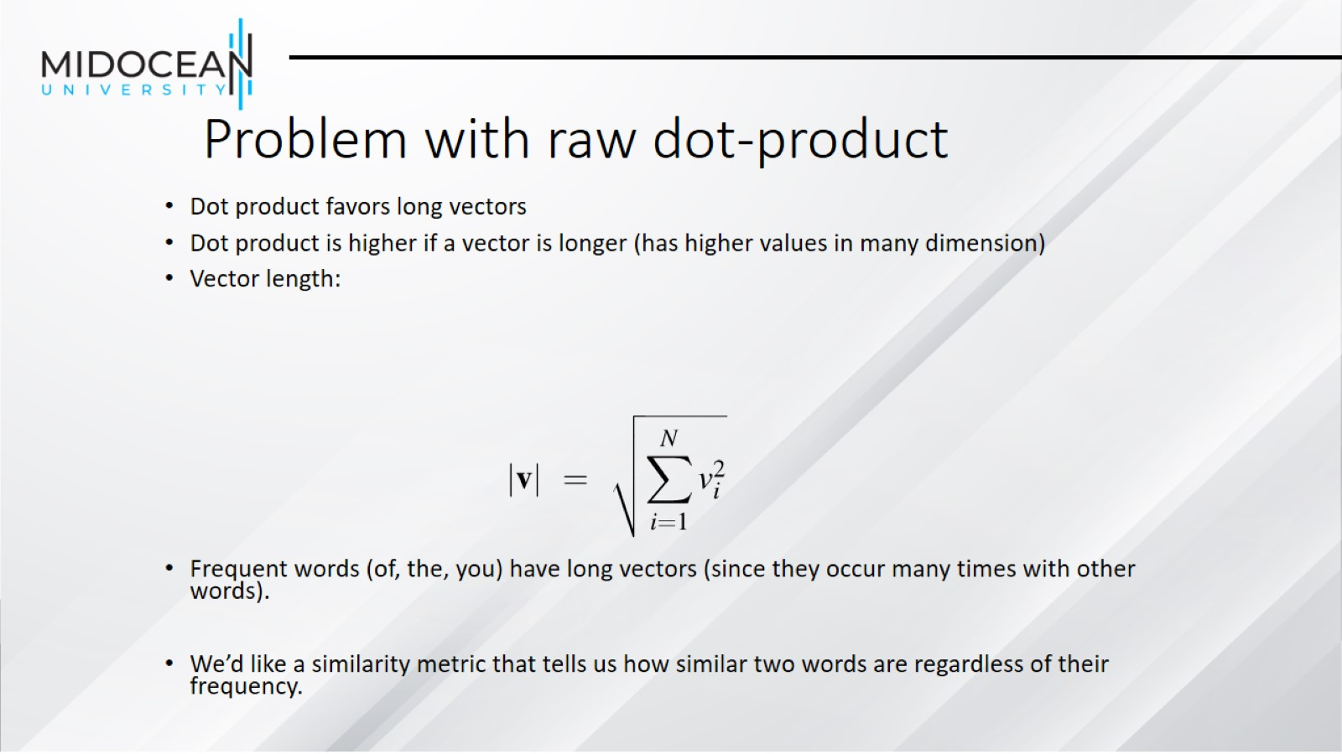
Problem with raw dot-product

Slide 35
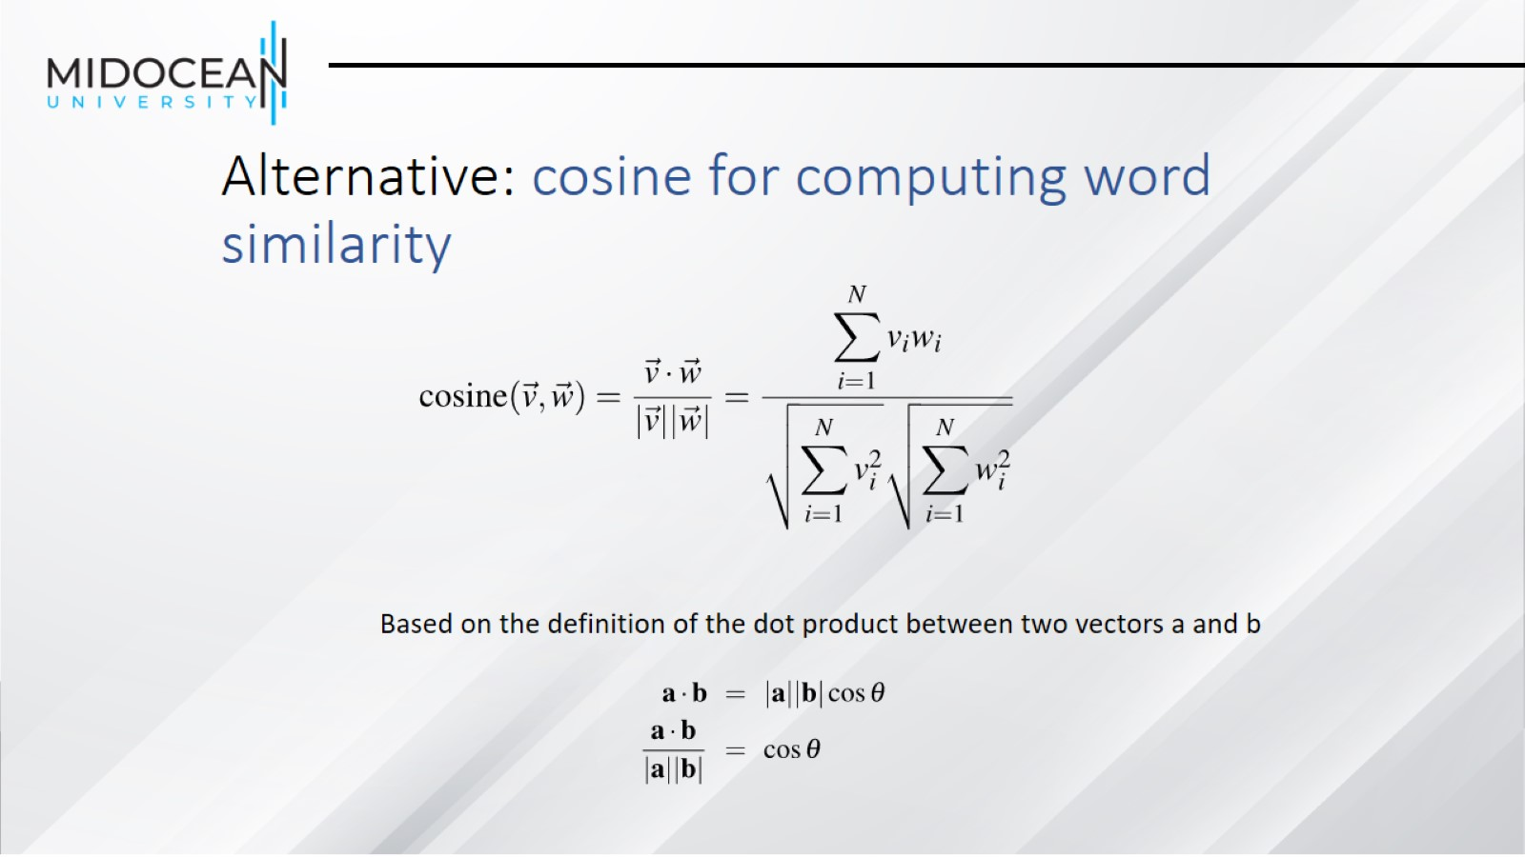
Alternative: cosine for computing word similarity

Slide 36
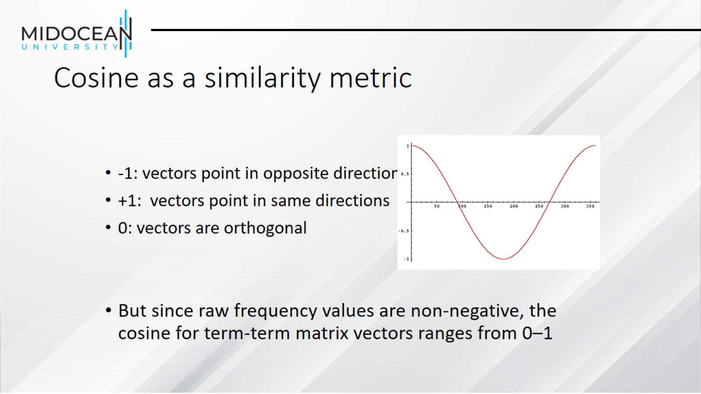
Cosine as a similarity metric

Slide 37
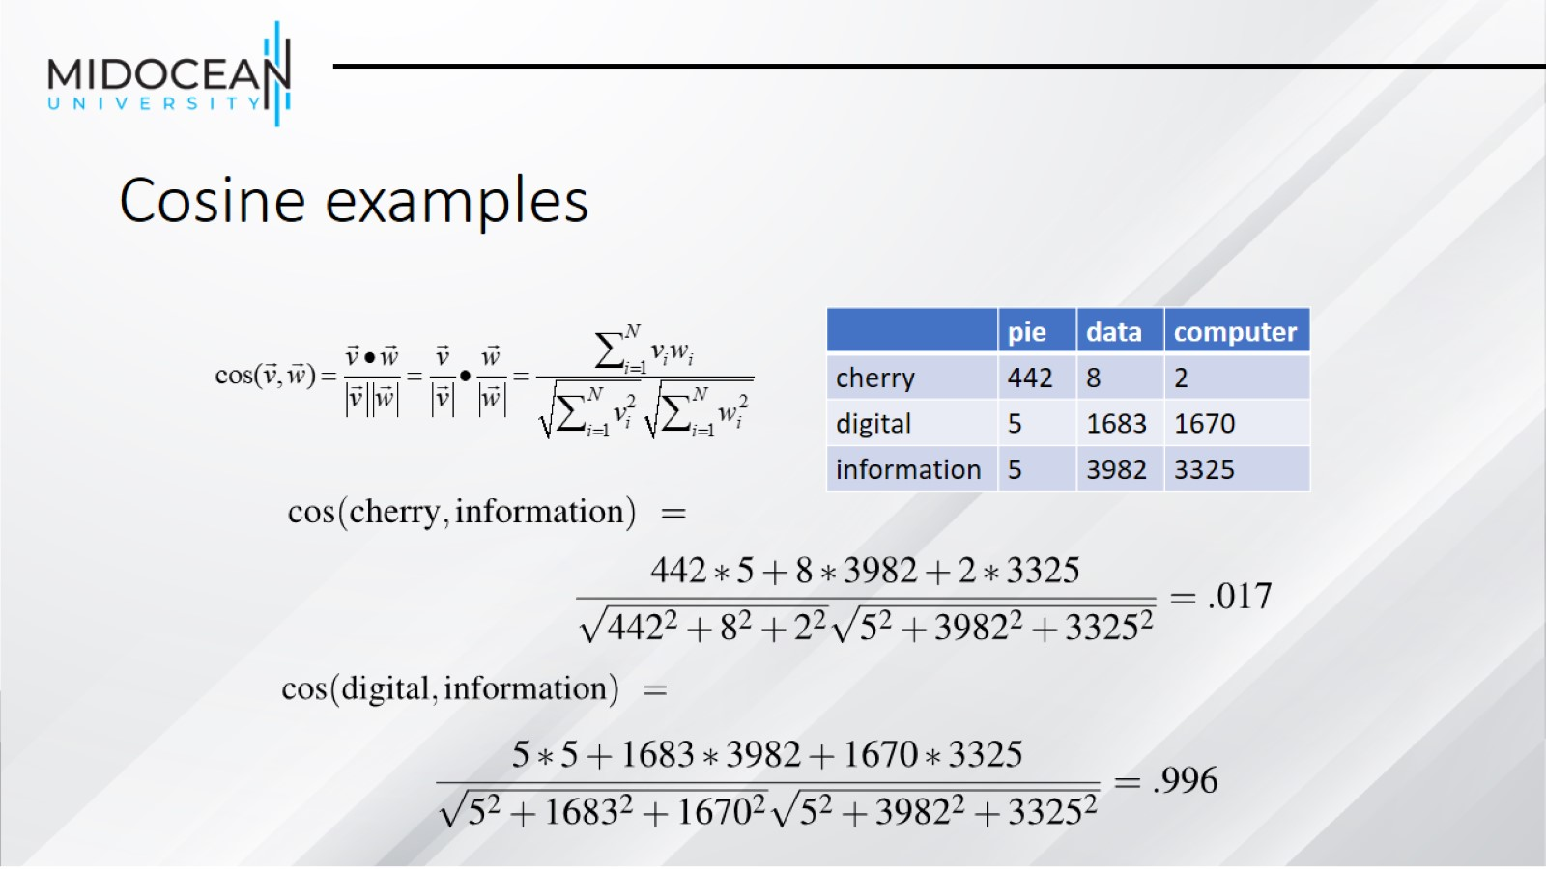
Cosine examples

Slide 38
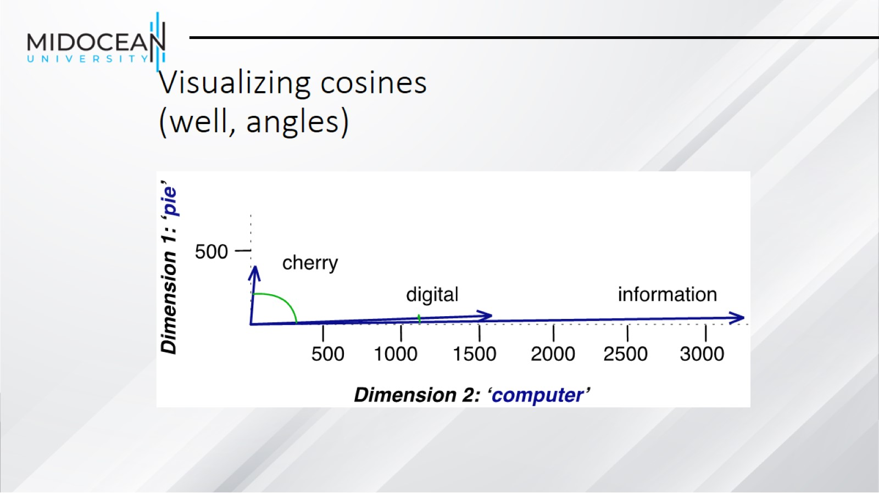
Visualizing cosines
(well, angles)

Slide 39
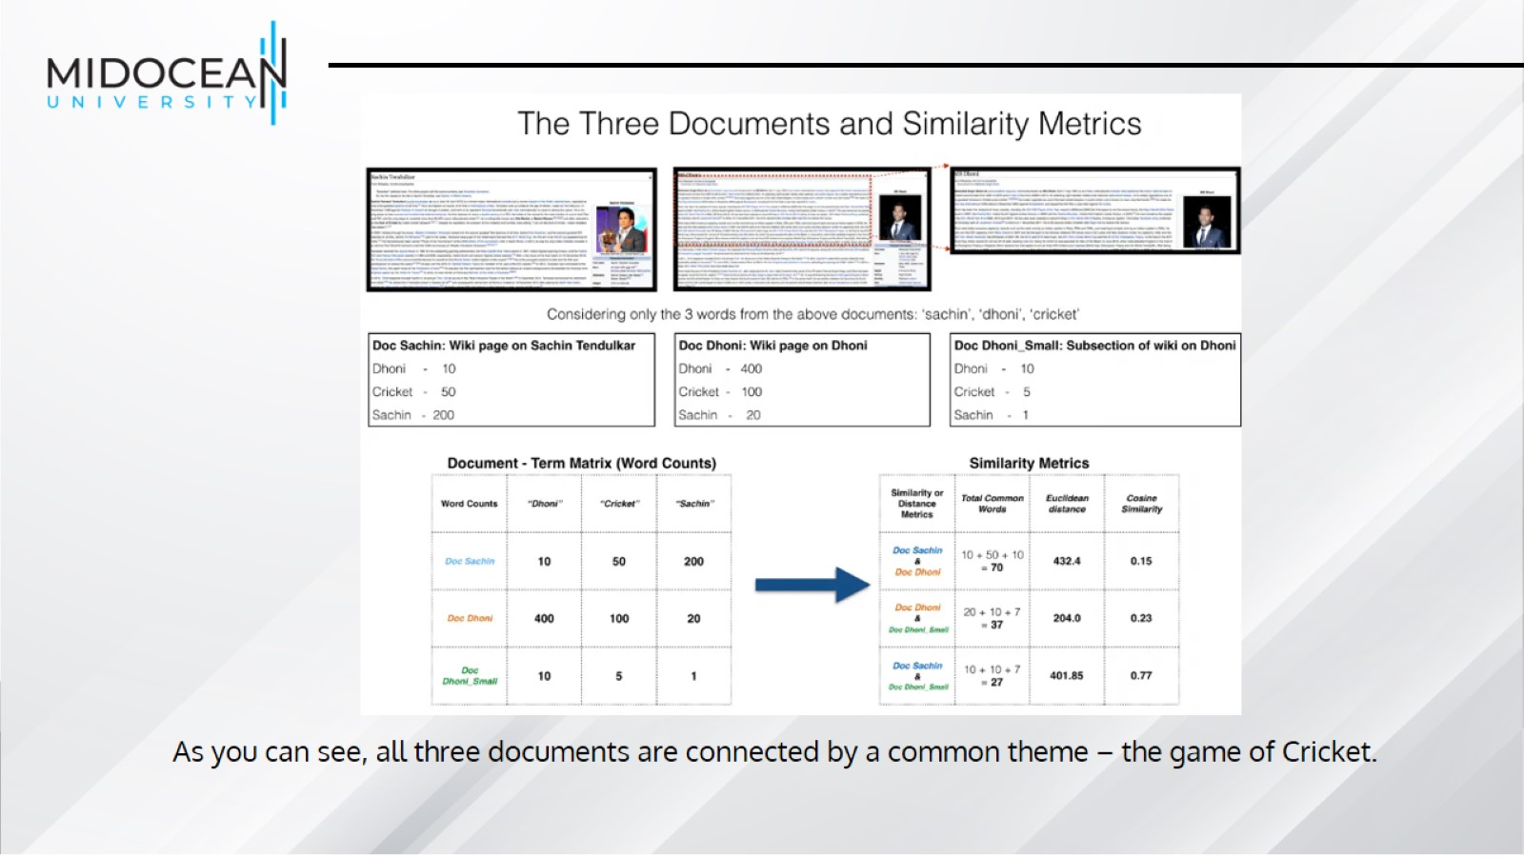

Slide 40
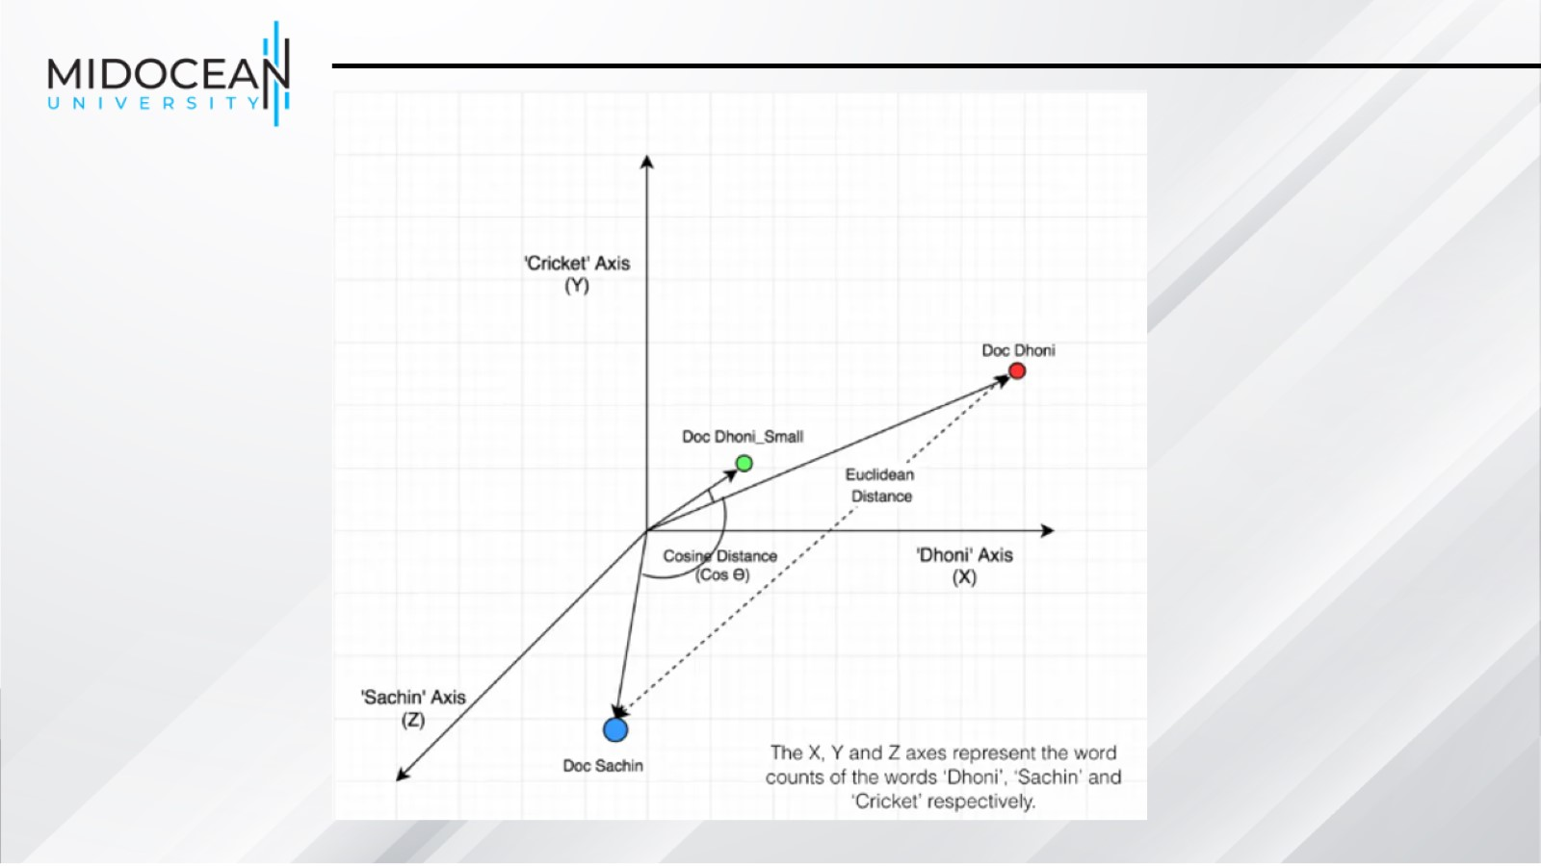

Slide 41
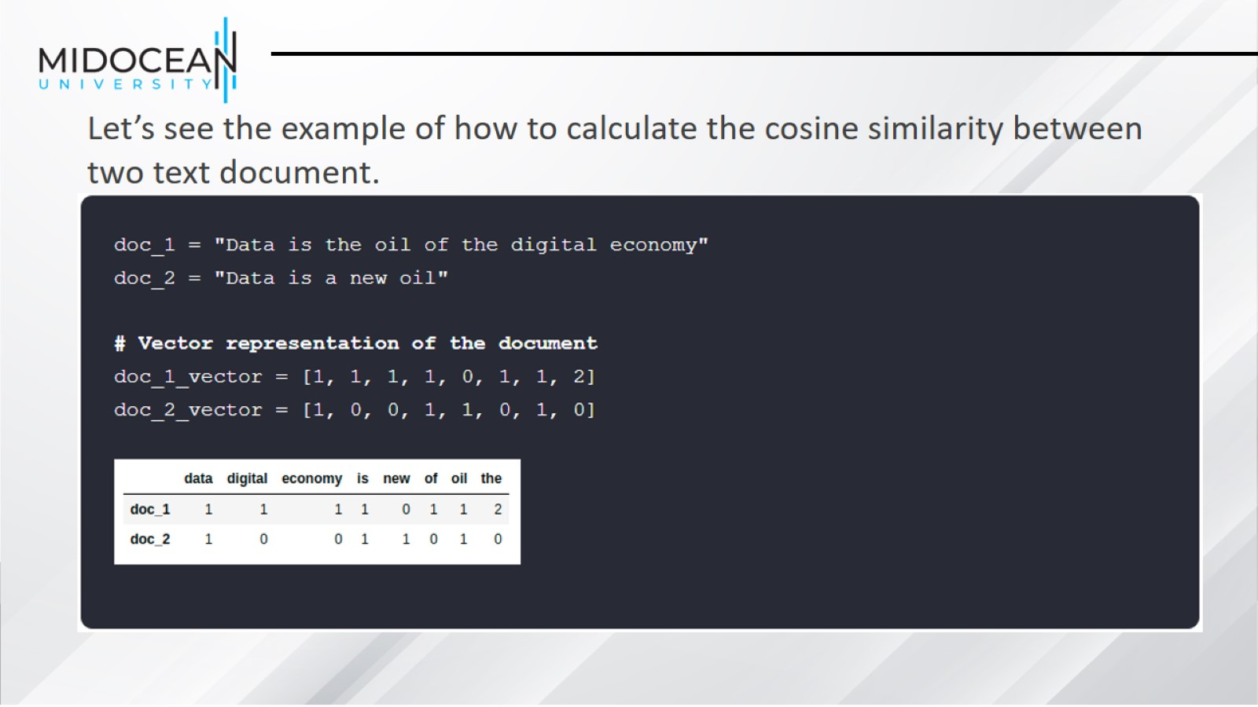

Slide 42
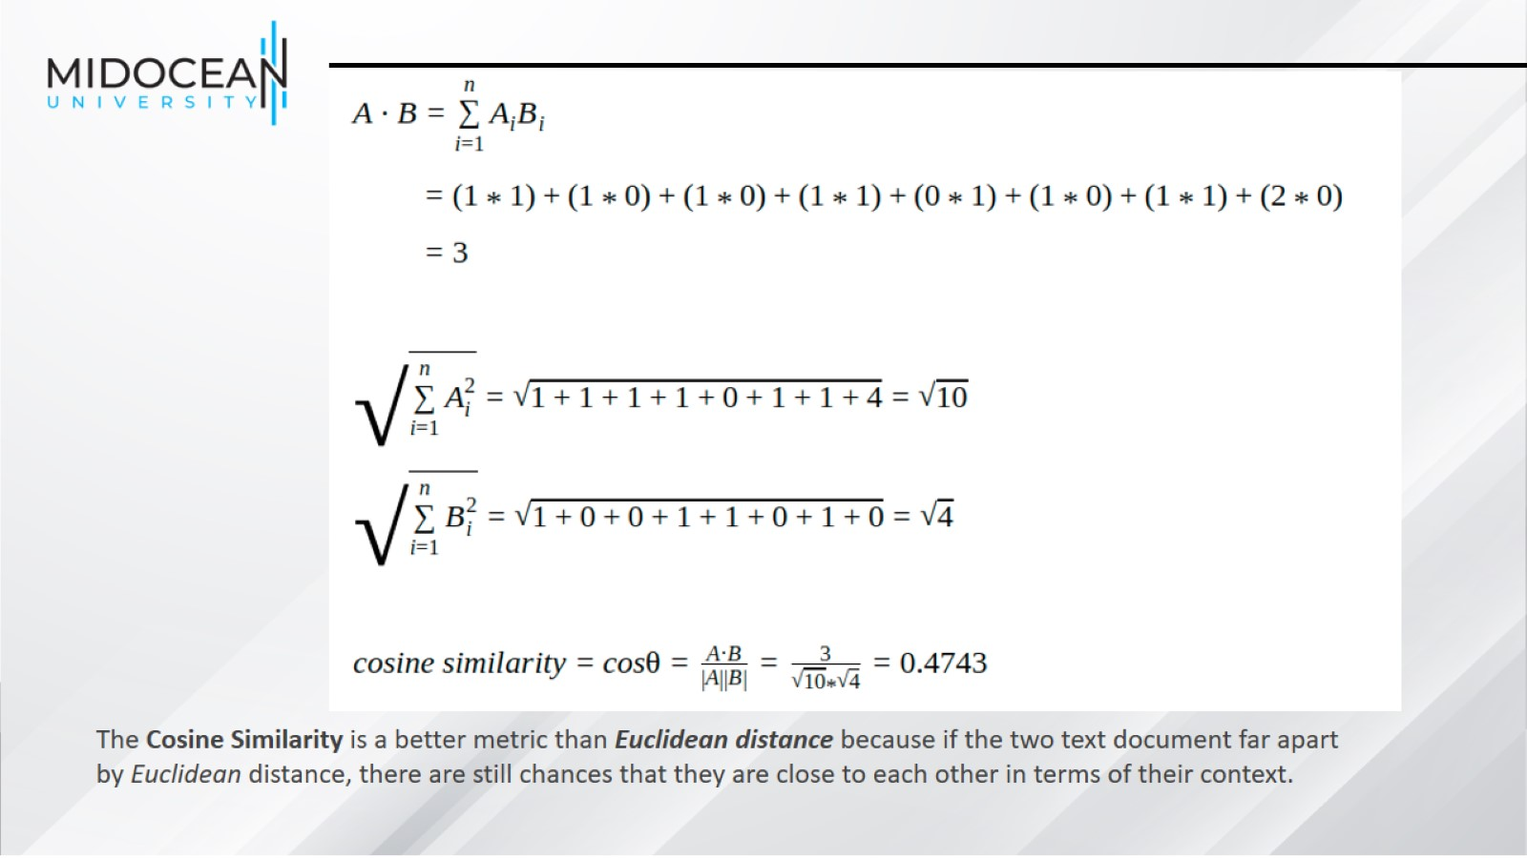

Slide 43
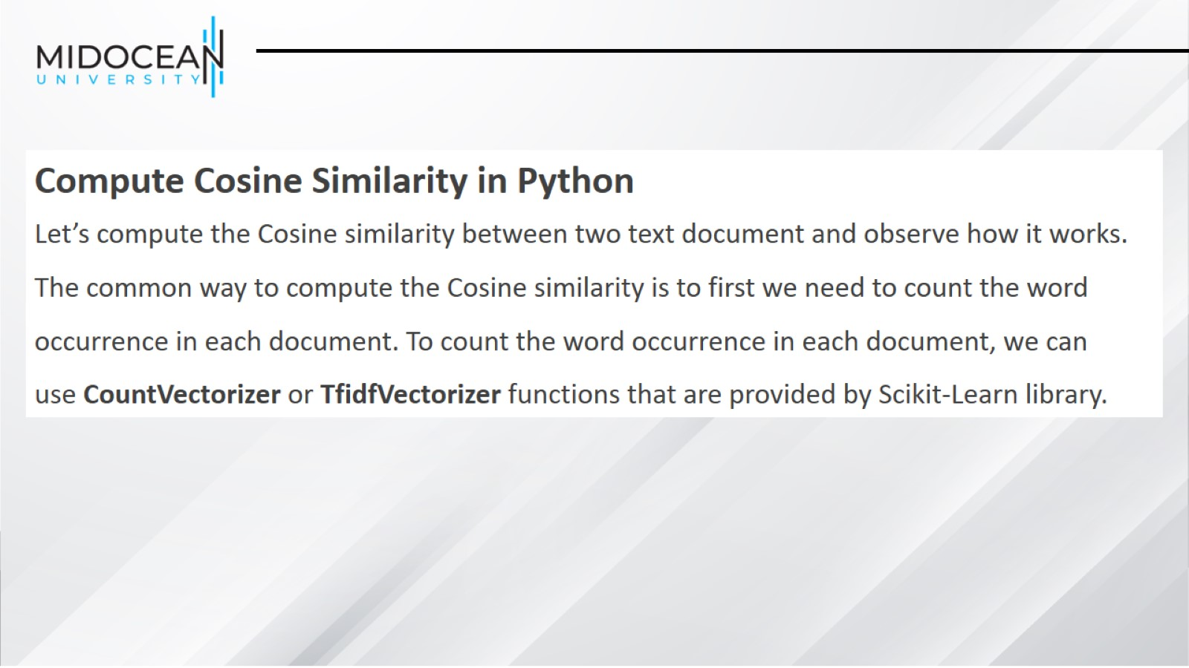

Slide 44
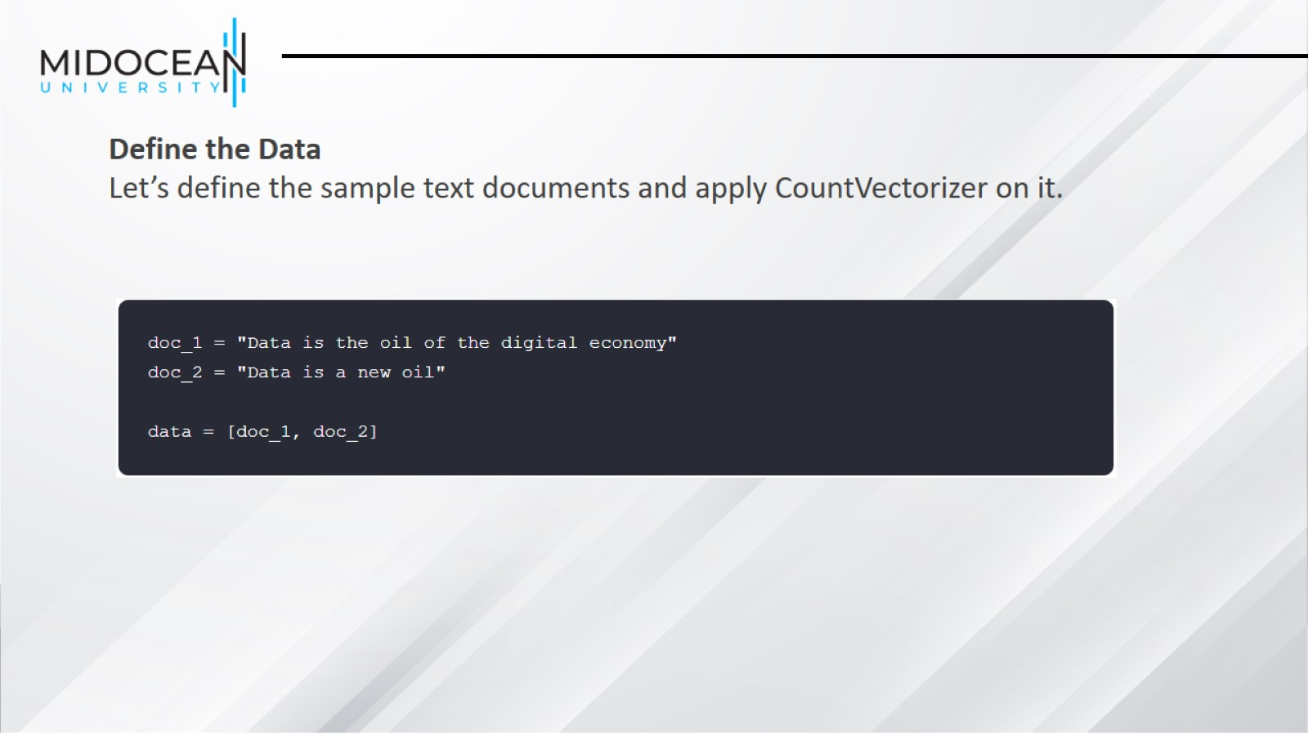

Slide 45
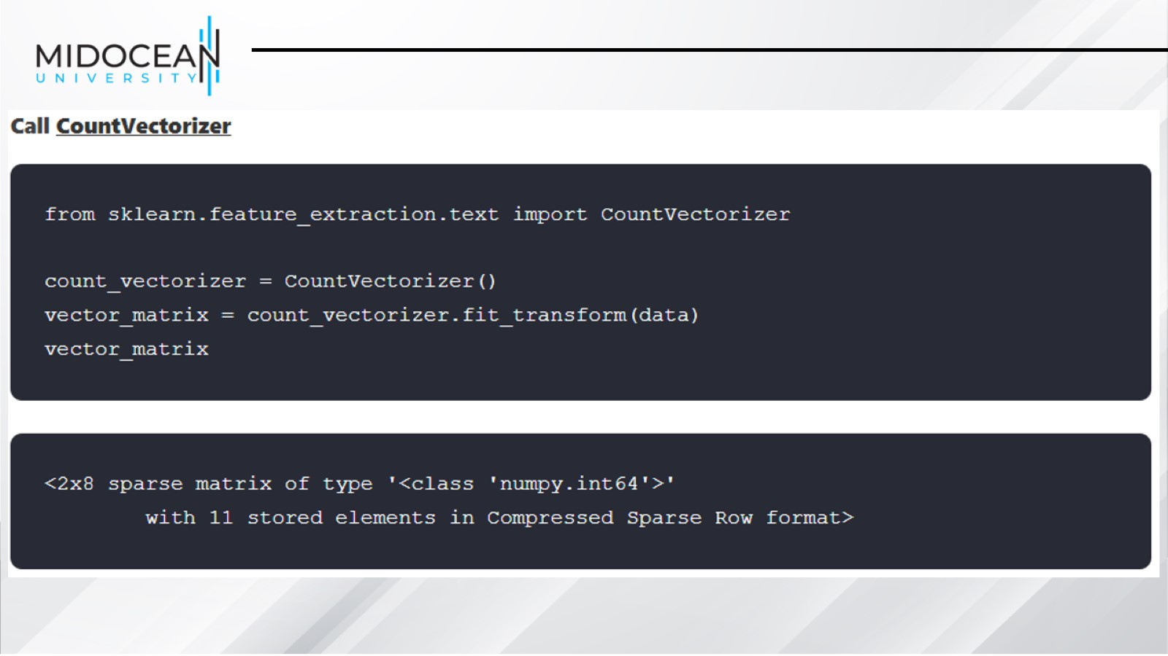

Slide 46
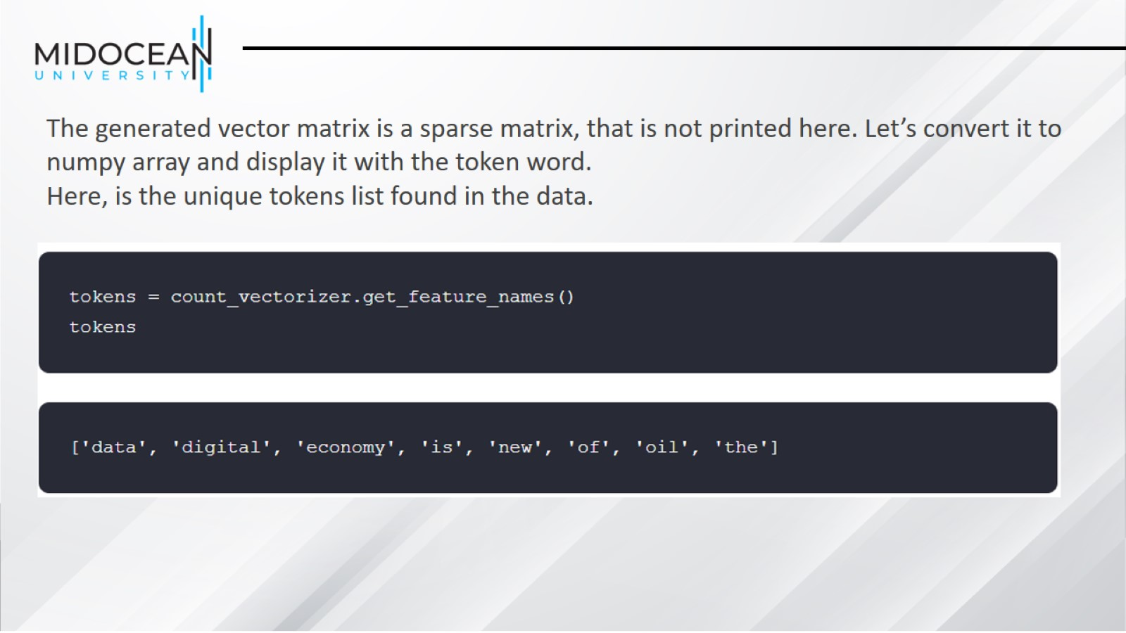

Slide 47
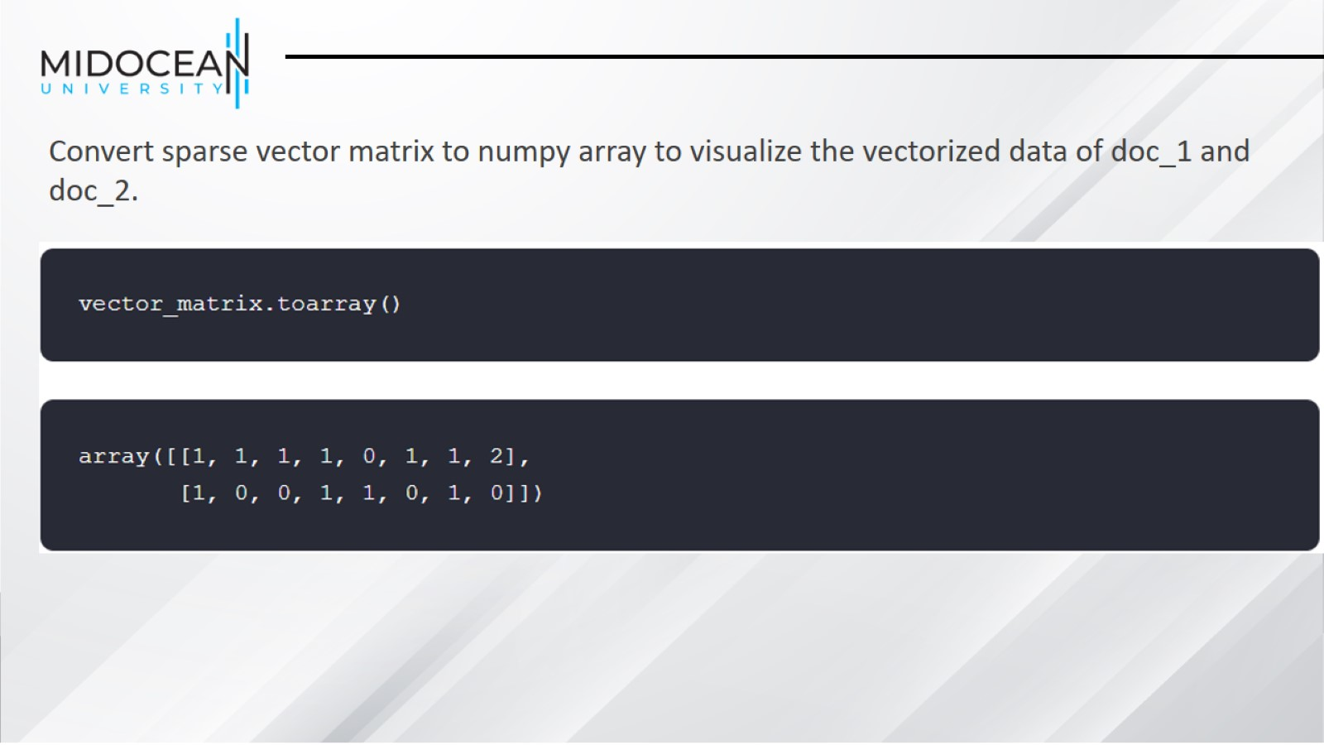

Slide 48
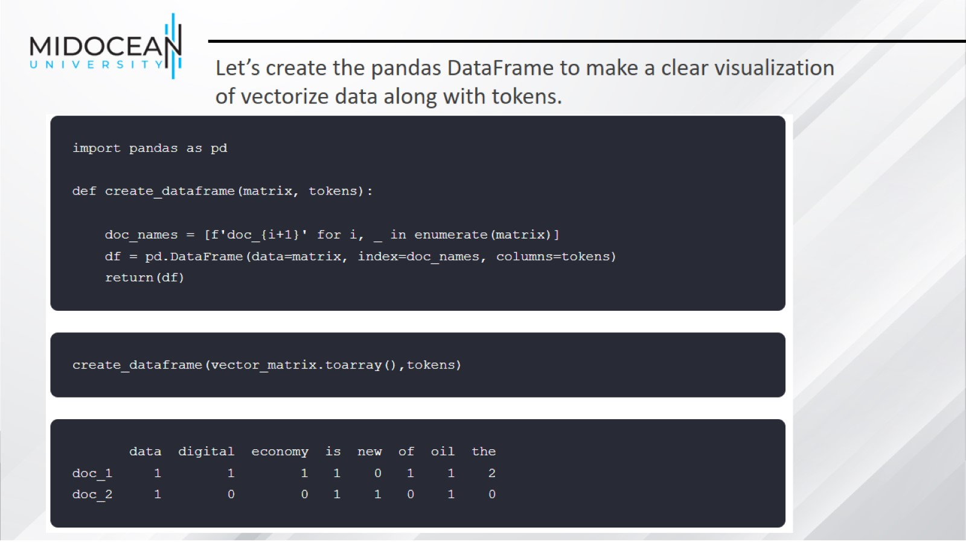

Slide 49
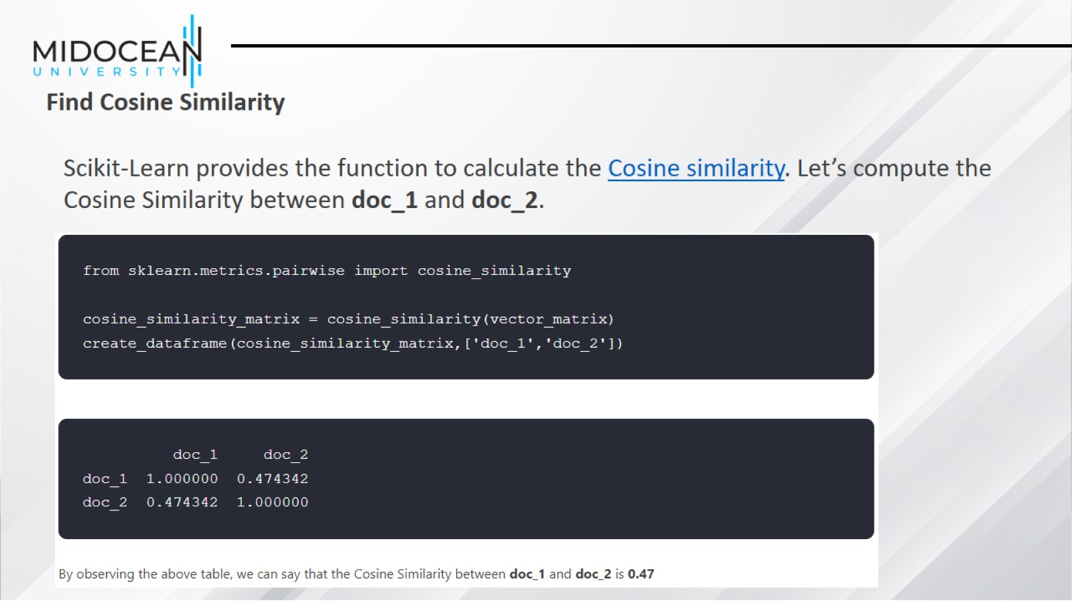

Slide 50
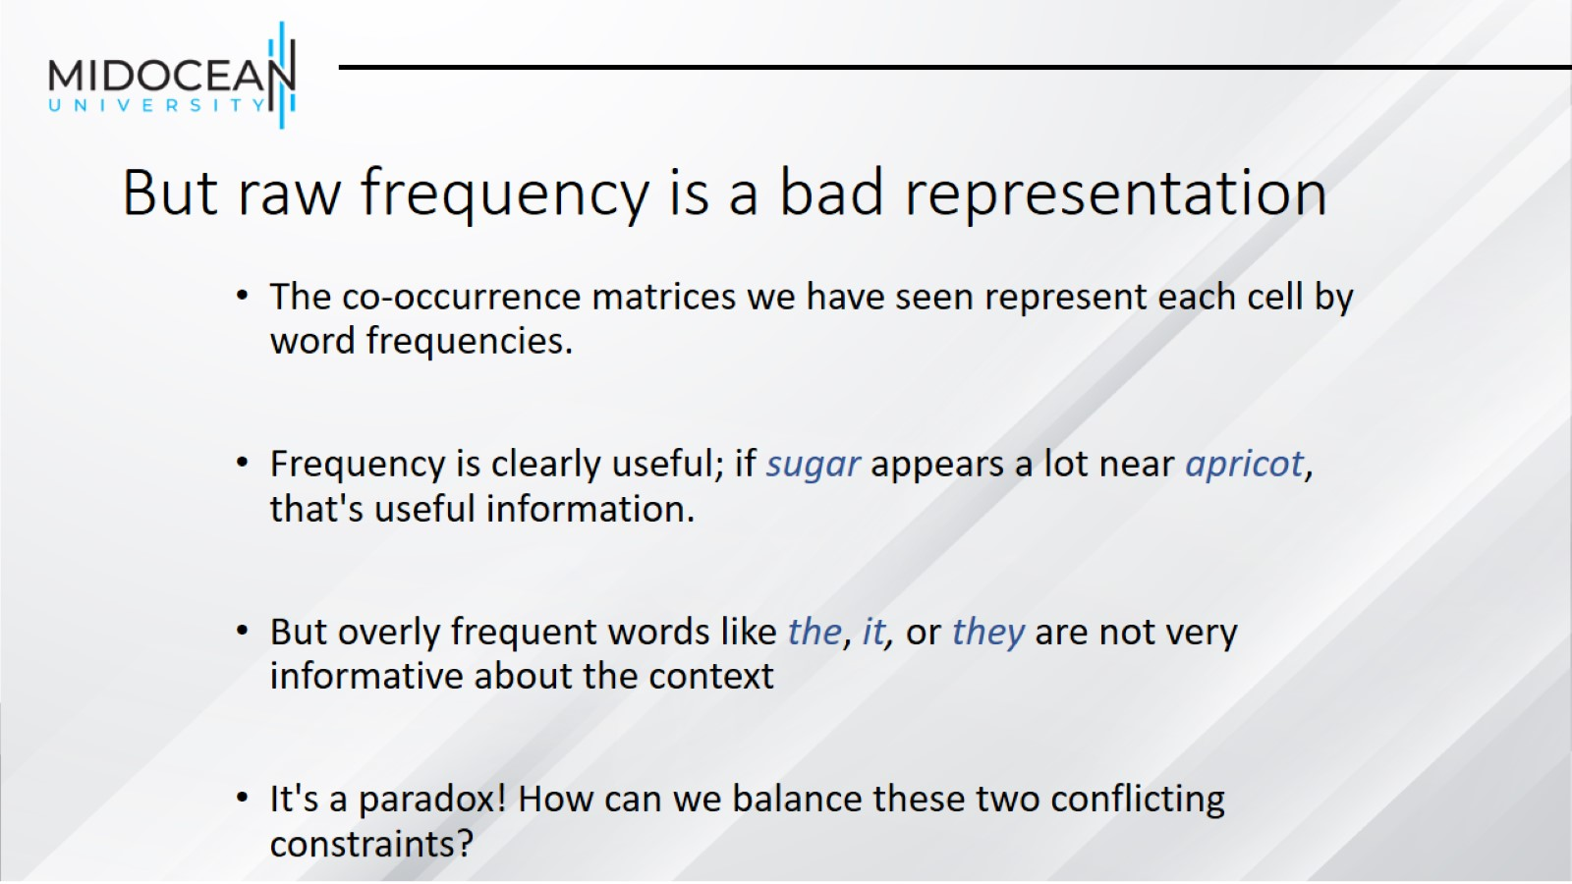
But raw frequency is a bad representation

Slide 51

Two common solutions for word weighting

Slide 52

Term frequency (tf)

Slide 53

Document frequency (df)

Slide 54

Inverse document frequency (idf)

Slide 55

What is a document?

Slide 56

Final tf-idf weighted value for a word

Slide 57


Slide 58


Slide 59


Slide 60


Slide 61


Slide 62


Slide 63

Pointwise Mutual Information

Slide 64

Positive Pointwise Mutual Information

Slide 65

Computing PPMI on a term-context matrix

Slide 66


Slide 67


Slide 68

Sparse versus dense vectors

Slide 69

Summary

Slide 70


