Slide 1

Building and Using Decision Models
Prepared by Dr. Mohamed Sleem
Subject code : FNT 631
Data Analysis
Lecture 8

Slide 2



Building and Using Decision Models
Lecture 8
Subject code : FNT 631
Data Analysis
Prepared by
Dr. Mohamed Sleem

Slide 3
Answer Review Questions
What are the components of a time series?
Answer:
Trend: The long-term movement or direction in a time series, indicating overall growth or decline over a period.
Seasonality: Regular and predictable patterns or cycles that repeat over a fixed period, such as daily, monthly, or annually.
Cyclical: Fluctuations that occur due to economic or business cycles, often spanning several years and not of fixed duration.
Irregular/Random: Unpredictable and random variations or noise in the data that do not follow any pattern and cannot be easily attributed to any known cause.

Slide 4
Answer Review Questions
What does the Delphi Method involve?
Answer:
Expert Panel: A group of selected experts in the relevant field who provide insights and opinions.
Questionnaire Rounds: Multiple rounds of surveys conducted to gather information, with each round refining the previous responses.
Anonymity: Ensuring that the responses from the experts remain anonymous to prevent bias and influence from other panel members.
Feedback: Providing summary feedback of the responses between rounds to allow experts to reconsider and refine their views.
Convergence: The process of reaching a consensus or common agreement among the experts through iterative refinement of responses.

Slide 5
Answer Review Questions
Name three statistical forecasting methods mentioned in the document.
Answer:
Moving Average: A method that smooths out short-term fluctuations and highlights longer-term trends by averaging data points over a specified number of periods.
Exponential Smoothing: A forecasting technique that applies decreasing weights to past observations, giving more significance to recent data points.
Autoregressive Integrated Moving Average (ARIMA): A sophisticated forecasting method that combines autoregression (AR), differencing (I), and moving average (MA) to model and predict time series data.

Slide 6
Objectives
Understand the components and importance of decision models in data analysis.
Develop skills in building and using various types of decision models.
Conduct What-If Analysis
Learn the application of Excel tools for model analysis and optimization.
Apply Common Mathematical Functions in Decision Models
Explore different statistical forecasting methods and their use in decision models.
Gain proficiency in performing what-if analysis, scenario management, and goal seeking.

Slide 7
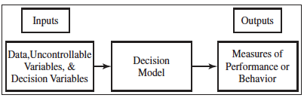
Models
A model is an abstraction or representation of a real system, idea, or object.
Models could be pictures, spreadsheets, or mathematical relationships
Models contain data, uncontrollable variables, and decision variables

Slide 8
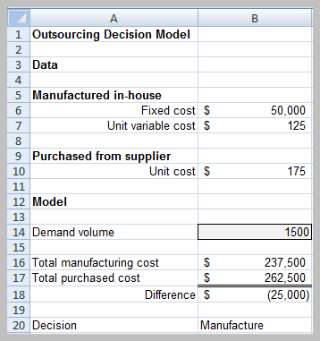
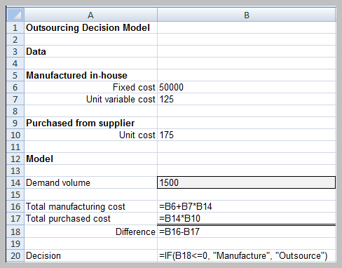
Decision Models – Outsourcing Example
Decision models are models that can be used to understand, analyze, or facilitate making a decision

Slide 9
Outsourcing Model
Model components
  F = fixed cost of in-house manufacturing
  V = unit variable cost of in-house manufacturing
  C = unit cost of outsourcing
  D = demand volume
Total Manufacturing Cost = TMC = F + V D
Total outsourcing cost = TOC = C D.

Slide 10
Types of Decision Models
Descriptive - describe relationships and provide information for evaluation
Prescriptive (optimization models) - determine an optimal policy, that is, the best course of action that a decision maker should take to maximize or minimize some objective

Slide 11
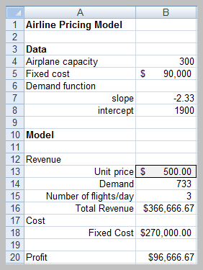
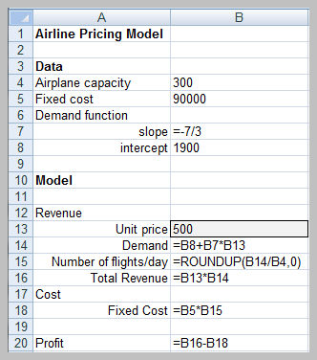
Airline Pricing Model

Slide 12
Model Analysis
What-If Analysis – evaluate how specific combinations of model inputs that reflect key model assumptions affect model outputs (often called sensitivity analysis).
Excel tools
  Data tables
  Scenario manager
  Goal seek

Slide 13
Data Tables
Summarizes the impact of one or two inputs on a specified output
Excel tools
  One-way data tables
  Two-way data tables

Slide 14
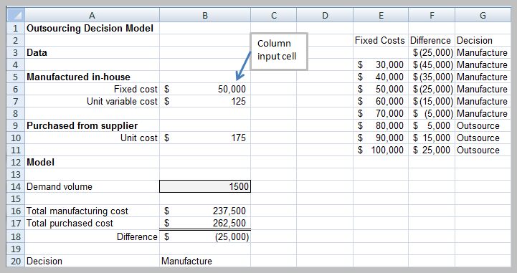
One Way Data Table

Slide 15
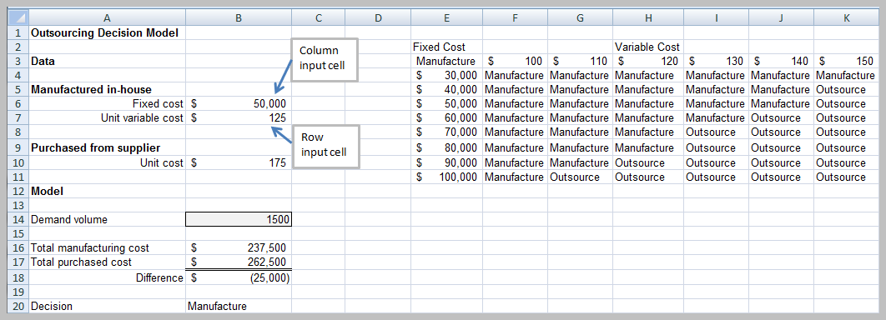
Two Way Data Table

Slide 16
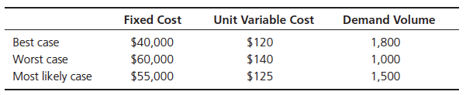
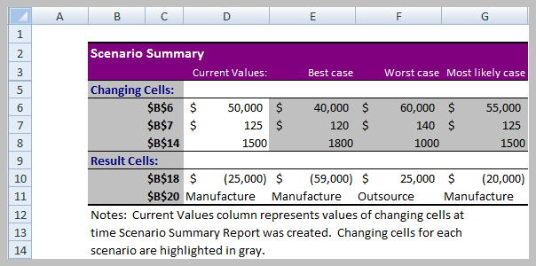
Scenario Manager

Slide 17
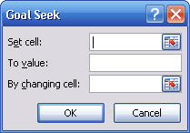
Goal Seek
Find the value of an input that produces a known result within a spreadsheet
Example: find the breakeven point in the outsourcing decision model
Set cell is B18;
To value = 0;
By changing cell is B14

Slide 18
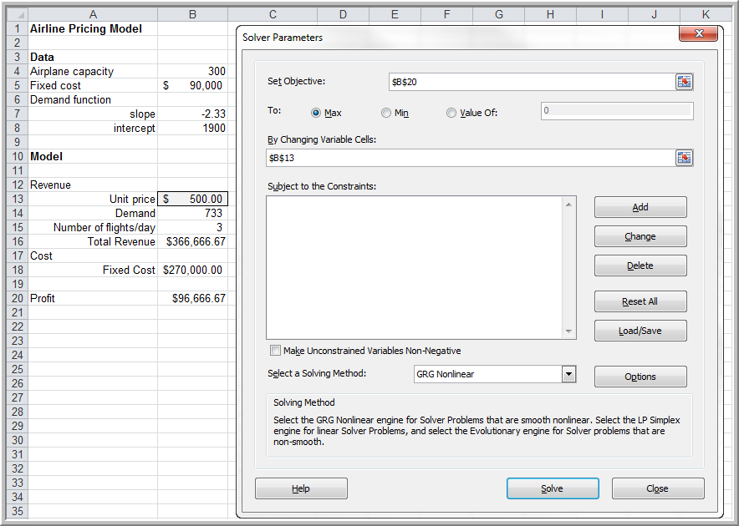
Optimization Models: Excel Solver
Solution:
Price = $428.57;
profit = $115,714.28

Slide 19
Tools for Model Building
Logic and business principles
Common mathematical functions
Data fitting
Spreadsheet engineering

Slide 20
Logic and Business Principles
Profit = Revenue - Cost
Revenue = (Unit price)(Quantity sold)
Cost = Fixed cost + Unit costQuantity produced
Quantity sold = Min(Quantity produced, Demand)
Profit = (Unit price)Min(Quantity produced, Demand) – [Fixed cost + (Unit cost)(Quantity produced)]

Slide 21
Modeling Example: Gasoline Consumption
m = miles/day driven
d = days/month
f = miles/gallon
Miles driven/month = md
Gallons consumed/month = md/f

Slide 22

Net Present Value
Measures the worth of a stream of cash flows, taking into account the time value of money.
A cash flow of F dollars t time periods in the future is worth F (1 + i)^{t} dollars today, where i is the discount rate.
Excel function NPV(rate, value1, value2,…)

Slide 23
Common Mathematical Functions
Linear: y = mx + b
Logarithmic: y = ln(x)
Polynomial: y = ax² + bx + c (quadratic)
Power: y = ax^{b}
Exponential: y = ab^{x}

Slide 24
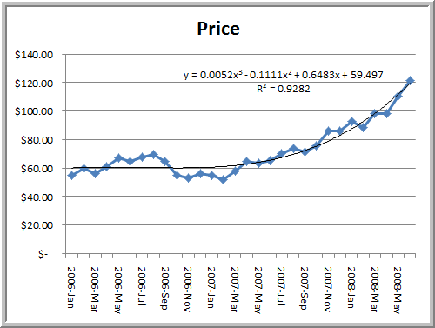
Data
Fitting

Slide 25
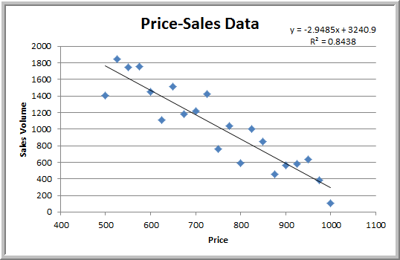
Revenue Model
Total revenue = PriceSales
  = Price × (-2.794 Price + 3149)
  = -2.794 Price² + 3149 Price

Slide 26
Spreadsheet Engineering
Improve the design and format of the spreadsheet itself.
Improve the process used to develop a spreadsheet.
Inspect your results carefully and use appropriate tools available in Excel.
  Use the Data Validation tool
  Inspect and audit formulas

Slide 27
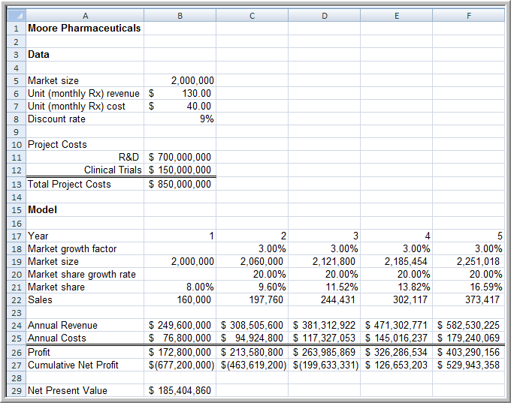
New Product Development Model

Slide 28
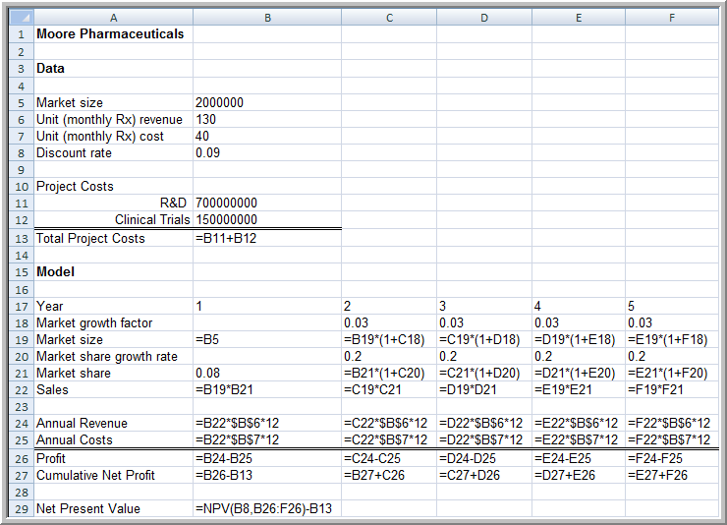
New Product Development Model Formulas

Slide 29
Single Period Purchase Decisions (Newsvendor Model)
C = purchase cost
R = sale price
S = salvage value
D = demand during a single period
Q = quantity purchased
Net profit = R Quantity Sold + S Surplus Quantity - C Q

Slide 30
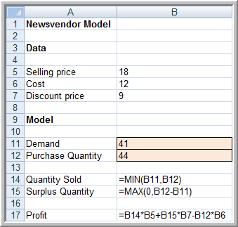
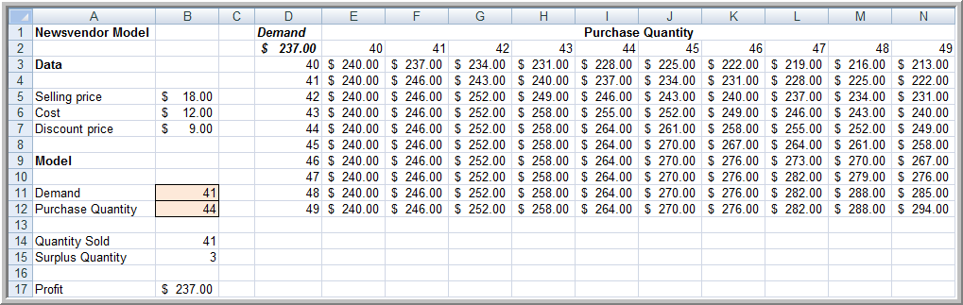
Newsvendor Model Spreadsheet

Slide 31
Monte Carlo Simulation
The process of generating random values for uncertain inputs in a model, computing the output variables of interest, and repeating this process for many trials in order to understand the distribution of the output results.

Slide 32
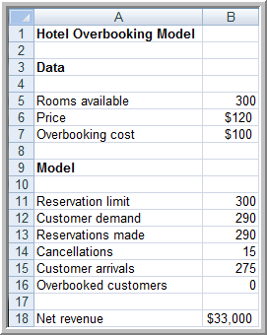
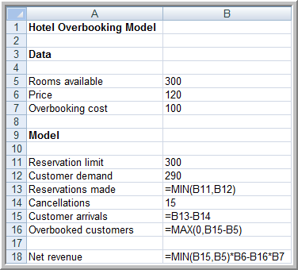
Overbooking Decisions

Slide 33
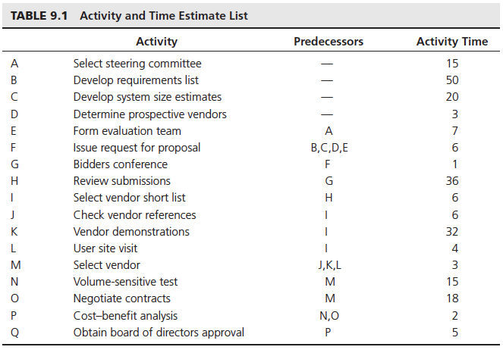
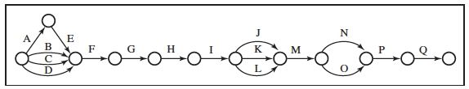
Project Management

Slide 34
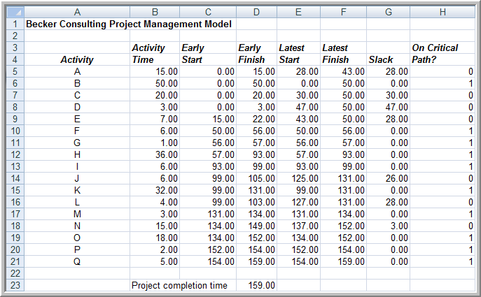
Spreadsheet Model

Slide 35
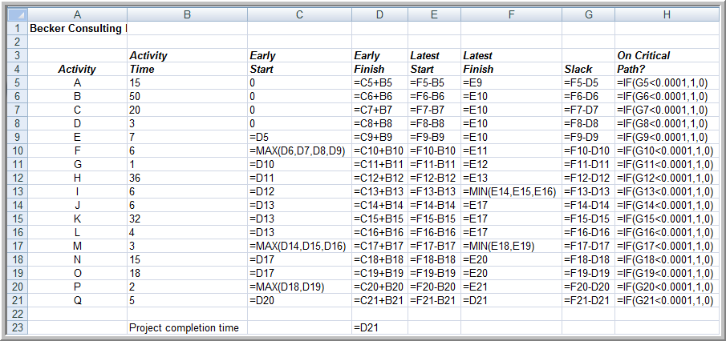
Model Formulas

Slide 36
Model Assumptions, Complexity, and Realism
All models reflect assumptions used by the modeler.
Assumptions simplify models and make them easier to manipulate and solve
Assumptions should be as realistic as necessary to make models useful but not overly complex
Assumptions should be clearly stated and documented

Slide 37
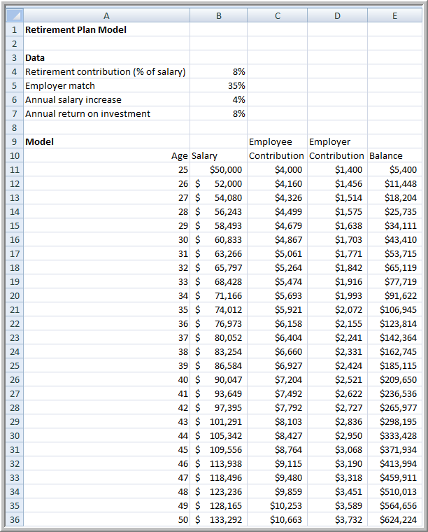
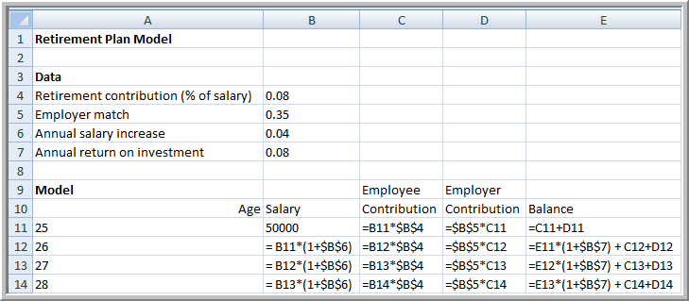
Example: Retirement Planning

Slide 38
Summary
Decision Models: Representations used to analyze and facilitate decision-making processes, including descriptive and prescriptive (optimization) models.
What-If Analysis: Evaluates how specific combinations of model inputs affect model outputs, often referred to as sensitivity analysis.
Excel Tools: Includes data tables, scenario manager, and goal seek to analyze model outcomes and optimize decisions.
Common Mathematical Functions: Linear, logarithmic, polynomial, power, and exponential functions used in decision models.
Monte Carlo Simulation: Generates random values for uncertain inputs in a model, computes output variables, and repeats the process to understand output distributions.
Spreadsheet Engineering: Involves improving spreadsheet design, development process, and using tools like data validation to ensure accurate results.

Slide 39
Review Questions
What is a decision model?
What are the key tools in Excel for performing what-if analysis?
What is the purpose of Monte Carlo Simulation in decision models?

Slide 40



Thank You

