Slide 1



Deep Learning & Neural Networks
Dr. Shahira Ahmed
DS710
Lecture 3

Slide 2


Slide 3
Lecture Outline
Linear Algebra Review
What is Vectorization?
How Vectorization is important in Machine learning?
Advantages of Vectorized Implementation
Demonstration on Colab
Representing Neural Network weighted sum as vectors
Training Network

Slide 4
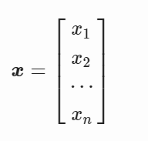
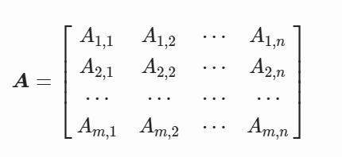
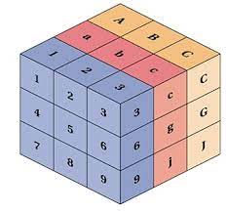
Linear Algebra Review
Scalars is only a Single numbers
Vectors: A vector is an array of numbers
Matrix:
A tensor is a n-dimensional array with n>2

Slide 5
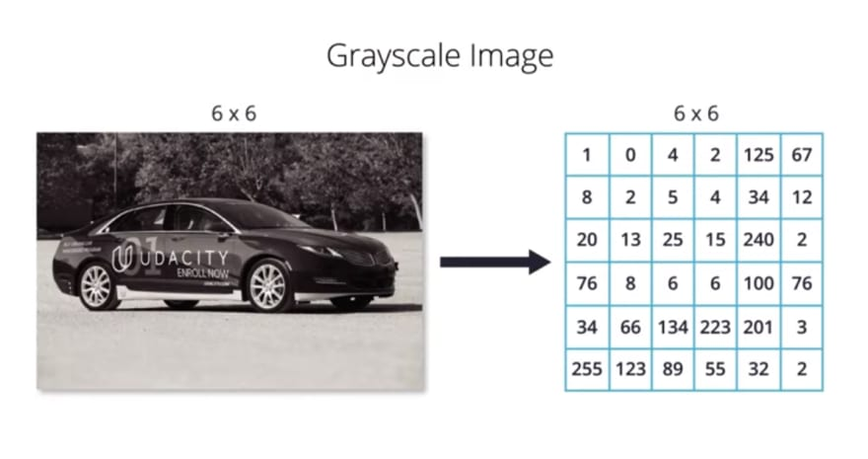
Linear Algebra Review
https://dev.to/sandeepbalachandran/machine-learning-going-furthur-with-cnn-part-2-41km

Slide 6
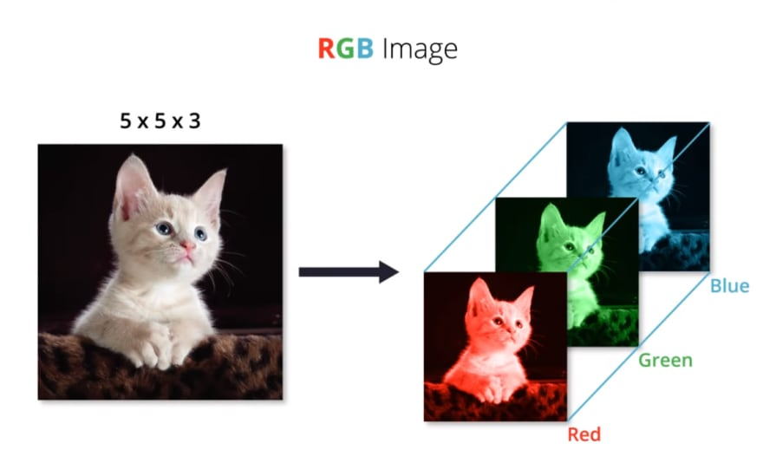
Linear Algebra Review
https://dev.to/sandeepbalachandran/machine-learning-going-furthur-with-cnn-part-2-41km

Slide 7
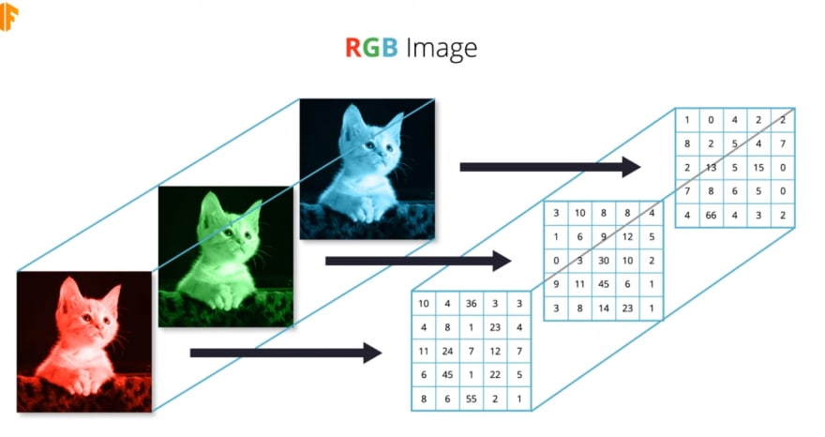
Linear Algebra Review
https://dev.to/sandeepbalachandran/machine-learning-going-furthur-with-cnn-part-2-41km

Slide 8
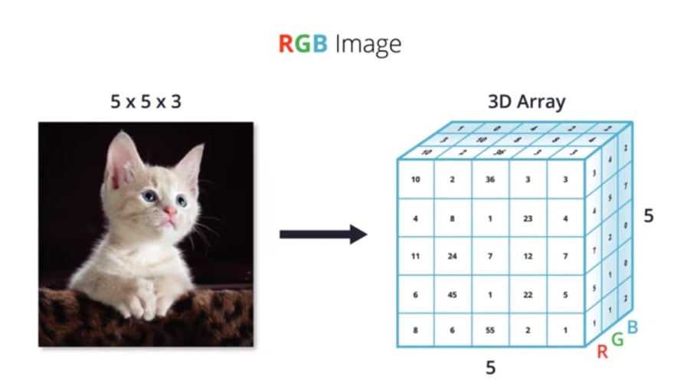
Linear Algebra Review
https://dev.to/sandeepbalachandran/machine-learning-going-furthur-with-cnn-part-2-41km

Slide 9
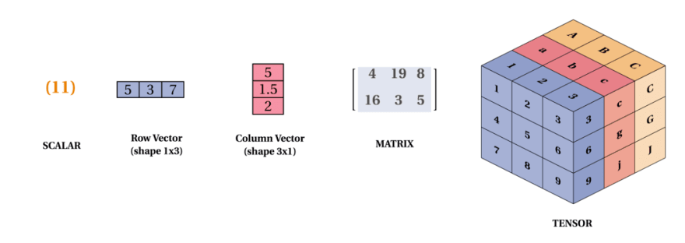
Linear Algebra Review
https://dev.to/mmithrakumar/scalars-vectors-matrices-and-tensors-with-tensorflow-2-0-1f66

Slide 10
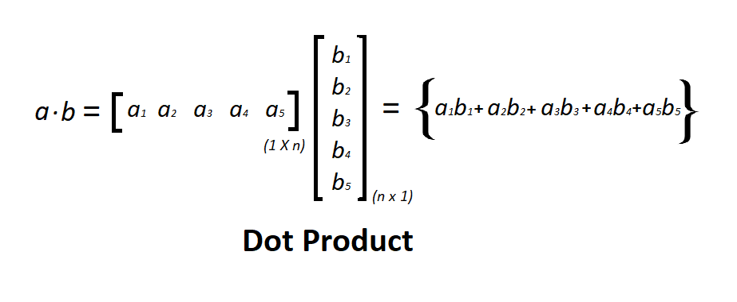
Dot Product
An algebraic operation in which two equal length vectors are being multiplied such that it produces a single number. Dot Product often called as inner product. This product results in a scalar number

Slide 11
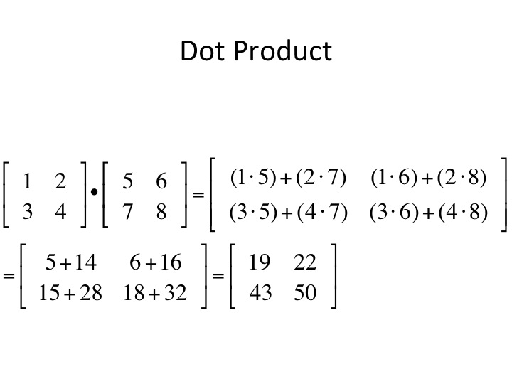
Dot Product

Slide 12
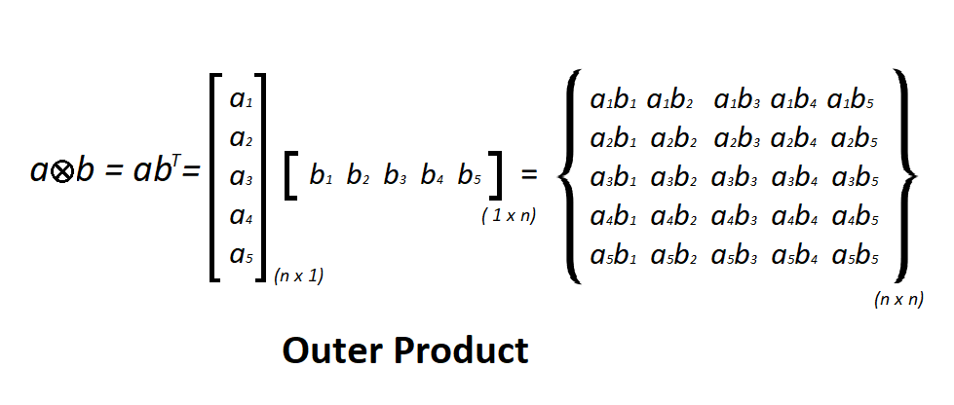
Outer Product
Multiply two vectors a and b with dimension n x 1 and m x 1 then the outer product of the vector results in a rectangular matrix of n x m.

Slide 13
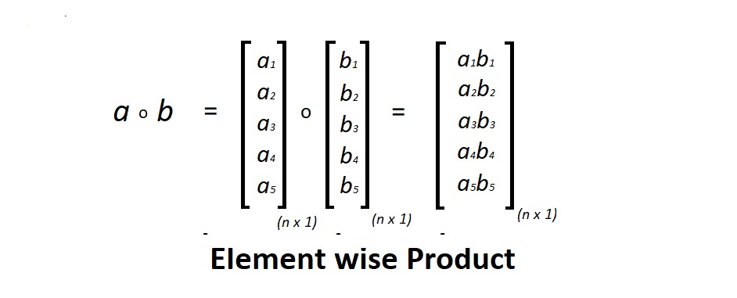
Element wise Product
Element-wise multiplication of two matrices is the algebraic operation in which each element of first matrix is multiplied by its corresponding element in the later matrix. Dimension of the matrices should be same.

Slide 14
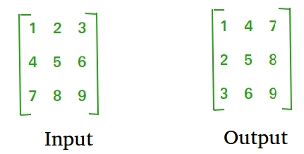
Transpose

Slide 15
What is Vectorization?
Vectorization in machine learning refers to the process of represents data into Vectors, Matrices, and Tensors.
Process data without using loops

Slide 16
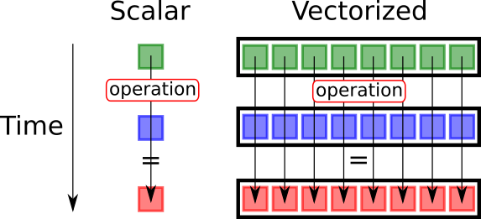
Why Vectorization
https://medium.com/@jwbtmf/vectorization-in-deep-learning-c47f0d171d0a

Slide 17
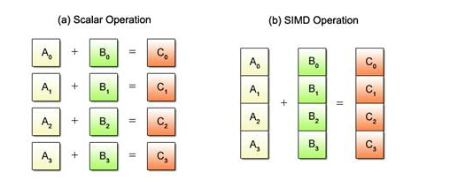
Why Vectorization?
SIMD is short for Single Instruction/Multiple Data, while the term SIMD operations refer to a computing method that enables the processing of multiple data with a single instruction
https://medium.com/@jwbtmf/vectorization-in-deep-learning-c47f0d171d0a

Slide 18
Why Vectorization?
Efficiency : Due to the fact that they make use of the parallel processing capability of contemporary CPUs and GPUs, vectorized operations are often performed significantly quicker than their non-vectorized equivalents. This can lead to significant speed-ups in training and inference.
Memory : Vectorized operations can also reduce memory usage.

Slide 19
Why Vectorization
Express data as matrices
Perform computations on multiple data points simultaneously
Performing parallel computations using matrix operations
Hardware accelerators like GPUs
Efficient memory utilization
Less Time- more speed

Slide 20
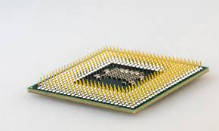
CPU vs GPU vs TPU
CPU (Central Processing Unit):
  A CPU is the primary processing unit in a computer system. CPUs excel at sequential processing and are optimized for tasks that require high single-threaded performance. They are commonly found in desktop and laptop computers, servers, and mobile devices.

Slide 21
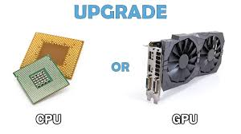
CPU vs GPU vs TPU
GPU (Graphics Processing Unit):
  A GPU is a specialized processor that is designed to handle computationally intensive tasks related to computer graphics and parallel processing. Originally developed for rendering graphics in video games, GPUs have evolved into highly parallel processors capable of performing complex mathematical calculations. They excel at tasks that can be broken down into many smaller, independent tasks that can be executed simultaneously. GPUs are commonly used in graphics-intensive applications, such as gaming, image processing, scientific simulations, and machine learning.

Slide 22
CPU vs GPU vs TPU
https://www.youtube.com/watch?v=-P28LKWTzrI

Slide 23
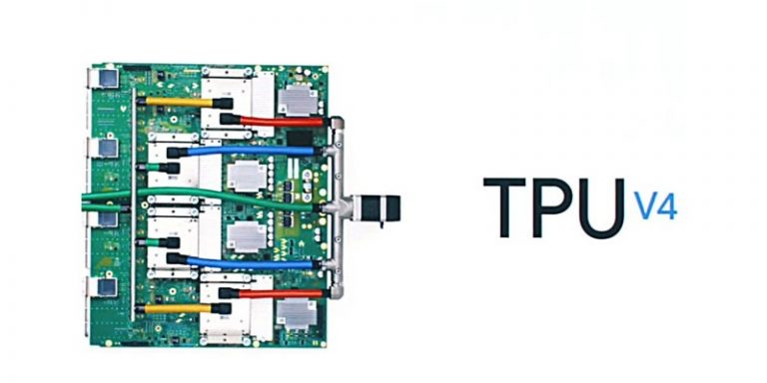
CPU vs GPU vs TPU
TPU (Tensor Processing Unit):
  A TPU is a specialized application-specific integrated circuit (ASIC) developed by Google for accelerating machine learning workloads.
  It is specifically designed to perform tensor operations, which are fundamental to many machine learning algorithms.
  TPUs are highly optimized for matrix multiplication and are capable of delivering significantly higher performance compared to CPUs and GPUs for deep learning tasks.
  They are commonly used in data centers and cloud computing platforms to accelerate machine learning training and inference.

Slide 24
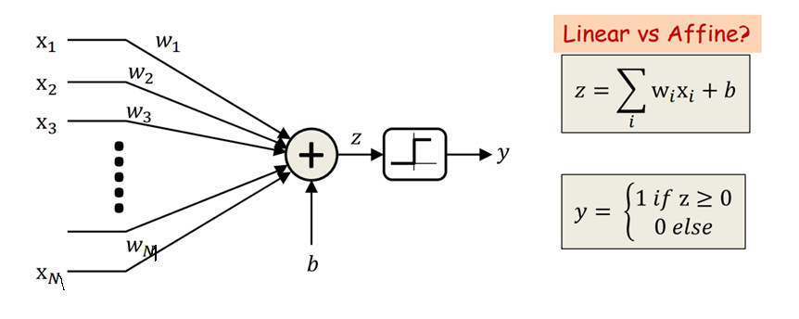
Recap: the perceptron
– “Fires” if the affine function of inputs is positive

Slide 25
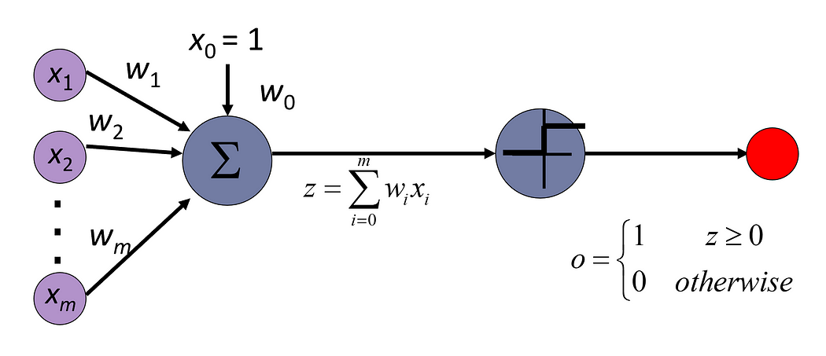
Recap: the perceptron
https://towardsdatascience.com/perceptrons-the-first-neural-network-model-8b3ee4513757

Slide 26
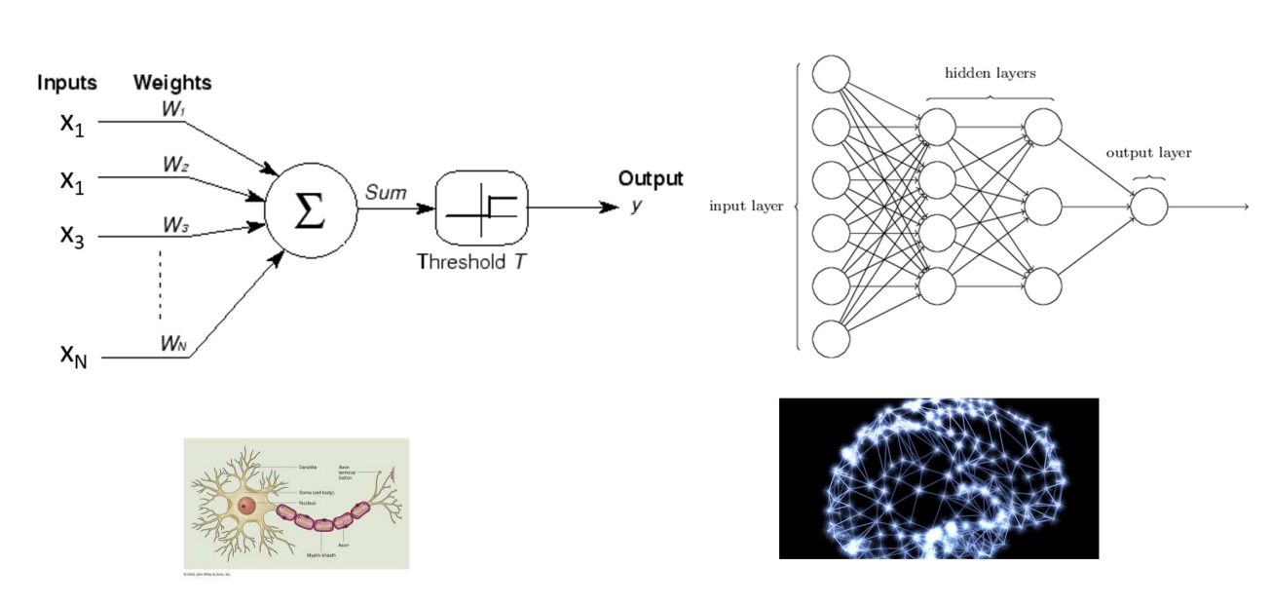
Recap : Nnets and the brain
Neural nets are composed of networks of computational models of neurons called perceptrons
https://deeplearning.cs.cmu.edu/S23/document/slides/lec2.universal.pdf

Slide 27
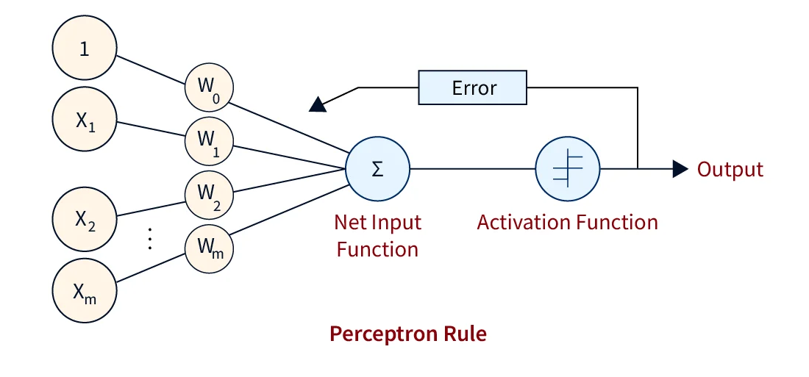

Learning the Network
Calculate Weights
https://www.scaler.com/topics/machine-learning/perceptron-learning-algorithm/

Slide 28
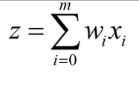
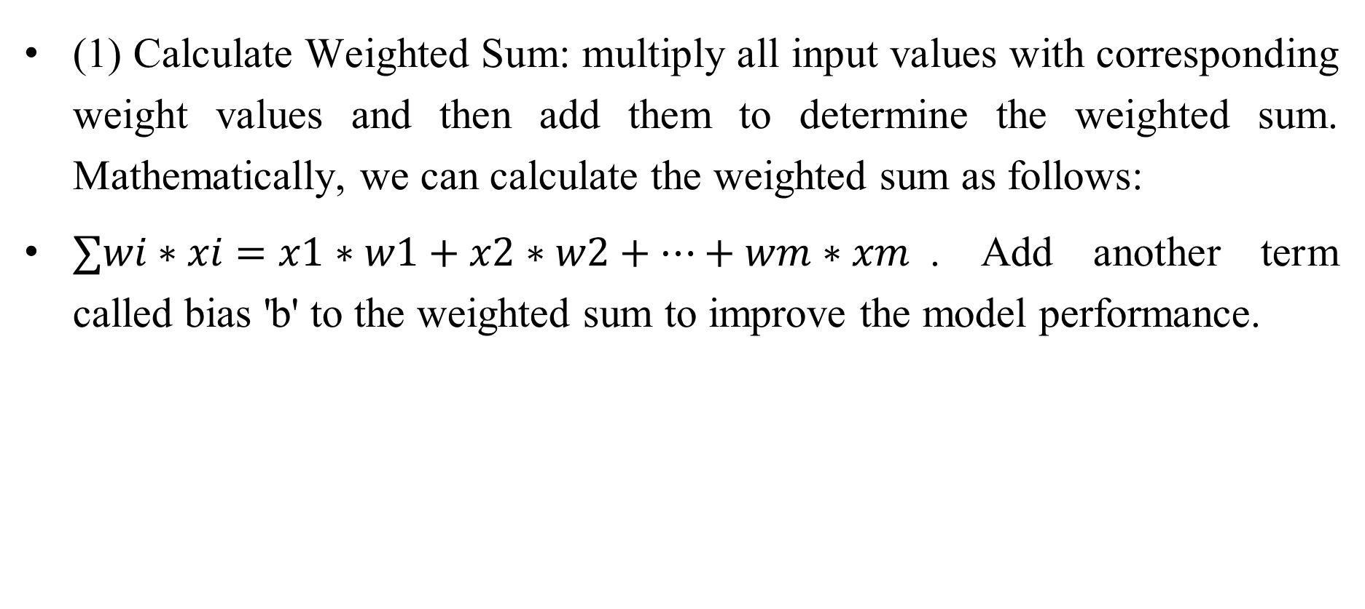
Perceptron learning algorithm
(1) Calculate Weighted Sum: multiply all input values with corresponding weight values and then add them to determine the weighted sum. Mathematically, we can calculate the weighted sum as follows:
$∑wi​∗xi​=x1​∗w1​+x2​∗w2​+…+wm∗xm$​. Add another term called bias 'b' to the weighted sum to improve the model performance.

Slide 29
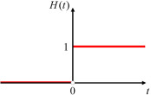
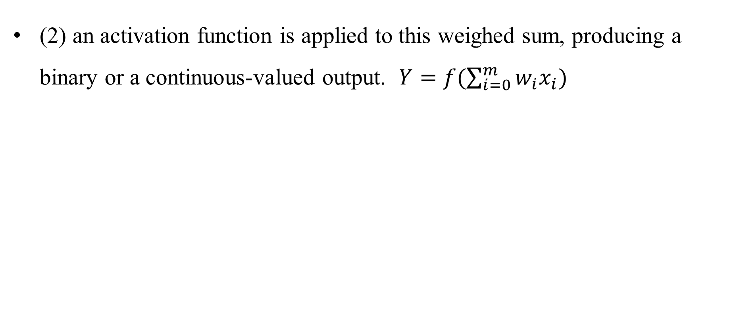
Perceptron learning algorithm
(2) an activation function is applied to this weighed sum, producing a binary or a continuous-valued output. $Y=f(\sum_{i=0}^{m}{w_{i}x_{i}})$

Slide 30
Perceptron learning algorithm
(3) Evaluate
  The difference between this output and the actual target value is computed to get the error term, E, generally in terms of mean squared error. The steps up to this form the forward propagation part of the algorithm(Predicted -Acual)^2.

Slide 31
Perceptron learning algorithm

Slide 32
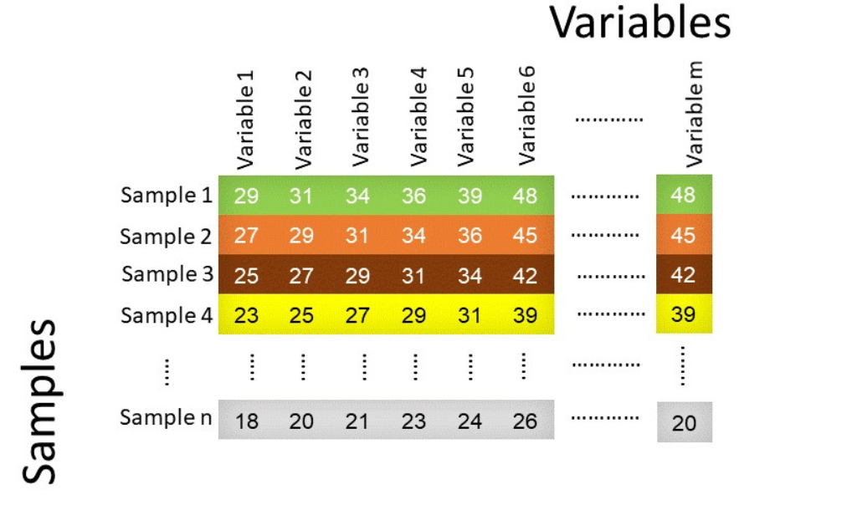
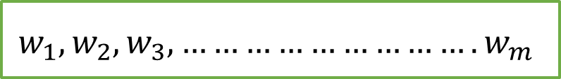
Matrix Operations
$$w_{1},w_{2},w_{3},……………………….w_{m}$$

Slide 33
Matrix Operations
$$w_{1},w_{2},w_{3},……………………….w_{m}$$

Slide 34
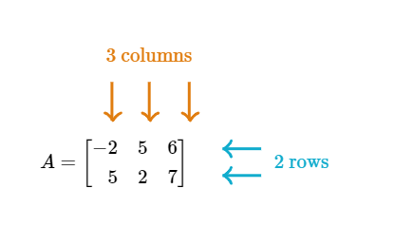
Matrix Operation
The dimensions of a matrix give the number of rows and columns of the matrix in that order.
2*3 Matrix
https://www.khanacademy.org/

Slide 35
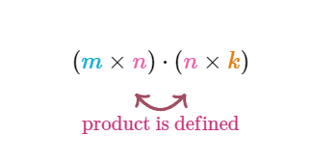
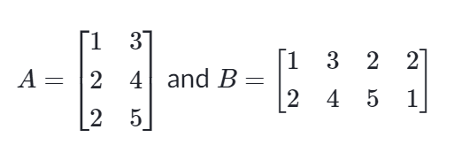
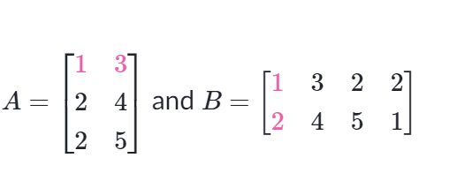
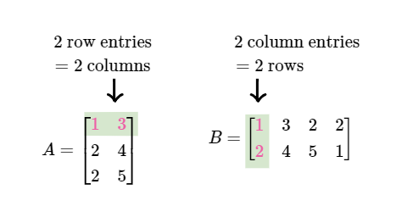
Matrix Operation

Slide 36

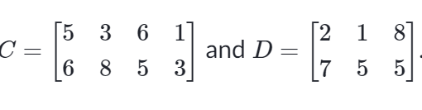
Matrix Operation
CD UnDefined

Slide 37

Matrix Operation
IS AB Defined?
IS BA Defined?
IS AB Defined?Yes
IS BA Defined?NO

Slide 38
Matrix Operations
$$w_{1},w_{2},w_{3},……………………….w_{m}$$
1*m
n*m

Slide 39


Matrix Operations
$$w_{1},w_{2},w_{3},……………………….w_{m}$$
1*m
$$w_{1}$$
$$w_{2}$$
$$w_{3}$$
$$w_{m}$$
m*1
n*m

Slide 40
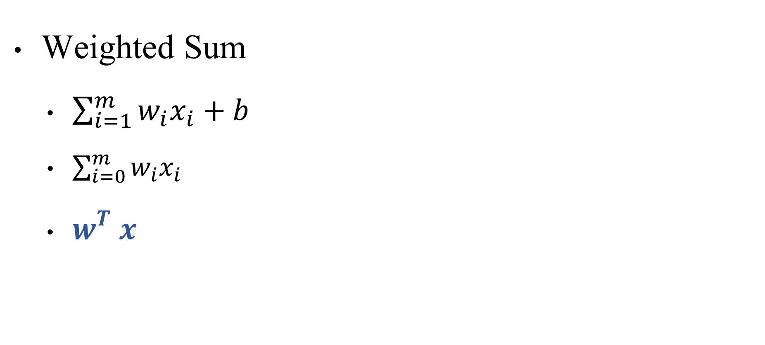
Matrix Operations
Weighted Sum
  $\sum_{i=1}^{m}{w_{i}x_{i}}+b$
  $\sum_{i=0}^{m}{w_{i}x_{i}}$
  $w_{}^{T}x_{}$

Slide 41
Learning the Network

Slide 42
Limitation of Perceptron
A perceptron model’s output can only be a binary number i.e. “0” or “1” because of activation function.
The perceptron model can only be used to categorize the input vectors’ linearly separable sets. If input vectors are non-linear, they can’t be properly classified.

Slide 43
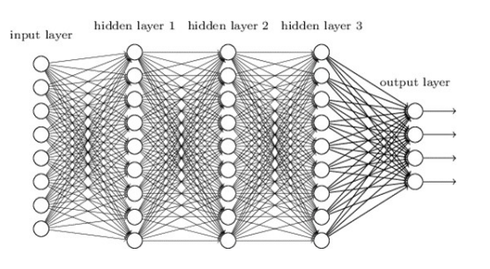
The multi-layer perceptron
A network of perceptrons
  Perceptrons “feed” other perceptrons.
https://deeplearning.cs.cmu.edu/S23/document/slides/lec2.universal.pdf

Slide 44

Option 1: Construct by hand
0,1
-1,0
1,0
0,-1
Given a function, handcraft a network to satisfy it
E.g.: Build an MLP to classify this decision boundary
https://deeplearning.cs.cmu.edu/S23/

Slide 45
Option 1: Construct by hand
0,1
-1,0
1,0
0,-1
Given a function, handcraft a network to satisfy it
E.g.: Build an MLP to classify this decision boundary
https://deeplearning.cs.cmu.edu/S23/

Slide 46
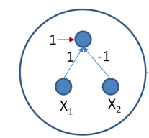

Option 1: Construct by hand
0,1
$$x_{1}−x_{2}+1$$
-1,0
1,0
0,-1
Given a function, handcraft a network to satisfy it
E.g.: Build an MLP to classify this decision boundary
https://deeplearning.cs.cmu.edu/S23/

Slide 47
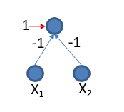
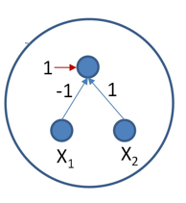

Option 1: Construct by hand
0,1
$${−x}_{1}−x_{2}+1$$
$$x_{1}−x_{2}+1$$
-1,0
1,0
0,-1
Given a function, handcraft a network to satisfy it
E.g.: Build an MLP to classify this decision boundary
https://deeplearning.cs.cmu.edu/S23/

Slide 48
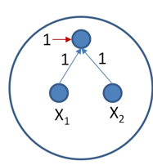
Option 1: Construct by hand
0,1
$${−x}_{1}−x_{2}+1$$
$$x_{1}−x_{2}+1$$
-1,0
1,0
0,-1
Given a function, handcraft a network to satisfy it
E.g.: Build an MLP to classify this decision boundary

Slide 49














Option 1: Construct by hand
1
X₂
1
1
-1
0,1
-1
-1
X₁
X₂
X₁
X₂
-1,0
1,0
X₁
1
1
1
1
0,-1
-1
1
X₁
X₂
-4
X₁
X₂
1
1
1
1
1
₁ -1
1
1
-1
1
1
-1
-1
1
1
https://deeplearning.cs.cmu.edu/S23/
https://deeplearning.cs.cmu.edu/S23/
Assuming simple perceptrons:
output = 1 if
X₁
X₂
19
i i i i

Slide 50
Option 1: Construct by hand
1
X₂
1
1
-1
0,1
-1
-1
X₁
X₂
X₁
X₂
-1,0
1,0
X₁
1
1
1
1
0,-1
-1
1
X₁
X₂
-4
X₁
X₂
1
1
1
1
1
₁ -1
1
1
-1
1
1
-1
-1
1
1
https://deeplearning.cs.cmu.edu/S23/
https://deeplearning.cs.cmu.edu/S23/
Assuming simple perceptrons:
output = 1 if
X₁
X₂
19
i i i i

Slide 51
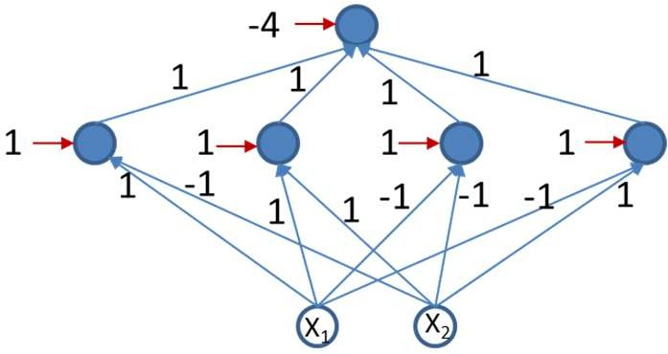
Option 1: Construct by hand
0,1
-1,0
1,0
0,-1
Given a function, handcraft a network to satisfy it
E.g.: Build an MLP to classify this decision boundary
Not possible for all but the simplest problems..
https://deeplearning.cs.cmu.edu/S23/
20

Slide 52
Summary
Vectorization
Advantages of Vectorized Implementation
Single vs Multilayer perceptron
Training Network by hand

