Slide 1



Discrete Mathematics
Dr. Shahira Ahmed
IT241
Lecture 2

Slide 2



Discrete Mathematics
Lecture 2
Relations & Functions
www.midocean.ae

Slide 3
Lecture Outline
Relations and Their Properties
Binary Relations
Representing Relations
Equivalence Relations
Partial Orderings
Functions

Slide 4
Relations and Their Properties

Slide 5
Cartesian Product
Definition: The Cartesian Product of two sets A and B, denoted by
A × B is the set of ordered pairs (a,b) where a ∈ A and b ∈ B .
Example:
A = {a,b} B = {1,2,3}
A × B = {(a,1),(a,2),(a,3), (b,1),(b,2),(b,3)}

Slide 6
Cartesian Product
Definition: The Cartesian Product of two sets A and B, denoted by
A × B is the set of ordered pairs (a,b) where a ∈ A and b ∈ B .
Example:
A = {a,b} B = {1,2,3}
A × B = {(a,1),(a,2),(a,3), (b,1),(b,2),(b,3)}
B× A = {(1,a),(2,a),(3,a), (1,b),(2,b),(3,b)}

Slide 7

Cartesian Product
Suppose that A = {1, 2}
A ×A
Solution
{1, 2} × {1, 2}
{(1,1), (1,2), (2,1), (2,2)}
$$A^{2}$$

Slide 8
Relationships
Relationships between elements of sets occur in many contexts. Every day we deal with relationships such :
  a business and its telephone number,
  an employee and his or her salary,
  a person and a relative.

Slide 9
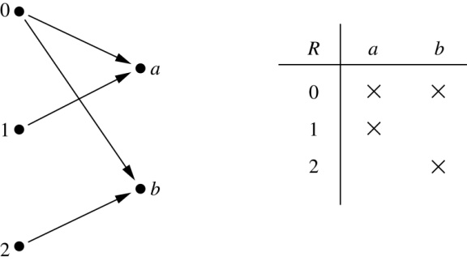
Binary Relations
Definition: A binary relation R from a set A to a set B is a subset R ⊆ A × B.
Example:
  Let A = {0,1,2} and B = {a,b}
  {(0, a), (0, b), (1,a) , (2, b)} is a relation from A to B.
  We can represent relations from a set A to a set B graphically or using a table:

Slide 10
Binary Relation on a Set
Definition: A binary relation R on a set A is a subset of A × A or a relation from A to A.
Example:
  Suppose that A = {a,b,c}. Then R = {(a,a),(a,b), (a,c)} is a relation on A.
  Let A = {1, 2, 3, 4}. The ordered pairs in the relation
  R = {(a,b) | a divides b} are
  (1,1), (1, 2), (1,3), (1, 4), (2, 2), (2, 4), (3, 3), and (4, 4).

Slide 11
Quiz
Consider these relations on the set of integers:
  R₁ = {(a,b) | a ≤ b}, R₄ = {(a,b) | a = b},
  R₂ = {(a,b) | a > b}, R₅ = {(a,b) | a = b + 1},
  R₃ = {(a,b) | a = b or a = −b}, R₆ = {(a,b) | a + b ≤ 3}.
Note that these relations are on an infinite set and each of these relations is an infinite set.

Slide 12
Quiz
Consider these relations on the set of integers:
  R₁ = {(a,b) | a ≤ b}, R₄ = {(a,b) | a = b},
  R₂ = {(a,b) | a > b}, R₅ = {(a,b) | a = b + 1},
  R₆ = {(a,b) | a + b ≤ 3}.
  Which of these relations contain each of the pairs
  (1,1)
  (1, 2)
  (2, 1)
  (1, −1)
  (2, 2)

Slide 13
Quiz
Consider these relations on the set of integers:
  R₁ = {(a,b) | a ≤ b}, R₄ = {(a,b) | a = b},
  R₂ = {(a,b) | a > b}, R₅ = {(a,b) | a = b + 1},
  R₆ = {(a,b) | a + b ≤ 3}.
  Which of these relations contain each of the pairs
  (1,1) in R₁, R₄ and R₆
  (2, 1) is R₂, R₅, and R₆

Slide 14
Quiz
Consider these relations on the set of integers:
  R₁ = {(a,b) | a ≤ b}, R₄ = {(a,b) | a = b},
  R₂ = {(a,b) | a > b}, R₅ = {(a,b) | a = b + 1},
  R₆ = {(a,b) | a + b ≤ 3}.
  Which of these relations contain each of the pairs
  (1,1) in R₁, R₄ and R₆
  (1, 2) in R₁ and R₆:
  (2, 1) is R₂, R₅, and R₆
  (1, −1) in R₂, and R₆
  (2, 2) in R₁ and R₄

Slide 15
Reflexive Relations
Definition: R is reflexive iff (a,a) ∊ R for every element a ∊ A. Written symbolically, R is reflexive if and only if
∀x[x∊U ⟶ (x,x) ∊ R]
If A = ∅ then the empty relation is reflexive vacuously. That is the empty relation on an empty set is reflexive!

Slide 16
Reflexive Relation
The following relations are reflexive?
  Set A={a,b,c}, R₁ ={(a,a), (b,b), (c,c),(a,c),(b,c)}
  Set B={1,2,3}, R₂ ={(1,1), (1,2), (2,2),(3,3),(2,1)}
  Set C={1,2,3,4},R₃={(1,1), (1,2), (2,2),(3,3),(3,1)}
Solution 1,2

Slide 17
Quiz
The following relations on the integers are reflexive?
If A = ∅ then the empty relation is reflexive vacuously. That is the empty relation on an empty set is reflexive!

Slide 18
Quiz
The following relations on the integers are reflexive?
  R₁ = {(a,b) | a ≤ b},
  R₂ = {(a,b) | a > b}
  R₃ = {(a,b) | a = b or a = −b},
  R₄ = {(a,b) | a = b}.
  R₅ = {(a,b) | a = b + 1}
  R₆ = {(a,b) | a + b ≤ 3}.

Slide 19
Quiz
The following relations on the integers are reflexive?
  R₁ = {(a,b) | a ≤ b}, → True
  R₂ = {(a,b) | a > b} (note that 3 ≯ 3), → False
  R₃ = {(a,b) | a = b or a = −b}, → True
  R₄ = {(a,b) | a = b}. → True
  R₅ = {(a,b) | a = b + 1} (note that 3 ≠3 + 1), → False
  R₆ = {(a,b) | a + b ≤ 3} (note that 4 + 4 ≰ 3).False

Slide 20
Symmetric Relations
Definition: R is symmetric iff (b,a) ∊ R whenever (a,b) ∊ R for all a,b ∊ A. Written symbolically, R is symmetric if and only if
  ∀x∀y [(x,y) ∊R ⟶ (y,x) ∊ R]

Slide 21
Symmetric Relation
The following relations are Symmetric?
  Set A={a,b,c}, R₁ ={(a,a), (b,b), (c,c),(a,c),(b,c)}
  Set B={1,2,3}, R₂ ={(1,1), (1,2), (2,2),(3,3),(2,1)}
  Set C={1,2,3,4},R₃={(1,1), (1,2), (2,2),(3,3),(3,1)}
Solution 2

Slide 22
Quiz
Example: The following relations on the integers are symmetric?
  R₁ = {(a,b) | a ≤ b}
  R₂ = {(a,b) | a > b}
  R₄ = {(a,b) | a = b},
  R₅ = {(a,b) | a = b + 1
  R₆ = {(a,b) | a + b ≤ 3}.

Slide 23
Quiz
The following relations on the integers are symmetric?
  R₁ = {(a,b) | a ≤ b} (note that 3 ≤ 4, but 4 ≰ 3),➔ False
  R₂ = {(a,b) | a > b} (note that 4 > 3, but 3 ≯ 4), ➔ False
  R₄ = {(a,b) | a = b}, ➔ True
  R₅ = {(a,b) | a = b + 1} (note that 4 = 3 + 1, but 3 ≠4 + 1). ➔ False
  R₆ = {(a,b) | a + b ≤ 3}. ➔ True

Slide 24
Symmetric Relation
The following relations are antisymmetric?
  Set A={a,b,c}, R₁ ={(a,a), (b,b), (c,c),(a,c),(b,c)}
  Set B={1,2,3}, R₂ ={(1,1), (1,2), (2,2),(3,3),(2,1)}
  Set C={1,2,3,4},R₃={(1,1), (1,2), (2,2),(3,3),(3,1)}
Solution 1,3

Slide 25
Antisymmetric Relations
Definition:such that for all a,b ∊ A if (a,b) ∊ R and (b,a) ∊ R, then a = b is called antisymmetric. Written symbolically, R is antisymmetric if and only if
  ∀x∀y [(x,y) ∊R ∧ (y,x) ∊ R ⟶ x = y]

Slide 26
Antisymmetric Relations
Example: The following relations on the integers are antisymmetric?
  R₁ = {(a,b) | a ≤ b},
  R₂ = {(a,b) | a > b},
  R₄ = {(a,b) | a = b},
  R₅ = {(a,b) | a = b + 1}.
  R₆ = {(a,b) | a + b ≤ 3}`

Slide 27
Antisymmetric Relations
Example: The following relations on the integers are antisymmetric?
  R₁ = {(a,b) | a ≤ b},➔True
  R₂ = {(a,b) | a > b}, ➔True
  R₄ = {(a,b) | a = b}, ➔True
  R₅ = {(a,b) | a = b + 1}. ➔True
  R₆ = {(a,b) | a + b ≤ 3} ➔False

Slide 28
Transitive Relations
Definition: A relation R on a set A is called transitive if whenever (a,b) ∊ R and (b,c) ∊ R, then (a,c) ∊ R, for all a,b,c ∊ A. Written symbolically, R is transitive if and only if
  ∀x∀y ∀z[(x,y) ∊R ∧ (y,z) ∊ R ⟶ (x,z) ∊ R ]

Slide 29
Quiz
The following relations on the integers are transitive?
  R₁ = {(a,b) | a ≤ b},
  R₂ = {(a,b) | a > b},
  R₄ = {(a,b) | a = b}.
  R₅ = {(a,b) | a = b + 1}
  R₆ = {(a,b) | a + b ≤ 3}

Slide 30
Quiz
The following relations on the integers are transitive?
  R₁ = {(a,b) | a ≤ b}, ➔ True
  R₂ = {(a,b) | a > b}, ➔ True
  R₃ = {(a,b) | a = b or a = −b}, ➔ True
  R₅ = {(a,b) | a = b + 1} ➔ False(note that both (3,2) and (4,3) belong to R₅, but not (3,3)),
  R₆ = {(a,b) | a + b ≤ 3} ➔ False (note that both (2,1) and (1,2) belong to R₆, but not (2,2)).

Slide 31
Combining Relations
Given two relations R₁ and R₂, we can combine them using basic set operations to form new relations such as R₁ ∪ R₂, R₁ ∩ R₂, R₁ − R₂, and R₂ − R₁.
Example: Let A = {1,2,3} and B = {1,2,3,4}.
  The relations R₁ = {(1,1),(2,2),(3,3)} and
  R₂ = {(1,1),(1,2),(1,3),(1,4)}
  can be combined using basic set operations to form new relations:
R₁ ∪ R₂ ={(1,1),(1,2),(1,3),(1,4),(2,2),(3,3)}
R₁ ∩ R₂ ={(1,1)}
R₁ − R₂ ={(2,2),(3,3)}
R₂ − R₁ ={(1,2),(1,3),(1,4)}

Slide 32
Representing Relations

Slide 33
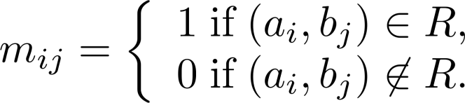
Representing Relations Using Matrices
The relation R is represented by the matrix
M_{R} = [m_{ij}], where

Slide 34
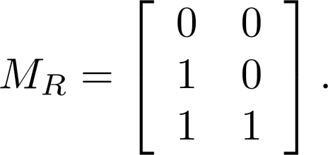
Examples of Representing Relations Using Matrices
Example 1: Suppose that A = {1,2,3} and B = {1,2}. Let R be the relation from A to B containing (a,b) if a ∈ A, b ∈ B, and a > b. What is the matrix representing R (assuming the ordering of elements is the same as the increasing numerical order)?
Solution: Because R = {(2,1), (3,1),(3,2)}, the matrix is

Slide 35
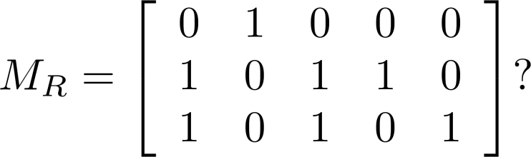
Examples of Representing Relations Using Matrices (cont.)
Example 2: Let A = {a₁,a₂, a₃} and B = {b₁,b₂, b₃,b₄, b₅}. Which ordered pairs are in the relation R represented by the matrix
Solution: Because R consists of those ordered pairs (a_{i},b_{j}) with m_{ij} = 1, it follows that:
R = {(a₁, b₂), (a₂, b₁),(a₂, b₃), (a₂, b₄),(a₃, b₁), {(a₃, b₃), (a₃, b₅)}.

Slide 36
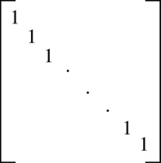
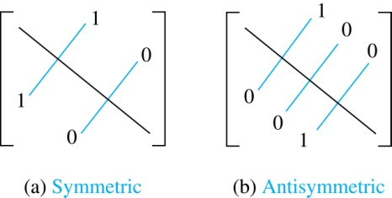
Matrices of Relations on Sets
If R is a reflexive relation, all the elements on the main diagonal of M_{R} are equal to 1.
R is a symmetric relation, if and only if m_{ij} = 1 whenever m_{ji} = 1. R is an antisymmetric relation, if and only if m_{ij} = 0 or m_{ji} = 0 when i≠ j.

Slide 37
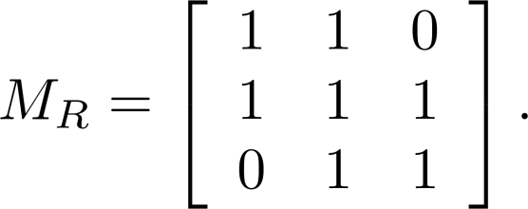
Example of a Relation on a Set
Suppose that the relation R on a set is represented by the matrix
Is R reflexive, symmetric, and/or antisymmetric?
Solution:
Because all the diagonal elements are equal to 1, R is reflexive.
Because M_{R} is symmetric.
R is symmetric and not antisymmetric because both m_{1,2} and m_{2,1} are 1.

Slide 38
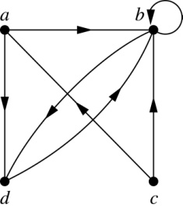
Representing Relations Using Digraphs
A drawing of the directed graph with vertices a, b, c, and d, and edges
(a, b), (a, d), (b, b), (b, d), (c, a), (c, b), and (d, b) is shown here.

Slide 39
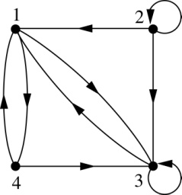
Examples of Digraphs Representing Relations
What are the ordered pairs in the relation
represented by this directed graph?
Solution: The ordered pairs in the relation are
(1, 3), (1, 4), (2, 1), (2, 2), (2, 3), (3, 1), (3, 3), (4, 1), and (4, 3)

Slide 40
Determining which Properties a Relation has from its Digraph
Reflexivity: A loop must be present at all vertices in the graph.
Symmetry: If (x,y) is an edge, then so is (y,x).
Antisymmetry: If (x,y) with x ≠ y is an edge, then (y,x) is not an edge.
Transitivity: If (x,y) and (y,z) are edges, then so is (x,z).

Slide 41
Quiz
Determining which Properties a Relation has from its Digraph
Reflexive? No, not every vertex has a loop
Symmetric? Yes (trivially), there is no edge from one vertex to another
Antisymmetric? Yes (trivially), there is no edge from one vertex to another
Transitive? Yes, (trivially) since there is no edge from one vertex to another
a
b
c
d

Slide 42
Quiz
Determining which Properties a Relation has from its
Reflexive? No, there are no loops
Symmetric? No, there is an edge from a to b, but not from b to a
Antisymmetric? No, there is an edge from d to b and b to d
Transitive? No, there are edges from a to b and from b to d, but there is no edge from a to d
a
b
c
d

Slide 43
Equivalence Relations
Definition 1: A relation on a set A is called an equivalence relation if it is
  reflexive,
  symmetric,
  transitive.

Slide 44
Divides
Show that the “divides” relation on the set of positive integers is not an equivalence relation.
Solution
  Reflexivity: a ∣ a for all a.
  Not Symmetric: For example, 2 ∣ 4, but 4 ∤ 2. Hence, the relation is not symmetric.
  Transitivity: the relation is transitive.

Slide 45
Partial Orderings
Definition : A relation R on a set S is called a partial ordering, or partial order
  Reflexive
  antisymmetric
  transitive.

Slide 46
Quiz
“greater than or equal” relation (≥) is a partial ordering on the set of integers”
  Reflexivity: a ≥ a for every integer a.
  Antisymmetry: If a ≥ b and b ≥ a , then a = b.
  Transitivity: If a ≥ b and b ≥ c , then a ≥ c.

Slide 47
Quiz
The divisibility relation (/) is a partial ordering on the set of integers.
Solution
  Reflexivity: a ∣ a for all integers a.
  Antisymmetry: If a and b are positive integers with a | b and b | a, then a = b.
  Transitivity: Suppose that a divides b and b divides c→ so a divides c. Therefore, the relation is transitive.

Slide 48
Relations vs Functions
A function is a relation where exactly one element of B is related to each element of A.
Example R={(2, 1),(3,6),(2,3),(5, 8)}is a function?
Solution False
Relations
Functions

Slide 49
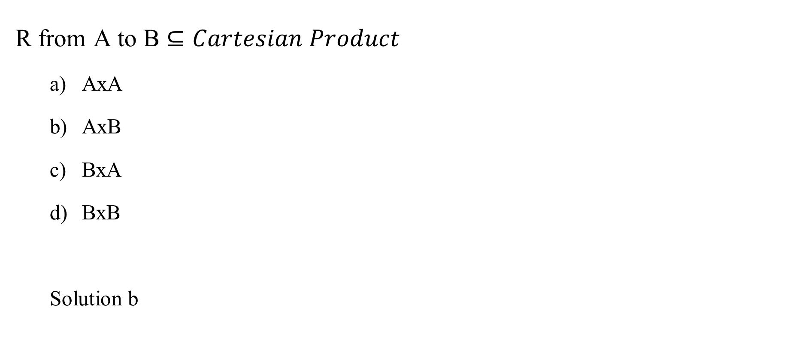
Quiz
R from A to B $⊆Cartesian Product$
  AxA
  AxB
  BxA
  BxB
  Solution b

Slide 50
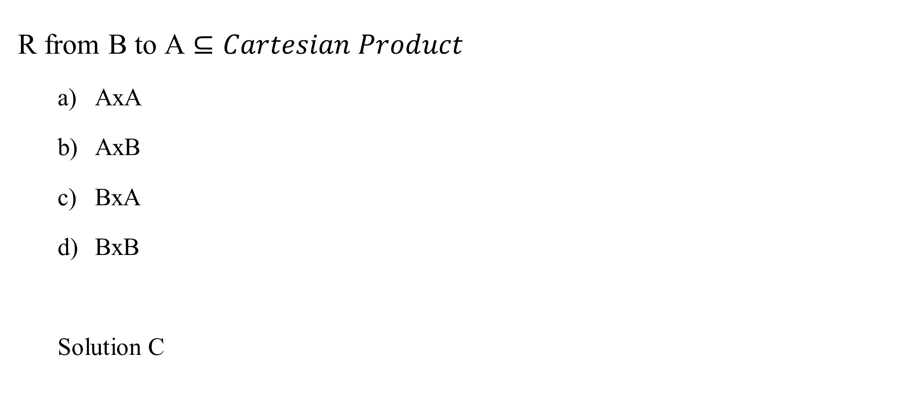
Quiz
R from B to A $⊆Cartesian Product$
  AxA
  AxB
  BxA
  BxB
  Solution C

Slide 51
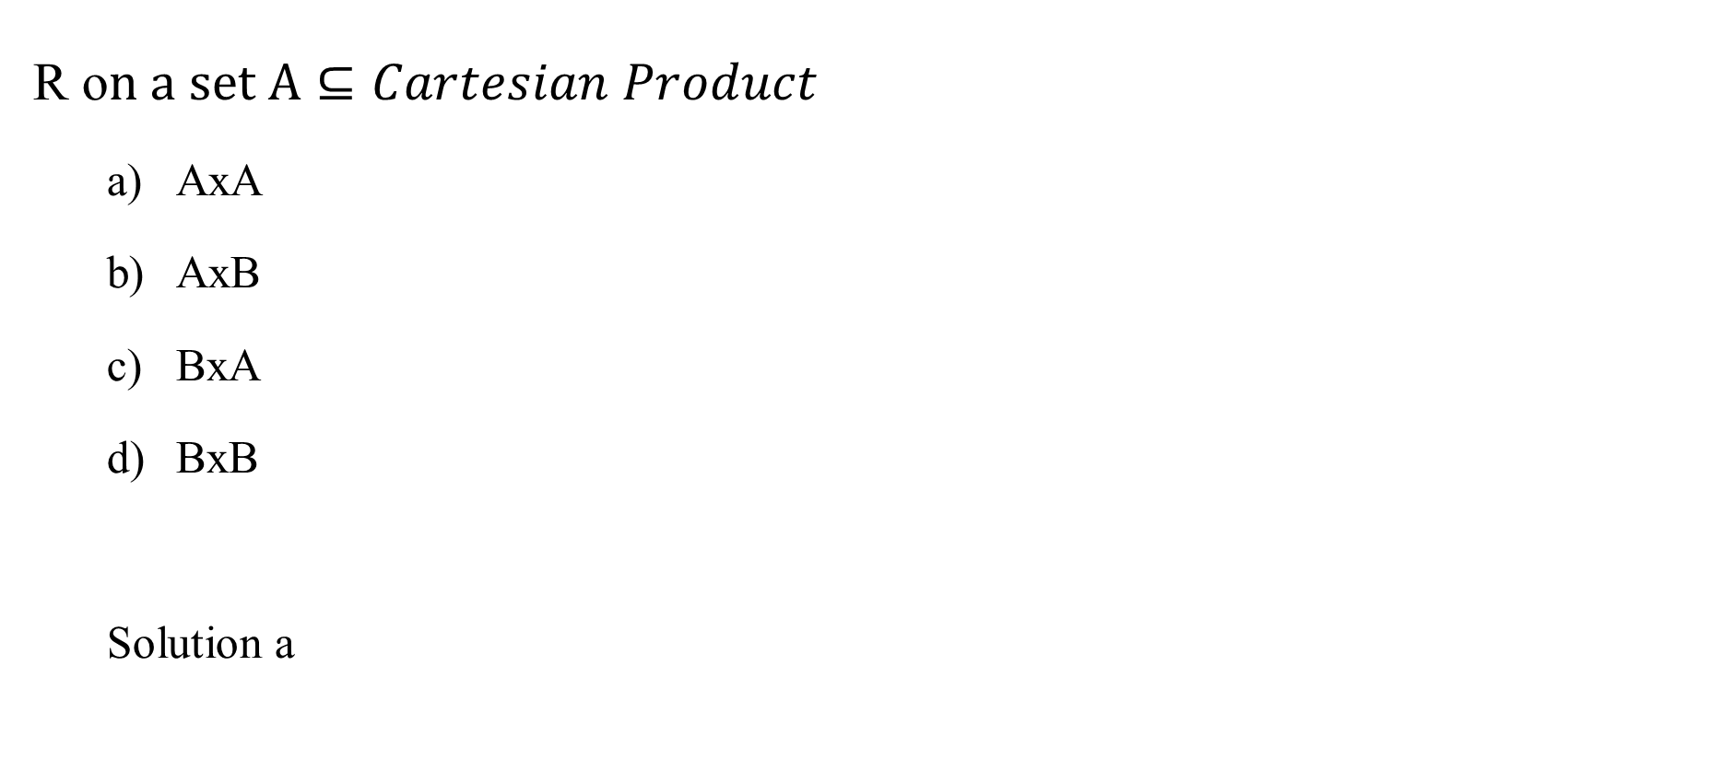
Quiz
R o$n a set A⊆Cartesian Product$
  AxA
  AxB
  BxA
  BxB
  Solution a

Slide 52
Quiz
List the ordered pairs in the relation R from
A = {0, 1, 2, 3, 4} to B = {0, 1, 2, 3}, where (a, b) ∈ R
if and only if
a) a = b.
b) a + b = 4.
c) a > b.

Slide 53
Quiz
List the ordered pairs in the relation R from
A = {0, 1, 2, 3, 4} to B = {0, 1, 2, 3}, where (a, b) ∈ R
if and only if
a) a = b.
b) a + b = 4.
c) a > b.
{(0, 0), (1, 1), (2, 2), (3, 3)}
{(1, 3), (2, 2),(3, 1), (4, 0)}
{(1, 0), (2, 0), (2, 1), (3, 0), (3, 1), (3, 2), (4, 0), (4, 1), (4, 2), (4, 3)}

Slide 54
Quiz
Find The property of Relation
  (a, a) ∈ R, for every a ∈ A
  (a, b) ∈ R, for every a ∈ A |a=b.
  (a, b) ∈ R and (b, c) ∈ R, then (a, c) ∈ R
  (a, b) ∈ R, then (b, a) ∈ R
  a,b ∊ A if (a,b) ∊ R and (b,a) ∊ R, then a = b

Slide 55
Quiz
Find The property of Relation
    (a, a) ∈ R, for every a ∈ A
    (a, b) ∈ R, for every a,b ∈ A |a=b.
    (a, b) ∈ R and (b, c) ∈ R, then (a, c) ∈ R
    (a, b) ∈ R, then (b, a) ∈ R
    a,b ∊ A if (a,b) ∊ R and (b,a) ∊ R, then a = b
  Solution
    Reflexive
    Reflexive
    Transitive
    Symmetric
    AntiSymmstric

Slide 56
Quiz
For each of these relations on the set {1, 2, 3, 4}, decide whether it is reflexive, whether it is symmetric, whether it is antisymmetric, and whether it is transitive.
{(2, 2), (2, 3), (2, 4), (3, 2), (3, 3), (3, 4)}
{(1, 1), (1, 2), (2, 1), (2, 2), (3, 3), (4, 4)}
{(2, 4), (4, 2)}
{(1, 2), (2, 3), (3, 4)}
{(1, 1), (2, 2), (3, 3),(4, 4)}
{(1, 3), (1,4), (2, 3), (2, 4), (3, 1), (3, 4)}

Slide 57
Quiz
For each of these relations on the set {1, 2, 3, 4}, decide whether it is reflexive, whether it is symmetric, whether it is antisymmetric, and whether it is transitive.
{(2, 2), (2, 3), (2, 4), (3, 2), (3, 3), (3, 4)}
{(1, 1), (1, 2), (2, 1), (2, 2), (3, 3), (4, 4)}
{(2, 4), (4, 2)}
{(1, 2), (2, 3), (3, 4)}
{(1, 1), (2, 2), (3, 3),(4, 4)}
{(1, 3), (1,4), (2, 3), (2, 4), (3, 1), (3, 4)}

Slide 58
Quiz
For each of these relations on the set {1, 2, 3, 4}, decide whether it is reflexive, whether it is symmetric, whether it is antisymmetric, and whether it is transitive.
{(2, 2), (2, 3), (2, 4), (3, 2), (3, 3), (3, 4)}
{(1, 1), (1, 2), (2, 1), (2, 2), (3, 3), (4, 4)}
{(2, 4), (4, 2)}
{(1, 2), (2, 3), (3, 4)}
{(1, 1), (2, 2), (3, 3),(4, 4)}
{(1, 3), (1,4), (2, 3), (2, 4), (3, 1), (3, 4)}

Slide 59
Quiz
For each of these relations on the set {1, 2, 3, 4}, decide whether it is reflexive, whether it is symmetric, whether it is antisymmetric, and whether it is transitive.
{(2, 2), (2, 3), (2, 4), (3, 2), (3, 3), (3, 4)}
{(1, 1), (1, 2), (2, 1), (2, 2), (3, 3), (4, 4)}
{(2, 4), (4, 2)}
{(1, 2), (2, 3), (3, 4)}
{(1, 1), (2, 2), (3, 3),(4, 4)}
{(1, 3), (1,4), (2, 3), (2, 4), (3, 1), (3, 4)}

Slide 60
Quiz
For each of these relations on the set {1, 2, 3, 4}, decide whether it is reflexive, whether it is symmetric, whether it is antisymmetric, and whether it is transitive.
  a) Transitive
  b) Reflexive, symmetric, transitive
  c) Symmetric
  d) Antisymmetric
  e) Reflexive, symmetric, antisymmetric, transitive
  f) None of these properties

Slide 61
Quiz
Suppose that A = {1, 2, 3} and B = {1, 2}. Let R be the relation from A to B containing (a, b) if a ∈ A, b ∈ B, and a > b. What is the matrix representing R?

Slide 62
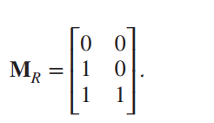
Quiz
Suppose that A = {1, 2, 3} and B = {1, 2}. Let R be the relation from A to B containing (a, b) if a ∈ A, b ∈ B, and a > b. What is the matrix representing R?
Solution
R = {(2, 1), (3, 1), (3, 2)}, the matrix for R is

Slide 63
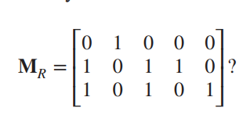
Quiz
Let A = {a1, a2, a3} and B = {b1, b2, b3, b4, b5}. Which ordered pairs are in the relation R represented by the matrix.Are the following pain in the relation
(a1, b2)
(a2, b1)
(a3, b3)
(a1,b1)
Solution
  True
  True
  True
  False

Slide 64
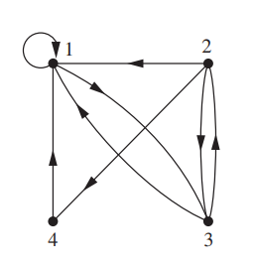
Quiz
List the ordered pairs in R?
{(1, 1), (1, 3), (2, 1), (2, 3), (2, 4), (3, 1), (3, 2), (4, 1)}

Slide 65
Quiz
Are the Following the ordered pairs in R?
(1, 1)
(1, 3)
(2, 1)
(4, 3)
(4,4)
(4,2)
Solution a,b,c

Slide 66
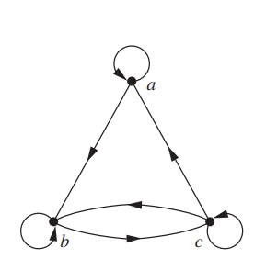
Quiz
Reflexive?
Symmetric?
antisymmetric?
Transitive?

Slide 67
Quiz
Reflexive?
Symmetric?
antisymmetric?
Transitive?
Because there are loops at every vertex of the directed graph of S1, it is reflexive. The relation S1 is neither symmetric nor antisymmetric because there is an edge from a to b but not one from b to a, but there are edges in both directions connecting b and c. Finally, S1 is not transitive because there is an edge from a to b and an edge from b to c, but no edge from a to c.

Slide 68
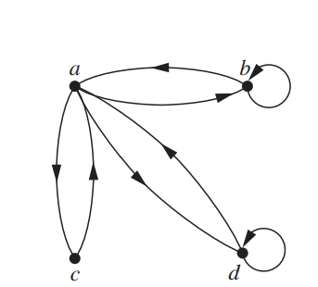
Quiz
Reflexive?
Symmetric?
antisymmetric?
Transitive?

Slide 69
Quiz
Reflexive?
Symmetric?
antisymmetric?
Transitive?
Because loops are not present at all the vertices of the directed graph of S2, this relation is not reflexive. It is symmetric and not antisymmetric, because every edge between distinct vertices is accompanied by an edge in the opposite direction. It is also not hard to see from the directed graph that S2 is not transitive, because (c, a) and (a, b) belong to S2, but (c, b) does not belong to S2

Slide 70
Quiz
True or False
A relation R is reflexive if the matrix diagonal elements are all 0
The binary relation R equal on the set of all integers is Symmetric
The binary relation R equal on the set of all integers is Reflexive
The binary relation R not equal on the set of all integers is Symmetric
The binary relation R not equal on the set of all integers is Reflexive

Slide 71
Quiz
True or False
A relation R is reflexive if the matrix diagonal elements are all 0
The binary relation R equal on the set of all integers is Symmetric
The binary relation R equal on the set of all integers is Reflexive
The binary relation R not equal on the set of all integers is Symmetric
The binary relation R not equal on the set of all integers is Reflexive
Solution False,True,True,True,False

Slide 72
Quiz
True or false
A relation on a set A is called an equivalence relation if it is Reflexive, symmetric, antisymmetric
2. A relation R on a set S is called a partial ordering, or partial order if it is Reflexive, antisymmetric, transitive.
Solution
False
True

Slide 73
Summary
Relations
  Reflexive
  Symmetric
  Antisymmetric
  Transitive
Representation of Relations
Equivalence
Partial ordering
Function

