Slide 1



Introduction to Information Systems – IT111
Eng. Eman Hamdy
Lecture 2 - Numbering system

Slide 2

Points to cover
Lecture
Numbering Systems
02
Decimal Numbering System
Binary Weights
Binary to Decimal Conversion
Decimal to Binary Conversion
Hexadecimal Numbers

Slide 3
Decimal Numbering System
Lecture
Numbering Systems
02
Base 10: explain why it is a base 10 system; there are numbers from
0 -9
Explain what are weights and give an example
102 101 100
567
5 x 100 + 6 x 10 + 7 x 1 è 500 + 60 + 7 è 567
Weight | Value
100 | 1
101 | 10
102 | 100
103 | 1000
104 | 10000

Slide 4

Decimal Numbering System
Lecture
02
Numbering Systems
Section Questions
Please answer these questions with them so they can answer the sheet
What is the weight of digit 6 in 1386? Answer: 100 = 1
Express 100 as a power of ten. Answer: 100 =

Slide 5
Binary Numbering System
Lecture
02
Numbering Systems
Base 2: Explain why it is a base 2 system; there are number s from
0 and 1
Explain the weights in a binary system and give an example
Binary Weights
Weight | Value
20 | 1
21 | 2
22 | 4
23 | 8
24 | 16
25 | 32
26 | 64
27 | 128

Slide 6
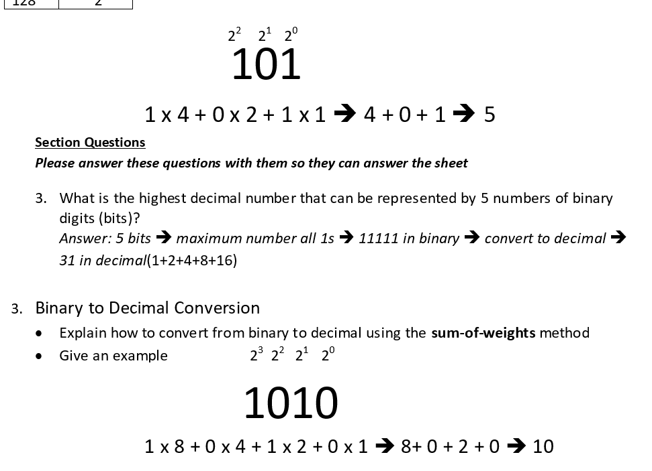
Lecture
Numbering Systems
02

Slide 7
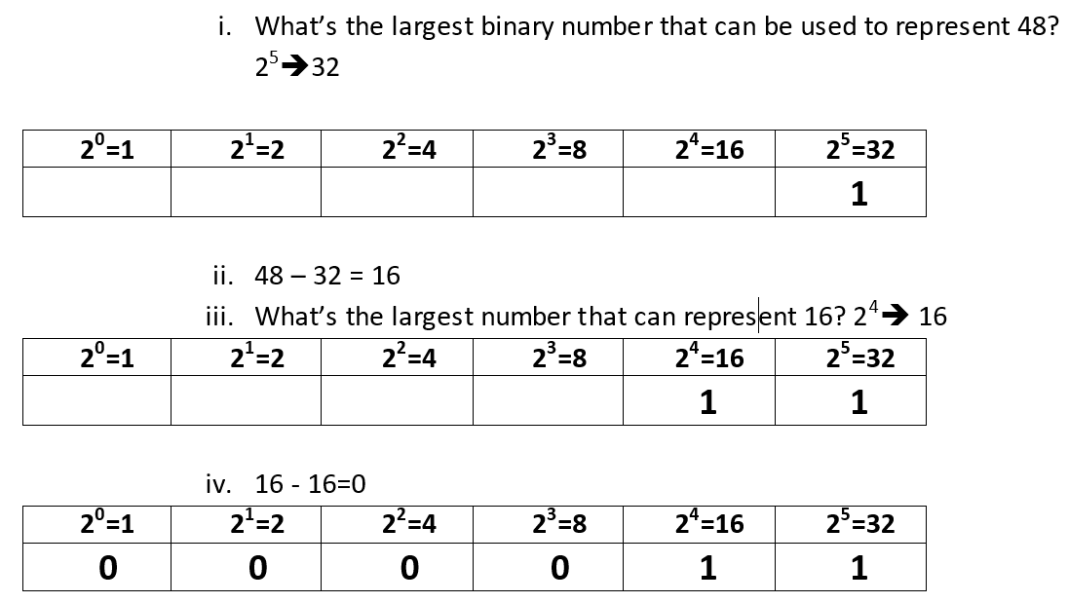
Lecture
Numbering Systems
02
Decimal to Binary Conversion
Explain how to convert from decimal to binary using the sum-of-weights method
Give an example
48

Slide 8
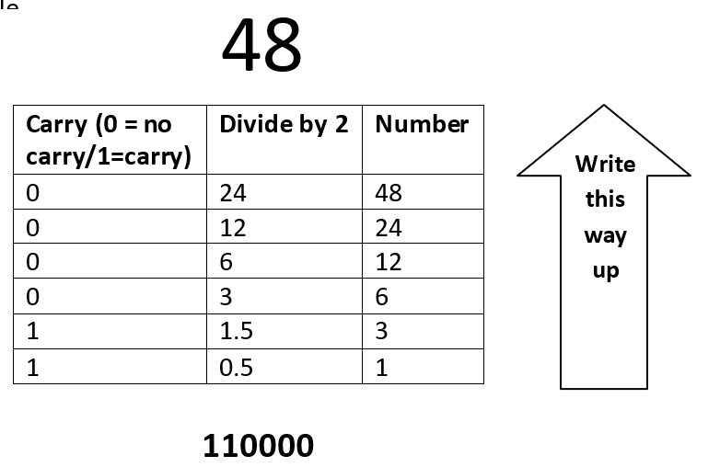
Lecture
Numbering Systems
02
Explain how to convert from decimal to binary using the divide-by-2 method
· Give an example
Number | Divide by 2 | Carry (0 = no carry/1=carry)
48 | 24 | 0
24 | 12 | 0
12 | 6 | 0
6 | 3 | 0
3 | 1.5 | 1
1 | 0.5 | 1

Slide 9
Lecture
Numbering Systems
02
Please answer these questions with them so they can answer the sheet
5. How many bits are required to represent 17?
Answer: Convert 17 to binary è 10001 ècount the bits è 5 bits

Slide 10
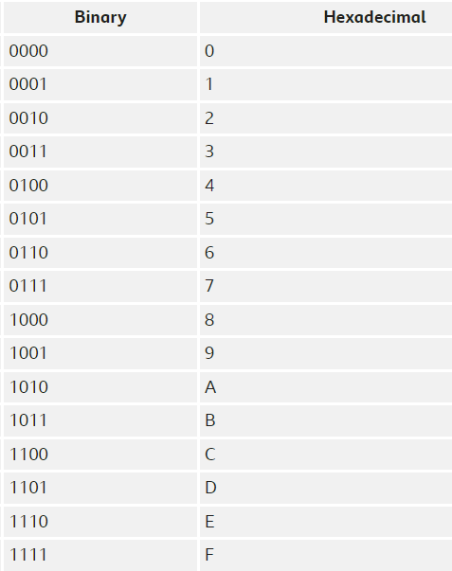
Lecture
Numbering Systems
02
Hexadecimal Numbers:
Hexa means 16. In the hexadecimal number system, it uses 16 digits. It consists of numbers and alphabets. It includes numbers 0, 1, 2, 3, 4, 5, 6, 7, 8, 9 and A, B, C, D, E, F; total 16 digits.
It is denoted by s16, where s is a hexadecimal number.
Examples: 1) A1₁₆ 2) EE9₁₆ 3) FD654₁₆

Slide 11
Lecture
Numbering Systems
02
Question 1: Convert A2B₁₆ to an equivalent binary number.
Solution: Given hexadecimal number = A2B₁₆
First, convert the given hexadecimal to the equivalent decimal number.
A2B₁₆ = (A × 16²) + (2 × 16¹) + (B × 16⁰)
= (A × 256) + (2 × 16) + (B × 1)
= (10 ×256) + 32 + 11
= 2560 + 43
= 2603(Decimal number)
Now we have to convert 2603₁₀ to binary
The binary number obtained is 101000101011₂
Hence, A2B₁₆ = 101000101011₂

Slide 12
Lecture
Numbering Systems
02
Question 2: Convert E₁₆ to an equivalent binary number.
Solution: Given, a hexadecimal number is E.
First, convert the given hexadecimal to the equivalent decimal number.
E₁₆ = E × 16⁰
= E × 1
= E
=14 (Decimal number)
Now we have to convert 14₁₀ to binary number.
The binary number obtained is 1110₂
Hence, E₁₆ = 1110₂

Slide 13
Thank you ☺

