Slide 1



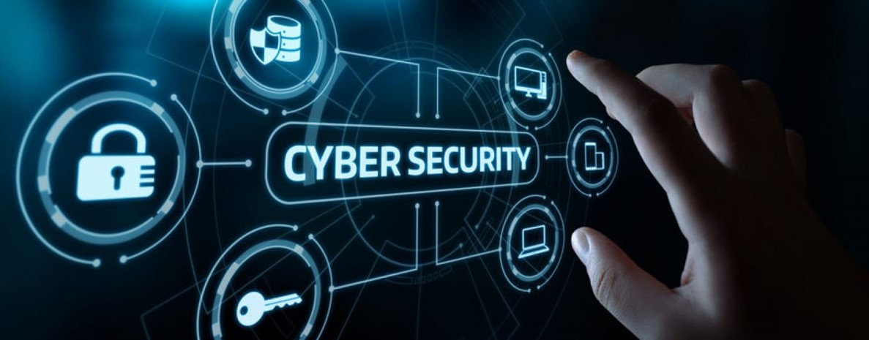

CyberSecurity Fundamentals (CYB670)
Master of Science in Cybersecurity
Dr. Redhwan M. A. Saad
Head of Cybersecurity Department
Faculty of Informatics
Midocean University
Orientation show عرض توجيهي
www.midocean.ae

Slide 2

Who am I?
  Assistant Professor in Internet Infrastructure Security
    Ph.D from USM, Malaysia, April. 2016
    Thesis: “ICMPv6 Echo Request DDoS Attack Detection Framework using a Back-propagation Neural Network”.
    M.Sc from “LETI”, RUSSIA, Sep.2007
    B.Sc from “LETI”, RUSSIA, Sep.2004
Cybersecurity Fundamentals, Dr. Redhwan M. A. Saad
www.midocean.ae

Slide 3



My Contact Information
  How to reach me
    By email at redhwan@midocean.ae
    ( please include “Cybersecurity Fundamentals” in subject line)
  Office hours
  Discussion Time (Tuesday at 9:00 PM) every week
  More about me:
https://scholar.google.com.my/citations?user=4CFExCUAAAAJ&hl=en
https://www.scopus.com/authid/detail.uri?authorId=56105545600
https://orcid.org/0000-0001-7241-9327
Cybersecurity Fundamentals, Dr. Redhwan M. A. Saad
www.midocean.ae

Slide 4

The course that will be taught
Cybersecurity Fundamentals
Cybersecurity Fundamentals, Dr. Redhwan M. A. Saad
www.midocean.ae

Slide 5
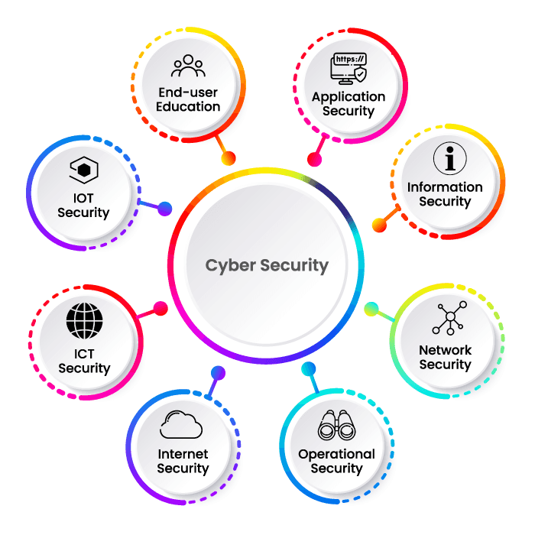





Importance of Cybersecurityالأمن السيبراني وأهميته
يُعرّف الأمن السيبراني بأنّه عملية حماية الأنظمة، والشبكات، وأجهزة الكمبيوتر، وما تحتويه من برامج من جميع أنواع الهجمات الرقمية والإلكترونية، ومنع الوصول إلى البيانات.
Cybersecurity Fundamentals, Dr. Redhwan M. A. Saad
www.midocean.ae

Slide 6
Primary Goal of This Course
This course has been designed to give students an extensive overview of cybersecurity issues, tools, and techniques that are critical in solving problems in cybersecurity domains.
This course aims to:
  Provide students with concepts of
  Computer security,
  Cryptography,
  Secure protocols,
  Detection and Prevention,
  and other Security Techniques.
Cybersecurity Fundamentals, Dr. Redhwan M. A. Saad
www.midocean.ae

Slide 7
What This Course is About
  The course will help students to gauge understanding in essential techniques in:
  Protecting information systems,
  IT infrastructure,
  Analyzing and monitoring potential threats and attacks,
  Devising security architecture,
  and Implementing security solutions.
Cybersecurity Fundamentals, Dr. Redhwan M. A. Saad
www.midocean.ae

Slide 8
Units of Course Contents
Module | Course Unit | No.of. Weeks | Contact Hours
1 | Lecture 1: Introduction to Networks Concepts | 1st | 3
2 | Lecture 2: Introduction to Cyber Security Concepts | 2nd | 3
3 | Lecture 3: Hackers and Cyber Crime | 3rd | 3
4 | Lecture 4: Malware | 4th | 3
5 | Lecture 5: Attacks Type | 5th | 3
6 | Lecture 6: Securing Your Computers | 6th | 3
7 | Lecture 7: Password Management | 7th | 3
8 | Lecture 8: Prevention from Cyberattacks | 8th | 3
9 | Lecture 9: Wireless Network Security and Mobile Device Security | 9th | 3
10 | Lecture 10: Secure Online Shopping and Cybersecurity Standards | 10th | 3
Cybersecurity Fundamentals, Dr. Redhwan M. A. Saad
www.midocean.ae

Slide 9

Teaching Methodology
منهجية التدريس
Recorded Lectures
المحاضرات المسجلة
Live Sessions
جلسات وحلقات النقاش
References
المراجع المعتمدة للمقرر الدراسي
Virtual Labs
المعامل الأفتراضية
www.midocean.ae

Slide 10
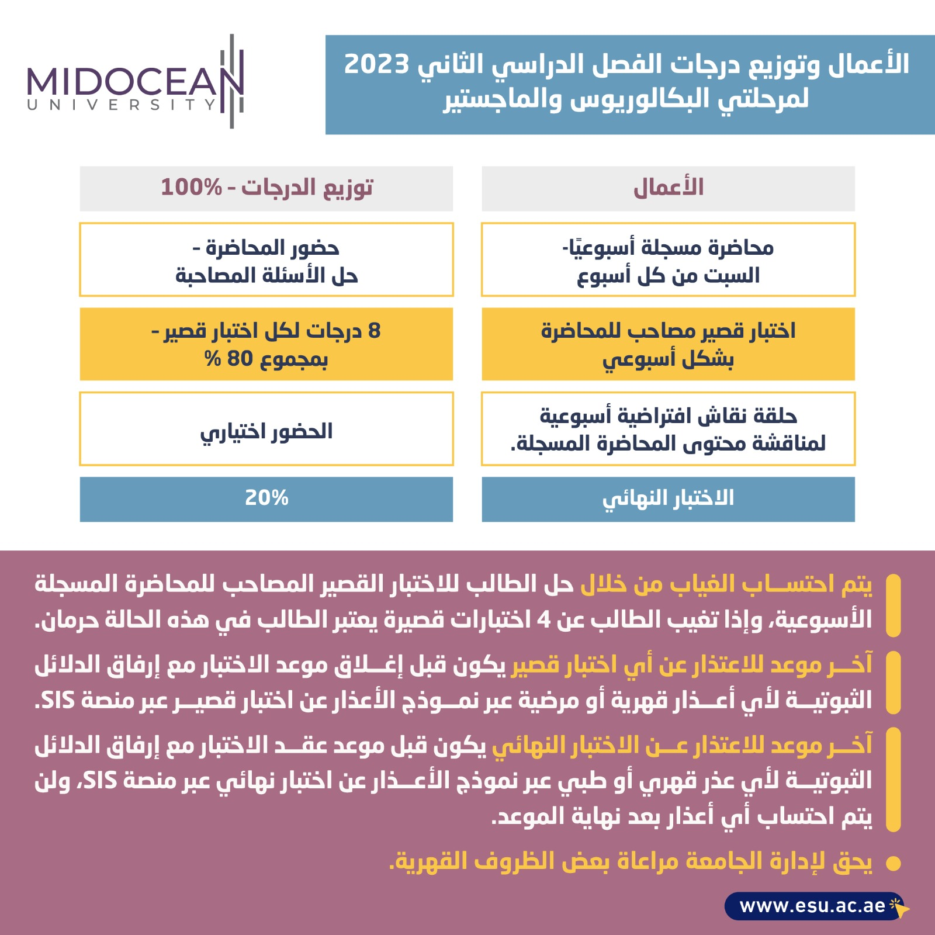
Study System
Cybersecurity Fundamentals, Dr. Redhwan M. A. Saad
www.midocean.ae

Slide 11

Course Information - Evaluation
  Assessment Method:
Short Exam
  80% marks
    Count of short Exam 10 (Weekly)
    8 Marks for each of short Exam.
  20% marks
  Final Examination
Cybersecurity Fundamentals, Dr. Redhwan M. A. Saad
www.midocean.ae

Slide 12
Learning Outcomes
After completion of this course, the students should be able to:
Understand, and identify various network technologies and cyber-attacks and its issues.
Understand the Cyber Crimes and origin of Malware, and its security.
Identify & Evaluate Information security threats and vulnerabilities in information system and apply security measures to real time scenarios.
Identify and learn of Security Protocols for avoiding basic level threat.
Demonstrate the use of standards to enhance information security in the development process and infrastructure protection.
Recognize the appropriate steps for information security risk, response, and recovery.
Demonstrate the ability to assess and implement access controls.
Cybersecurity Fundamentals, Dr. Redhwan M. A. Saad
www.midocean.ae

Slide 13
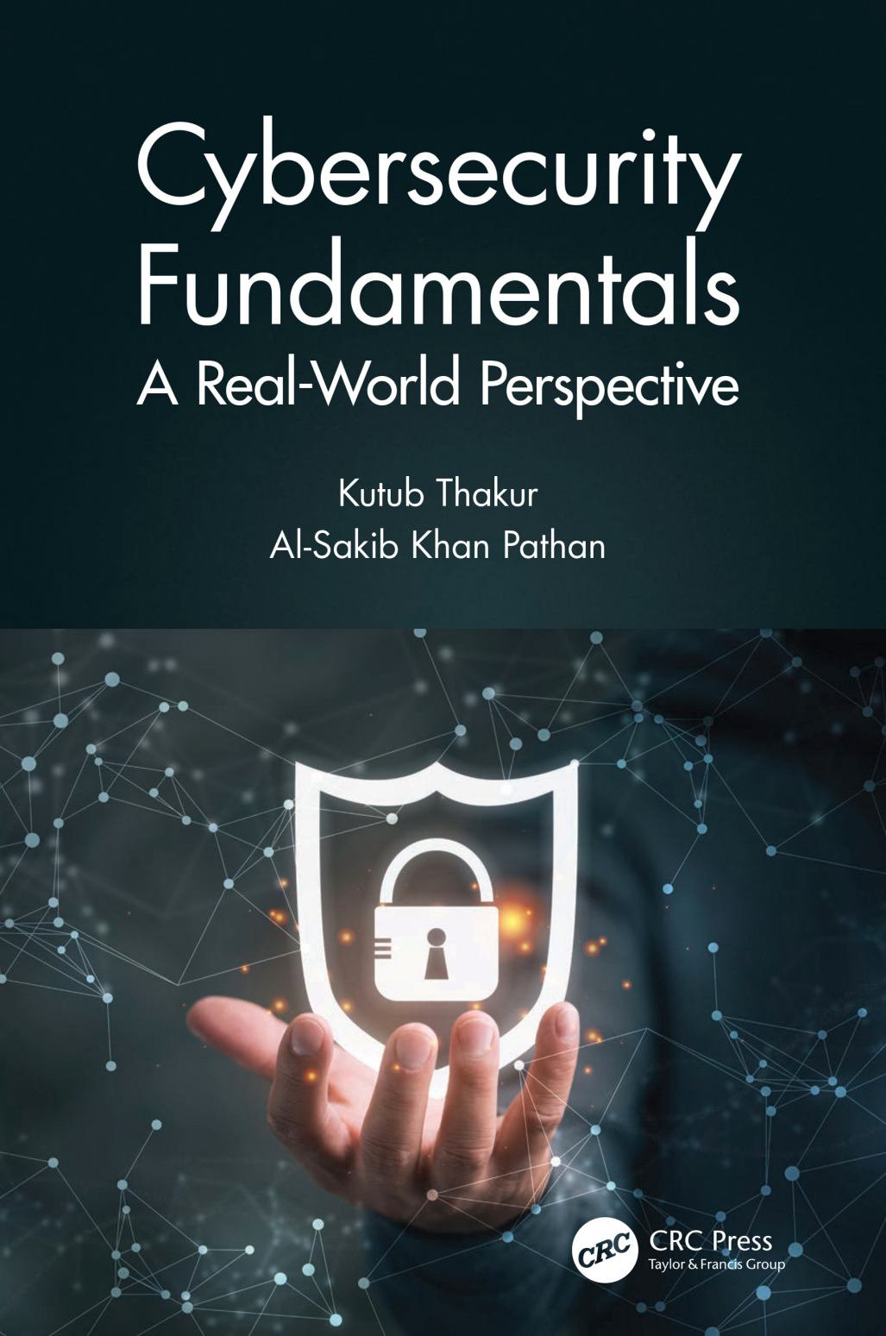
Learning Resources:
Credit Hours:
3 credit hours.
  Required Textbook:
  ISACA, C. (2015). Cybersecurity Fundamentals: ISACA Rolling Meadows.
  Graham, J., Olson, R., & Howard, R. (Eds.). (2016). Cyber security essentials. CRC Press.
  Essential References:
  Thakur, K., & Pathan, A. S. K. (2020). Cybersecurity Fundamentals: A Real-World Perspective. CRC Press.
Cybersecurity Fundamentals, Dr. Redhwan M. A. Saad
www.midocean.ae

Slide 14
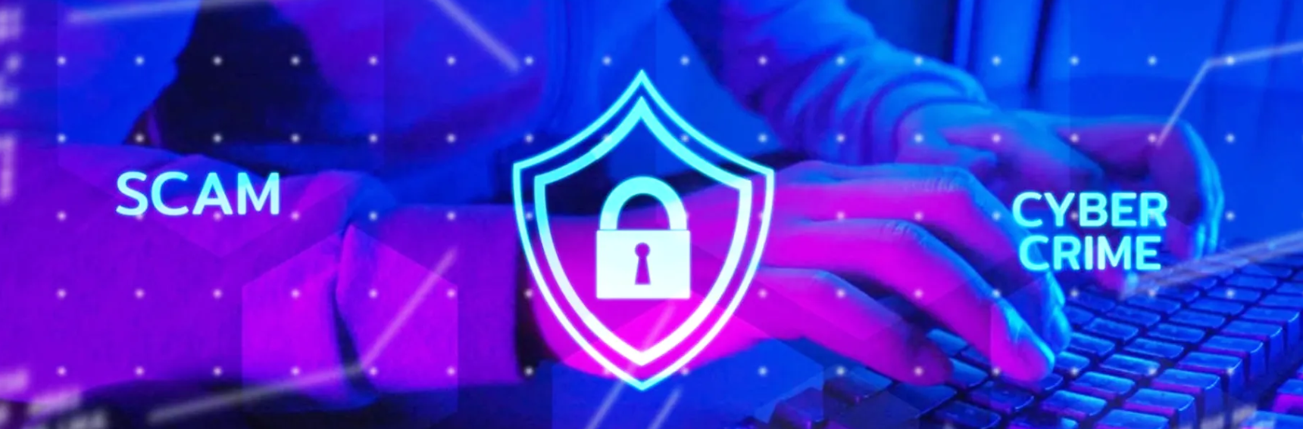

Thank You

