Slide 1


Prepared by Dr. Wesam Ahmed
IT393‎
Business Intelligence
Lecture 1

Slide 2



An Overview of Business Intelligence, Analytics, and Decision Support
Lecture 1
IT393‎
Business Intelligence
Prepared by
Dr. Wesam Ahmed

Slide 3

01
Learning Objectives:
1.1 Understand the need for computerized support of managerial decision making
1.2 Recognize the evolution of such computerized support to the current state—analytics/data science
1.3 Describe the business intelligence (BI) methodology and concepts
1.4 Understand the various types of analytics
1.5 Understand the nature of data as it relates to business intelligence (BI) and analytics

Slide 4
Changing Business Environments and Evolving Needs for Decision Support and Analytics:
02
Understand the Importance of Business Intelligence
The business environment is constantly changing, and it is becoming more and more complex.
Organizations, private and public, are under pressures that force them to respond quickly to changing conditions and to be innovative in the way they operate.
Making such decisions may require considerable amounts of relevant data, information, and knowledge. Processing these, in the framework of the needed decisions, must be done quickly, frequently in real time, and usually requires some computerized support.
This course is about using business analytics as computerized support for managerial decision making.

Slide 5
Changing Business Environments and Evolving Needs for Decision Support and Analytics:
02
Understand the Importance of Business Intelligence
Some developments have clearly contributed to facilitating growth of decision support and analytics in a number of ways, including the following:
Group communication and collaboration: Assembling a group of decision makers, especially experts, in one place can be costly. Information systems can improve the collaboration process of a group and enable its members to be at different locations .
Improved data management : The data may include text,sound, graphics, and video, and they can be in different languages. Systems today can search, store, and transmit needed data quickly, economically, securely, and transparently.

Slide 6
Changing Business Environments and Evolving Needs for Decision Support and Analytics:
02
Understand the Importance of Business Intelligence
Some developments have clearly contributed to facilitating growth of decision support and analytics in a number of ways, including the following:
Anywhere, anytime support: Using wireless technology, managers can access information anytime and from any place, analyze and interpret it, and communicate with those involved. This perhaps is the biggest change that has occurred in the last few years. The speed at which information needs to be processed and converted into decisions has truly changed expectations for both consumers and businesses.

Slide 7
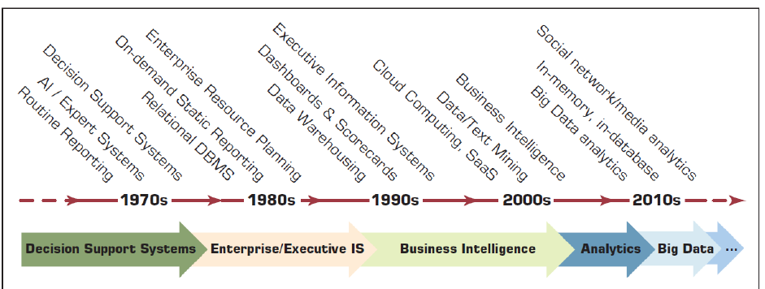
Evolution of Computerized Decision Support to Analytics/Data Science:
03
Understand the Importance of Business Intelligence
Figure 1.1 Evolution of Decision Support, Business Intelligence, and Analytics

Slide 8
04
DSS (Decision Support Systems):
Understand the Importance of Business Intelligence
DSS defined
Decision making process
Decision support framework
Components

Slide 9
05
The Concept of DSS:
Understand the Importance of Business Intelligence
DSS -interactive computer-based systems, which help decision makers utilize data and models to solve unstructured problems. (Gorry and Scott-Morton, 1971)
Decision support systems couple the intellectual resources of individuals with the capabilities of the computer to improve the quality of decisions.
DS as an Umbrella Term to describe any computerized system that supports decision making in an organization.
BI is an evolution of decision support concepts over time.

Slide 10
06
Phases of Decision-Making Process:
Understand the Importance of Business Intelligence
Humans consciously or subconsciously follow a systematic decision-making process -Simon (1977)
  1) Intelligence(Define the problem or opportunity)
  2) Design(Construct a model that describes the real-world problem and Identify possible solutions)
  3) Choice(Compare, choose, and recommend a potential solution to the problem)
  4) Implementation(putting a recommended solution to work)
  5) Monitoring (a part of intelligence?)

Slide 11
An Early Decision Support Framework(by Gory and Scott-Morten, 1971):
07
Gorry and Scott-Morton (1971) proposed a framework that is a 3-by-3 matrix
Degree of Structuredness: decision-making processes fall along a continuum that ranges from highly structured (sometimes called programmed) to highly unstructured (i.e., nonprogrammed) decisions.
Structured processes are routine and typically repetitive problems for which standard solution methods exist.
Unstructured processes are fuzzy, complex problems for which there are no cut-and-dried solution methods. In a structured problem, the procedures for obtaining the best solution are known. The objectives are clearly defined. Common objectives are cost minimization and profit maximization.
Semistructured problems fall between structured and unstructured problems, having some structured elements and some unstructured elements.

Slide 12
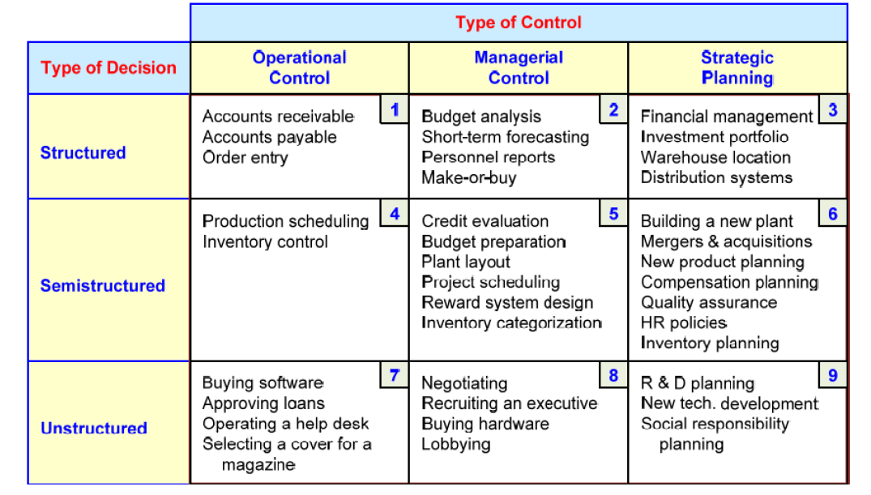
An Early Decision Support Framework(by Gory and Scott-Morten, 1971):
08
Understand the Importance of Business Intelligence

Slide 13
A Framework for Business Intelligence :
09
Gorry and Scott-Morton (1971) proposed a framework that is a 3-by-3 matrix
DSS→ BI
Definition of Business Intelligence :An umbrella term that combines architectures, tools, databases, analytical tools, applications, and methodologies.
  BI's major objective is to enable easy access to data (and models) to provide business managers with the ability to conduct analysis. By analyzing historical and current data, situations, and performances, decision makers get valuable insights that enable them to make more informed and better decisions.
  The process of BI is based on the transformation of data to information, then to decisions, and finally to actions.

Slide 14
A Framework for Business Intelligence :
10
Gorry and Scott-Morton (1971) proposed a framework that is a 3-by-3 matrix
The Architecture of BI
A BI system has four major components: a data warehouse, with its source data; business analytics, a collection of tools for manipulating, mining, and analyzing the data in the data warehouse; business performance management (BPM) for monitoring and analyzing performance; and a user interface (e.g., a dashboard). The relationship among these components is illustrated in Figure 1.2.

Slide 15
A Framework for Business Intelligence :
11
Gorry and Scott-Morton (1971) proposed a framework that is a 3-by-3 matrix
1.Data Warehouse
Function: It consolidates data from different formats and systems (e.g., databases, spreadsheets, CRM/ERP systems) into a unified format for easy access and analysis.
Example: A retail company’s data warehouse might store data from its sales database, customer database, and supplier database.
2. Business Analytics
Definition and Function : A collection of tools and techniques used to manipulate, mine, and analyze data stored in the data warehouse.
Example: Using a data visualization tool like Tableau to create a sales trend dashboard.

Slide 16
A Framework for Business Intelligence :
12
Gorry and Scott-Morton (1971) proposed a framework that is a 3-by-3 matrix
3. Business Performance Management (BPM)
Definition: A set of processes and tools for monitoring, analyzing, and optimizing organizational performance.
Example: A company might use BPM to track KPIs like customer lifetime value (CLV) and adjust strategies based on performance.
4. User Interface (UI)
Definition: Provides an intuitive interface for users to access analytics, generate reports, and visualize data. It ensures that insights are easily understandable and actionable.
Example: A manager using a dashboard to monitor real-time sales data and KPIs.

Slide 17
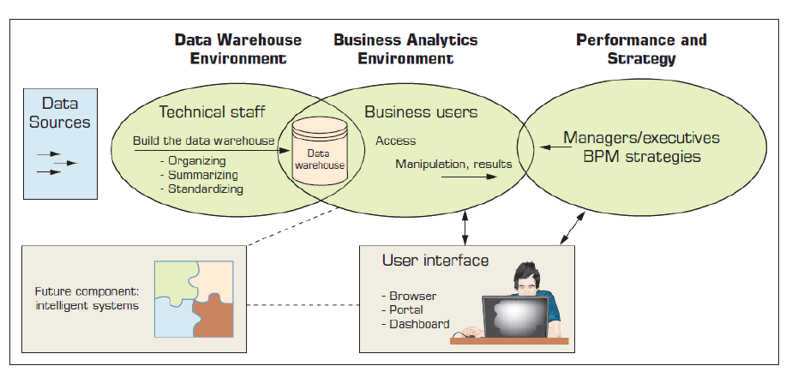
A Framework for Business Intelligence :
13
Gorry and Scott-Morton (1971) proposed a framework that is a 3-by-3 matrix
The Architecture of BI:
Figure 1.2 A High-Level Architecture of BI

Slide 18
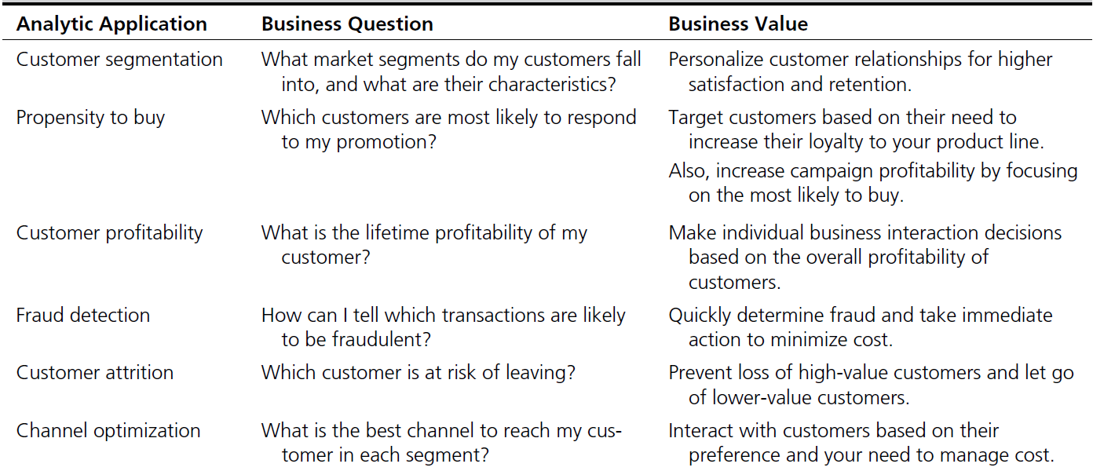
BI Analytical Applications:
14
Gorry and Scott-Morton (1971) proposed a framework that is a 3-by-3 matrix
Examples of many applications of BI are provided in Figure 1.3.

Slide 19
DSS-BI Connections:
15
Gorry and Scott-Morton (1971) proposed a framework that is a 3-by-3 matrix
Similarities and differences?
First, their architectures are very similar because BI evolved from DSS. However, BI implies the use of a data warehouse, whereas DSS may or may not have such a feature. BI is, therefore, more appropriate for large organizations (because data warehouses are expensive to build and maintain), but DSS can be appropriate to any type of organization.
Second, most DSS are constructed to directly support specific decision making. BI systems, in general, are geared to provide accurate and timely information, and they support decision support indirectly.

Slide 20
DSS-BI Connections:
16
Gorry and Scott-Morton (1971) proposed a framework that is a 3-by-3 matrix
Third, most BI systems are constructed with commercially available tools and components that are fitted to the needs of organizations. In building DSS, the interest may be in constructing solutions to very unstructured problems. In such situations, more programming (e.g., using tools such as Excel) may be needed to customize the solutions.
Fourth, many of the tools that BI uses are also considered DSS tools. For example, data mining and predictive analysis are core tools in both areas.

Slide 21
Analytics Overview:
17
Gorry and Scott-Morton (1971) proposed a framework that is a 3-by-3 matrix
Analytics…a relatively new term/buzz-word
Analytics…the process of developing actionable decisions or recommendations for actions based on insights generated from historical data
According to the Institute for Operations Research and Management Science (INFORMS): Analytics represents the combination of computer technology, management science techniques, and statistics to solve real problems.

Slide 22
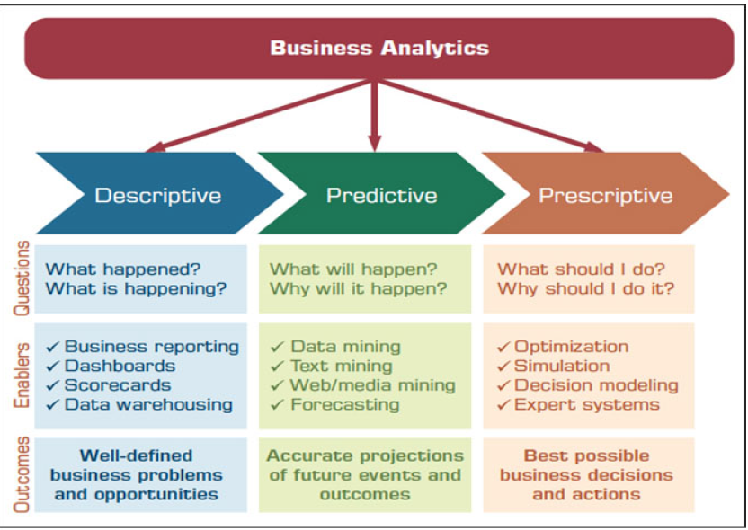
Business Analytics:
18
Gorry and Scott-Morton (1971) proposed a framework that is a 3-by-3 matrix
Figure 1.3 Three Types of Analytics

Slide 23
Business Analytics:
19
Gorry and Scott-Morton (1971) proposed a framework that is a 3-by-3 matrix
Descriptive or reporting analytics: refers to knowing what is happening in the organization and understanding some underlying trends and causes of such occurrences.
This involves, first of all, consolidation of data sources and availability of all relevant data in a form that enables appropriate reporting and analysis. From this data infrastructure we can develop appropriate reports, queries, alerts, and trends using various reporting tools and techniques.
A significant technology that has become a key player in this area is visualization. Using the latest visualization tools in the marketplace, we can now develop powerful insights into the operations of our organization.
Application Cases 1.1 and 1.2 highlight some such applications in the healthcare domain.

Slide 24
Business Analytics:
20
Gorry and Scott-Morton (1971) proposed a framework that is a 3-by-3 matrix
Descriptive or reporting analytics: refers to knowing what is happening in the organization and understanding some underlying trends and causes of such occurrences.
This involves, first of all, consolidation of data sources and availability of all relevant data in a form that enables appropriate reporting and analysis. From this data infrastructure we can develop appropriate reports, queries, alerts, and trends using various reporting tools and techniques.
A significant technology that has become a key player in this area is visualization. Using the latest visualization tools in the marketplace, we can now develop powerful insights into the operations of our organization.
Application Cases 1.1 and 1.2 highlight some such applications in the healthcare domain.

Slide 25
Application Case 1:
21
Gorry and Scott-Morton (1971) proposed a framework that is a 3-by-3 matrix
Eliminating Inefficiencies at Seattle Children’s Hospital
Seattle Children’s was the seventh highest ranked children’s hospital in 2011, according to U.S. News & World Report. For any organization that is committed to saving lives, identifying and removing the inefficiencies from systems and processes so that more resources become available to cater to patient care become very important. At Seattle Children’s,management is continuously looking for new ways to improve the quality, safety, and processes from the time a patient is admitted to the time they are discharged. To this end, they spend a lot of time in analyzing the data associated with the patient visits. To quickly turn patient and hospital data into insights, Seattle Children’s implemented Tableau Software’s business intelligence application. It provides a browser based on easy-to-use analytics to the stakeholders; this makes it intuitive for individuals to
create visualizations and to understand what the data has to offer.

Slide 26
Application Case 1:
22
Gorry and Scott-Morton (1971) proposed a framework that is a 3-by-3 matrix
Eliminating Inefficiencies at Seattle Children’s Hospital
The data analysts, business managers, and financial analysts as well as clinicians, doctors,and researchers are all using descriptive analytics to solve different problems in a much faster way. They are developing visual systems on their own,resulting in dashboards and scorecards that help in defining the standards, the current performance achieved measured against the standards, and how these systems will grow into the future. Through the use of monthly and daily dashboards, day-to-day decision making at Seattle Children’s has improved significantly. Seattle Children’s measures patient wait-times and analyzes them with the help of visualizations to discover the root causes and contributing factors for patient waiting. They found that early delays cascaded during the day. They focused on on-time appointments of patient services as one of the solutions to improving patient overall waiting time and increasing the availability of beds.

Slide 27
Application Case 1:
23
Gorry and Scott-Morton (1971) proposed a framework that is a 3-by-3 matrix
Eliminating Inefficiencies at Seattle Children’s Hospital
Seattle Children’s saved about $3 million from the supply chain, and with the help of tools like Tableau, they are finding new ways to increase savings while treating as many patients as possible by making the existing processes more efficient.
Questions for Discussion
1. Who are the users of the tool?
2. What is a dashboard?
3. How does visualization help in decision making?
4. What are the significant results achieved by the use of Tableau?
Source: Tableausoftware.com, “Eliminating Waste at Seattle Children’s,” tableausoftware.com/eliminating-waste-at-seattlechildrens (accessed February 2013).

Slide 28
Application Case 1:
24
Gorry and Scott-Morton (1971) proposed a framework that is a 3-by-3 matrix
Questions for Discussion
Who are the users of the tool?
*Answer (data analysts, business managers, and financial analysts as well as clinicians, doctors,and researchers)
2. What is a dashboard?
*Answer (A dashboard is a visual display tool that presents key performance indicators (KPIs), metrics, and data in an intuitive format.)

Slide 29
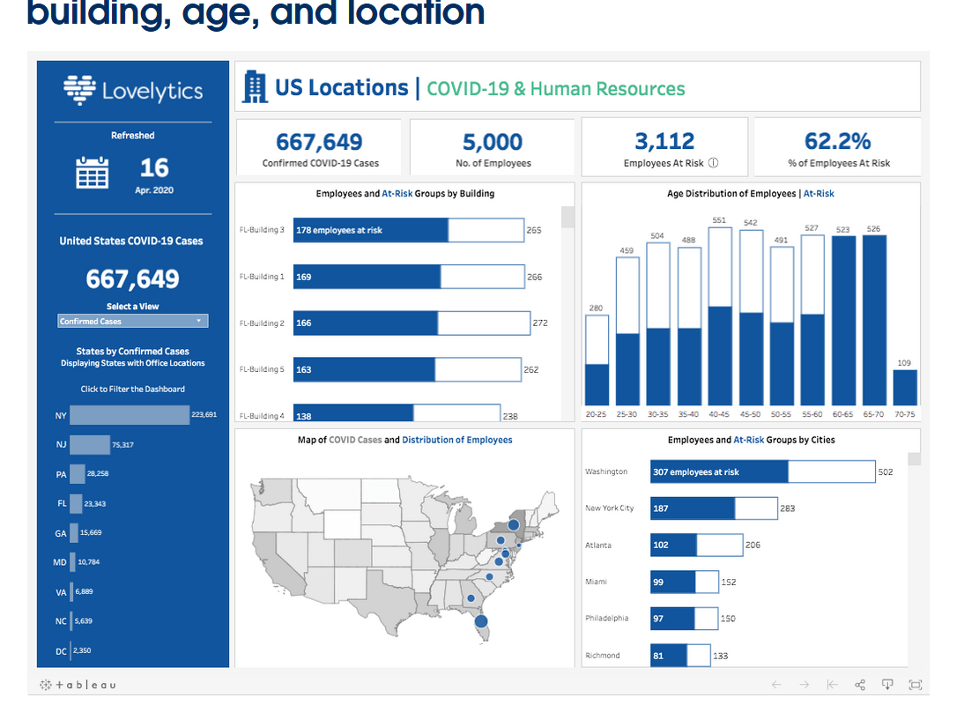
Application Case 1:
25
Gorry and Scott-Morton (1971) proposed a framework that is a 3-by-3 Tableau Dashboard Example

Slide 30
Application Case 1:
26
Gorry and Scott-Morton (1971) proposed a framework that is a 3-by-3 matrix
Questions for Discussion
3. How does visualization help in decision making?
Simplifying complex data: Presenting data in charts, graphs, and maps makes it easier to understand and interpret.
Identifying trends and patterns: Visual representations help users quickly spot trends, outliers, and correlations in the data.
Facilitating communication: Visualizations make it easier to share insights with stakeholders, enhancing collaboration and alignment.
Supporting rapid decision-making: By providing real-time data, visualizations enable quicker responses to changing conditions.

Slide 31
Application Case 1:
27
Gorry and Scott-Morton (1971) proposed a framework that is a 3-by-3 matrix
Questions for Discussion
4. What are the significant results achieved by the use of Tableau?
Improved patient wait-times: By analyzing wait-time data, the hospital identified early delays as a key issue and implemented measures to improve on-time appointments, thereby reducing overall patient waiting times and increasing bed availability.
Enhanced day-to-day decision-making: The use of monthly and daily dashboards significantly improved operational decision-making, enabling the hospital to respond more effectively to daily challenges.
Cost savings: The hospital saved approximately $3 million in supply chain costs and identified additional ways to increase savings while treating more patients by optimizing existing processes.

Slide 32
Application Case 1:
27
Gorry and Scott-Morton (1971) proposed a framework that is a 3-by-3 matrix
Questions for Discussion
4. What are the significant results achieved by the use of Tableau?
Improved patient wait-times: By analyzing wait-time data, the hospital identified early delays as a key issue and implemented measures to improve on-time appointments, thereby reducing overall patient waiting times and increasing bed availability.
Enhanced day-to-day decision-making: The use of monthly and daily dashboards significantly improved operational decision-making, enabling the hospital to respond more effectively to daily challenges.
Cost savings: The hospital saved approximately $3 million in supply chain costs and identified additional ways to increase savings while treating more patients by optimizing existing processes.

Slide 33
The Nature of Data:
28
Gorry and Scott-Morton (1971) proposed a framework that is a 3-by-3 matrix
Data: a collection of facts
– usually obtained as the result of experiences, observations, or experiments
• Data may consist of numbers, words, images, …
• Data is the source for information and knowledge
• Data quality and data integrity → critical to analytics

Slide 34
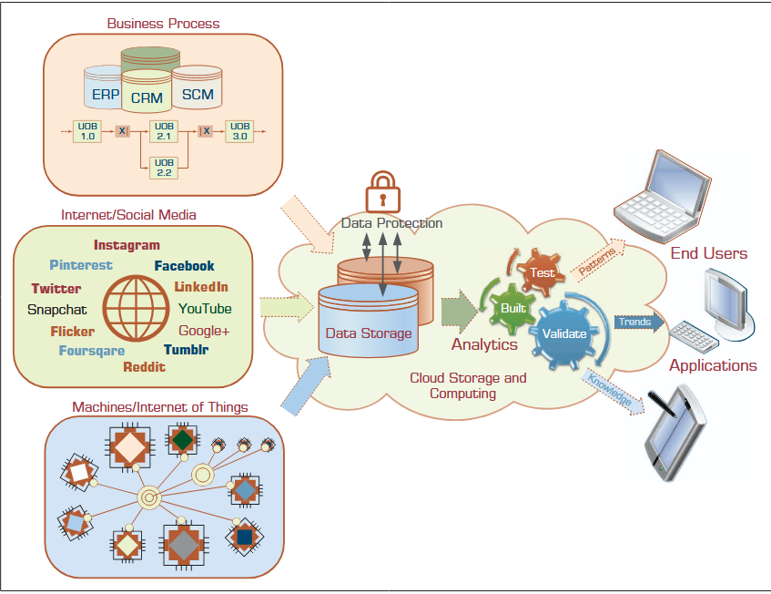
The Nature of Data:
29
Gorry and Scott-Morton (1971) proposed a framework that is a 3-by-3 matrix
Figure1.4 A Data to Knowledge Continuum.

Slide 35
A Simple Taxonomy of Data:
30
Gorry and Scott-Morton (1971) proposed a framework that is a 3-by-3 matrix
Data (datum—singular form of data): facts
• Structured data
– Targeted for computers to process
– Numeric versus nominal
• Unstructured/textual data
– Targeted for humans to process/digest
• Semi-structured data?
– XML, HTML, Log files, etc.

Slide 36
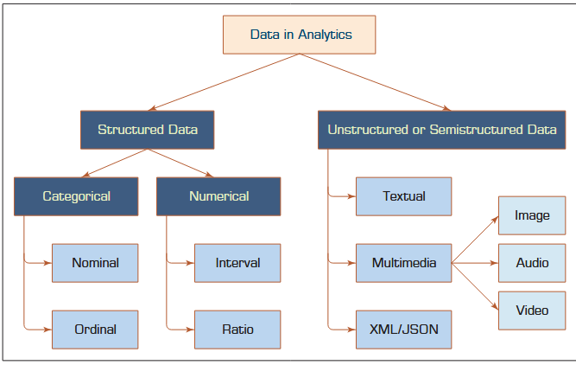
A Simple Taxonomy of Data:
31
Figure 2.2 shows a simple data taxonomy
Figure 1.5 shows a simple data taxonomy

Slide 37
A Simple Taxonomy of Data:
32
Gorry and Scott-Morton (1971) proposed a framework that is a 3-by-3 matrix
Categorical data represent the labels of multiple classes used to divide a variable into specific groups.
Examples of categorical variables include race, sex, age group, and educational level.
The categorical data may also be called discrete data, implying that it represents a finite number of values with no continuum between them. Even if the values used for the categorical (or discrete) variables are numeric, these numbers are nothing more than symbols and do not imply the possibility of calculating fractional values.

Slide 38
A Simple Taxonomy of Data:
33
Gorry and Scott-Morton (1971) proposed a framework that is a 3-by-3 matrix
Nominal data contain measurements of simple codes assigned to objects as labels, which are not measurements.
For example, the variable marital status can be generally categorized as (1) single, (2) married, and (3) divorced.
Nominal data can be represented with binomial values having two possible values (e.g., yes/no, true/false, good/bad), or multinomial values having three or more possible values (e.g.,brown/green/blue, white/black/Latino/Asian, single/married/divorced).

Slide 39
A Simple Taxonomy of Data:
33
Gorry and Scott-Morton (1971) proposed a framework that is a 3-by-3 matrix
Ordinal data contain codes assigned to objects or events as labels that also represent the rank order among them.
For example, the variable credit score can be generally categorized as (1) low, (2) medium, or (3) high. Similar ordered relationships.
can be seen in variables such as age group (i.e., child, young, middle-aged, elderly) and educational level (i.e., high school, college, graduate school).

Slide 40
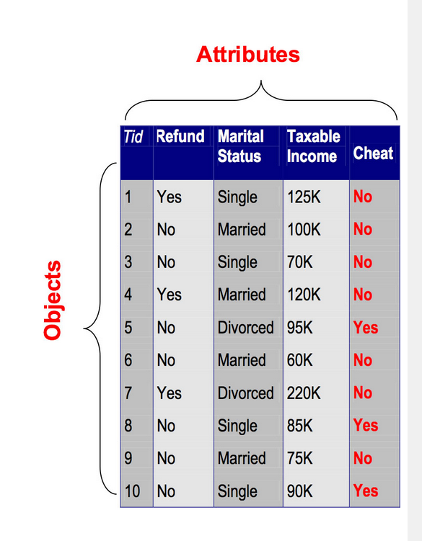
A Simple Taxonomy of Data:
33
Gorry and Scott-Morton (1971) proposed a framework that is a 3-by-3 matrix
Figure 1.6 Example of categorical data

Slide 41


Thank You

