Slide 1



Machine Learning
for Finance
Lecture 9
FNT633
Forecasting Part 2
Time Series Models
Prepared by
Dr. Diaa Salama

Slide 2
Week
10
Today
Forecasting
Time Series Models
www.midocean.ae

Slide 3
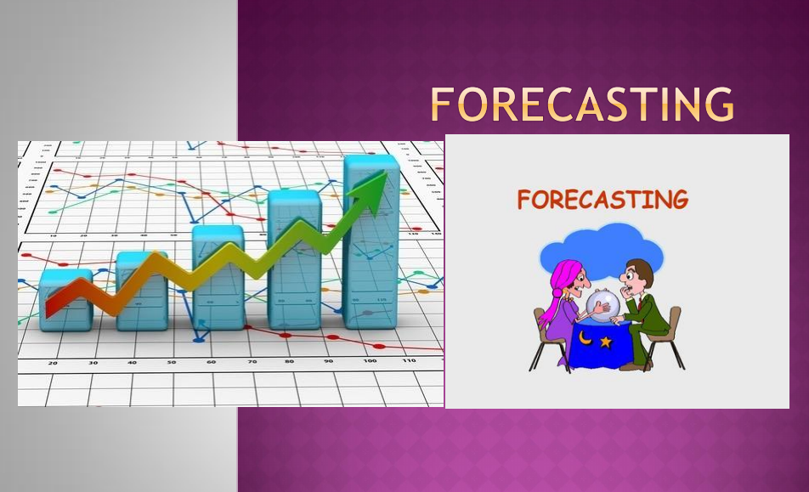
Week
10
Forecasting
www.midocean.ae

Slide 4
Week
What Kind of Problem do I Need to Solve?
How do I Solve it?
10
The Problem to Solve | The Category of Techniques | Covered in this Course
I want to group items by similarity. I want to find structure (commonalities) in the data | Clustering | K-means clustering
I want to discover relationships between actions or items | Association Rules | Apriori
I want to determine the relationship between the outcome and the input variables | Regression | Linear Regression Logistic Regression
I want to assign (known) labels to objects | Classification | Naïve Bayes Decision Trees
I want to find the structure in a temporal process I want to forecast the behavior of a temporal process | Time Series Analysis | ACF, PACF, ARIMA
I want to analyze my text data | Text Analysis | Regular expressions, Document representation (Bag of Words).
www.midocean.ae

Slide 5
Week
10
Agenda
    Appreciate the importance of forecasting to every organization
    List different types of forecasting method
    Discuss the characteristics of judgmental forecasting
    Use a variety of approaches to judgmental forecasting
    Describe the characteristics of projective forecasting
    Understand the importance of time series
    Calculate errors and a tracking signal for forecasts
    Forecast using simple averages, moving averages, and exponential smoothing
    Forecast time series with seasonality and trend.
www.midocean.ae

Slide 6
Week
10
Introduction to Forecasting
What is forecasting?
  Primary Function is to Predict the Future using (time series related or other) data we have in hand
Why are we interested?
  Affects the decisions we make today
Where is forecasting used ?
  forecast demand for products and services
  forecast availability/need for manpower
  forecast inventory and materiel needs daily
www.midocean.ae

Slide 7
Week
10
Forecasting Learning Objective
Generate forecasts for data with different patterns: level, trend, seasonality, and cyclical
Describe causal modeling using linear regression
Compute forecast accuracy
Explain how forecasting models should be selected.
www.midocean.ae

Slide 8
Week
10
Forecasting steps
    Decide what needs to be forecast
        Level of detail, units of analysis & time horizon required
    Evaluate and analyze appropriate data
        Identify needed data & whether it’s available
    Select and test the forecasting model
        Cost, ease of use & accuracy
    Generate the forecast
    Monitor forecast accuracy over time
www.midocean.ae

Slide 9
Week
10
Methods of forecasting
One classification of forecasting methods concerns the time in the future they cover
  Long-term forecasts; look ahead several years – the time typically needed to build a new factory
  Medium-term forecasts look ahead between three months and two years –the time typically needed to replace an old product by a new one.
  Short-term forecasts cover the next few weeks – describing the continuing demand for a product.
www.midocean.ae

Slide 10
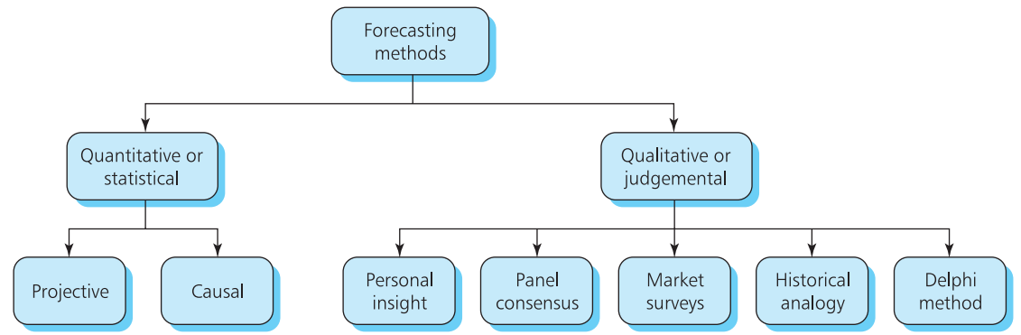
Week
10
Methods of forecasting
    Another classification of methods draws a distinction between qualitative and quantitative approaches
www.midocean.ae

Slide 11
Week
10
Time Series Pattern
    Projective forecasts often work with time series, such as monthly unemployment figures, daily rainfall, weekly sales, quarterly profit, and annual fuel consumption.
    When you have a time series it is always useful to draw a graph, and a simple scatter diagram shows any underlying patterns.
      constant series (Level) ; with observations taking roughly the same value over time, such as annual rainfall
      series with a trend ; with values either rising or falling steadily, such as the gross national product per capita
      seasonal series; which have a cyclical component, such as the weekly sales of soft drinks.
www.midocean.ae

Slide 12
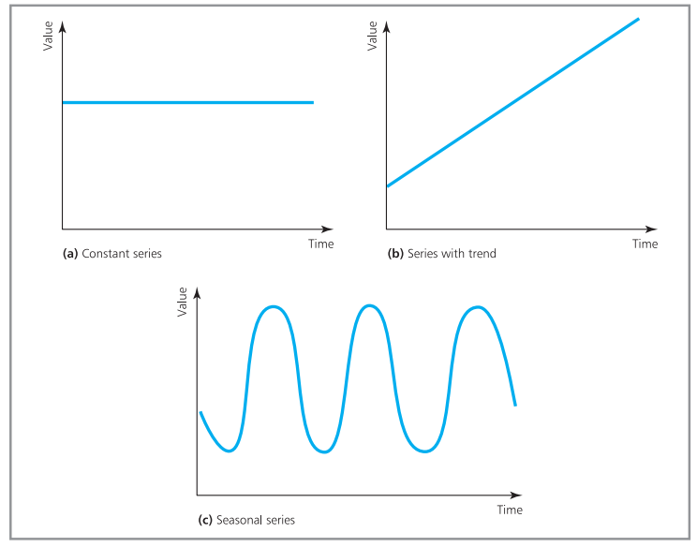
Week
10
Time Series Pattern
www.midocean.ae

Slide 13
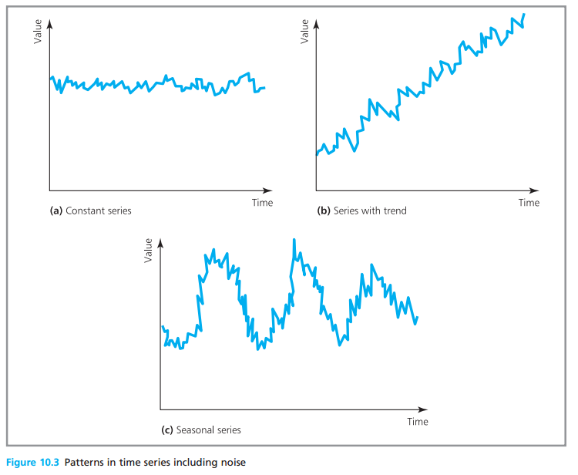
Week
10
Time Series Pattern
    If observations followed such simple patterns, there would be no problems with forecasting.
    Unfortunately, there are nearly always differences between actual observations and the underlying pattern.
    Random noise is apply to on the underlying pattern
Constant series, for example, does not always take exactly the same value, but is somewhere close. Then:
200 205 194 195 208 203 200 193 201 198
is a constant series of 200 with superimposed noise.
www.midocean.ae

Slide 14
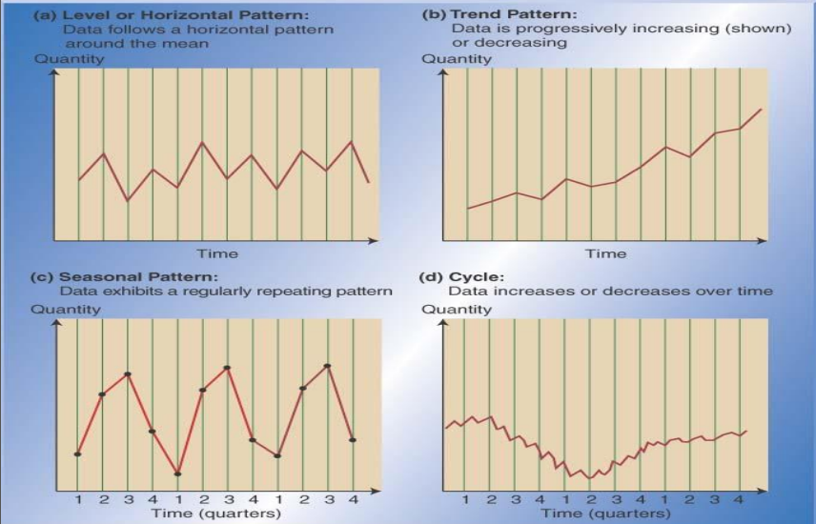
Week
10
Time Series Pattern
www.midocean.ae

Slide 15

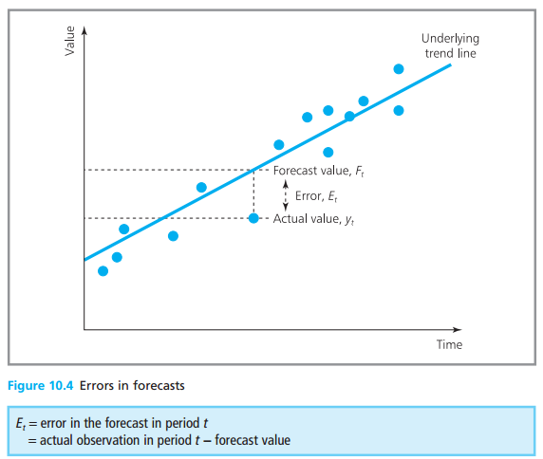

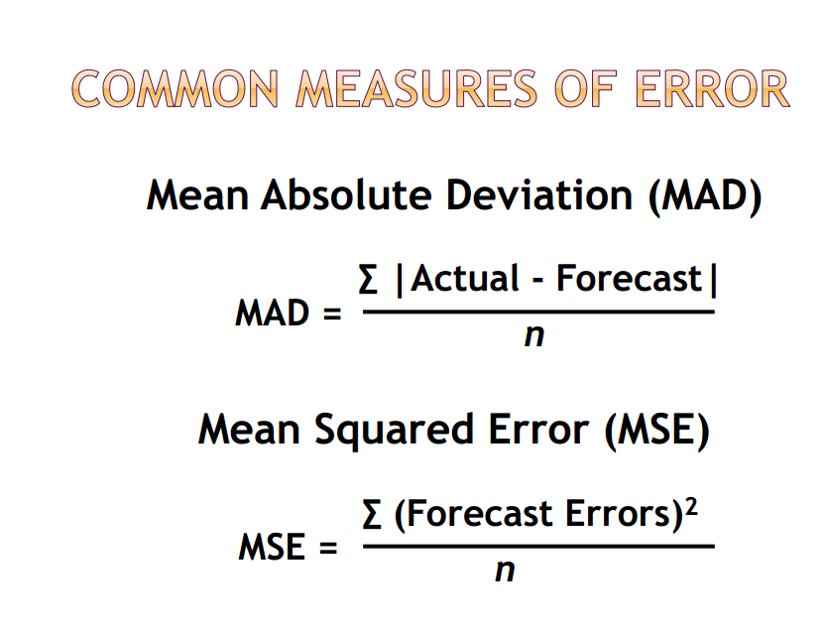
Week
10
Common Measures of Error
www.midocean.ae

Slide 16
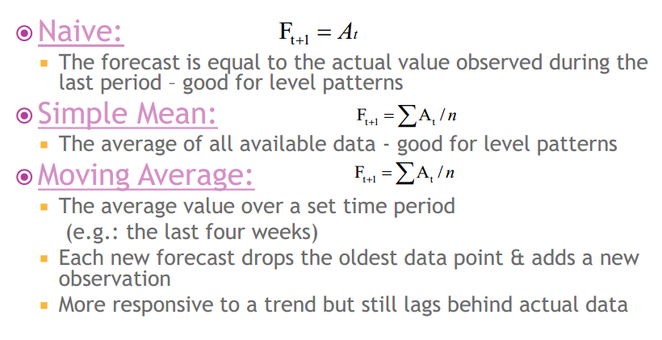
Week
10
Time Series Model
www.midocean.ae

Slide 17
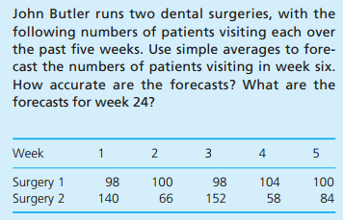
Week
10
Time Series Model
www.midocean.ae

Slide 18
Week
10
Simple Averages model
    Simple averages can give good forecasts for constant series
        Simple averages do not work well when the underlying Pattern changes
        The problem is that older data tends to swamp the latest figures and the forecast is very slow to follow the changing pattern.
www.midocean.ae

Slide 19
Week
10
Simple Average model limitations
    Suppose that demand for an item has been constant at 100 units a week for the past two years (104 weeks). Simple averages give a forecast demand for week 105 of 100 units.
    But if the actual demand in week 105 suddenly rises to 200 units, simple averages give a forecast for week 106
    If demand continues at 200 units a week, following forecasts are:
    If demand continues at 200 units a week, following forecasts are:
www.midocean.ae

Slide 20
Week
10
Simple Average model limitations
    Simple averages only actually work for constant series.
    The forecasts are rising but the response is very slow.
    But very few time series are in fact stable over long periods, so this restriction makes them of limited value.
    The problem with simple averages is that old, out-of-date data tends to swamp newer, more relevant data.
    A way around this is to ignore old data and use only a number of the most recent observations.
www.midocean.ae

Slide 21
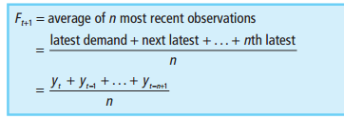
Week
10
Moving Average method
As patterns of demand tend to vary over time
  only a certain amount of historical data is relevant to future forecasts.
  The problem with simple averages is that old, out-of-date data tends to swamp newer, more relevant data
the principle of moving averages is to ignore old data and use only a number of the most recent observations.
www.midocean.ae

Slide 22
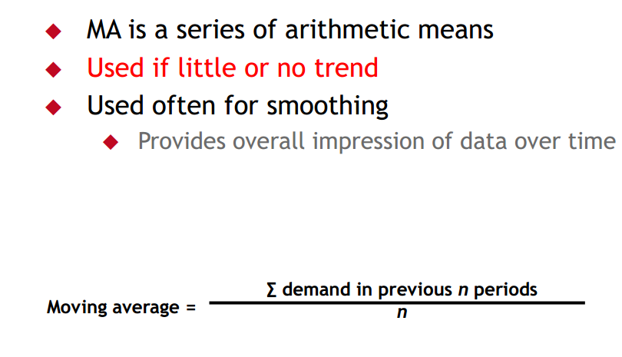
Week
10
Moving Average method
www.midocean.ae

Slide 23
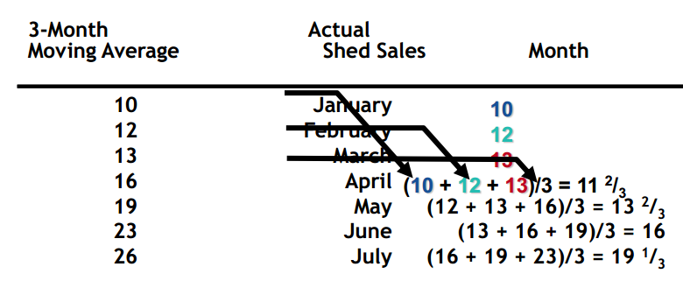
Week
10
Moving Average Example
www.midocean.ae

Slide 24
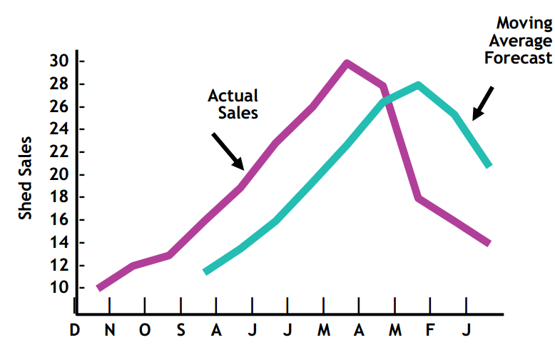
Week
10
Graph of Moving Average
www.midocean.ae

Slide 25
Week
10
Weighted Moving Average model
www.midocean.ae

Slide 26
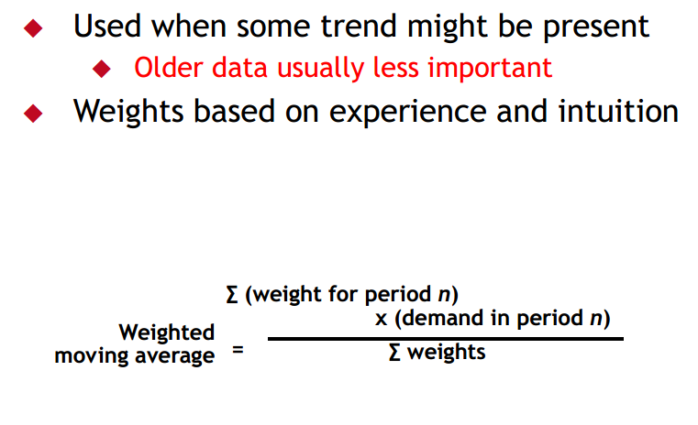
Week
10
Weighted Moving Average model
www.midocean.ae

Slide 27
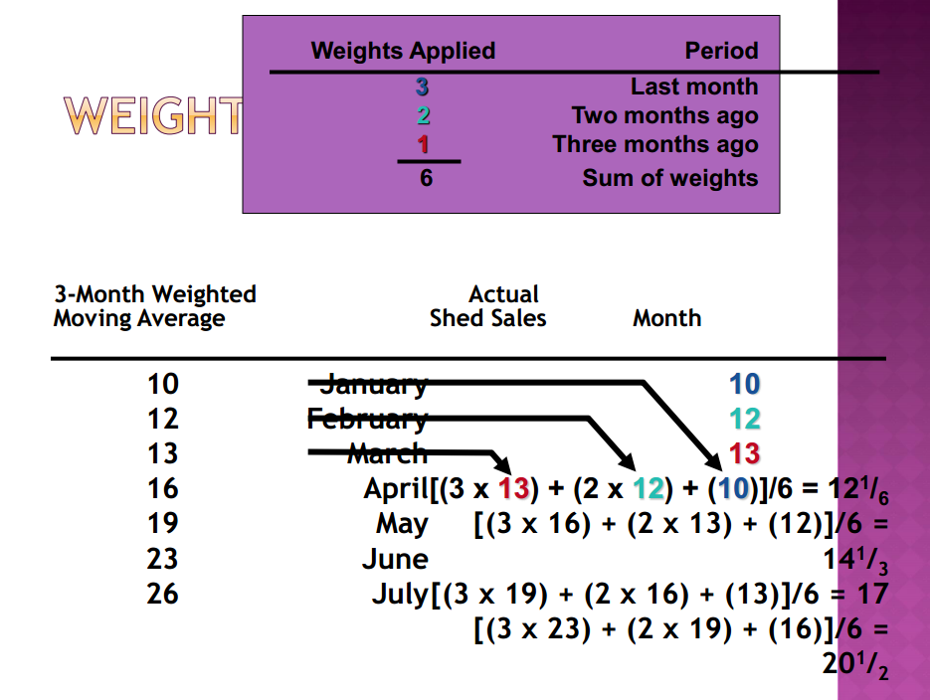
Week
10
Weighted Moving Average model
www.midocean.ae

Slide 28
Week
10
Weighted Moving Average model
www.midocean.ae

Slide 29
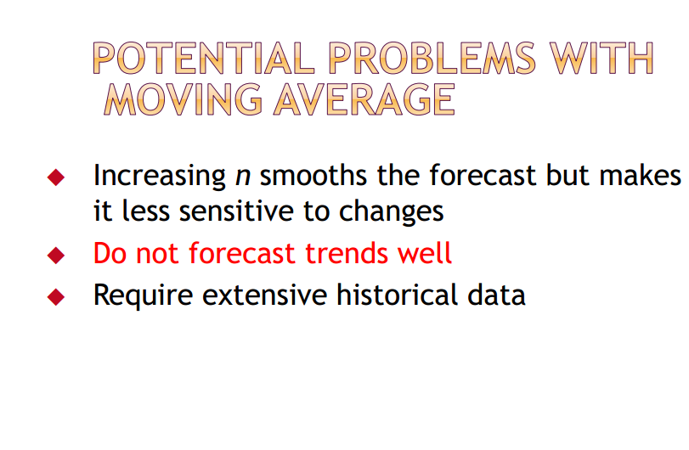
29

Slide 30
Week
10
www.midocean.ae

Slide 31
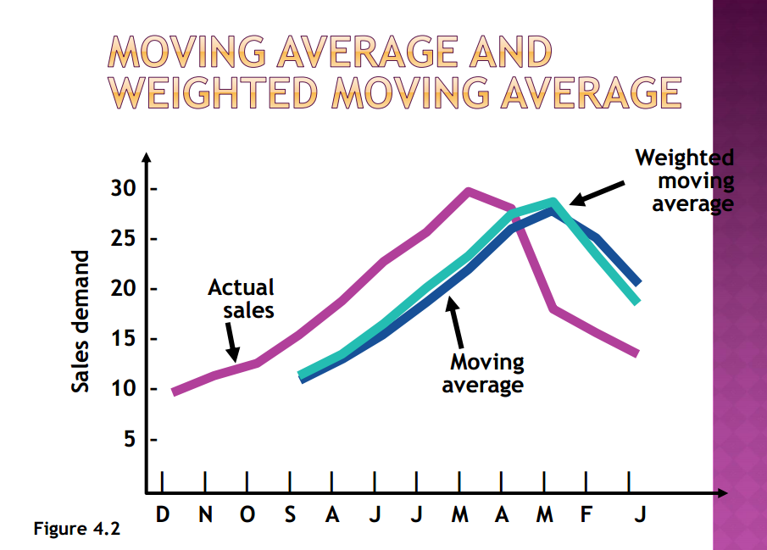
Week
10
www.midocean.ae

Slide 32
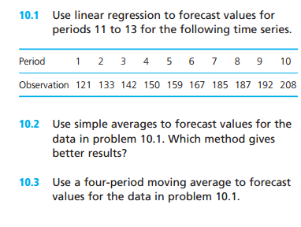
Week
10
Quiz
www.midocean.ae

Slide 33
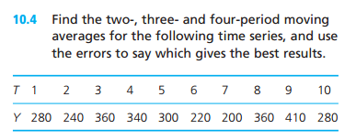
Week
10
Quiz
www.midocean.ae

Slide 34
Week
10
www.midocean.ae

Slide 35
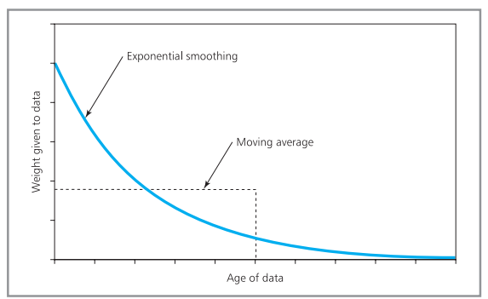
Week
Weighted Moving Average model
10
    Weights given to data with exponential smoothing and moving average
www.midocean.ae

Slide 36
Week
10
    Exponential smoothing
www.midocean.ae

Slide 37

Week
10
Exponential smoothing
    Exponential smoothing is based on the idea that as data gets older it becomes less relevant and should be given less weight.
    we can do weighting by using the latest observation to update a previous forecast.
    The calculation for the new forecast can be calculated by
α is a smoothing constant
www.midocean.ae

Slide 38
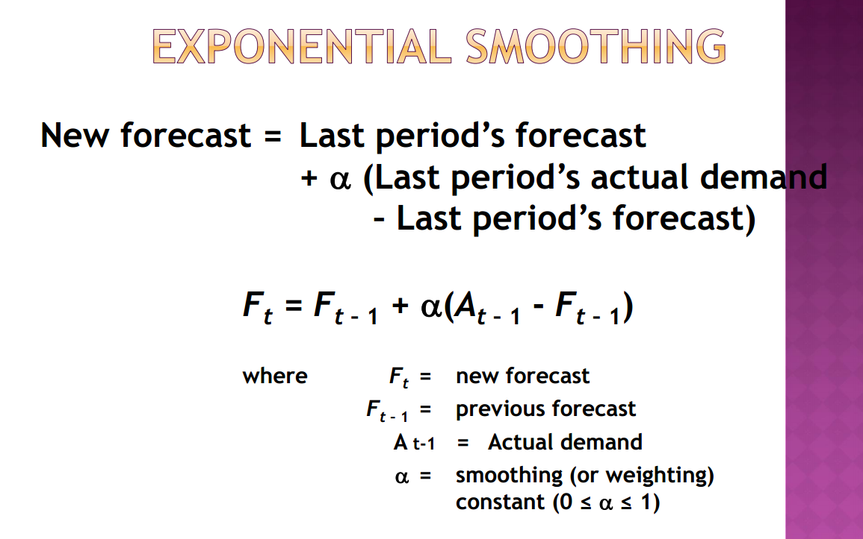
Week
10
Exponential smoothing
www.midocean.ae

Slide 39
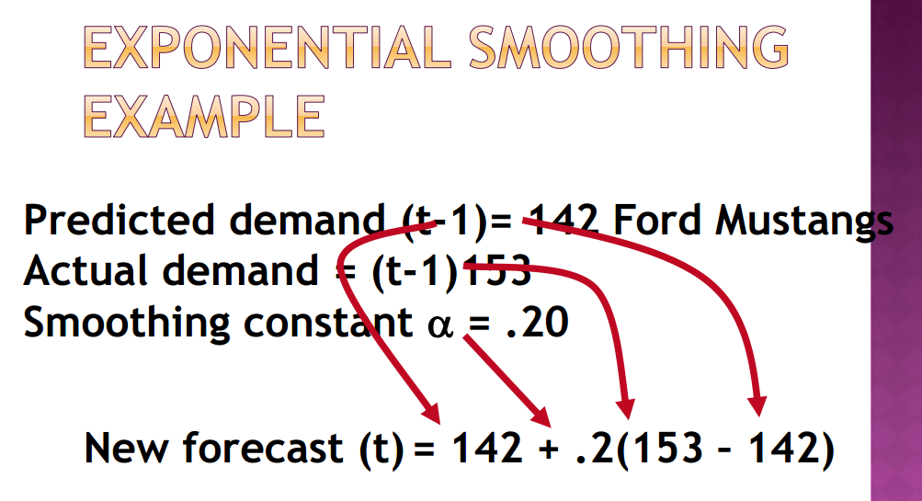
Week
10
Exponential smoothing
www.midocean.ae

Slide 40
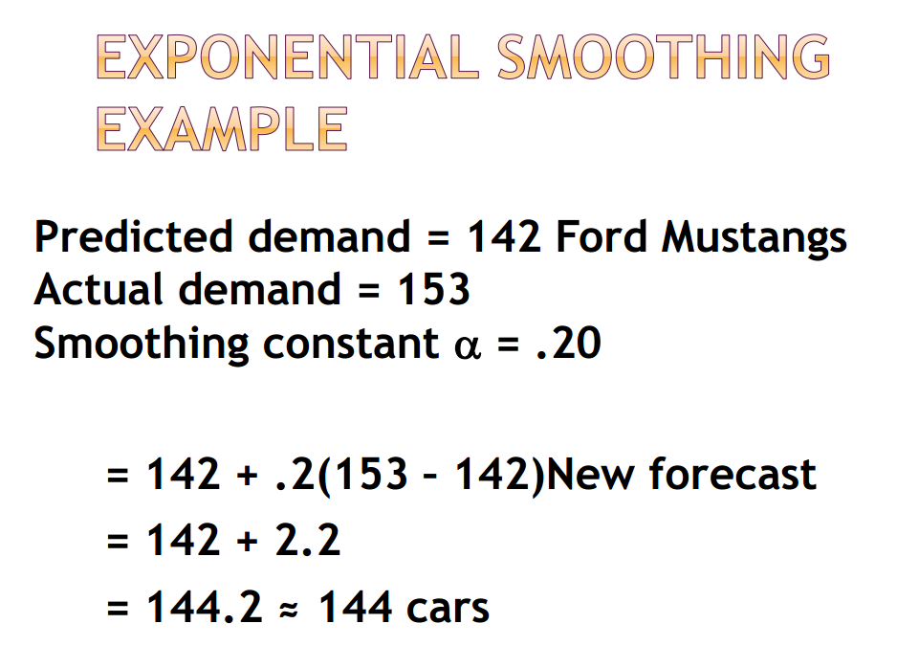
Week
10
Exponential smoothing
www.midocean.ae

Slide 41
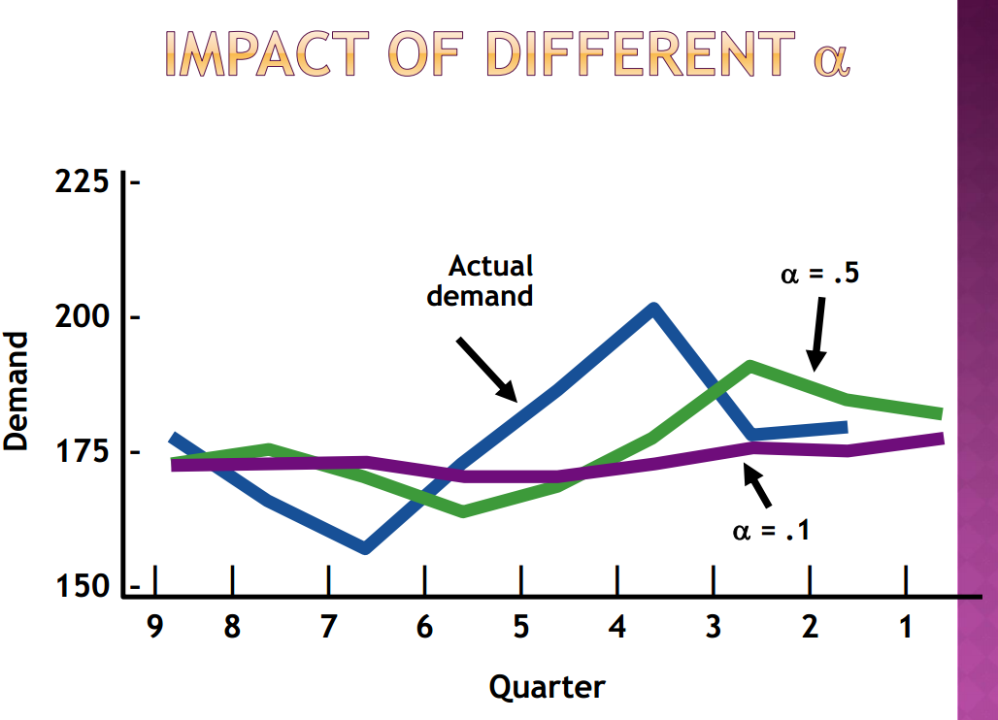
Week
10
Exponential smoothing
www.midocean.ae

Slide 42
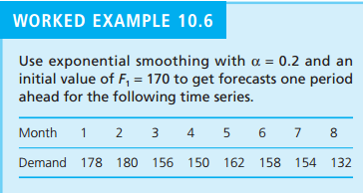
Week
10
Exponential smoothing
www.midocean.ae

Slide 43
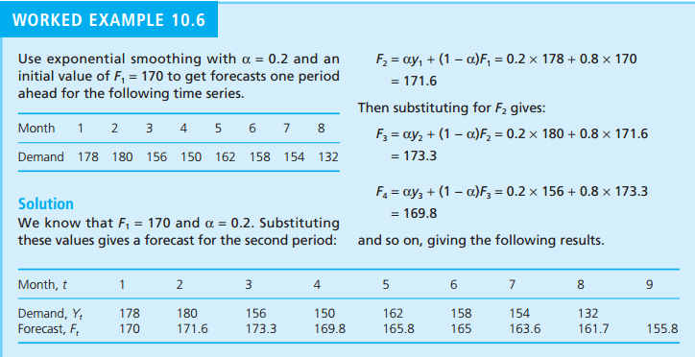
Week
10
Exponential smoothing
www.midocean.ae

Slide 44
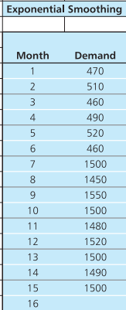
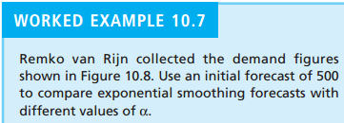
Week
10
Exponential smoothing
α is 0.1 , 0.2 , 0.3 , and 0.4
www.midocean.ae

Slide 45
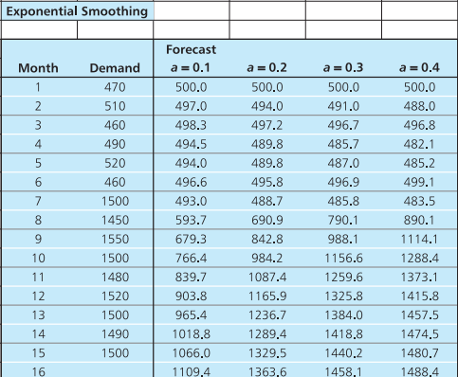
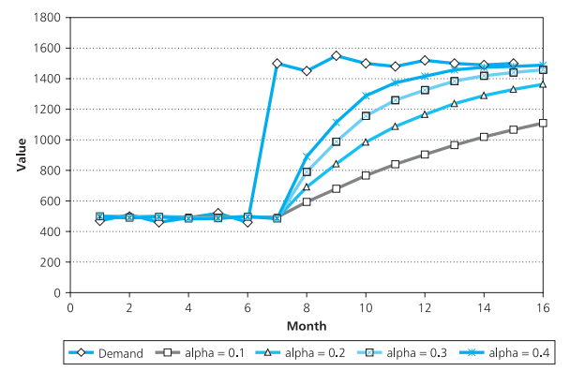
Week
10
Exponential smoothing
www.midocean.ae

Slide 46
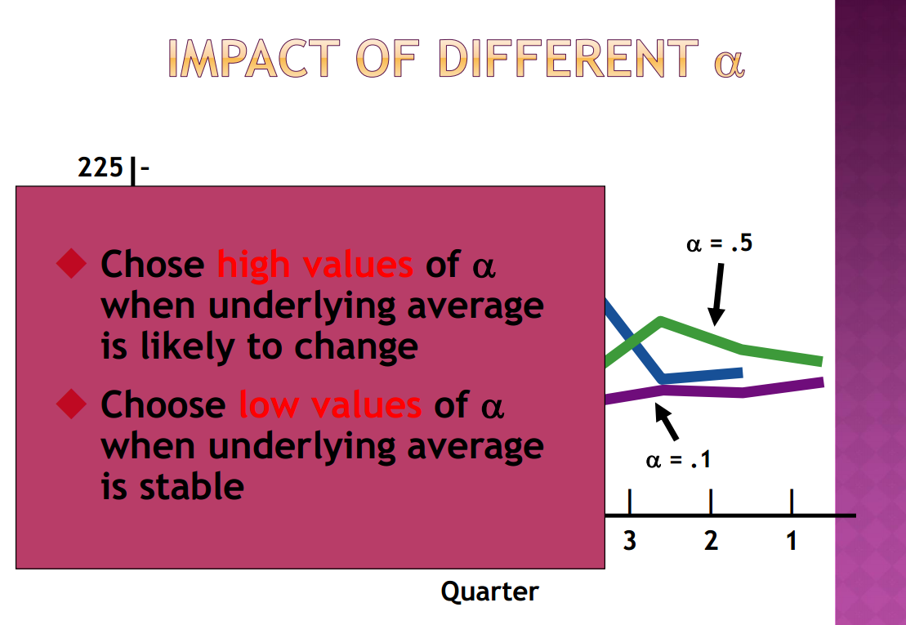
Week
10
Exponential smoothing
www.midocean.ae

Slide 47
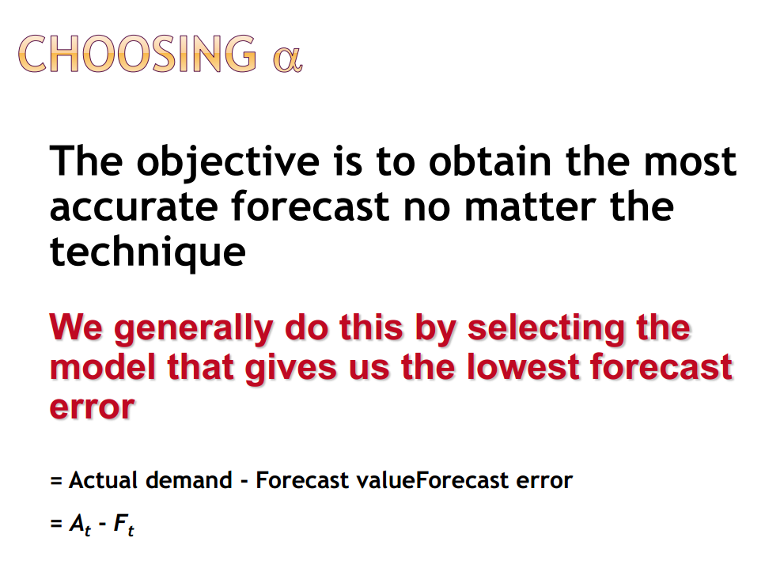
Week
10
Exponential smoothing
www.midocean.ae

Slide 48
Week
10
Exponential smoothing
www.midocean.ae

Slide 49
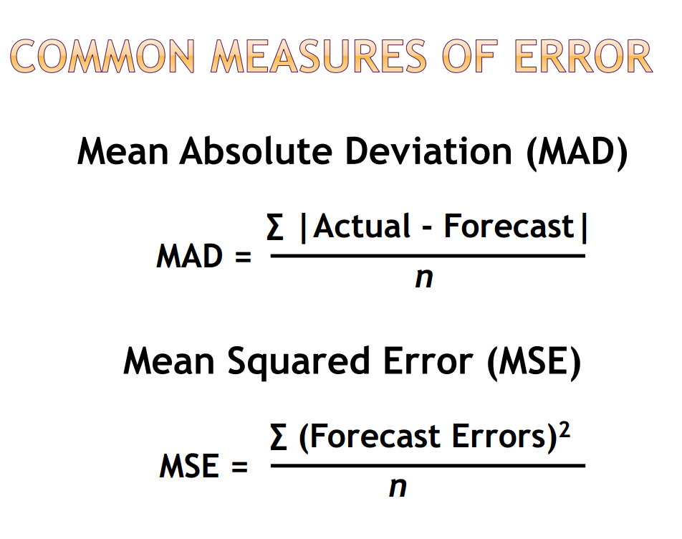
Week
10
Exponential smoothing
www.midocean.ae

Slide 50
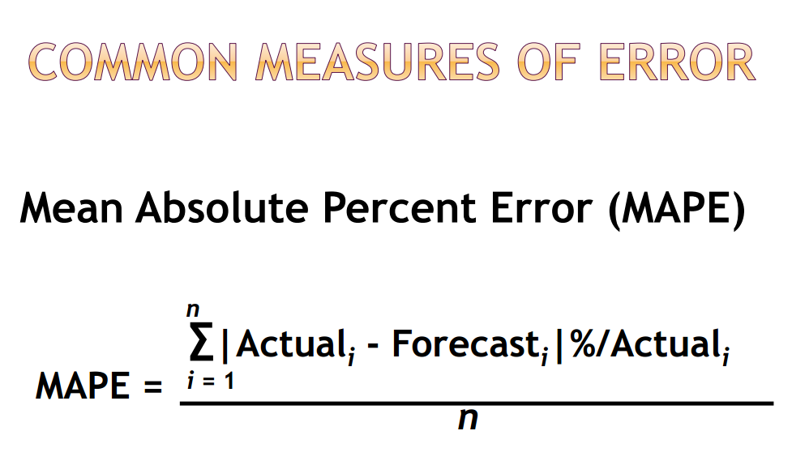
Week
10
Exponential smoothing
www.midocean.ae

Slide 51
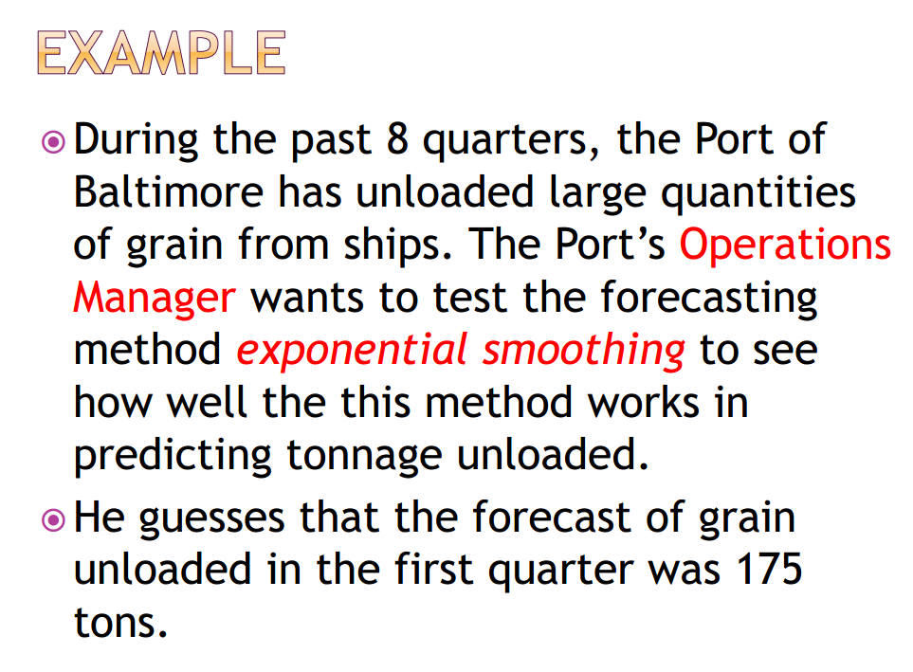
Week
10
Exponential smoothing
www.midocean.ae

Slide 52
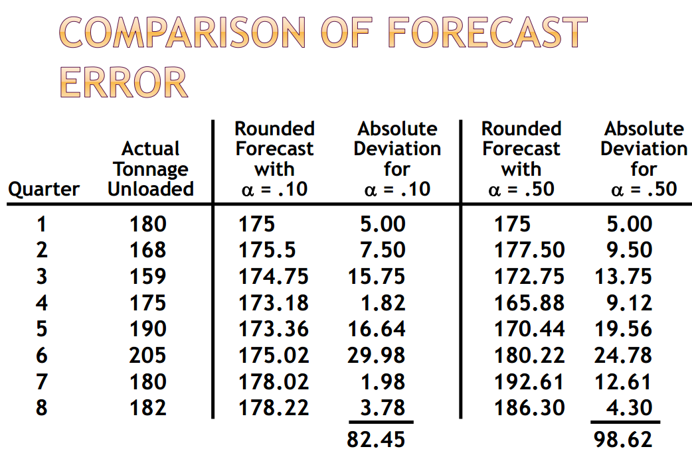
Week
10
Exponential smoothing
www.midocean.ae

Slide 53
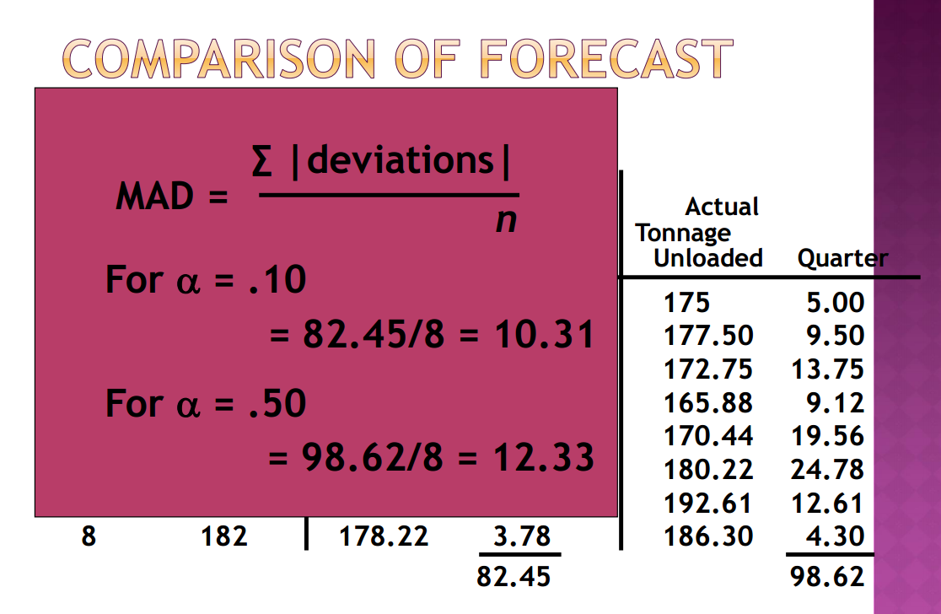
Week
10
www.midocean.ae

Slide 54
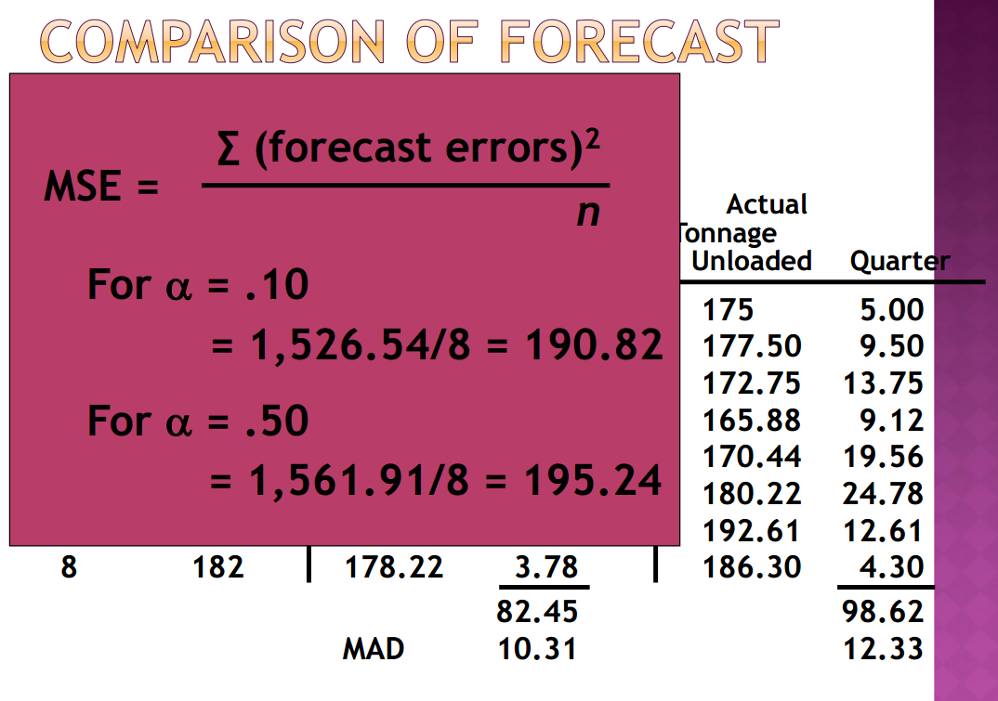
Week
10
www.midocean.ae

Slide 55
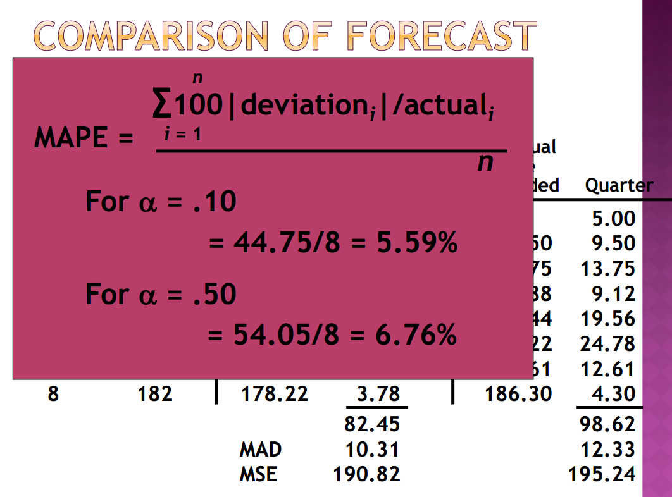
Week
10
www.midocean.ae

Slide 56
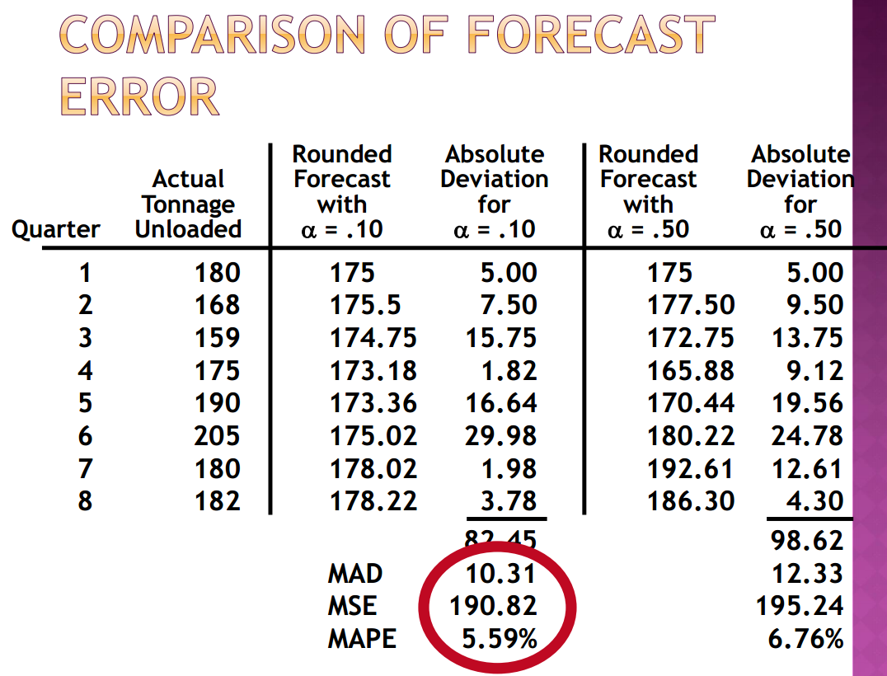
Week
10
www.midocean.ae

Slide 57
Week
10
    Forecasts with seasonality and trend
www.midocean.ae

Slide 58
Week
10
Forecasts with seasonality and trend
    The earlier methods we have described so far give good results for constant time series
    but they need adjusting for other patterns
      The easiest way of doing this is to divide the underlying pattern into separate components,
      Then forecast each component separately
      Then we get the final forecast by recombining the separate components.
      The observation is made up of three components
      Trend(T) is the long-term direction of a time series
      Seasonal factor(S) is the regular variation around the trend, which shows the variation in demand over a year
      Residual(R) is the random noise that we cannot properly explain.
www.midocean.ae

Slide 59
Week
10
Forecasts with seasonality and trend
    Adding these three components gives an ‘additive model’ which assumes that an observation, y
www.midocean.ae

Slide 60
Week
10
Forecasts with seasonality and trend
    the seasonal factor, S, is an amount we add to the trend to allow for the season.
        If summer sales are 100 units higher than the trend, Shas a value of 100;
        if winter sales are 100 units lower than the trend, Shas a value of −100.
    This additive model is easy to establish,
        but it can underestimate variations, particularly when there is a significant trend.
www.midocean.ae

Slide 61

Week
10
Forecasts using multiplicative model
    it is better to use indices for seasonal variations, and put these into a ‘multiplicative model
    If summer sales are 50% higher than the trend, Shas a value of 1.5
    if winter sales are 50% lower than the trend, Shas a value of 0.5
    As we do not know the random elements R, we cannot include this in forecasts
www.midocean.ae

Slide 62
Week
10
Exponential smoothing with Trend adjustment
www.midocean.ae

Slide 63
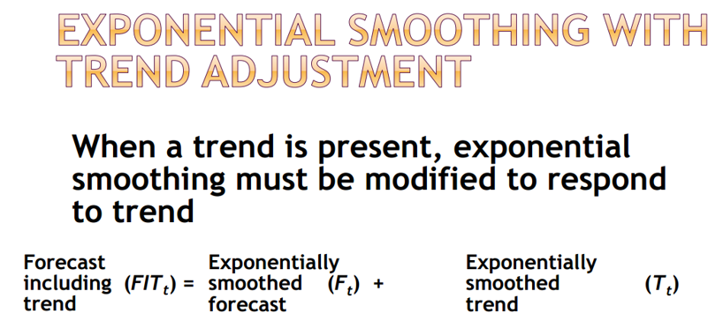
Week
10
Exponential smoothing with Trend adjustment
www.midocean.ae

Slide 64
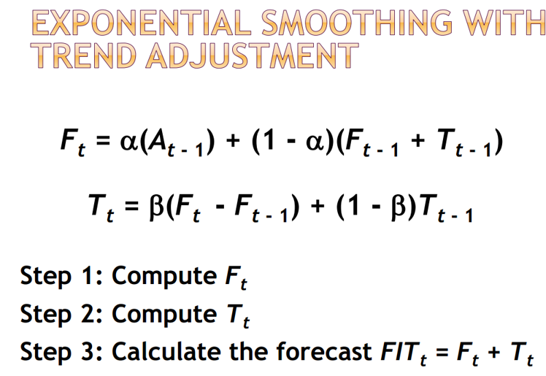
Week
10
Exponential smoothing with Trend adjustment
www.midocean.ae

Slide 65
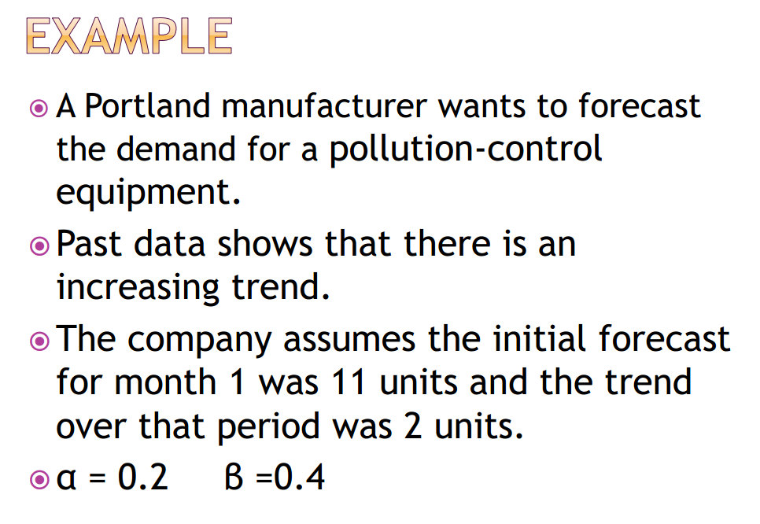
Week
10
Exponential smoothing with Trend adjustment
www.midocean.ae

Slide 66
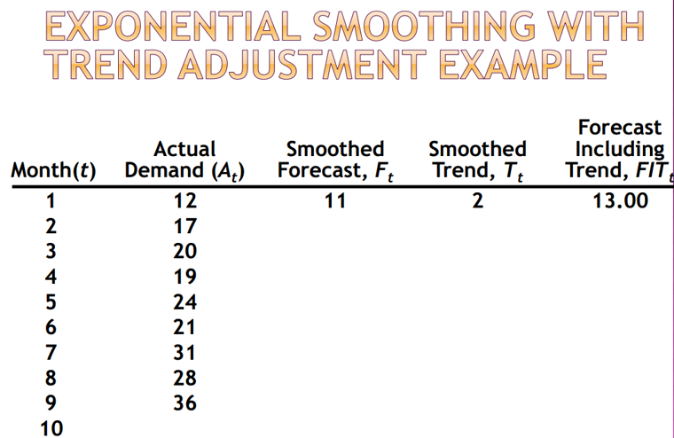
Week
10
Exponential smoothing with Trend adjustment
www.midocean.ae

Slide 67
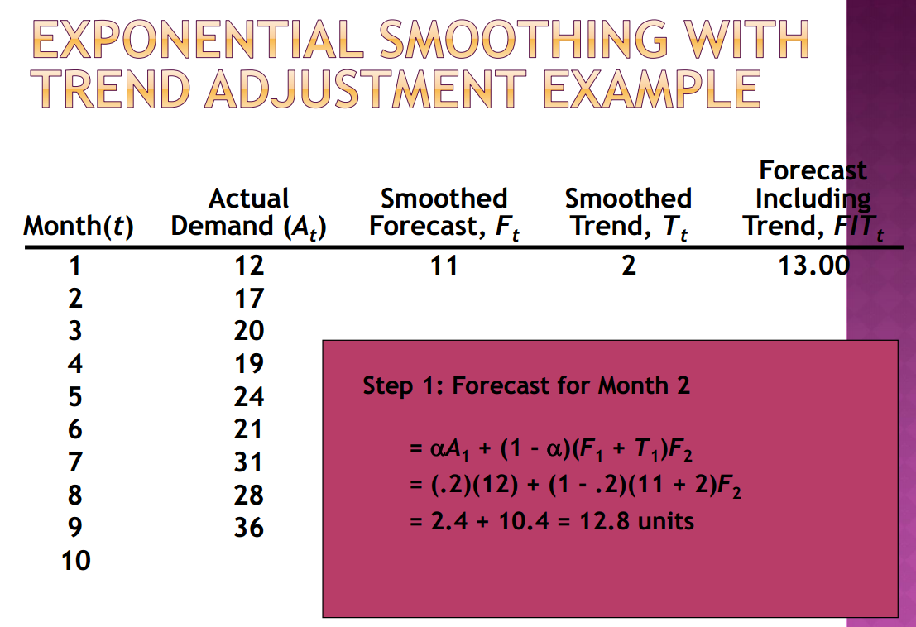
Week
10
Exponential smoothing with Trend adjustment
www.midocean.ae

Slide 68
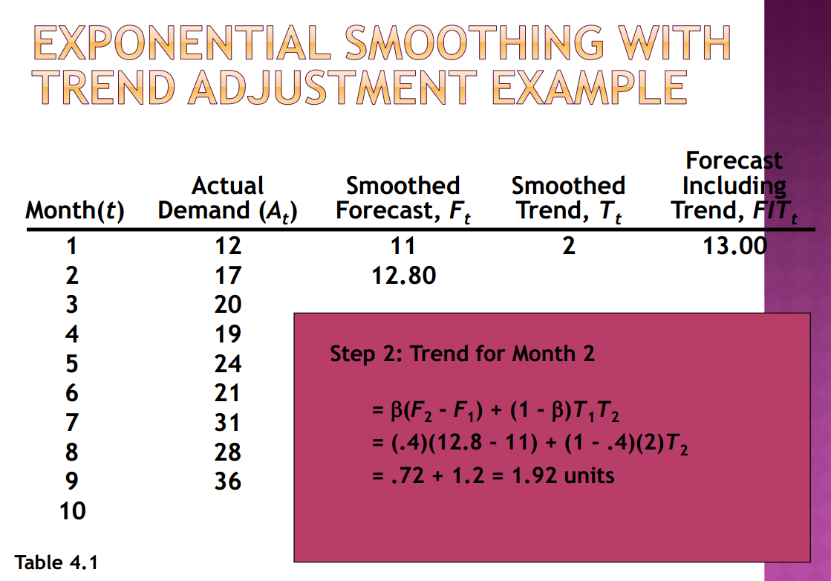
Week
10
Exponential smoothing with Trend adjustment
www.midocean.ae

Slide 69
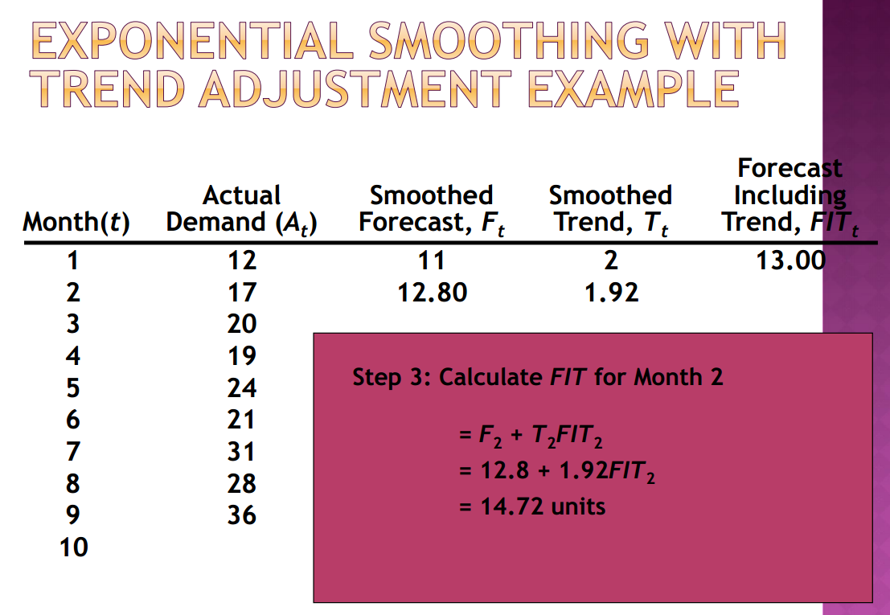
Week
10
Exponential smoothing with Trend adjustment
www.midocean.ae

Slide 70
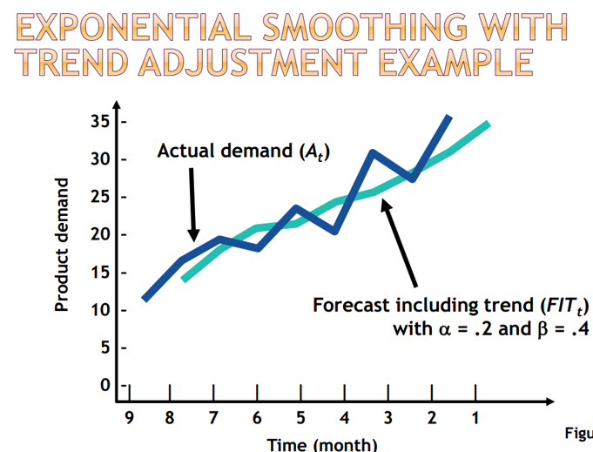
Week
10
Exponential smoothing with Trend adjustment
www.midocean.ae

Slide 71
Week
10
Trend Projection
www.midocean.ae

Slide 72
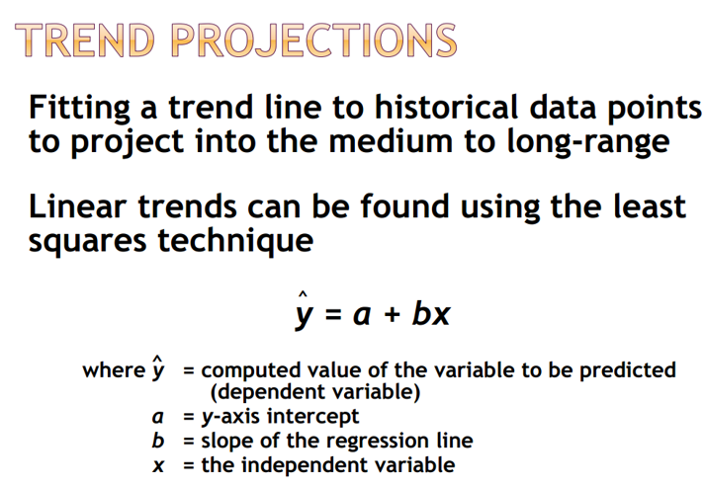
Week
10
Trend Projection
www.midocean.ae

Slide 73
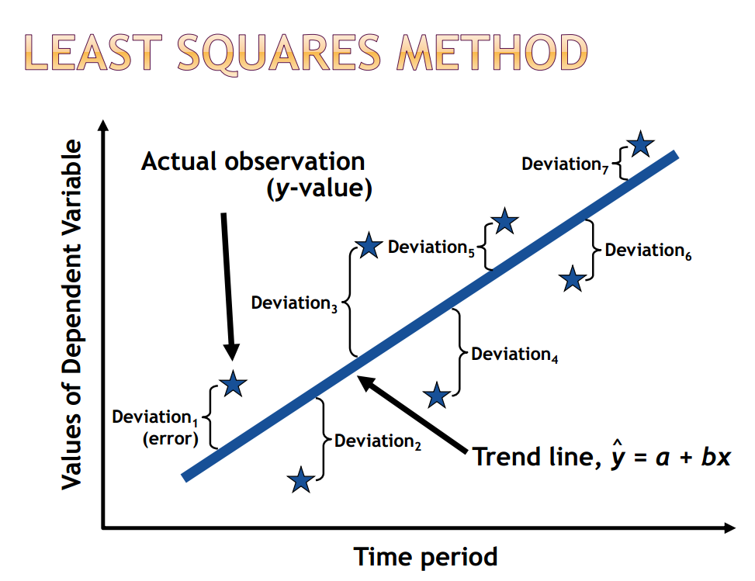
Week
10
Trend Projection
www.midocean.ae

Slide 74

Week
10
Trend Projection
www.midocean.ae

Slide 75

Trend Projection
75

Slide 76
Week
10
Trend Projection
www.midocean.ae

Slide 77

Week
10
Trend Projection
www.midocean.ae

Slide 78

Week
10
Trend Projection
www.midocean.ae

Slide 79

Week
10
Trend Projection
www.midocean.ae

Slide 80



Thank You

