Slide 1



Digital Analytics
MKT631
Lecture 2
Prepared by
Dr. Karim Ahmed
www.midocean.ae

Slide 2
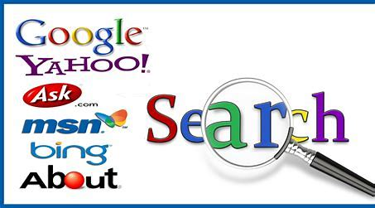
Search Engines
and the Internet

Slide 3

Lecture Content
Search Engines: Introduction
Types of Search Engines
Essential Functions of Search Engines
How Search Engines Work?
Search Engine Analytics
Best Practices for Doing SEO for Digital Marketing
Search Engine Optimization as Owned Media
Consumer Behavior and Search
Key Search Measures
www.midocean.ae

Slide 4
Search Engines
Search engines are Internet services or software designed to search information
on the Web that corresponds to a request (e.g., keywords) specified by the user.
Considering that there are billions of websites on the Internet, search engines play a
crucial role in helping us find the right information in a limited amount of time.
A search engine serves as the gateway to social media and helps find information.
Search engines yield two types of search results: organic and paid. Businesses
use marketing to optimize the search results to their advantage.
www.midocean.ae

Slide 5
Search Engines
Search engines rank organic results based on more than 200 ranking factors in an algorithm. Based on organic search ranking factors, businesses primarily focus on Search Engine Optimization (SEO), the process of optimizing a website to receive the most visitors through a search engine. By contrast, Search Engine Marketing (SEM) focuses on paid search business solutions. SEM involves the process of buying traffic through paid search listing paired to specific keywords that are being searched for on the search engine.
www.midocean.ae

Slide 6
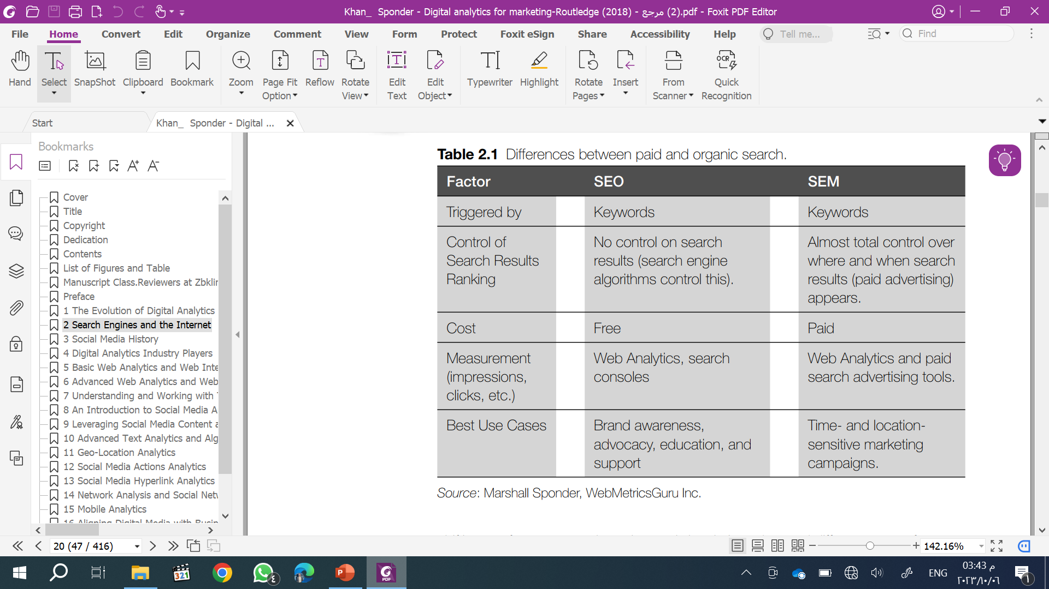
Search Engines
www.midocean.ae

Slide 7
Types of Search Engines
Based on the mechanisms they operate; search engines can be divided into three
categories:
• Crawler-based
• Directories
• Meta search engines
www.midocean.ae

Slide 8
Types of Search Engines
• Crawler-based Search Engines
As the name suggests, crawler-based search engines create their databases or lists
automatically without any human intervention. Examples of crawler-based search
engines are Google.com and Bing.com. Crawler-based search engines are widely
used to find and access content over the Internet. They operate in three steps:
1. Web crawling
2. Indexing
3. Searching
www.midocean.ae

Slide 9
Types of Search Engines
• Crawler-based Search Engines
1. Web crawling
Search engines start by collecting and storing information about webpages. This mechanism is termed Web crawling. A Web crawler, also known as a Web spider or bot, is a computer program or software specifically designed to collect and store data about websites for indexing.
2. Indexing
Indexing helps classify a site correctly for searching purposes. The data crawled or extracted is then indexed and stored in a database for quick access. Every search engine may follow different techniques for indexing webpage data. Common indexing techniques include storing meta tags, which are used in the header of a webpage and provide descriptions of the website and keywords related to a website.
www.midocean.ae

Slide 10
Types of Search Engines
• Crawler-based Search Engines
3. Searching
Searching is the final step in search engine operations. When a user requests specific information by entering keywords in a search engine, the search engine queries the index and provides a list of the most relevant webpages by matching it with the indexed keywords.
However, it may not be that simple. Search engines use a variety of factors to rank
and provide a list of matching websites based on:
• On page: Content quality as determined by search algorithms.
• Off page: Links from other websites, search engines, social media, and email.
• Metadata and usability: Title, description, keywords, alternative text, custom meta tags, mobile accessibility, page display speed, etc.
www.midocean.ae

Slide 11
Types of Search Engines
• Directories
The directory listings are manually compiled and created by human editors. People who want to be listed in a directory submit an address, title, and brief description of their website, which is then reviewed by the editor and included in it. Some good examples of human-created directories are Yahoo Directory, Open Directory, and LookSmart.
www.midocean.ae

Slide 12
Types of Search Engines
• Meta Search Engines
Meta search engines compile and display results from other search engines. When
a user enters a query, the meta search engine submits the query to several individual
search engines, and results returned from all the search engines are integrated, ranked, and displayed to the user. Examples of meta search engines include
Metacrawler, Mamma, and Dogpile. By integrating results from several search engines, meta search engines are capable of handling large amounts of data and can save time by focusing on one meta search engine.
www.midocean.ae

Slide 13
Essential Functions of Search Engines
Digital marketers use search engines for:
• Brand awareness: A brand is seen and recognized by consumers in a top search result once a branded search term or the name of the brand is searched for.
• Online sales: Search engines drive traffic to webpages to purchase a product or
service.
• Lead generation: Organic search can acquire potential consumers through the content or targeted keywords used. Paid search aids in search and Web Analytics, which can be employed in Return on Investment (ROI) calculations.
www.midocean.ae

Slide 14
How Search Engines Work?
The Three-Step Search Engine Process
1. Search indexes evolved as a sorted “master list” of the websites and pages of each website currently available on the World Wide Web, found by the Internet crawlers a search engine employs to get the data in the first place.
2. Once a user enters a search term or phrase, it is evaluated by the search engine, which tries to understand what the term means and identify any misspellings present.
3. The most relevant pages in the search index are matched with the query and served up to the user by the search engine, operating on its unique set of search algorithms.
www.midocean.ae

Slide 15
Search Engine Analytics
When we talk about search engine analytics, we mean two things:
1. Search Engine Optimization (SEO)
2. Search engine trends analysis
www.midocean.ae

Slide 16
Search Engine Optimization and Search Engine Marketing
Search Engine Optimization (SEO) is the set of techniques used to improve a
website’s ranking on a Search Engine Result Page (SERP). A SERP is the list of the
results returned by a search engine in response to a user’s query.
Organic and Paid Search Results
There are a couple of main differences between organic (unpaid) and paid search
results. Paid search results are tailored to the searcher. paid search results are paid advertisements. For example, if you search ‘cars’ frequently, you will see more ads for cars as then your paid search results will be related to that as well.
Organic results appear mainly because of their relevance to the user’s query.
www.midocean.ae

Slide 17
Search Engine Optimization and Search Engine Marketing
A study tested the effect of sponsored ad ranks on the click-through and conversion rates for an online retailer and found that top positions usually had higher click-through rates, but not necessarily higher conversion rates. Conversion rates depend on the searcher’s experience on the landing page(s) and are not under the search engine’s direct control.
Search engines are becoming more intelligent and successful in matching search
results with a searcher’s experience on landing pages via algorithms and analytics.
www.midocean.ae

Slide 18
Search Engine Optimization and Search Engine Marketing
Social media marketers strive to develop search engine strategies to make their websites appear at the top of search results. When a site appears on the first page of
the search results, users are more likely to pay attention to it. Search engine ranking
is even more crucial to the business owners when the website is selling products or
services. High rankings on SERPs can mean more Internet traffic to a website, which
in some cases converts to more paying clients and higher return on investment. For
social media marketers, it is important to understand the mechanism behind the SERP ranking. There may be a variety of factors search engines consider to rank websites, such as keywords and relevance.
www.midocean.ae

Slide 19
Search Engine Optimization and Search Engine Marketing
However, the most important factor that determines SERP ranking is the PageRank. PageRank is an algorithm used by Google search engines to rank websites’ SERPs. The higher-ranking websites are displayed on the top of the search results page. Google’s PageRank algorithm predominantly relies on the quality of incoming hyperlinks, in-links, to rank websites.
Users can access SEO metrics by using free SEO tools such as Open SEO Stats;
an extension for Google Chrome is available at http://pagerank.chromefans.org. With
Open SEO Stats, users can determine the ranking of a website based on Google
PageRank. Google PageRank uses a scale of zero to ten to indicate the importance
the Google search engine allocates to the page.
www.midocean.ae

Slide 20
Search Trend Analytics
Search engine trends analytics deals with analyzing and understanding the keywords people use in a search engine against a timeline, such as a month or year, or even across several years. Consequently, search engine data is a gateway into the minds of customers. Through search engines, customers find what they want. Thus, search trend analysis can provide valuable information to the social marketers.
Google Trends is one of the most insightful trend analysis tools. Google Trends uses massive amounts of search engine data to analyze the world’s interests and predict trends.
www.midocean.ae

Slide 21
Search Trend Analytics
From a business perspective, Google Trends can help answer a variety of questions, including the following:
• How do people search for your brand?
• When does interest spike in your products or services?
• Which keywords are driving more traffic?
• Which regions are interested in your brand?
• What are trending topics over the Internet?
• How are your competitors performing?
www.midocean.ae

Slide 22
Search Trend Analytics
The following are commonly used social media analytics tools; most of them are also free to use.
• Google Trends is a search engine analytics tool. More information is available at
http://trends.google.com.
• Canopy is a multimedia analytics tool designed to support deep investigation of large multimedia collections, such as images, videos, and documents. More information on Canopy is available at www.vacommunity.org/article32.
www.midocean.ae

Slide 23
Search Trend Analytics
• Google Alerts is a content detection and notification service that automatically
notifies users when new content appears on the Internet (e.g., social media, the Web, blogs, video, and discussion groups) matches a set of search terms based on user queries. Users are alerted through email. More information is available at www.google.com/alerts.
• Icerocket specializes in blog searches and captures activity on Facebook, X, and Flickr. More information is found at www.icerocket.com.
• TweetBeep is like Google Alerts for Twitter. Users choose keywords and receive
daily search results via email. More information is available at http://tweetbeep.com
www.midocean.ae

Slide 24
Best Practices for Doing SEO
for Digital Marketing
www.midocean.ae

Slide 25
For an effective SEO strategy, keyword research has the most value, but there are no shortcuts to developing SEO as an effective marketing channel. The general guidelines suggest that choosing the right “words” or “keywords” seems to be the best strategy, but that keyword should be supplemented with compelling content geared to your audience. Spending time creating interesting content for specific website visitors is the most effective SEO tactic, but it is also one of the most difficult to do effectively or to scale since content creation is time-consuming and the results are incalculable. On the other hand, keyword research takes less effort and is effective. In fact, the process of creating new content and choosing the best keywords for it takes so much time and effort that a marketer must make informed choices as to best allocate their time and resources.
www.midocean.ae

Slide 26
URLs
Uniform Resource Locator (URL) is used to specify addresses on the World Wide Web. A URL is the fundamental network identification for any resource connected to the Internet (e.g., hypertext pages, images, and sound files).
While URLs should be unique to a site, they are carefully considered before they are assigned. For example, a URL should include the most relevant keywords because search engines still consider keywords within URLs as a ranking factor. Additionally, relevant keywords in URLs help target audiences recall the website. Keywords strategically placed in the URL help search engines to understand the meaning within the content of webpages and websites. Thus, searchers are provided with more relevant content, based on what they are searching for.
www.midocean.ae

Slide 27
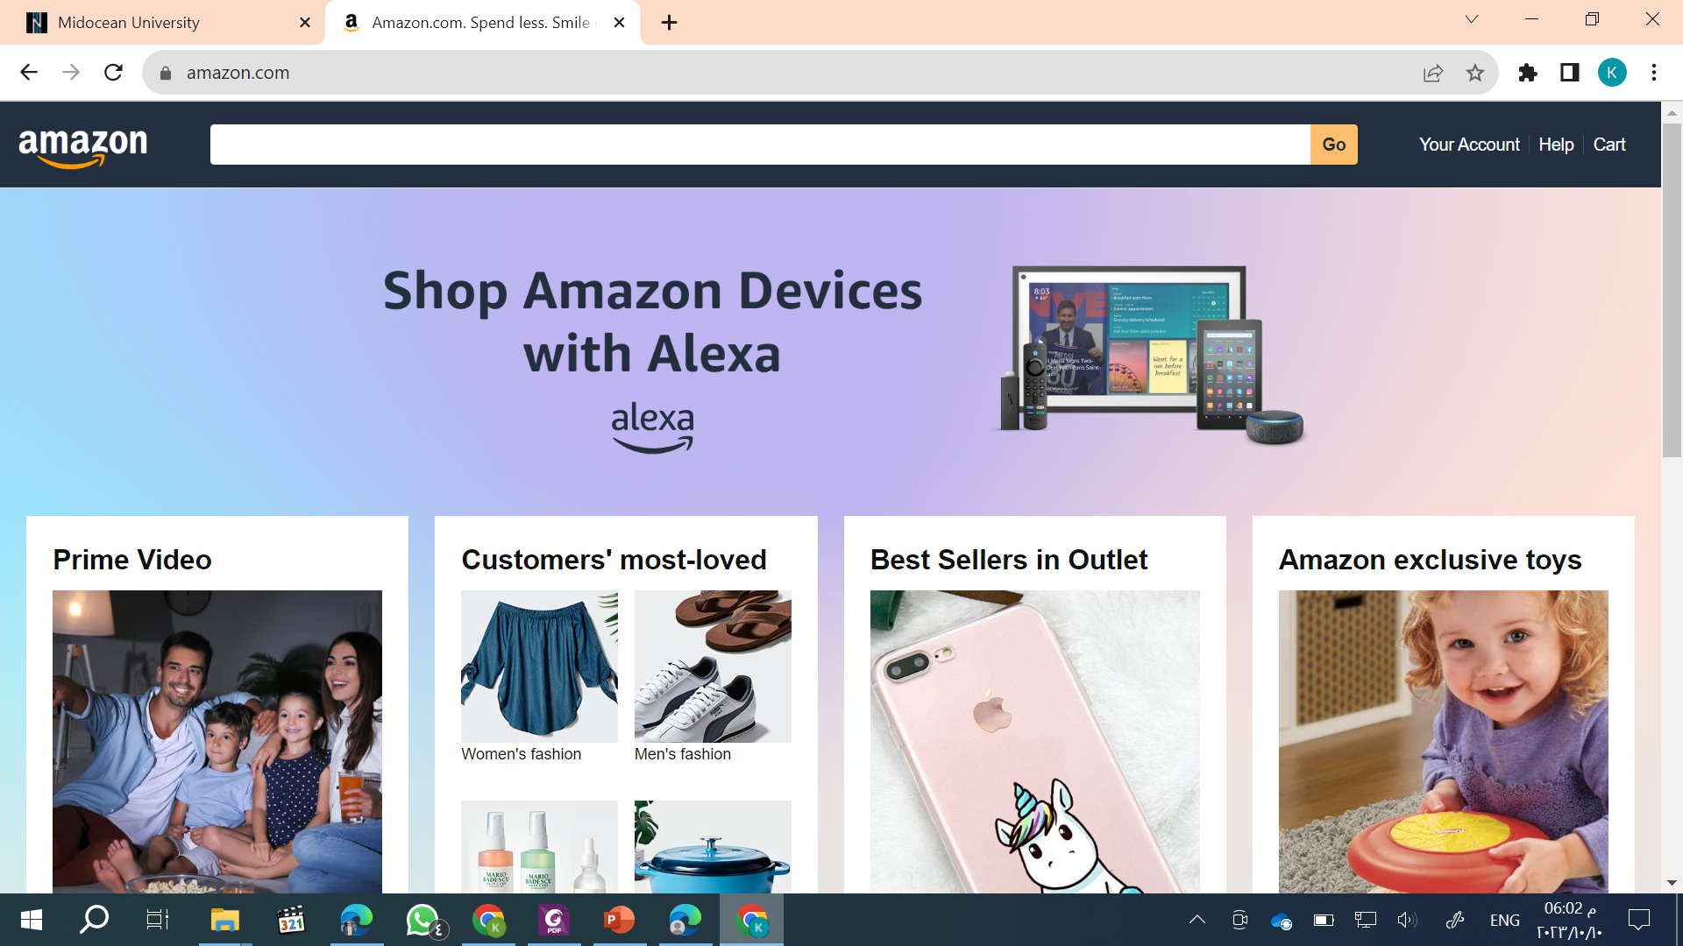
Title Tag
The title tag is an HTML element critical to both SEO and user experience. It briefly and accurately describes the topic and theme of an online document. The title tag is displayed in the top bar of Internet browsers.
www.midocean.ae

Slide 28
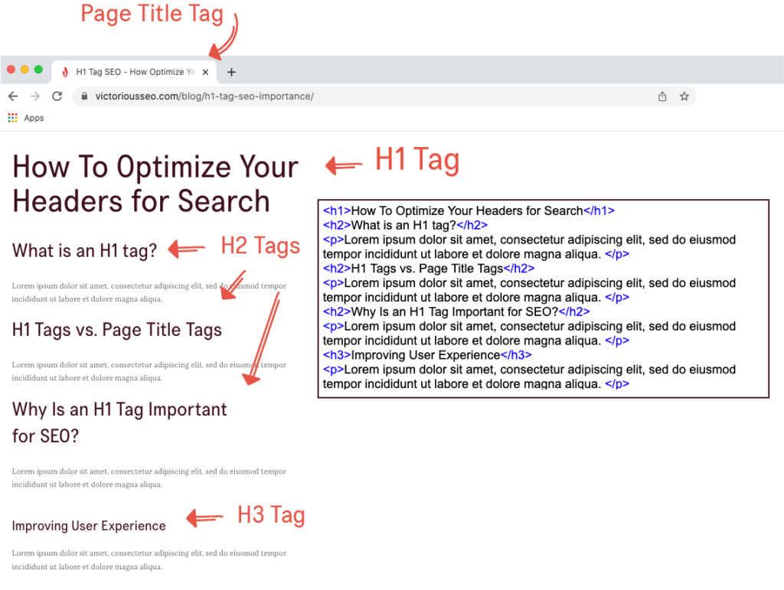
Header Tags
The header tag, or the <h1> tag in HTML, will usually be the title of a post, or other emphasized text on the page. It will usually be the largest text that stands out. There are other header tags in HTML like an h2, h3, h4, etc.
www.midocean.ae

Slide 29
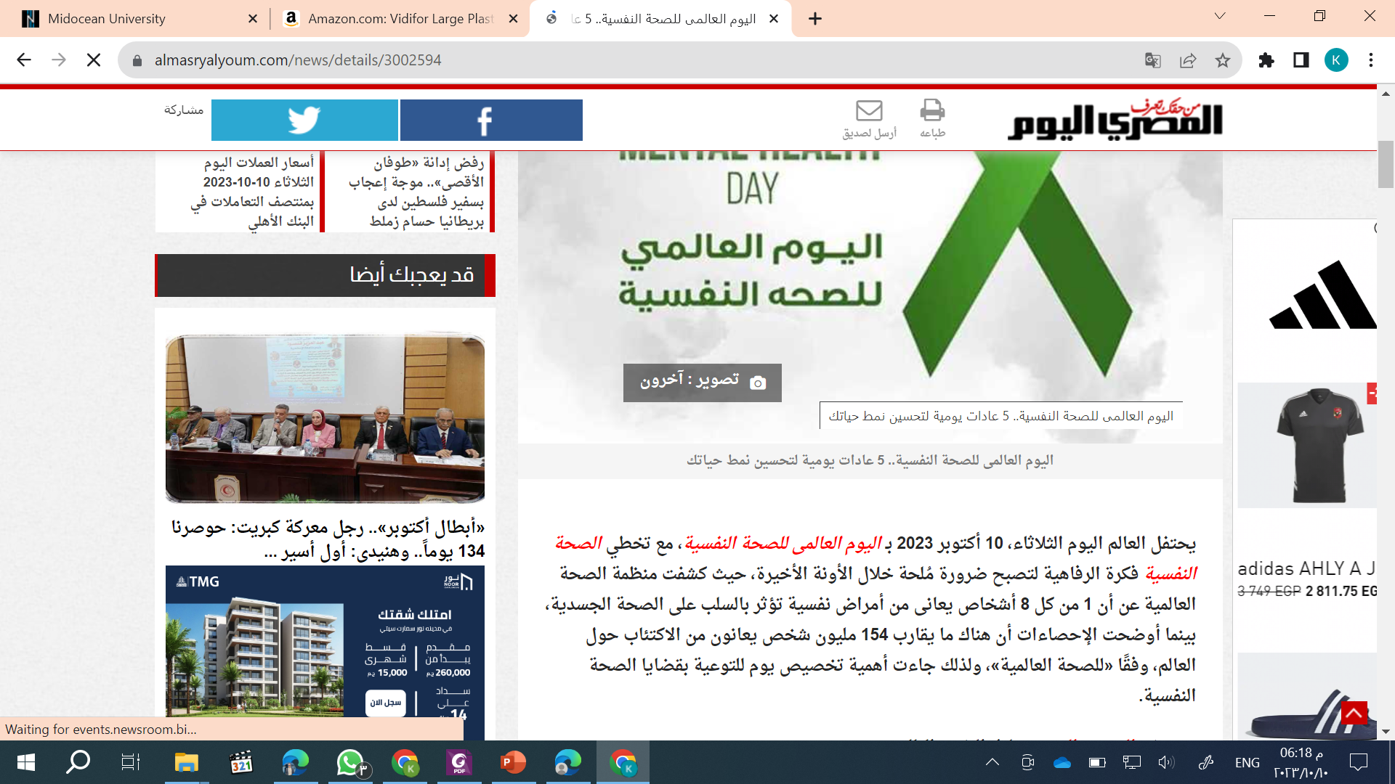
Main Content (Body Text)
The main content is not usually the first item on a webpage. Users must navigate through an extensive list of navigation links, sub-lists of links, corporate icons, site searches, etc. before arriving at the main content.
www.midocean.ae

Slide 30
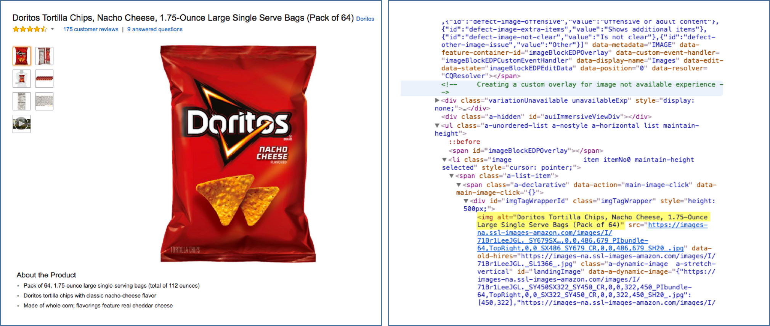
Alt Text
Alternative text (alt text) is a word or phrase inserted as an attribute in an HTML document to tell website viewers the nature or contents of an image. The alt text appears in a blank box that would normally contain the picture.
www.midocean.ae

Slide 31
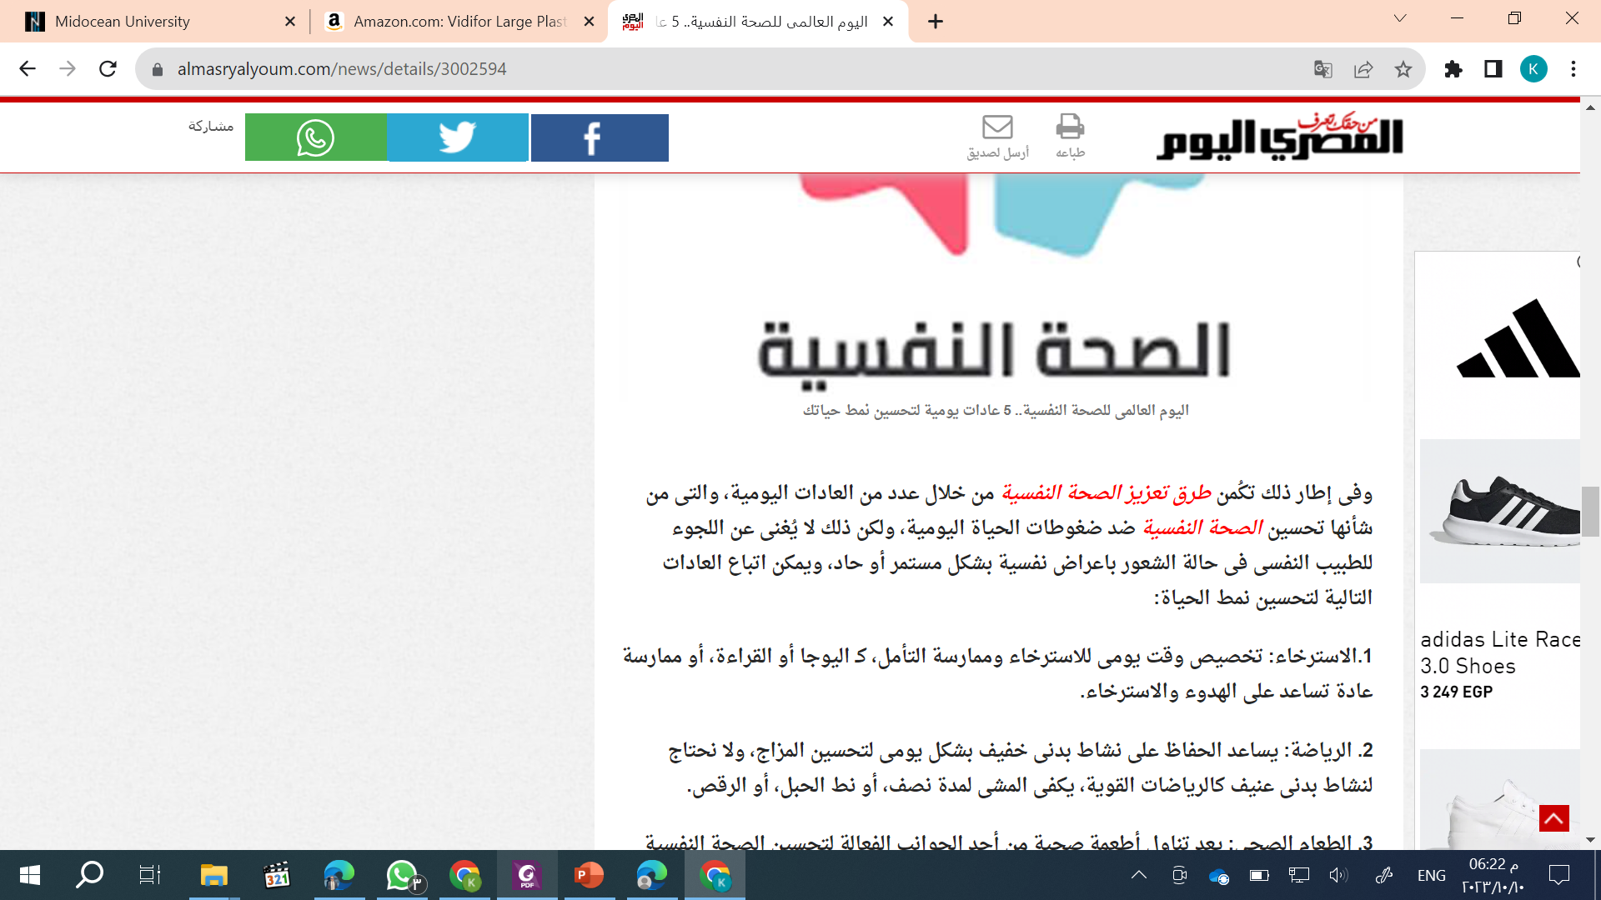
Anchor Text
Anchor text is highlighted in a hypertext link and can be clicked on to open the target
webpage.
www.midocean.ae

Slide 32
Organic Search
Organic search engine optimization involves creating or changing website copy and
site links for high search engine results. When websites have optimized content and
keyword meta tags, search engines know how to categorize the site more efficiently.
Organic search is still considered “free visibility.” Any business or blog can rank highly on an organic search result, but the amount of work put into SEO may still not result in achieving the top result. Results can be imprecise. However, it is usually a profitable investment over the long term.
www.midocean.ae

Slide 33
Principles of SEO
• Design for relevant and popular content
• Optimize content
• Spread content for the entirety of the Web
• Adjust site to changing search algorithms
www.midocean.ae

Slide 34
Search Engine Optimization as Owned Media
SEO is a process of working on pages or websites that a stakeholder has access to
(i.e., a webmaster or business owner/operator). SEO is an owned media channel.
One controls and leverages organic content to capture and keep consumers.
Owned media content is improved through optimization techniques. The result of effective SEO is more visibility or higher ranking in search results and more search referrals to the site.
www.midocean.ae

Slide 35
Search Engine Optimization as Owned Media
However, effective search engine optimization is not easy to do. Business and site owners are being told by search engines to focus on the quality of their content
and user experience instead of focusing on the manipulation of Internet search
capabilities.
Now, businesses are spending time and energy on specialized marketing analytics by channel. Marketing analytics is specialized because no single analytics platform captures all the readouts on all marketing channels.
www.midocean.ae

Slide 36
Consumer Behavior and Search
The way consumers engage with online search engines is evolving. Recent trends in queries demonstrate shifts in consumer interests, needs, and intent. Google reports that near me searches are increasing across almost every category, with people combining locally sensitive searches with other intent signals.
www.midocean.ae

Slide 37
Consumer Behavior and Search
In 2018 and 2019, “where to buy” + “near me” mobile queries increased more than 200 percent. Examples include “where to buy flowers near me,” “where to buy stamps near me,” and “where to buy pumpkins near me.” During that time, mobile
searches for “store open near me” (“grocery store open near me” and “auto parts store open near me”), and “on sale” + “near me” (“tires on sale near me” and “houses on sale near me”) increased more than 250 percent year over year.
www.midocean.ae

Slide 38
Key Search Measures
www.midocean.ae

Slide 39
As we’ve seen, understanding what consumers look for as they search online is an important component to a brand’s success. But how can the brand understand what works (and what doesn’t) in search marketing? Every brand online should track a few critical metrics:
www.midocean.ae

Slide 40
Click-Through Rate
Click-through rate is a very important metric that identifies the percent of consumers who saw a search ad and clicked on it. The number can help gauge the effectiveness of search strategies that target consumers, as well as the design’s effectiveness in engaging consumers.
In Google Ads, you can access CTR data for your advertising campaigns. It is an essential metric to evaluate the performance of your ad campaigns.
www.midocean.ae

Slide 41
Conversion Rate
Conversion rate is the percent of consumers who, after clicking on a search ad, take action on the linked page. Tracked actions include making a purchase on the page, downloading a file, or any number of activities the brand deems to be positive.
You can track conversion rates for your advertising campaigns through:
Google Ads, Google Analytics, and Google Tag Manager.
www.midocean.ae

Slide 42
Cost Per Action
Another metric that’s important to assessing search marketing success is cost per action (CPA). This measure takes the cost invested in a search campaign and divides that cost by the number of a tracked consumer action. Those actions could be clicks – cost per click, or CPC – or any other conversion actions the brand deems important.
www.midocean.ae

Slide 43
Impression Share
Impression share is the number of impressions a search ad received divided by the number of impressions the ad was eligible to receive. Effectively, impression share measures the percent of times an ad showed up in a SERP when a consumer entered a search on which the advertisers placed a bid.
Impression Share is a metric used in online advertising, primarily in platforms like Google Ads. It measures the visibility and reach of your advertisements by indicating the percentage of times your ads were displayed to users out of the total number of opportunities they could have been shown. In simpler terms, it tells you how often your ads were seen relative to how often they could have been seen.
www.midocean.ae

Slide 44
Share of Search (SOS)
Measuring a brand’s relevance to consumers’ online searches provides a sense for awareness, interest, and many other key brand attributes. Calculate share of search (SOS) by dividing the number of searches for a brand by total searches conducted for brands in the category.
For example, auto manufactures can gain great insight into the popularity of their vehicles by comparing the searches conducted for one of their sedans against all searches for sedans. Analysts can conduct SOS at a company level, brand level, or product level, and can compare the item being searched against the entire market or a select group of key competitors.
www.midocean.ae

Slide 45
In this lecture, we discussed:
Search Engines:
(Introduction - Types - Essential Functions - How does it Work?)
Search Engine Analytics
Best Practices for Doing SEO for Digital Marketing
Search Engine Optimization as Owned Media
Consumer Behavior and Search
Key Search Measures
www.midocean.ae

Slide 46


Thank You

