Slide 1
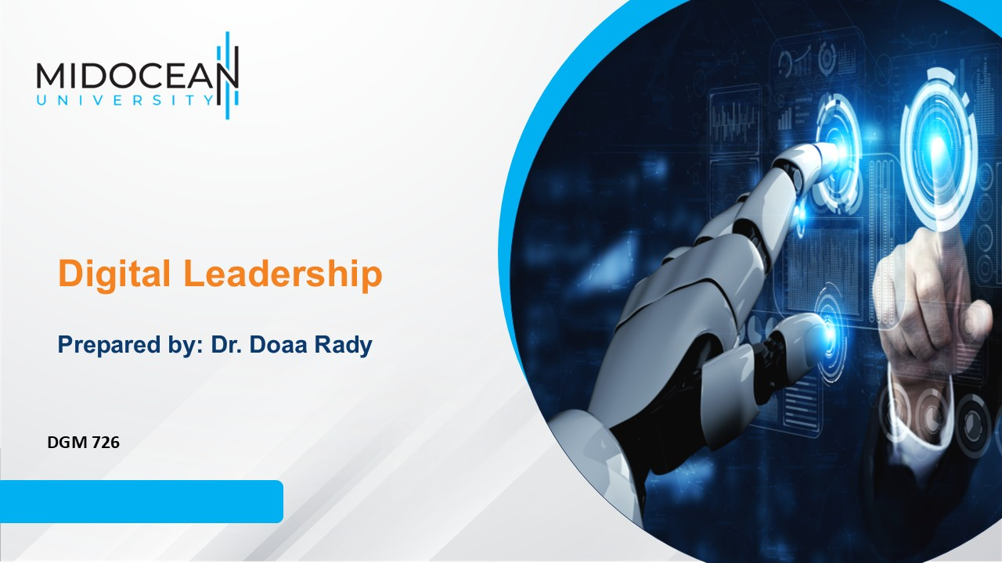
Lecture 1
Management & Leadership

Slide 2

Learning Aims from Live sessions
Go deep by discussion and examples
Connect Lectures’ Topics
Answer Questions
Lec.1
Leadership
Digitization & Digitalization
Media

Slide 3
Lec.1
Previous Lecture
Introduction about Leadership & Management
Managers vs. Leaders
Values, Attitude & Behavior

Slide 4
Lecture outline
What is Management?
Why management is important?
Levels of Management
Management Functions
Organizational Performance
What are Management Roles?
Qualities of Successful Managers
What is Leadership and Digital Leadership?
Leadership Functions
Comparison Bet. Mangers & Leaders Activities
Lec.1

Slide 5
Lec.1
Learning Outcomes
This lecture aims to understand management & leadership definitions and functions with examples in media industry.
It aims to compare between Mangers & Leaders Activities

Slide 6

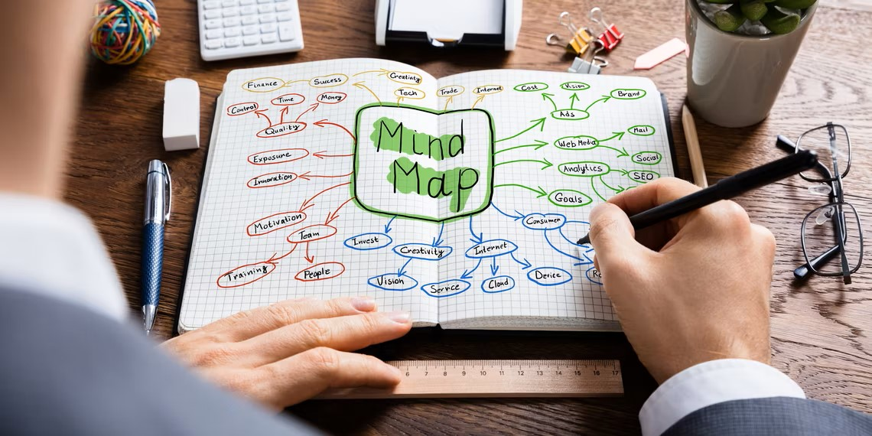
How to Study?
Mind Map
Lec.1

Slide 7
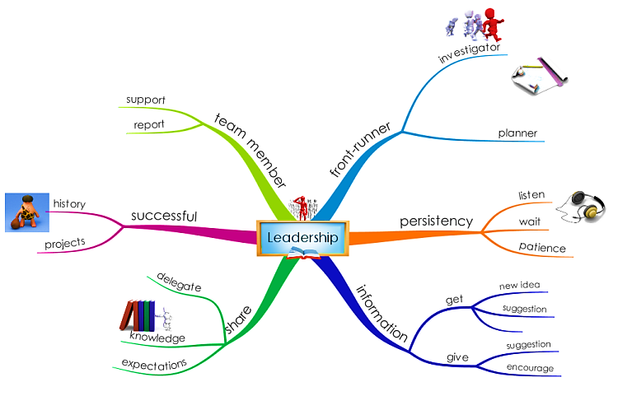
How to Study?
Mind Map
Lec.1

Slide 8
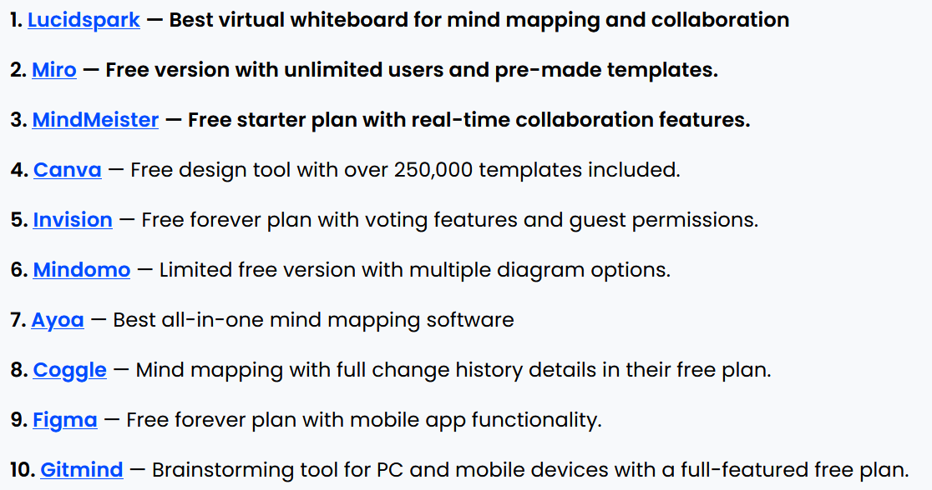
How to Study?
Mind Map
Lec.1
Coggle
GitMind
InfoRapid KnowledgeBase Builder
Scapple
Wondershare EdrawMind
Source: https://www.makeuseof.com/tag/8-free-mind-map-tools-best-use/
Source: https://thedigitalprojectmanager.com/tools/best-free-mind-mapping-software/

Slide 9
Lec.1
What is Management?

Slide 10
Lec.1
What is Management?
Management is a process which exists to get results by making the best use of the human, financial & material resources available.
The planning, organizing, leading, and controlling of human and other resources to achieve organizational goals effectively and efficiently.بفعالية وكفاءة

Slide 11
Lec.1
What is Management?
Resources include people, skills, know-howالمعرفة العملية أو الخبرة التقنية and experience, machineryالآلات, raw materials, computers and IT, patentsبراءات الاختراع., financial capital رأس المال, and loyal customers and employees.
“It is the art of getting things done through others.”
(Mary Parker Follet)

Slide 12
Lec.1
Why management is important?
1. The more efficient and effective use of resources that organizations make of those resources, the greater the relative well-being and prosperity الرفاهية والرخاء of people in that society
2. Helps people deal with their bosses and coworkers
3. Opens a path to a well-paying job and a satisfying career

Slide 13

Lec.1
Are you satisfied with your career?
How many of you are considering a change?

Slide 14
Lec.1
What are Management Levels?

Slide 15
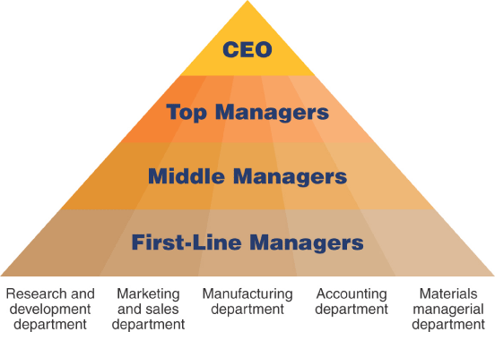
Lec.1
Levels of Management
Areas of Managers
Department
  A group of managers and employees who work together and possess similar skills or use the same knowledge, tools, or techniques

Slide 16
Lec.1
Levels of Management
First line managers - Responsible for daily supervision of the non-managerial employees who perform many of the specific activities necessary to produce goods and services
Middle managers - Supervise first-line managers. Responsible for finding the best way to organize human and other resources to achieve organizational goals

Slide 17
Lec.1
Levels of Management
Top managers – Responsible for the performance of all departments and have cross-departmental responsibility.
  Establish organizational goals and monitor middle managers
  Decide how different departments should interact
  Ultimately responsible for the success or failure of an organization
Chief executive officer (CEO) is company’s most senior and important manager
Strategies and plans
(discuss with top managers)

Slide 18
Lec.1
Management Functions

Slide 19
Lec.1
Management Functions
• Managers at all levels in all organizations perform each of the four essential managerial tasks of planning التخطيط, organizing التنظيم , leadingالقيادة , and controllingالتحكم والمراقبة .
Lower(الإدارة المباشرة) – Closely supervise work of subordinates المرؤوسين.
Middle (الإدارة الوسطى/التنفيذية)– Carry out activities to further goals of organization. (ex.: heads of sales, programming, marketing, etc.)
Top (الإدارة العليا)– Coordinate company’s activities and provide overall direction.

Slide 20
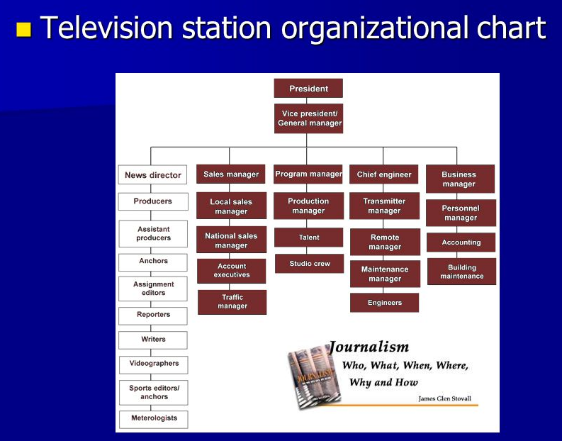
Lec.1

Slide 21
Lec.1
Management Functions
Four Functions of Management Includes defining goals, establishing strategy, and developing plans to coordinate activities.
Determining what tasks are to be done, who is to do them, how the tasks are to be grouped, who reports to whom, and where decisions are to be made.
Includes motivating subordinates, directing others, selecting the most effective communication channels, and resolving conflicts.
Monitoring activities to ensure they are being accomplished as planned and correcting any significant deviations.

Slide 22
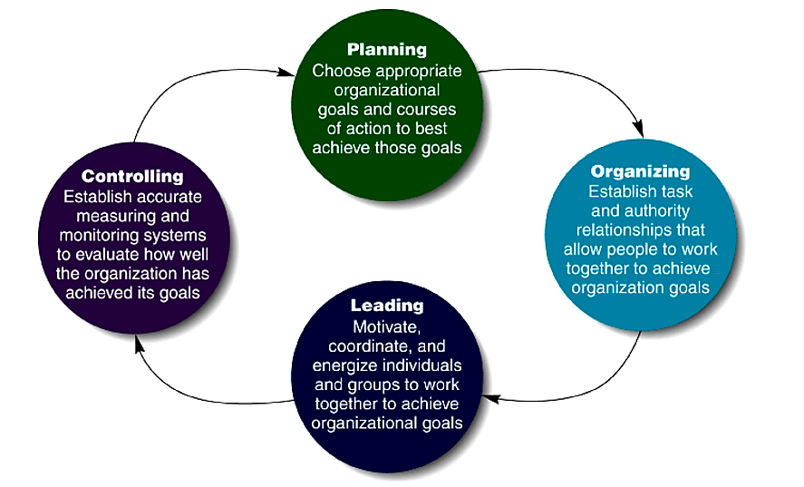
Lec.1
Management Functions

Slide 23
Lec.1
Management Functions
Planning is the process of identifying and selecting appropriate organizational goals and courses of actionمسارات العمل أو سبل الإجراء.
Steps in the Planning Process
  Deciding which goals, the organization will pursue
  Deciding what courses of action to adopt to attain those goals
  Deciding how to allocate organizational resources
  Complex, difficult activity
  Strategy to adopt is not always immediately clear
  Done under uncertainty

Slide 24
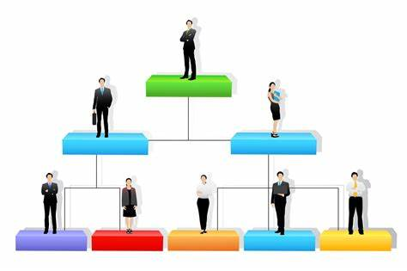
Lec.1
Management Functions
Organizing is a task that managers perform to create a structure of working relationships that allow organizational members to interact and cooperate to achieve organizational goals
  Involves grouping people into departments according to the kinds of job-specific tasks they perform
  Managers lay out lines of authority and responsibility
  Decide how to coordinate organizational resources
  Organizational Structure
  A formal system of task and reporting relationships that coordinates and motivates members so that they work together to achieve organizational goals
الهيكل التنظيمي
نظام رسمي للمهام وعلاقات إعداد التقارير يقوم بتنسيق وتحفيز الأعضاء بحيث يعملون معًا لتحقيق الأهداف التنظيمية

Slide 25

Lec.1
Management Functions
Organizing process
in Media Organization

Slide 26
Lec.1
Management Functions
Organizing process in Media Organization
  Sales department – sale of time to advertisers, principal source of revenue for broadcast stations. Subdivided to national sales, local or regional sales
  Program department – Headed by program manager/director. Plans, selects, schedules and monitors programming, provides content for website
  Promotion and Marketing department – Attract and maintain audiences
  News department – Usually kept separate from entertainment function, supervised by news director.
  Production department – Headed by production or creative director. Writes and produces commercials, technical support for newscast production, master control.

Slide 27
Lec.1
Management Functions
Organizing process in Media Organization
  Engineering department – Headed by chief engineer. Selects, operates, maintains studio, control room, transmitting equipment, computers.
  Business department – Accounting, secretarial, billing, payroll, HR
  [Sometimes] Traffic – Daily scheduling of all content to be aired, compiles availability sheet for times available for purchase by advertisers, monitoring of ad content to ensure compliance with contracts. Sometimes with Sales department.
  [Sometimes] Continuity – Writing of commercial copy, often with Sales department.

Slide 28
Lec.1
Management Functions
تقوم بصياغة رؤية تنظيمية واضحة لأعضائها لإنجازها، وتنشيط وتمكين الموظفين بحيث يفهم الجميع الدور الذي يلعبونه في تحقيق الأهداف التنظيمية
Leading is articulating a clear organizational vision for its members to accomplish, and energize and enable employees so that everyone understands the part they play in achieving organizational goals
  Leadership involves using power, personality, and influence, persuasion, and communication skills
  Outcome of leadership is highly motivated and committed workforce

Slide 29
Lec.1
Management Functions
Leading/Influencing/Directing: Getting employees to carry out their responsibilities with enthusiasm and effectiveness.
Motivation – basic “hygiene” needs, then motivators الدافعية والتحفيز
Communication – Top-down, and bottom-up
Training – Must make certain employees have opportunities to gain the skills they need. Make sure it is directly related to employee’s responsibilities.
Personal influence – Must command respect, loyalty
Related to competence, willingness to listen and act on employee complaints, honesty, integrity, etc.

Slide 30
Lec.1
Management Functions
Controlling is determining degree to which objectives are being achieved.
Task of managers is to evaluate how well an organization has achieved its goals and to take any corrective actions needed to maintain or improve performance
The outcome of the control process is the ability to measure performance accurately and regulate organizational efficiency and effectiveness
Periodic evaluations of individuals and departments
Based on objective, measurable, known criteria.
مؤشرات الأداء الرئيسيةkey performance indicators (KPIs)

Slide 31
Lec.1
Management Functions &
Levels of Management

Slide 32
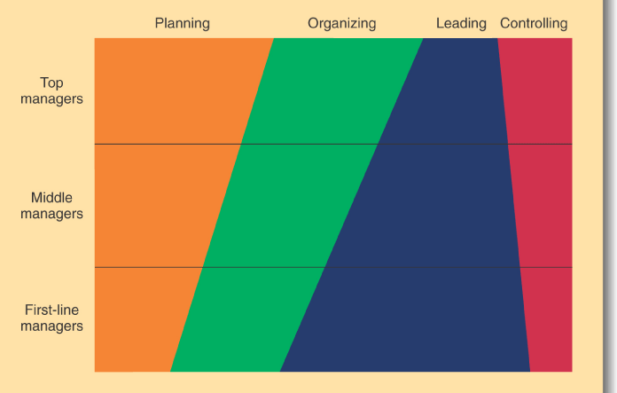
Lec.1
Management Functions & Levels of Management

Slide 33
Lec.1
What is
Organizational Performance?

Slide 34
Lec.1
Organizational Performance
Organizational Performance الأداء التنظيمي
Is a measure of how efficiently and effectively managers use available resources to satisfy customers and achieve organizational goals.
هو مقياس لمدى كفاءة وفعالية المديرين في استخدام الموارد المتاحة لإرضاء العملاء وتحقيق أهداف المنظمة.
Efficiency الكفاءة
  is a measure of how well or how productively resources are used to achieve a goal هو مقياس لمدى جودة أو إنتاجية استخدام الموارد لتحقيق هدف ما
Effectivenessالفعالية
  is a measure of the appropriateness of the goals an organization is pursuing and the degree to which they are achieved.
هو مقياس لمدى ملاءمة الأهداف التي تسعى المنظمة إلى تحقيقها ومدى تحقيقها.

Slide 35
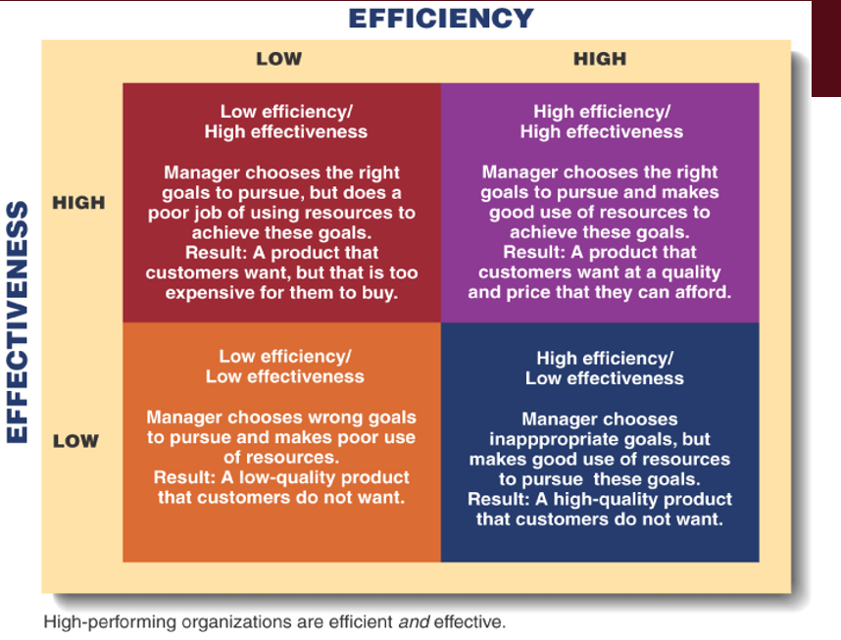
Lec.1
Organizational Performance

Slide 36
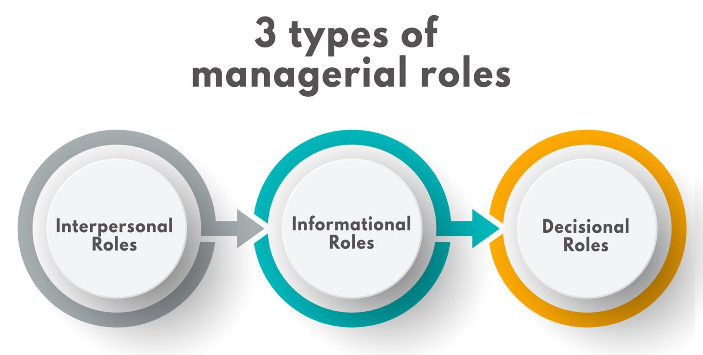
Lec.1
What are Management Roles?
10 أدوار فرعية

Slide 37
3 أدوار فرعية
Lec.1
Management Roles
Interpersonal Roles الأدوار الشخصيةthat managers assume to provide direction and supervision to both employees and the organization as a whole.
  Figurehead رمز—symbolizing the organization’s mission and what it is seeking to achieve.
  Leader قائد—training, counseling, and mentoring high employee performance.
  Liaison منسق/ متصل —linking and coordinating the activities of people and groups both inside and outside the organization (owners and employees).
1
2
3

Slide 38
3 أدوار فرعية
Lec.1
Management Roles
Informational Roles الأدوار المعلوماتيةassociated with the tasks needed to obtain and transmit information in the process of managing the organization.
  Monitor مراقب—analyzing information from both the internal and external environment.
  Disseminator ناشر—transmitting information to influence the attitudes and behavior of employees.
  Spokesperson متحدث رسمي —using information to positively influence the way people in and out of the organization respond to it.
1
2
3

Slide 39
4 أدوار فرعية
Lec.1
Management Roles
Decisional Roles "الأدوار المتعلقة باتخاذ القرار"associated with methods managers use in planning strategy and utilizing resources. associated with the tasks needed to obtain and transmit information in the process of managing the organization.
  Entrepreneur ريادي/ رائد أعمال —deciding which new projects or programs to initiate and to invest resources in.
  Disturbance handler معالج للاضطرابات / والنزاعات —managing an unexpected event or crisis.
  Resource allocator مخصص الموارد—assigning resources between functions and divisions, setting the budgets of lower managers.
  Negotiator مفاوض—reaching agreements between other managers, unions, customers, or shareholders.
1
2
3
4

Slide 40

Lec.1
Qualities of
Successful Managers

Slide 41
Lec.1
Qualities of Successful Managers
Willingness to work hard—Passion الرغبة في العمل الجاد
Perseverance & determinationالمثابرة والعزيمة
Willingness to take riskالمخاطرة المحسوبة
Ability to inspire enthusiasm تحفيز حماس الموظفين
Toughness yet Empatheticتوازن بين الجدية والتعاطف

Slide 42
Lec.1
Qualities of Successful Managers
10 Most Common Managerial Behaviors
    1.Communication
    2.Achievement Result Orientation
    3.Customer Focus
    4.Teamwork
    5.Leadership
    6.Planning & Organizing
    7.Commercial/Business Awareness
    8.Flexibility/Adaptability
    9.Developing Others
    10.Problem Solving

Slide 43
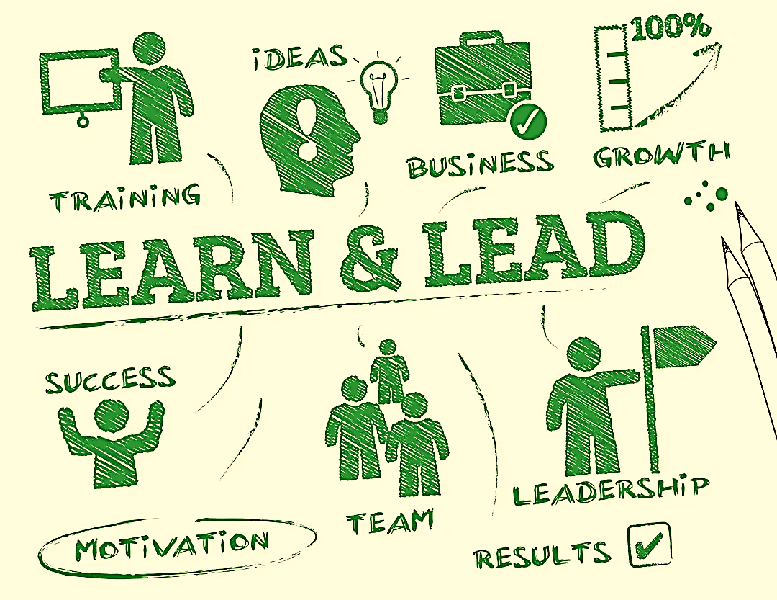
Lec.1
What is Leadership?

Slide 44
Lec.1
What is Leadership?
Leading people
Influencing people
Commanding people
Guiding people
Leadership in Times of Change
Good leaders are sensitive to the impact of change & uncertainty
“Effective change leadership is the key to shifting people’s perceptions from seeing change as a threat to seeing it as an exciting challenge”
Hooper & Potter
"إصدار الأوامر للناس"

Slide 45
Lec.1
What is Leadership?
Leadership has increasingly become a concept more relevant to organizations because leading means managing change.
لقد أصبحت القيادة مفهوما أكثر أهمية بالنسبة للمنظمات لأن القيادة تعني إدارة التغيير.
Nowadays, we live in an ever-changing world and the media and entertainment industry is affected.
The technological changes, the citizen journalism, the lowering of entry barriers and the rising competition have forced companies to look for talented and trained people who can lead.
إن التغيرات التكنولوجية وصحافة المواطن وخفض حواجز الدخول وتزايد المنافسة أجبرت الشركات على البحث عن أشخاص موهوبين ومدربين قادرين على القيادة.

Slide 46
Lec.1
What is Leadership?
A leader can make changes and evolves through the years.
  Children identify themselves with football players, ballerinas, action heroes and even their parents.
  Youngsters turn to look for identity in social leaders.
  An adult will try to identify themselves with persons related to their field of work.
Following with this definition, we could say that not only those elected, not even the senior managers of the organizations can be considered leaders.
  Those who manage an area of the company, a section, whether be a supervisor of a group, leader of a syndicate, coach, leader of a football team or dean at university’s school will be leaders, in different areas, but at the end will performance some kind of leadership.

Slide 47
Lec.1
What is Leadership?
Becoming a leader is not easy, but learning how to lead is easier than it is believed since we all have the ability to lead.
Leaders must know themselves
  must know their strengths and weaknesses,
  what they want,
  how to communicate it,
  how to convince others,
  how to get the necessary support to reach their goals.

Slide 48
Lec.1
What is Leadership?
Leaders can overcome their weakness and boost their strength.
They focus on relationships and trust in others.
They are not focusing on the number of followers that they have, but the quality of work that results from working with them.
They are responsible for the efficiency of the organizations; therefore, the final responsibility will fall upon them.
المسؤولية عن كفاءة المؤسسة

Slide 49
Lec.1
What is Leadership?
Digital leadership is currently considered a necessity in improving organizational performance by creating competitive advantage in the era of the industrial revolution 4.0.
Digital leadership: practice-oriented research has linked digitization and leadership.
Digital leadership refers to the leadership abilities to manage the staff’s online activities (e.g., posting product descriptions & handling customer queries), leading marketing activities, problem-solving, and decision-making concerning online activities of the business.

Slide 50
Lec.1
Leadership Functions

Slide 51
Lec.1
Leadership Functions
Managers vs. Leaders - Common Activities
  Planning
  Organizing
  Leading / Directing
  Controlling

Slide 52
Lec.1
Leadership Functions
Planning
Manager Budgeting Sets targets Detailed steps Allocates resources | Leader Devises strategy Sets direction Creates vision
Organizing
Manager Creates structure Job descriptions Staffing Hierarchy Delegates Training | Leader Gets people on board for strategy Communication Networks

Slide 53
Lec.1
Leadership Functions
Leading / Directing Work
Manager Solves problems Negotiates Brings to consensus | Leader Empowers people Cheerleads مُشَجِّع (بأنشطة وشعارات) Encourages
Controlling
Manager Implements control systems Performance measures Identifies variances Fixes variances | Leader Motivates Inspires Gives sense of accomplishmentإنجاز

Slide 54
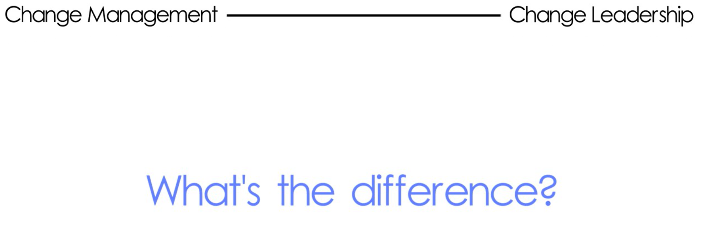

Lec.1
Video
https://youtu.be/xMhfhuB2SME

Slide 55
Lec.1
Comparison & Discussion
Mangers & Leaders Activities

Slide 56
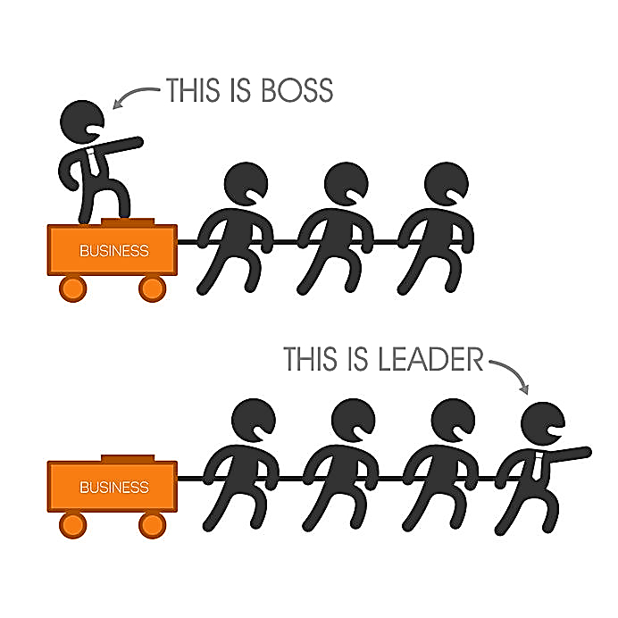
Lec.1
Mangers & Leaders Activities

Slide 57
Conclusion
We learned about:
What is Management?
Why management is important?
Levels of Management
Management Functions
Organizational Performance
What are Management Roles?
Qualities of Successful Managers
What is Leadership and Digital Leadership?
Leadership Functions
Comparison Bet. Mangers & Leaders Activities
Lec.1

Slide 58


Lec.1
References
Allam, R. (2011). Broadcast Programming . Pringle & Starr, chapter 4. Media Management Course; AUC.
Pringle, P. (2006). Electronic Media Management. Routledge.
Bli-Group-Wp. (2011). Leadership Course material. Amideast Egypt. Business Intelligence, Training & Consulting, http://bli-group.com/
Deevado, A. B. (2011, October 1). The organization structure of a television station by Andrew Bishop Mkandawire (ab deevado)-mc Yr 4 4th May, 2012 Share World Open University-BT Campus. Retrieved January 29, 2023, from https://abdeevado.blogspot.com/2011/10/organization-structure-of-television.html (Stovall, JG. 2011. ‘Television and Radio Charts’. Accessed at www.enhow.com. Date Accessed: 26/02/11.)
Benavides, C. (2013). Innovation and leadership in the media industry: Semantic scholar. Retrieved January 5, 2023, from https://dadun.unav.edu/handle/10171/36645
Borah, P. S., Iqbal, S., & Akhtar, S. (2022). Linking social media usage and SME's sustainable performance: The role of Digital Leadership and Innovation Capabilities. Technology in Society, 68, 101900. https://doi.org/10.1016/j.techsoc.2022.101900
Tulungen, E. E., Tewal, B., & Pandowo, M. (2022). The Role of Digital Leadership Mediated by Digital Skill in Improving Organizational Performance. Journal of Accounting Research, Organization and Economics, 5(2), 156-171.

Slide 59



Thank You

