Slide 1


Introduction
Prepared by Dr. Ahmed Alqarni
MGM 115
Critical Thinking
Introduction

Slide 2

Introduction
About the course:
This course is designed to improve a student's ability to analyse and evaluate the kinds of arguments and theories commonly met with in everyday life. The course also helps students improve their own arguments and presentations by showing them how to draw sound conclusions from available evidence and how to construct well-reasoned cases to support these conclusions.
Although the course focuses on the informal logic of everyday language, it includes some training in elementary formal logic. Students are taught how to apply fundamental rules and standards of logical reasoning to the sorts of arguments encountered in newspapers, magazines and other media, and university-level textbooks in most fields.

Slide 3
Introduction
Course Objectives:
Demonstrate an understanding of the nature of critical and analytical thinking.
Create well-written answers and opinions about a variety of topics using critical thinking skills and models.
Detect errors in reasoning and explain how the reasoning is in error
Evaluate evidence and make appropriate inferences from that evidence
Experience group dynamics through collaborative learning activities during the semester.
Analyze and interpret data.

Slide 4
Introduction
Topics:
Introduction: The Language of Argumentation
Analyzing Arguments: Content and Structure
Evaluating Arguments: Validity, Soundness, and Problems of Interpretation
Syllogistic Reasoning
Common Fallacies of Reasoning
Nondeductive Arguments
The Use and Misuse of Statistics
Explanations and Empirical Theories
Conceptual Theories and Definitions
Writing a Short Critical Essay

Slide 5

Topic 1:Introduction: The Language of Argumentation
1
2
3
4
Why Language Matters
Claims
Arguments
Working Vocabulary
Everyone is trying to convince you — precise language is your defense.
The building block: a declarative sentence that's true or false.
Premises offered as reasons for a conclusion — and what isn't one.
A glossary you'll reuse in every topic that follows.

Slide 6
Topic 2: Analyzing Arguments: Content and Structure
1
2
3
4
Why We Repair Arguments
Rules for Filling Gaps
Structure of Compound Claims
Structure of General Claims

Slide 7
Topic 3: Evaluating Arguments: Validity, Soundness, and Problems of Interpretation
1
2
3
4
Validity and Strength
Soundness
Problems of Interpretation
Testing Through Refutation

Slide 8
Topic 4: Syllogistic Reasoning
1
2
3
4
Categorical Claims
Testing with Diagrams
Hypothetical Syllogisms
Common Invalid Forms

Slide 9
Topic 5: Common Fallacies of Reasoning
1
2
3
4
Structural & Content
Fallacies of Refutation
Fallacies of Language
Fallacies of Emotion

Slide 10
Topic 6: Nondeductive Arguments
1
2
3
4
What Is Nondeductive Reasoning?
Reasoning by Analogy
Generalizing from a Sample
When Is a Generalization Good?

Slide 11
Topic 7: The Use and Misuse of Statistics
1
2
3
4
The Use and Misuse of Statistics
Misleading Claims with Numbers
Graphs
Averages
Statistics in Generalizations

Slide 12
Topic 8: Explanations and Empirical Theories
1
2
3
4
What Is the Cause?
Worked Examples
Building and Testing Theories
Cause and Effect in Populations

Slide 13
Topic 9: Conceptual Theories and Definitions
1
2
3
4
Persuasive Definitions
What Is a Definition?
Types of Definitions
Criteria for a Good Definition

Slide 14
Topic 10: Writing a Short Critical Essay
1
2
3
Before you write
Writing the first draft
After writing the first draft

Slide 15
Introduction
Textbook:
The main material and reference for this course is mainly based on:
Textbook: Critical Thinking, Third Edition, Richard. Epstein with Carolyn Kernberger Illustrations by Alex Raffi.

Slide 16
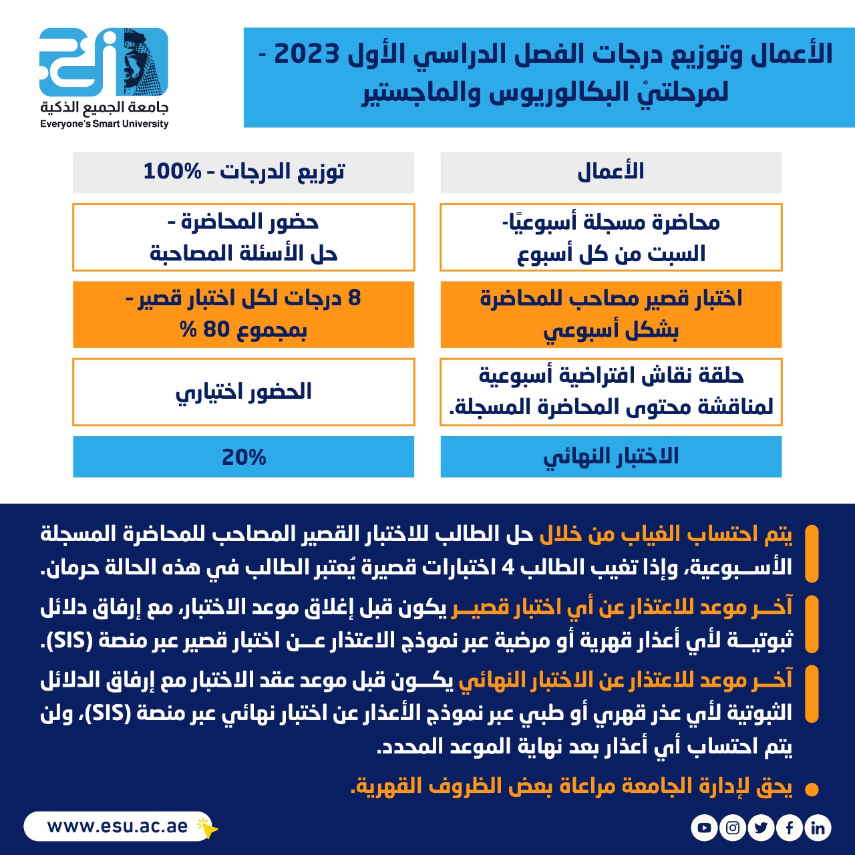
Introduction

Slide 17


Thank You

