Slide 1



Program and Portfolio Management
PMG 665
Orientation Lecture
Introduction to the course
Prepared by
Dr. Sami Alzahrani

Slide 2
Orientation
Course Description
Lecture
This course addresses the fundamental principles of managing portfolios and programs.
Portfolios translate an organization’s business strategy into a collection of activities that can be managed with desired benefits and results.
Program management deals with managing several related projects in a cohesive, multi-project environment, and provides benefits that one might not get from managing the projects individually.
0 – 2

Slide 3
Orientation
Course Description
Lecture
Both portfolio and program management align projects with business objectives.
This course also describes the processes that follow project cost estimation and pricing.
0 – 3

Slide 4
Orientation
General Objectives
Lecture
Students will be able to:
1
  Evaluate critical success factors for projects and programs, use these factors to create project portfolios that align with strategic goals of the organization and describe best practices for managing such a portfolio.
2
  Construct a program management plan that describes best practices for the creation and management of programs and how to coordinate activities such as finance, procurement, and risk across programs.
3
  Given a case consisting of a specific set of project contexts and plans within a project portfolio, recommend approaches for managing and balancing resource demands, allocations, and stakeholder expectations across the projects, programs, and the portfolio.
0 – 4

Slide 5
Orientation
General Objectives
Lecture
Students will be able to:
4
  Given a specific program context, which includes a plan, cost, schedule, and deliverable metrics, analyze the project data, classify various project expenditures as capital or operational, and recommend approaches for funding the project.
0 – 5

Slide 6

Orientation
Course Schedule and Topics
Lecture
Week | Lecture | Lecture Topic | Discussion Panel | Quiz
Week 1 | Orientation Lecture | Introduction to the course
Week 2 | Lecture 1 | Introduction to Program and Portfolio Management
Week 3 | Lecture 2 | Strategic Planning and Program Management
Week 4 | Lecture 3 | Change Management: The Good, the Bad and the Ugly
Week 5 | Lecture 4 | Program Initiation
Week 6 | Lecture 5 | Benefits Management
Week 7 | Lecture 6 | The Earned Benefit Method for Controlling Program Performance
Week 8 | Lecture 7 | Communication and Its Power at the Program Level
Week 9 | Lecture 8 | Decision Gate Discipline for Programs.
Week 10 | Lecture 9 | Program Risk Management.
Week 11 | Lecture 10 | Information Structuring “Methodology”: Tools and Techniques for Effective Program Management
Week 12 | - | - | -
Week 13 | - | Beginning of Final Exams | -
0 – 6

Slide 7

Lecture
Introduction to Program and Portfolio Management
01
How Did Program Management Originate?
What is a Program, and What Should be Managed as a Program?
What is program management’s place in the organization?
Competitive advantages through program management.
What is a PMO?
Scalable structure and processes.
How does program management close the gap?
An introduction path for program management.
Specific business benefits of program management.
Program management focuses on complexities.
0 – 7

Slide 8
Lecture
Strategic Planning and Program Management
02
What is strategic planning?
Program life cycle and program benefits management
Pre-program preparations
Program initiation
Program setup
Delivery of program benefits
Program closure
Benefits of managing the strategic plan as a program
0 – 8

Slide 9
Lecture
Change Management: The Good, the Bad and the Ugly
03
What is Change Management ?
Top ten reasons people are resistant to change
How to address change resistance and change
Program roles & responsibilities
0 – 9

Slide 10
Lecture
Program Initiation
04
What is Program ?
Program or project manager, who cares?
Caution: program managers require special skills!
Do not accidentally immediately jump into planning or executing!
Executive also has expectations
Estimates and guesses are synonymous
0 – 10

Slide 11
Lecture
Benefits Management
05
Benefits Categories
Benefits management life cycle
0 – 11

Slide 12
Lecture
The Earned Benefit Method for Controlling Program Performance
06
The benefits management life cycle
Benefits assessment
Business case development
Benefits realization planning
Benefits realization
Benefits realization completion
0 – 12

Slide 13
Lecture
Communication and Its Power at the Program Level
07
Determine the power brokers
Have a clear and achievable strategy
Communication and diversity of program stakeholders
Getting it right: communication type, strategy and channel
Star with the most important
Use the communication log
Rapport Building: Dose the magic !
Manage the communication channels
Listen to win the influence
Constant engagement
Build strong personality: focusing on the power of non-verbal communication
Keep it simple
0 – 13

Slide 14
Lecture
Decision Gate Discipline for Programs
08
The role of decision gates
Scheduling
Planning for decision gates
Content of the decision gate presentation
Passing through decision gates
Decision gates as business process
0 – 14

Slide 15
Lecture
Program Risk Management
09
What is risk?
Risk categories, triggers, and the risk register
The relationship of risk management between projects and programs
The importance of program risk management
Risk communication planning
Common risk processes, tools, and techniques
What is effective risk management?
0 – 15

Slide 16
Lecture
Information Structuring “Methodology”: Tools and Techniques for Effective Program Management
10
Information structuring methodology in context with the enterprise management framework
Program external factors
Program “internal” constantly changing factors
Program “internal” and “external” constantly changing factors
Program management information system tools
Program best practices
0 – 16

Slide 17
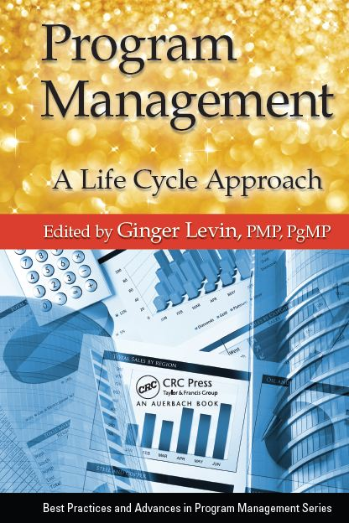
Orientation
Lecture
Required Textbook:
Program Management: A Life Cycle Approach. by Ginger Levin, PMP, PgMP.
0 – 17

Slide 18
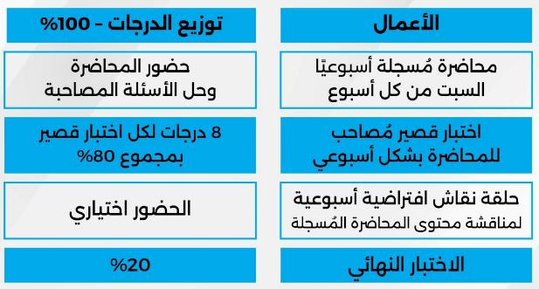
الأعمال وتوزيع درجات الفصل الدراسي
0 – 18

Slide 19
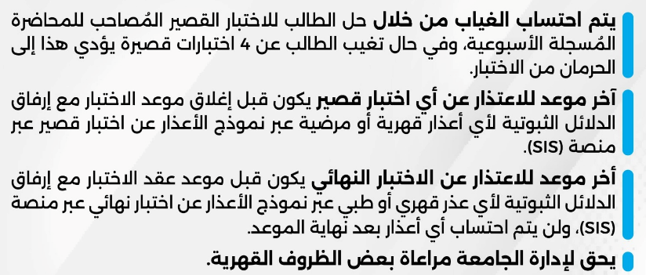
سياسة الغياب والاعتذار
0 – 19

Slide 20
المحاضرات
ستتاح المحاضرة الأسبوعية على المنصة التعليمية Moodle
كل يوم سبت في تمام الساعة 12 ظهراً
بتوقيت مكة المكرمة
0 – 20

Slide 21
حلقات النقاش
حضور حلقات النقاش اختياري.
ينصح بشدة الحرص على الحضور لتعزيز المكتسبات العلمية من محتوى المحاضرة.
يفضل مشاهدة المحاضرة المسجلة وتلخيصها قبل حضور حلقة النقاش.
رابط حلقة النقاش متوفر على المنصة التعليمية وهو ثابت لجميع حلقات النقاش الخاصة بالمادة.
0 – 21

Slide 22
الاختبارات القصيرة
تعد الإجابة على الاختبار القصير بمثابة الحضور للطالب.
يتكون الاختبار القصير من ٨ أسئلة (٨ درجات).
سيتاح الاختبار القصير على المنصة التعليمية Moodle كل يوم سبت في تمام الساعة 10 مساءً بتوقيت مكة المكرمة.
ويترك لمدة أسبوع ، ثم يغلق في يوم السبت الذي يليه تمام الساعة 9 مساءً بتوقيت مكة المكرمة
0 – 22

Slide 23
الاختبار النهائي
سيتاح الاختبار النهائي على المنصة التعليمية Moodle حسب مواعيد الاختبارات النهائية والتي سيتم الإعلان عنها نهاية الفصل الدراسي.
يتكون الاختبار النهائي من 20 سؤال، كل سؤال بدرجة.
الاختبار النهائي من 20 درجة.
0 – 23

Slide 24



Thank You

