Slide 1



Accounting Principles Prepared by Dr. Hoda Metwally Lecture 9
Completing the Accounting
Cycle

Slide 2

Accounting Principles Prepared by Dr. Hoda Metwally Lecture 9
Completing the Accounting
Cycle

Slide 3
The Accounting cycle

Slide 4
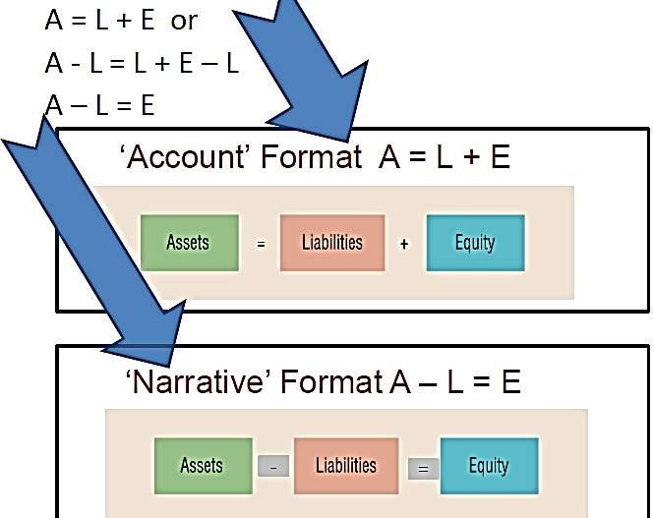

Accounting Equation

Slide 5
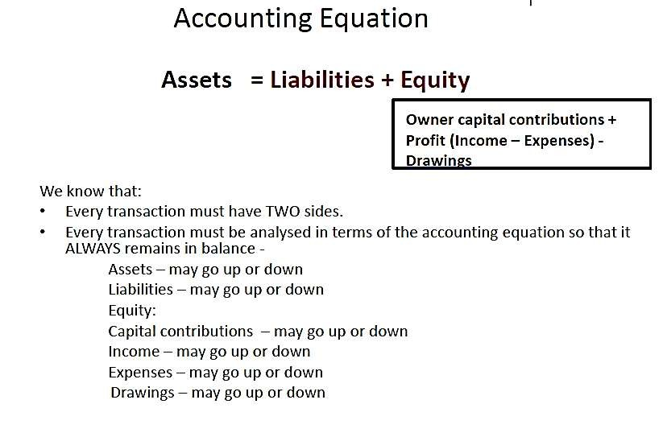


Slide 6
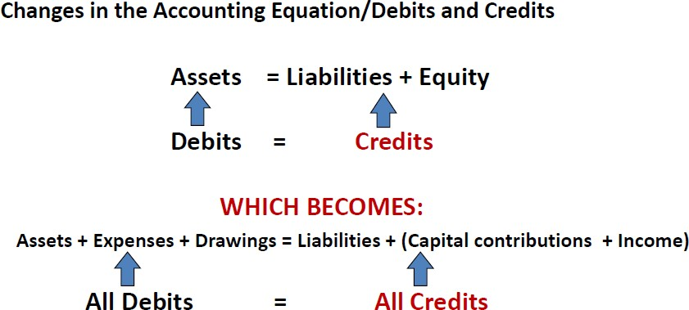

Slide 7
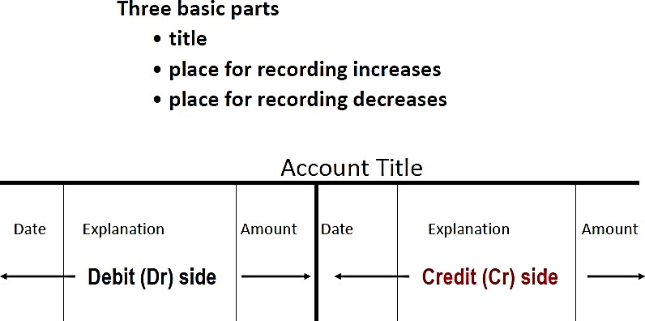
Ledger Account

Slide 8
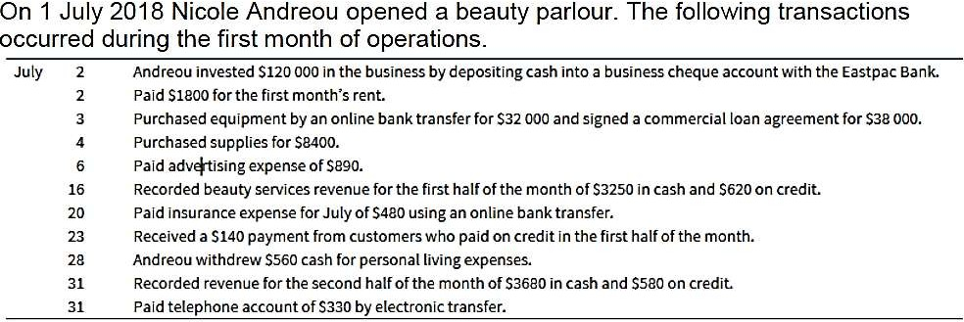
Comprehensive Problem

Slide 9
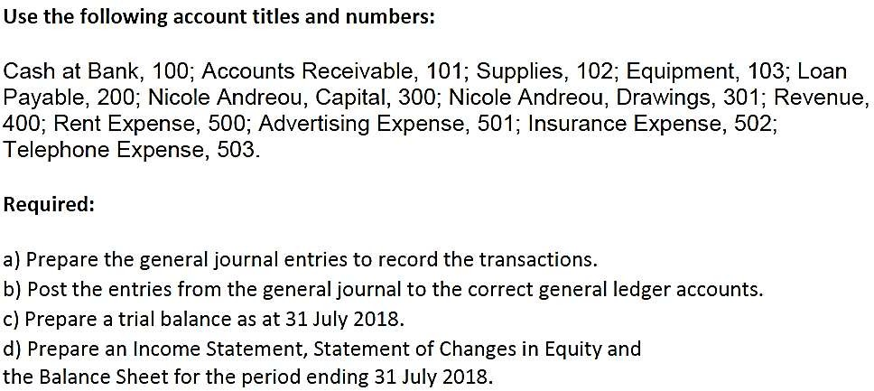

Slide 10
General Journal
Date Details
2 July Cash at Bank
Debit ($)
Credit ($)
120 000
Nicole Andreou, Capital 120 000
**Cash invested by the owner
2 July | Rent expense | 1 800
• | Cash at Bank |  | 1 800
**Rent paid
3 July Equipment 70 000
•
Cash at Bank Loan payable
32 000
38 000
-------------**Equipment purchased for cash and loan payable---------------------

Slide 11
4 July Supplies
8 400
Cash at Bank 8 400
**Supplies purchased -
6 July
Advertising expense 890
Cash at Bank 890
-**Cash paid for advertising
16 July Cash at Bank 3250
Accounts Receivable 620 Revenue
3 870
-**Revenue for first half of month

Slide 12
Insurance expense
Cash at Bank
20 July
480
480
**Cash paid for insurance
23 July Cash at Bank 140
Accounts receivable 140
-----------------------**Receipt of payment from customers-------------------
28 July
Nicole Andreou, Drawings 560
Cash at Bank 560
**Drawings by owner

Slide 13
31 July
Cash at Bank Accounts Receivable
3 680
580
Revenue
4 260
----------**Revenue for second part of the month----------------------------
31 July
Telephone expense 330
Cash at Bank 330
**Telephone expenses paid

Slide 14
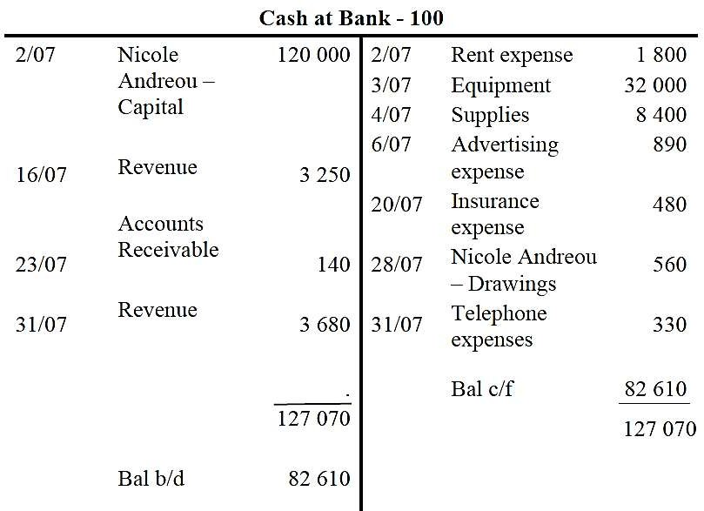

Slide 15
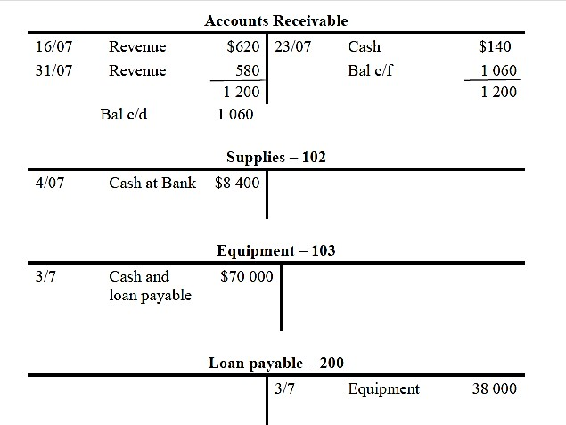

Slide 16
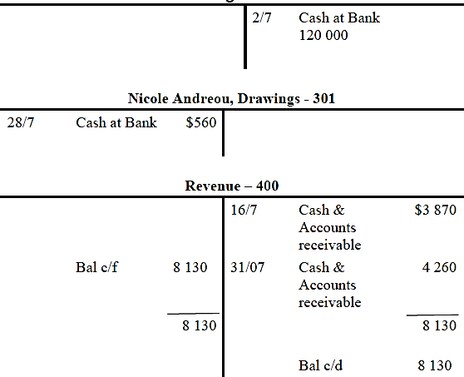
Nicole Andreou, Capital – 300

Slide 17
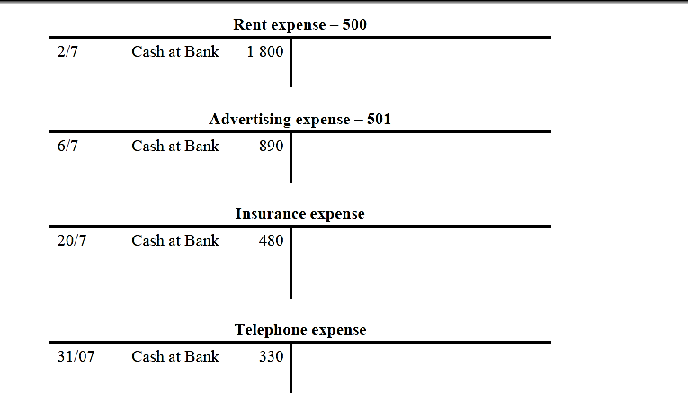

Slide 18
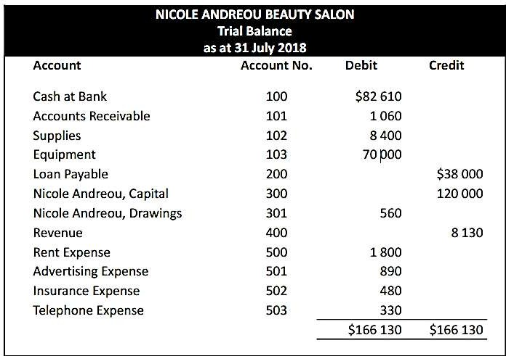

Slide 19
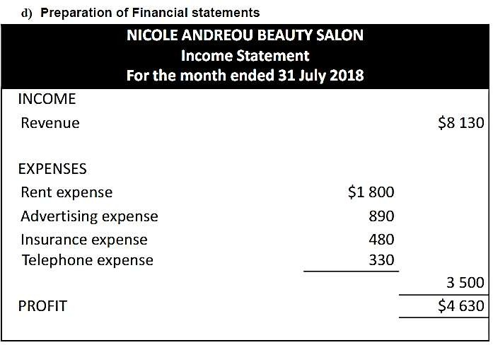

Slide 20
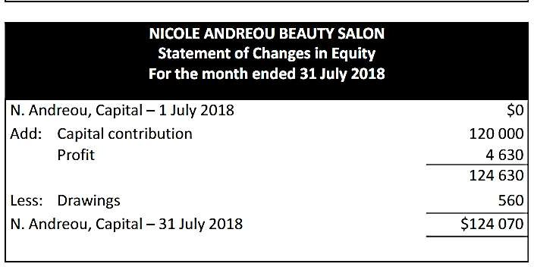

Slide 21
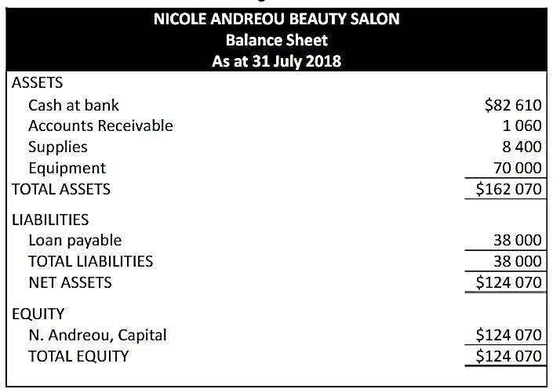

Slide 22
Completing the Accounting Cycle

Slide 23


















Completing the Accounting Cycle
Summary of Accounting Cycle
Classified Statement of Financial Position
Using a
Worksheet
Closing the
Books
Steps in
preparation
Preparing financial statements
Preparing
adjusting entries
Preparing closing
entries
Posting closing
entries
Preparing a post- closing trial balance
Reversing entries—An optional step
Correcting entries—An avoidable step
Intangible assets
Property, plant, and equipment
Long-term
investments
Current assets
Equity
Non-current
liabilities
Current liabilities

Slide 24



Using A Worksheet
Worksheet
A multiple-column form used in preparing financial
statements.
Not a permanent accounting record. Five step process.
Use of worksheet is optional.
SO 1 Prepare a worksheet.

Slide 25


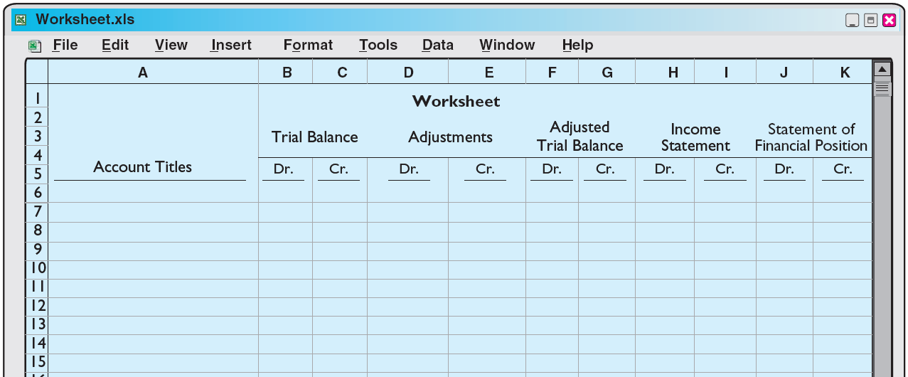
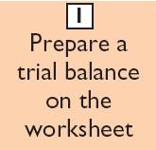
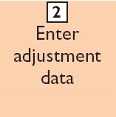
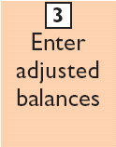
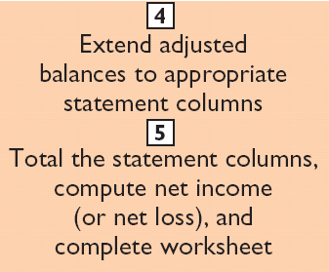

Steps in Preparing a Worksheet
Illustration 4-1
SO 1 Prepare a worksheet.

Slide 26
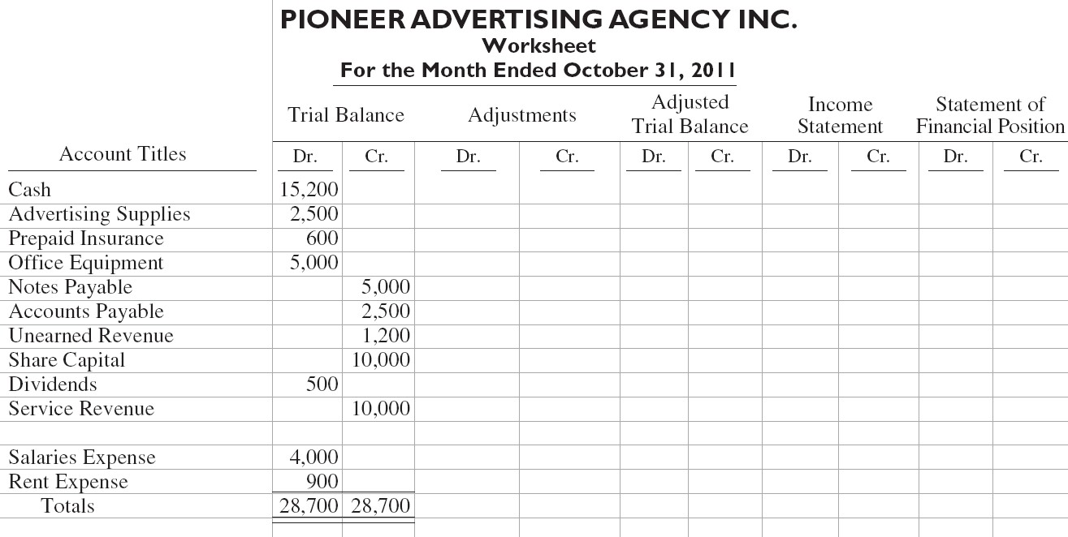
Steps in Preparing a Worksheet
Illustration:
Illustration 4-2
Preparing a trial balance
SO 1 Prepare a worksheet.

Slide 27
Steps in Preparing a Worksheet
1. Prepare a Trial Balance on the Worksheet
Adjusted Trial Balance
Income Statement
Statement of Financial Position
Trial Balance
Adjustments
Account Titles | Dr. | Cr. | Dr. | Cr. | Dr. | Cr. | Dr. | Cr. | Dr. | Cr.
Cash | 15,200
Advertising Supplies | 2,500
Prepaid Insurance | 600
Office Equipment | 5,000
Notes Payable |  | 5,000
Accounts Payable |  | 2,500
Unearned Revenue |  | 1,200
Share Capital |  | 10,000
Dividends | 500
Service Revenue |  | 10,000
Salaries Expense Rent
Totals
4,000
900
28,700 28,700
Trial balance amounts come directly from ledger accounts.
Include all accounts
with balances.
SO 1 Prepare a worksheet.

Slide 28
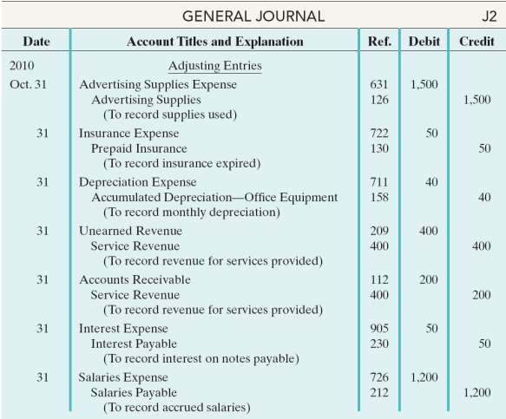

Steps in Preparing a Worksheet
Illustration 3-22 General journal showing adjusting entries
Adjusting Journal Entries
SO 1 Prepare a worksheet.

Slide 29
Steps in Preparing a Worksheet
2. Enter the Adjustments in the Adjustments Columns
 | Account Titles | Trial Balance Adjustments | Adjusted Trial Balance |  | Income Statement |  | Statement of Financial Position
 |  | Dr. Cr. Dr. Cr. | Dr. | Cr. | Dr. | Cr. | Dr. | Cr.
 | Cash 15,200 Advertising Supplies 2,500 ^{(a)} 1,500 Prepaid Insurance 600 ^{(b)} 50 Office Equipment 5,000 Notes Payable 5,000 Accounts Payable 2,500 Unearned Revenue 1,200 (d) 400 Share Capital 10,000 Dividends 500 Service Revenue 10,000 ^{(d)} 400 (e) 200 Salaries Expense 4,000 ^{(g)}1,200 Rent 900 Totals 28,700 28,700 Advertising Supplies Expense ^{(a)}1,500 Insurance Expense ^{(b)} 50 Accumulated Depreciation ^{(c)} 40 Depreciation Expense ^{(c)} 40 Accounts Receivable ^{(e)} 200 Interest Expense ^{(f)} 50 Interest Payable ^{(f)} 50 Salaries Payable ^{(g)} 1,200 Totals 3,440 3,440 |  | Adjustments Key: Supplies Used. Insurance Expired. Depreciation Expensed. Service Revenue Earned. Service Revenue Accrued. Interest Accrued. Salaries Accrued. Enter adjustment amounts, total adjustments columns, and check for equality.
Add additional accounts as needed.
SO 1 Prepare a worksheet.

Slide 30
Steps in Preparing a Worksheet
3. Complete the Adjusted Trial Balance Columns
Adjusted Trial Balance Dr. Cr.
Income Statement
Dr. Cr.
Statement of Financial Position Dr. Cr.
Trial Balance Dr. Cr.
Adjustments Dr. Cr.
Account Titles
Cash
15,200
15,200
Advertising Supplies | 2,500 |  |  |  | ^{(a)} 1,500 |  | 1,000
Prepaid Insurance | 600 |  |  |  | (b) ₅₀ |  | 550
Office Equipment | 5,000 |  |  |  |  |  | 5,000
Notes Payable |  | 5,000 |  |  |  |  |  | 5,000
Accounts Payable |  | 2,500 |  |  |  |  |  | 2,500
Unearned Revenue |  | 1,200 | (d) | 400 |  |  |  | 800
Share Capital |  | 10,000 |  |  |  |  |  | 10,000
Dividends Service Revenue | 500 | 10,000 |  |  | (d) | 400 | 500 | 10,600
Salaries Expense | 4,000 |  | ^{(g)}1,200 |  | (e) | 200 | 5,200
Rent | 900 |  | 900
Totals | 28,700 28,700
Advertising Supplies Expe | nse |  | ^{(a)}1,500 1,500
Insurance Expense Accumulated Depreciation Depreciation Expense Accounts Receivable Interest Expense
Interest Payable Salaries Payable
Totals
(b)
50
50
(c)
40
40
(c)
(e)
(f)
40
200
50
40
200
50
(f)
50
50
1,200
^{(g)} 1,200
3,440 3,440
30,190
30,190
Total the adjusted trial balance
columns and check for equality.
SO 1 Prepare a worksheet.

Slide 31
Steps in Preparing a Worksheet
4. Extend Amounts to Financial Statement Columns
Adjusted Trial Balance Dr. Cr.
Income Statement
Dr. Cr.
Statement of Financial Position Dr. Cr.
Trial Balance Dr. Cr.
Adjustments Dr. Cr.
Account Titles
Cash
15,200
15,200
Advertising Supplies | 2,500 |  |  |  | ^{(a)} 1,500 |  | 1,000
Prepaid Insurance | 600 |  |  |  | (b) ₅₀ |  | 550
Office Equipment | 5,000 |  |  |  |  |  | 5,000
Notes Payable |  | 5,000 |  |  |  |  |  | 5,000
Accounts Payable |  | 2,500 |  |  |  |  |  | 2,500
Unearned Revenue |  | 1,200 | (d) | 400 |  |  |  | 800
Share Capital |  | 10,000 |  |  |  |  |  | 10,000
Dividends Service Revenue | 500 | 10,000 |  |  | (d) | 400 | 500 | 10,600 |  | 10,600
Salaries Expense | 4,000 |  | ^{(g)}1,200 |  | (e) | 200 | 5,200 |  | 5,200
Rent | 900 |  | 900 |  |  |  |  | 900
Totals | 28,700 28,700
Advertising Supplies Expe | nse |  | ^{(a)}1,500 1,500 |  |  |  |  | 1,500
Insurance Expense Accumulated Depreciation Depreciation Expense Accounts Receivable Interest Expense
Interest Payable Salaries Payable
Totals
(b)
50
50
50
(c)
40
40
(c)
(e)
(f)
40
200
50
40
200
50
40
(f)
50
50
50
1,200
^{(g)} 1,200
3,440 3,440 30,190
30,190
7,740
10,600
Extend all revenue and expense account
balances to the income statement columns.
SO 1 Prepare a worksheet.

Slide 32

Steps in Preparing a Worksheet
4. Extend Amounts to Financial Statement Columns
Adjusted Trial Balance Dr. Cr.
Income Statement
Dr. Cr.
Statement of Financial Position Dr. Cr.
15,200
Trial Balance Dr. Cr.
Adjustments Dr. Cr.
Account Titles
Cash
15,200
15,200
Advertising Supplies | 2,500 |  |  |  | ^{(a)} 1,500 |  | 1,000 |  | 1,000
Prepaid Insurance | 600 |  |  |  | (b) ₅₀ |  | 550 |  | 550
Office Equipment | 5,000 |  |  |  |  |  | 5,000 |  | 5,000
Notes Payable |  | 5,000 |  |  |  |  |  | 5,000 |  |  |  | 5,000
Accounts Payable |  | 2,500 |  |  |  |  |  | 2,500 |  |  |  | 2,500
Unearned Revenue |  | 1,200 | (d) | 400 |  |  |  | 800 |  |  |  | 800
Share Capital |  | 10,000 |  |  |  |  |  | 10,000 |  |  |  | 10,000
Dividends Service Revenue | 500 | 10,000 |  |  | (d) | 400 | 500 | 10,600 |  | 10,600 | 500
Salaries Expense | 4,000 |  | ^{(g)}1,200 |  | (e) | 200 | 5,200 |  | 5,200
Rent | 900 |  | 900 |  |  |  |  | 900
Totals | 28,700 28,700
Advertising Supplies Expe | nse |  | ^{(a)}1,500 1,500 |  |  |  |  | 1,500
Insurance Expense Accumulated Depreciation Depreciation Expense Accounts Receivable Interest Expense
(b)
50
50
50
(c)
40
40
40
(c)
(e)
(f)
40
200
50
40
200
50
40
200
50
Interest Payable | (f) ₅₀ |  |  | 50 |  |  |  | 50
Salaries Payable |  | ^{g)} 1,200 1,200 1,200
Totals | 3,440 | 3,440 | 30,190 | 30,190 | 7,740 | 10,600 | 22,450 | 19,590
(
Extend all asset, liability, and equity account balances to the statement of financial position columns.
SO 1 Prepare a worksheet.

Slide 33
Steps in Preparing a Worksheet
5. Total Columns, Compute Net Income (Loss)
Adjusted Trial Balance Dr. Cr.
Income Statement
Dr. Cr.
Statement of Financial Position Dr. Cr.
15,200
Trial Balance Dr. Cr.
Adjustments Dr. Cr.
Account Titles
Cash
15,200
15,200
Advertising Supplies | 2,500 |  |  |  | ^{(a)} 1,500 |  | 1,000 |  | 1,000
Prepaid Insurance | 600 |  |  |  | (b) ₅₀ |  | 550 |  | 550
Office Equipment | 5,000 |  |  |  |  |  | 5,000 |  | 5,000
Notes Payable |  | 5,000 |  |  |  |  |  | 5,000 |  |  |  | 5,000
Accounts Payable |  | 2,500 |  |  |  |  |  | 2,500 |  |  |  | 2,500
Unearned Revenue |  | 1,200 | (d) | 400 |  |  |  | 800 |  |  |  | 800
Share Capital |  | 10,000 |  |  |  |  |  | 10,000 |  |  |  | 10,000
Dividends Service Revenue | 500 | 10,000 |  |  | (d) | 400 | 500 | 10,600 |  | 10,600 | 500
Salaries Expense | 4,000 |  | ^{(g)} 1,200 |  | (e) | 200 | 5,200 |  | 5,200
Rent | 900 |  | 900 |  |  |  |  | 900
Totals | 28,700 28,700
Advertising Supplies Expe | nse |  | ^{(a)}1,500 1,500 |  |  |  |  | 1,500
Insurance Expense Accumulated Depreciation Depreciation Expense Accounts Receivable Interest Expense
Interest Payable Salaries Payable
Totals
Net income
Totals
(b)
50
50
50
(c)
40
40
40
(c)
(e)
(f)
40
200
40
200
40
200
50
(f)
50
50
50
50
1,200
50
1,200
7,740 10,600 22,450 19,590
2,860 2,860
^{(g)} 1,200
3,440 3,440 30,190 30,190
Compute Net Income or Net Loss.
10,600 10,600 22,450 22,450
SO 1 Prepare a worksheet.

Slide 34
Steps in Preparing a Worksheet
Review Question
Net income is shown on a worksheet in the:
income statement debit column only.
statement of financial position debit column only.
income statement credit column and statement of financial position debit column.
income statement debit column and statement of financial position credit column.
SO 1 Prepare a worksheet.

Slide 35


Preparing Financial Statements from a Worksheet
Worksheet
Income statement is prepared from the income statement columns.
Statement of financial position and retained earnings statement are prepared from the statement of financial position columns.
Companies journalize and post adjusting entries.
SO 1 Prepare a worksheet.

Slide 36
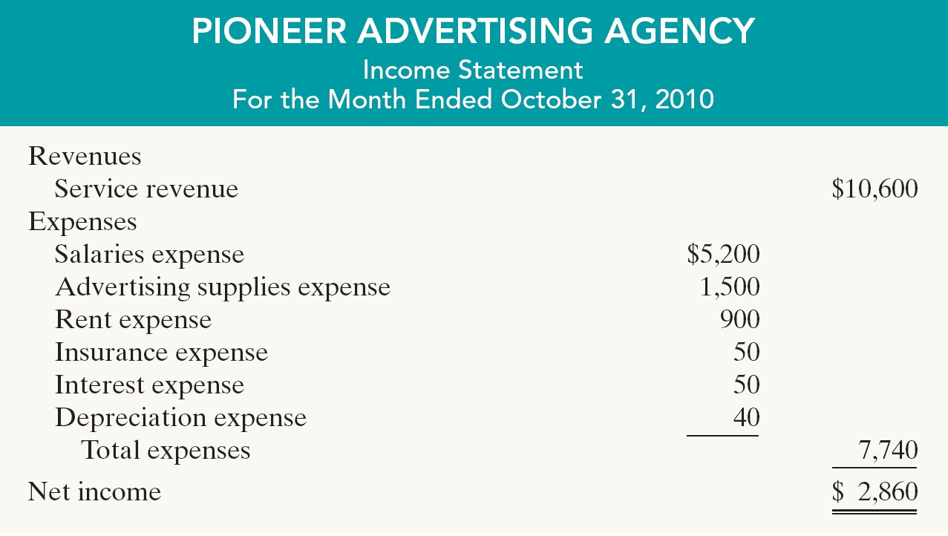

Preparing Financial Statements from a Worksheet
Illustration 4-4
SO 1 Prepare a worksheet.

Slide 37
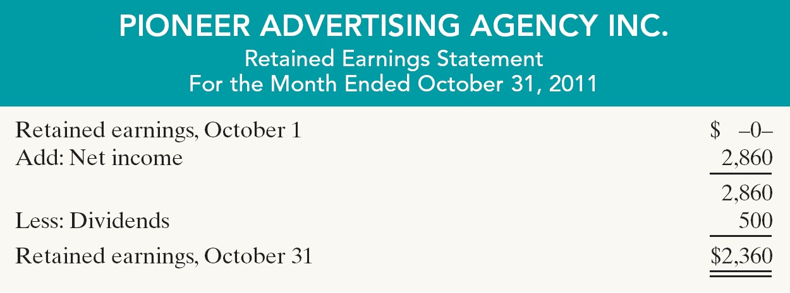
Preparing Financial Statements from a Worksheet
Illustration 4-4
SO 1 Prepare a worksheet.

Slide 38
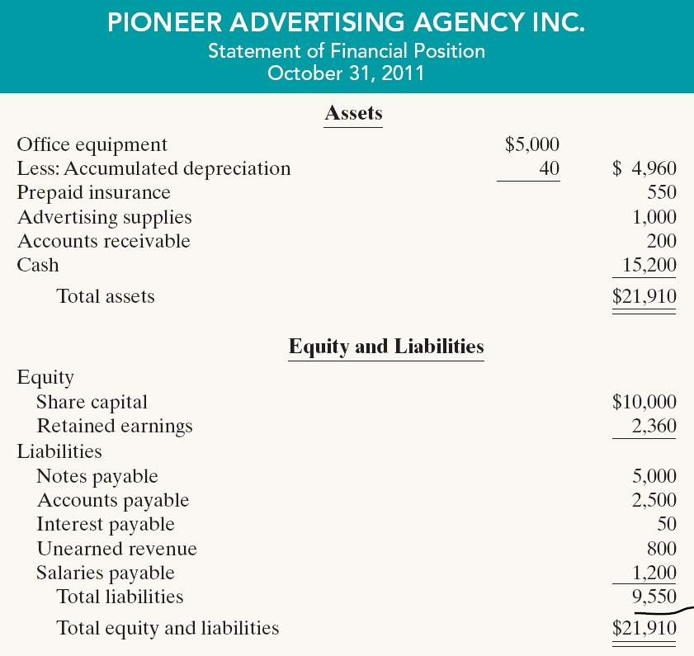
Preparing Financial Statements from a Worksheet
Illustration 4-4

Slide 39


Preparing Adjusting Entries from a Worksheet
Adjusting Entries
The adjusting entries are prepared from the
adjustments columns of the worksheet.
Journalizing and posting of adjusting entries follows the preparation of financial statements when a worksheet is used.
SO 1 Prepare a worksheet.

Slide 40


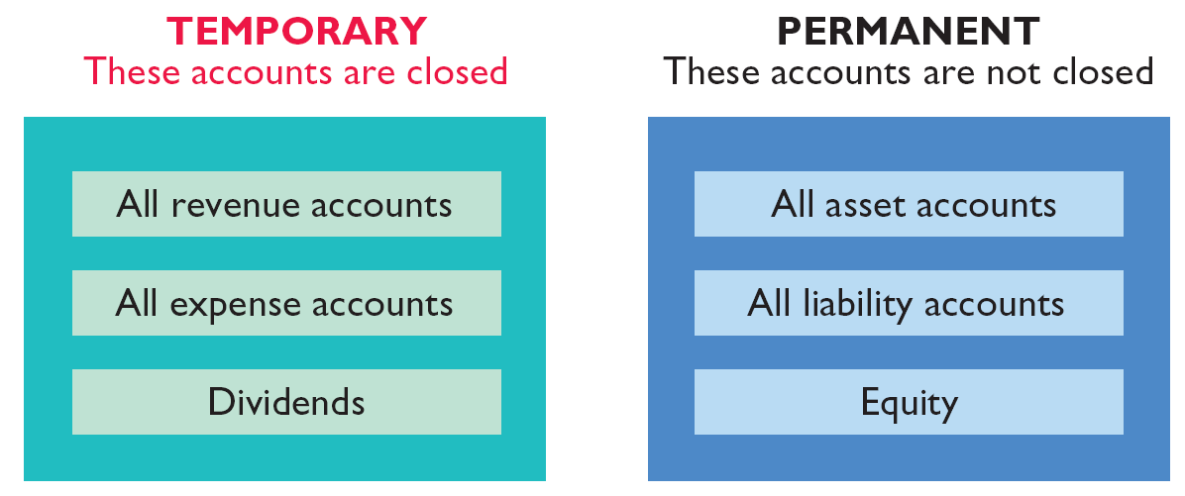
Closing the Books
At the end of the accounting period, the company makes
the accounts ready for the next period.
Illustration 4-5
SO 2 Explain the process of closing the books.

