Slide 1


Introduction
to
Operations
Management
Prepared by Dr. Injy Nashaat
Lecture 1

Slide 2


Operations
Management
www.midocean.ae

Slide 3
Operations Management
What is operations?
  The part of a business organization that is responsible for producing goods or services
How can we define operations management?
  The management of systems or processes that create goods and/or provide services
1-3

Slide 4
Good or Service?
Goods are physical items that include raw materials, parts, subassemblies, and final products
    Automobile
    Computer
    Oven
    Shampoo
Services are activities that provide some combination of time, location, form or psychological value
    Air travel
    Education
    Haircut
    Legal counsel
1-4

Slide 5
Supply Chain
A sequence of activities and organizations involved in producing and delivering a good or service
Suppliers’
suppliers
Direct
suppliers
Producer
Distributor
Final
customers
1-5

Slide 6
The Transformation Process
Value-Added
Inputs
Land
Labor
Capital
Information
Transformation/
Conversion
Process
Outputs
Goods
Services
Measurement
and Feedback
Measurement
and Feedback
Measurement
and Feedback
Control
Control = The comparison of feedback against previously established standards to determine if corrective action is needed
"Added value" does not necessarily have to be a positive number, because "added" means increase or decrease.
Feedback = Measurements taken at various points in the transformation process
1-6

Slide 7
Goods-service Continuum
Products are typically neither purely service- or purely goods-based
Goods Services
Surgery, Teaching
Songwriting, Software Development
Computer Repair, Restaurant Meal
Home Remodeling, Retail Sales
Automobile Assembly, Steelmaking
1-7

Slide 8
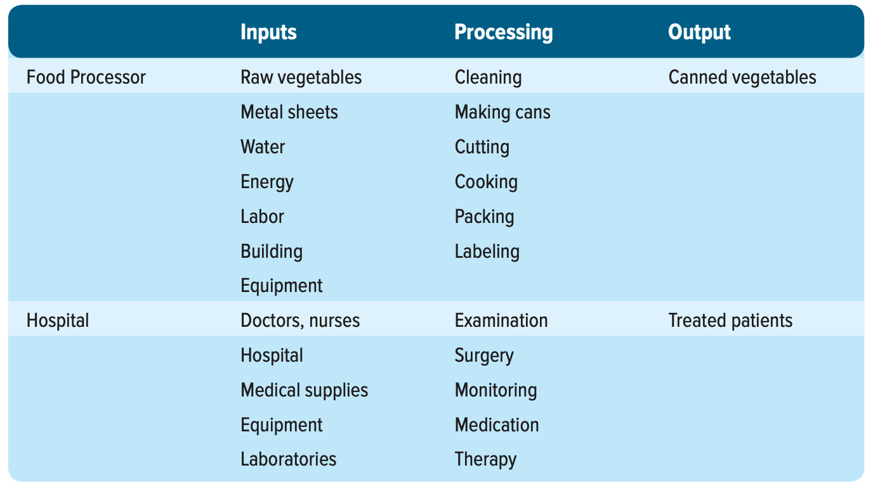
Illustrations of the transformation process
1-8

Slide 9
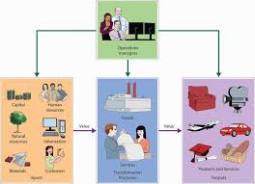
Manufacturing vs. Service
Degree of customer contact
Labor content of jobs
Uniformity of input
Uniformity of output
Measurement of productivity
Production and delivery
Quality assurance
Amount of inventory
Evaluation of work
Ability to patent design
1-9

Slide 10
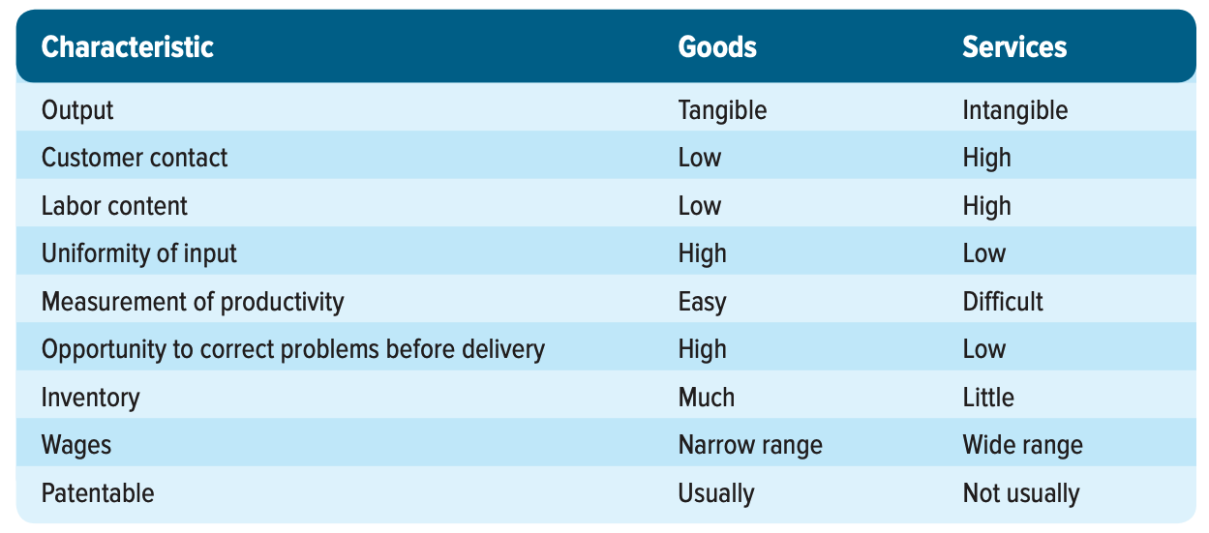
Typical differences between production of goods and provision of services
Compared to production, where material costs must be considered, measuring productivity in services is simpler.
1-10

Slide 11
Why Study Operations Management?
Every aspect of business affects or is affected by operations
Many service jobs are closely related to operations
  Financial services
  Marketing services
  Accounting services
  Information services
Through learning about operations and supply chains you will have a better understanding of:
  The world you live in
  The global dependencies of companies and nations
  Reasons that companies succeed or fail
  The importance of working with others
1-11

Slide 12
Basic Functions of the Business Organization
Organization
Marketing
Operations
Finance
1-12

Slide 13
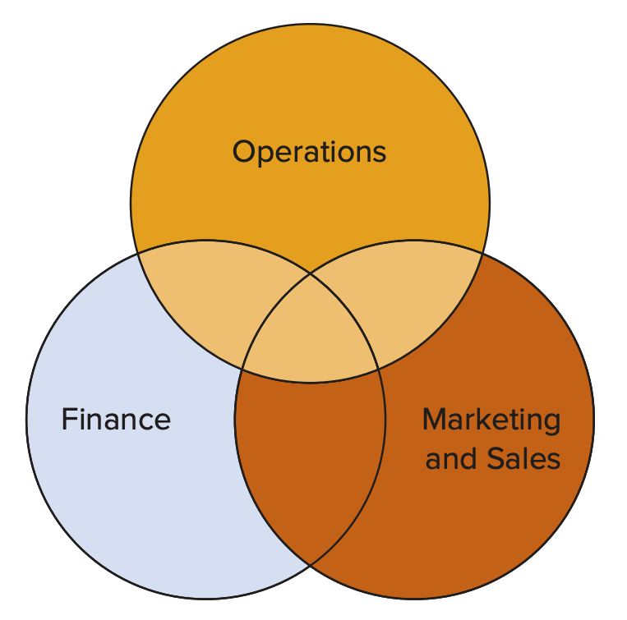
Function Overlap
Finance & operations
  Budgeting
  Economic analysis of investment proposals
  Provision of funds
Marketing & operations
  Demand data
  Product and service design
  Competitor analysis
  Lead time data
1-13

Slide 14
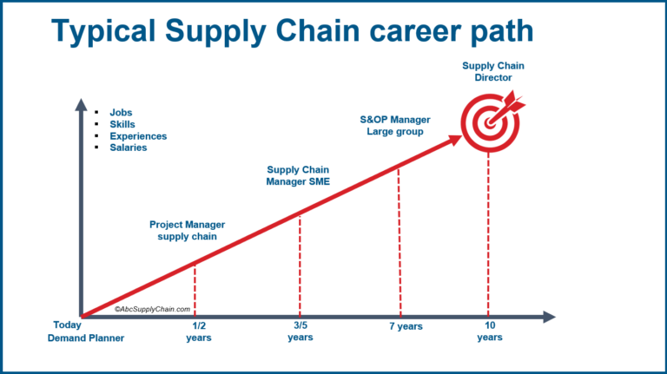
OM and Supply Chain Career Opportunities
Operations manager
Supply chain manager
Production analyst
Schedule coordinator
Production manager
Industrial engineer
Purchasing manager
Inventory manager
Quality manager
1-14

Slide 15
OM-Related Professional Societies
APICS - The Association for Operations Management
American Society for Quality (ASQ)
Institute for Supply Management (ISM)
Institute for Operations Research and Management Science (INFORMS)
The Production and Operations Management Society (POMS)
The Project Management Institute (PMI)
Council of Supply Chain Management Professionals (CSCMP)
1-15

Slide 16
Process Management
Process - one or more actions that transform inputs into outputs
Three Categories of Business Processes:
Upper-management processes | These govern the operation of the entire organization.
Operational processes | These are core processes that make up the value stream.
Supporting processes | These support the core processes.
1-16

Slide 17
Supply & Demand
Operations &
Supply Chains
Sales & Marketing
Supply
>
Demand
Wasteful
Costly
Supply
<
Demand
Opportunity Loss
Customer Dissatisfaction
Supply
=
Demand
Ideal
1-17

Slide 18
Process Variation
Four Sources of Variation:
Variety of goods or services being offered | The greater the variety of goods and services offered, the greater the variation in production or service requirements.
Structural variation in demand | These are generally predictable. They are important for capacity planning.
Random variation | Natural variation that is present in all processes. Generally, it cannot be influenced by managers.
Assignable variation | Variation that has identifiable sources. This type of variation can be reduced, or eliminated, by analysis and corrective action.
Variations can be disruptive to operations and supply chain processes. They may result in additional costs, delays and shortages, poor quality, and inefficient work systems.
1-18

Slide 19
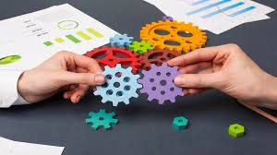
Scope of Operations Management
The scope of operations management ranges across the organization.
The operations function includes many interrelated activities such as:
  Forecasting
  Capacity planning
  Locating facilities
  Facilities and layout
  Scheduling
  Managing inventories
  Assuring quality
  Motivating employees
  And more . . .
1-19

Slide 20
Role of the Operations Manager
The Operations function consists of all activities directly related to producing goods or providing services.
A primary function of the operations manager is to guide the system by decision making.
  System design decisions
  System operation decisions
The level of similarity is one consideration in the design of production systems.
1-20

Slide 21
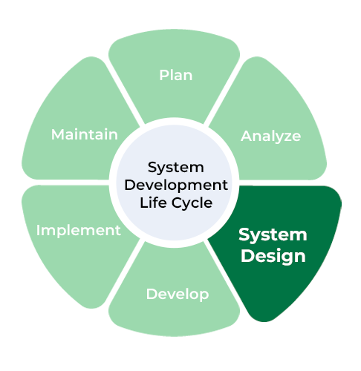
System Design Decisions
System design
  Capacity
  Facility location
  Facility layout
  Product and service planning
  Acquisition and placement of equipment
These are typically strategic decisions that
  usually require long-term commitment of resources
  determine parameters of system operation
1-21

Slide 22
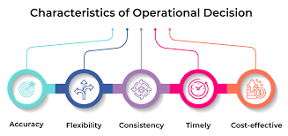
System Operation Decisions
System operation
  These are generally tactical and operational decisions
    Management of personnel
    Inventory management and control
    Scheduling
    Project management
    Quality assurance
Operations managers spend more time on system operation decision than any other decision area
  They still have a vital stake in system design
  They usually use both quantitative and qualitative approaches, as they intend to make ethical decisions.
1-22

Slide 23
OM Decision Making
Most operations decisions involve many alternatives that can have quite different impacts on costs or profits
Typical operations decisions include:
  What: What resources are needed, and in what amounts?
  When: When will each resource be needed? When should the work be scheduled? When should materials and other supplies be ordered?
  Where: Where will the work be done?
  How: How will the product or service be designed? How will the work be done? How will resources be allocated?
  Who: Who will do the work?
  Therefore, Service often requires greater labor content, whereas manufacturing is more capital intensive.
1-23

Slide 24
General Approach to Decision Making
Modeling is a key tool used by all decision makers
  Model - an abstraction of reality; a simplification of something
  Common features of models:
    They are simplifications of real-life phenomena
    They omit unimportant details of the real-life systems they mimic so that attention can be focused on the most important aspects of the real-life system
  Physical Model – miniature airplane
  Schematic Model – drawing of a city
  Mathematical Model – Inventory optimization
1-24

Slide 25
Understanding Models
Keys to successfully using a model in decision making
  What is its purpose?
  How is it used to generate results?
  How are the results interpreted and used?
  What are the model’s assumptions and limitations?
1-25

Slide 26
Benefits of Models
Generally easier to use and less expensive than dealing with the real system
Require users to organize and sometimes quantify information
Increase understanding of the problem
Enable managers to analyze “What if?” questions
Serve as a consistent tool for evaluation and provide a standardized format for analyzing a problem
Enable users to bring the power of mathematics to bear on a problem
1-26

Slide 27
Model Limitations
Quantitative information may be emphasized at the expense of qualitative information
Models may be incorrectly applied, and the results misinterpreted
  This is a real risk with the widespread availability of sophisticated, computerized models placed in the hands of uninformed users
The use of models does not guarantee good decisions
1-27

Slide 28
Quantitative Approaches
A decision-making approach that frequently seeks to obtain a mathematically optimal solution
  Supported by computer calculations
  Often work together with qualitative approaches
1-28

Slide 29
Metrics and Trade-Offs
Analysis of trade-offs
  A trade-off is giving up one thing in return for something else
  Carrying more inventory (an expense) to achieve a greater level of customer service
Performance metrics
  All managers use metrics to manage and control operations
    Profits
    Costs
    Quality
    Productivity
    Flexibility
    Inventories
    Schedules
    Forecast accuracy
1-29

Slide 30
Systems Perspective
System - a set of interrelated parts that must work together
  The business organization is a system composed of subsystems
    Marketing subsystem
    Operations subsystem
    Finance subsystem
The systems perspective
  Emphasizes interrelationships among subsystems
  Main theme is that the whole is greater than the sum of its parts
  The output and objectives of the organization take precedence over those of any one subsystem
  That means we concentrate on efficiency within the whole system and so secure total efficiency.
1-30

Slide 31
Establishing Priorities
In nearly all cases, certain issues or items are more important than others
Recognizing this allows managers to focus their attention to those efforts that will do the best
  Pareto Phenomenon - a few factors account for a high percentage of occurrence of some event(s)
    The critical few factors should receive the highest priority
    This is a concept that is appropriately applied to all areas and levels of management
Pareto phenomenon that states that roughly 80% of outcomes come from 20% of causes
1-31

Slide 32
Historical Evolution of OM
Industrial Revolution
Scientific management
Human relations movement
Decision models and management science
Influence of Japanese manufacturers
Production lines raised living standards while simultaneously increasing output.
1-32

Slide 33
Industrial Revolution
Pre-Industrial Revolution
  Craft production - System in which highly skilled workers use simple, flexible tools to produce small quantities of customized goods
Some key elements of the industrial revolution
  Began in England in the 1770s
  Division of labor - Adam Smith, 1776
  Application of the “rotative” steam engine, 1780s
  Cotton gin and interchangeable parts - Eli Whitney, 1792
Management theory and practice did not advance appreciably during this period
1-33
Notes:
.

Slide 34
Scientific Management
Movement was led by efficiency engineer, Frederick Winslow Taylor
  Believed in a “science of management” based on observation, measurement, analysis and improvement of work methods, and economic incentives
  Management is responsible for planning, carefully selecting and training workers, finding the best way to perform each job, achieving cooperation between management and workers, and separating management activities from work activities
  Emphasis was on maximizing output
1-34

Slide 35

Human Relations Movement
The human relations movement emphasized the importance of the human element in job design
  Lillian Gilbreth – applications of psychology
  Abraham Maslow – motivation theory, 1940s;
  hierarchy of needs, 1954
  Frederick Hertzberg – Two Factor Theory, 1959
  Therefore, People who work in the field of operations should have skills that include both knowledge and people skills.
1-35

Slide 36
Decision Models & Management Science
F.W. Harris – mathematical model for inventory management, 1915
Dodge, Romig, and Shewart – statistical procedures for sampling and quality control, 1930s
Tippett – statistical sampling theory, 1935
Operations Research (OR) Groups – OR applications in warfare
George Dantzig – linear programming, 1947
1-36

Slide 37
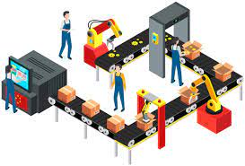
Influence of Japanese Manufacturers
Refined and developed management practices that increased productivity
  Credited with fueling the “quality revolution”
  Just-in-Time production
1-37

Slide 38

Operations Today
Technology Management
Global competition
Communications
Working with fewer resources
Revenue management
Agility
A combination of goods and services.
1-38

Slide 39

Key Issues for Operations Managers Today
Economic conditions
Innovating
Quality problems
Risk management
Cyber-security
Competing in a global economy
1-39

Slide 40



Thank You

