Slide 1


Project Business
Analysis
Prepared by Eng. Ahmed Hussein, MBA, PfMP©, PMP©, CMP APMG
PMG 461
Bachelor of Project Management
Lecture 9

Slide 2



Advanced Tools and Techniques
Lecture 9
PMG 461
Project Business Analysis
Prepared by
Eng. Ahmed Hussein, MBA, PfMP©, PMP©, CMP APMG
www.midocean.ae

Slide 3
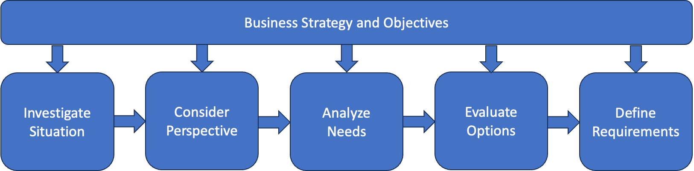
In Previous Lectures
Pre-Project
Project
Elicitation
www.midocean.ae

Slide 4

Lecture
What we will cover
09
Developing a Business Case
Defining the problem, Current and Future States
Evaluating Alternatives
www.midocean.ae

Slide 5

Lecture
Developing a Business Case
09
www.midocean.ae

Slide 6
Business Case
A documented economic feasibility study used to establish the validity of the benefits of a project (aimed to solve a problem or capture an opportunity) and that is used as a basis for the authorization of further project management activities.
Once Approved:
  Allocate Budget for project
  Appoint Project Manager
  Develop Charter
www.midocean.ae

Slide 7
Components of a Business Case (1/2)
Executive Summary
Concise overview of key points and conclusions.
Problem or Opportunity
Context and background information.
Problem or opportunity being addressed
Business Objectives
Objectives and alignment with organizational goals.
Alternatives
What options or alternatives have you considered
Benefits
Tangible (ex. Revenue increase, Profitability growth, quality improvement)
Intangibles (ex. Customer Satisfaction, Brand Image)
Costs
Upfront Costs (project costs or capital costs)
Alternatives Evaluation (Market, Technical, Operational, Financial)
On-going costs (operational costs)
Measurable, realistic goals.
www.midocean.ae

Slide 8
Components of a Business Case (2/2)
Financial Analysis
Cost Benefit Analysis
Risks, Assumptions and Constraints
Recommendation
Clear decision based on analysis.
Associated risks, sensitivity analysis
Cash flow projections
ROI, NPV, IRR, Payback period)
Any assumptions made or imposed constraints
Implementation Plan
Timelines, milestones, resources, responsibilities.
www.midocean.ae

Slide 9
Business Analyst Role in Business Case
Elicitation: Understanding the situation
Defining the problem
Determining the required objectives
Identifying options
Analyzing options (Market, Technical, Operational, Financial)
Perform Cost-Benefit Analysis
Evaluate Options and propose Optimal Option
www.midocean.ae

Slide 10
Lecture
Defining the Problem, Current and Future States
09
www.midocean.ae

Slide 11
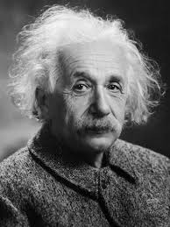
“If I had an hour to solve a problem, I’d spend 55 minutes thinking about the problem and 5 minutes thinking about solutions.”
-Albert Einstein
www.midocean.ae

Slide 12
Understanding the Situation
(Elicit information relevant to the situation)
Problem or Opportunity
Symptoms for the problem or opportunity
Stakeholders
Size of the problem or opportunity
Situation Statement
Root Causes
Related Goals and Objectives
www.midocean.ae

Slide 13
Situation (or problem) Statement
Problem (or Opportunity) of A
Has the effect of B
With the impact of C
Objective statement about a problem or opportunity that includes, the situation facing the organization, its direct effect, and business impact (or result).
www.midocean.ae

Slide 14
Examples
Inefficient supply chain management
Has the effect of delayed deliveries and increased inventory costs
With the impact of reduced profitability and customer satisfaction
Problem
Implementing an e-commerce platform
Has the effect of expanding market reach and improving customer engagement
With the impact of increased sales revenue and brand visibility
Opportunity
www.midocean.ae

Slide 15
Gap Analysis
Environmental Factors
Find the Gaps
Missing/Required Capabilities
Where are we?
Where do we want to be?
What do we have?
What do we need to have?
Current State
Capabilities and Performance Indicators
Future State
Capabilities and Performance Indicators
What is missing?
www.midocean.ae

Slide 16
How to find the Gaps?
Determine Area for Analysis
Based on situation statement and root causes.
Identify Internal and External Factors
Internal and external factors using methods like PESTLE SWOT, or CATWOE.
Analyze Current State
Use historical data to set performance standards and analyze performance in terms of processes, people capabilities, and trends
Define Future State
Identify desired capabilities and performance indicators.
Compare Current State to Future State
(Gap Analysis)
Capability table to Categorize current and desired capabilities.
Compare and quantify the gap.
Assess whether business requirements are met.
Determine steps to meet objectives
www.midocean.ae

Slide 17
PESTLE Analysis
A framework to help organizations assess their broad environment
An examination of the political, economic, sociocultural, technological, legal and environmental issues in the external business environment.
PESTEL Analysis
Political
Economical
Social
Legal
Technological
Environmental
www.midocean.ae

Slide 18
MOST Analysis
Examines current Mission, Objectives, Strategy, and Tactics.
Checks for Clarity and support inside the organization.
Mission: a statement declaring what business the organization is in, and what it is intending to achieve.
Objectives: the goals against which the organization’s achievements can be measured.
Strategy: the approach that is going to be taken by the organization in order to achieve the objectives and mission.
Tactics: the detailed means by which the strategy will be implemented.
www.midocean.ae

Slide 19
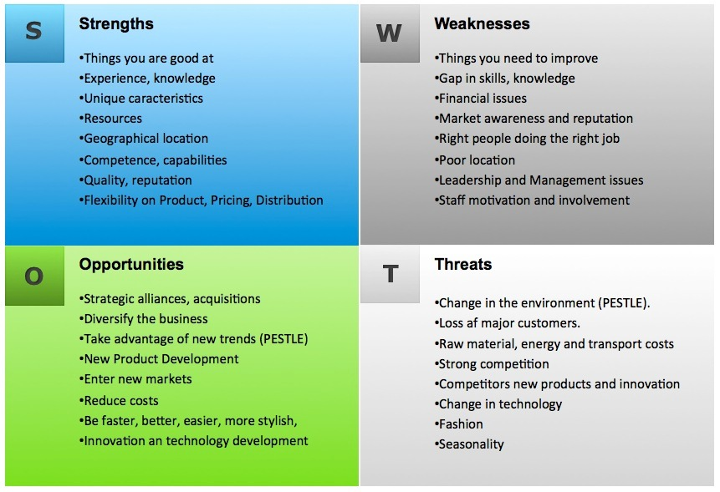
SWOT Analysis
A SWOT analysis generates information that is helpful in matching a company’s goals, programs and capacities to the environment.
It can identify strategic areas for change.
Analyzes the external and internal environments.
  Strengths and Weaknesses are Internal
  Opportunities and Threats are External
www.midocean.ae

Slide 20
Mckinsey 7s Framework
STRUCTURE
Organization is made up of 7 interacting elements.
These components might need to change to fill the gap between current and future state.
Analyze the 7 components and determine changes needed to fill the gap.
Hard Elements: Strategy, Structure, and Systems
Soft Elements: Shared Values, Skills, Style, Staff
STRATEGY
SYSTEMS
SHARED
VALUES
SKILLS
STYLES
(of Leadershipt)
STAFF
www.midocean.ae

Slide 21
Using Mckinsey 7s to Determine Solution
What should we do to solve the specific business problem?
What structure do we need to execute the solution?
What business system do we need to use or implement in the future state
What leadership style and cultural qualities will help us to achieve the future state?
How should staff help managers to achieve the future state?
What are the specific skills that we need to develop?
Which principles need to be modified in the future state?
www.midocean.ae

Slide 22
Project Objectives Should
Align with Business Objectives
Example | Project Objectives | Business Objectives
Increase Revenue | Launch a new product line. | Increase overall sales revenue by X%.
Customer Satisfaction | Implement a customer feedback system. | Achieve a customer satisfaction rating of X%.
Reduce Operation Costs | Implement process automation in manufacturing. | Reduce manufacturing costs by X% within the next year.
Enhance Brand Awareness | Launch a marketing campaign targeting new demographics. | Increase brand recognition in the target market by X%.
Expand Market Reach | Open new retail locations in strategic locations. | Increase market share in specific regions by X%.
www.midocean.ae

Slide 23
Lecture
Evaluating Alternatives
08
www.midocean.ae

Slide 24
Options and Alternates
An Option or alternate represents a possible proposed solution.
For each option or alternate we should elicit information, gather data and analyze it.
This might includes:
  Technical Analysis
  Operational Analysis
  Market Analysis
  Financial Analysis
Then we compare all options against each other and make-decision about the optimal option to propose it.
www.midocean.ae

Slide 25
Components of Market Analysis
Introduction
Overview of the market analysis study.
Purpose and objectives of the study.
Scope and methodology.
Industry Overview
Description of the industry and its key segments.
Market size, growth trends, and projections.
Key drivers and challenges affecting the industry.
Market Segmentation
Identification and analysis of market segments.
Demographic, geographic, psychographic, and behavioral factors influencing segmentation.
Size and growth potential of each segment.
Competitor Analysis
Identification of major competitors in the market.
Assessment of competitors' strengths, weaknesses, opportunities, and threats (SWOT analysis).
Analysis of competitors' market share, pricing strategies, distribution channels, and marketing tactics.
Customer Analysis
Identification of target customer demographics and characteristics.
Assessment of customer needs, preferences, and buying behavior.
Analysis of customer satisfaction levels and loyalty.
Market Trends and Opportunities
Identification and analysis of current market trends.
Assessment of emerging opportunities and threats.
Analysis of technological advancements, regulatory changes, and other factors impacting the market.
Market Entry Strategies
Evaluation of potential strategies (e.g., product differentiation, pricing strategies, distribution channels).
Assessment of risks and challenges associated with market entry.
Recommendation of the most suitable market entry approach based on the analysis.
Conclusion
Summary of key findings from the market analysis study.
Implications for business strategy and decision-making.
Recommendations for future actions and areas for further research
www.midocean.ae

Slide 26
Components of Operational Analysis
Introduction
Conclusion
Summary of the overall impact of the operational analysis on the organization.
Closing remarks and next steps for implementing recommendations.
Overview of the operational analysis study.
Purpose and objectives of the analysis, scope and methodology.
Organizational Overview
Description of the organization's structure, functions, operations, key departments and their roles.
Mission, vision, and strategic goals of the organization.
Process Analysis
Identification and documentation of key business processes.
Analysis of process efficiency, effectiveness, and reliability, identification of bottlenecks, inefficiencies, and areas for improvement.
Resource Analysis
Assessment of human resources, including skills, capabilities, and training needs, analysis of physical resources, such as equipment, facilities, and technology.
Evaluation of financial resources, including budget allocation and cost management.
Performance Metrics
Identification of key performance indicators (KPIs) for measuring operational performance. Analysis of KPI trends and benchmarks against industry standards or organizational goals.
Assessment of performance gaps and areas needing improvement.
Quality Management
Evaluation of quality control processes and procedures, analysis of customer feedback, complaints, and satisfaction levels.
Identification of opportunities for enhancing product or service quality.
Supply Chain Analysis
Assessment of supply chain processes, including procurement, logistics, and inventory management. Analysis of supplier relationships, lead times, and costs.
Identification of risks and opportunities in the supply chain.
Technology Integration
Evaluation of technology infrastructure and systems. Analysis of IT capabilities, including software applications and data management. Identification of opportunities for leveraging technology to streamline operations and improve efficiency.
Recommendations and Action Plan
Summary of key findings and insights from the operational analysis. Recommendations for improving operational efficiency, effectiveness, and performance.
Action plan with specific initiatives, timelines, and responsible parties.
www.midocean.ae

Slide 27
Components of Technical Analysis
Introduction
Overview of the technical analysis study. Purpose and objectives of the analysis. Scope and methodology.
Technical Infrastructure Overview
Description of the organization's technical infrastructure, including hardware, software, and network systems. Overview of key technical components and their roles in supporting business operations. Assessment of the current state of technical infrastructure.
System Analysis
Identification and evaluation of existing systems and applications used within the organization. Analysis of system functionality, performance, and reliability. Assessment of system integration and compatibility.
Security Analysis
Evaluation of cybersecurity measures and protocols. Analysis of vulnerabilities, threats, and risks to the organization's technical assets. Assessment of compliance with industry standards and regulations.
Data Management
Analysis of data storage, retrieval, and processing capabilities. Assessment of data quality, integrity, and security. Evaluation of data backup and recovery procedures.
Technology Trends
Identification of emerging technologies relevant to the organization's industry or operations. Analysis of potential impact and opportunities presented by new technologies. Assessment of readiness to adopt and integrate new technologies.
Infrastructure Performance
Measurement and analysis of infrastructure performance metrics, such as uptime, response time, and throughput. Identification of performance bottlenecks and areas for improvement. Assessment of scalability and capacity planning.
IT Governance
Evaluation of IT governance frameworks, policies, and procedures. Analysis of IT asset management practices and procedures. Assessment of compliance with regulatory requirements and industry best practices.
Recommendations and Action Plan
Summary of key findings and insights from the technical analysis. Recommendations for improving technical infrastructure, systems, and security. Development of an action plan with specific initiatives, timelines, and responsible parties.
Conclusion
Summary of the overall impact of the technical analysis on the organization. Importance of ongoing monitoring and maintenance of technical assets. Closing remarks and next steps for implementing recommendations.
www.midocean.ae

Slide 28
Financial Analysis
Benefits → Annual Benefits X Years
Cost:
Project Cost + Annual operating cost x Years
Time: Life in years for the product/solution
www.midocean.ae

Slide 29
Financial Appraisal Methods
Method | Definition | Interpretation
Cost-Benefit Analysis | A method used to compare the costs of a project with the benefits it will generate over a specified period. It helps assess whether the benefits outweigh the costs. | Net Benefits = Benefits - Costs - Higher is better
Internal Rate of Return (IRR) | A metric used to estimate the profitability of an investment. It represents the discount rate at which the net present value (NPV) of all cash flows from the investment equals zero. Higher IRR indicates higher potential profitability. | % Higher is better
Return on Investment (ROI) | A measure used to evaluate the efficiency or profitability of an investment. It calculates the ratio of the net profit or benefits derived from an investment to the initial cost or investment amount. | % Higher is better
Net Present Value (NPV) | A method used to evaluate the profitability of an investment by calculating the present value of all future cash flows generated by the investment, discounted back to the present at a specified rate. A positive NPV indicates that the investment is expected to generate value. | Amount Higher is better
Payback Period | The time it takes for an investment to generate cash flows sufficient to recover the initial investment cost. It is a simple measure of investment risk and liquidity, with shorter payback periods generally considered more favorable. | Duration in years Lower is better
www.midocean.ae

Slide 30
Examples
Example 1:
Method | Option A | Option B | Option C | Best Option
Cost-Benefit Ratio | 5 M | 7 M | 10 M | Option C
Example 2:
Method | Option D | Option E | Option F | Best Option
Payback period | 4.2 | 2.5 | 3.2 | Option E
Example 3:
Method | Option G | Option H | Option I | Best Option
ROI | 15% | 12% | 10% | Option G
www.midocean.ae

Slide 31
Selecting the best alternate
Evaluation can be based on several factors, i.e. financial and non-financial factors
There are several Decision-Making methods, as:
Decision-Making Tree
Decision Making Matrix
Effort-Impact Matrix
www.midocean.ae

Slide 32
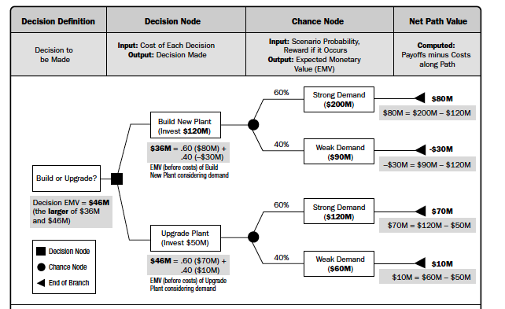
Decision Trees
A decision support tool that uses a graphical representation, similar to a tree or model, of decisions and their potential consequences, including their likelihood, resource costs, and benefits.
Used when main concern is financials and considers uncertainties.
www.midocean.ae

Slide 33
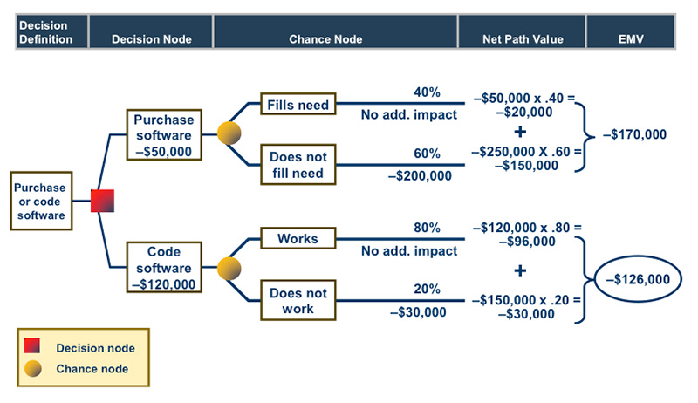
Decision Tree Example
www.midocean.ae

Slide 34
Effort–Impact Matrix
Evaluate alternatives based on only two elements:
  Effort required to implement the alternative, and
  Impact of applying the alternative on solving the problem
Fast way to evaluate
Can be objective or subjective
3 | 2 | 1
4 | 3 | 2
5 | 4 | 3
High
Impact
Low
High
Effort
Low
www.midocean.ae

Slide 35
Decision-Making Matrix
Used to analyze, compare, and evaluate alternatives to assist in choosing the best one.
Used in complex scenarios when there are more than one factor to consider
Can be done in a workshop with multiple stakeholders
Each factor can have a weight representing its importance
Option | Degree of solving problem | Cost | Time | Risks | Overall Score
 | Rate 1-5 | Rate 1-5 | Rate 1-5 | Rate 1-5
Option A | 3 | 5 | 4 | 3 | 15
Option B | 4 | 2 | 4 | 2 | 12
Option C | 4 | 4 | 4 | 5 | 17
Best Option
www.midocean.ae

Slide 36
Lecture
Key Points
09
Business Analysts are getting more involved in pre-project phase to develop business case
We need to define the problem or opportunity clearly through problem statment
We perform gap analysis to define Current and future states, and solutions to close the gap.
Many strategic analysis tools can be used (PESTLE, SWOT, MOST, 7s)
We gather data and perform market, operational, technical and financial analysis to come up with options or alternates
We select the best alternate based on a decision-making model.
www.midocean.ae

Slide 37

For Discussion Panel:
Watch the video “How to Write a Business Case - Project Managment Training”
Reading, Chapter 3 “Strategy Analysis”
from textbook “Business Analysis” by James Cadle, Malcolm Eva, Keith Hindle, Debra Paul, 2nd edition
Lecture
09
For Discussion Panel and Next Lecture
www.midocean.ae

Slide 38


Thank You

