Slide 1


Risk Management
Prepared by Dr. Majid Saad
MGM510
Lec.7 : Financial Operations of Insurers

Slide 2

Lec.7 : Financial Operations of Insurers
““To manage an insurance enterprise successfully, you must understand the volatility inherent in each portfolio of risks and investments. Further, you must understand the impact that unexpected volatility has on the balance sheet, income statement, and cash flows.”
Mike Keyes,
Chairman of the Board and former CEO,
Oregon Mutual Insurance Company.”

Slide 3

Lecture objectives
After studying this chapter, you should be able to:
Understand the three major sections of the balance sheet for a property and casualty insurance company: assets, liabilities, and policyholders’ surplus.
Identify the sources of revenues and types of expenses incurred by a property and casualty insurance company.
Explain how profitability is measured in the property and casualty insurance industry.
Understand the balance sheet and income and expense statement of a life insurance company, and explain how profitability is measured in the life insurance industry.
Explain the objectives of rate making in the property and casualty insurance industry and discuss the basic rate-making methods, including judgment rating, class rating, and merit rating..
www.midocean.ae

Slide 4
Property and Casualty Insurers
To understand the financial operations of an insurance company, it is necessary to examine the insurer’s financial statements. Two important financial statements are the balance sheet and the income and expense statement.
Balance Sheet
A balance sheet is a summary of what a company owns (assets), what it owes (liabilities), and the difference between total assets and total liabilities (owners’ equity). A balance sheet shows these values on a specific date. This financial statement is called a balance sheet because the two sides of the financial statement must be equal:
Total assets = Total liabilities + Owners’ equity
www.midocean.ae

Slide 5
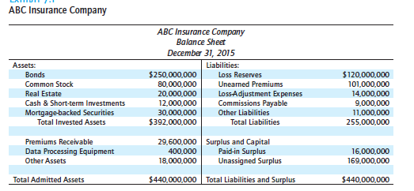
Balance Sheet
www.midocean.ae

Slide 6
Assets
The primary assets for an insurance company are financial assets. An insurance company invests premium dollars and retained earnings in financial assets. These investments also provide an important source of income for an insurer. As with most insurance companies, ABC’s primary investment holding is bonds. Other investments are in common and preferred stock, real estate, mortgage-backed securities, marketable securities, and cash/cash equivalents. The company’s assets total $440 million.
www.midocean.ae

Slide 7
Liabilities
Although the assets of an insurance company are relatively straightforward, the liabilities are more complex. An insurer is required by law to maintain certain reserves on its balance sheet. Because premiums
are paid in advance, but the period of protection extends into the future, an insurer must establish reserves to assure that premiums collected in advance will be available to pay future losses. A property and casualty insurer is required to maintain two principal types of financial reserves:
1- Loss Reserves.
2- Unearned Premium Reserve.
www.midocean.ae

Slide 8
Income and Expense Statement
The income and expense statement summarizes revenues received and expenses paid during a specified
period of time .
Revenues
Revenues are cash inflows that the company can claim as income. The two principal sources of revenues for an insurance company are premiums and investment income.
Earned premiums represent the portion of the premiums for which insurance protection has been provided.
The second major source of income is investment income.
www.midocean.ae

Slide 9
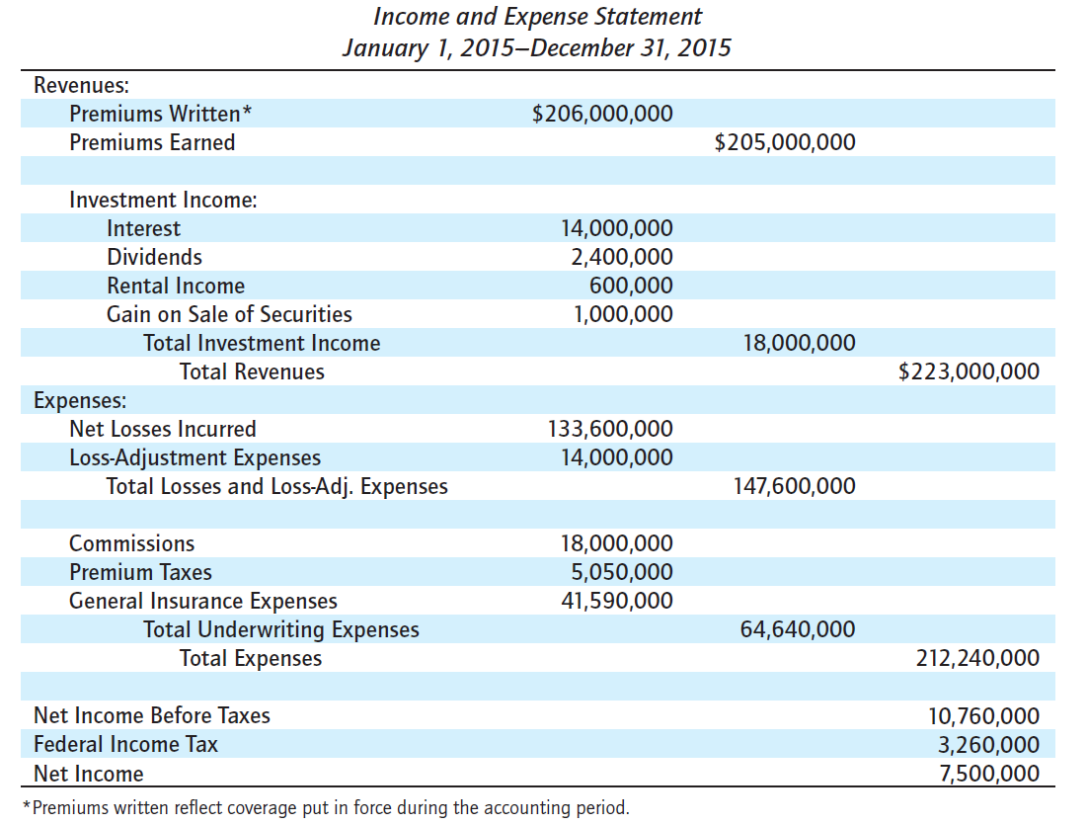
Income and Expense Statement
www.midocean.ae

Slide 10
Expenses
Partially offsetting the company’s revenues were the company’s expenses, which are cash outflows from the business.
Underwriting expenses are the other major category of expenses.
The other major expenses in Insurance Companies is the cost of adjusting claims.
www.midocean.ae

Slide 11
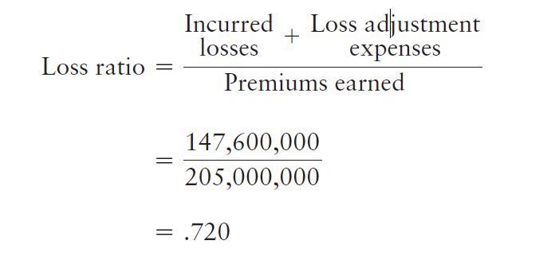
Measuring Profit or Loss
One way of measuring the performance of an insurance company is to consider how the company did in its core business, underwriting risks.
A simple measure that can be used is the insurance company’s loss ratio. The loss ratio is the ratio of incurred losses and loss adjustment expenses to premiums earned.
The formula and the loss ratio are: ( form the example –slide 9)
www.midocean.ae

Slide 12
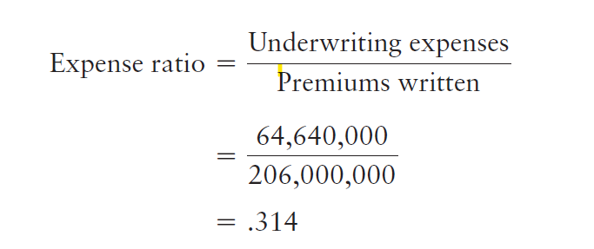
Measuring Profit or Loss
A second important performance measure is the expense ratio. The expense ratio is equal to the company’s underwriting expenses divided by written premiums..
The expense ratio: ( form the example –slide 9)
www.midocean.ae

Slide 13
Underwriting expenses
Underwriting expenses include acquisition costs (commissions), general expenses, and underwriting costs. Some coverages, such as personal lines, are less costly to underwrite. Underwriting costs for large
commercial accounts may be much higher. Obviously, a low expense ratio is preferred by insurers.
Expense ratios are usually in the 25 percent to 40 percent range.
www.midocean.ae

Slide 14
Measuring Profit or Loss
For an overall measure of underwriting performance, the combined ratio can be calculated. The combined ratio is the sum of the loss ratio and expense ratio:
Combined ratio = Loss ratio + Expense ratio
The combined ratio is one of the most common measures of underwriting profitability. If the combined ratio exceeds 1 (or 100 percent), it indicates an underwriting loss. If the combined ratio is less than 1 (or 100 percent), it indicates an underwriting profit.
www.midocean.ae

Slide 15
Measuring Profit or Loss
The investment income ratio compares net investment income to earned premiums.
The overall operating ratio is equal to the combined ratio minus the investment income ratio.
www.midocean.ae

Slide 16
Recent Underwriting Results
The property and casualty insurance industry has not been highly profitable over time. The industry has lagged profitability benchmarks for various industry groups in most years.
www.midocean.ae

Slide 17
Balance Sheet in Life Insurance Companies
Balance Sheet:
The balance sheet for a life insurance company is similar to the balance sheet of a property and casualty
insurance company.
Assets
Like the property and casualty insurance companies discussed earlier, the assets of a life insurance company are primarily financial assets.
www.midocean.ae

Slide 18
Balance Sheet in Life Insurance Companies
There are three major differences between the assets of a property and casualty insurance company and the assets of a life insurance company:
The first major difference is the average duration of the investments. The matching principle states that an organization should match the maturities of its sources and uses of funds.
The second major difference is created by the savings element in cash-value life insurance. Permanent
life insurance policies develop a savings element over time called the cash value.
The third major difference in assets between a property and casualty insurer and a life insurance company is that a life insurance company may have separate account assets. To protect policyholders, state laws place limitations on a life insurance company’s general investments.
www.midocean.ae

Slide 19
Balance Sheet in Life Insurance Companies
Liabilities
Policy reserves are the major liability item of life insurers. Under the level-premium method of
funding cash-value life insurance, premiums paid during early years are higher than necessary to pay death claims, while those paid in later years are insufficient to pay death claims.
The excess premiums paid during the early years result in the creation of a policy reserve. Policy reserves are a liability item on the balance sheet that must be offset by assets equal to that amount.
Policy serves are often called legal reserves because state insurance laws specify the minimum basis for calculating them.
The reserve for amounts held on deposit is a liability that represents funds owed to policyholders and to beneficiaries.
www.midocean.ae

Slide 20
Balance Sheet in Life Insurance Companies
The asset valuation reserve is a statutory account designed to absorb asset value fluctuations not caused by changing interest rates. The net effect of this reserve is to smooth the company’s reported surplus over time.
Policyholders’ Surplus As with property and casualty insurance companies, policyholders’ surplus is the
difference between a life insurer’s total assets and total liabilities.
www.midocean.ae

Slide 21
Income and Expense Statement
The income and expense statement for a life insurance company is similar to the statement reviewed earlier for a property and casualty insurance company. The major sources of revenues are premiums received for the various products sold (e.g., ordinary life insurance, group life insurance, annuities, and health insurance) and income from investments. As with property and casualty insurers, investment income can take the form of periodic cash flows (interest, dividends, and rental payments) and realized capital gains or losses.
Like a property and casualty insurance company, claims payments are a major expense for a life insurance company.
www.midocean.ae

Slide 22
Income and Expense Statement
Increased reserves, general insurance expenses, agents’ commissions and licenses, premium taxes, and fees round out the list of important expenses.
A life insurer’s net gain from operations before dividends and taxes is the insurer’s total revenues less the insurer’s total expenses. A life insurer’s net gain from operations (also called net income) equals total
revenues less total expenses, policyholder dividends, and federal income taxes.
www.midocean.ae

Slide 23
Measuring Financial Performance
A number of measures can be used to gauge the financial performance of the life insurance industry. For example, pre-tax or after-tax net income could be compared to total assets. An alternative measure is the rate of return on policyholders’ surplus, similar to a return on equity (ROE) ratio.
www.midocean.ae

Slide 24
Rate Making in Property and Casualty Insurance
Given the competitive nature of the insurance industry, premiums charged by insurance companies are
important. Before examining specific rate-making methods in property and casualty insurance, the objectives of rate making are discussed.
www.midocean.ae

Slide 25
Objectives in Rate Making
Rate making, or insurance pricing, has several basic objectives. Because insurance rates, primarily property and casualty insurance rates, are regulated by the states, certain statutory and regulatory requirements must be met. Also, due to the overall goal of profitability, certain business objectives must be stressed. Thus, rate-making goals can be classified into two categories: regulatory objectives and business objectives..
www.midocean.ae

Slide 26
Objectives in Rate Making
Regulatory Objectives:
The goal of insurance regulation is to protect the public. States enact rating laws that require insurance rates to meet certain standards
In general, rates charged by insurers must be adequate, not excessive, and not unfairly discriminatory.
Rates must be adequate. This means the rates charged by insurers should be high enough to pay all losses and expenses.
Rates must not be excessive. This means that the rates should not be so high that policyholders are paying more than the actual value of their protection.
Rates must not be unfairly discriminatory. This means that exposures that are similar with respect to losses and expenses should not be charged significantly different rates.
www.midocean.ae

Slide 27
Objectives in Rate Making
Business Objectives
Insurers are also guided by business objectives in designing a rating system. The rating system should meet all of these objectives: simplicity, responsiveness, stability, and encouragement of loss control .
The rating system should be easy to understand so that producers can quote premiums with a minimum
amount of time and expense.
The rating system should be easy to understand so that producers can quote premiums with a minimum amount of time and expense.
commercial insurance purchasers should understand how their premiums are determined so that they can take active steps to reduce their insurance costs.
www.midocean.ae

Slide 28
Objectives in Rate Making
Business Objectives
Rates should be stable over short periods of time so that consumer satisfaction can be maintained. If rates change rapidly, insurance consumers may become irritated and dissatisfied. They may then look to government to control the rates or to enact a government insurance program.
Rates should also be responsive over time to changing loss exposures and changing economic conditions. To meet the objective of rate adequacy, the rates should increase when loss exposures increase.
Finally, the rating system should encourage loss control activities. Loss-control efforts are designed to
reduce the frequency and severity of losses. This point is important because loss control tends to keep insurance affordable. Profits are also stabilized. As you will see later, certain rating systems provide a strong financial incentive for the insured to engage in loss control.
www.midocean.ae

Slide 29
Basic Rate-Making Definitions
You should be familiar with some basic terms that are widely used in rate making.
A rate is the price per unit of insurance...
The pure premium refers to that portion of the rate needed to pay losses and loss-adjustment expenses.
The loading refers to the amount that must be added to the pure premium for other expenses, profit, and a margin for contingencies.
The gross rate consists of the pure premium and a loading element.
Finally, the gross premium paid by the insured consists of the gross rate multiplied by the number of exposure units.
www.midocean.ae

Slide 30
Rate-Making Methods
There are three basic rate-making methods in property and casualty insurance: judgment, class, and merit rating. Merit rating, in turn, can be broken down into schedule rating, experience rating, and retrospective rating. Thus, the basic rating methods can be conveniently classified as follows:
Judgment rating
Class rating
Merit rating
- Schedule rating
- Experience rating
- Retrospective rating
www.midocean.ae

Slide 31
Judgment Rating
Judgment rating means that each exposure is individually evaluated, and the rate is determined largely by the judgment of the underwriter.
This method is used when the loss exposures are so diverse that a class rate cannot be calculated, or when
credible loss statistics are not available.
www.midocean.ae

Slide 32
Class Rating
The second type of property and casualty rating is class rating. Most rates used today are class rates. Class rating means that exposures with similar characteristics are placed in the same underwriting class, and each is charged the same rate.
The rate charged reflects the average loss experience for the class as a whole. Class rating is based on the assumption that future losses to insureds will be determined largely by the same set of factors.
www.midocean.ae

Slide 33
Class Rating methods
There are two basic methods for determining class rates: the pure premium method and the loss
ratio method.
www.midocean.ae

Slide 34
Pure Premium Method
The pure premium is that portion of the gross rate needed to pay losses and loss-adjustment expenses. The pure premium can be determined by dividing the dollar amount of incurred losses and loss-adjustment expenses by the number of exposure units.
www.midocean.ae

Slide 35
Loss Ratio Method.
Under the loss ratio method, the actual loss ratio is compared with the expected loss ratio, and the rate is adjusted accordingly. The actual loss ratio is the ratio of incurred losses and loss-adjustment expenses to earned premiums.
The expected loss ratio is the percentage of the premium that can be expected to be used to pay losses.
www.midocean.ae

Slide 36
Merit Rating
The third principal type of rating in property-casualty insurance is merit rating. Merit rating is a rating plan by which class rates (manual rates) are adjusted upward or downward based on individual loss experience. Merit rating is based on the assumption that the loss experience of a particular insured will differ substantially from the loss experience of other insureds. Thus, class rates are modified upward or downward depending on individual loss experience. There are three types of merit rating plans: schedule rating, experience rating, and retrospective rating.
www.midocean.ae

Slide 37
Schedule Rating.
Under a schedule rating plan, each exposure is individually rated. A basis rate is determined for each exposure, which is then modified by debits or credits for undesirable or desirable physical features.
Schedule rating is based on the assumption that certain physical characteristics of the insured’s operations will influence the insured’s loss experience. Thus, the physical characteristics of the exposure to be insured are extremely important in schedule rating.
Schedule rating is used in commercial property insurance for large, complex structures, such as an industrial plant.
www.midocean.ae

Slide 38
Experience Rating
Under experience rating, the class or manual rate is adjusted upward or downward based on past loss experience. The most distinctive characteristic of experience rating is that the insured’s past loss experience is used to determine the premium for the next policy period. The loss experience over the last 3-5 years is typically used to determine the premium for the next policy year. If the insured’s loss experience is better than the average for the class as a whole, the class rate is reduced..
www.midocean.ae

Slide 39
Retrospective Rating
Retrospective Rating. Under a retrospective rating plan, the insured’s loss experience during the current policy period determines the actual premium paid for that period. Under this rating plan, a provisional premium is paid at the start of the policy period. At the end of the period, a final premium is calculated based on actual losses that occur during the policy period.
There is a minimum and a maximum premium that must be paid. In practice, the actual premium paid generally will fall somewhere between the minimum and maximum premium, depending on the insured’s loss experience during the current policy period.
Retrospective rating is widely used by large firms in workers compensation insurance, general liability insurance, auto liability and physical damage insurance, and burglary and glass insurance.
www.midocean.ae

Slide 40
Rate Making in Life Insurance
Life insurance actuaries use a mortality table or individual company experience to determine the probability of death at each attained age. The probability of death is multiplied by the amount the life insurer will have to pay if death occurs to determine the expected value of the death claims for each policy year. These annual expected values are then discounted back to the beginning of the policy period to determine the net single premium (NSP).
www.midocean.ae

Slide 41



Thank You

