Slide 1


DIGITAL CONTENT DIRECTION
DGM 733
Prepared by:
Dr. Sherihan Mohamed
Lecture 4

Slide 2


Lecture 3
Conclusion:
* Public Relations: What Is PR?
* Copywriting, Editing and Other Essentials.
* Risk and Crisis Management.
* Convergence and SMIs.
* Who Are SMIs?
* Conclusion
* References

Slide 3

Lecture 4
Digital Content Direction
Digital Content:
production media

Slide 4
Lecture 4
OUTLINES:
* What Is Freelancing?
* Understanding Freelancers.
* Benefits and Drawbacks of Being a Freelancer.
* Types of Freelancers.
* Conclusion
* References

Slide 5
Lecture 4
Digital Content Direction
What Is Freelancing?

Slide 6

What Is Freelancing?
Lecture 4
It is probable that Every Content Producer will engage in freelance work at some point, whether it becomes their primary source of income or simply a side hustle. This path can appear to be a liberating and flexible way to make a living, at least when viewed from a distance.

Slide 7
Freelancers need to think like CEOs and act like entrepreneurs. Everyone else’s business is their business—literally!
They must be able to seamlessly slot into, or add value to, the operations of often quite disparate clients.

Slide 8

What Is Freelancing?
Lecture 4
Freelancing refers to working independently, where you essentially operate As your own boss. It involves envisioning and establishing yourself as a small business entity that offers or rents out its products or services to a range of different clients.

Slide 9
Freelancing gives content producers the illusion of control, but in reality, such work is a constant negotiation between what you want to produce and sell and what the market wants to buy.
Rather than working for one employer, it can feel like you’re working for an ever-changing array of short-term bosses each with their own rules, demands and ways of working.

Slide 10

What Is Freelancing?
Lecture 4
A freelancer Is Not an employee of a firm and may therefore be at liberty to complete different jobs concurrently by various individuals or firms unless contractually committed to working exclusively until a particular project is completed.

Slide 11

A freelancer is a person who earns income on a per-job or per-task basis, typically engaging in short-term projects as an independent contractor rather than a permanent employee.

Slide 12
Lecture 4
Digital Content Direction
Understanding Freelancers

Slide 13

Understanding Freelancers
Lecture 4
Typically, freelancers are considered independent workers and may do their contract work full-time or as a side job to supplement full-time employment, time permitting.

Slide 14
Freelancers, as independent contractors, typically require signed contracts for the job to be done and will agree to a predetermined fee based on the time and effort required to complete the task. This fee may be a flat fee or a per-hour, per-day, or per-project fee, or some other similar measure.

Slide 15
Understanding Freelancers
Lecture 4
A freelancer tends to work in the creative, skilled, or service sector, such as in film, art, design, editing, copywriting, proofreading, media, marketing, music, acting, journalism, video editing and production, illustration, tourism, consulting, website development, computer programming, event planning, photography, language translation, tutoring, catering, and many more.

Slide 16
Some media professionals have freelancing thrust upon them by circumstance, e.g., redundancy or retrenchment. Others freelance because they are new to an industry and see it as a way of building a portfolio as they chase ongoing positions.

Slide 17
Understanding Freelancers
Lecture 4
For some freelancers, it is the way they choose to work. Regardless of where you fit on that spectrum, to be successful, you need to remain open to that idea of negotiation, and to be flexible and adaptable, so as to be able to change as the nature of the work you take on does.

Slide 18
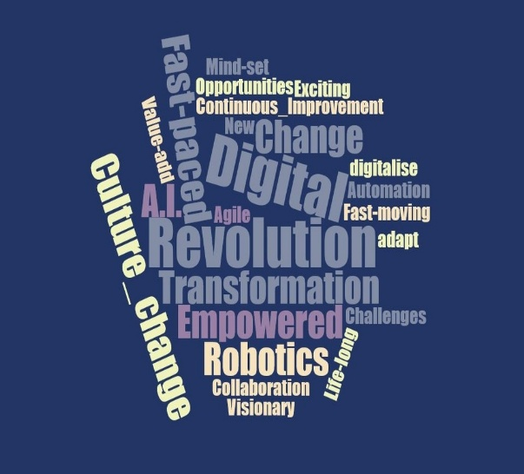
The digital revolution in the late 1990s and early 2000s made working across great distances easier.
It removed the need for anything other than an online relationship between producer and client in many cases.

Slide 19
Understanding Freelancers
Lecture 4
This and other factors, such as the Global Financial Crisis of 2008 saw a push from employers in media industries to make such working relationships short-term and insecure and to rely more heavily on freelancers, as this allowed them to scale their workforces up and down as necessary, thereby minimising financial risk.

Slide 20
The emergence in the 2010s of the gig economy saw the further normalisation of short-term and contingent work via the introduction of digital apps and platforms to industries that had traditionally operated in an employer employee relationship— think Uber versus taxi driving.

Slide 21
Lecture 4
Digital Content Direction
Benefits and Drawbacks
of Being a Freelancer

Slide 22

Benefits and Drawbacks of Being a Freelancer
Lecture 4
The benefits of being a freelancer include:
* Enjoying The Freedom to work from Home or Other Non-traditional Work Environments.
* Benefiting from a Flexible Schedule and achieving a more Balanced Work-life Dynamic.

Slide 23
* Freelance work can offer advantages to individuals who have been laid off, helping to decrease overall unemployment rates within an economy.
* A freelancer is their own boss—they ⁽¹⁾decide their workload, ⁽²⁾set their own schedule, ⁽³⁾choose their dress code, and ⁽⁴⁾manage every other aspect of how they operate.

Slide 24

Benefits and Drawbacks of Being a Freelancer
Lecture 4
* Freelancing involves handling a variety of projects for multiple clients. Each assignment offers something unique and presents a chance to enhance your skills. As you progress, you'll likely be continuously learning and adapting to new challenges.

Slide 25
The Drawbacks of being a freelancer include:
* Uncertainty about future income can be a significant challenge.
* There may be a lack of job stability and inconsistency in securing new projects.
* Freelancers also typically do not receive employer-provided benefits, such as health insurance or retirement plans, and may sometimes earn lower hourly rates compared to salaried employees.

Slide 26

Benefits and Drawbacks of Being a Freelancer
Lecture 4
* One of the drawbacks of freelancing is the absence of benefits that are typically provided when working for a traditional company.
* A freelancer's income is entirely dependent on the volume of work they take on and complete.

Slide 27

* Being self-employed requires setting up your own workspace, which might involve designating a part of your home as an office or securing a workspace elsewhere. Both options can incur expenses such as rent, furniture, office supplies, and internet services.

Slide 28
Benefits and Drawbacks of Being a Freelancer
Lecture 4
* Although the prospect of working free from office politics and without a mandatory dress code may seem attractive, over time, a freelancer might begin to miss certain aspects of having coworkers, such as social interaction and a sense of community.

Slide 29
Lecture 4
Digital Content Direction
Types of Freelancers

Slide 30

Types of Freelancers
Lecture 4
An example of a freelancer would be an independent journalist who reports on stories of their own choosing and then sells their work to the highest bidder. Another example is a web designer or an app developer who does one-time work for a client and then moves on to another client.

Slide 31
Other contexts in which freelancers often work include:
1. Content Producer: The opportunities are virtually endless for freelance writing and content-producing jobs. Content production is among the most popular types of freelance jobs today on platforms like WriterAccess.

Slide 32

Types of Freelancers
Lecture 4
As long as you are reliable and quick and can produce unique and quality content, you can keep yourself pretty busy.
Medical and technical writing jobs tend to pay more, as well as press releases, but there are also plenty of options for website content, blogs, and social media content.

Slide 33
Types of Freelancers
Lecture 4
2. Web Designer or Web Developer: Since every business needs a website to be successful online, it makes sense that web designers and web developers are in high demand.
A web designer or web developer will work with their clients to plan, design, and code websites that look great and bring in traffic.

Slide 34
Many designers have the capability of working in any industry as well as other design projects outside of websites, including brochures, emails, logos, and more.
Web developers, on the other hand, tend to specialize in different areas.
There is a significant amount of web design work on various freelance platforms, so make sure to check it out.

Slide 35

Types of Freelancers
Lecture 4
3. Virtual Assistant: Virtual assistants are growing in popularity due to the fact that more companies are looking to outsource some of their more day-to-day tasks.

Slide 36
A virtual assistant can help clients free up some of their time so it can be spent on more business-related projects.
These individuals offer a variety of administrative-related services remotely. They can take phone calls, schedule appointments and meetings, manage emails, make travel arrangements, and so much more.

Slide 37

Types of Freelancers
Lecture 4
4. Accountant/Financial Consultant: Every company is in need of financial expertise at some point in the duration of their business, which makes accountants, bookkeepers, and financial consultants in high demand.

Slide 38

Plus, there’s the fact that most people don’t like to deal with this side of the business, leading them to outsource.
From handling a company’s finances to evaluating its financial status, these freelancers can handle most financial tasks for a client.

Slide 39
Types of Freelancers
Lecture 4
5. Bilingual Services: With more businesses taking a global stance with their presence, the need for freelancers with bilingual skills is more important than ever before.
Translators for Spanish, French, and German tend to be the most popular, and remote bilingual jobs are steadily increasing on FlexJobs.
These freelancers may be called upon to produce content, translate and transcribe, and more.

Slide 40
6. Social Media Specialist: In order to succeed in today’s day and age, it is imperative for all businesses to have an online presence and a brand following.
However, when it comes to social media efforts, it takes up a lot of time. As a result, many organizations opt-out.

Slide 41
Types of Freelancers
Lecture 4
7. App Developer: Businesses are constantly looking for new ways to get into the hands of their customers, which is where a custom app can come into play.
After all, most consumers today have a smartphone that they spend the majority of their time on.

Slide 42
8. Graphic Designer: At some point, every business will need some form of graphic design. This may be a logo, website design, or advertisement.
With that being said, graphic design pertains to various aspects of business, including advertising, marketing, business cards, outdoor signage, and more.

Slide 43
OUTLINES:
Lecture 4
* What Is Freelancing?
* Understanding Freelancers.
* Benefits and Drawbacks of Being a Freelancer.
* Types of Freelancers.
* Conclusion
* References

Slide 44

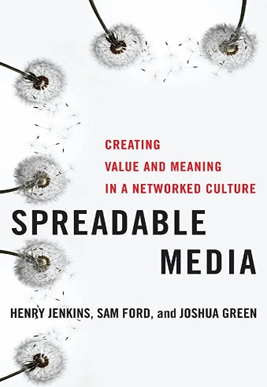

Jay Daniel Thompson & John Weldon (2022), Content Production for Digital Media: An Introduction, Springer Nature Singapore.
Jenkins, H., Ford, S., & Green, J. (2013). Spreadable media: Creating value and meaning in a networked culture. New York University Press.
Intro
Recommended Reference

Slide 45



Thank You

Slide 46


DIGITAL CONTENT DIRECTION
Lecture 4
DMG 733
Prepared by:
Dr. Sherihan Mohamed

