Slide 1


Strategic And Operational Risk Management
PMG 630
Dr. Ayman Hassan
  Lecture ① : Introduction To Operational Risks

Slide 2

Content
The concept of risk ( Hazards, Risks, and Accidents )
Types of corporate risks
Brief history of Operational risk
Operational Risk and Operational Risk Management
Objectives of operations management
Operational risk management
Classification Of Operational Risk events
The importance of a systems approach
Conclusion

Slide 3
The concept of risk
What is a risk ?
Definition: Risk means future uncertainty about deviation from the expected outcome, and various risks arise due to uncertainty arising from various factors affecting the situation.
So we note that...risk is related to uncertainty, and therefore it is a probability rate that is less than 100% and greater than 0%
Why take the risk?
There is a positive relationship between risk and profit. “More risk, more profit, and so on. Less risk, less profit.” There is no action without relative risk

Slide 4
2-Hazards, Risks, and Accidents
Hazards, Risks, and Accidents
These three terms—accidents, hazards, and risks—are very important, related, but distinct concepts that form the foundation of operational risk management.

Slide 5
2-1. Hazards
What is Hazard ?
To put it simply, a hazard is something that does not directly cause harm but has the potential to cause harm or loss.
To put it simply More, a hazard is something that can cause harm, so hazard is source of danger
For example,

Slide 6



2-1-1. Hazard Examples, Around the House
Sharp Objects
Poisoning
Falls
Many of these accidents are preventable and dealing with a serious accident that could have been avoided can lead to a lifetime of guilt.
Accidents in the home claim 18,000 lives each year in America alone.
It is the common household hazards that account for 21 million medical visits annually.
it costs around $220 billion a year.

Slide 7
2-2. Risks
risk, is a combination of two things – the chance that the hazard will cause harm and how serious that harm could be.
We previously said that risk is the chance or probability of harm occurring, and if harm occurs, how serious is it?
For example, crossing a road - the cars and other traffic are the main hazards; and your mental calculation of the risk is a combination of how likely it is that you’ll be hit by a vehicle, along with how seriously you might be injured. And, there are things that could affect the likelihood and there are things that could affect the severity.

Slide 8
2-3. Accidents
Accident
An event or series of events that results in death, injury, loss of system or service, or environmental damage.
Accidents: So, accidents are a term that makes us anxious about “an annoying word,” especially if they are characterized as unexpected and unplanned.
Or say an unfortunate event resulting in particular from negligence or ignorance, a traffic accident, for example, or a fall from an escalator
There are incidents that are happy for some and painful for others

Slide 9
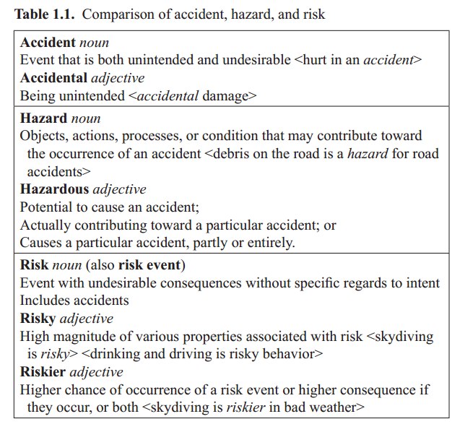
2-4. Accident, Hazard, Risk “ the meaning “

Slide 10
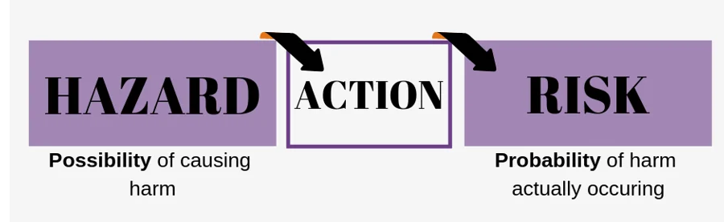
2-5. Comparison between, Hazard and Risk
For example, it’s possible that a bottle of bleach could be used incorrectly, causing harm. But you need to ask, how probable is it that this is going to happen? Until an action has actually occurred, it is only a hazard, not a risk.
Another example could be working at heights. Standing on top of a tall building is a hazard. The risk is how probable will you slip or step off the building and cause harm to yourself.

Slide 11
3. Types of corporate risks
Risk
systematic risk
unsystematic risk
The systematic risk Is the result of external variables that cannot be controlled, are not specific to the industry or security, and affect the entire market.
Unsystematic risk refers to risks that arise from controlled variables that are known, are industry or security specific, and can be controlled.

Slide 12
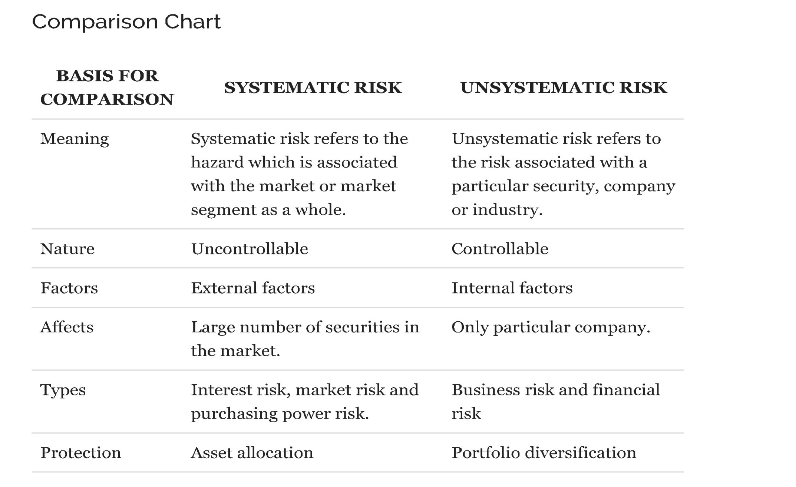
3-1. Systematic Risk Vs Unsystematic Risk

Slide 13
3-2. Types of corporate risks
Financial risk
Non- Financial risk
Credit Risk
Market risk
Liquidity risk
Operational Risk
Strategic Risk
Solvency Risk
Tail Risk
Model Risk
Compliance Risk
Legal Risk
Settlement Risk
It risk
Climate risk
Reputation risk

Slide 14

3-3. Financial & Non- Financial Risks
What Is Financial Risk?
Financial risk is the possibility of losing money on an investment or business venture. Some more common and distinct financial risks include credit risk, liquidity risk, and operational risk.

Slide 15

3-4. Financial & Non- Financial Risks
What is Non-Financial risk?
NFR is a broad term that is usually defined by exclusion, that is, any risks other than the traditional financial risks of market, credit, and liquidity
When we are talking about non-financial risk, be clear that we are talking about operational and strategic risk.

Slide 16

4-Brief History Of Operational Risk
(Basel Committee), which was established in 1974, Since then, risk management has spread beyond the financial and banking industries. The Integrated Internal Control Framework was issued in 1992.
Therefore, in the early 1990s, the term operational risk was first formally used in the finance industry for the purpose of identifying fraudulent financial reporting. By the early 2010s, operational risk and its management had gained broader description and acceptance.
Nowadays, it can be broadly described as having the goal to reduce or mitigate the possibility of something going wrong in any type of operation including, but not limited to, financial operations.

Slide 17
5- Operational Risk and Operational risk Management
What Is Operation?
In the context of a systems approach, operation can be described as a sequence of processes designed to attain the objectives of the elements or the system as a whole. The operation of an automobile may be described as processes in the following sequence:
1. Fastening the seatbelt
2. Engaging the brake pedal
3. Turning on the ignition
4. Placing the gear in the right setting
5. Disengaging the brake pedal 6. Engaging the gas pedal … and so on.

Slide 18
5-1. Operational Risk and Operational risk Management
What is Operations Management ?
Operations management is the administration of business structure, practices, and processes to enhance efficiency and maximize profit. It refers to the management of functions that a business needs to run effectively day-to-day, including:
Overseeing multiple departments and providing goals
Overseeing and streamlining processes
Balancing revenue and costs
Developing strategic plans
Production, logistics, and supply chain

Slide 19
5-2.Operations Management
We can say :
  Operations management is generally described as the planning, arranging, and controlling activities that change an organization's raw materials or inputs into finished products and services.
  The overall activities covered by operations management include product creation, development, manufacturing and distribution. The concept also relates to various activities such as inventory control, purchasing control, quality control, logistics, warehousing, and evaluation.
  Since operations management covers the entire operations of an organization, it mainly focuses on the efficiency and effectiveness of a company's operations.

Slide 20
5-3. Operational Risk and Operational risk Management
What are the Objectives of Operations Management ?
The overall objective of operations management on a particular system is to design and control operations to attain the system goals, For a production system, some of these goals are possibly the following:
• Produce the right quantity and quality products.
• Minimize shortages in raw materials, machine resources, and needed personnel.
• Minimize total cost of production.
• Minimize disruption in delivery of finished products.
• Minimize the number of defective products.
• Maximize return (e.g., profit).

Slide 21
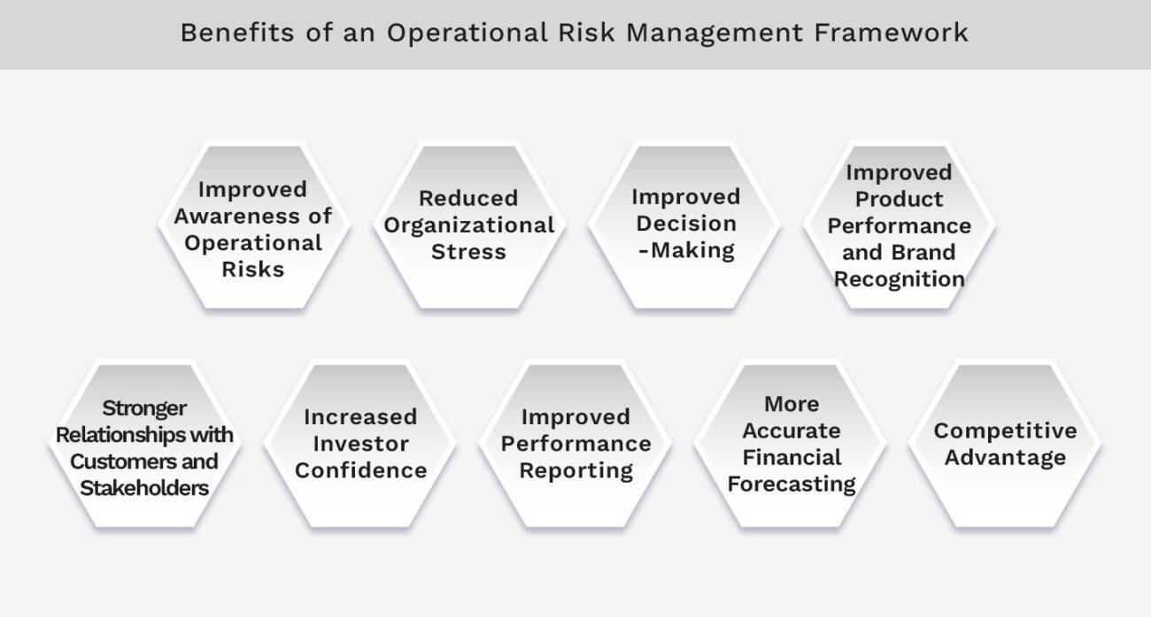
5-4. Operational Risk and Operational risk Management
What is operational risk management?
Operational risk management (ORM) is a process focused on identifying, assessing, prioritizing, and mitigating risks that arise from an organization’s day-to-day operations and business workflows.
It involves the systematic process of understanding, managing, and monitoring risks to minimize the potential negative impact on an organization’s objectives and outcomes.

Slide 22
5-5.operational risk management
We can say …
  The concept of risk has been described earlier, simply as potential events with undesirable consequences (noun).
  The following are some of the ways of describing operational risks:
  The risk of loss resulting from inadequate or failed internal .
  processes, people, and systems or from external events.
  A measure of the link between a firm’s business activities and the variation in its business results.

Slide 23
5-6.Operational Risk
What are operational risks according to the Basel Committee concept?
Operational Risk is described by the Basel Committee on Banking Supervision as "the risk of loss resulting from inadequate or failed internal processes, people and systems, or from external events.
As such, operational risk captures business continuity plans, environmental risk, crisis management, process systems and operations risk, people related risks and health and safety, and information technology risks."
Example of the concept

Slide 24
5-7. Examples of operational risk
Employee conduct and employee error
Breach of private data resulting from cyber attacks
Technology risks tied to automation, robotics, and artificial intelligence
Business processes and controls
Development and introduction of new products
Physical events, such as natural disasters
Internal and external fraud
Workplace safety risks
We can say :
A poorly trained employee may directly lose the company a sales opportunity, or the company's reputation can suffer indirectly from poor customer service.

Slide 25

6.Operational Risk Management Goals
The goal in the operational risk management function is to focus on the risks that have the most impact on the organization and to hold accountable employees who manage operational risk.
As the name suggests, the primary objective of operational risk management is to mitigate risks related to the daily operations of an organization. The practice of Operational Risk Management focuses on operations and excludes other risk areas such as financial risks.

Slide 26
6-1. Operational Risk Management Goals
Operational Risk Management proactively seeks to protect the organization by eliminating or minimizing risk.
This is The main goal….

Slide 27
7. Classification Of Operational Risk events
  Operational risk events are often classified in some manner to help analysts and managers to better address the risks. The manner of categorization depends on the field of application and industry.
  One way to categorize operational risks is by identifying distinct elements of the system that can be construed as the primary cause of the risk event.

Slide 28
7-1. The 7 types of operational risk
Classifying risks according to the category to which they belong makes it easier to identify them, Here are the 7 types of operational risk that exist so that you can recognize them within your company.
1. Internal fraud
2. External fraud
3. Technological failures
4. Process execution and management
5. Labor Relations and Workplace Safety
6. Damage to tangible assets
7. Customers, products and business practices

Slide 29
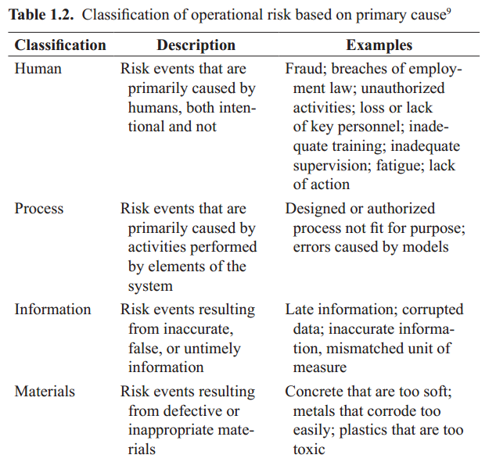
7-2. Classification Of Operational Risk Based on primary cause.

Slide 30
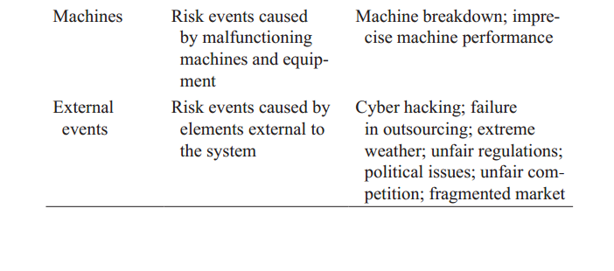
7-3. Classification Of Operational Risk Based on primary cause.

Slide 31
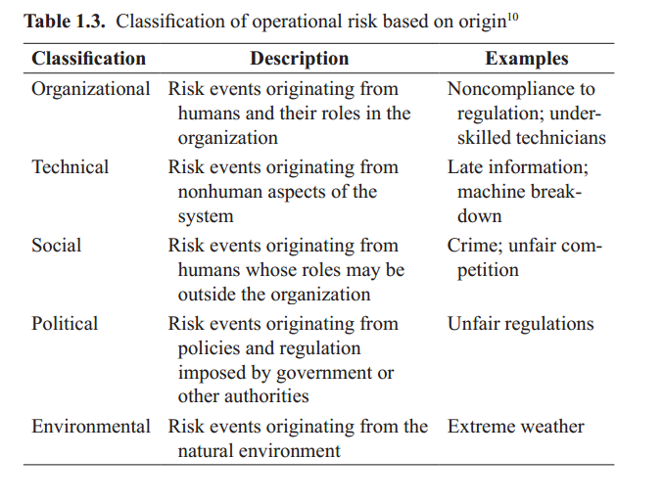
7-4.Classification Of Operational Risk Based on Origin

Slide 32
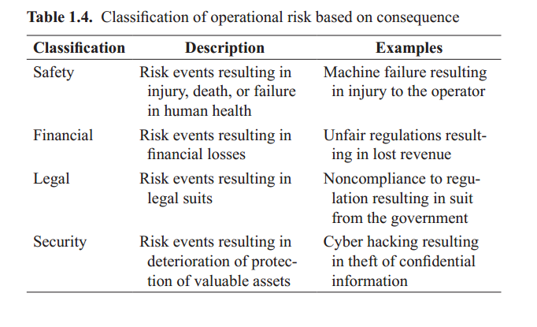
7-5.Classification Of Operational Risk Based on Consequence

Slide 33
8. Importance Of systems approach
What is a system?
  A system can be described as a collection of interrelated elements contributing toward a common goal.
  As an example, an automobile can be described as a system made up of a collection of elements (transmission, power, electronics, and other elements) all contributing toward the common goal of transporting passengers and cargo.

Slide 34
8-1. ways to characterize a system
2. What are the ways to characterize a system?
  A system can be characterized by the means of the elements that make them up, their objectives, or the nature of their interrelationships.
  For example, a modern automobile can be characterized by its automatic transmission, four-wheel drivetrain, electronic ignition, six cylinder engines, antilock brakes, and other elements that make up the particular automobile.
  This same system can also be characterized by how its elements work together.

Slide 35
8-2. systems approach
  3.What is a systems approach?
  A systems approach pertains to the approach of analyzing an entity by recognizing the elements that make it up, their objectives and their interrelationships.
  This approach is often employed by analysts in various fields or disciplines of applied sciences, for example, engineering, pure sciences, and social sciences.

Slide 36
8-3. Recognizing goals And objectives
4.What is the importance of recognizing goals And objectives?
  For the purpose of operational risk management, recognizing goals and objectives of elements as individuals and the system that they form as a whole would lend credibility to an analyst’s statement of whether the events are intentional or not and if the consequences are desirable or undesirable. As the previous section emphasized, intent and consequences are important in describing accidents, hazards, and risks, which can be separately viewed as obstacles or impediments to the achievement of goals and objectives.

Slide 37
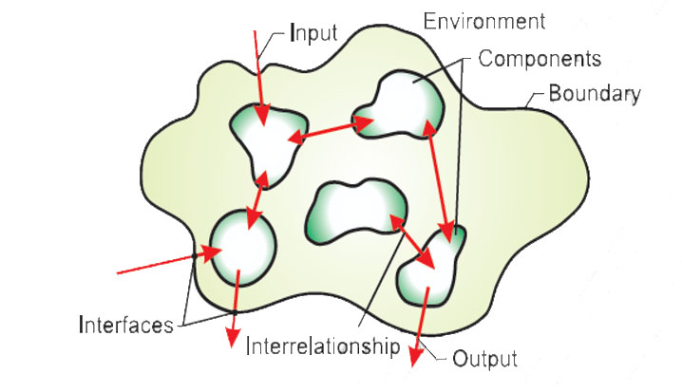
8-4. Recognizing interrelationships among elements of a system
5.What is the importance of recognizing interrelationships among elements of a system?
  Part of effective operational risk management is understanding the sequence of events that eventually lead to accidents. This sequence of events, in many ways, is within the realm of how various elements of the system are interrelated. This recognition of sequence of events is import-ant in any attempt to prevent the occurrence of a risk event or reduce the consequence if it does occur.

Slide 38
8-5. Recognizing system boundaries
6.What is the importance of recognizing system boundaries?
  Part of operational risk management, particularly the management aspect, implies some degree of control on how elements of a system will behave or relate to each other. Recognizing system boundaries is an acknowledgement of the degree of control one may have over these elements. Elements that, for some reason or another, do not lend themselves to control and are often designated as outside the system boundary.

Slide 39
8-6. Recognizing system boundaries
  System boundaries are the limits or borders that separate a system from its surroundings.
  They can be physical, logical, temporal, spatial, functional, or conceptual, depending on the purpose and perspective of the analysis.
  System boundaries help to define the scope, context, and interfaces of a system, as well as its inputs, outputs, and feedback loops. System boundaries are not fixed or absolute, but rather flexible and relative, depending on the level of abstraction, the stakeholder needs, and the system goals.

Slide 40

8-7. Recognizing system boundaries, EXAMPLE
  Physical, social, economic and political system boundaries define the (provisional) scope for action for an intervention in Sustainable Sanitation and Water Management. Source: SEECON (n.y.)

Slide 41
9. Conclusion
Through the lecture...we certainly learned the following:
The concept of risk in general
We knew the difference between risk, hazards and accidents
We know the types of institutional risks
We reviewed a brief history of operational risk
We learned what operational risk and operational risk management are
We know the objectives of operations management
What is operational risk management?
We have presented examples of operational risks
We know the classification of operational risk events

Slide 42
10. References & Resources
Operational Risk Management, C. Ariel Pinto, Luna Mylene Magpili, Raed M. Jaradat, Chapter 1.
Operational Risk Management: Overview and Guide, Vice Vicente, https://www.auditboard.com/
Operational risk management (ORM): An overview (thomsonreuters.com)
Operational risk management (ORM): An overview (thomsonreuters.com)

Slide 43

01
My Best Wishes …
Dr. Ayman Hassan

