Slide 1



Plant Leaf Disease Classification Using Deep Learning Models
15
DISEASE CLASSES
Mahmoud Al Ra'e
Hussein Mudeheg
ID: 253001641
ID: 253001186
Supervisor: Dr. Hager Saleh
College of Informatics | Midocean University
M.SC. IN ARTIFICIAL INTELLIGENCE
3 CNN ARCHITECTURES · 20,638 IMAGES

Slide 2
Presentation Agenda
Introduction
Proposed Framework
01
05
Motivation & technical background
End-to-end pipeline
Problem Statement
Methodology
02
06
Why automated detection matters
Data, augmentation & training
Related Work
Experimental Results
03
07
CNN, ViT & IoT literature
Comparative evaluation
Objectives & Contribution
Discussion & Conclusion
04
08
Scope of this study
Findings & recommendation

Slide 3
Introduction
Why deep learning, and why transfer learning, for leaf disease diagnosis
1
2
3
The diagnostic gap
Deep learning & CNNs
Transfer learning
Plant diseases are usually diagnosed by visual inspection. This is slow, subjective, and unreliable when symptoms of different diseases look alike or field conditions vary.
CNNs automatically learn visual features from images, starting with simple edges and colors, then disease specific patterns in deeper layers with no manual feature engineering needed.
Reusing ImageNet pre trained weights let a model reach high accuracy on with far less training data and time than learning from scratch.
PLANT DISEASE CLASSIFICATION - MIDOCEAN UNIVERSITY
03

Slide 4
Problem Statement
UN's - Food and Agriculture Organization (FAO)
80%
of human food
comes from plants
30–40%
global crop loss
from diseases
$220B
annual economic
loss worldwide
Why this is difficult in practice
Farmers rely on personal experience, which can be inaccurate and subjective
Early disease symptoms are hard to detect visually
Many diseases look alike, leading to frequent misdiagnosis
Field conditions - lighting, background, camera angle - complicate detection
Manual inspection does not scale to large farms
PLANT DISEASE CLASSIFICATION - MIDOCEAN UNIVERSITY
04

Slide 5
Related Work - Key Studies
CNN, Vision Transformer, and IoT approaches to plant disease detection (1 of 2)
Authors / Year | Model Used | Dataset | Accuracy | Key Focus
Too et al., 2019 | DenseNet121 | PlantVillage | ~99.7% | Fine-tuning transfer learning across 38 disease classes
Chen et al., 2022 | ViT-B/16 | PlantDoc | ~99% | ViT outperforms CNNs under real-world (wild) conditions
Xie et al., 2023 | Dise-Efficient (EfficientNetV2) | PlantVillage + IP102 | 98–99% | Lightweight model for disease & pest identification
Talaat & Ibrahim, 2023 | CNN + IoT system | PlantVillage + Field | ~97–99% | Real-time IoT-integrated disease monitoring
Rahman et al., 2024 | YOLOv4 | PlantVillage | mAP ≈ 95% | Simultaneous detection & localization of disease regions
Duhan et al., 2025 | RTR_Lite + MobileNetV2 | Multi-dataset | ~98% | Accurate, fast inference for mobile / edge deployment
Bhola & Kumar, 2025 | CNN (VGG / ResNet / Inception) | Vegetable field | ~92–93% | Early-stage vegetable disease detection from leaf images
Kheir et al., 2025 | MobilePlantViT | Multi-crop | 80–99% | Hybrid CNN + ViT balanced for mobile deployment
PLANT DISEASE CLASSIFICATION - MIDOCEAN UNIVERSITY
05

Slide 6
Related Work - Key Studies
CNN, Vision Transformer, and IoT approaches to plant disease detection (2 of 2)
Authors / Year | Model Used | Dataset | Accuracy | Key Focus
Thanjaivadivel, 2025 | EnConv (Enhanced CNN) | 39-disease multi-crop | 99.87% | Global-pooling CNN with improved feature retention
Real-Time Monitoring, 2024 | CNN + VGG/DenseNet/MobileNet | PlantVillage + Camera | ~95–97% | IoT-integrated real-time leaf disease detection system
CMI Constrained DL, 2023 | CropLeafNet (ResNet+MobileNetV2) | PlantVillage | +2–4% gain | Conditional mutual information for multi-disease detection
Rajput & Doddamani, 2024 | BoVW + DSIFT + SVM/LightGBM | Pigeon Pea (custom) | ~92–95% | Traditional feature extraction - no deep network
Singh et al., 2020 | Faster R-CNN / SSD | PlantDoc | Moderate | Real-world dataset - complex backgrounds & lighting
Tan & Le, 2019 | EfficientNet (B0–B7) | PlantVillage | >99% | Balanced depth / width / resolution scaling for efficiency
He et al., 2016 | ResNet (50 / 101 / 152) | ImageNet | High baseline | Residual learning with skip connections for deep networks
Gap addressed in this study: reported accuracies above are rarely comparable - different datasets, splits, and preprocessing make architecture effects hard to isolate. We hold every one of those factors fixed and vary only the backbone.
PLANT DISEASE CLASSIFICATION - MIDOCEAN UNIVERSITY
06

Slide 7
Objectives & Contribution
Scoped to the transfer-learning CNN comparison actually carried out
GENERAL OBJECTIVE
Develop and rigorously compare transfer-learning CNN models for plant leaf disease classification to support faster, more reliable early diagnosis.
O1
Apply transfer learning using three CNN backbones - ResNet50, EfficientNetB0 and MobileNetV2 on the PlantVillage dataset
O2
Evaluate and compare the models on accuracy, precision, recall, and F1-score
O3
Assess computational efficiency parameter count and training time to judge suitability for real-world deployment
O4
Analyze per-class and confusion-matrix errors to identify which disease pairs remain visually difficult to separate
KEY CONTRIBUTION
A controlled, apples-to-apples comparison of three widely used CNN backbones under one identical preprocessing, training, and evaluation protocol
PLANT DISEASE CLASSIFICATION - MIDOCEAN UNIVERSITY
07

Slide 8
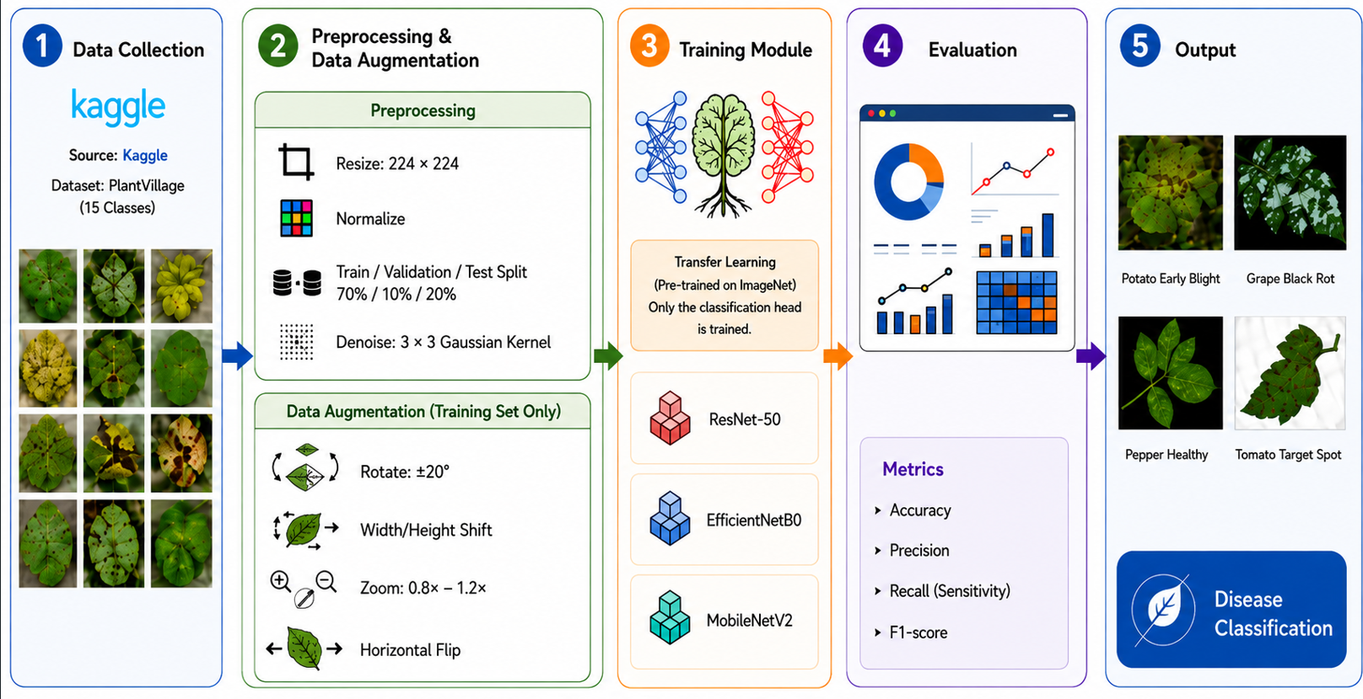
Proposed Framework
Every notebook (ResNet50, EfficientNetB0, MobileNetV2) follows this identical Steps
PLANT DISEASE CLASSIFICATION - MIDOCEAN UNIVERSITY
08

Slide 9
Methodology - Architecture & Training
PlantVillage: 20,638 leaf images across 15 classes, three crops
20,638
15
3
images
classes
crops
Class breakdown by crop
Train / validation / test split
Crop | Classes | Includes
Pepper | 2 | Bacterial spot, healthy
Potato | 3 | Early blight, Late blight, healthy
Tomato | 10 | Bacterial spot, Early/Late blight, Leaf Mold, Septoria, Spider mites, Target Spot, Yellow Leaf Curl & Mosaic virus, healthy
Train
Val
Test
14,440
2,058
4,140
70%
10%
20%
Fixed seed = 42, applied identically within each of the 15 classes and all three models train and test on exactly the same images.
PLANT DISEASE CLASSIFICATION - MIDOCEAN UNIVERSITY
09

Slide 10
Methodology — Augmentation & Preprocessing
Training-only augmentation, plus the preprocessing choice that made the comparison fair
1. Quality control
Every image verified with PIL's verify() — 1 corrupted file found and removed. Remaining images denoised with a light 3×3 Gaussian kernel (local copy only; Drive archive untouched).
Each backbone uses its own preprocess_input
2. Training-set augmentation (only)
Why it matters
Rotation up to ±20°
Width / height shift up to 20%
Zoom up to 20%
Random horizontal flip
Fill mode: 'nearest'

Slide 11
Results - Overall Performance
Overall test-set performance
Model | Accuracy | Precision | Recall | F1-Score | Parameter | Time
ResNet50 | 96.47% | 96.55% | 96.20% | 96.33% | 24.1M | 63.5 min
EfficientNetB0 | 95.97% | 95.80% | 95.74% | 95.67% | 4.38M | 66.0 min
MobileNetV2 | 92.13% | 92.08% | 91.75% | 91.69% | 2.59M | 63.2 min
Training Strategy: Maximum 20 epochs with Early Stopping (patience = 5, monitoring validation loss)
and restore the best model weights to reduce overfitting.
PLANT DISEASE CLASSIFICATION - MIDOCEAN UNIVERSITY
12

Slide 12
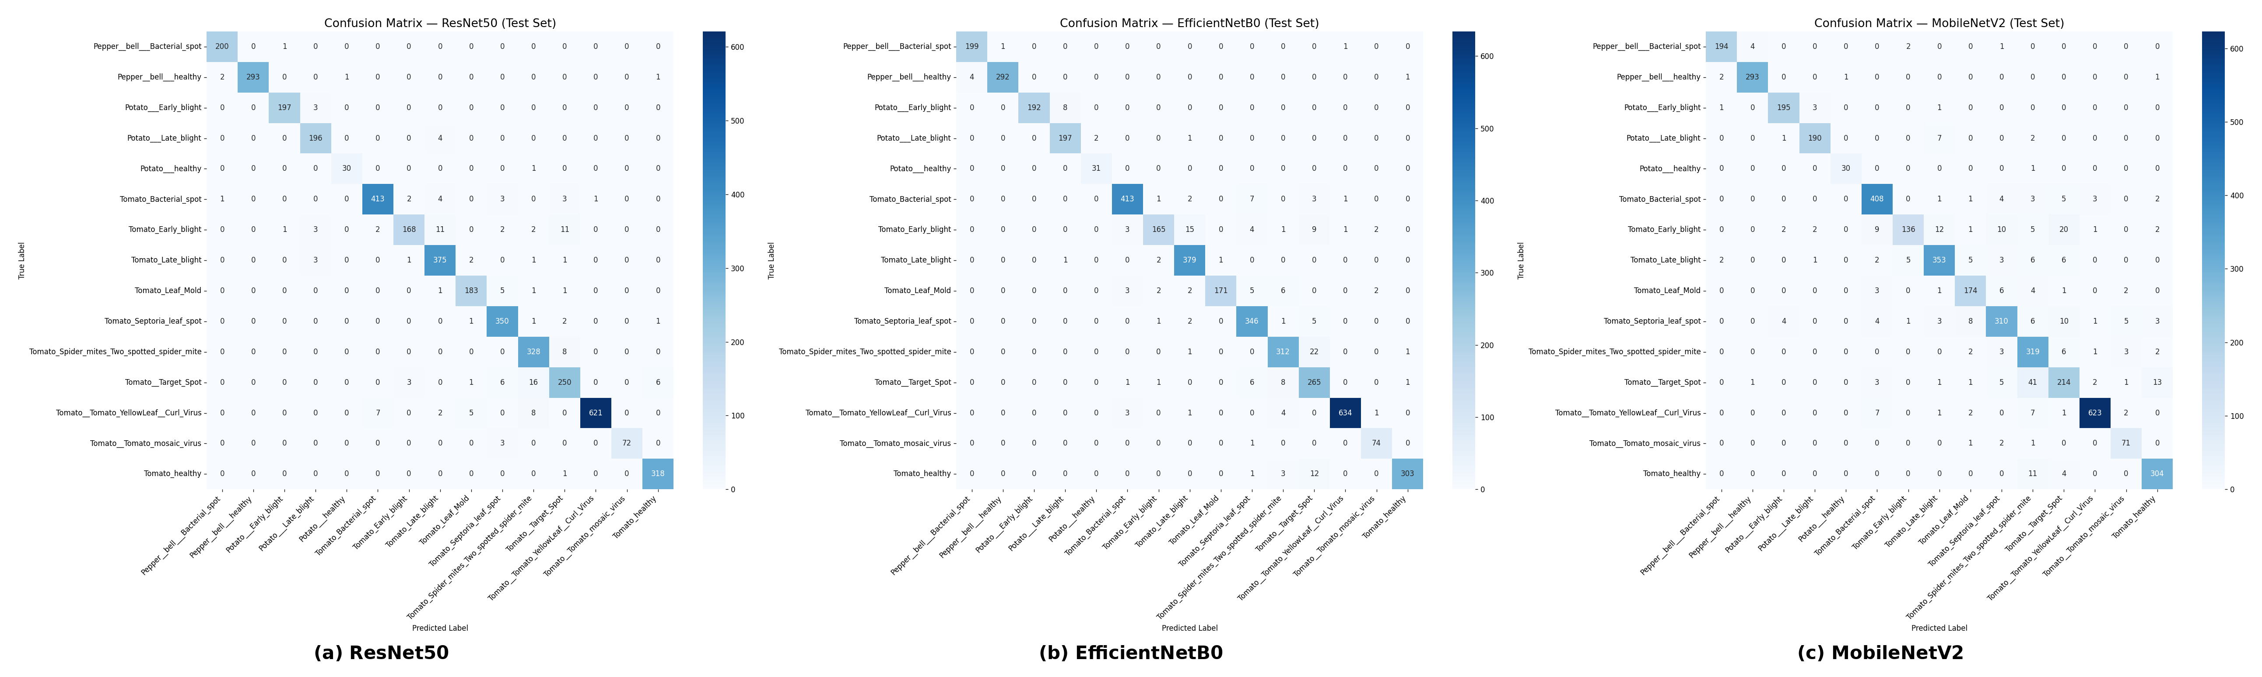
Results - Confusion Matrix Analysis
Diagonal values represent correct predictions; off-diagonal values represent errors. ResNet50 achieved the cleanest matrix, while MobileNetV2 showed the most confusion among similar tomato diseases.
PLANT DISEASE CLASSIFICATION - MIDOCEAN UNIVERSITY
14

Slide 13
Discussion
Discussion
Which model, for which use case
ResNet50
EfficientNetB0
MobileNetV2
Maximum accuracy
Best trade-off
Edge / mobile deployment
Choose when predictive accuracy is the priority and compute is not constrained.
Near-ResNet50 accuracy at under 1/5 of the parameters — practical for constrained environments.
Smallest footprint and fastest inference — fits mobile and embedded devices.

Slide 14
Conclusion
Conclusion
1
2
3
Controlled comparison
Beyond accuracy
Class-level error analysis
ResNet50, EfficientNetB0, and MobileNetV2 evaluated under one identical experimental protocol.
Predictive performance assessed together with model size and training time — not accuracy in isolation.
Confusion patterns traced to specific, visually similar disease pairs — grounded in plant pathology.
Bottom line
ResNet50 wins on raw accuracy EfficientNetB0 offers the best accuracy to size trade-off.
MobileNetV2 is the lightest and fastest to deploy.
The right choice depends on the target platform not on accuracy alone.
This comparative framework can support the development of intelligent agricultural monitoring systems, matched to the hardware they will actually run on.

Slide 15
Thank You
Questions & Discussion
Mahmoud Al Ra'e · Hussein Mudeheg
Supervisor: Dr. Hager Saleh · College of Informatics, Midocean University, UAE

