Slide 1


Prepared by Dr. Omar Al-kasasbeh
FNT628
Blockchain and Cryptocurrencies
Lecture 0

Slide 2



Blockchain and Cryptocurrencies
FNT 628
Blockchain and Cryptocurrencies
Prepared by
Dr. Omar Al-kasasbeh

Slide 3
Lecture
Fundamentals of Blockchain
1
1. Understand the origin, definition, and evolution of blockchain technology.
2. Explain key blockchain concepts and how blockchain works.
3. Identify the main components of a blockchain system.

Slide 4
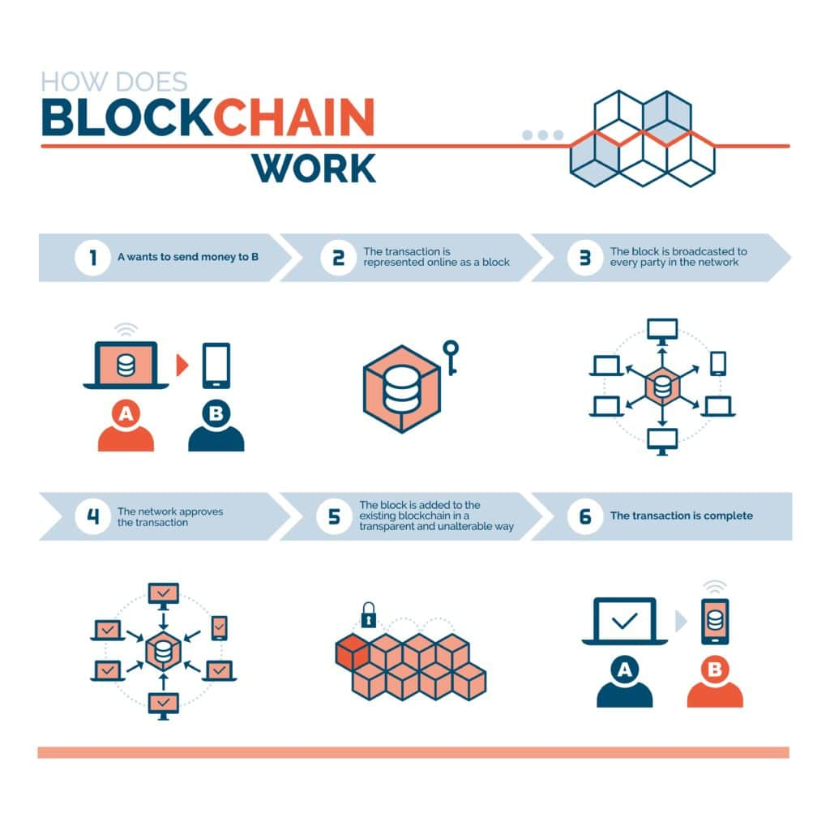
Lecture
1

Slide 5
Lecture
Blockchain Technology
2
Explain the key use cases of blockchain technology.
Describe how Blockchain Technology works and its main components.
Analyze the role of Blockchain Technology in financial and digital applications.

Slide 6
Lecture
2

Slide 7
Lecture
Decentralized Finance - DEFI
3
Understand the key features of Decentralized Finance (DeFi).
Describe the main DeFi applications and services.
3. Analyze the benefits and risks of DeFi in the financial ecosystem.

Slide 8

Lecture
3

Slide 9
Lecture
Digital Currencies
4
Define digital currencies and their main types.
Explain how digital currencies operate within financial systems.
Analyze the opportunities and risks associated with digital currencies.

Slide 10

Lecture
4

Slide 11
Lecture
5
An Overview of Crypto Markets
1. Understand the structure and main characteristics of crypto markets.
2. Identify the key participants and instruments in crypto markets.
3. Analyze market dynamics and risks in crypto market

Slide 12

Lecture
5

Slide 13
Lecture
6
Cryptocurrency
1. Understand cryptocurrency and its key characteristics.
2. Explain how cryptocurrencies function within blockchain networks.

Slide 14

Lecture
6

Slide 15
Lecture
Cryptocurrency and Banking Industry
7
1. the role and impact of cryptocurrency in the banking industry.
2. Explore the regulatory, security, and operational challenges of cryptocurrencies.
3. Analyze the benefits and risks of integrating cryptocurrencies into banking practices.

Slide 16
Lecture
7

Slide 17
Lecture
Cryptocurrency and Monetary Policy
8
Explore the challenges cryptocurrencies pose to central banks and financial regulation.
2. Analyze the potential effects of cryptocurrency adoption on money supply and economic stability.

Slide 18
Lecture
9
Crypto Investment Strategies
Understand different investment strategies in the cryptocurrency market.
2. Explore risk management and portfolio diversification techniques for crypto assets.
3. Analyze market trends and tools to make informed cryptocurrency investment

Slide 19

Lecture
9

Slide 20
Lecture
Technical Trading and Cryptocurrency Markets
10
1. Understand Cryptocurrency Market Dynamics
2- Explain how Algorithmic & AI-Based Trading in Crypto Markets

Slide 21


Thank You

