Slide 1


Prepared by Dr. Wesam Ahmed
IT402
Internet of Things
Lecture 6

Slide 2



IoT Networking Protocols – Part 2
Lecture 6
IT402‎
Internet of Things
Prepared by
Dr. Wesam Ahmed

Slide 3

06
Learning Objectives:
1.1 Explain IoT networking application layer
1.2 Machine-to-Machine (M2M)
1.3 One Machine-to-Machine (M2M)

Slide 4
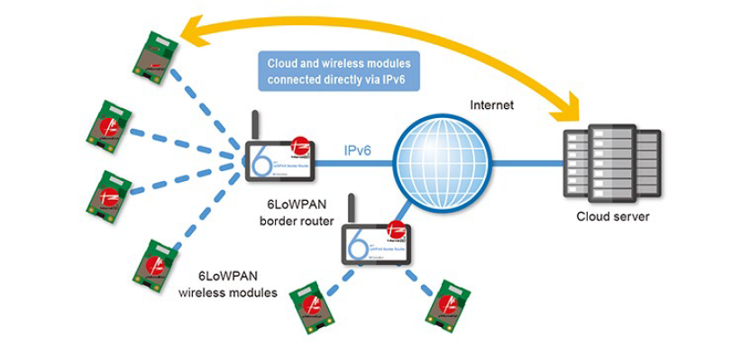
06
IoT Networking Protocols
Understand the Importance of Business Intelligence
Internet Layer:
The Internet Layer in IoT is responsible for addressing, routing, and transferring data packets between devices across different networks — essentially ensuring that data from IoT devices can travel to cloud servers, gateways, or other devices reliably.

Slide 5
06
IoT Networking Protocols
Understand the Importance of Business Intelligence
Internet Layer:
It allows IPv6 packets to be transmitted efficiently over low-power, low-data-rate wireless networks.
Because IoT devices have limited power, memory, and bandwidth, standard IPv6 packets (which have large headers) need optimization — that’s where IPv6 over Low power Wireless Personal Area Networks (6LoWPAN ) helps.
IPv6 over Low power Wireless Personal Area Networks (6LowPAN) provides three main functions:
6LoWPAN compresses IPv6 headers to just a few bytes to save bandwidth and energy.

Slide 6
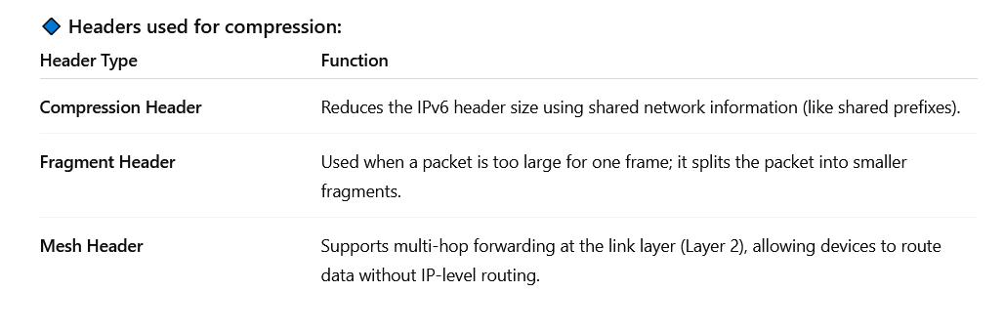
06
IoT Networking Protocols
IPv6 header compression: 6LowPAN
Internet Layer:
IPv6 header compression: 6LowPAN introduces three headers for each of the three functions that it provides. Those headers are: Compression header, Fragment header, and Mesh header.
IPv6 packet segmentation and reassembly
Layer 2 forwarding (also referred to as Mesh Under).

Slide 7
06
IoT Networking Protocols
Understand the Importance of Business Intelligence
Internet Layer:
IPv6 Packet Segmentation and Reassembly
Since IEEE 802.15.4 frames are small, large IPv6 packets must be fragmented into smaller pieces before transmission.
Each fragment is labeled with a Fragment Header.
At the destination, the fragments are reassembled into the full IPv6 packet.
Example:
If an IPv6 packet = 1000 bytes, and the frame can carry only 100 bytes →
It is split into 10 fragments, sent individually, and reassembled by the receiver.

Slide 8
06
IoT Networking Protocols
IPv6 header compression: 6LowPAN
Internet Layer:
Layer 2 Forwarding (Mesh Under)
Also known as Mesh Under routing.
It enables multi-hop communication at the data link layer (Layer 2) — meaning packets can hop across multiple devices without IP routing at every hop.
This is useful in mesh networks, where small IoT nodes act as both transmitters and routers.
Example:
A packet can travel from Sensor A → Sensor B → Gateway,
even if A and Gateway are not directly connected — B helps forward the packet.

Slide 9
06
IoT Networking Protocols
IPv6 header compression: 6LowPAN
Internet Layer:
IEEE 802.15.4 TSCH (Time Slotted Channel Hopping) is a Data Link Layer technology used in low-power, reliable, and time-synchronized IoT networks, such as industrial IoT (IIoT).
However, IPv6 was designed for traditional Internet networks — it doesn’t natively understand the timing, synchronization, or limited resources of TSCH networks.
An adaptation layer is required in order to run the IPv6 stack on top of IEEE 802.15.4 TSCH .
It handles functions such as network formation, maintenance, scheduling, and security, which are essential for reliable IoT networking.

Slide 10
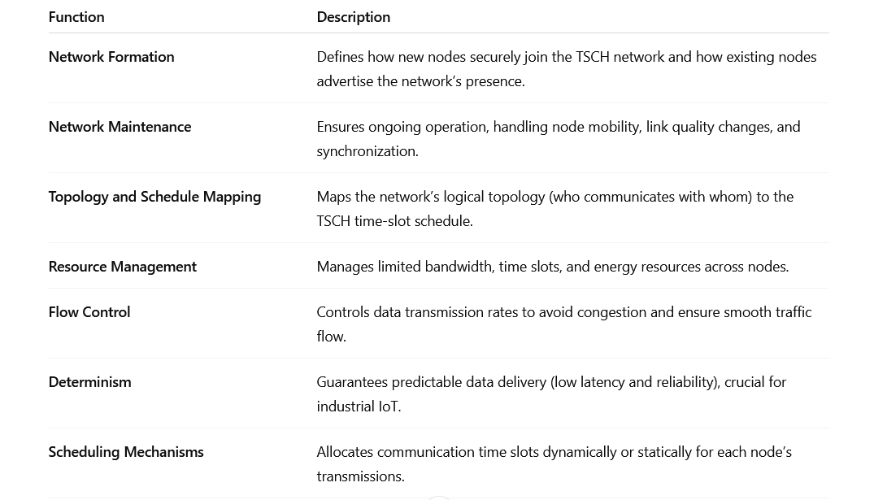
06
IoT Networking Protocols
IPv6 header compression: 6LowPAN
Goals are to address the following issues:

Slide 11
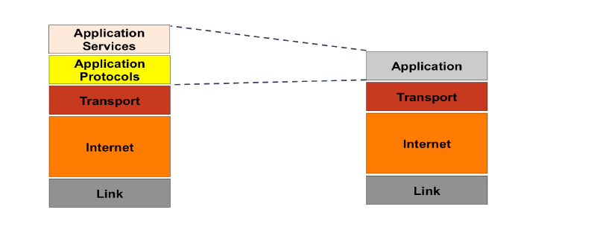
06
IoT Networking Protocols
IPv6 header compression: 6LowPAN
Application Protocols Layer:

Slide 12
06
IoT Networking Protocols
IPv6 header compression: 6LowPAN
Application Protocols Layer:
The Application Protocols Layer in the Internet of Things (IoT) is responsible for managing the communication between IoT devices (Things, Gateways) and Applications or Cloud Services.
It ensures that data collected by sensors can be properly sent, received, interpreted, and acted upon.
They typically support the flow of data (e.g. readings or measurements) from Things to Applications and the flow of command or control information (e.g. to trigger or actuate end-devices) in the reverse direction.

Slide 13
06
IoT Networking Protocols
IPv6 header compression: 6LowPAN
Application Protocols Layer:
From devices to applications
This is the data flow from IoT sensors or devices sending information to the cloud, server, or application for processing, analysis, or storage.
The data typically includes:
  Sensor readings (temperature, humidity, pressure, etc.)
  Device status updates (battery level, location, etc.)
  Event notifications or alerts
📡 Example:
A smart thermostat sends the current room temperature to a mobile app or cloud server every minute.

Slide 14
06
IoT Networking Protocols
IPv6 header compression: 6LowPAN
From applications to devices
This is the control flow in the reverse direction, where the application sends commands or control messages to IoT devices to perform certain actions.
The commands may include:
  Turning a device ON/OFF
  Changing configurations (e.g., sampling rate, thresholds)
  Triggering actuators (e.g., open a valve, start a motor)
Example:
A user changes the target temperature from a mobile app → the command is sent to the thermostat → the device adjusts the heater accordingly.

Slide 15
06
IoT Networking Protocols
IPv6 header compression: 6LowPAN
Application protocols define the semantics and mechanisms for message exchanges between the communicating endpoints.
In simple terms, this means that application protocols specify how devices and applications talk to each other both what their messages mean (semantics) and how they are sent and received (mechanisms).
The landscape of the Application Protocols Layer in IoT is currently crowded with competing protocols and standards, each having its own set of strengths and weaknesses and with no clear path towards convergence being agreed upon by the industry yet.
IoT systems are very diverse — devices vary in:
Power consumption (battery vs. mains-powered)
Network connectivity (Wi-Fi, cellular, Zigbee, LoRa, Bluetooth, etc.)
Data needs (small sensor readings vs. large data streams)
Latency and reliability requirements (industrial vs. consumer IoT)
Because of these differences, no single protocol works best for every case — so multiple standards coexist.

Slide 16
06
IoT Networking Protocols
IPv6 header compression: 6LowPAN
Applications Protocols vary in the data serialization formats used to encode information into messages.
Data serialization means converting structured data (like sensor readings or commands) into a format that can be easily transmitted over a network and then reconstructed by the receiver.
Challenges in IoT data serialization formats:
Mapping between the formats used in constrained devices and those used by applications in the World Wide Web. Popular data serialization formats on the Web include XML and (JavaScript Object Notation) JSON.
Example:
A sensor sends data as CBOR (compact binary).
The gateway converts it to JSON for a web dashboard.
This translation uses time, CPU, and energy.

Slide 17
06
IoT Networking Protocols
IPv6 header compression: 6LowPAN
Challenges in IoT data serialization formats:
The impact data serialization formats have on device resource utilization, socially energy consumption.
Serialization requires CPU cycles and memory, and larger data formats mean more energy to transmit.
IoT devices are often battery-powered, so efficient serialization is crucial.
The impact data serialization formats have on network bandwidth utilization.
The size of serialized data affects network traffic and bandwidth usage.

Slide 18

06
IoT Networking Protocols
IPv6 header compression: 6LowPAN
Quality of Service (QoS):
Application protocols should provide control over the real-time behavior and performance of IoT applications by means of a rich set of QoSPolicies.
QoS ensures that the right data reaches the right place, at the right time, using the right amount of resources.

Slide 19
06
IoT Networking Protocols
QoS Control Areas:
Control of Local Resources
Protocols must efficiently manage local device resources such as:
  Memory buffers
  CPU processing power
  Transmission queues
Ensures that a device doesn’t overload or crash due to excessive communication.
🔹 Policies:
Resource Limits Policy:
Defines how much memory or buffer space the protocol can use for storing messages.
Time Filter Policy:
Sets the minimum interval between consecutive samples (data messages), preventing flooding or redundant data.
Example:
A temperature sensor sends data only every 10 seconds instead of every second → saves CPU and bandwidth.
IPv6 header compression: 6LowPAN

Slide 20
06
IoT Networking Protocols
QoS Control Areas:
End-to-End Data Transfer Properties
QoS also defines how messages behave from sender to receiver, across the entire IoT system.
Example:
An industrial robot controller must receive motion commands without delay — this requires low-latency and reliable data transfer.
Resource Utilization in QoS : QoS policies also influence how much energy and processing power are consumed by the Application protocol for data transmission and reception.
Limiting message rates and buffer sizes reduces power use.
Scheduling or delaying transmissions optimizes CPU and network load.
Proper QoS configuration ensures system stability and longer battery life.
IPv6 header compression: 6LowPAN

Slide 21
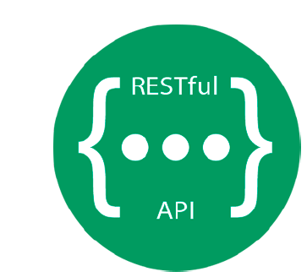
06
IoT Networking Protocols
IPv6 header compression: 6LowPAN
RESTfull Model:
Some Application protocols follow a set of constraints defined by the REpresentationalState Transfer (REST) architectural model.
REST is an architectural style for designing networked applications. It defines a set of constraints and principles that make communication between clients (like IoT devices or apps) and servers (like cloud platforms) simple, scalable, and reliable.
In IoT, REST is used to allow Things (sensors, gateways, or actuators) to communicate with web applications and services in a lightweight and standardized way.

Slide 22
06
IoT Networking Protocols
IPv6 header compression: 6LowPAN
RESTfull Model:
REST is a distributed client-server software architecture is an ideal model for IoT. The REST architectural is simple, scalable and reliable.
Key Features of REST in IoT:
Client/Server Communication Model: This allows for separation of concerns where the server focuses on functions such as data storage whereas clients focus on the user interface and user state. Uniform interfaces separate the clients from the servers.
This separation of concerns allows:
Servers to handle data storage, processing, and logic.
Clients to handle user interface and device interaction.

Slide 23
06
IoT Networking Protocols
IPv6 header compression: 6LowPAN
Key Features of REST in IoT:
Stateless Communication:
Each request from a client to a server must contain all necessary information to understand and process it.
The server must not store any client context that continues between requests.
The client maintains its own state (e.g., authentication, session data). In other words, requests are self-contained from a server perspective.
Example:
When a smart light sends a request to turn ON, it includes all required details (like device ID, authentication token, and command).
The server doesn’t need to remember previous requests.

Slide 24
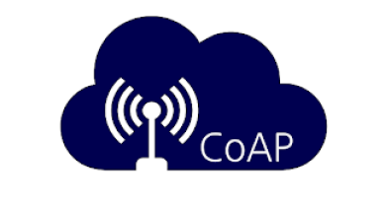
06
IoT Networking Protocols
IPv6 header compression: 6LowPAN
The Constrained Application Protocol (CoAP):
CoAPis a lightweight alternative to HTTP, targeted for constrained nodes in Low-power and Lossy Networks (LLNs).
CoAP is designed for constrained nodes (limited CPU, memory, and energy) and LLNs (networks with high packet loss, low bandwidth, or intermittent connectivity).
How CoAP Works
Simple Example: Read a Temperature Sensor
Client sends a CoAP GET request to the sensor resource.
Sensor responds with the temperature value.
Optionally, messages can be acknowledged to ensure delivery.
All of this happens with fewer messages and smaller headers compared to HTTP, saving energy, bandwidth, and time.

Slide 25
06
IoT Networking Protocols
IPv6 header compression: 6LowPAN
The Constrained Application Protocol (CoAP):
Similar to HTTP, CoAPis a RESTful protocol. It supports the Create, Read, Update and Delete (CRUD) verbs but in addition provides built in support for the publish/subscribe paradigm via the new Observe verb.
meaning it uses standard CRUD operations to interact with resources:
  Create (POST): Add a new resource or data
  Read (GET): Retrieve data from a resource
  Update (PUT): Modify existing data
  Delete (DELETE): Remove a resource
Example: A smart light bulb exposes a “status” resource:
GET /light/status → Returns ON/OFF state
PUT /light/status → Changes the state

Slide 26
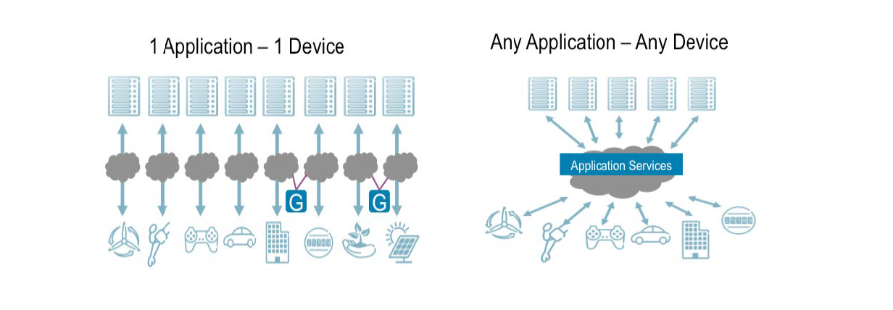
06
IoT Networking Protocols
IPv6 header compression: 6LowPAN
Application Services Layer:
1 Application – 1 Device: traditional M2M deployments.
Any Application – Any Device: Represents modern IoT architecture using an Application Services Layer (ASL) or Common Abstraction Layer.
This Figure 6.1 illustrates the evolution from fragmented M2M systems to an interoperable IoT architecture enabled by a Common Application Services Layer.

Slide 27
06
IoT Networking Protocols
IPv6 header compression: 6LowPAN
1 Application – 1 Device
Represents traditional M2M deployments.
Each device (e.g., wind turbine, vehicle, sensor) is connected to a dedicated application through its own proprietary communication stack.
Systems are isolated — data cannot be easily shared or reused.
Integration across industries or domains is difficult.

Slide 28
06
IoT Networking Protocols
IPv6 header compression: 6LowPAN
Any Application – Any Device
Represents modern IoT architecture using an Application Services Layer (ASL) or Common Abstraction Layer.
Devices communicate through standardized APIs and data models provided by the ASL.
Applications can access data from any device, regardless of vendor or technology.
Result: The system shifts from “one application per device” to “any application can use any device,” enabling true IoT interoperability.

Slide 29
06
IoT Networking Protocols
IPv6 header compression: 6LowPAN
Machine-to-Machine (M2M) deployments have existed for over two decades. M2M deployments have been used across industries such as manufacturing, energy, transportation, and utilities. These systems enabled devices to communicate with centralized applications for monitoring and control. However, these early M2M solutions were typically built in isolation — each system developed its own vertical stack, with proprietary protocols and data models. This led to fragmentation across the ecosystem.
Proprietary Protocols: non-standard communication methods developed by a specific vendor or organization for their own devices and systems. Example: A smart meter might use a vendor-specific TCP/IP message format, while a vehicle tracking system uses a custom XML-over-SMS protocol.
Proprietary data models refer to custom or vendor-specific ways of structuring and naming data generated by devices.

Slide 30
06
IoT Networking Protocols
IPv6 header compression: 6LowPAN
Application Services Layer
To overcome this fragmentation, a Common Abstraction Layer—often called the Application Services Layer (ASL)—is introduced between devices and applications.
What It Does:
Acts as a middleware or service enablement layer between devices and applications.
Provides standardized interfaces and data models so that any application can communicate with any device.
the Common Abstraction Layer transforms fragmented M2M ecosystems into open, flexible IoT environments—where any application can work with any device through a shared, standardized platform.

Slide 31
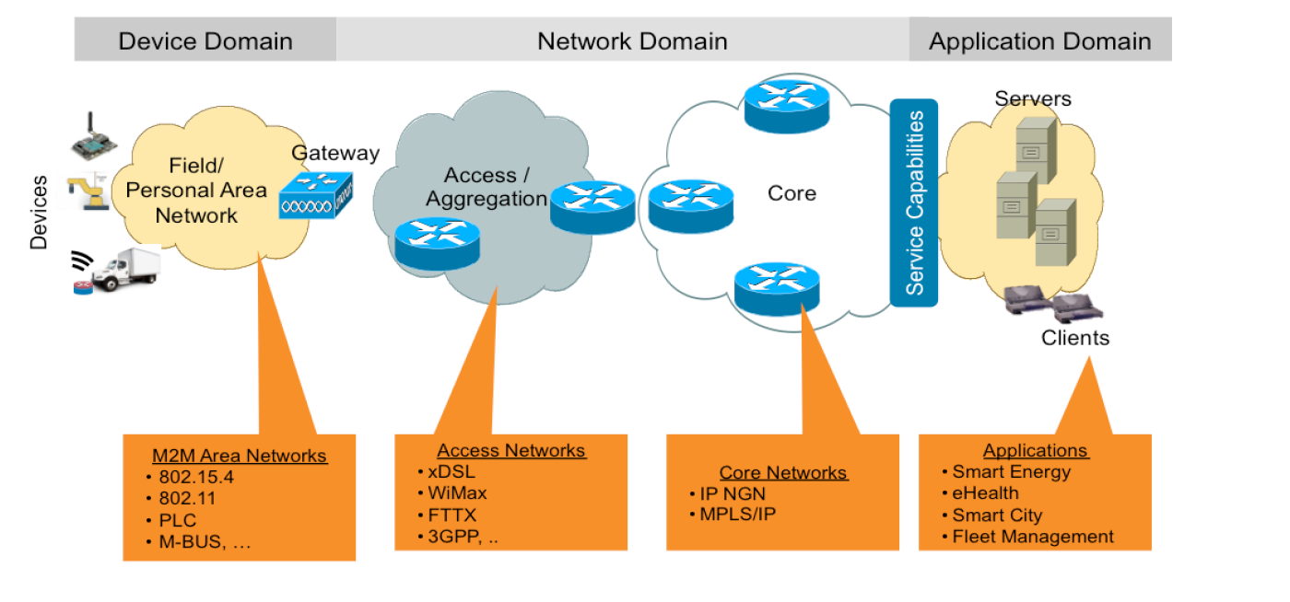
06
IoT Networking Protocols
IPv6 header compression: 6LowPAN
Machine-to-Machine (M2M)

Slide 32
06
IoT Networking Protocols
How M2M Works
Devices (machines) collect data from the environment (e.g., temperature, speed, pressure).
M2M communication allows these devices to share this data directly with each other or through a gateway.
The Gateway aggregates data and forwards it to higher layers (network and application domains).
In the Application Domain, data is analyzed and used in systems like Smart Energy, Smart Cities, eHealth, etc.
IPv6 header compression: 6LowPAN

Slide 33
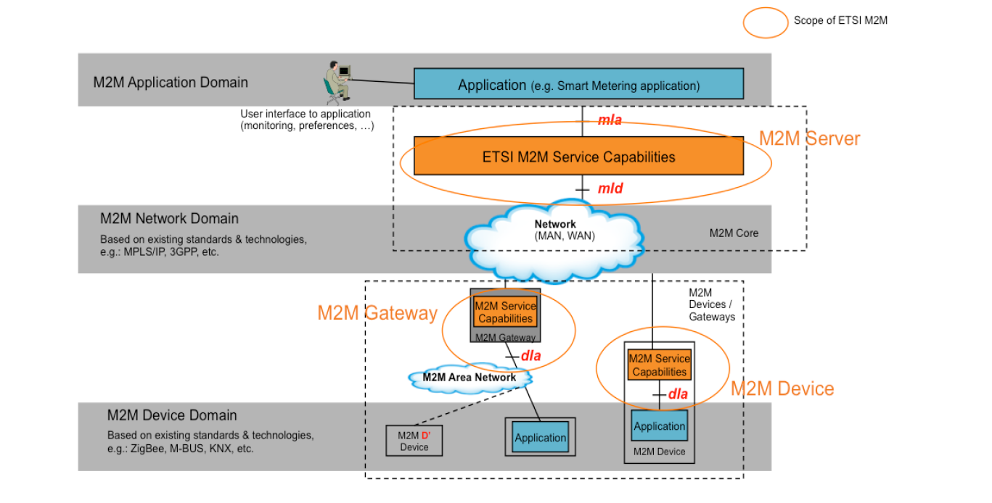
06
IoT Networking Protocols
IPv6 header compression: 6LowPAN
M2M Protocols

Slide 34
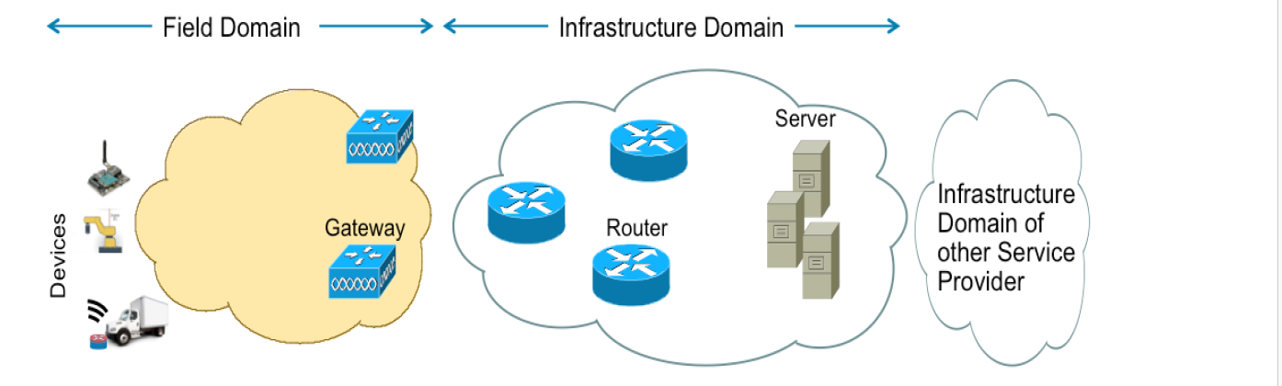
06
IoT Networking Protocols
IPv6 header compression: 6LowPAN
One M2M
The oneM2M standard defines a common framework for IoT deployments, so that devices, networks, and applications can interoperate seamlessly — regardless of vendor or technology.

Slide 35
06
IoT Networking Protocols
IPv6 header compression: 6LowPAN
One M2M
OneM2M standards consider any IoT deployment to be comprised of two domains:
Field Domain: includes the Things (e.g. sensors, actuator) and gateways that collect or act on data.
Infrastructure Domain: includes the communication networks (aggregation, core) and data centers that support large-scale IoT operations.

Slide 36
06
IoT Networking Protocols
IPv6 header compression: 6LowPAN
One M2M
Each of these domains includes three flavors of entities:
Application Entity,
Common Services Entity
Network Services Entity.
Application Entity (AE):
Purpose: Implements the application logic for a specific IoT use case.
Functions: Performs domain-specific tasks (e.g., monitoring, control, analytics).
Examples:
Home automation AE (controls lights, thermostat)
Smart parking AE (detects free parking spaces)

Slide 37
06
IoT Networking Protocols
IPv6 header compression: 6LowPAN
One M2M
Common Services Entity (CSE)
Purpose: Acts as a middleware layer between applications (AEs) and the underlying network.
It provides common service functions that every application can use — instead of each AE having to implement them separately.
The Common Services Entity (CSE) provides the following set of common functions to applications:
Identity Management: Identification of Applications Entities and CSEs.
Data Exchange: Supports storing & sharing of data between applications and devices, in addition to event notification.
Security & Access control: Provides control over access to data (who can access what and when, etc.).

Slide 38
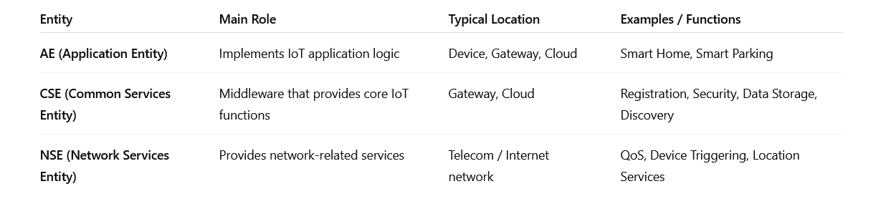
06
IoT Networking Protocols
IPv6 header compression: 6LowPAN
One M2M
Network Services Entity (NSE)
Purpose: Provides network-level support and value-added services to the Common Services Entity.
Example Providers:
Telecom operators (e.g., 4G/5G network services)

Slide 39
Summary
06
Gorry and Scott-Morton (1971) proposed a framework that is a 3-by-3 matrix
IoT networking layers
M2M

Slide 40


Thank You

