Slide 1


Project Risk& Supply
Chain Risk Management

Slide 2


Project Risk& Supply
Chain Risk Management
Lecture 11
PMG 663
Project Risk &Supply Chain Risk
Prepared by
Dr. Dalia Hosni
www.midocean.ae

Slide 3

Chapter
10
Materials Management
www.midocean.ae

Slide 4

Chapter
10
Materials Management

Slide 5
Chapter
10
Introduction
Material management is an approach for planning, organizing, and controlling all those activities principally concerned with the flow of materials into an organization.
The scope of Materials Management varies greatly from company to company and may include material planning and control, production planning, Purchasing, inventory control, in-plant materials movement, and waste management.

Slide 6
Chapter
10
What is Materials Management?
Coordinating function that balances the conflicting objectives of marketing, production, and finance by managing the flow of Materials.
Balancing the Resources of the company with Customer Demand

Slide 7
Chapter
10
Role of Materials Management
Make the best use of company resources
Provide the desired level of customer service (demand)

Slide 8
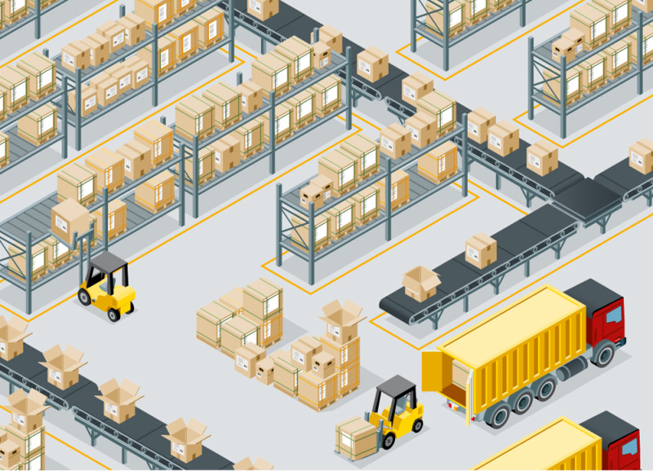
Chapter
10
Purpose of Material Management
To gain economy in purchasing
To satisfy the demand during period of replenishment
To carry reserve stock to avoid stock out
To stabilize fluctuations in consumption
To provide reasonable level of client services

Slide 9
Chapter
10
Objective of material management
Primary
Right price
High turnover
Low procurement
& storage cost
Continuity of supply
Consistency in quality
Good supplier relations
Development of personnel
Good information system
Secondary
Forecasting
Inter-departmental harmony
Product improvement
Standardization
Make or buy decision
New materials & products
Favorable reciprocal relationships

Slide 10
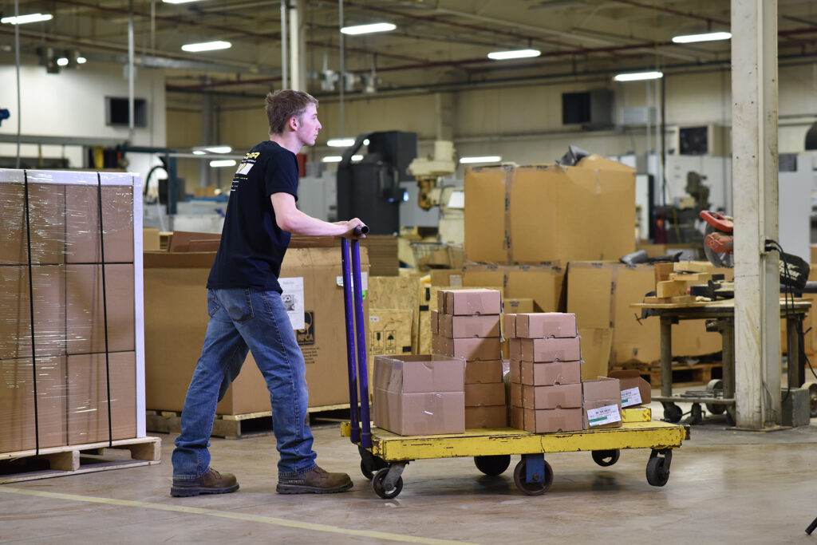
Chapter
10
Materials management functions
Material planning and programming
Purchasing and outsourcing
Inventory control
Storekeeping and warehousing
Codification

Slide 11
Chapter
10
Basic principles of material management
Effective management & supervision
It depends on managerial functions of
                Planning
                Organizing
                Staffing
                Directing
                Controlling
                Reporting
                Budgeting

Slide 12
Chapter
10
Basic principles of material management
2.Sound purchasing methods
3.Skillful & hard poised negotiations
4.Effective purchase system
5.Should be simple
6.Must not increase other costs
7.Simple inventory control programme

Slide 13
Chapter
10
Elements of material management
Demand estimation
Identify the needed items
Calculate from the trends in Consumption during last 2 years.
Review with resource constraints

Slide 14
Chapter
10
Advantages of material management
Reduced operating costs and timely production.
Greater job satisfaction on the part of both the workers and the employer.
Every inch of the space is properly utilized.
The issue of materials is also facilitated.
It helps in maintaining effective production planning and control.

Slide 15
Chapter
10
Summary
Material management is an important management tool which will be very useful in getting the right quality & right quantity of supplies at right time, having good inventory control & adopting sound methods of condemnation & disposal will improve the efficiency of the organization & also make the working atmosphere healthy any type of organization, whether it is Private, Government ,Small organization, Big organization and Household.
Even a common man must know the basics of material management so that he can get the best of the available resources and make it a habit to adopt the principles of material management in all our daily activities

Slide 16
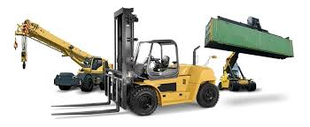
Chapter
10
Materials Handling, Storage, Use, and Disposal

Slide 17
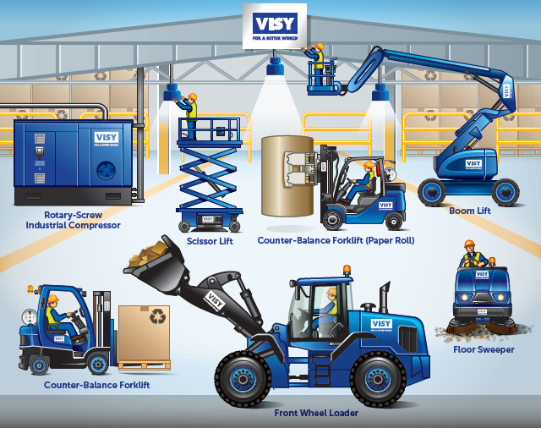
Chapter
10
Types of Equipment
Materials handling equipment is mechanical equipment used for the movement, storage, control and protection of materials, goods and products throughout the process of manufacturing, distribution, consumption and disposal.
Types of Material Handling Equipment - YouTube

Slide 18
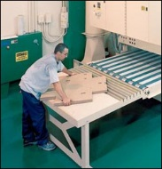
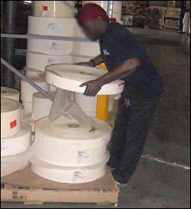
Chapter
10
Hazards Associated with Materials Handling
Factors contributing to injuries:
Weight and bulkiness of objects
Bending, twisting, turning movements

Slide 19
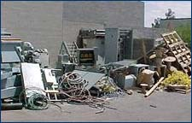
Chapter
10
Hazards Associated with Materials Handling
Hazards:
Improper operation of equipment
Accumulated materials or clutter

Slide 20
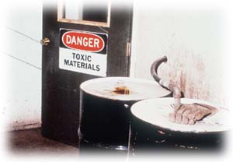
Chapter
10
Hazards Associated with Materials Handling
Unsafe conditions of materials or containers
Flammability or toxicity of some materials

Slide 21
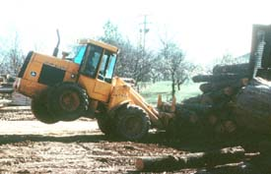
Chapter
10
Hazards Associated with Materials Handling
Weight of materials
Binding ties or other devices that secure bundles or
bound materials

Slide 22
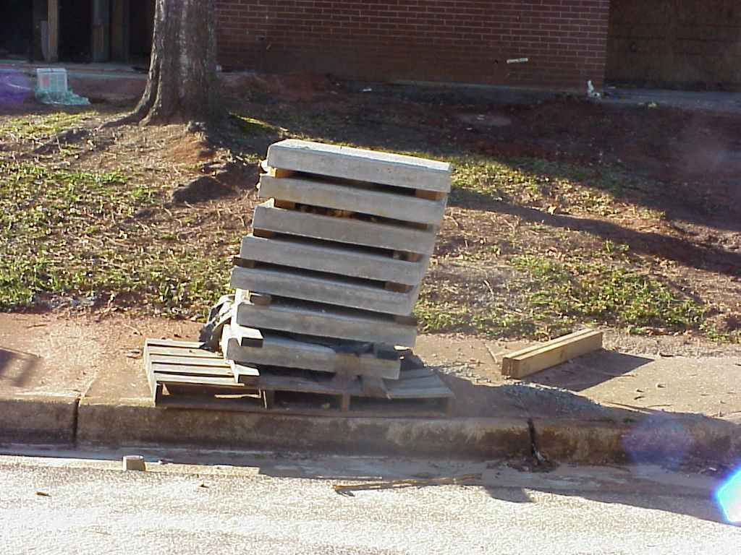
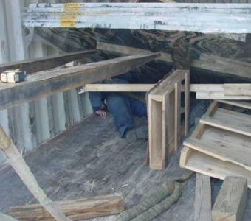
Chapter
10
Hazards Associated with Materials Handling
Improperly stacked materials
Struck-by or caught-in/-between hazards

Slide 23

Chapter
10
Materials Handling, Storage, Use, and Disposal
Types of injuries commonly reported:
Sprains, strains, tears
Soreness and pain
Bruises and contusions
Cuts, lacerations, punctures, crushing, and amputations

Slide 24
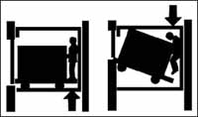
Chapter
10
Materials Handling, Storage, Use, and Disposal
Examples of events or exposures leading to injuries:
Contact with objects
and equipment
Transportation incidents
Exposure to harmful substances or environments

Slide 25
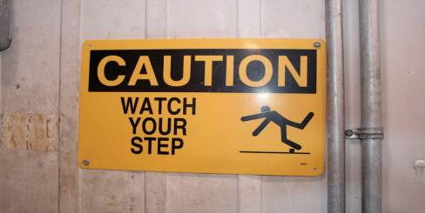
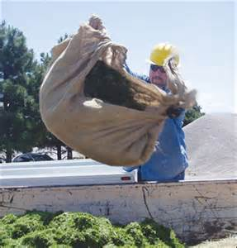
Chapter
10
Materials Handling, Storage, Use, and Disposal
Falls, slips, trips, or loss of balance
Repetitive motion
Overexertion

Slide 26
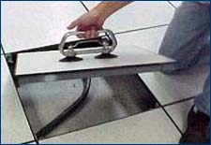
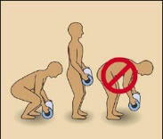
Chapter
10
Preventing Hazards
Moving materials manually:
Use devices to assist with holding loads
Wear PPE
Use proper lifting technique
Seek help for oversized loads
Use blocking materials

Slide 27
Chapter
10
Preventing Hazards
Do not leave unused slings suspended on a crane hook
Store wall-mounted cranes against the wall
Continuously observe equipment for any sign of problems during operation.
Don’t allow yourself to become distracted.

Slide 28

Chapter
10
Preventing Hazards
Operated only by thoroughly trained
and qualified workers
Crane operators:
  Must be qualified
  Should know what they are lifting and what it weighs

Slide 29
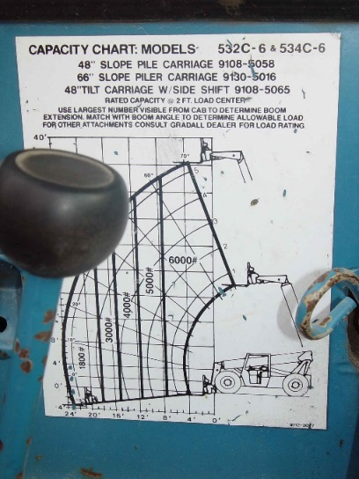
Chapter
10
Preventing Hazards
Eliminate/reduce crane
hazards by:
Knowing
  Load
  Capacity of the crane
  When the load is safe to lift
Always checking crane
load chart and never
exceed load limits

Slide 30
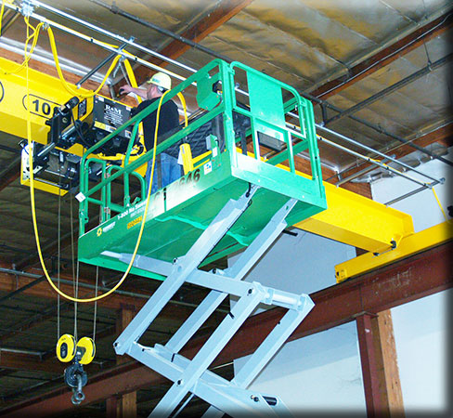
Chapter
10
Preventing Hazards
Inspection of crane by a qualified person
  Modified, repaired, or adjusted
  Post-assembly
  At least every 12 months
  Equipment not in regular use
Visual inspection by a
competent person
  Prior to each shift
  Monthly

Slide 31
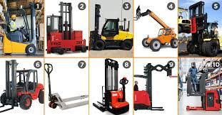
Chapter
10
Preventing Hazards
Forklifts
Main causes of injuries
  Forklift overturns
  Forklift striking workers
  on foot
  Persons crushed by forklifts
  Persons falling from forklifts

Slide 32

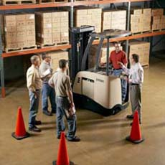
Chapter
10
Preventing Hazards
Illegal forklift operators
  Anyone under 18
  Anyone not properly trained

Slide 33
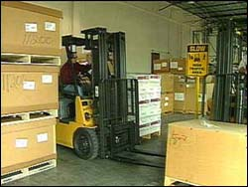
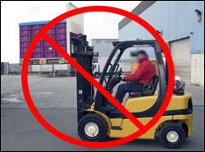
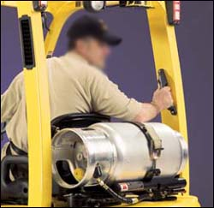
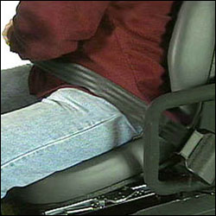
Chapter
10
Preventing Hazards
  Driving the forklift
    Obstructed vision
    Travel path
    Approaching people
    Elevated platform
    Seat belts and
    Raising/lowering forks
    Safe distance

Slide 34



Thank You

