Slide 1

Network Security
Prepared by Dr. Mohammed Anbar
Lecture 10
Email Security

Slide 2

Chapter
08
Learning objectives
Understand email basics,
Explain email security,
Explain email security threats,
Explain Pretty Good Privacy (PGP),
Explain Secure/Multipurpose Internet Mail Extension (S/MIME).

Slide 3
Chapter
08
Electronic mail (E-mail)
E-mail is a computer-based application for the exchange of messages between users.
A worldwide e-mail network allows people to exchange e-mail messages very quickly.
E-mail is the electronic equivalent of a letter, but with advantages in timeliness and flexibility.

Slide 4
Chapter
08
E-mail (cont. )
Three major components:
user agents
mail servers
simple mail transfer protocol (SMTP)
User Agent or mail reader
composing, editing, and reading mail messages. Examples of user agents are (i)Outlook and (ii)Thunderbird
Outgoing, and incoming messages stored on the server

Slide 5
Chapter
08
E-mail (cont. )
Mail servers:
mailbox contains incoming messages for the user
message queue of outgoing (to be sent) mail messages
SMTP protocol between mail servers to send email messages
  Client: sending mail server
  Server: receiving mail server

Slide 6
Chapter
08
Scenario: Alice sends message to Bob
Alice uses UA to compose a message “to” bob@someschool.edu
Alice’s UA sends the message to her mail server; the message is placed in the message queue.
The client side of SMTP opens a TCP connection with Bob’s mail server.
SMTP client sends Alice’s message over the TCP connection.
Bob’s mail server places the message in Bob’s mailbox.
Bob invokes his user agent to read the message.

Slide 7
Chapter
08
Email Security
Email is the most popular and well-regarded network services
Email contents are not secure
  may be inspected in transit
  or by suitably privileged users on the destination system

Slide 8
Chapter
08
Email Security Enhancements
Confidentiality
  protection from disclosure
Authentication
  of the sender of the message
Message integrity
  Protection from modification
Non-repudiation of origin
  Protection from the denial by the sender

Slide 9
Chapter
08
Common email security threats
Delivering malware through spam
Malware is one of the most dangerous, yet frequent threats is malware, which is frequently transmitted through emails.
Victims are readily tricked into downloading malicious files by spam messages that pretend to be legitimate senders like clients, partners, or suppliers.
Victims usually are unaware that they are downloading malware onto their systems.
The process of infecting the entire IT infrastructure might take days or even months. The attackers can stealthily gain control of the victim's computer and then infiltrate the company IT network to distribute the malware to neighboring computers.

Slide 10
Chapter
08
Common email security threats (cont.)
Credential Theft via Phishing Emails
Phishing emails are quite like spam, with the exception that they are more personalized and frequently intended to trick victims into directly disclosing sensitive information.
For example, attackers could somehow acquire a list of customer data from a financial institution, possibly leaked from a previous data breach.
The list may contain the customers’ names, email addresses, bank account numbers, and perhaps other personal information.
The attackers may utilize this list to create spear-phishing emails that are extremely convincing in order to trick the victims into clicking a bogus link that asks them to enter their online banking login information.

Slide 11
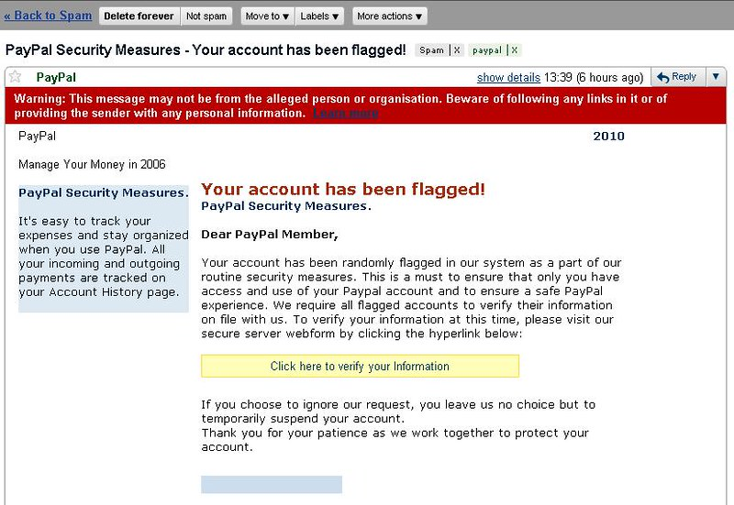
Chapter
08
Common email security threats (cont.)
Credential Theft via Phishing Emails

Slide 12
Chapter
08
Common email security threats (cont.)
Malicious Bot and DDoS Attacks
Attackers can employ compromised botnets to send a myriad number of emails to a targeted organization, resulting in the email server crashing from system overload, similar to what a traditional DDoS attack does to the victim's web server.
B2B companies are more likely to be the target of DDoS attacks on their email servers because a significant portion of their sales is conducted via email.

Slide 13
Chapter
08
Common email security threats (cont.)
Authentication Attacks on mail servers
Attackers may choose to concentrate on the email inbox itself. In this scenario, attackers would try to access the email server by breaking authentication via brute force, credential stuffing, and other techniques.
As a result, the attackers would then have access to any email messages and attachments kept on the system

Slide 14
Chapter
08
Pretty Good Privacy Basics
PGP stands for Pretty Good Privacy which is invented by Phil Zimmermann.
PGP was designed to provide all four aspects of security, i.e., privacy, integrity, authentication, and non-repudiation in the sending of email.
PGP uses a digital signature to provide integrity, authentication, and non-repudiation.
PGP uses a combination of secret key encryption and public key encryption to provide privacy. Therefore, we can say that the digital signature uses one hash function, one secret key, and two private-public key pairs.
PGP is an open-source and freely available software package for email security.

Slide 15
Chapter
08
Pretty Good Privacy Basics (cont.)
PGP provides authentication through the use of a Digital Signature.
It provides confidentiality through the use of symmetric block encryption.
It provides compression by using the ZIP algorithm, and EMAIL compatibility using the radix-64 encoding scheme.
Available as a plug-in for popular e-mail clients, can also be used as stand-alone software.
- Microsoft Exchange
- outlook

Slide 16
Chapter
08
Why Is PGP Popular?
Based on well-known algorithms
  These algorithms have survived extensive public review and are considered extremely secure.
  Integrated these algorithms into a general-purpose application
It is cross-platform (can run on Windows, UNIX, Macintosh, etc.)
  Open and free code.
Wide range of applicability from corporations that wish to select and enforce standardized security to individuals
Independent – meaning not developed or controlled by governmental or standards organizations
- Based on mutual trust between clients

Slide 17
Chapter
08
PGP Services
Digital signature | DSS/SHA or RSA/SHA | A hash code of a message is created using SHA-1. This message digest is encrypted using DSS or RSA with the sender's private key and included with the message.
Message encryption | CAST or IDEA or Three-key Triple DES with Diffie-Hellman or RSA | A message is encrypted using CAST-128 or IDEA or 3DES with a one-time session key generated by the sender. The session key is encrypted using Diffie-Hellman or RSA with the recipient's public key and included with the message.

Slide 18
Chapter
08
PGP Services
Compression | ZIP | A message may be compressed, for storage or transmission, using ZIP.
Email compatibility | Radix 64 conversion | To provide transparency for email applications, an encrypted message may be converted to an ASCII string using radix 64 conversion.
Segmentation |  | To accommodate maximum message size limitations, PGP performs segmentation and reassembly.

Slide 19
Chapter
08
PGP Options
PGP can provide
Authentication/Digital Signature
Confidentiality/Encryption
Confidentiality & Authentication

Slide 20
Chapter
08
Option 1: Authentication/Digital Signature
Sender creates a message
Sender generates a hash code of the message
uses SHA-1 algorithm in order to generate 160-bit hash code
Hash code encrypted with RSA (sender’s private key)
the result is prepended to the message
Receiver recovers the hash code
uses RSA with the sender’s public key
Receiver generates a new hash code of the message and compares the two codes.
If the two matches, the message is accepted as authentic.

Slide 21
Chapter
08
Authentication/Digital Signature
Source A
Destination B
Private key
A
Public key
A
Message
M
Message
M
DP
H
EP
| |
ZIP
UNZIP
Compare
H

Slide 22
Chapter
08
PGP Signed Message
-----BEGIN PGP SIGNED MESSAGE-----
Hash: SHA1
This is simply the text of the message.
It has not been encrypted, simply signed
-----BEGIN PGP SIGNATURE-----
Version: PGPfreeware 6.5.3 for non-commercial use <http://www.pgp.com>
iEYEARECAAYFAj5Ha6AACgkQ99/KQPj2cRNHsQCffKf64LwWQMfRIiKUfs6QrokB7twAnR5gDobzGapPgyLKQ0gLklj1WIIp=gXad
-----END PGP SIGNATURE-----

Slide 23
Chapter
08
Option 2: Confidentiality/Encryption
Sender generates a message and also a session key
  The session key is a random 128-bit number to be used as a session
  key for this message only
Sender encrypts the message
Uses CAST-128 (IDEA or 3DES) algorithm with the session key
Sender encrypts the Session key with RSA and prepended to the message
Receiver decrypts the session key
  uses RSA with its private key
Receiver decrypts the message with the Session key

Slide 24

Chapter
08
Confidentiality/Encryption (cont.)
Source A
Destination B
Public key
KUb
Private key
KRb
Session key
Ks
EP
DP
Message
M
Message
M
Session key
Ks
Message
M
ZIP
EC
| |
UNZIP
DC

Slide 25
Chapter
08
Option 3: Confidentiality & Authentication
Source A
Destination B
Public key
KUb
Private key
KRb
Public key
KRa
Session key
Ks
Private key
KRa
EP
DP
M
DP
M
Session key
Ks
Compare
M
H
EP
| |
ZIP
EC
| |
H
DC
UNZIP

Slide 26
Chapter
08
Compression
Saving space both for e-mail transmission and for file storage
PGP uses ZIP to compress the message
PGP compresses the message after applying the signature but before message encryption.
Encryption is applied after compression to strengthen cryptographic security.

Slide 27
Chapter
08
Segmentation and reassembly
E-mail facilities are often restricted to a maximum message length.
Longer messages must be broken up into segments, which will be mailed separately.
PGP automatically subdivides a message that is too large into segments that are small enough to send via e-mail.
The receiver strips off all e-mail headers and reassembles the block.

Slide 28
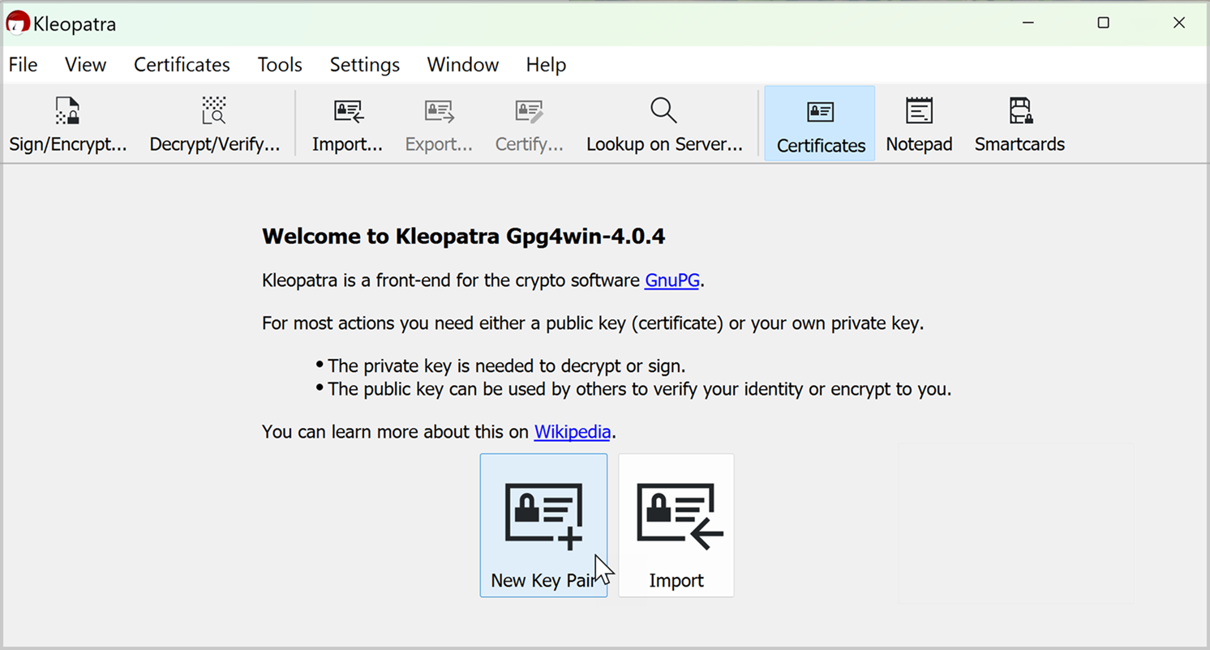
Chapter
08
PGP Encryption using Kleopatra (installation and demo)
Kleopatra Download: https://www.gpg4win.org/download.html
Online PGP Key Generator
https://www.attogtech.com/pgp-key-generator/

Slide 29
Chapter
08
Secure/Multipurpose Internet Mail Extension (S/MIME )
Security enhancement to MIME email
- Original Internet RFC822 email was text only
-MIME provided support for varying content types and multi-part messages Image, video, audio
-S/MIME added security enhancements
Have S/MIME support in various modern mail agents: MS Outlook, Netscape, etc

Slide 30
Chapter
08
SMTP Limitations
SMTP Limitations - Can not transmit, or has a problem with:
  executable files, or other binary files (jpeg image)
  “national language” characters (non-ASCII)
  messages over a certain size
  lines longer than a certain length (72 to 254 characters)

Slide 31
Chapter
08
S/MIME Functions
Enveloped Data: Encrypted content and encrypted session keys for recipients.
Signed Data: Message Digest encrypted with the private key of “signer.”
Clear-Signed Data: Signed but not encrypted.
Signed and Enveloped Data: Various orderings for encrypting and signing.

Slide 32
Chapter
08
S/MIME Cryptographic Algorithms
Hash functions : SHA-1 and MD5
Digital Signatures: DSS and RSA
Secret-Key Encryption: Triple-DES, RC2/40 (exportable)
Public-Private Key Encryption: RSA with key sizes of 512 and 1024 bits.

Slide 33
Chapter
08
References
Stallings, W. (2006). Cryptography and network security principles and practices 4th edition

Slide 34

Thank you

