Slide 1


Data Structures and Algorithms
Prepared by Prof. Shereen Taie
IT251
Information Technology Department
Lecture 1

Slide 2




Data Structures and
Algorithms
Lecture 1
IT251
Information Technology Department
Prepared by
Prof. Shereen Taie
www.midocean.ae

Slide 3
What is an algorithm?
Chapter
01
www.midocean.ae

Slide 4
Definition:
An algorithm is a Step By Step process to solve a problem, where each step indicates an intermediate task.
Algorithm contains finite number of steps that leads to the solution of the problem.
Chapter
01
www.midocean.ae

Slide 5
What is an algorithm?
It’s a set of well-defined rules for solving some computational problem.
  a bunch of numbers and you want to rearrange them so that they’re in sorted order.
  you have a road map and you want to compute the shortest path from some origin to some destination.
  you need to complete several tasks before certain deadlines, and you want to know in what order you should finish the tasks so that you complete them all by their respective deadlines.
Chapter
01
www.midocean.ae

Slide 6
Why Study Algorithms?
Chapter
01
www.midocean.ae

Slide 7
Why Study Algorithms?
Important for all other branches of computer science
  Routing protocols in communication networks take credit of classical shortest path algorithms.
  Public-key cryptography relies on efficient number-theoretic algorithms.
  Computer graphics requires the computational primitives supplied by geometric algorithms.
  Database indices rely on balanced search tree data structures.
  Computational biology uses dynamic programming algorithms to measure genome similarity.
  Challenging (Good for the brain)
Chapter
01
www.midocean.ae

Slide 8
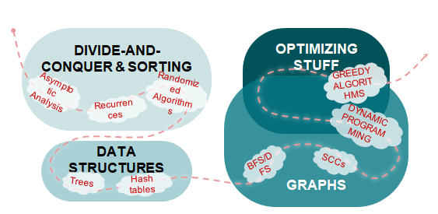
OUR TOPIC ROADMAP
Chapter
01
www.midocean.ae

Slide 9
Properties /Characteristics of an Algorithm
Chapter
01
www.midocean.ae

Slide 10
Algorithm has the following basic properties:
  Input-Output: Algorithm takes input and produces the required output. This is the basic characteristic of an algorithm.
  Finiteness: An algorithm must terminate in countable number of steps.
  Definiteness: Each step of an algorithm must be stated clearly and unambiguously.
  Effectiveness: Each and every step in an algorithm can be converted in to programming language statement.
  Generality: Algorithm is generalized one. It works on all set of inputs and provides the required output. In other words it is not restricted to a single input value.
Chapter
01
www.midocean.ae

Slide 11
Categories of Algorithm:
Based on the different types of steps in an Algorithm, it can be divided into three categories, namely The written program is buggy.
  Sequence
  Selection and
  Iteration
Chapter
01
www.midocean.ae

Slide 12
Sequence:
The steps described in an algorithm are performed successively one by one without skipping any step.
The sequence of steps defined in an algorithm should be simple and easy to understand.
Each instruction of such an algorithm is executed, because no selection procedure or conditional branching exists in a sequence algorithm.
Chapter
01
www.midocean.ae

Slide 13
Sequence Example:
// adding two numbers
Step 1: start
Step 2: read a,b
Step 3: Sum=a+b
Step 4: write Sum
Step 5: stop
Chapter
01
www.midocean.ae

Slide 14
Selection:
The sequence type of algorithms are not sufficient to solve the problems, which involves decision and conditions.
In order to solve the problem which involve decision making or option selection, we go for Selection type of algorithm.
The general format of Selection type of statement is as shown below:
if(condition)
Statement 1;
else
Statement 2;
The above syntax specifies that if the condition is true, statement 1 will be executed otherwise statement 2 will be executed.
Chapter
01
www.midocean.ae

Slide 15
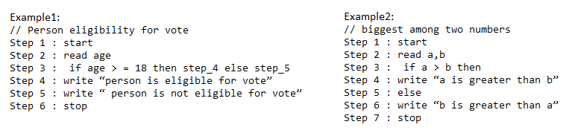
Selection Examples:
Chapter
01
www.midocean.ae

Slide 16
Iteration:
Iteration type algorithms are used in solving the problems which involves repetition of statement.
In this type of algorithms, a particular number of statements are repeated ‘n’ no. of times.
Chapter
01
www.midocean.ae

Slide 17
Iteration Example:
Step 1 : start
Step 2 : counter =1
Step 3 : sum=0
Step 2 : read grade
Step 3 : repeat step 4 until counter > 5
Step 4 : (a) sum = grade +sum
(b) Average =sum/5
(c) counter = counter + 1
Step 5 : write Average
Step 6 : stop
The input: 10, 25, 30, 40, 50
The output: 215/5 = 43
Chapter
01
www.midocean.ae

Slide 18
Algorithm analysis Importance
To detect
  The written program is buggy.
  The program may be inefficient
  If the program is running on a large data set, then the running time becomes an issue
Chapter
01
www.midocean.ae

Slide 19
Analysis Aspects
Correctness
  Does the input/output relation match algorithm requirement?
Amount of work done (complexity)
  Basic operations to do task in a finite amount of time
Amount of space used e.g. Memory used
Chapter
01
www.midocean.ae

Slide 20
Performance Analysis of Algorithm
Chapter
01
www.midocean.ae

Slide 21
Performance Analysis an Algorithm:
The Efficiency of an Algorithm can be measured by the following metrics:
i. Time Complexity and
ii. Space Complexity.
Chapter
01
www.midocean.ae

Slide 22
Performance Analysis an Algorithm:
i. Time Complexity:
  The amount of time required for an algorithm to complete its execution is its time complexity.
  An algorithm is said to be efficient if it takes the minimum (reasonable) amount of time to complete its execution.
  ii. Space Complexity:
  The amount of space occupied by an algorithm is known as Space Complexity.
  An algorithm is said to be efficient if it occupies less space and required the minimum amount of time to complete its execution
Chapter
01
www.midocean.ae

Slide 23

Chapter
01
Asymptotic analysis
www.midocean.ae

Slide 24
Asymptotic analysis:
Asymptotic analysis refers to computing the running time of any operation in mathematical units of computation.
For example, the running time of one operation is computed as O(n) and may be for another operation it is computed as O(n²).
This means the first operation running time will increase linearly with the increase in n and the running time of the second operation will increase exponentially when n increases. Similarly, the running time of both operations will be nearly the same if n is significantly small.
Chapter
01
www.midocean.ae

Slide 25
ASYMPTOTIC ANALYSIS (High Level Idea)
We’ll express the asymptotic runtime of an algorithm using
BIG-O NOTATION
THE POINT OF ASYMPTOTIC NOTATION
suppress constant factors and lower-order terms
too system dependent
irrelevant for large inputs
Chapter
01

Slide 26
ASYMPTOTIC ANALYSIS (High Level Idea)
THE POINT OF ASYMPTOTIC NOTATION
suppress constant factors and lower-order terms
too system dependent
irrelevant for large inputs
2500
when n is small...
2000
0.1n^{1.6} + 300
Runtime (ms)
1500
1000
0.008n²
500
0
0
100
200
300
400
500
600
Chapter
n (input size)
01

Slide 27
ASYMPTOTIC ANALYSIS (High Level Idea)
THE POINT OF ASYMPTOTIC NOTATION
suppress constant factors and lower-order terms
too system dependent
irrelevant for large inputs
2500
when n is small...
50000
2000
40000
0.1n^{1.6} + 300
Runtime (ms)
Runtime (ms)
30000
1500
1000
0.008n²
20000
500
10000
when n gets bigger!
0
0
0
100
200
300
400
500
600
0
1000
2000
3000
4000
5000
6000
Chapter
n (input size)
n (input size)
01

Slide 28
ASYMPTOTIC ANALYSIS (High Level Idea)
THE POINT OF ASYMPTOTIC NOTATION
suppress constant factors and lower-order terms
too system dependent
irrelevant for large inputs
2500
when n is small...
O(n^{1.6})
50000
2000
40000
0.1n^{1.6} + 300
Runtime (ms)
Runtime (ms)
30000
1500
1000
0.008n²
20000
500
10000
when n gets bigger!
0
O(n²)
0
0
100
200
300
400
500
600
0
1000
2000
3000
4000
5000
Chapter
n (input size)
n (input size)
01

Slide 29
ASYMPTOTIC ANALYSIS (High Level Idea)
To compare algorithm runtimes in this class, we compare their Big-O runtimes
  Ex: a runtime of O(n²) is considered “better” than a runtime of O(n³)
  Ex: a runtime of O(n^{1.6}) is considered “better” than a runtime of O(n²)
  Ex: a runtime of O(1/n) is considered “better” than O(1)
  O(1/n) = O(1*n⁻¹ ) , O(1) = (1*n⁰ )
Chapter
01

Slide 30
The time required by an algorithm falls under three types:
Best Case:
  Minimum time required for program execution.
Average Case:
  Average time required for program execution.
Worst Case:
  Maximum time required for program execution.
Chapter
01
www.midocean.ae

Slide 31
ASYMPTOTIC NOTATIONS
Chapter
01
www.midocean.ae

Slide 32
Asymptotic Notations:
Following are the commonly used asymptotic notations to calculate the running time complexity of an algorithm.
Ο Notation
Ω Notation
θ Notation
Chapter
01
www.midocean.ae

Slide 33
Worst Case
Big Oh Notation, Ο
Chapter
01
www.midocean.ae

Slide 34
Big Oh Notation, Ο:
The notation Ο(n) is the formal way to express the upper bound of an algorithm's running time.
It measures the worst case time complexity or the longest amount of time an algorithm can possibly take to complete.
Chapter
01
www.midocean.ae

Slide 35
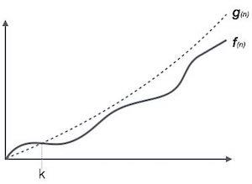
Big Oh Notation, Ο:
For example, for a function f(n)
Ο(f(n)) = { g(n) : there exists c > 0 and n₀ such that f(n) ≤ c.g(n) for all n > n₀. }.
Chapter
01
www.midocean.ae

Slide 36
Best Case
Omega Notation, Ω
Chapter
01
www.midocean.ae

Slide 37
Omega Notation, Ω:
The notation Ω(n) is the formal way to express the lower bound of an algorithm's running time.
It measures the best case time complexity or the best amount of time an algorithm can possibly take to complete.
Chapter
01
www.midocean.ae

Slide 38
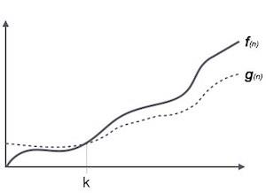
Omega Notation, Ω:
For example, for a function f(n)
Ω(f(n)) = { g(n) : there exists c > 0 and n₀ such that g(n) ≤ c.f(n) for all n > n₀. }.
Chapter
01
www.midocean.ae

Slide 39
Average Case
Theta Notation, θ
Chapter
01
www.midocean.ae

Slide 40
Theta Notation, θ:
The notation θ(n) is the formal way to express both the lower bound and the upper bound of an algorithm's running time.
Chapter
01
www.midocean.ae

Slide 41
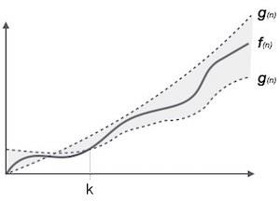
Big Oh Notation, Ο:
It is represented as follows
θ(f(n)) = { g(n) if and only if g(n) = Ο(f(n)) and g(n) = Ω(f(n)) for all n > n₀. }.
Chapter
01
www.midocean.ae

Slide 42
Some common Big O run times
O(log n), also known as log time. Example: Binary search.
O(n), also known as linear time. Example: Simple search.
O(n * log n). Example: A fast sorting algorithm, like quicksort.
O(n²). Example: A slow sorting algorithm, like selection sort.
O(n!). Example: A really slow algorithm, like the traveling salesperson.
Chapter
01

Slide 43
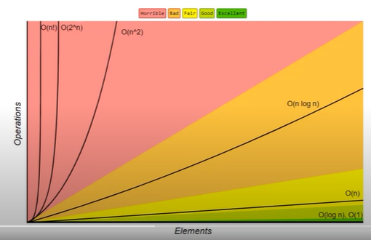
Growth Rates of Common Functions
Chapter
01

Slide 44
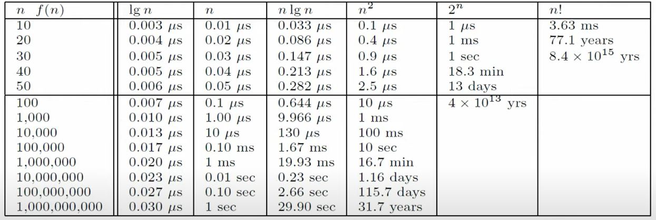
Growth Rates of Common Functions
Chapter
01

Slide 45
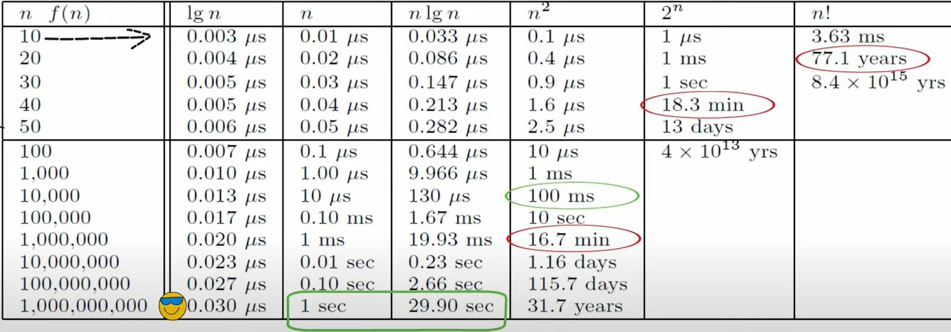
Growth Rates of Common Functions
Chapter
01

Slide 46




Thank You

