Slide 1


Financial Accounting
Prepared by Dr. Emad Zaher
Assistant Professor of Accounting
MGM611
Lecture (8)
Plant Assets

Slide 2

Plant Assets(Non current assets)
Property ,Plant ,and Equipment
(IAS 16)

Slide 3
Chapter Outline
  Learning Objectives
LO 1 Explain the accounting for plant asset expenditures.
LO 2 Illustrate cost of plant assets.
LO 3 Apply depreciation methods to plant assets.
LO 4 Discuss how plant assets depreciation revised.

Slide 4
Plant Asset Expenditures
Plant assets are resources that have
physical substance (a definite size and shape)
are used in the operations of a business
are not intended for sale to customers
are expected to be of use to the company for a number of years
Referred to as property, plant, and equipment; plant and equipment; and fixed assets.

Slide 5
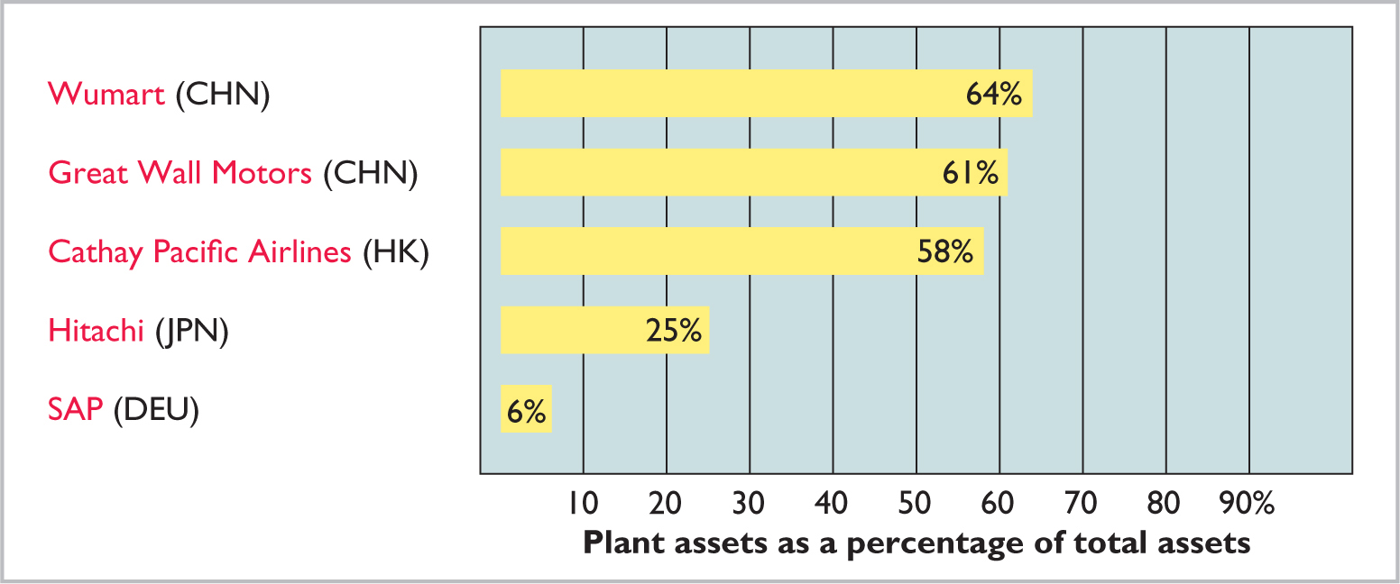
Plant Asset Expenditures
Plant assets are critical to a company’s success.

Slide 6
Plant Asset Expenditures
Determining the Cost of Plant Assets
Historical Cost Principle requires that companies record plant assets at cost.
Cost consists of all expenditures necessary to acquire an asset and make it ready for its intended use.

Slide 7
Determining the Cost of Plant Assets
Land
All necessary costs incurred in making the land ready for its intended use increase (debit) the Land account.
  Costs typically include:
    cash purchase price,
    closing costs such as title and attorney’s fees,
    real estate brokers’ commissions, and
    accrued property taxes.
    Removal cost (Razing cost)

Slide 8
Determining the Cost of Plant Assets
Illustration: Lew Ltd. acquires real estate at a cash cost of $2,000,000. The property contains an old warehouse that is razed at a net cost of HK$60,000 ($75,000 in costs less $15,000 proceeds from salvaged materials). Additional expenditures are the attorney’s fee, $10,000, and the real estate broker’s commission, $80,000. Determine the amount to be reported as the cost of the land.

Slide 9
Determining the Cost of Plant Assets
Illustration: Determine the amount to be reported as the cost of the land.
 | Land
Cash price of property | HK$2,000,000
Net removal cost of warehouse (HK$75,000 - HK$15,000) | 60,000
Attorney’s fee | 10,000
Real estate broker’s commission | 80,000
Cost of land | HK$2,150,000
Lew makes the following entry:
Land 2,150,000
Cash 2,150,000
  LO 1

Slide 10
Determining the Cost of Plant Assets
Land Improvements
Structural additions with limited lives that are made to land. Cost includes all expenditures necessary to make the improvements ready for their intended use.
Examples: driveways, parking lots, fences, landscaping, and underground sprinklers
Limited useful lives
Expense (depreciate) cost of land improvements over their useful lives
  LO 1

Slide 11
Determining the Cost of Plant Assets
Buildings
Includes all costs related directly to purchase or construction.
Purchase costs:
Purchase price, closing costs (attorney’s fees, title insurance, etc.) and real estate broker’s commission
Remodeling and replacing or repairing the roof, floors, electrical wiring, and plumbing

Slide 12
Determining the Cost of Plant Assets
Buildings
Includes all costs related directly to purchase or construction.
Construction costs:
Contract price
Payments for architects’ fees
Building permits
Excavation costs
Prepared by Dr. Emad Zaher

Slide 13
Determining the Cost of Plant Assets
Equipment
Includes all costs incurred in acquiring the equipment and preparing it for use.
Costs typically include:
Cash purchase price
Sales taxes
Freight charges
Insurance during transit paid by purchaser
Assembling, installing, and testing
Painting and lettering
Prepared by Dr. Emad Zaher

Slide 14
Determining the Cost of Plant Assets
Illustration: Huang Group purchases a delivery truck at a cash price of $420,000. Related expenditures consist of sales taxes $13,200, painting and lettering $5,000, motor vehicle license $800, and a three-year accident insurance policy $16,000. Compute the cost of the delivery truck.
 | Equipment
Cash price | HK$420,000
Sales taxes | 13,200
Painting and lettering | 5,000
Cost of delivery truck | HK$438,200

Slide 15
Determining the Cost of Plant Assets
Illustration: Huang Group purchases a delivery truck at a cash price of $420,000. Related expenditures consist of sales taxes $13,200, painting and lettering $5,000, motor vehicle license $800, and a three-year accident insurance policy $16,000. Prepare the journal entry to record these costs.
Equipment 438,200
License Expense 800
Prepaid Insurance 16,000
Cash 455,000

Slide 16
Expenditures During Useful Life
Ordinary Repairs are expenditures to maintain the operating efficiency and productive life of the unit.
Debit to Maintenance and Repairs Expense
Referred to as revenue expenditures
Additions and Improvements are costs incurred to increase the operating efficiency, productive capacity, or useful life of a plant asset.
Debit plant asset affected
Referred to as capital expenditures
Prepared by Dr. Emad Zaher

Slide 17
DO IT! 1 Cost of Plant Assets
Assume that Jing Feng Heating and Cooling purchases a delivery truck for $150,000 cash, plus sales taxes of $9,000 and delivery costs of $5,000. The buyer also pays $2,000 for painting and lettering, $6,000 for an annual insurance policy, and $800 for a motor vehicle license. Explain how each of these costs would be accounted for.
Solution
The first four payments ($150,000, $9,000, $5,000, and $2,000) are included in the cost of the truck ($166,000)
The payments for insurance and the license are operating costs and therefore are expensed

Slide 18
Depreciation Methods
Depreciation
Process of allocating to expense the cost of a plant asset over its useful (service) life in a rational and systematic manner.
Process of cost allocation, not asset valuation
Applies to land improvements, buildings, and equipment, not land
Depreciable because the revenue-producing ability of asset will decline over the asset’s useful life

Slide 19
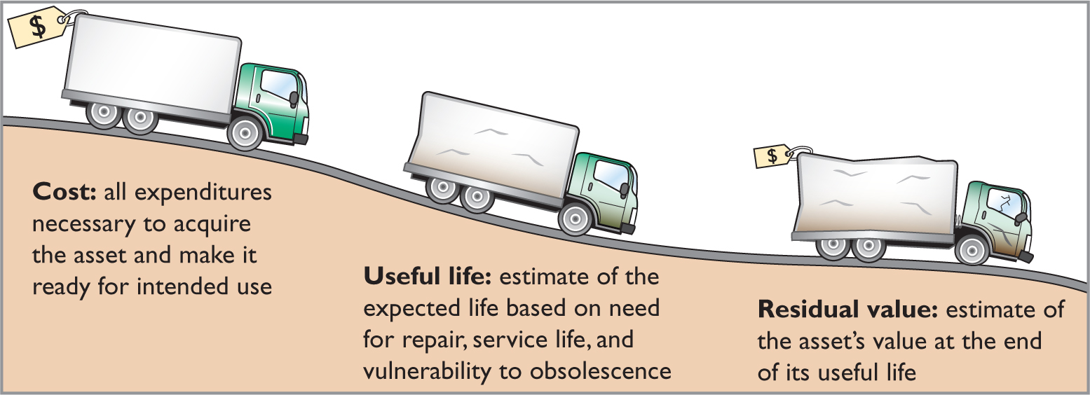
Factors in Computing Depreciation
ILLUSTRATION 10.6
Three factors in computing depreciation
Helpful Hint
Depreciation expense is reported on the income statement. Accumulated depreciation is reported on the statement of financial position as a deduction from plant assets.
Alternative Terminology
Another term sometimes used for salvage value is residual value.

Slide 20
Depreciation Methods
Management selects the method it believes best measures an asset’s contribution to revenue over its useful life.
Examples include:
  Straight-line method
  Declining-balance method
  Units-of-activity method

Slide 21
Depreciation Methods
Illustration: Barb’s Florists purchased a small delivery truck on January 1, 2020.
Cost €13,000
Expected salvage value € 1,000
Estimated useful life in years 5
Estimated useful life in miles 100,000
Required: Compute depreciation using the following.
(a) Straight-Line (b) Units-of-Activity (c) Declining Balance

Slide 22
Straight-Line Method
Expense is same amount for each year
Depreciable cost = Cost less residual value
Cost | - | Residual Value | = | Depreciable Cost
€13,000 | - | €1,000 | = | €12,000
Depreciable Cost | ÷ | Useful Life (in years) | = | Annual Depreciation Expense
€12,000 | ÷ | 5 | = | €2,400

Slide 23
Straight-Line Method
Illustration for Barb’s Florists
 |  | Computation |  |  |  | Annual Depreciation Expense |  | End of Year
Year |  | Depreciable Cost | x | Depreciation Rate | = |  |  | Accumulated Depreciation |  | Book Value
2020 |  | €12,000 |  | 20% |  | €2,400 |  | € 2,400 |  | €10,600
2021 |  | 12,000 |  | 20 |  | 2,400 |  | 4,800 |  | 8,200
2022 |  | 12,000 |  | 20 |  | 2,400 |  | 7,200 |  | 5,800
2023 |  | 12,000 |  | 20 |  | 2,400 |  | 9,600 |  | 3,400
2024 |  | 12,000 |  | 20 |  | 2,400 |  | 12,000 |  | 1,000
2020 Journal Entry
Depreciation Expense 2,400
Accumulated Depreciation 2,400

Slide 24
Straight-Line Method
Partial Year
Assume the delivery truck was purchased on April 1, 2020.
Year |  | Depreciable Cost | x | Rate | = | Annual Depreciation Expense | x | Partial Year | = | Current Year Expense |  | Accumulated Depreciation
2020 |  | €12,000 | x | 20% | = | €2,400 | x | 9/12 | = | € 1,800 |  | € 1,800
2021 |  | 12,000 |  | 20 |  | 2,400 |  |  |  | 2,400 |  | 4,200
2022 |  | 12,000 |  | 20 |  | 2,400 |  |  |  | 2,400 |  | 6,600
2023 |  | 12,000 |  | 20 |  | 2,400 |  |  |  | 2,400 |  | 9,000
2024 |  | 12,000 |  | 20 |  | 2,400 |  |  |  | 2,400 |  | 11,400
2025 |  | 12,000 | x | 20 | = | 2,400 | x | 3/12 | = | 600 |  | 12,000
 |  |  |  |  |  |  |  |  |  | €12,000

Slide 25
Declining-Balance Method
Accelerated method
Decreasing annual depreciation expense over asset’s useful life
Twice straight-line rate with Double-Declining-Balance
Rate applied to book value

Slide 26
Declining-Balance Method
Illustration for Barb’s Florists
ILLUSTRATION 10.13
Double-declining-balance depreciation schedule
 |  | Computation |  |  |  | Annual Depreciation Expense |  | End of Year
Year |  | Book Value Beg. of Year | x | Depreciation Rate | = |  |  | Accumulated Depreciation |  | Book Value
2020 |  | €13,000 |  | 40% |  | €5,200 |  | € 5,200 |  | €7,800
2021 |  | 7,800 |  | 40 |  | 3,120 |  | 8,320 |  | 4,680
2022 |  | 4,680 |  | 40 |  | 1,872 |  | 10,192 |  | 2,808
2023 |  | 2,808 |  | 40 |  | 1,123 |  | 11,315 |  | 1,685
2024 |  | 1,685 |  | 40 |  | 685* |  | 12,000 |  | 1,000
* Computation of €674 (€1,685 × 40%) is adjusted to €685 in order for book value to equal residual value.

Slide 27
Declining-Balance Method
Partial Year
Assume the delivery truck was purchased on April 1, 2020.
Year |  | Book Value Beg. of Year | x | Rate | = | Annual Depreciation Expense | x | Partial Year | = | Current Year Expense |  | Accumulated Depreciation
2020 |  | €13,000 | x | 40% | = | €5,200 | x | 9/12 | = | € 3,900 |  | € 3,900
2021 |  | 9,100 |  | 40 |  | 3,640 |  |  |  | 3,640 |  | 7,540
2022 |  | 5,460 |  | 40 |  | 2,184 |  |  |  | 2,184 |  | 9,724
2023 |  | 3,276 |  | 40 |  | 1,310 |  |  |  | 1,310 |  | 11,034
2024 |  | 1,966 |  | 40 |  | 786 |  |  |  | 786 |  | 11,820
2025 |  | 1,180 | x | 40 | = | 472 |  | Plug |  | 180 |  | 12,000
 |  |  |  |  |  |  |  |  |  | €12,000

Slide 28
DO IT! 2a Straight-Line Depreciation
On January 1, 2020, Iron Mountain Ski purchased a new snow-grooming machine for €50,000. The machine is estimated to have a 10-year life with a €2,000 residual value. What journal entry would Iron Mountain Ski make at December 31, 2020, if it uses the straight-line method of depreciation?
Solution
Depreciation Expense 4,800
Accumulated Depreciation 4,800
(€50,000 - €2,000) ÷ 10 = €4,800

Slide 29
Depreciation and Income Taxes
Tax laws do not require taxpayer to use the same depreciation method on the tax return that is used in preparing financial statements.
Many companies use straight-line in their financial statements to maximize net income.
They also use an accelerated depreciation method on their tax returns to minimize their income taxes.

Slide 30
Revising Periodic Depreciation
Accounted for in period of change and future periods (Change in Estimate)
No change in depreciation reported for prior years
Not considered an error
Use a step-by-step approach:
  determine new depreciable cost
  divide by remaining useful life

Slide 31
Revised Depreciation
Illustration: Chambers Landscaping purchased a piece of equipment for £36,000. It estimated a 6-year life and £6,000 residual value. Thus, straight-line depreciation was £5,000 per year [(£36,000 − £6,000) ÷ 6]. At the end of year three (before the depreciation adjustment), it estimated the new total life to be 10 years and the new residual value to be £2,000. Compute the revised depreciation.

Slide 32
Revised Depreciation
Original depreciation expense = [(£36,000 − £6,000) ÷ 6] = £5,000
Accumulated depreciation after 2 years = 2 × £5,000 = £10,000
Book value = £36,000 − £10,000 = £26,000

Slide 33
Revised Depreciation
Book value after 2 years of depreciation £26,000
Less: New residual value 2,000
Depreciable cost £24,000
Remaining useful life (10 − 2) 8 years
Revised annual depreciation (£24,000 ÷ 8) £ 3,000

Slide 34
Prepared by Dr. Emad Zaher

Slide 35
Prepared by Dr. Emad Zaher

Slide 36
Depreciation schedule, straight – line method
 | Cost | Depreciation | Accumulated | Book
 |  | expense | Depreciation | Value
 | L.E. | L.E. | L.E. | L.E.
Date of purchase | 10000 | -- | -- | 10000
End of first year | 10000 | 1800 | 1800 | 8200
End of second year | 10000 | 1800 | 3600 | 6400
End of third year | 10000 | 1800 | 5400 | 4600
End of fourth year | 10000 | 1800 | 7200 | 2800
End of fifth year | 10000 | 1800 | 9000 | 1000
Prepared by Dr. Emad Zaher

Slide 37
Prepared by Dr. Emad Zaher

Slide 38
On October 1, 2020, Holt Company places a new asset into service. The cost of the asset is €160,000 with an estimated 5-year life and €40,000 residual value at the end of its useful life. What is the depreciation expense for 2020 if Holt Company uses the straight-line method of depreciation?
a. €6,000
b. €32,000
c. €8,000
d. €16,000
Answer(A)
Prepared by Dr. Emad Zaher

Slide 39
Equipment was purchased for $120,000. Freight charges amounted to $5,600 and there was a cost of $16,000 for building a foundation and installing the equipment. It is estimated that the equipment will have a $24,000 residual value at the end of its 5-year useful life. Depreciation expense each year using the straight-line method will be
a. $28,320.
b. $23,520.
c. $19,680.
d. $19,200.
Answer(B)
Prepared by Dr. Emad Zaher

Slide 40



Thank You

