Slide 1

The Firm and the Financial Manager
Lecture 9
Introduction To finance
Prepared by
Dr. Mohamed Hamouda
www.midocean.ae

Slide 2

The Firm and the Financial Manager

Slide 3
Chapter Objectives
What is Financial Management?
10 principles of financial management.
What are the Decisions that Financial Manager must be Concern?
The Goal of the Firm.
Organization of the Financial Management Function.
Understand the agency problems.

Slide 4
What is Financial Management?
Financial Management means planning, organizing, directing and controlling the financial activities of the organization.
(الإدارة المالية يعني التخطيط والتنظيم و التوجيه والسيطرة على الأنشطة المالية للمنظمة)
It refers the efficient and effective management of money (funds) in such a manner as to achieve the goals of the organization.

Slide 5
Ten Principles of Financial Management
“It is necessary to understand these principles in order to understand finance.”

Slide 6
Principle 1: The Risk-Return Trade-off
We won’t take on additional risk unless we expect to be compensated with additional return.
Investment choices have different amounts of risk and expected returns.
The more risk an investment has, the higher its expected return will be.

Slide 7
Principle 2: The Time Value of Money
A dollar received today is worth more than a dollar received in the future.
Because we can earn interest on money received today, it is better to receive money earlier rather than later.

Slide 8
Principle 3: Cash—
Not Profits—Is King
Cash Flow, not accounting profit, is used as our measurement tool.
Cash flows, not profits, are actually can be reinvested.

Slide 9
Principle 4: Incremental Cash Flows
The incremental cash flow is the difference between the projected cash flows if the project is selected, versus what they will be, if the project is not selected.

Slide 10
Principle 5: The Curse of Competitive Markets
It is hard to find exceptionally profitable projects
If an industry is generating large profits, new entrants are usually attracted. The additional competition and added capacity can result in profits being driven down to the required rate of return.
Product Differentiation, Service and Quality can separate products from competition

Slide 11
Principle 6: Efficient Capital Markets
The markets are quick and the prices are right.
The values of all assets and securities at any instant in time fully reflect all available information.

Slide 12
Principle 7: The Agency Problem
Managers won’t work for the owners unless it is in their best interest
A agency problem resulting from conflicts of interest between the manager/agent and the stockholder/owners.
  Managers may make decisions that are not in line with the goal of maximization of shareholder wealth.

Slide 13
Principle 8: Taxes Bias Business Decisions
The cash flows we consider are the after-tax incremental cash flows to the firm as a whole.

Slide 14
Principle 9: All Risk is Not Equal
Some risk can be diversified away, and some cannot
The process of diversification can reduce risk, and as a result, measuring a project’s or an asset’s risk is very difficult.

Slide 15
Principle 10: Ethical Behavior is Doing the Right Thing, and Ethical Dilemmas Are Everywhere in Finance
Each person has his or her own set of values, which forms the basis for personal judgments about what is the right thing

Slide 16
Decisions of Financial Manager
Investment Decisions (Capital Budgeting)
(Investment decisions revolve around how to best allocate money to maximize their value.)
Financing Decisions (Capital Structure)
(Financing decisions revolve around how to pay for investments and expenses)
Asset Management Decisions (Working Capital Management Decisions)

Slide 17
Investment Decisions
how, when, where and how much money will be spent on investment opportunities.
A firm has many options to invest their funds but firm has to select the most appropriate assets for investment which will bring maximum benefit for the firm.
What specific assets should be acquired?
What assets (if any) should be reduced or eliminated?
Notes:
A firm has many options to invest their funds but firm has to select the most appropriate assets for investment which will bring maximum benefit for the firm.
how, when, where and how much capital will be spent on investment opportunities.

Slide 18
Investment Decisions
What specific assets should be acquired?
What assets (if any) should be reduced or eliminated?

Slide 19
Financing Decisions
Determine how the assets will be financed.
A company can raise finance from various sources such as by issue of shares, debentures or by taking loan and advances. These sources of finance can be divided into two categories: owners fund (no risk involve) and borrowers fund (risk involve).
Find the least expensive sources of fund.

Slide 20
Financing Decisions
What is the best type of financing?
Mix type financing.
What is the best financing mix?
Mixer debt and equity.
What is the best dividend policy?
Paying a consistent percentage of net earnings.
How will the funds be physically acquired?

Slide 21
Asset Management Decisions
How do we manage existing assets efficiently?
Financial Manager has varying degrees of operating responsibility over assets.
Greater emphasis on current asset management than fixed asset management.
Notes:
How much cash and inventory should be keep on hand?
Should we sell on credit? If so, what terms will we offer, and to whom will we extend them?
How will we obtain any needed short-term financing? If so, will we purchase on credit or will we borrow in the short-term and pay cash?

Slide 22
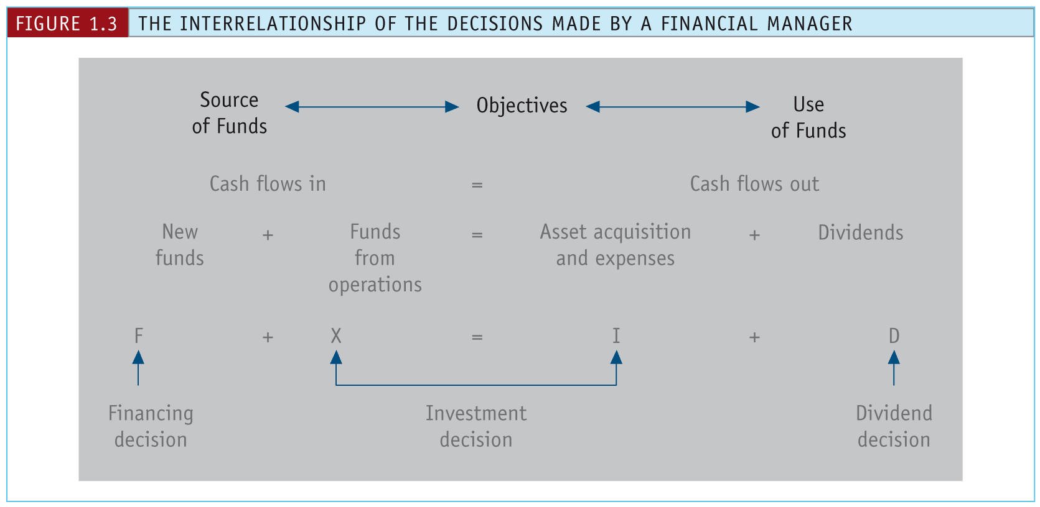
Interrelationship of the decisions made by a Financial Manager
Notes:
Adding depreciation and amortization expenses to earnings
Funds from Operations = Net Income + Depreciation + Amortization - Gains on Sales of Property .
Amortization Expenses: capital expenses for intangible assets over a specific period of time
Example: Broadcast licenses, Copyrights, Patents, Taxi licenses, Trademarks

Slide 23
What are the Goals of the Firm? (General Goals)
Survival
Avoid financial distress and bankruptcy
Beat the competition
Maximize sales or market share
Minimize costs
Maximize profits
Maintain steady earnings growth.

Slide 24
Shortcomings of these General Goals
Problems
These goals are either associated with increasing profitability or reducing risk.
  Could increase current profits while harming firm (e.g., defer maintenance, issue common stock to buy Treasury-bills, etc.).
  Does not specify timing or duration of expected returns.
  Calls for a zero payout dividend policy.
  They are not consistent with the long-term interests of shareholders.
So it is necessary to find a goal that can encompass both profitability and risk.

Slide 25
The Real Goal of the Firm
Maximization of Shareholder Wealth!
Shareholders’ wealth can be measured as the current value per share of existing shares.

Slide 26
Strengths of Shareholder Wealth Maximization
Takes account of: current and future profits and EPS; the timing, duration, and risk of profits; dividend policy; and all other relevant factors.
Thus, share price serves as a barometer for business performance.
Notes:
EPS = Earnings Per Share.

Slide 27
The Modern Organization
Modern Organization
Shareholders
Management
There exists a SEPARATION between owners and managers.

Slide 28
Role of Management
Management acts as an agent for the owners (shareholders) of the firm.
An agent is an individual authorized by another person, called the principal, to act in the latter’s behalf.

Slide 29
Agency Theory
Jensen and Meckling developed a theory of the firm based on agency theory.
Agency Theory is a branch of economics relating to the behavior of principals and their agents.

Slide 30
Agency Theory
Principals must provide incentives so that management acts in the principals’ best interests and then monitor results.
Incentives include stock options, perquisites, and bonuses.
Notes:
Perquisites are advantages (some monetary, some not e.g. free lunch, parking space, etc.) that come with a job.
Bonus is usually a monetary compensation tied to performance
An employee stock option is a contract issued by an employer to an employee to purchase a set amount of shares of company stock at a fixed price for a limited period of time.

Slide 31
Social Responsibility
Wealth maximization does not stop the firm from being socially responsible.
Assume we view the firm as producing both private and social goods.
Then shareholder wealth maximization remains the appropriate goal in governing the firm.

Slide 32
Organization of the Financial Management Function
Board of Directors
President
(Chief Executive Officer)
Vice President
Operations
Vice President Finance
Vice President
Marketing

Slide 33
Organization of the Financial Management Function
Vice President of Finance
Treasurer
Capital Budgeting
Cash Management
Credit Management
Dividend Disbursement
Fin Analysis/Planning
Pension Management
Insurance/Risk Mngmt
Tax Analysis/Planning
Controller
Cost Accounting
Cost Management
Data Processing
General Ledger
Government Reporting
Internal Control
Preparing Fin Stmts
Preparing Budgets
Preparing Forecasts

Slide 34
Challenges of Financial Manager
7 challenges faced by finance manager

Slide 35
Challenges of Financial Manager
1. Managing cash flow
Every business can suddenly fall due to a lack of adequate cash flow, which in turn happens due to poor cash flow management. This is one of the biggest challenges faced by finance managers.
The inflow and outflow of the company money need to be precisely tracked to get the right insight. Most of the traditionally recorded financial statements are intently not meant to give you information regarding the cash flow and its improvement.
They are simply statements made for record-keeping, not business management. Automated billing and collection processes and report management can significantly help in improving the cash flow of your business.
Without these, cashflow inadequacies will catch up to your business — maybe not now but definitely later, and it's not a pretty picture. The phrase to remember here is “you can’t manage what you can’t measure.”

Slide 36
Challenges of Financial Manager
2. Not having a plan for using the budget
You cannot run your business by just sitting in your office and thinking that the business bank account has enough to cover all your expenses and pay the bills.
It won’t be long before your business ends up in a debt cycle and ultimately all the finances go out of your hand. The best business advice to avoid ruining the business finances is to run your company on a budget
Create a calculated budget and make sure to stick to it. Developing a budget will not only help you wisely manage your business money but will also prove to be immensely helpful in future financial forecasting and analyzing the directions where the business can grow.
﻿Along with this, keep updating the budget regularly according to the changing situations and major business decisions.

Slide 37
Challenges of Financial Manager
3. Not raising enough capital
Not being able to get their expected amount of funding is one of the other challenges faced by finance manager in an organization. However, it is extremely important to have a solid business proposal and growth plan to attract investors to invest in your business.
Without the funding money, your business development would be near impossible. There are five main ways through which you can raise funding:
• Venture funding
• SBA- bank loans
• Private Equity
• Loans from friends and family
• Bank loans

Slide 38
Challenges of Financial Manager
4. Too much debt
There are various reasons why entrepreneurs take loans and sometimes they do max out their options. If the debt is not properly handled and repaid, the business can sink.
Whichever way you are trapped, debt can cause short and long-term effects. For example, the business may take time to build profits and even meet the bare minimum. Till that time, the employees and vendors would be on hold and overhead costs would add up.
To reduce your debt and pay it back in time, determine the areas where you can effectively reduce costs. Look for creative financing options like crowdfunding and angel investors and group your business loans together to make it into one payment.﻿

Slide 39
Challenges of Financial Manager
5. Not having a proper reporting
Small businesses are recommended to record all their transactions and it would be even better if is done under the guidance of a financial accounting expert. Records include earnings, expenses, and sales.
Private companies are not mandated to disclose their accounting reports publicly. But not keeping a proper report and not keeping track of the financial data leads to major problems.
This includes improper tax filing with the wrong revenue estimation, extra interest charges, and many more.
On the other hand, public companies are required to disclose their financial reports and inaccurate filing would lead to financial management problems which would take immense firefighting strategies because the records were public.

Slide 40
Challenges of Financial Manager
6. Poor tax compliance
Managing corporate finance problems is a heavy task, and complicating it with overpaying taxes is not at all a good idea. Almost 85% of small businesses end up overpaying their federal income taxes every year
Others are underpaying and moving on the wrong side of the authorities. Both these situations are harmful to any company because it takes intensive effort, time, and money.
﻿The most significant issue that all businesses face when it comes to federal taxes is not the payment aspect — it is compliance. This is a heavy burden, especially for small businesses

Slide 41
Challenges of Financial Manager
7. Not paying bills on time
Everyone who is a part of your business in any way has to be paid. For all the goods and services you use for your business, bills have to be paid on time. Sometimes, a late payment can be overlooked.
But if your business becomes one of those which keep repeating the late payment process, you will end up paying loads of money as fines.
This can cause damage to your supplier relationship, which ultimately means that the business will be facing a hard time finding the basic raw material.
Most companies are still doing their accounts payable process manually which is extremely time-consuming and labor-intensive. It makes the business prone to more errors and maybe even fraud.

Slide 42
The End

